Slide 1
AUTOMATED FASHION IMAGE CAPTIONING SYSTEM Guided By: Professor Aamir Jafari Group 6: Amrutha Jayachandradhara Vishal Fulsundar

Slide 2
Problem Statement & Objectives
The Challenge:
E-commerce platforms possess vast inventories where manual tagging is labor-intensive and error-prone.
Accurate captions are essential for SEO, user experience, expensive and slow. and accessibility.
Sometimes copied or extremely generic → “Blue printed shirt for men” instead of “Men’s slim-fit blue printed cotton shirt, casual wear”.
Project Goal:
Build and analyze an explainable image-and-metadata-based captioning system for fashion products, and compare it to a large vision-language model
Train models to generate coherent text descriptions (captions) given an input image.

Slide 3
Dataset Overview
Structure: A multimodal collection combining structured tabular data with visual assets.
Sources:
https://www.kaggle.com/datasets/hiteshsuthar101/myntra-fashion-product-dataset
Metadata:
Sourced from styles.csv, focusing on product attributes like product DisplayName.
id: 10002
gender: Women
masterCategory: Apparel
subCategory: Dress
articleType: Sleeveless Dress
baseColour: Red
year: 2012
season: Summer

Slide 4
Dataset Overview
Imagery: Local directory of images (.jpg, .jpeg, .png).
Total 14.5 Images we have from the Myntra Fashion Product dataset.
Images provide VISUAL grounding Color, Shape, Texture, Clothing type, Visual cues
Our dataset consists of product images and structured catalog metadata originally derived from the Myntra fashion dataset.
Each product has a unique image and metadata fields like gender, category, subcategory, and product name.

Slide 5
Data Processing Pipeline (ETL)
Ingestion & Cleaning:
Load the raw metadata from CSV
Standardize column names
Remove rows with missing or corrupted fields
Filter irrelevant categories (if needed)
Normalize text (lowercase, strip spacxe
Merging:
Each metadata row has an id — this maps to an image
checks if the image file exists
adds a new column
Now every product row has:
metadata
the corresponding image location

Slide 6
Data Processing Pipeline (ETL)
Validate Images:
tries opening every image with PIL
removes corrupted/unreadable images
ensures uniform image format (RGB)
logs missing images
Splitting: Data is partitioned into Train (70%), Validation (15%), and Test (15%) sets .
Ensure each split keeps the same distribution of:
genders, categories, brands etc…
Vocabulary: Frequency-based vocabulary constructed by filtering rare words (appearing < 2 times).
tokenize cleaned captions
count word frequencies
keep top-K words (e.g., 10k)
assign IDs to each
Special tokens added: <pad>, <bos>, <eos>, <unk>

Slide 7
Baseline Architecture (ResNet + Transformer)
Encoder -
ResNet-50 (images: (B, 3, 224, 224)
ResNet Feature Extraction - ResNet output feature map: (B, 2048, 7, 7) - 7×7 grid of deep visual features(
Global Average Pooling -
We reduce the 7×7 spatial map into a single vector: (B, 2048)
Decoder
: Transformer Decoder , captions: (B, L) image_emb = Linear(2048 → 512)
Transformer decoder works in a hidden dimension memory shape = (B, 1, 512)
Masked Self-Attention- Prevents decoder from “seeing the future” , Allows attention over previous words
Cross-Attention -
Query = decoder hidden state
Key = encoder memory (B, 1, 512) ,
Value = encoder memory (B, 1, 512)

Slide 8
Feed-Forward Network Feed-Forward Network
Output - logits = Linear(512 → vocab_size) shape: (B, L-1, vocab_size)
Loss Computation:
loss = CrossEntropy (logits, decoder_target)
Data Flow Diagram - Image (3×224×224) ↓ ResNet-50 Encoder ↓ (B, 2048) Global Avg Pool ↓ (B, 2048) Linear Projection ↓ (B, 512) Unsqueeze → Memory (B, 1, 512) ↓ Transformer Decoder <— Caption Tokens (B, L) ↓ Logits (B, L-1, V) ↓ Cross-Entropy Loss
Backpropagation-
Decoder gradients flow backward → update decoder parameters
Through cross-attention → update encoder projection
Through encoder output → update ResNet weights
The Decoder uses Cross-Attention:
Query = decoder hidden state
Key = image memory
Value = image memory
So the decoder looks at the image embedding to decide the next word.

Slide 9
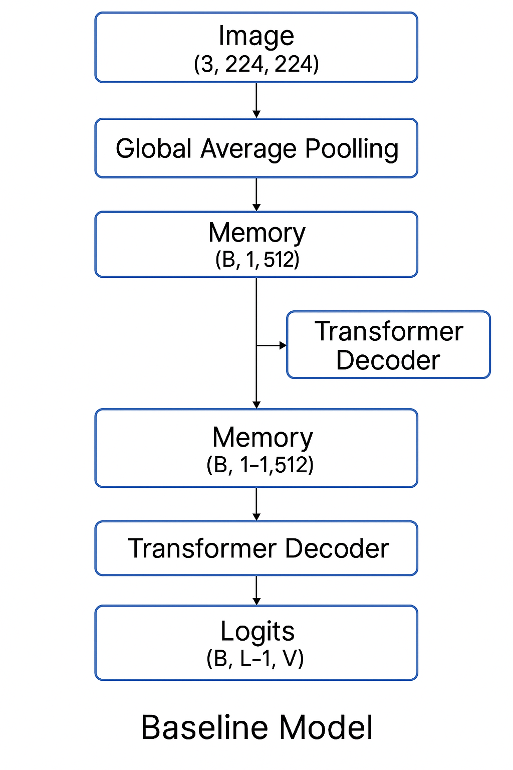
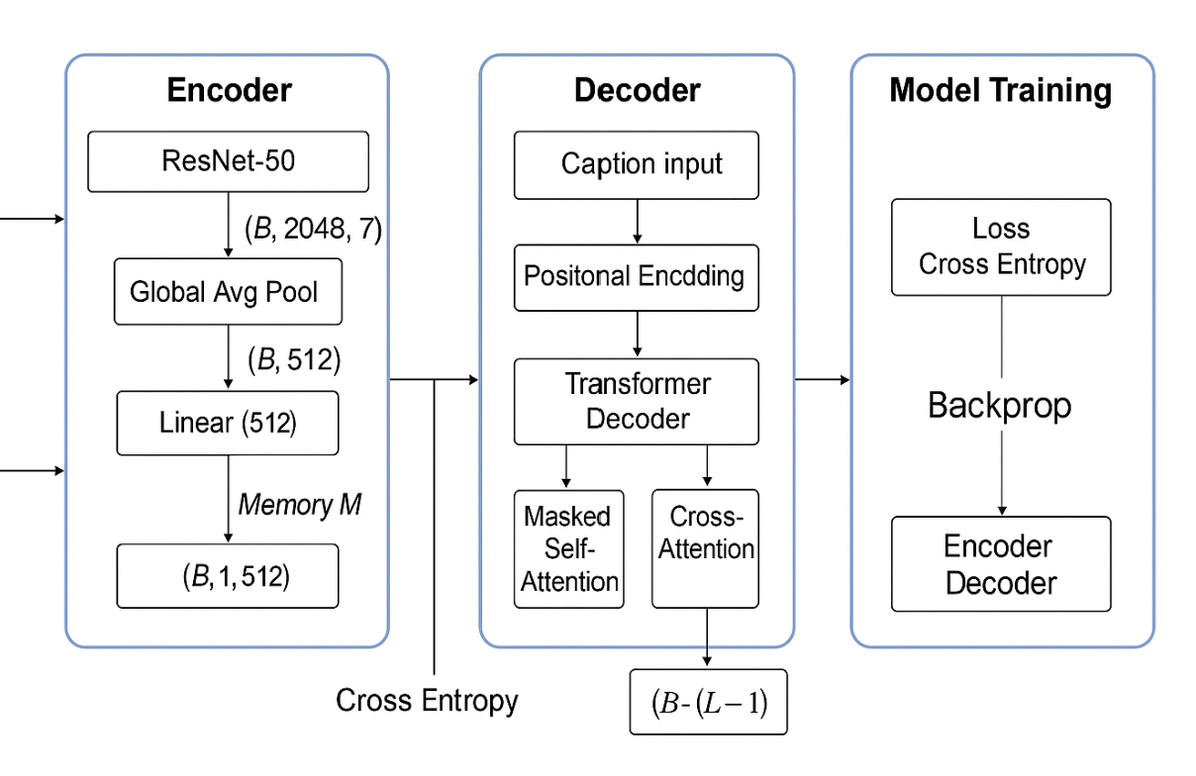
Baseline Architecture (ResNet + Transformer)

Slide 10
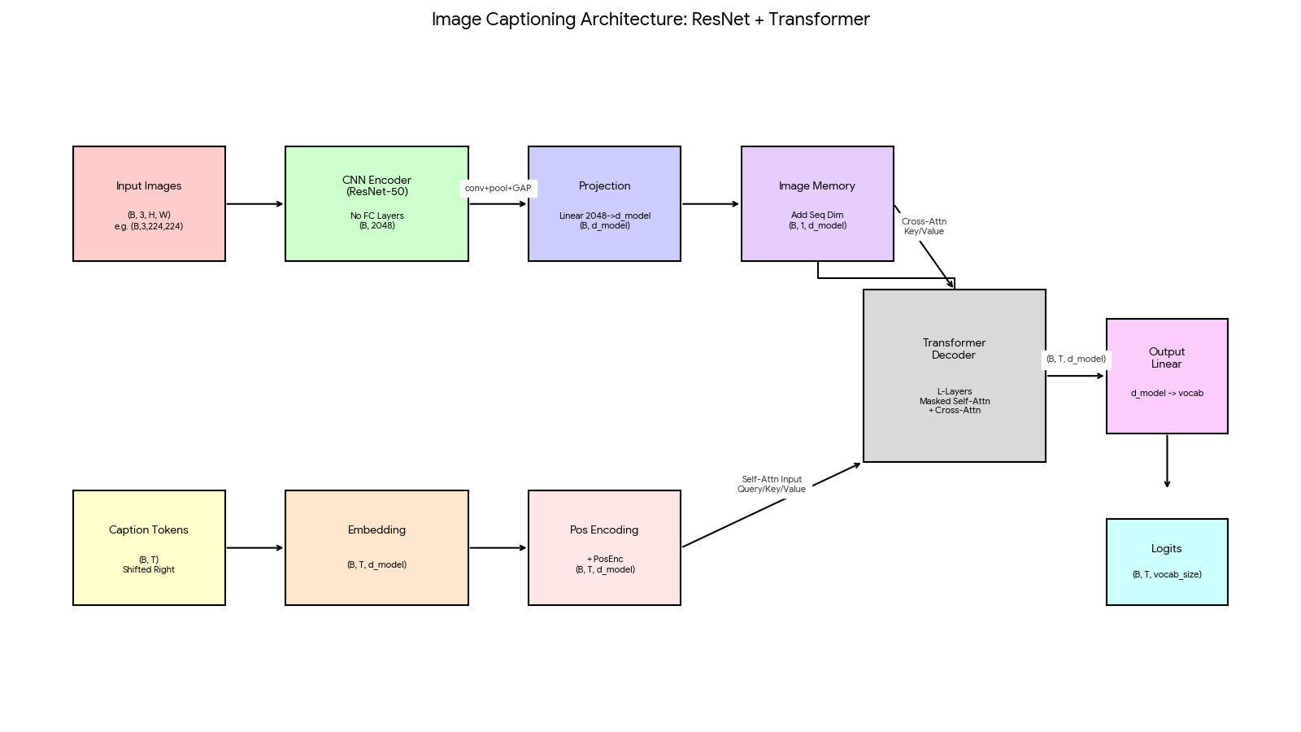
ResNet + Transformer Architecture

Slide 11
Model-1 Architecture (Image + Metadata Fusion Model)
extends the baseline architecture by introducing metadata embeddings and a fusion layer.
This helps the model use structured catalog information that images alone cannot reliably capture.
Image Encoder (MobileNetV2)
(B, 3, 224, 224) Golabal Pooling ---> image_vec: (B, 1280)
Metadata Embedding Layers-
gender_emb: (B, 16)
masterCategory_emb: (B, 32) ------->
subCategory_emb: (B, 32)
articleType_emb: (B, 32)
brand_emb: (B, 32)
metadata_vec: (B, D_meta) ---> D_meta = 16 + 32 + 32 + 32 + 32 = 144

Slide 12
Fusion of Image and Metadata
concat = [image_vec ; metadata_vec] (B, 1280 + 144) = (B, 1424)
Linear Fusion Layer –
fused_vec = Linear(1424 → 512)
fused_vec: (B, 512)
Transformer Decoder (Same as Baseline)
Model-1 memory = image + metadata
Image encoded by MobileNetV2 → 1280-d vector
Metadata encoded via embeddings → ~144-d vector
Concatenate → 1424-d fusion input
Linear fusion → 512-d fused memory
Transformer decoder generates caption
Cross-attention uses fused memory (not image only)
Greatly improves semantic accuracy and category prediction

Slide 13
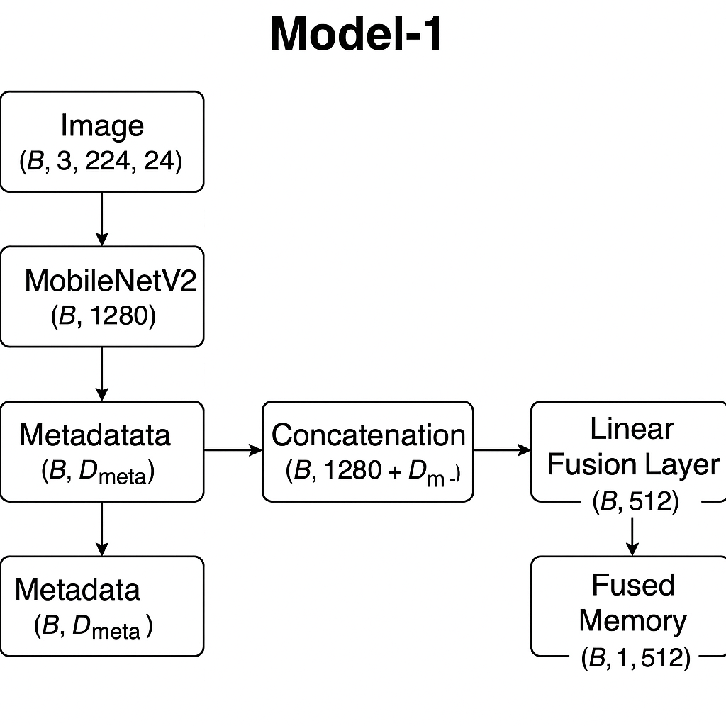
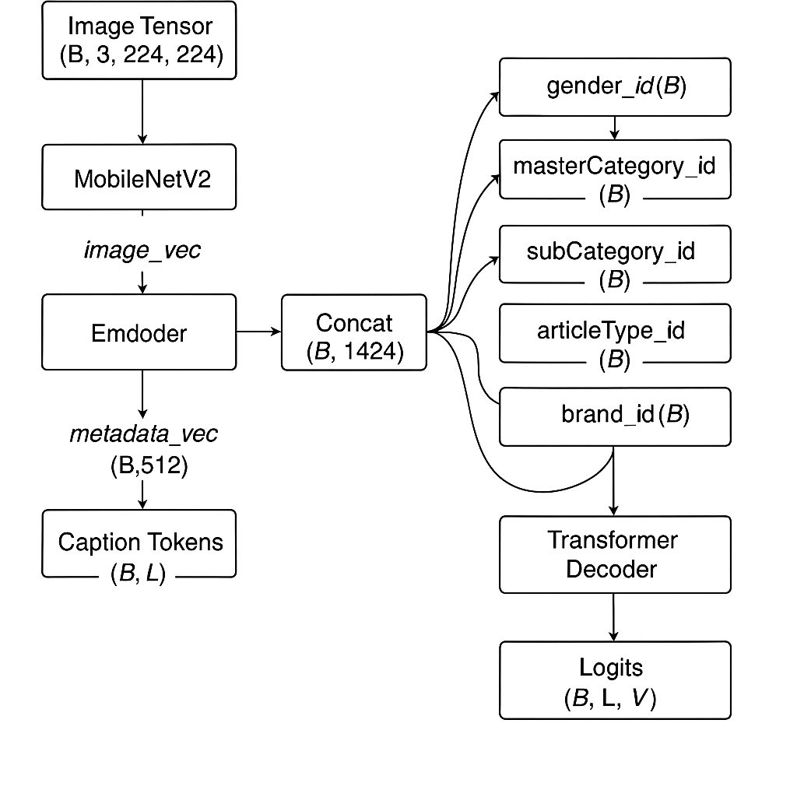
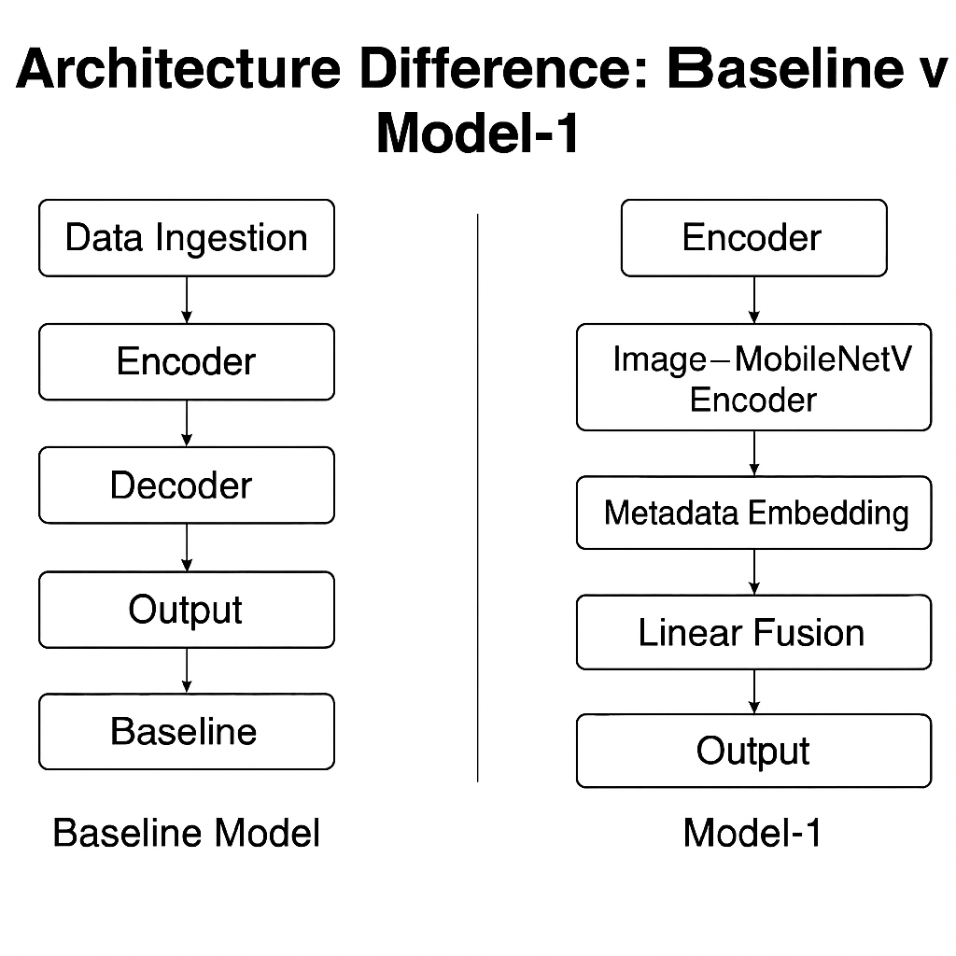

Slide 14
Model-1 Evaluation
Metric | Score
BLEU-1 | 0.45
BLEU-2 | 0.49
BLEU-3 | 0.51
BLEU-4 | 0.67
ROUGE-L | 0.63
Evaluation Metrics Used - Generated Caption vs Ground Truth Caption
BLEU-1, BLEU-2, BLEU-3, BLEU-4 → Measures n-gram overlap between generated and ground-truth captions.
ROUGE-L → Measures Longest Common Subsequence → structural similarity.
Model-1 achieves higher BLEU and ROUGE scores by combining visual features with structured metadata, resulting in captions that are semantically precise, attribute-aware, and closer to ground-truth descriptions

Slide 15
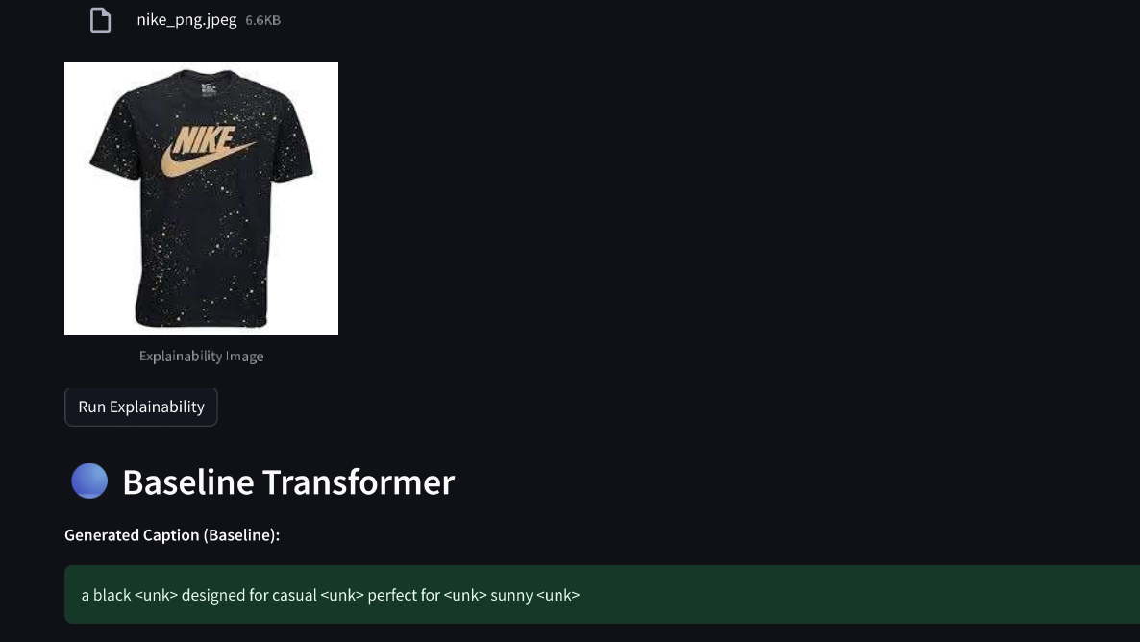
Model The Limitation
Analysis:
The appearance of <unk> (unknown tokens) proves the vocabulary is too limited.
It misses the brand "Nike" and the "splatter" pattern entirely.

Slide 16
Advanced Approach - Qwen2-VL
Core Difference: Unlike the baseline (fixed 224x224), Qwen2-VL utilizes Native Dynamic Resolution.
Visual Encoder: Processes images at their native aspect ratio by converting them into variable sequences of patches.
C-Abstractor: Uses 2x2 pooling to reduce visual token count by 4x while retaining spatial info.
LLM Backbone: Compressed visual tokens are fed into the Qwen2 LLM (7B) to generate captions.

Slide 17
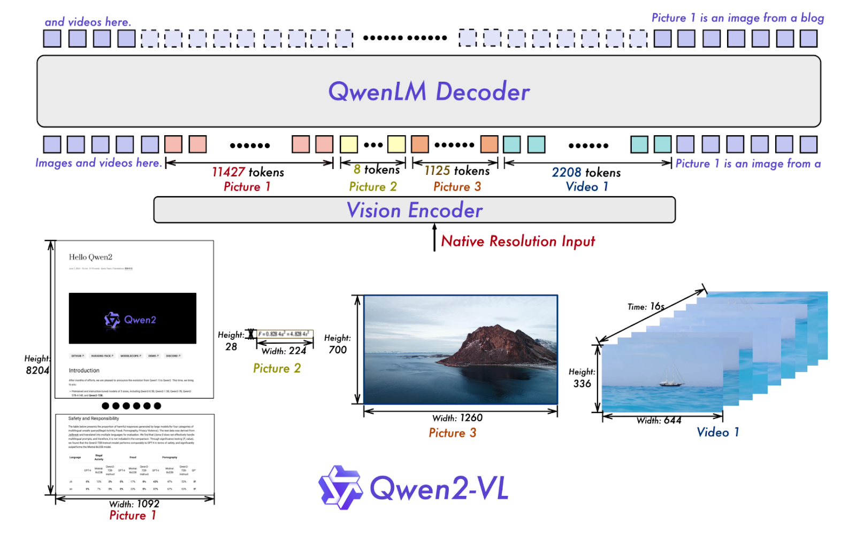
QWEN2-VL Architecture

Slide 18
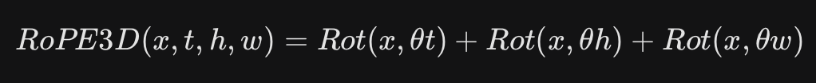
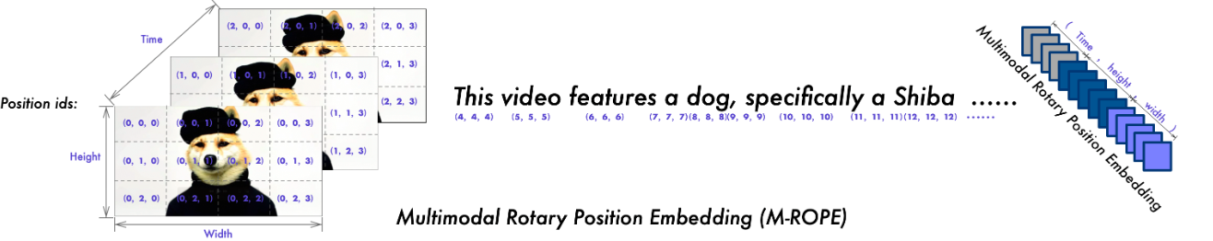
Key Innovation - M-ROPE
How it understands Space:
Standard models read left-to-right (1D).
Qwen2-VL uses M-ROPE (Multimodal Rotary Positional Embedding).
The Math: It decomposes position into 3D: Time, Height, and Width.

Slide 19
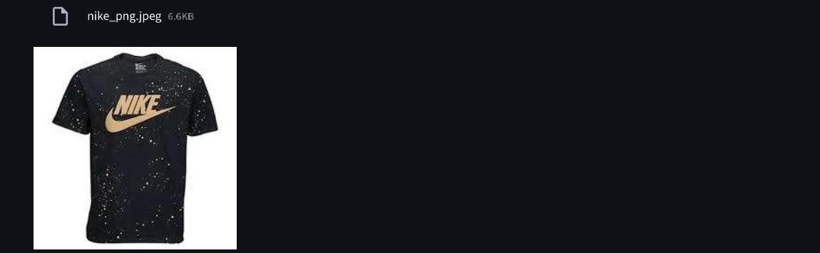
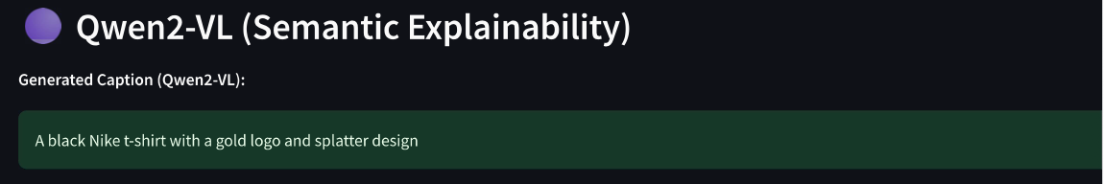
Model Evaluation(Qualitative)
Analysis:
Accuracy: It correctly identified "Nike" (Brand) and "Splatter" (Pattern).
Confidence: Confidence score jumped from 6.67 (Model-1) to 9.54 (Qwen).

Slide 20
Conclusion
Summary:
Baseline: Good for general shapes ("Black Shirt") but fails on details.
Qwen2-VL: Superior for e-commerce due to native resolution and OCR capabilities.
We built a complete multimodal image captioning system that integrates visual features and structured metadata. Our Model-1 architecture significantly improves semantic accuracy over the baseline and produces captions closer to human e-commerce catalogs. Through Qwen2-VL benchmarking and gradient-based explainability, we demonstrate the strengths, limitations, and interpretability of our system.

Slide 21
Thankyou !!

