Slide 1
Hypothesis Testing Exercise
A F&B manager wants to determine whether there is any significant difference in the diameter of the cutlet between two units. A randomly selected sample of cutlets was collected from both units and measured? Analyze the data and draw inferences at 5% significance level. Please state the assumptions and tests that you carried out to check validity of the assumptions.
Minitab File : Cutlets.mtw

Slide 2
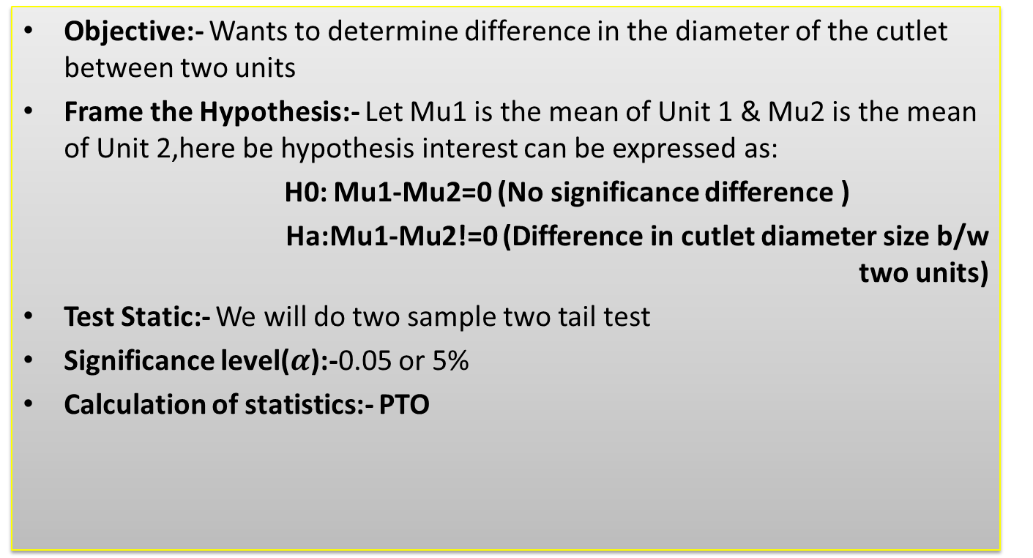
Hypothesis Testing Exercise-1
Objective:- Wants to determine difference in the diameter of the cutlet between two units
Frame the Hypothesis:- Let Mu1 is the mean of Unit 1 & Mu2 is the mean of Unit 2,here be hypothesis interest can be expressed as:
H0: Mu1-Mu2=0 (No significance difference )
Ha:Mu1-Mu2!=0 (Difference in cutlet diameter size b/w two units)
Test Static:- We will do two sample two tail test
Significance level($α$):-0.05 or 5%
Calculation of statistics:- PTO

Slide 3
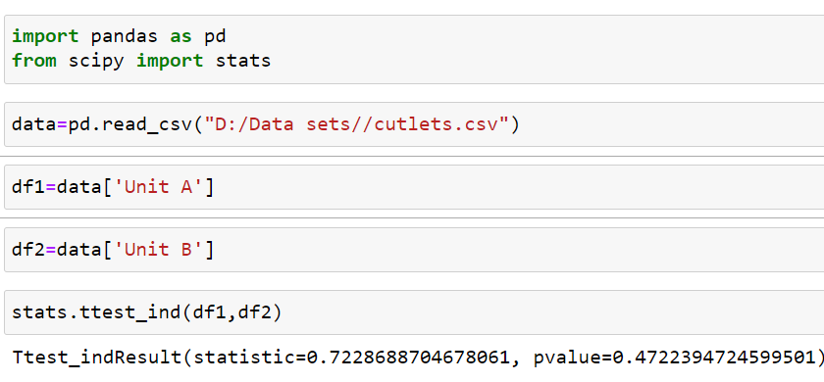
Hypothesis Testing Exercise-1
Calculation of statistics through the python
Conclusion
P-value=0.47
We can say our P-value is greater than significance level then we have failed to reject null Hypothesis .
Conclusion :- There is not significant difference in the diameter of the cutlet between two units

Slide 4
Hypothesis Testing Exercise
A hospital wants to determine whether there is any difference in the average Turn Around Time (TAT) of reports of the laboratories on their preferred list. They collected a random sample and recorded TAT for reports of 4 laboratories. TAT is defined as sample collected to report dispatch.
Analyze the data and determine whether there is any difference in average TAT among the different laboratories at 5% significance level.
Minitab File: LabTAT.mtw

Slide 5
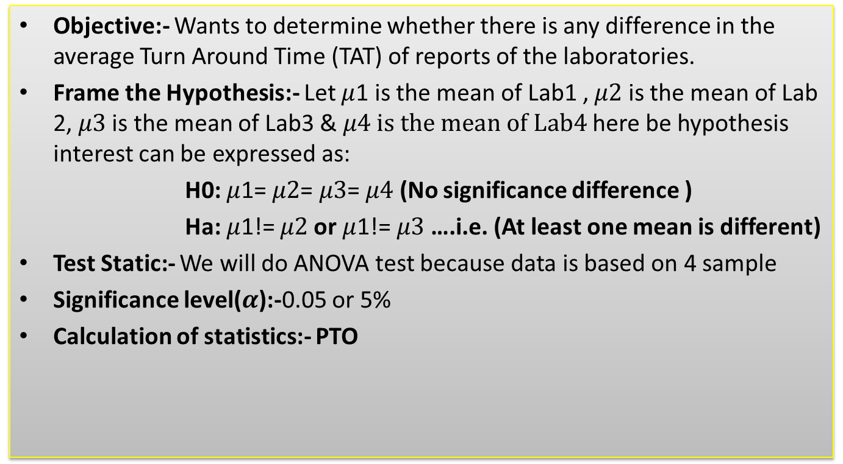
Hypothesis Testing Exercise-2
Objective:- Wants to determine whether there is any difference in the average Turn Around Time (TAT) of reports of the laboratories.
Frame the Hypothesis:- Let $μ$1 is the mean of Lab1 , $μ2$ is the mean of Lab 2, $μ3$ is the mean of Lab3 & $μ4 is the mean of Lab4$here be hypothesis interest can be expressed as:
H0: $μ$1= $μ2$= $μ3$= $μ4$ (No significance difference )
Ha: $μ$1!= $μ2$or $μ$1!= $μ3$ ….i.e. (At least one mean is different)
Test Static:- We will do ANOVA test because data is based on 4 sample
Significance level($α$):-0.05 or 5%
Calculation of statistics:- PTO

Slide 6
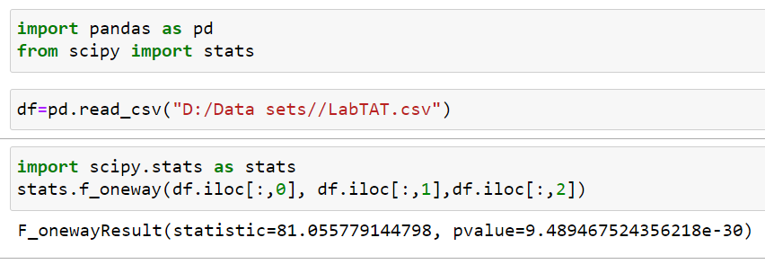
Hypothesis Testing Exercise-2
Calculation of statistics through the python
Conclusion
P-value=0.948…..e-30
We can say our P-value is less than significance level then we have to reject null Hypothesis .
Conclusion :- There is difference in average TAT among the different laboratories

Slide 7
Hypothesis Testing Exercise
Sales of products in four different regions is tabulated for males and females. Find if male-female buyer rations are similar across regions.
 | East | West | North | South
Males | 50 | 142 | 131 | 70
Females | 550 | 351 | 480 | 350
Check p-value
If p-Value < alpha, we reject Null Hypothesis
H0
All proportions are equal
Ha
Not all Proportions are equal
Buyer Ratio.mtw

Slide 8
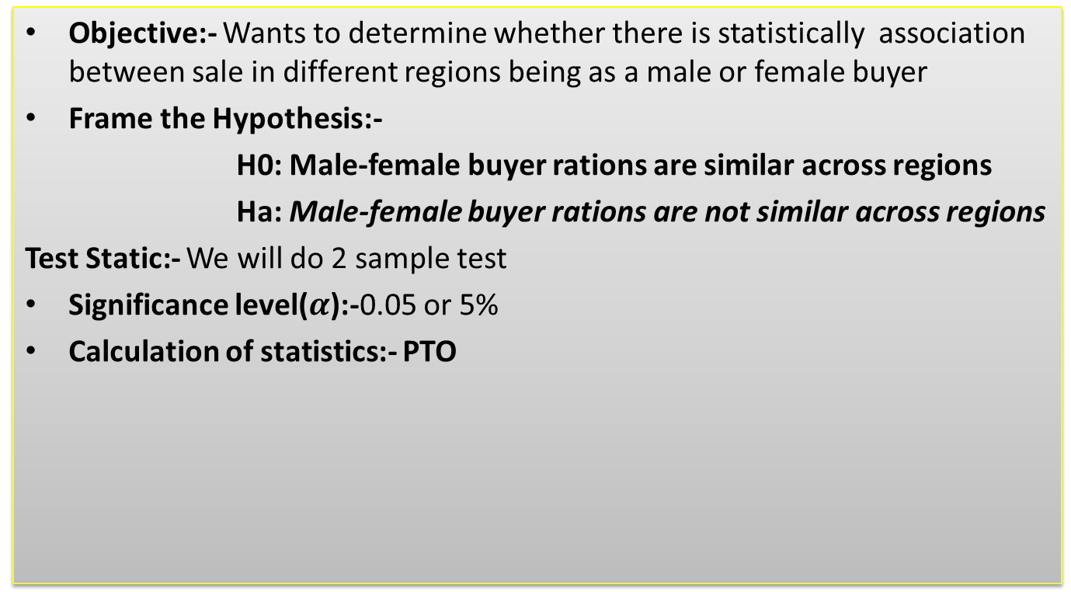
Hypothesis Testing Exercise-3
Objective:- Wants to determine whether there is statistically association between sale in different regions being as a male or female buyer
Frame the Hypothesis:-
H0: Male-female buyer rations are similar across regions
Ha: Male-female buyer rations are not similar across regions
Test Static:- We will do 2 sample test
Significance level($α$):-0.05 or 5%
Calculation of statistics:- PTO

Slide 9
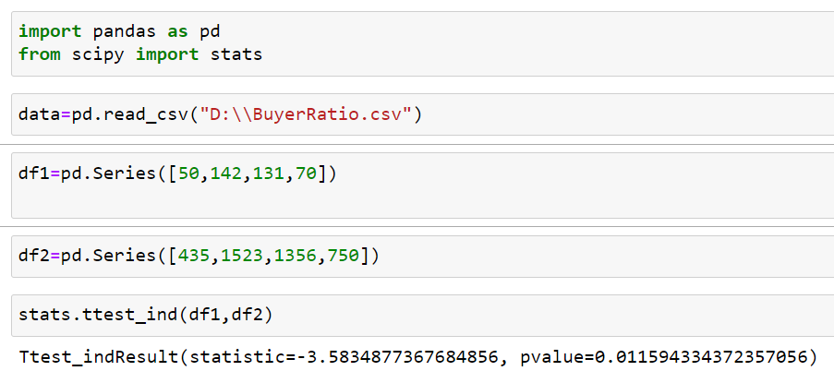
Hypothesis Testing Exercise-3
Calculation of statistics through the python
Conclusion
P-value=0.0115
We can say our P-value is less than significance level then we have to reject null Hypothesis .
Conclusion :- Male-female buyer rations are not similar across regions

Slide 10
Hypothesis Testing Exercise-3
2nd way Calculation of statics:- Chi square
Expected Frequencies
 | East | West | North | South | Total
Male | 111.0169 | 91.21893 | 113.0523 | 77.71186 | 393
Female | 488.9831 | 401.7811 | 497.9477 | 342.2881 | 1731
Total | 600 | 493 | 611 | 420 | 2124
Test Statistics |  |  |  | Total
33.53603 | 28.26954 | 2.849314 | 0.7653 | 65.42019
7.6139 | 6.418215 | 0.646898 | 0.173751 | 14.85276
Grand Total |  |  |  | 80.27295
Degree of freedom=(No. of Row-1)*(No. of column -1)=(2-1)(4-1)=3
AT 0.05 significance level critical value will be 7.82
Test statistic=80.27> critical value=7.82
Conclusion:- Test statistic is larger than the critical value we can reject the null hypothesis then we can say male-female buyer rations similar across regions

Slide 11
Hypothesis Testing Exercise
TeleCall uses 4 centers around the globe to process customer order forms. They audit a certain % of the customer order forms. Any error in order form renders it defective and has to be reworked before processing. The manager wants to check whether the defective % varies by centre. Please analyze the data at 5% significance level and help the manager draw appropriate inferences
Minitab File: CustomerOrderForm.mtw
Fantaloons Sales managers commented that % of males versus females walking in to the store differ based on day of the week. Analyze the data and determine whether there is evidence at 5 % significance level to support this hypothesis.
Minitab File: Fantaloons.mtw

Slide 12
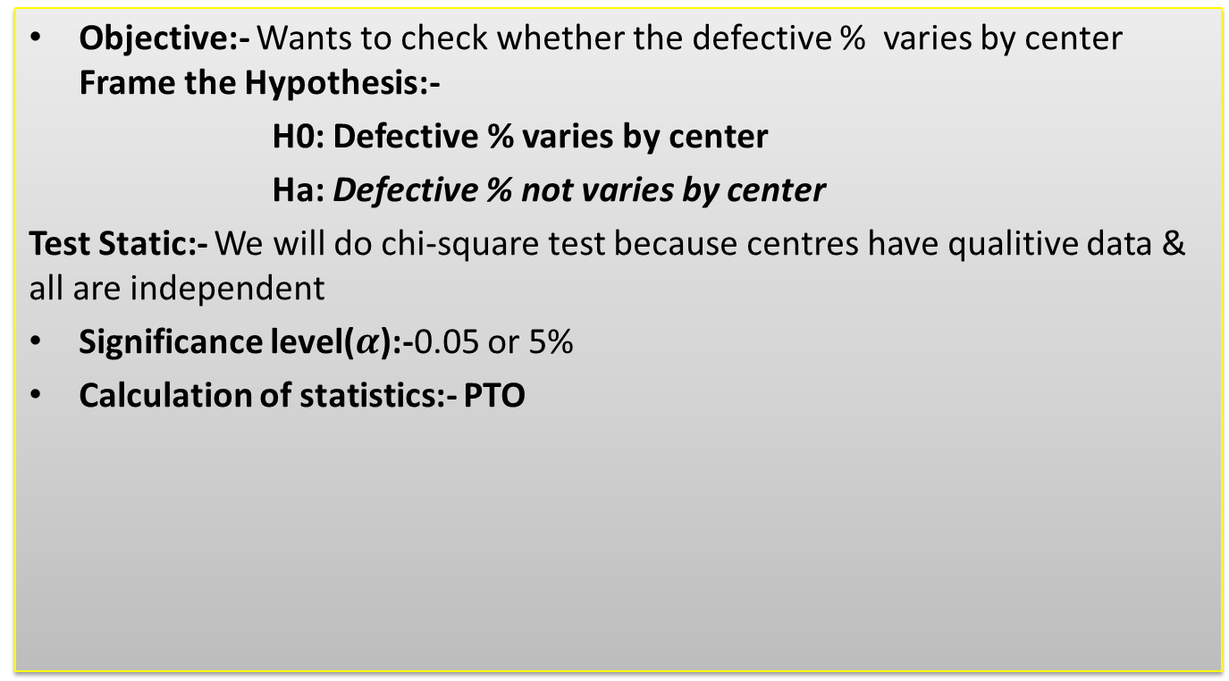
Hypothesis Testing Exercise-4
Objective:- Wants to check whether the defective % varies by center Frame the Hypothesis:-
H0: Defective % varies by center
Ha: Defective % not varies by center
Test Static:- We will do chi-square test because centres have qualitive data & all are independent
Significance level($α$):-0.05 or 5%
Calculation of statistics:- PTO

Slide 13
Hypothesis Testing Exercise-4
Calculation of statics:- Chi square
Expected Frequencies
 | Philippines | Indonesia | Malta | India | Total
Error Free | 271.75 | 271.75 | 271.75 | 271.75 | 1087
Defective | 28.25 | 28.25 | 28.25 | 28.25 | 113
Total | 300 | 300 | 300 | 300 | 1200
Test Statistics |  |  |  | Total
0.00207 | 0.083027 | 0.027829 | 0.25046 | 0.363385
0.019912 | 0.798673 | 0.267699 | 2.409292 | 3.495575
Grand Total |  |  |  | 3.858961
Degree of freedom=(No. of Row-1)*(No. of column -1)=(2-1)(4-1)=3
AT 0.05 significance level critical value will be 7.82
Test statistic=3.85< critical value=7.82
Conclusion:- Test statistic is smaller than the critical value we fail to reject the null hypothesis then we can say defective % varies by center.

Slide 14
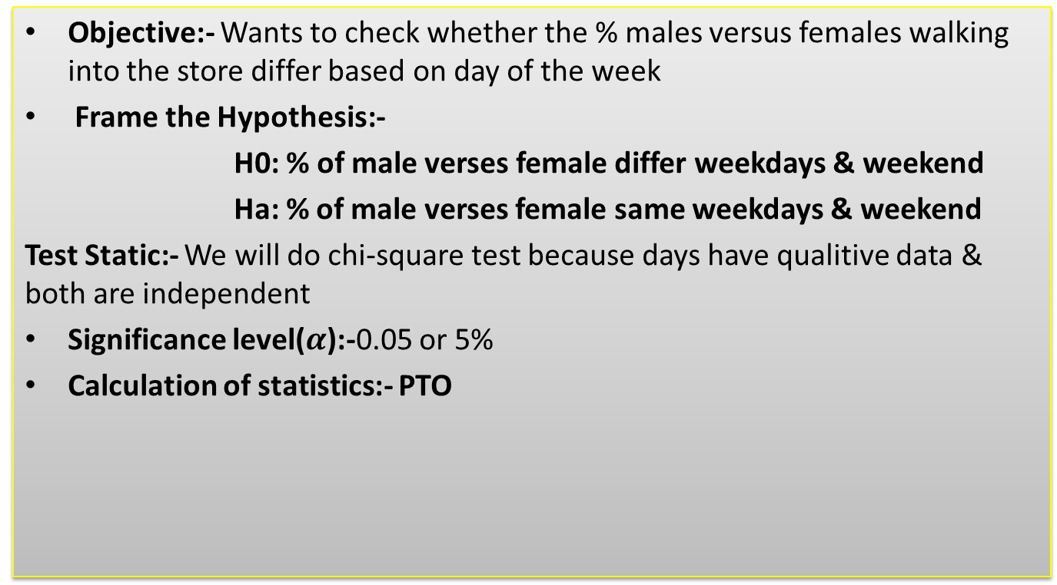
Hypothesis Testing Exercise-5
Objective:- Wants to check whether the % males versus females walking into the store differ based on day of the week
Frame the Hypothesis:-
H0: % of male verses female differ weekdays & weekend
Ha: % of male verses female same weekdays & weekend
Test Static:- We will do chi-square test because days have qualitive data & both are independent
Significance level($α$):-0.05 or 5%
Calculation of statistics:- PTO

Slide 15
Hypothesis Testing Exercise-5
Calculation of statics:- Chi square
Expected Frequencies
 | Weekdays | Weekend
Male | 140 | 140
Female | 260 | 260
Total | 400 | 400
Total
280
520
800
Test Statistics |  | Total
5.207143 | 5.207143 | 10.41429
2.803846 | 2.803846 | 5.607692
Grand Total |  | 16.02198
Degree of freedom=(No. of Row-1)*(No. of column -1)=(2-1)(2-1)=1
AT 0.05 significance level critical value will be 3.84
Test statistic=16.02> critical value=3.84
Conclusion:- Test statistic is greater than the critical value reject the null hypothesis then we can say in store % of male verses female not differ weekdays & weekend.

