Slide 1
IBM SkillsBuild Data Analytics with AI Internship 2026
AICTE–BharatCares–IBM SkillsBuild Internship Program
Customer Segmentation
and Sales Analytics
Using K-Means Clustering
VISALINI S · 2024PECML192
PANIMALAR ENGINEERING COLLEGE · DEPARTMENT OF ARTIFICIAL INTELLIGENCE AND MACHINE LEARNING

Slide 2
02 / 10
FRAMING
Why customer segmentation?
Transactions
Behaviour
Groups
Businesses generate large volumes of customer transaction data.
Raw records do not directly reveal which customers are regular, inactive, or highly valuable.
RFM analysis and K-Means clustering group customers by similar purchasing behaviour.

Slide 3
03 / 10
FRAMING
The business challenge is turning transactions into action
Transaction complexity
One-size engagement
Behavioural segments
Large retail datasets are difficult to convert into actionable customer insight.
Treating every customer similarly can weaken targeted engagement and retention activity.
A data-driven approach identifies groups based on purchasing behaviour.
TRANSACTIONS → BEHAVIOURAL FEATURES → ACTIONABLE SEGMENTS

Slide 4
04 / 10
METHOD
Eight steps from raw data to recommendations
01
Load and examine the Online Retail dataset.
02
Clean and prepare transaction data.
03
Perform exploratory data analysis.
04
Calculate customer-level RFM metrics.
05
Standardize RFM features.
06
Determine a suitable K-Means cluster count.
07
Visualize and interpret customer segments.
08
Develop business recommendations.

Slide 5
05 / 10
DATASET
The dataset starts broad and ends analysis-ready
ORIGINAL TRANSACTIONS
ORIGINAL COLUMNS
TRANSACTION PERIOD
CLEANED TRANSACTIONS
8
Dec 2010
– Dec 2011
541,909
392,692
ORIGINAL COLUMNS
ORIGINAL TRANSACTIONS
FINAL CLEANED TRANSACTIONS
ATTRIBUTES · INVOICENO · STOCKCODE · DESCRIPTION · QUANTITY · INVOICEDATE · UNITPRICE · CUSTOMERID · COUNTRY

Slide 6
06 / 10
PREPARATION
Cleaning removes noise without losing customer signal
01
02
03
541,909
−5,268
−135,037
raw transactions
duplicates
records without CustomerID
04
05
06
−8,912
392,692
TotalPrice
invalid quantity or price records
cleaned transactions
Create TotalPrice; parse InvoiceDate with the correct day-first format.

Slide 7
07 / 10
FEATURE ENGINEERING
RFM turns purchase history into customer behaviour
RECENCY
FREQUENCY
MONETARY
92.54
4.27
£2,048.69
DAYS · HOW RECENTLY THE CUSTOMER PURCHASED
UNIQUE INVOICES · NUMBER OF UNIQUE INVOICES
MEAN TOTAL CUSTOMER PURCHASE VALUE
CUSTOMER BEHAVIOUR
ANALYSIS BASE
RFM representation
4,338
UNIQUE CUSTOMERS ANALYSED

Slide 8
08 / 10
CLUSTERING
ELBOW METHOD · PROVIDED RANGE
K-Means finds four groups in standardized RFM space
Standardize RFM features using StandardScaler. Examine the Elbow Method for k = 1 to 10.
k=1
k=2
k=3
k=4
k=5
k=6
k=7
k=8
k=9
k=10
Selected solution: k = 4 · final inertia 4,096.30
k = 4
FINAL NUMBER OF CLUSTERS
FINAL INERTIA · 4,096.30
SILHOUETTE SCORE · 0.6162

Slide 9
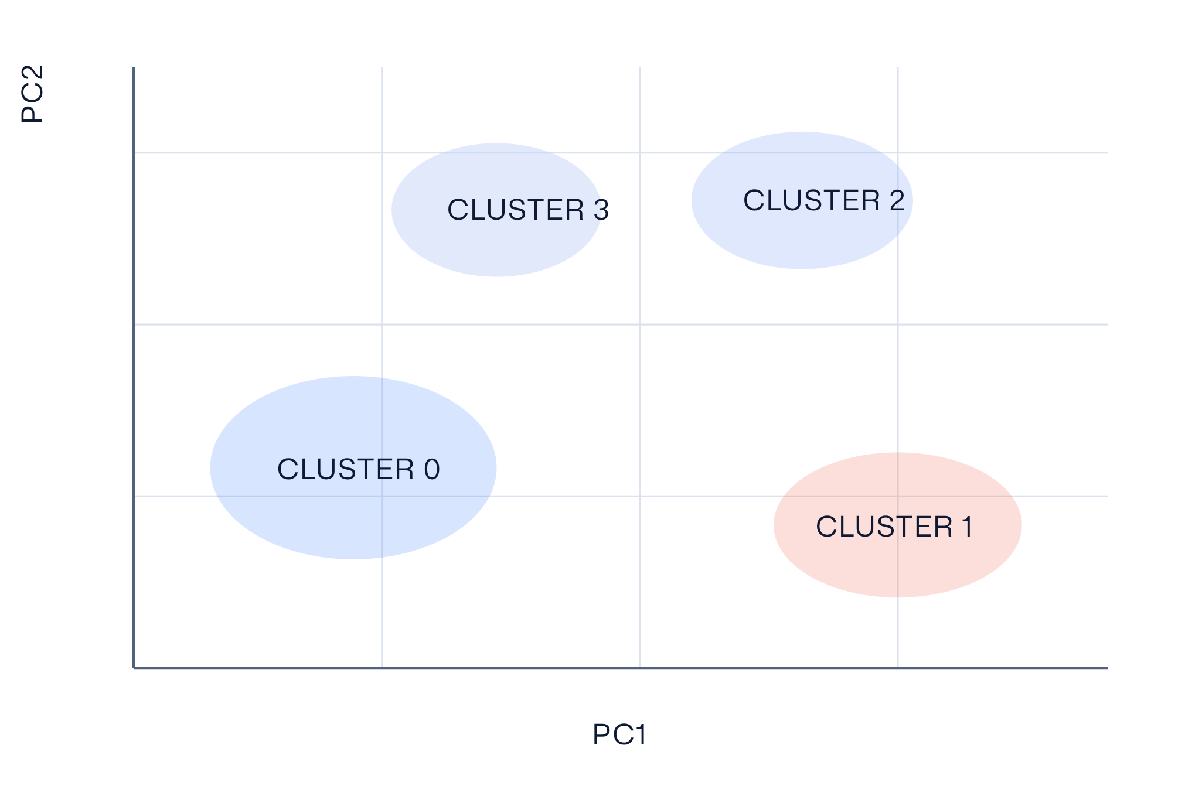
09 / 10
DIMENSION REDUCTION
PCA makes the four segments visible
PCA visualizes the standardized RFM feature space in two dimensions.
PC1: 55.47%
PC2: 30.25%
COMBINED VARIANCE EXPLAINED
85.73%

Slide 10
10 / 10
SEGMENTS
Four segments reveal distinct engagement patterns
CLUSTER 0
CLUSTER 1
Regular Customers
At-Risk / Inactive Customers
3,054 CUSTOMERS
1,067 CUSTOMERS
Recency 43.70 days
Frequency 3.68
Monetary £1,353.63
Recency 248.08 days
Frequency 1.55
Monetary £478.85
CLUSTER 2
CLUSTER 3
VIP / Champion Customers
High-Value Loyal Customers
13 CUSTOMERS
204 CUSTOMERS
Recency 7.38 days
Frequency 82.54
Monetary £127,187.96
Recency 15.50 days
Frequency 22.33
Monetary £12,690.50

