Slide 1


BookingPulse
Presented By-
Patil Pranavkumar Laxman (239183)
Ingle Vishal Navnath (239159)

Slide 2
Project Introduction
Welcome to BookingPulse, where the world of hospitality meets seamless convenience. Our platform serves as a bridge between hotel owners and guests, offering a user-friendly interface for hotel owners to showcase their properties and enabling customers to effortlessly browse, compare, and book accommodations. With BookingPulse, finding the perfect hotel room is just a click away, revolutionizing the way we experience travel and hospitality.

Slide 3
Objective (Purpose):
Simplify the process for hotel owners to list and manage their properties on a centralized platform.
Enhance the booking experience for customers by providing easy access to a diverse range of accommodations and personalized recommendations.
Optimize revenue generation for hotel owners through increased visibility and efficient property management.
Ensure secure and seamless transactions for customers through integrated payment gateways.
Foster collaboration between hotel owners and guests to create a harmonious booking ecosystem that sets new standards for convenience and satisfaction.

Slide 4
Scope:
Develop a user-friendly web application accessible from various devices.
Implement features for hotel owners to create and manage property listings.
Incorporate search and filtering functionality for customers to browse accommodations.
Integrate secure payment gateways for seamless transactions.
Provide personalized recommendations and booking assistance.

Slide 5
Technology Used:
Operating System: Windows 10 or above
Backend Technology: J2EE
Frontend Technology: HTML, CSS, JavaScript, React.js
IDE: STS
Web Server: Apache Tomcat (9.x)
Database: MySQL 8.0
Java Version: JDK 11

Slide 6
S/W and H/W Requirements
Server Side:
Processor: Intel core i3 or above
HDD: 500 GB or above
RAM: 4GB or above
Database: MySQL
Client Side (minimum requirement):
Processor: Intel Dual Core
HDD: Minimum 80GB Disk Space
RAM: Minimum 2GB
OS: Windows 7, Linux

Slide 7
Functionalities - Module wise /user wise
BookingPulse consists of two modules named below
1. Admin
2. Customer/User
User Roles:
Admin : Admin can login to the system.
Admin : login, add hotel , delete hotel, update hotel details, remove user.
Customer/User : register itself, logins ,update her/his details, view hotels and rooms, book rooms.

Slide 8
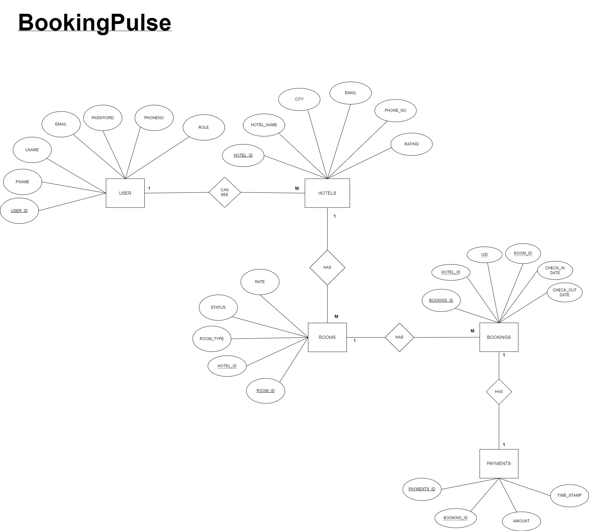
UML Diagrams: E-R Diagram

Slide 9
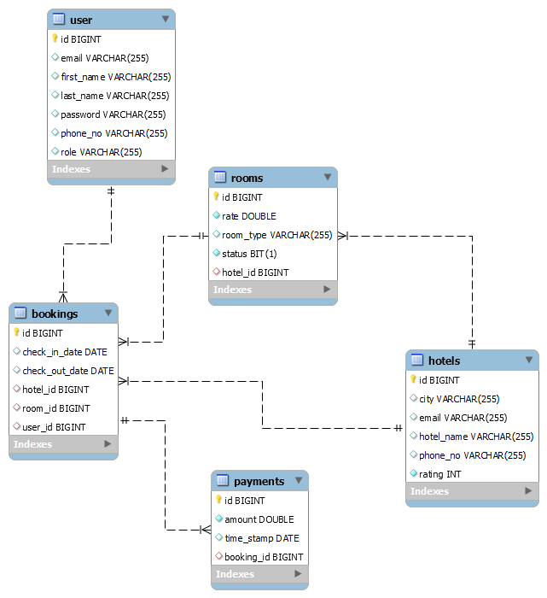
Class Diagram(MySQL Auto generated)

Slide 10
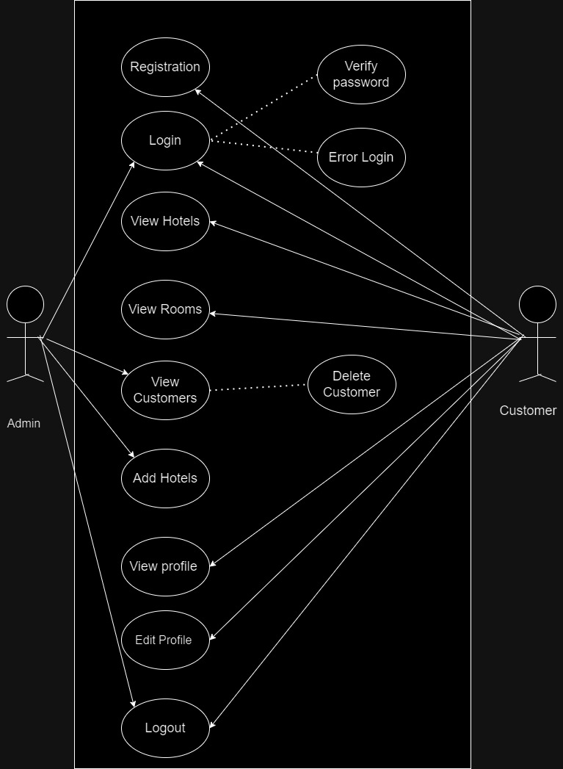
Use Case

Slide 11
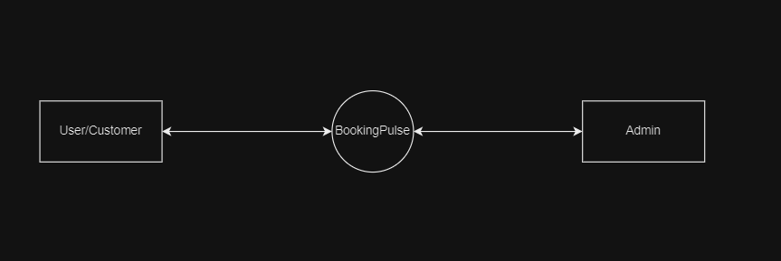
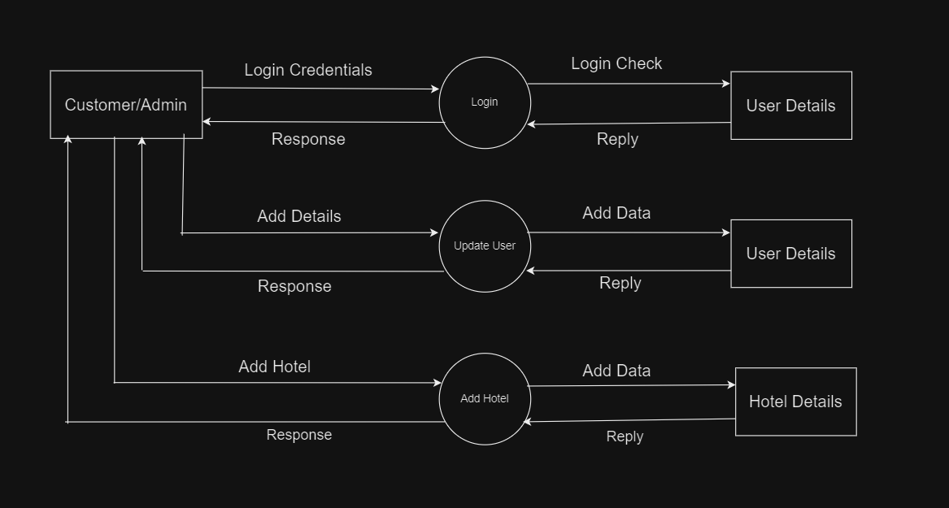
DFD diagrams
Level 0:
Level 1:

Slide 12
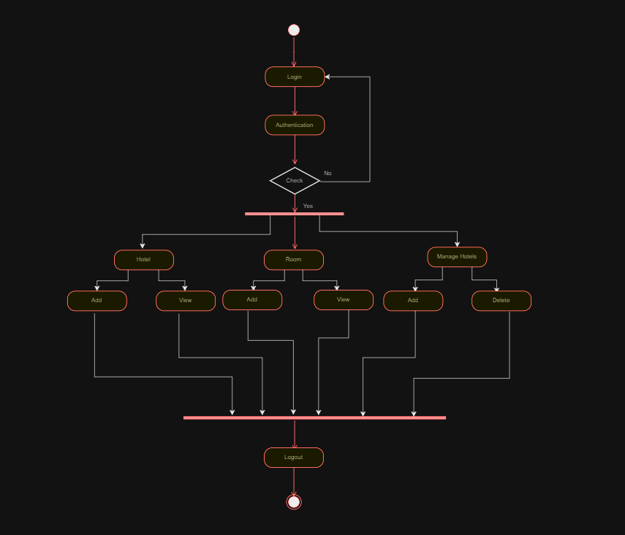
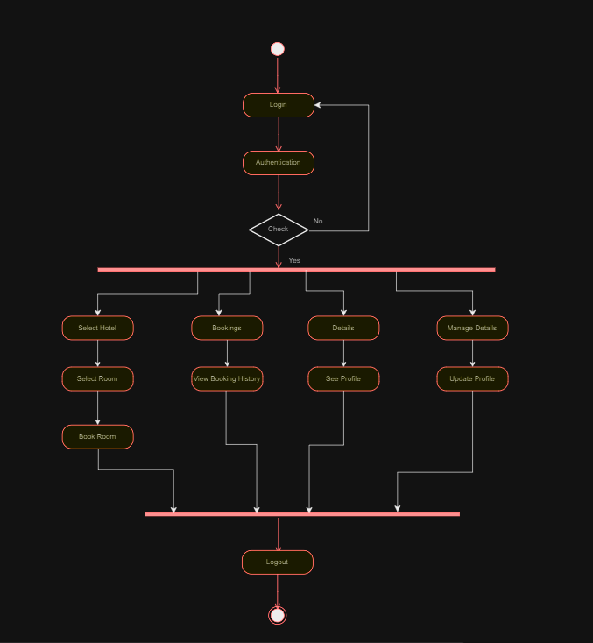
Activity
Diagram
Admin Activity Diagram
User Activity Diagram

Slide 13
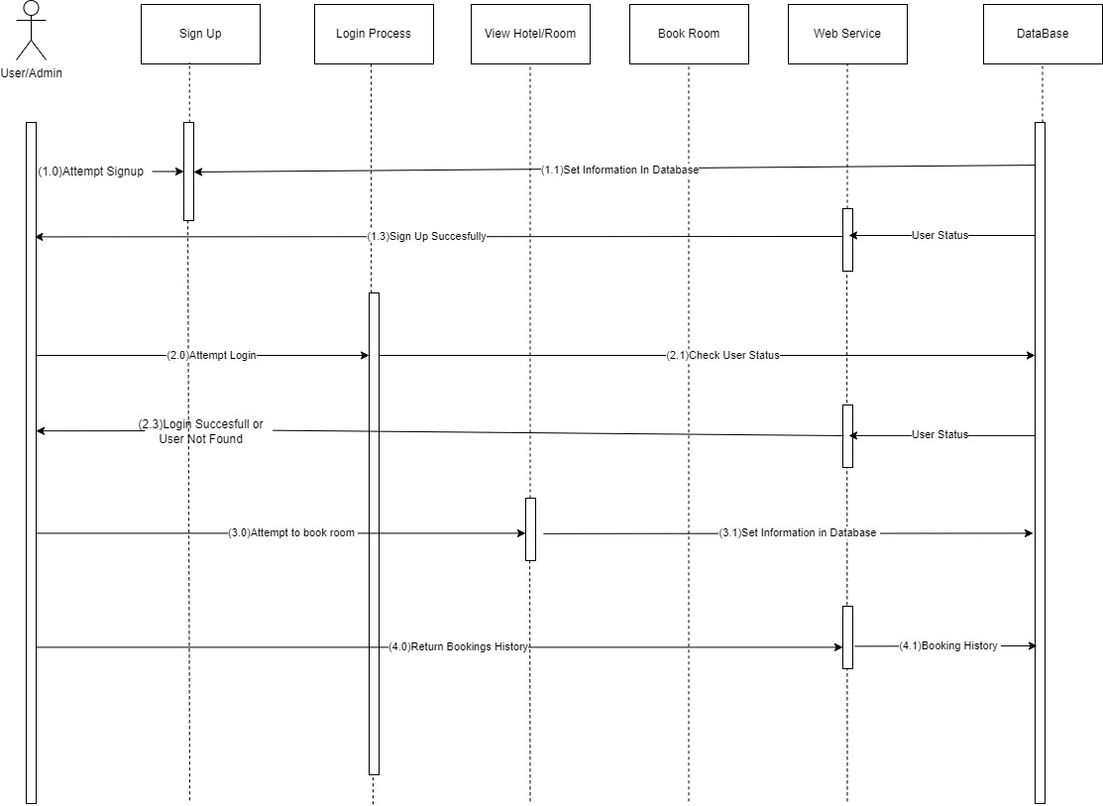
Sequence
Diagram

Slide 14
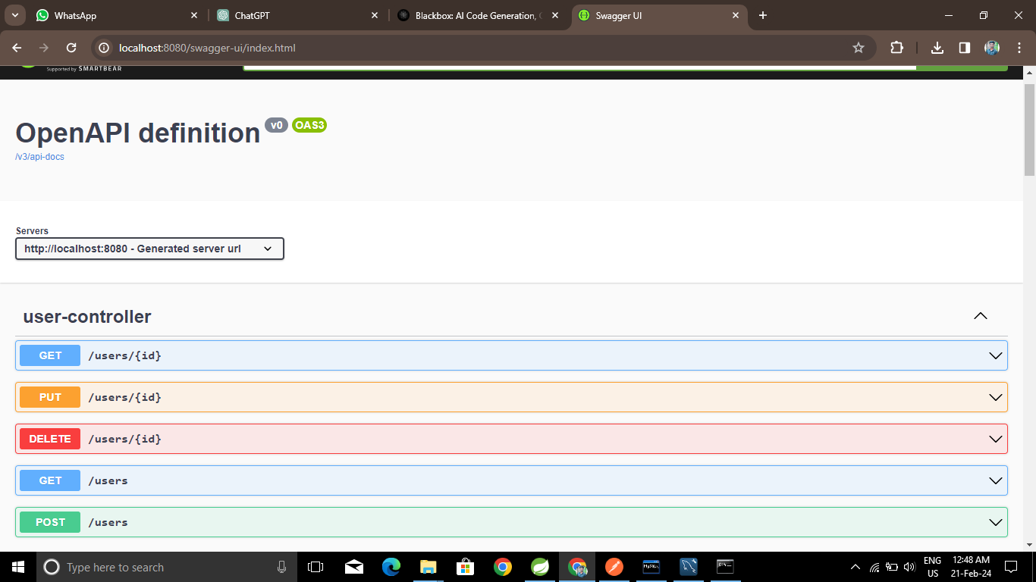
UI
Screen Shots

Slide 15
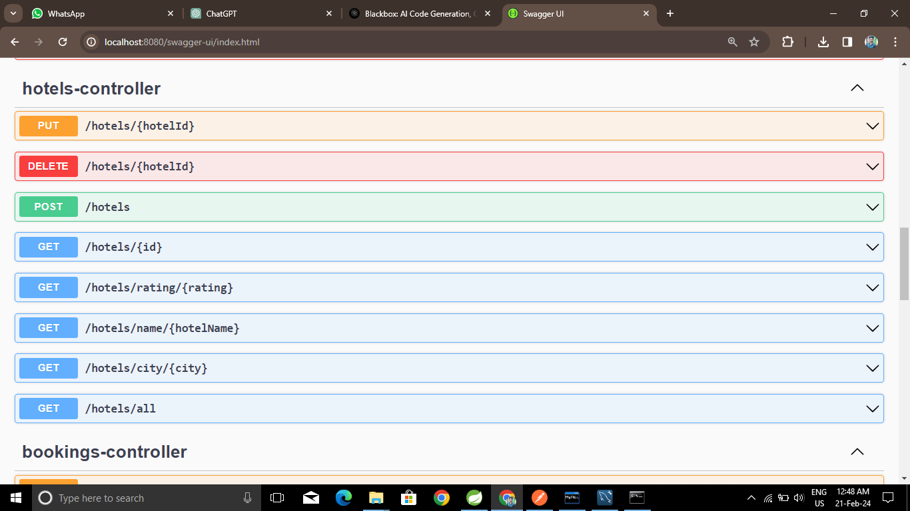
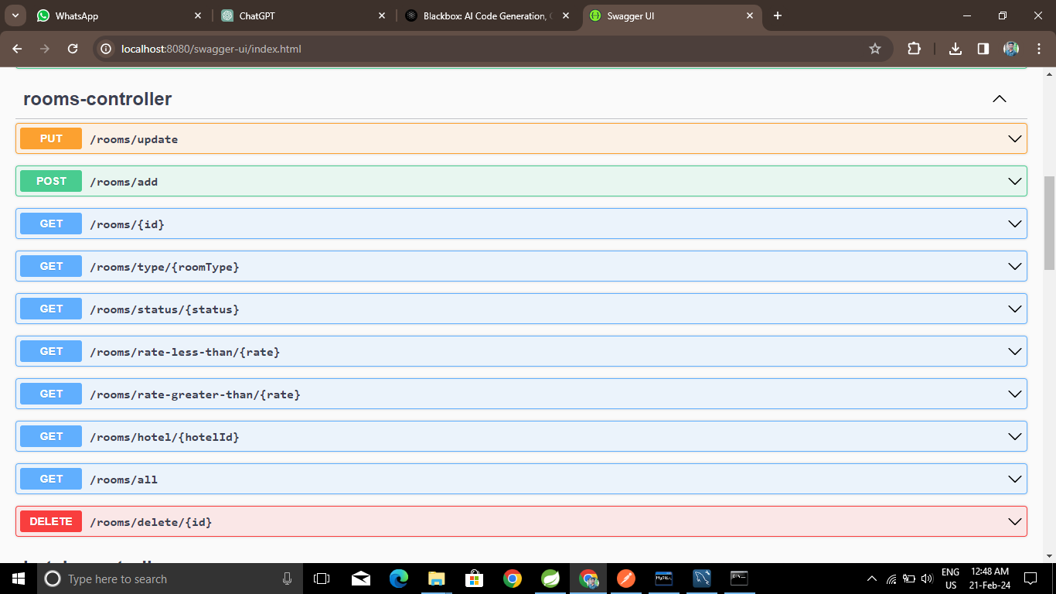

Slide 16
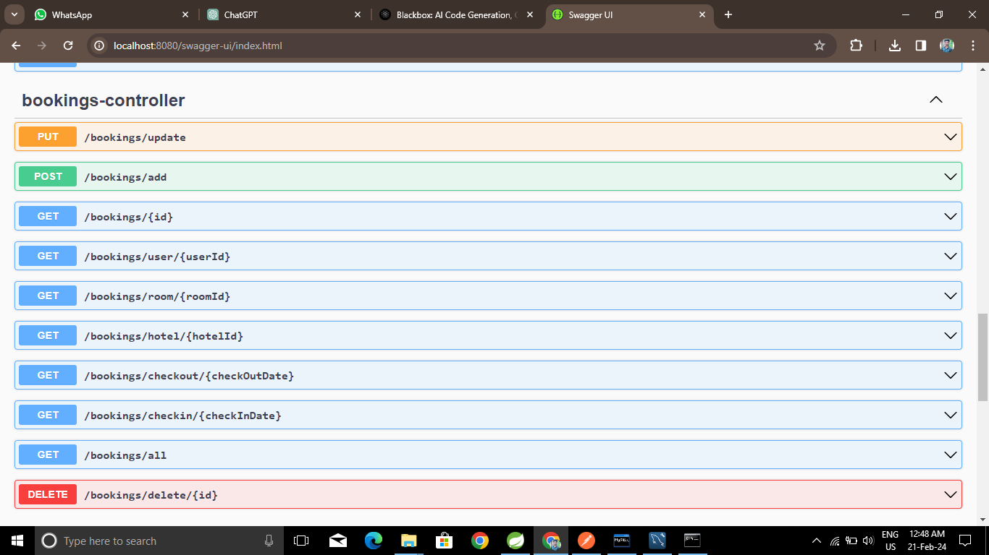
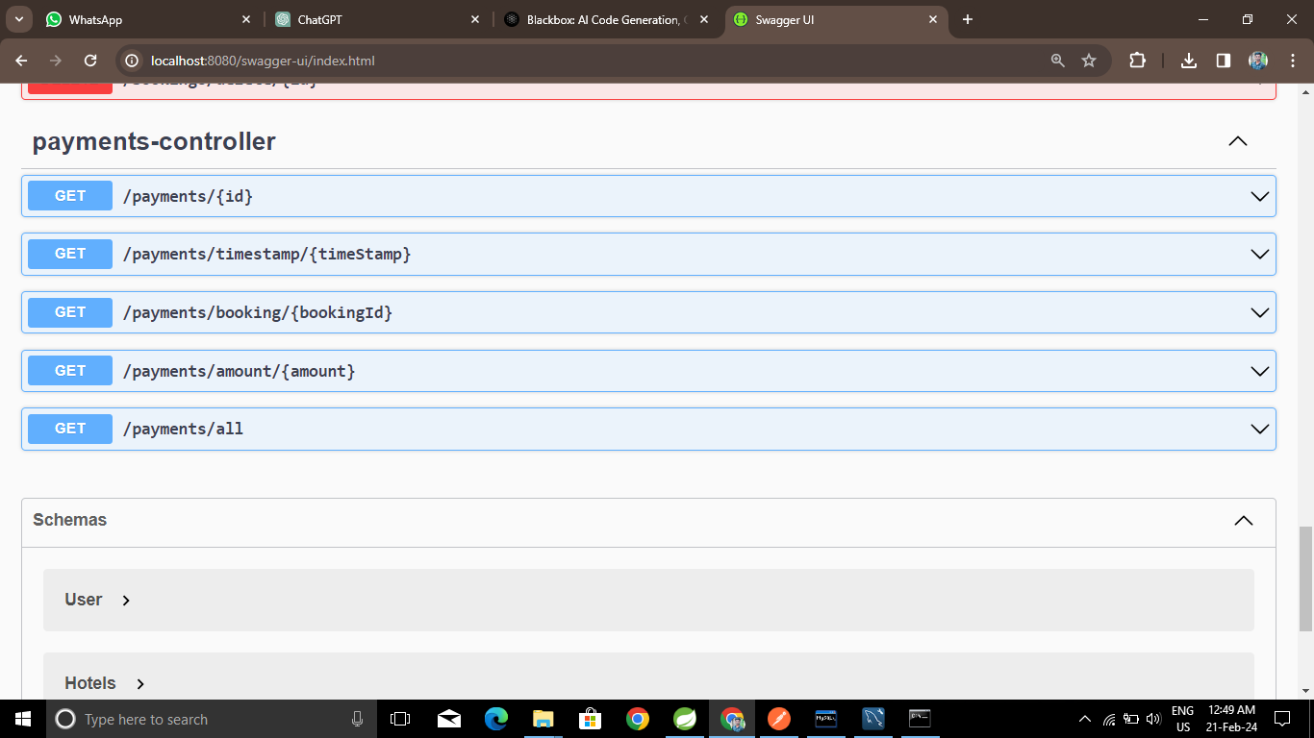

Slide 17
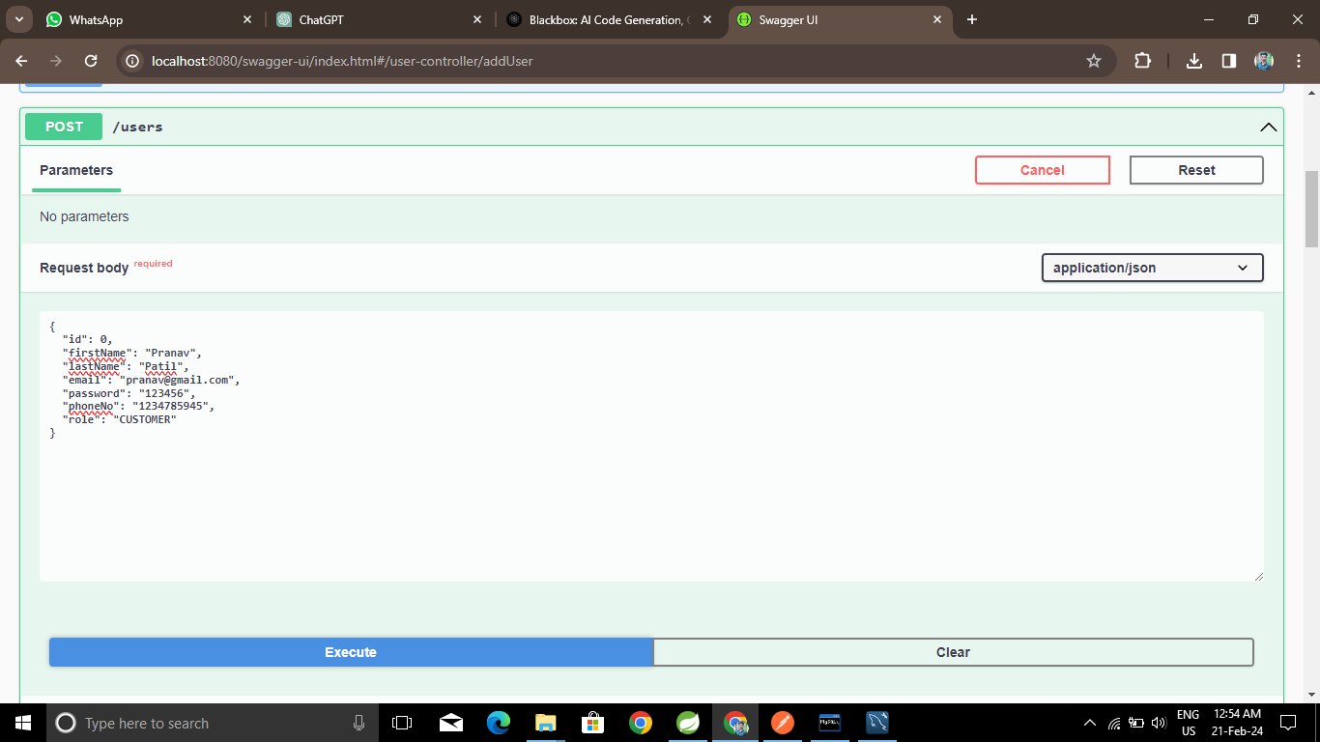

Slide 18
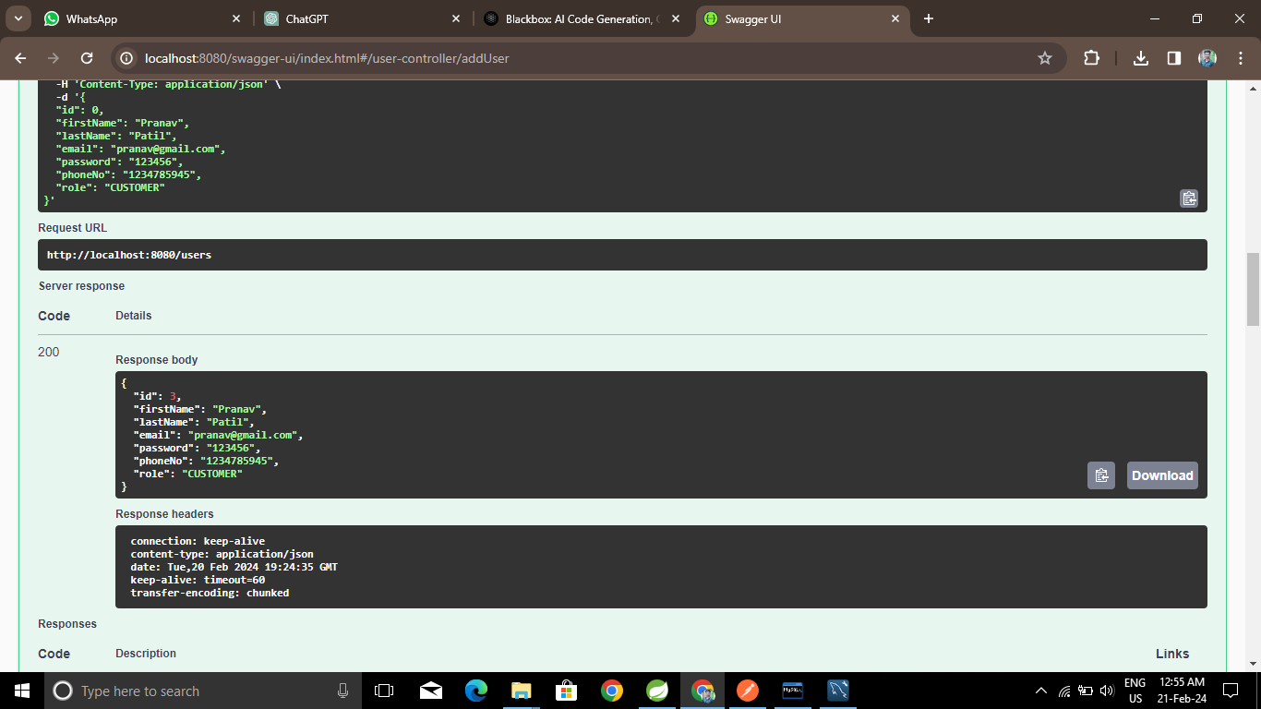

Slide 19
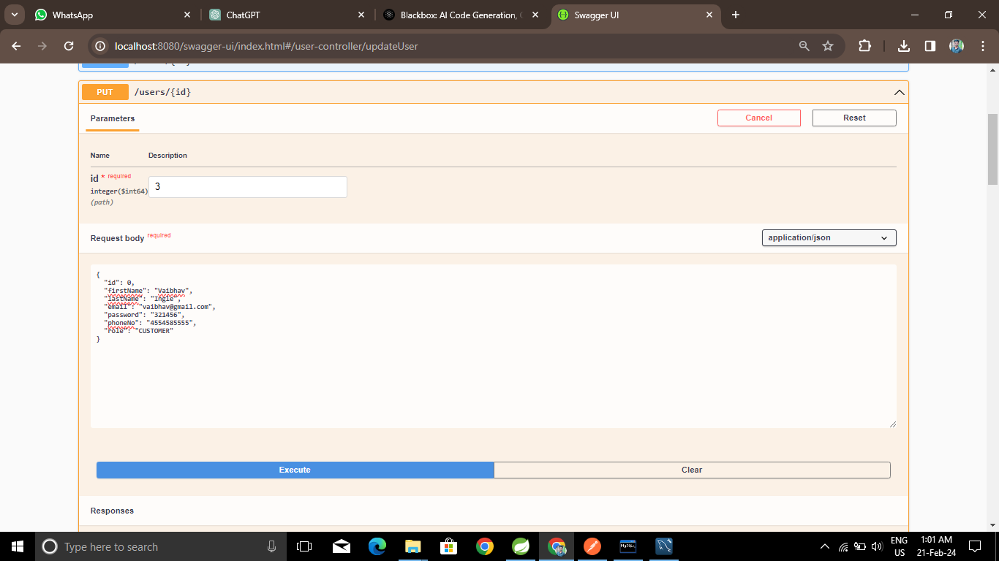

Slide 20
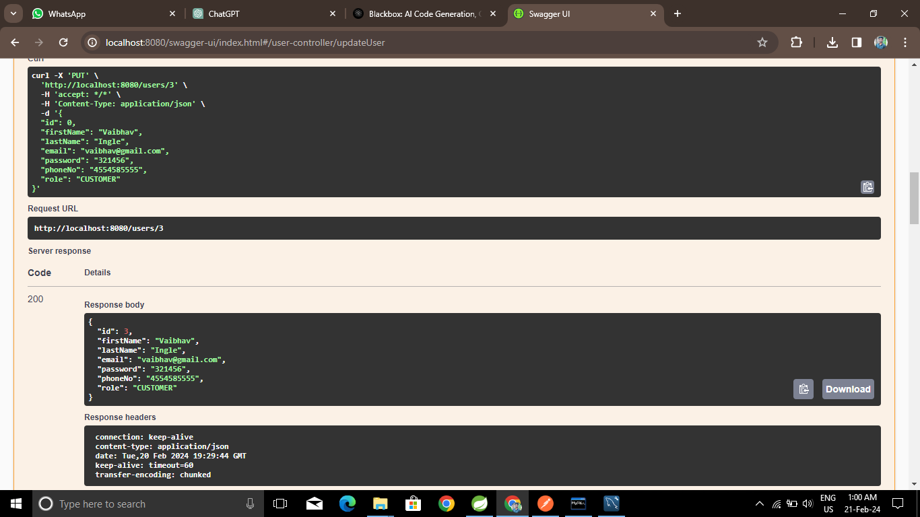

Slide 21
Futures Scope
Expansion of Services: Integrate additional features such as car rentals, tour bookings, and restaurant reservations to offer customers a comprehensive travel planning experience.
Global Reach: Extend the platform's reach to include a wider range of international destinations and accommodations, catering to the needs of travelers worldwide.
Enhanced Personalization: Implement advanced algorithms and AI-driven recommendations to further personalize the booking experience based on user preferences and behavior.

Slide 22
Conclusion
BookingPulse represents a paradigm shift in the hospitality industry, offering a comprehensive solution that seamlessly connects hotel owners and guests on a single, user-friendly platform. Through intuitive design, advanced technology, and a commitment to excellence, BookingPulse has transformed the hotel booking experience, setting new standards for convenience, accessibility, and satisfaction. As we continue to innovate and expand our services, we look forward to shaping the future of travel and hospitality, empowering both travelers and hoteliers to explore new horizons and create unforgettable experiences.

Slide 23
References
http://www.javatpoint.com/java-tutorial
http://www.w3.org
http://www.wikipedia.org
https://www.tutorialspoint.com/java

Slide 24

THANK YOU

