Slide 1

CAPSTONE PROJECT PHASE I
CodeArchaeologist
An AST-Guided, LLM-Powered System for Legacy Code
Comprehension and Automated Documentation
Vishal Kumar Jangir · 23BBTCS280
Syed Mudassir · 23BBTCS258
Junaid Pasha · 23BBTCS257
Guide
Mr. Sheik Jamil Ahmed
Department of CSE
School of Engineering and Technology CMR University 2026–27
Notes:
Vishal opens the presentation. Explain that the local Python implementation is available for demonstration. Describe the long title without claiming perfect comprehension. Team and guide details follow the populated title slide in the supplied eight-page PDF. Confirm these details before submission.

Slide 2
Presentation outline
01
Problem statement and final objectives
02
Literature survey and identified gaps
03
System architecture and detailed design
04
Data-flow diagrams and use cases
05
Working model, verification, and remaining evaluation
SoET, CMRU
02
Notes:
Vishal introduces the problem, objectives, and literature. Syed explains architecture and design. Junaid presents the implementation, results, and next work. This is a suggested speaking allocation, not a statement that each member completed a specific task.

Slide 3
Problem statement
Understanding an unfamiliar Python project requires tracing definitions, calls, and behavior across files.
01
Documentation may be absent or out of date.
02
Static structure helps navigation but does not fully explain behavior.
03
Generated explanations can misread source and need inspectable evidence.
04
A local tool should connect each finding or answer to the actual source.
SoET, CMRU
03
Notes:
Vishal describes an unfamiliar Python project with missing documentation. Manual inspection can reveal its behavior, but relationships across files are tedious to trace. The project combines explicit static records with a local language model. Do not repeat the earlier unsupported claim that existing tools cannot explain code.

Slide 4
Final project objectives
01
Extract Python definitions, imports, calls, and source locations.
02
Visualize module dependencies and supported function calls.
03
Report complexity, parse errors, and potentially unused symbols.
04
Generate documentation and source-linked local AI explanations.
05
Retrieve code by meaning and support natural-language questions.
SoET, CMRU
04
Notes:
Vishal presents five objectives. Clarify that unused-code findings are candidates and that the project has not measured reduced onboarding time or hallucination rates.

Slide 5
Literature survey 1
Study | Contribution | Relevance to this project
CodeBERT Feng et al., 2020 | Joint representations of code and natural language | Motivates semantic matching between questions and source.
Codex Chen et al., 2021 | Code language models evaluated on programming tasks | Motivates language-model assistance and explicit error review.
GraphCodeBERT Guo et al., 2021 | Incorporates data-flow structure into code representations | Supports examining structure when building code context.
SoET, CMRU
05
Notes:
Vishal summarizes the research contributions, then distinguishes research inspiration from the installed models. CodeBERT, Codex, and GraphCodeBERT are not installed components. Sources: https://aclanthology.org/2020.findings-emnlp.139/ https://arxiv.org/abs/2107.03374 https://arxiv.org/abs/2009.08366

Slide 6
Literature survey 2
Study | Contribution | Relevance to this project
DeepCom Hu et al., 2018 | Uses Java method structure for comment generation | Motivates extracting structured method information.
Transformer summarization Ahmad et al., 2020 | Studies attention and relative code-token positions | Motivates focused summaries of bounded source context.
Big code survey Allamanis et al., 2018 | Organizes probabilistic models and applications of code | Frames code learning and its evaluation challenges.
SoET, CMRU
06
Notes:
Vishal explains that the research studies address related learning tasks. Their published results are not evidence of this application’s accuracy. Sources: https://ink.library.smu.edu.sg/sis_research/4292/ https://aclanthology.org/2020.acl-main.449/ https://arxiv.org/abs/1709.06182

Slide 7
Identified gaps and challenges
Engineering challenge | Implemented response
Cross-file relationships are difficult to inspect | AST symbol records with dependency and call graphs.
Repository content exceeds a small model context | Retrieve bounded source chunks and relevant analysis.
Fluent answers may contain unsupported claims | Expose source lines and reject unknown source labels.
Dynamic Python calls are hard to resolve | Keep unresolved calls visible and label unused candidates.
Demonstration should run without a paid API | Local CPU generation and local embedding models.
SoET, CMRU
07
Notes:
Vishal concludes the literature section. These are engineering requirements for this implementation, not claims that no other tool offers the features. Hand over to Syed for detailed design.

Slide 8
Methodology
Folder, ZIP, or demo
Validate input
Create snapshot
Parse and analyze
Build search index
Explore and explain
Static reports and source evidence remain available when generation is unavailable.
SoET, CMRU
08
Notes:
Syed walks through the implemented stages. Analysis does not execute uploaded code. Search and generation operate on saved snapshots. Reanalyze rebuilds a saved snapshot; import changed source as a new project.

Slide 9
System architecture
Python AST
Graphs and metrics
SQLite
Projects and notes
HTTP
React interface
Browser on this computer
FastAPI
ProjectService
BGE retrieval
NumPy vectors
Source snapshots
Reports and index
Evidence
Local Qwen
llama.cpp
All application services and model inference run locally after first-time setup.
SoET, CMRU
09
Notes:
Syed explains the actual deployment. React and FastAPI use loopback port 8765. The bundled local llama.cpp server uses port 8081. SQLite stores metadata and notes, while snapshots and indices are files. This is a local single-user application with no application login. See the delivered source docs/ARCHITECTURE.md.

Slide 10
Detailed module design
Subsystem | Main files | Output
Input and snapshots | ingestion.py, collector.py | Validated Python-only source snapshot
Static analysis | parser.py, analyzer.py, models.py | Symbols, graph edges, metrics, limitations
Retrieval | retrieval.py | Chunks, vectors, ranked source evidence
Generation | ai.py, service.py | Short facts, source labels, saved notes
Persistence and export | storage.py, reporter.py | SQLite records and downloadable reports
Application and UI | api.py, server.py, React | Local endpoints and interactive views
SoET, CMRU
10
Notes:
Syed gives the contract for each implemented subsystem. The file names are actual source modules. Data moves through ProjectService so the interface does not need to understand parsing internals.

Slide 11
Data-flow diagram level 0
Python source, questions,
analysis and export requests
0
CodeArchaeologist
Developer
Reports, diagrams, answers,
source references, errors
Context boundary includes the interface, backend, local models, and local storage.
SoET, CMRU
11
Notes:
Syed names this the context diagram. The developer supplies source, questions, and requests. CodeArchaeologist returns results, explanations, source references, or errors. Local models and storage are internal to the system boundary. DFD arrows represent data, not program control.

Slide 12
Data-flow diagram level 1
Source
Records
Index
1.0
Validate and import
2.0
Analyze source
3.0
Index source
4.0
Retrieve and explain
Snapshot
JSON and docs
Index files
D1 Source snapshots
D2 Analysis and reports
D3 Chunks and vectors
AI notes
Reports
5.0
Assemble export
D4 Projects and notes
Saved notes
Developer provides source to 1.0, questions to 4.0, and export requests to 5.0.
SoET, CMRU
12
Notes:
Syed describes the logical processes. P1 validates and snapshots input, P2 analyzes it, P3 indexes source, P4 retrieves and explains, and P5 assembles exports. The simplified view combines report and index files in D2 and D3 while D4 is SQLite metadata and notes.

Slide 13
Data-flow diagram level 2 analysis
Input: D1 source snapshot
2.1
Discover files
2.2
Parse AST
2.3
Resolve calls
2.4
Compute metrics
2.5
Write report
Syntax errors and unresolved calls
Output: D2 analysis.json and generated reports
SoET, CMRU
13
Notes:
Syed expands process 2.0 only. Collector paths feed the parser, which returns typed records and syntax errors. The resolver builds supported call relationships. Metrics and candidate flags then join the records in versioned JSON. Dynamic unresolved calls remain explicit.

Slide 14
Use-case diagram
CodeArchaeologist local application
UC01 Import project
UC02 Explore source
Developer
UC03 Inspect graphs and quality
UC04 Search code
UC05 Ask or explain
UC06 Export documentation
UC07 Reopen or reanalyze
SoET, CMRU
14
Notes:
Syed explains the single user role and the system boundary. Import and saved-project access are separate use cases. AI explanation requires ready local generation, while static views and search can still work without generation. These are application use cases, not account roles.

Slide 15
Use-case contracts
Use case | Precondition | Success and failure behavior
UC01 Import | Readable folder or valid ZIP | Create saved snapshot and report. Reject unsafe paths or limits.
UC05 Ask or explain | Ready project and available model | Retrieve evidence and save answer. Return error if model or source labels fail.
UC06 Export | Ready project | Download JSON, Markdown, SVG, offline HTML, and saved AI notes.
UC07 Reanalyze | Existing saved project | Rebuild the stored snapshot. Changed original source requires a new import.
SoET, CMRU
15
Notes:
Syed presents preconditions and observable outcomes. An invalid ZIP fails without executing code. A model-unavailable answer is a clear error rather than a fabricated explanation. Successful export includes only saved real AI notes.

Slide 16
Question-answer sequence
Developer UI
FastAPI service
Search index
Local Qwen
SQLite
Submit question
Retrieve evidence
Source chunks
Question and context
Facts and labels
Validate and save note
7 Return answer with source links to the interface
SoET, CMRU
16
Notes:
Syed reads the sequence from top to bottom. The backend loads report and search index, retrieves evidence, creates bounded context, calls local generation, validates supplied source labels, persists successful notes, and returns the result. Source-label validation cannot establish factual correctness.

Slide 17
Data and storage design
projects
id TEXT PRIMARY KEY
name, source_kind
created_at, updated_at
status, stage, error
summary JSON text
retrieval_mode
notes
id INTEGER PRIMARY KEY
project_id TEXT
kind, target, question
content, provider, model
citations JSON text
created_at
1 to many
Logical project link. The application manages this relationship.
SoET, CMRU
17
Notes:
Syed explains the actual schema. projects.id logically links notes.project_id. The current schema does not declare a database foreign-key constraint. JSON stores summary and citations. Source/report/index files live under a generated project identifier.

Slide 18
Analysis output contract
schema_version 1.0.0
project name, root, generated_at
summary counts and average complexity
modules definitions, imports, locations
call_graph nodes and supported edges
quality complex, long, and invalid code
unresolved_calls
dead_code potentially unused candidates
limitations interpretation boundaries
Static analysis is the shared contract for reports, retrieval, and the interface.
SoET, CMRU
18
Notes:
Syed explains schema version 1.0.0. Module records contain symbols, imports and parse errors. Call edges contain source, target, label and resolution. Web imports use relative file paths. Source snippets are retrieved from validated snapshot paths, not arbitrary filesystem requests.

Slide 19
Static-analysis algorithms
01
Collect supported Python files and preserve package names.
02
Extract definitions, imports, signatures, calls, and line ranges.
03
Resolve supported local, imported, self, and inferred-instance calls.
04
Estimate complexity and flag functions at score 8 or length 60 lines.
05
Keep unresolved calls and syntax errors available for review.
SoET, CMRU
19
Notes:
Junaid begins implementation. Python ast parses source text without import or execution. Complexity starts at one and counts supported branches in the current function scope. Candidate flags are heuristics. The details are in parser.py and analyzer.py.

Slide 20
Retrieval and local generation
Question
Hybrid retrieval
Bounded evidence
Local generation
Label checks
BGE-small-en-v1.5 384-dimensional vectors
Qwen2.5-Coder-1.5B-Instruct Q2_K CPU inference
Valid source labels help inspection. They do not prove each sentence is correct.
SoET, CMRU
20
Notes:
Junaid explains AST-derived chunks, normalized 384-dimensional BGE vectors, and hybrid ranking. The semantic score has weight 0.8 and lexical cosine 0.2. A labeled lexical fallback is available. Source comments are untrusted context. Sources for model identity: https://huggingface.co/BAAI/bge-small-en-v1.5 and https://huggingface.co/Qwen/Qwen2.5-Coder-1.5B-Instruct-GGUF

Slide 21
Implemented technology stack
Layer | Delivered implementation
Parser and graph analysis | Python ast, typed records, custom resolver and edge lists
Web application | FastAPI, Uvicorn, React, local SVG graph views
Persistence | SQLite, immutable source snapshots, JSON and Markdown reports
Semantic search | FastEmbed, BGE-small-en-v1.5, ONNX Runtime, NumPy
Generation | Qwen2.5-Coder-1.5B-Instruct Q2_K with llama.cpp
Packaging | Windows launchers, pinned Python dependencies, prebuilt UI
SoET, CMRU
21
Notes:
Junaid distinguishes this stack from the earlier proposal. This edition uses Python AST and custom graph logic, not tree-sitter or NetworkX. NumPy stores the vector matrix, not FAISS or Chroma. The application does not train a model.

Slide 22
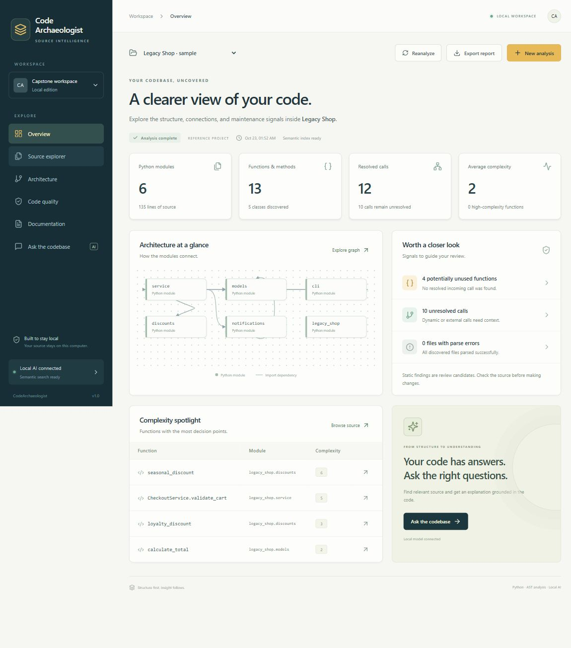
Working application
Legacy Shop reference project
6 modules
13 functions and methods
135 source lines
12 resolved call edges
0 parse errors
Measured fixture results, not a general accuracy benchmark.
SoET, CMRU
22
Notes:
Junaid demonstrates the same Legacy Shop project shown in the screenshot. Open Source explorer, select calculate_total, then switch Architecture from module graph to call graph. The picture is a captured running interface, not a design mockup. Evidence: verification/overview-final.jpg and verification/VERIFICATION.md in the source delivery.

Slide 23
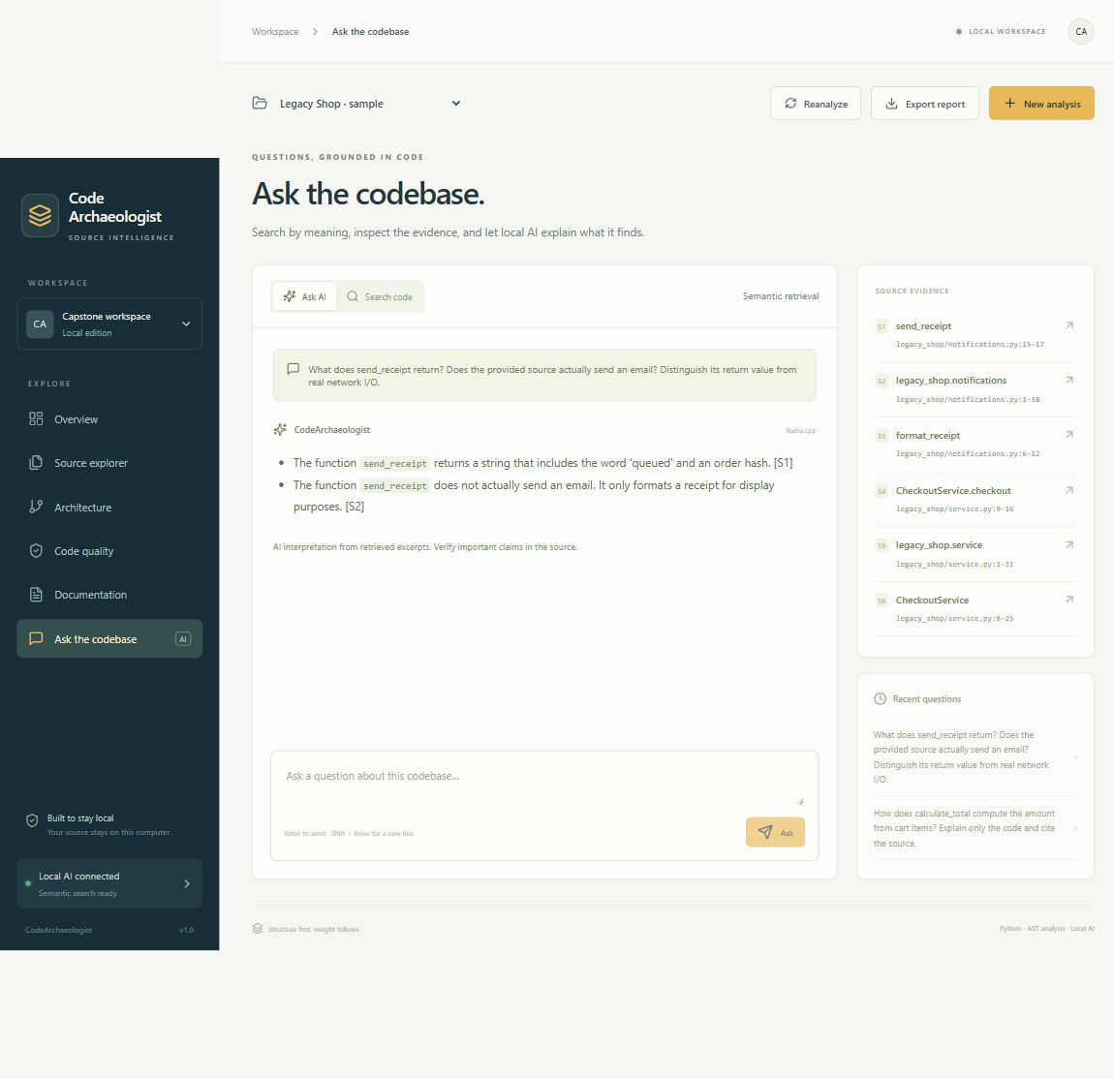
Local AI with inspectable source
Real local model response
The recorded calculation answer took 24.7 seconds on this computer.
Answers and citations still need source review.
No paid API or model training is required.
SoET, CMRU
23
Notes:
Junaid asks the sample question and opens the source references. The real recorded explanation is short and can miscite evidence. For example, the saved calculation answer assigns rounding to a source label that points to checkout. The more focused symbol explanation points directly to calculate_total. Do not claim that source-label validation detects this semantic mismatch. Evidence: verification/live-model-results.json.

Slide 24
Verification results
Check | Observed result | Scope
Automated tests | 15 passed | Parser, CLI, API, input handling, persistence, AI protocol
Exact expected symbol in top 3 | 2 of 4 questions | Small Legacy Shop fixture
Relevant source excerpt in top 3 | 4 of 4 questions | Module excerpt may cover the expected function
Recorded AI question latency | 24.73 seconds | One CPU inference example
Application self-analysis | 22 modules, 118 functions | Saved implementation snapshot, no parse errors
SoET, CMRU
24
Notes:
Junaid states the measurement scope. Fifteen automated tests passed. Four handwritten semantic questions were evaluated on the six-file fixture. Source coverage counts a module excerpt that contains the expected function. These are distinct retrieval measures. Source: delivered verification/VERIFICATION.md and live-model-results.json, checked 23 October 2026.

Slide 25
Limitations and future work
01
Dynamic Python behavior leaves some calls unresolved.
02
Unused-code and complexity findings require developer review.
03
Small-model answers can be incorrect or cite the wrong excerpt.
04
Broader repository testing and accuracy evaluation remain.
05
Other languages, Git URL import, accounts, and live watching are future work.
SoET, CMRU
25
Notes:
Junaid explains that local operation and Python-only scope are current boundaries. Graph resolution is heuristic. A public service would need separate authentication and deployment design. Broad accuracy and onboarding benefit require controlled evaluation.

Slide 26
Project status and presentation roles
Area | Current status
Analysis foundation | Implemented and covered by regression tests
Local AI and semantic interface | Implemented and exercised with actual local models
Broader evaluation | Remaining work on additional repositories and reviewed answers
Vishal Kumar Jangir | Suggested sections: problem, objectives, literature
Syed Mudassir | Suggested sections: architecture, DFDs, use cases, data design
Junaid Pasha | Suggested sections: implementation, demo, results, limitations
SoET, CMRU
26
Notes:
Junaid closes the implementation section. This table describes current software status and a suggested presentation split. All three students should demonstrate understanding of the whole system. Genuine geotagged work photos, guide approval, signatures, and physical printing must be completed before submission.

Slide 27
References
[1] Feng et al. CodeBERT. Findings of EMNLP, 1536–1547, 2020.
[2] Chen et al. Evaluating Large Language Models Trained on Code. arXiv:2107.03374, 2021.
[3] Guo et al. GraphCodeBERT. ICLR, 2021. arXiv:2009.08366.
[4] Hu et al. Deep Code Comment Generation. ICPC, 200–210, 2018.
[5] Ahmad et al. A Transformer-based Approach for Source Code Summarization. ACL, 4998–5007, 2020.
[6] Allamanis et al. A Survey of Machine Learning for Big Code and Naturalness. ACM Computing Surveys, 2018.
SoET, CMRU
27
Notes:
The six studies are background research, not installed runtime components. Bibliographic entries and model/runtime links are in the Phase-I report. Sources: https://aclanthology.org/2020.findings-emnlp.139/ https://arxiv.org/abs/2107.03374 https://arxiv.org/abs/2009.08366 https://ink.library.smu.edu.sg/sis_research/4292/ https://aclanthology.org/2020.acl-main.449/ https://arxiv.org/abs/1709.06182

Slide 28
CodeArchaeologist
Questions and live demonstration
Guide Mr. Sheik Jamil Ahmed
Vishal Kumar Jangir Syed Mudassir Junaid Pasha
CMR University School of Engineering and Technology 2026–27
Notes:
All members should be ready to answer questions. Close with a live source walkthrough instead of claiming perfect generated documentation. Guide and student details follow the populated supplied title slide and should be confirmed before final submission.

