Slide 1
LIBRARY MANAGEMENT SYSTEM
Mini Project
(Mr. Akash Chauhan)
Class Co-ordinator
CSE-K-III-Sem
(CSE Department)
GEHU Dehradun
(CSE Department)
GEHU Dehradun
(Mrs. Sonali Gupta)
Project Guide
Resource Person
Submitted By :Vishal Kumar Jha
B-Tech (CSE)/3rd SEM/K
20011993

Slide 2

ABOUT PROJECT
A Simple yet efficient library manager using C++ file handling
Has basic student and admin access options
Book info, issue and return records
Student records
Admin privileges protected by
password

Slide 3
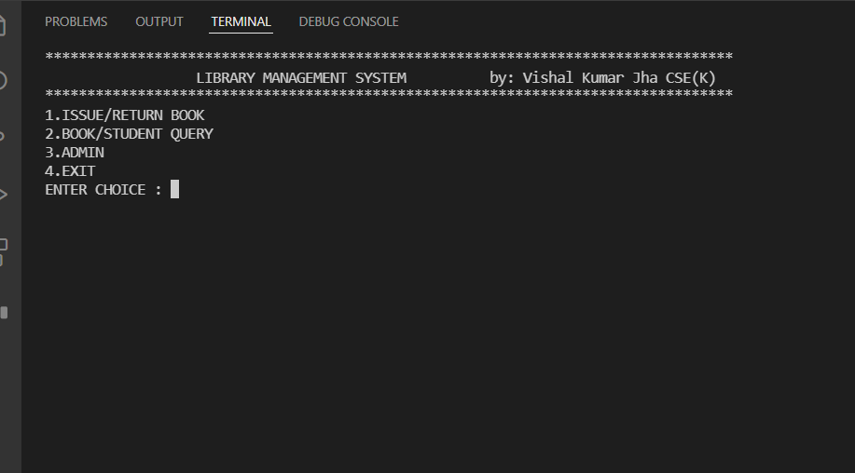
Main menu

Slide 4
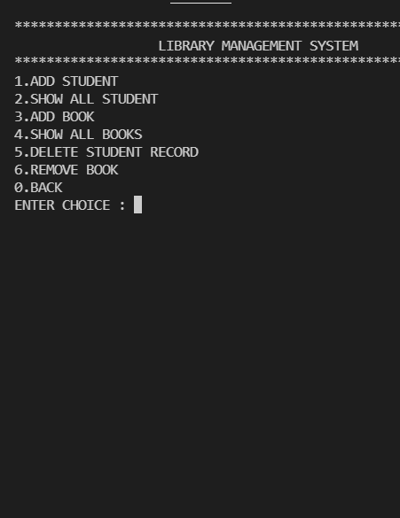
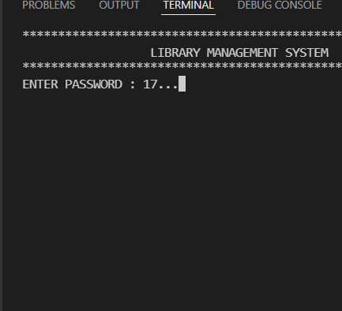
Admin menu

Slide 5
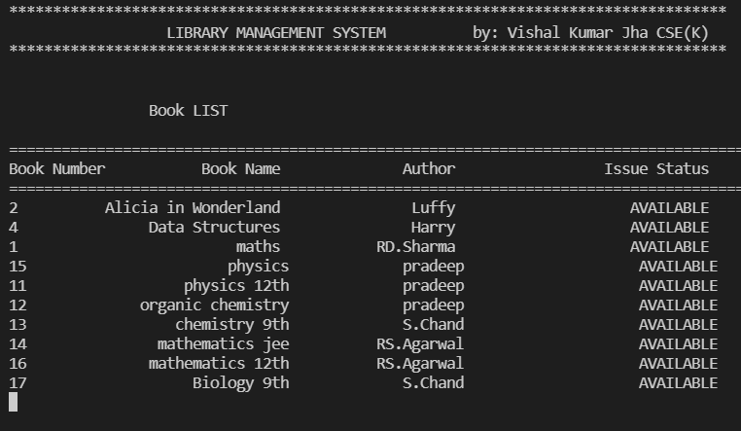
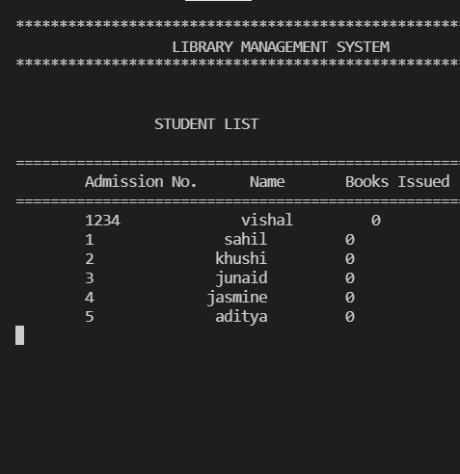
Book and student records
The admin menu gives the access to all records of books and students

Slide 6
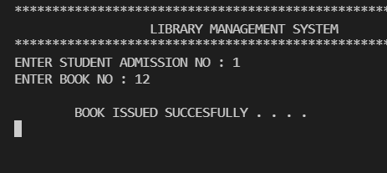
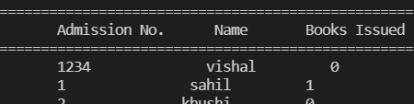

Issue and return system
On issuing a book the book id and student id are asked which then turn the book status to unavailable and the student’s issued books increase by 1.
And visa-versa in the case of returning the book.

Slide 7
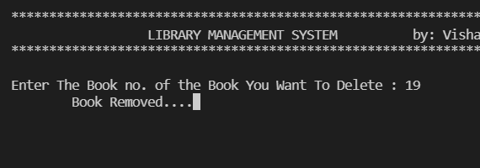
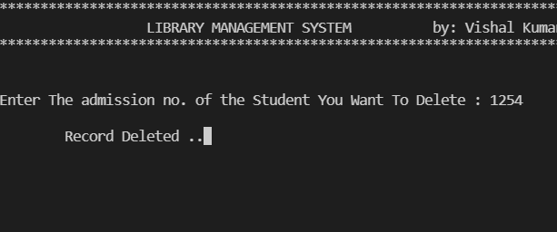
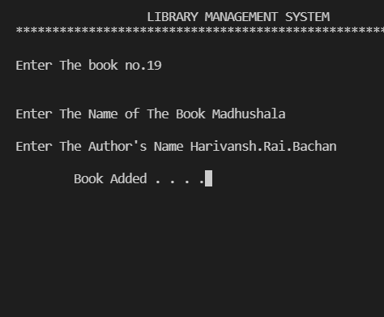
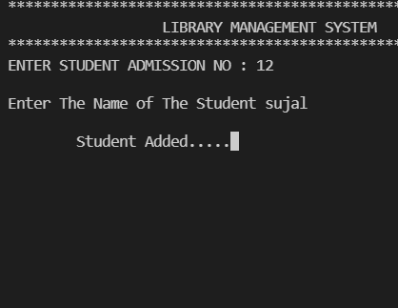
Removing and adding records
Admin privilege basically for librarian , provides removing or adding of books and student’s record creation and deletion.

Slide 8
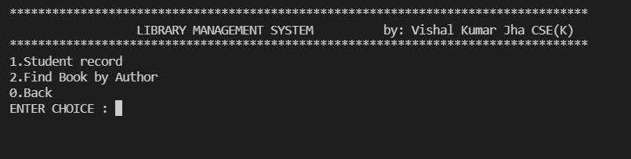
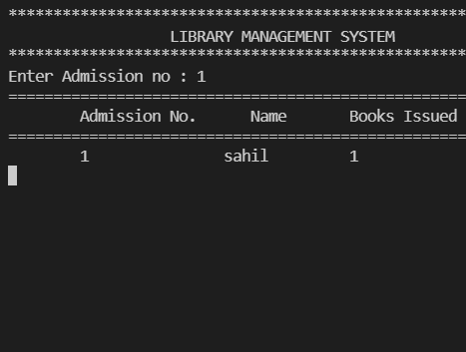
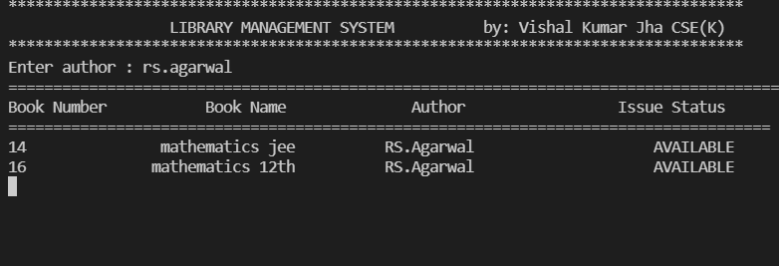
queries
In the student menu itself there is the option to get the details about a certain book or about the details of a student through author name and student id respectively.

Slide 9
FINAL CONCLUSION
I haven't met My expectations yet.
I still have to learn about Introducing a good GUI into this project and need to learn reducing the complexity of my code especially in file handling.
I learnt about the implementation of binary file handling and working on nested switch case to make an efficient menu driven program.

Slide 10

For your time and support

