Slide 1
CourtIQ: Centre Court Analytics
Validated tennis point data, Kafka/Spark replay streaming, point-level scoring, risk review signals, API, and dashboard
Point rows
Matches
Kafka/Spark
Frontend/API
1.92M+
10.5K+
PASSED
PASSED
1

Slide 2
Problem Statement
Tennis analytics needs point-level context, not only final scores.
Raw tennis point feeds are noisy, sparse, and not model-ready.
Point outcome predictions must avoid future leakage.
Streaming demos need reproducible event replay, scoring, and validation evidence.
Risk outputs must be framed as review signals, not misconduct proof.
Project Goal
End-to-end validated analytics platform
Bounded Demo
Local runtime, scalable design
2

Slide 3
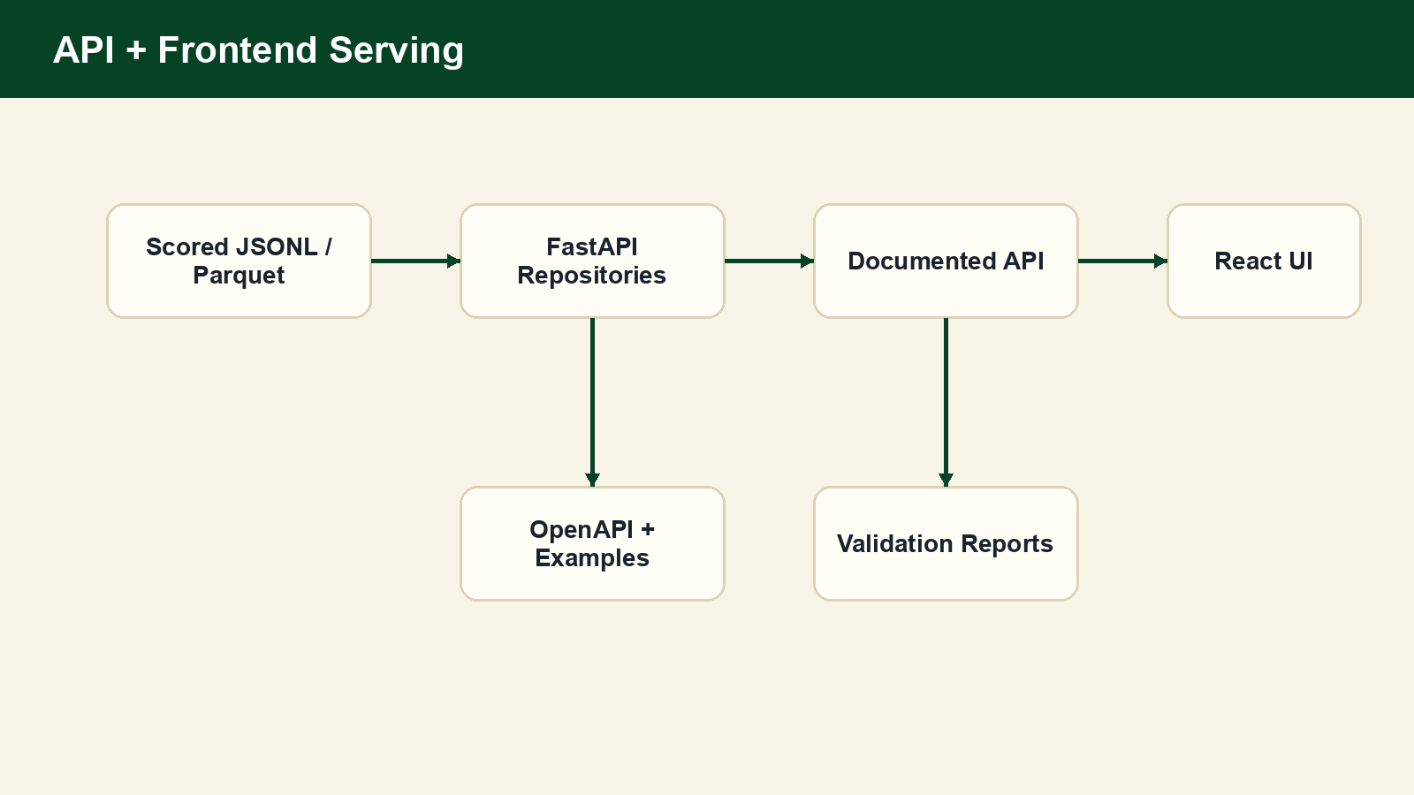
Product Demo Overview
Centre Court Analytics: a product shell over real scored output.
Dashboard: validated KPIs, model quality, and replay status.
Match Browser + Replay Center: player-first match labels and point timeline.
Prediction Center: point-level probability output, not betting odds.
Validation + Pipeline Monitor: evidence for API, scoring, Kafka, and Spark.
3

Slide 4
Why This Is a Big Data Project
The local demo is bounded; the architecture is built for scale.
1.9M+ point-level rows and 10K+ singles matches processed into Parquet zones.
Schema contracts, data quality reports, validation scripts, and quarantine evidence.
Spark ETL / feature processing concepts used for scalable batch stages.
Kafka replay stream and Spark Structured Streaming runtime validated locally.
Checkpointed streaming scorer writes scalable local JSONL/Parquet sinks.
FastAPI/frontend serve validated scored outputs for analysis and presentation.
4

Slide 5
Dataset and Scale
Validated tennis point data became the foundation for modeling and replay.
Curated point rows
Curated matches
Replay events
1,922,136
10,508
1,917,672
Replay matches
Player baselines
Full demo scored events
10,464
1,891
9,049
Surface coverage is unavailable; surface analytics remain planned.
Rally length coverage is sparse; not used as a primary MVP feature.
ATP bridge remains unvalidated; no ATP-derived claims are made.
5

Slide 6
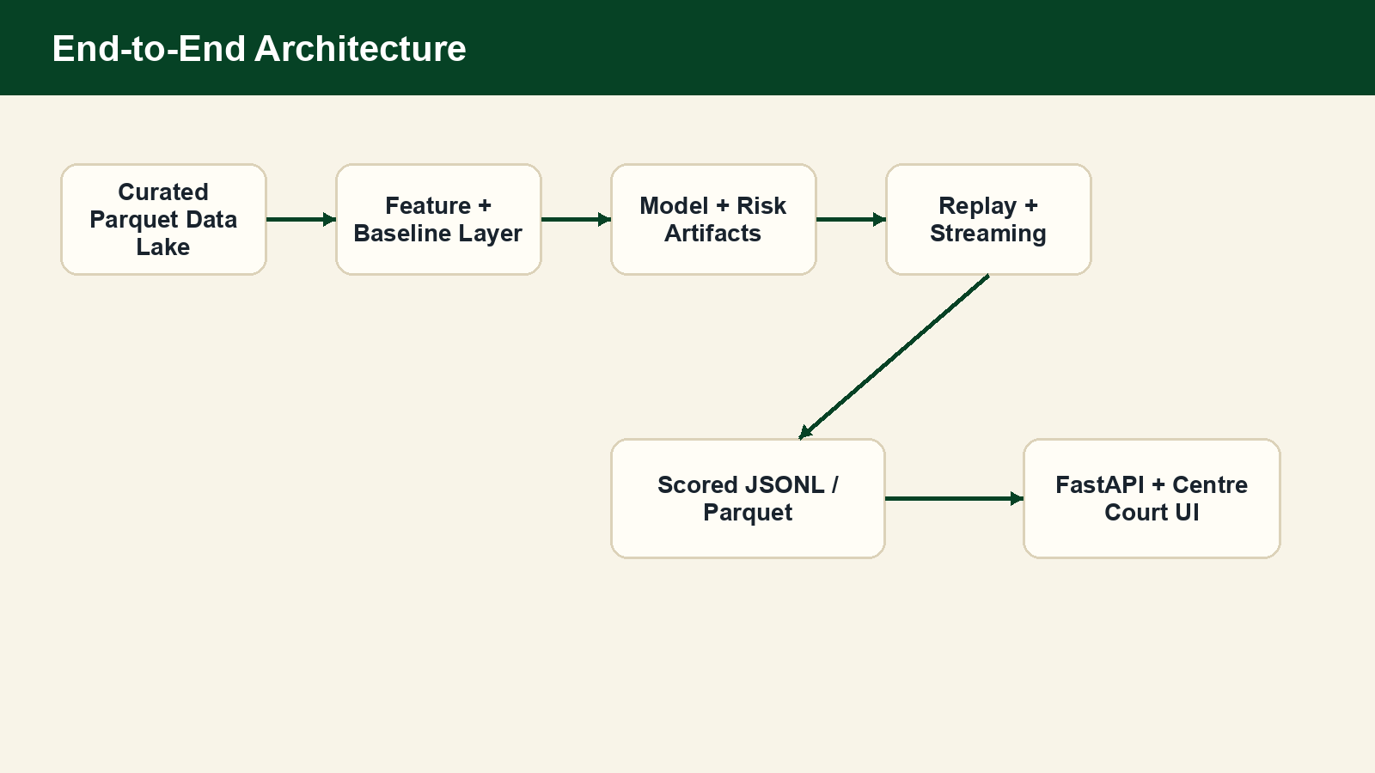
End-to-End Architecture
6

Slide 7
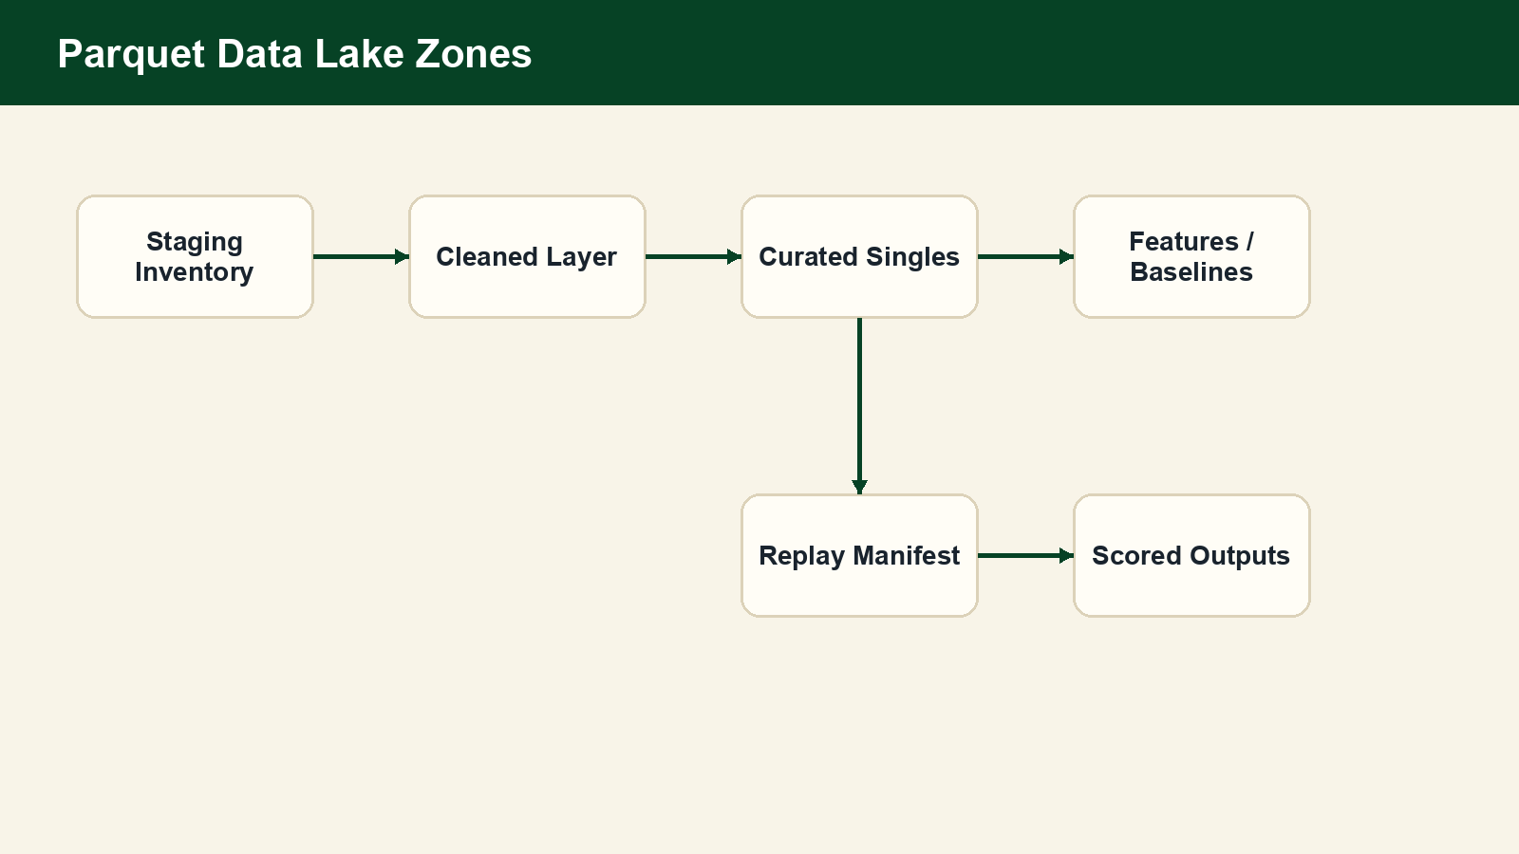
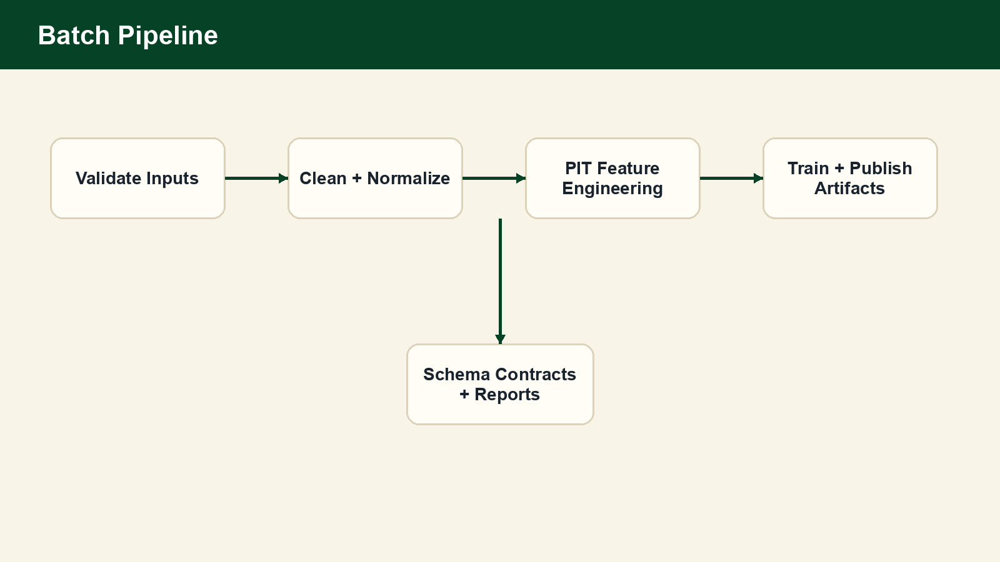
Data Lake + Cleaning Pipeline
Cleaned and curated layers are Parquet-backed.
Singles-only filtering, deterministic placeholders, and quarantine handling.
Reports track invalid winners/servers, missing metadata, and feature availability.
7

Slide 8
Feature Engineering and Point-in-Time Safety
Features are sorted by match and event index.
All cumulative and rolling features use prior events only.
First point in each match has zero prior counts.
Recent-window features use only earlier points.
Tests prove current point winner does not leak into current features.
Point features
1,922,136 rows
Match features
10,508 rows
Point-in-time
Validated true
8

Slide 9
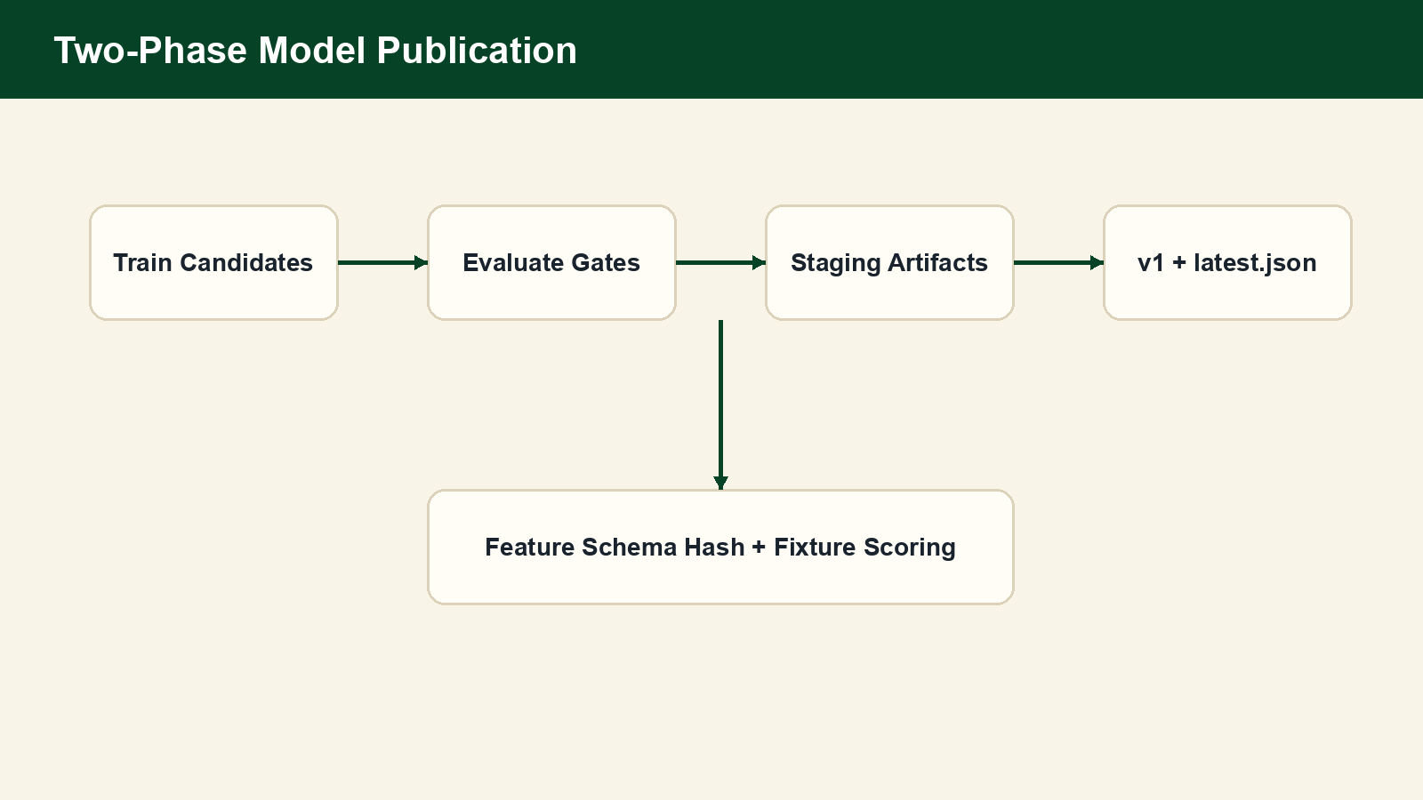
Model Training and Evaluation
Primary target: Player A wins the current point.
Selected model: HistGradientBoosting classifier.
Two-phase publication: staging validation → v1 artifact → latest.json pointer.
Feature schema hash prevents inference-time mismatch.
Feature count
Validation AUC
26
0.6395
Test AUC
Test Brier
0.6415
0.2347
9

Slide 10
Replay Architecture
Replay manifest selects validated singles matches for deterministic event replay.
Synthetic match and event IDs are deterministic and schema-validated.
Dry-run JSONL path remains reproducible without Kafka.
Kafka mode publishes canonical point_event_v1 messages keyed by synthetic_match_id.
Manifest rows
1,917,672
Validated dry-run
1,000 events
Full catalog
10,464 matches
10

Slide 11
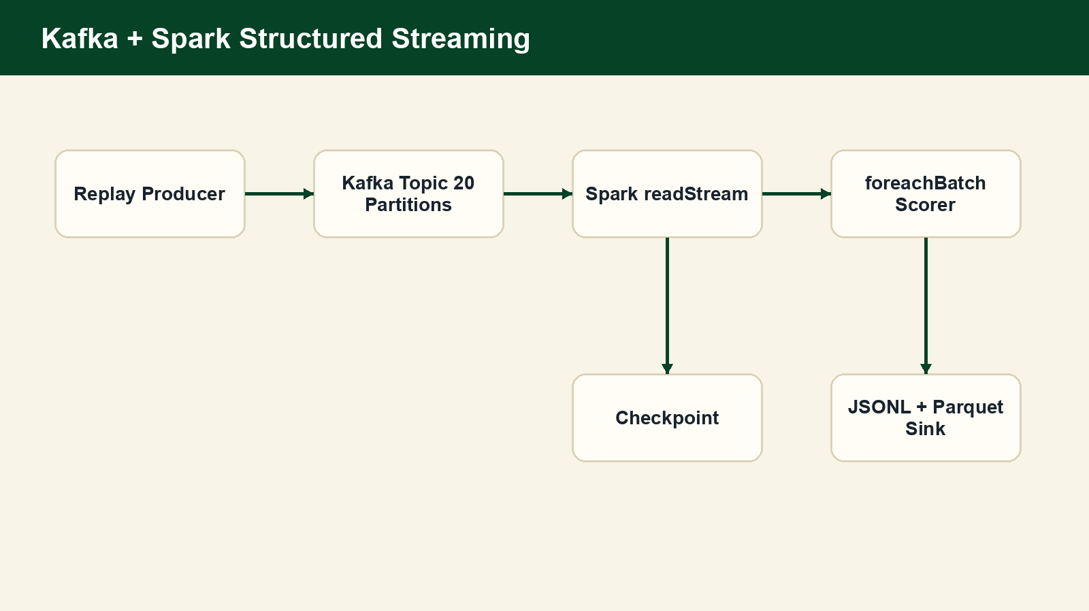
Kafka + Spark Structured Streaming Architecture
Runtime status: PASSED with 1000 Kafka events and 1000 Spark-scored events.
Spark uses foreachBatch to reuse validated Python scoring logic.
Checkpointing is local and suitable for demo validation, not production exactly-once claims.
11

Slide 12
Scoring + Risk Pipeline
Online feature builder maintains state per synthetic match.
Odds model outputs point_probability_player_a / player_b.
Risk config computes conservative baseline-deviation signals.
Risk score is a statistical review signal only.
No fake anomaly labels or misconduct claims are used.
JSONL throughput
2454.2 ev/s
Avg latency
0.384 ms
Spark scored
1000
12

Slide 13
API and Frontend Product
FastAPI serves validated scored files and model metadata.
OpenAPI snapshot and response examples are exported.
Centre Court Analytics React app exposes Analytics, Replay, ML Model, and Data Ops sections.
Unsupported modules are labeled planned or sample-derived.
13

Slide 14
Validation and Testing Evidence
Pytest
API validation
Frontend build
Final preflight
70 passed
PASSED
PASSED
PASSED
Kafka runtime
Spark streaming
Kafka events
Spark scored
PASSED
PASSED
1000
1000
Validation scripts write JSON evidence under data/results/.
Contracts guard point events, scored events, model metadata, and API responses.
14

Slide 15
Difficulties and Engineering Tradeoffs
Sparse surface/rally metadata blocked certain feature families.
Avoiding point-in-time leakage required strict lag/shift logic and synthetic tests.
Kafka image tag and runtime setup required hardening before validation.
Spark model scoring used foreachBatch to avoid fragile distributed sklearn loading.
Dashboard needed product polish while preserving truthful data semantics.
15

Slide 16
Team Contributions
3-member contribution split for the final report.
Team Member 1
Team Member 2
Team Member 3
Data engineering + cleaning + validation
Modeling + scoring + risk artifacts
Streaming/API/frontend/demo integration
Cross-cutting work: contracts, tests, documentation, validation reports, demo runbooks.
Replace placeholder labels with actual member names if desired before presenting.
16

Slide 17
Limitations
Point probabilities are not betting odds and not match-win probabilities.
Risk scores are statistical anomaly signals, not proof of misconduct or match-fixing.
Surface analytics and official rankings are not claimed; current views are sample-derived or planned.
Local Spark/Kafka demo is bounded; production scaling needs managed infrastructure and stronger sink semantics.
ATP bridge remains unvalidated.
17

Slide 18
Future Work
Add reliable tournament/surface metadata and official rankings integration.
Build match-level prediction model separately from point-level scoring.
Move streaming jobs to managed Kafka/Spark infrastructure.
Add persistent serving storage after schema contracts stabilize.
Add monitoring dashboards for drift, latency, and replay coverage.
18

Slide 19
Demo Flow
Start local product: bash scripts/run_full_demo.sh
Show Dashboard → Match Browser → Replay Center → Point Timeline.
Show Prediction Center and Model Performance with point-level language.
Show Validation and Pipeline Monitor evidence.
Optional Big Data proof: bash scripts/run_streaming_demo.sh --max-events 1000.
Frontend
API docs
Streaming
http://127.0.0.1:5173
http://127.0.0.1:8000/docs
Kafka + Spark reports
19

Slide 20
Closing: What We Built
A validated data-to-product tennis analytics system.
Batch data lake, point-in-time features, model artifacts, and risk config.
Real Kafka replay and Spark Structured Streaming scoring evidence.
FastAPI + Centre Court dashboard for demo-ready exploration.
Honest limitations and reproducible validation artifacts.
Final claim
Validated local Big Data analytics demo
20

