Slide 1
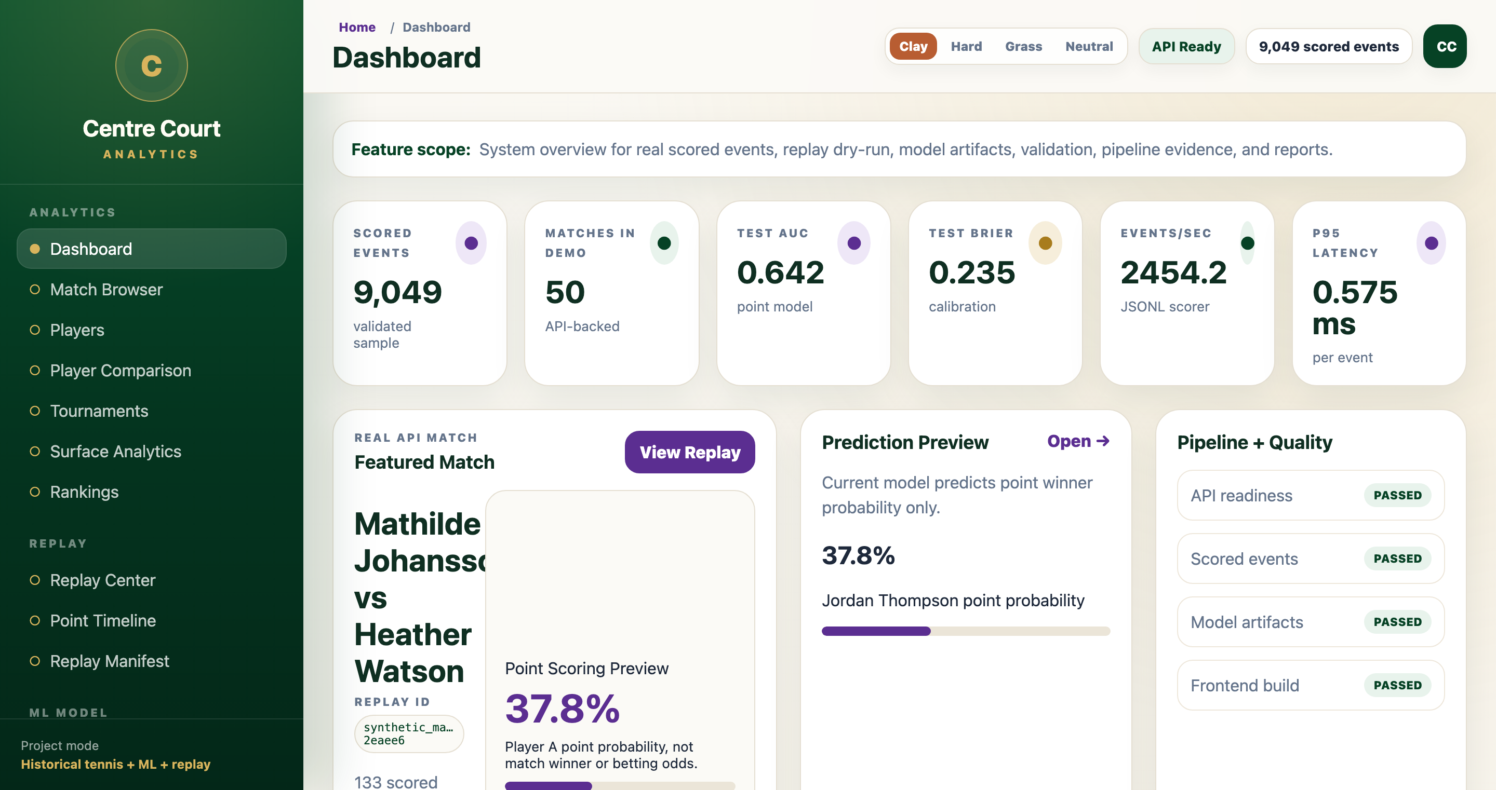
CourtIQ
Centre Court Analytics
Replay historical tennis points as a stream, score them live, and serve the results through an analytics dashboard.
POINT ROWS
MATCHES
KAFKA/SPARK SCORED
TESTS PASSED
1.92M+
10.5K+
1000
70
01

Slide 2
Problem + Goal
Turn historical point data into a replayable, model-scored tennis analytics product.
RAW DATA
MODEL RISK
DEMO GAP
messy point records, missing metadata
future leakage can invalidate results
batch files alone do not prove streaming
Goal: validated data lake → replay stream → online features → point model → risk signal → API/dashboard.
Keep the language honest: point probability is not betting odds; risk is not proof of misconduct.
02

Slide 3
Final Product Demo Snapshot
The final UI is a product, not just an output table.
Dashboard KPIs and validation evidence
Match Browser and Replay Center
Point Scoring Center + Model Performance
Pipeline Monitor and Reports
Centre Court dashboard
File-backed API + real scored outputs
03

Slide 4
Why This Satisfies Big Data Scope
POINT ROWS
MATCHES
REPLAY EVENTS
KAFKA PARTITIONS
1.92M
10.5K
1.92M
20
SPARK SCORED
TESTS
API ROWS
FEATURE ROWS
1000
70
9049
1.92M
Parquet data lake zones with schema contracts and data-quality reports.
Spark-style batch feature processing plus Kafka replay stream.
Spark Structured Streaming runtime with checkpointing and JSONL/Parquet sink.
Local demo is bounded; replay/scoring design is horizontally scalable.
04

Slide 5
Dataset Scale + Data Quality
CURATED POINT ROWS
CURATED MATCHES
PLAYER BASELINES
1,922,136
10,508
1,891
Singles-only curated Parquet data
Invalid/special point evidence preserved
Reports for missing winners, servers, elapsed time, rally length
Surface coverage is 0%; surface analytics are planned, not claimed
05

Slide 6
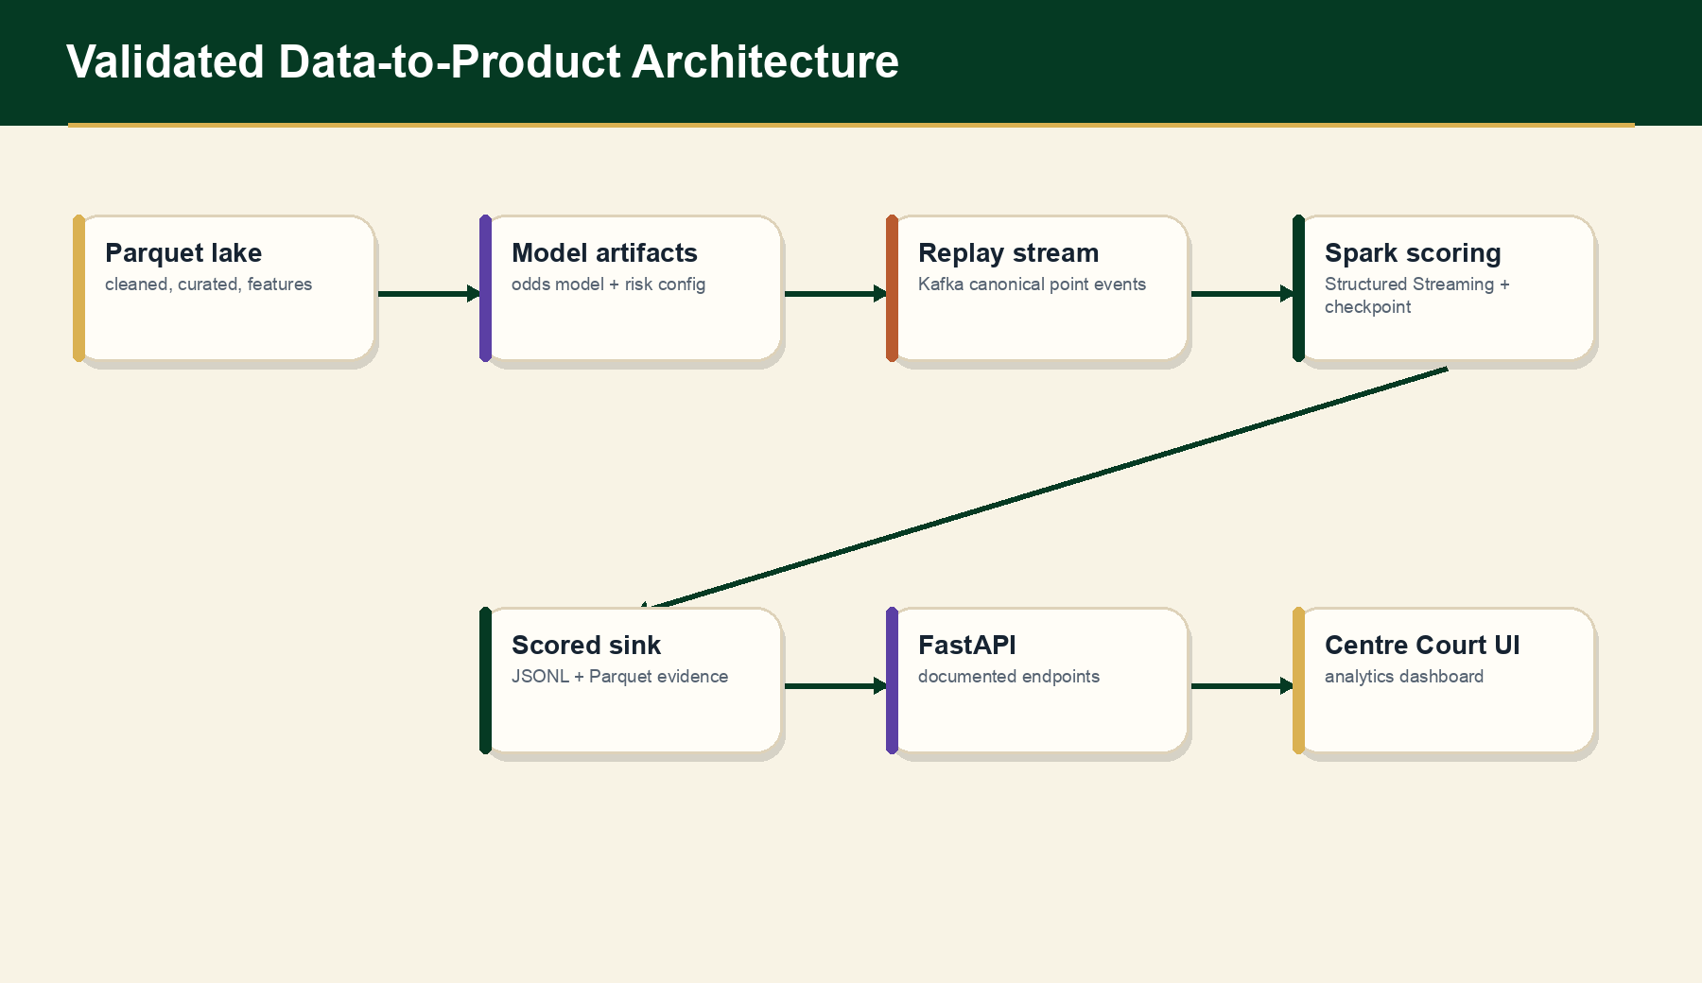
End-to-End Architecture
06

Slide 7
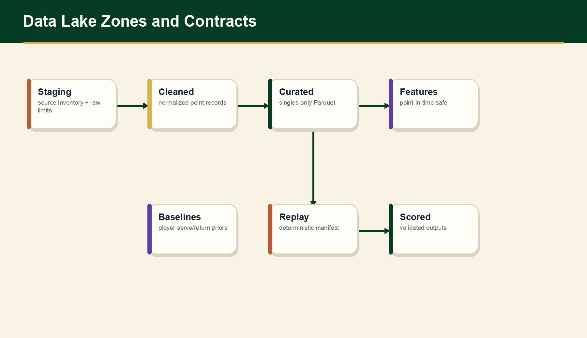
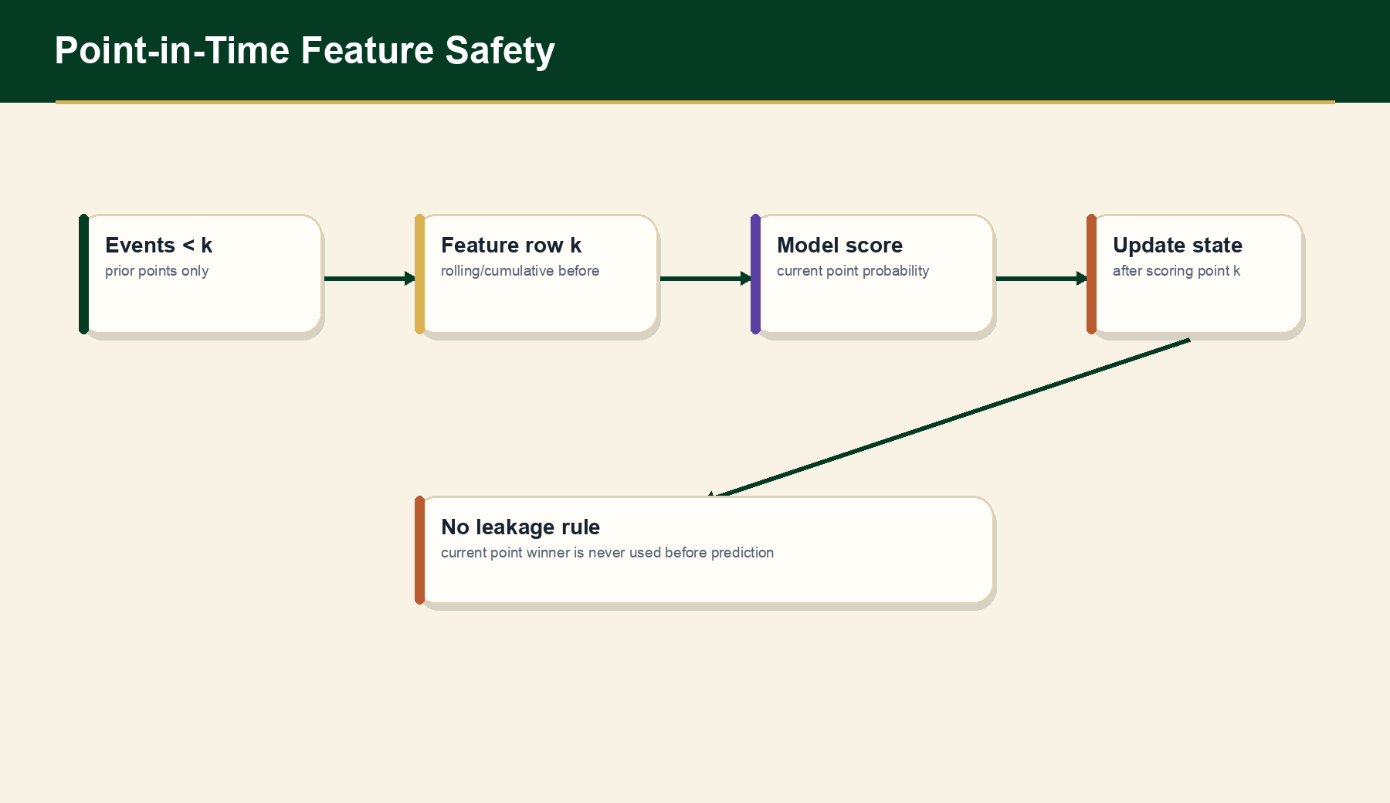
Data Lake + Cleaning Pipeline
07

Slide 8
Point-in-Time Feature Engineering
For event k, features use only events < k.
Cumulative, rolling, and recent-window features are shifted before scoring.
Tests prove the current point winner is not included in current-row features.
This matters because score-state leakage produced unrealistically high metrics before removal.
08

Slide 9
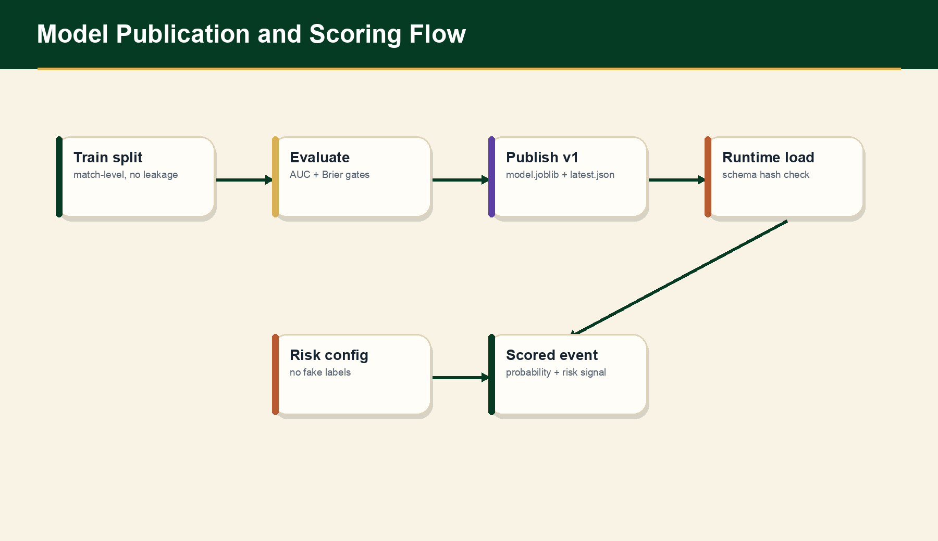
Model Training + Evaluation
TARGET
MODEL
Player A wins current point
HistGradientBoosting
FEATURES
VAL AUC
26
0.6395
TEST AUC
TEST BRIER
0.6415
0.2347
Not betting odds. Not match-win probability.
09

Slide 10
Replay System
Replay manifest: 1,917,672 canonical point events.
Synthetic match/event IDs are deterministic replay metadata.
Dry-run JSONL remains deterministic fallback.
Kafka mode publishes point_event_v1 messages keyed by synthetic_match_id.
REPLAY MANIFEST
10,464 matches
DRY-RUN VALIDATION
1000 events
PARTITION KEY
synthetic_match_id
10

Slide 11
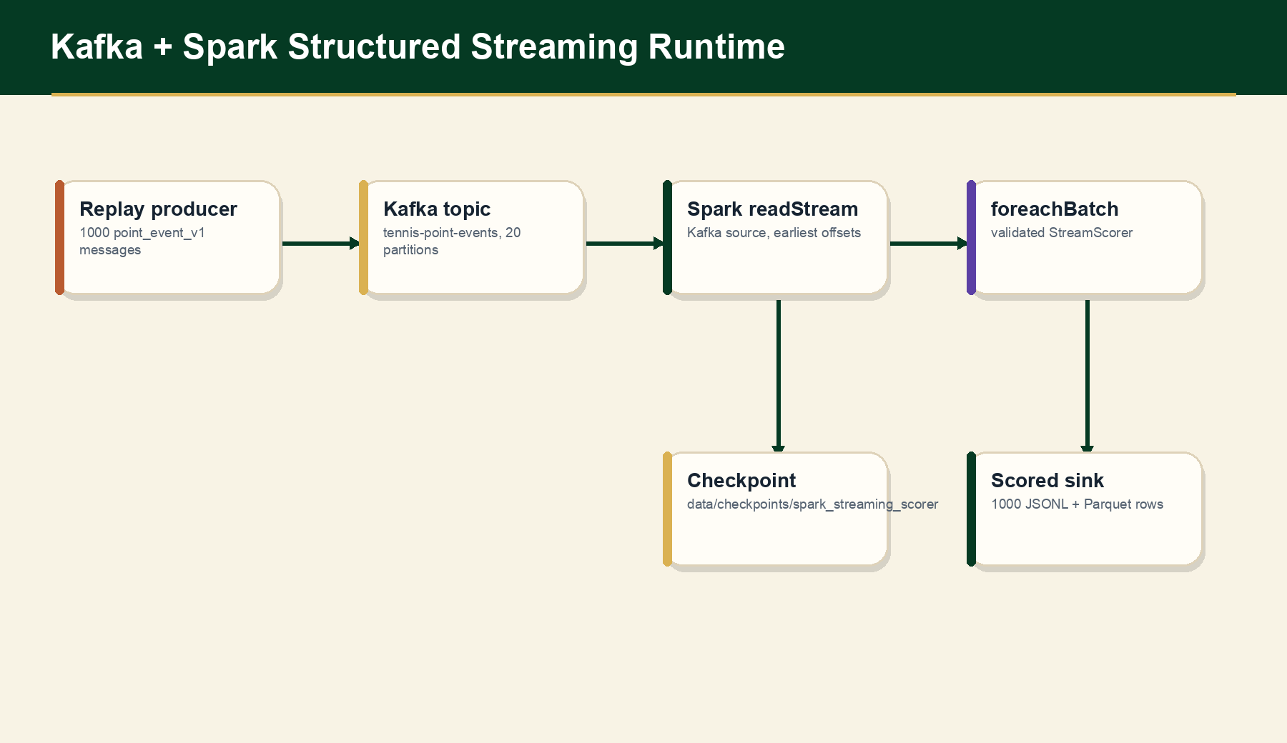
Kafka + Spark Structured Streaming
Runtime proof: Kafka PASSED, Spark Structured Streaming PASSED, 1000 events scored, checkpoint exists.
11

Slide 12
Scoring + Risk Pipeline
Online feature builder maintains match state.
Published model returns point_probability_player_a/player_b.
Risk config uses conservative baseline-deviation rules.
No fake anomaly labels; risk is a review signal only.
JSONL THROUGHPUT
AVG LATENCY
2454/sec
0.384 ms
SPARK BATCH
INVALID EVENTS
1000 scored
0
12

Slide 13
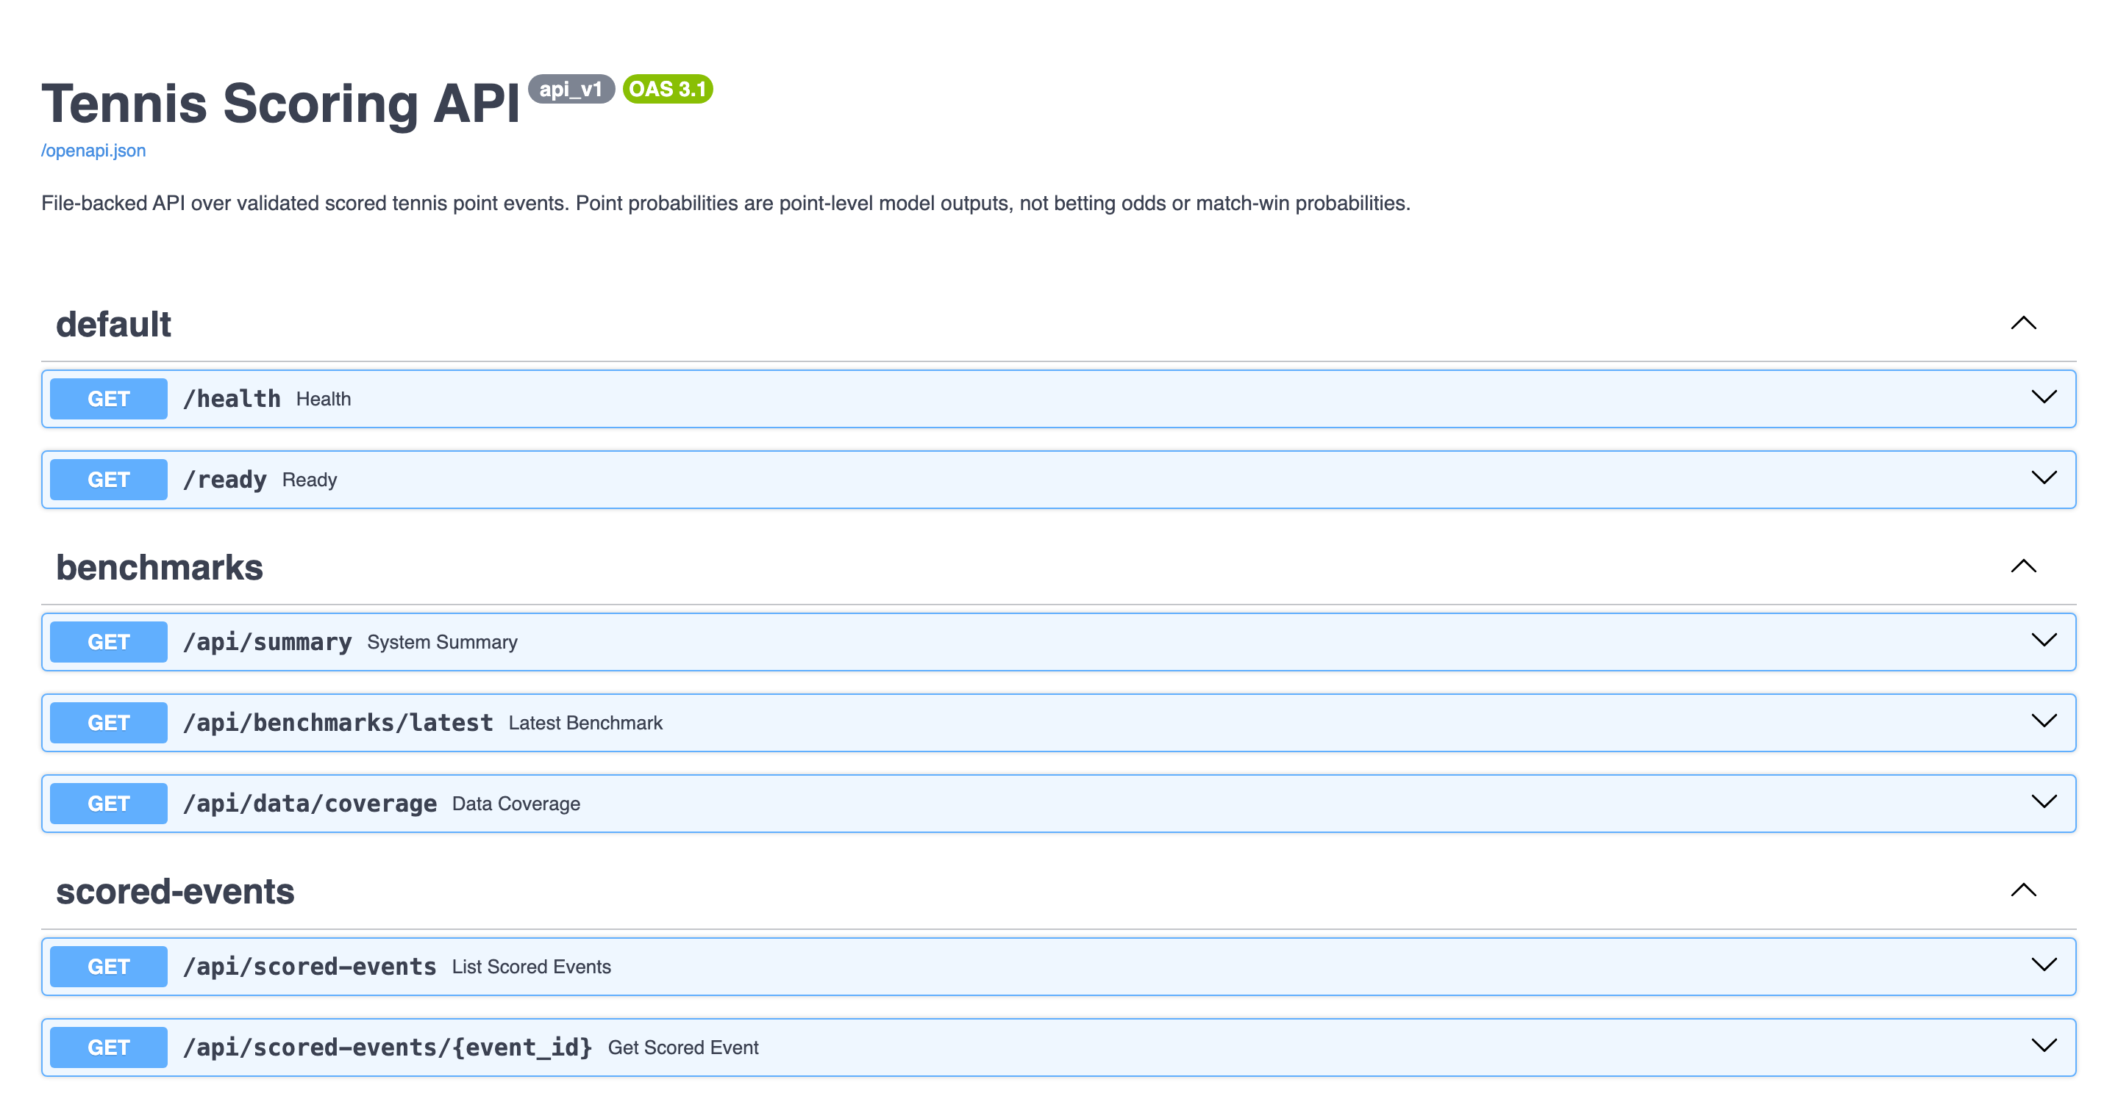
API + Centre Court Dashboard
FastAPI exposes health, summary, scored events, matches, replay catalog, risk, models, benchmarks.
Frontend groups workflows into Analytics, Replay, ML Model, and Data Ops.
13

Slide 14
Validation Evidence Matrix
DATA LAYER
data/features/validation_report.json
PASSED
MODEL
model_eval reports
PASSED
REPLAY
replay dry-run validation
PASSED
KAFKA
kafka_runtime_report.json
PASSED
SPARK
spark_streaming_validation_report.json
PASSED
API
api_validation_report.json
PASSED
FRONTEND
frontend_validation_report.json
PASSED
TESTS
pytest tests
70 passed
14

Slide 15
Difficulties + Engineering Tradeoffs
PROBLEM
DECISION
RESULT
Sparse metadata
excluded surface/rally primary features
honest limitations
PROBLEM
DECISION
RESULT
Feature leakage
strict lagged features and tests
defensible metrics
PROBLEM
DECISION
RESULT
Replayability
deterministic synthetic IDs
stream-ready manifest
PROBLEM
DECISION
RESULT
Kafka/Spark friction
fixed image + foreachBatch
runtime evidence
PROBLEM
DECISION
RESULT
Product polish
Centre Court shell
demo-ready UX
15

Slide 16
Team Contributions
TEAM MEMBER 1
TEAM MEMBER 2
TEAM MEMBER 3
Data engineering, cleaning, Parquet zones, validation
Feature engineering, modeling, risk scoring, evaluation
Kafka/Spark, API, frontend, demo integration
Shared: contracts, tests, reports, runbooks, final validation.
Replace placeholders with actual names before presenting if desired.
16

Slide 17
Limitations + Future Work
Point probability is not betting odds or match-win probability.
Risk score is not proof of misconduct or match-fixing.
Surface analytics, official rankings, and ATP bridge remain future work.
Local demo is not a production deployment.
Next: managed streaming, persistent serving store, richer metadata, monitoring dashboards.
17

Slide 18
Demo Flow + Closing
1. Start: bash scripts/run_full_demo.sh
2. Show Dashboard → Match Browser → Replay Center → Point Timeline.
3. Show Model Performance → Validation → Pipeline Monitor.
4. Streaming proof: bash scripts/run_streaming_demo.sh --max-events 1000.
Close: validated data-to-product pipeline with real Kafka/Spark evidence.
FRONTEND
127.0.0.1:5173
API DOCS
127.0.0.1:8000/docs
STREAMING
Kafka + Spark reports
18

