Slide 1
dbt
From Raw Tables to True Profit
A dbt profitability model for the Jaffle Shop
Irfan Aadil · github.com/itsirfan/university_workshop_starter
Notes:
OPENING (15 sec): Hi, I'm Irfan. Revenue tells you who sells the most — it doesn't tell you who makes the most. I built a dbt model that answers the profit question for the Jaffle Shop, end to end: sources, tests, marts, and one finding that changes what the business should do next.

Slide 2
1 · The Analytics Question
Which product types generate the highest gross profit — not just revenue — and what share of margin erosion is attributable to perishable supply costs?
Success criteria
A fct_order_items model where every line item carries revenue, supply cost, and gross margin — so each supporting question is answered with a single query.
Which product types yield the highest gross margin %?
Do top-revenue products rank the same by profit?
What is the margin gap between perishable and non-perishable supply bases?
Notes:
QUESTION (25 sec): My question, stated up front with success criteria: which product types generate the highest gross PROFIT — not just revenue — and how much margin is eroded by perishable supply costs? Success looks like a fact table where every order line carries revenue, cost, and margin — so each supporting question is one query away.

Slide 3
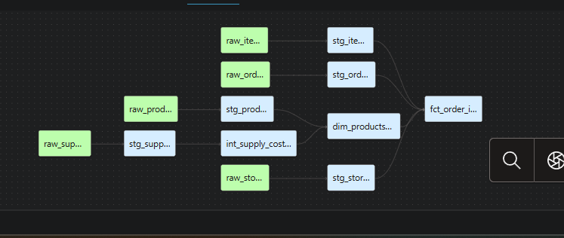
2 · A Model Built for the Question
The real dbt DAG — seeds → staging (1:1) → intermediate → marts
fct_order_items
1 row per item sold — carries revenue, supply cost, and gross margin. The success criterion, delivered.
Why the intermediate model matters: one product maps to many supplies — joining supplies straight onto order items would fan out and double-count revenue. Aggregating cost to product grain first (int_supply_costs_per_sku) keeps every margin number honest.
Notes:
MODEL (30 sec): This is the real dbt DAG — six staging models doing 1:1 renames, one intermediate, two marts. The design decision I want to highlight is the intermediate model: supplies are many-to-one against product, so joining them directly onto order items would fan out and double-count revenue. int_supply_costs_per_sku aggregates cost to product grain first, then joins. fct_order_items — one row per item sold — carries revenue, cost, and margin, which is exactly the success criterion from slide one.

Slide 4
3 · Tested, Documented, Trustworthy
Core tests
Business-logic tests
unique + not_null on every primary key
Across staging, intermediate, and marts
not_null on all foreign keys
unique_combination_of_columns on (supply_id, product_id) — encodes the true grain of supplies
expression_is_true: supply costs can never be negative
Every model + column carries a description — a new analyst can follow the DAG unaided
Caught in development: supply_id alone is NOT unique — it repeats per SKU.
dbt build: all models built, all tests passing ✓
Notes:
TESTING (25 sec): Every primary key has unique and not-null tests. But the tests I'd defend are the business-logic ones: testing uniqueness on the COMBINATION of supply_id and product_id — because supply_id alone isn't unique, something the standard test actually caught during development — and asserting costs can never go negative. Every model and column is documented, so someone new can follow the DAG without me in the room.

Slide 5
4 · The Finding: Perishables Eat the Jaffle Margin
80.3%
beverage gross margin
77.7%
jaffle gross margin
89% of jaffle supply cost is perishable,
vs
73% for beverages.
Notes:
INSIGHT (35 sec): Here's what the model found. Beverages earn an 80.3% gross margin; jaffles 77.7%. That gap isn't random — it's perishability. 89% of every dollar of jaffle supply cost is perishable — bread, cheese, avocado — versus 73% for beverages. So the products we're famous for are the ones most exposed to spoilage-driven cost. Revenue alone would never show you this: beverages also out-earn jaffles at $4,510 vs $2,308 in this sample, so on every axis — revenue, margin, risk — beverages are quietly the better business.

Slide 6
5 · What the Business Should Do Next
1
Renegotiate or re-source perishable jaffle supplies
89% of jaffle supply cost is perishable — the single biggest controllable margin lever.
2
Rebalance menu promotion toward beverages
Higher margin AND higher revenue: promote the winner, don't subsidise the laggard.
3
Extend the model: store-level P&L + waste tracking
Only one store has orders in this sample; the model is built to answer the store question the day multi-store data lands.
github.com/itsirfan/university_workshop_starter — README · lineage · tests · this deck
Notes:
CLOSE (20 sec): So the actionable next steps: one — renegotiate perishable jaffle supplies; that's the biggest controllable lever. Two — shift promotion toward beverages, which win on margin AND revenue. Three — the model is deliberately built to extend: the day multi-store data lands, the store-level P&L is one query away. Repo's on GitHub — README, lineage, tests, and this deck. Thank you.

Slide 7
Mapping to Your Rubric
14 / 14
1
Analytics question clarity
Question + success criteria stated up front in README
2/2
2
Model supports the question
fct_order_items answers the primary question in one query; int model prevents fan-out
2/2
3
Documentation & readability
schema.yml in every layer; model + column descriptions; grain notes
2/2
4
Core testing (2+, incl. PK)
unique + not_null on every PK across all layers; FK not_null
2/2
5
Business logic test
unique_combination (supply_id, product_id) encodes true grain; costs ≥ 0
2/2
6
Insight with evidence
89% vs 73% perishable exposure explains the 2.5-pt margin gap
2/2
7
Actionable next step(s)
Renegotiate perishable jaffle supplies; re-run by store_id when data lands
2/2
Notes:
RUBRIC WALKTHROUGH (discussion): For transparency, let me map this directly onto your rubric. [Walk each row top to bottom, one sentence each — the evidence column is your script.] Everything on this slide is verifiable in the repo: the README, the schema files, and the test results.

Slide 8
Q&A — Design Decisions I'll Defend
Why no _sources.yml?
The raw tables are dbt seeds — seeds are referenced with ref(); source() is for data loaded outside dbt. Grain + PK tests live on staging instead.
Why an intermediate model?
The SKU-grain cost aggregation is needed by both marts. Isolating it handles fan-out risk in exactly one place — guarded by a uniqueness test.
How confident are the margins?
Percentages validated independently against the raw seeds. Caveat: cost here excludes batch-level waste — real spoilage would make jaffles look worse, so the insight is conservative.
Single store only?
Stated openly in the README. The model is built so the store-level cut runs the day multi-store data exists.
Notes:
Q&A APPENDIX: Keep this up during questions. Each answer is one breath long. If asked 'what would you do with another day': metrics/semantic layer for governed margin definitions, snapshots on supply costs to track price changes over time, and hosted dbt docs so the lineage graph is clickable for stakeholders.

