Slide 1

Zomato Restaurants Analysis
Subject
Data Analytics and Visualization (1IT508)
Competition
INSIGHTVISTA 2026
Team name
Team Insights
From raw Bangalore restaurant data to business recommendations
Team members
240840116058
240840116042
240840116047
240840116013
240840116036
Notes:
Introduce the team (Team Insights), the subject Data Analytics and Visualization (1IT508) and the INSIGHTVISTA 2026 competition. Our project analyses Zomato restaurant data for Bangalore.

Slide 2
,
Problem Statement
Analyze Zomato restaurant data to understand restaurant performance, customer ratings, pricing, online ordering, table booking, cuisine preferences, and geographic distribution.
01
Raw and incomplete data
02
Cuisine data is difficult to compare
The dataset contains missing ratings and cost values, plus two unnecessary index columns.
Many restaurants list multiple cuisines, making direct category analysis harder.
03
Important patterns are hidden
04
Business decisions need evidence
With 7,105 restaurant records, it is difficult to quickly compare ratings, prices, areas and services.
Zomato needs clear insights to identify improvement opportunities in online ordering, table booking and customer experience.
Our objective: Clean and process the data, build an interactive Power BI dashboard, and recommend data-driven actions for Zomato.

Slide 3




Observations from the raw data
7,105 × 12
125 gaps
Raw dataset size
Missing rating and cost
7,105 restaurants and 12 columns across 30 Bangalore areas, including 2 unnamed index columns.
68 restaurants have no rating and 57 have no cost, affecting 121 restaurants in total.
74%
₹6,000 max
List more than one cuisine
Skewed cost for two
5,282 restaurants list 2 or more cuisines, giving 2,175 unique combinations that cannot be charted as they are.
The median is ₹400 but the average is ₹540, because a few very expensive restaurants pull it up.
Notes:
Four things stood out when we first explored the data: its size, the missing values, the multi-cuisine text column, and the skewed cost. Each of these decided a cleaning step on the next slide.

Slide 4

From raw data to final data
1
2
3
4
5
Load
Drop
Check
Remove
Create
Read the CSV in Google Colab with Latin-1 encoding.
Removed the 2 unnamed index columns.
Found 68 missing ratings and 57 missing costs, with no duplicate rows.
Dropped 121 rows (1.7%) so no rating is invented.
Added primary cuisine, type group and cost range columns.
Raw data
Final data
0 missing values
0 duplicate rows
4 new columns
7,105 rows × 12 columns
6,984 rows × 14 columns
Notes:
We loaded the file, dropped the index columns, checked for gaps and removed the 121 incomplete rows. We chose to remove rather than fill the nulls because ratings are our main measure and under 2% of rows were affected. The result is 6,984 clean rows and 14 columns.

Slide 5




Solution: the final clean dataset
Restaurant | Area | Primary cuisine | Rating | Cost (₹) | Cost range
#FeelTheROLL | Bellandur | Fast Food | 3.4 | 200 | ≤200
#refuel | Bannerghatta Road | Cafe | 3.7 | 400 | 201-400
'@ Biryani Central | Marathahalli | Biryani | 2.7 | 550 | 401-600
'@ The Bbq | Bellandur | BBQ | 2.8 | 700 | 600-800
'@Italy | Banashankari | Italian | 4.1 | 700 | 601-800
'@North Parontha Hut | Indiranagar | North Indian | 2.8 | 300 | 201-400
What we did with it
Cleaned
Removed 121 incomplete rows and 2 index columns.
Enriched
Added primary cuisine, type group and cost ranges.
Measured
Built 6 KPIs plus top 10 area and top 8 cuisine measures.
14 columns in total: the 10 original columns plus 4 we created (primary cuisine, type group, cost range and cost range order). Sample of 6 of the 6,984 rows.
Visualised
Made 6 charts and 3 slicers in a Power BI dashboard.
Notes:
This is the final dataset we load into Power BI. Apart from cleaning it we added helper columns so that charts are readable: one main cuisine per restaurant, five named restaurant types plus Other, and seven cost ranges.

Slide 6
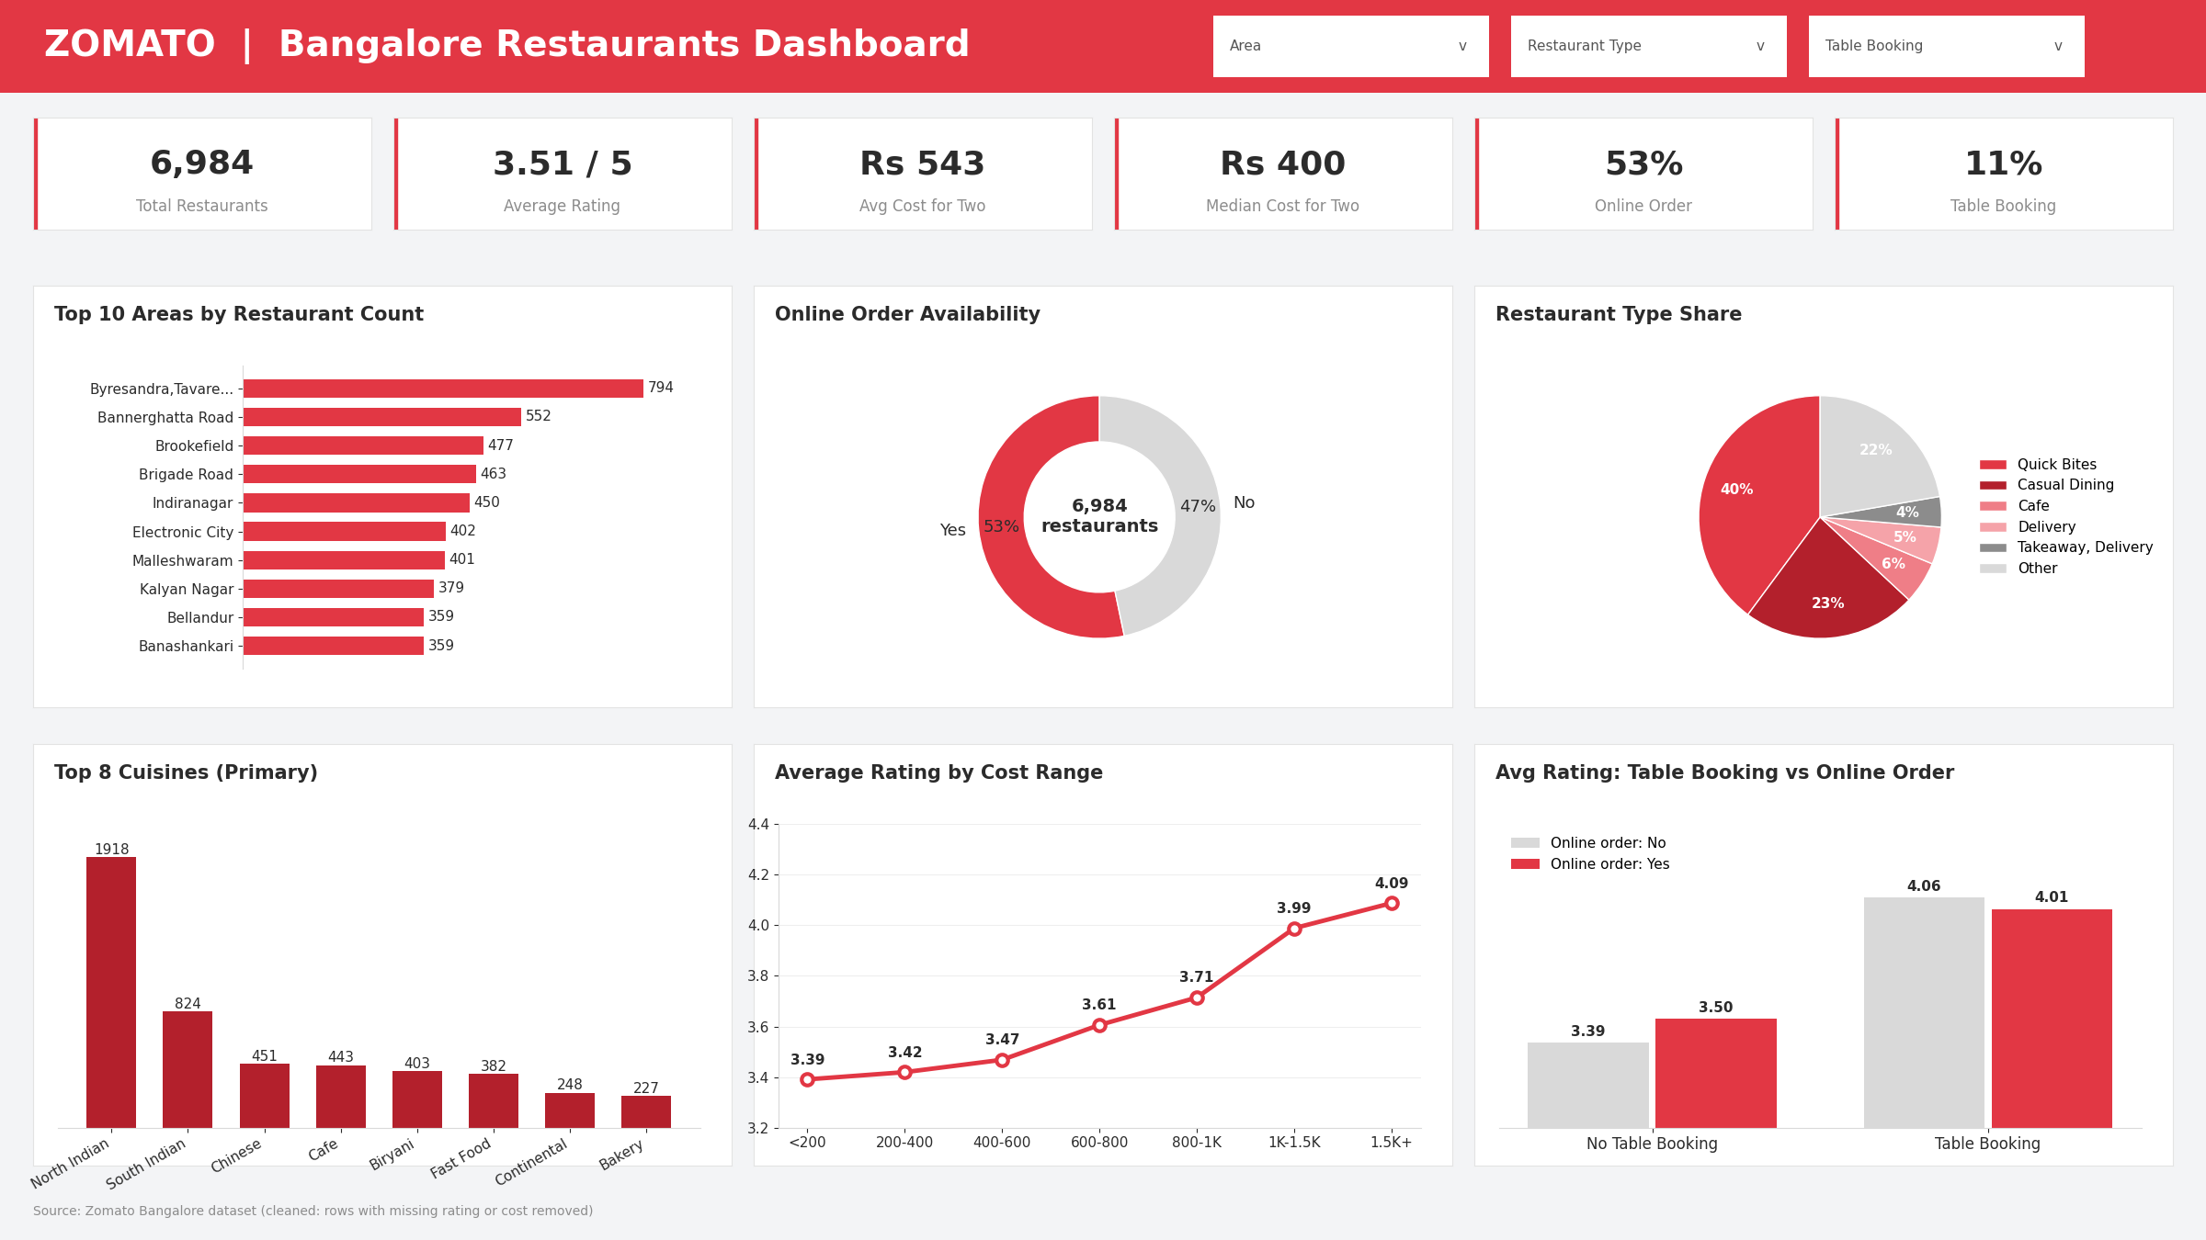
Dashboard and key insights
Key insights
Higher price, higher rating
Average rating climbs from 3.39 (up to ₹200) to 4.09 (above ₹1,500).
Table booking stands out
Rated 4.04 on average against 3.45 without, yet only 11% offer it.
Quick Bites rate below average
The largest group, 40% of restaurants, averages 3.40 against 3.69 for cafes.
Location matters
Among larger areas, Brigade Road averages 3.68 while Electronic City averages only 3.36.
Power BI dashboard: 6,984 restaurants across 30 Bangalore areas
Notes:
The dashboard has six KPI cards, six charts and three slicers. Four insights stand out: rating rises with price, table booking is linked with higher ratings, Quick Bites are the largest group but rate below average, and area matters. Area comparison uses areas with 150 or more restaurants. These are associations, not proof of cause.

Slide 7





Recommendations for Zomato
Grow table booking
Only 11% offer it, yet those restaurants rate about 0.4 higher even within the same price band. Push onboarding for mid and high price restaurants.
Close the online ordering gap
47% of restaurants are not online. Among larger areas the online share is lowest in Koramangala 4th Block (25%) and Brigade Road (41%).
Lift Quick Bites and budget quality
They are 40% of listings and average 3.40. Offer rating-improvement support and highlight the best performers.
Focus on weaker areas
Among larger areas, Electronic City (3.36), HSR (3.39) and Marathahalli (3.41) rate lowest. Run local partner support and campaigns there.
Build more reviews
58% of restaurants have under 50 ratings. Prompt reviews after orders, and promote highly rated niche cuisines such as American (3.98) and Asian (3.95).
Notes:
Five actions for Zomato, each tied to a number from the data. Table booking and online ordering are growth levers, Quick Bites and weaker areas are quality levers, and reviews make ratings more reliable. Booking and rating are associated, so we recommend testing before scaling.

