Slide 1
Cropthesis
A CROP YIELDING EXPLORATION

Slide 2

A CROP YIELDING EXPLORATION USING DATASCIENCE
PRESENTED BY
PRATHAMESH GIRI
VISHAL KAJALE
HRITIK SANGHAVI
CHETAN DAULANI
DEPARTMENT OF COMPUTER ENGINEERING,
SANDIP INSTITUTE OF TECHNOLOGY AND RESEARCH CENTRE,NASHIK

Slide 3
Contents
Introduction…………………………………………………….……….…..……03
Problem Definition………………………………………………….…..….…….05
Working Methodology and Code Snippets.……………………….…..…………07
Motivation………………………………………………………….….…………10
Design / Proposed System……………………………………………..…………11
Requirements………………………………………………………….………….12
Applications………………………………………………………………………14
Result…………………………………………………………………………..…15
Conclusion and Future Scope……………………………………………….……15
10. References…………….………………………………………………………….

Slide 4
Introduction
What is Crop yielding Analysis?
Crop yields are critically dependent on weather. A growing empirical literature models this relationship in order to project climate change impacts on the sector. We describe an approach to yield modeling that uses a semiparametric variant of a deep neural network, which can simultaneously account for complex nonlinear relationships in high-dimensional datasets, as well as known parametric structure and unobserved cross-sectional heterogeneity.
Using data on corn yield from the US Midwest, we show that this approach outperforms both classical statistical methods and fully-nonparametric neural networks in predicting yields of years withheld during model training. Using scenarios from a suite of climate models, we show large negative impacts of climate change on corn yield, but less severe than impacts projected using classical statistical methods. In particular, our approach is less pessimistic in the warmest regions and the warmest scenarios.

Slide 5
Why crop analysis is important
• The environment
• Better flows and access
• Socio economic aspect
• Increased wealth
• Increased income
• Increased employment
• Economic growth
• Health and nutrition
• Reduced diseases
• Reduce morbidity

Slide 6
Using python for crop analysis
MATPLOTLIB
Matplotlib is a plotting library for the Python programming language and its numerical mathematics extension NumPy.
Matplotlib is a library for making 2D plots of arrays in Python.

Slide 7
PILLOW
Pillow is a Python Imaging Library (PIL), which adds support for opening, manipulating, and saving images. The current version identifies and reads a large number of formats. Write support is intentionally restricted to the most commonly used interchange and presentation formats.

Slide 8
PYTHON GUI – TKINTER
Python offers multiple options for developing GUI (Graphical User Interface). Out of all the GUI methods, tkinter is most commonly used method. It is a standard Python interface to the Tk GUI toolkit shipped with Python. Python with tkinter outputs the fastest and easiest way to create the GUI applications. Creating a GUI using tkinter is an easy task.

Slide 9
PANDAS
Pandas is a software library written for the Python programming language for data manipulation and analysis. In particular, it offers data structures and operations for manipulating numerical tables and time series.

Slide 10
WORKING METHODLOGY
There are many factors which influence the yield of crop like rainfall, temperature humidity, soil, etc. Crop prediction helps farmers in selecting proper crop for plantation to maximize their earning. This will be the purpose of our script.
To take the input data such as whether conditions in past year/month, rainfall period, temperature etc.
Analyze the data to find the best period for cultivation and the whether conditions in upcoming future and production prediction from past available data.
To input the large datasets of past years to find out the accurate results of crop prediction

Slide 11
OBJECTIVES
To assess the scope and suitability of machine learning methods for predictions of crop yield in rainfed area (using weather variables),
To develop initial machine learning models for crop yield predictions in rainfed area
To analyze the performance of the model developed

Slide 12
MOTIVATION
To help the farmer for getting ROI(Return On Investment).
Accurate hypothesis for the crop yielding.
Collection of more valid details of soil,latitude and suitable crop can greatly accelerate the efficiency of Work.
To encourage the farmer for accomplishing self development.
“A FARMER IS A MAGICIAN WHO PRODUCES MONEY FROM THE MUD”

Slide 13
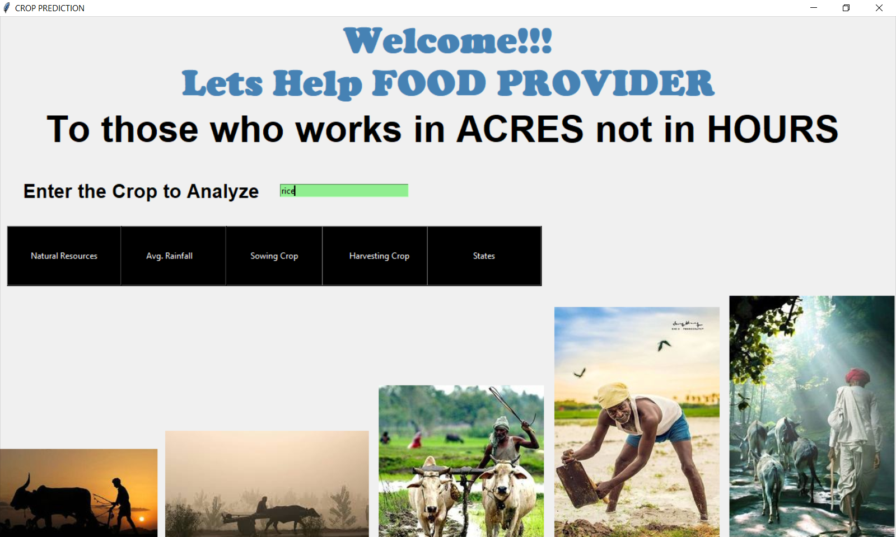
RESULTS

Slide 14
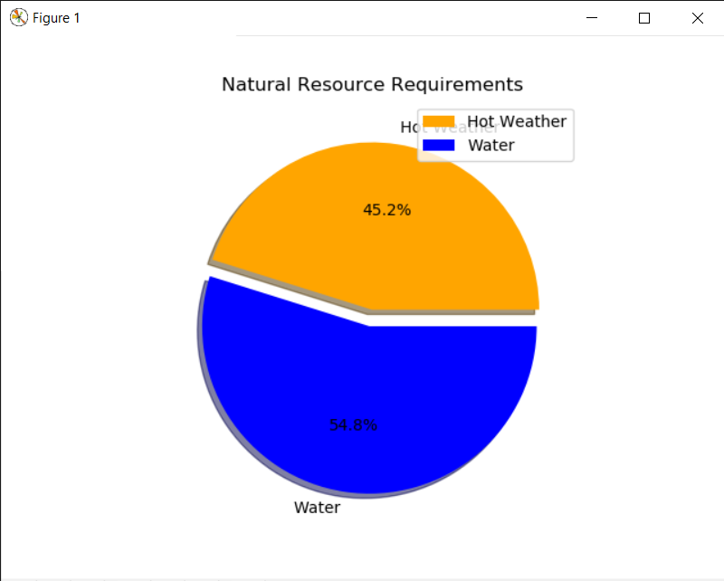

Slide 15
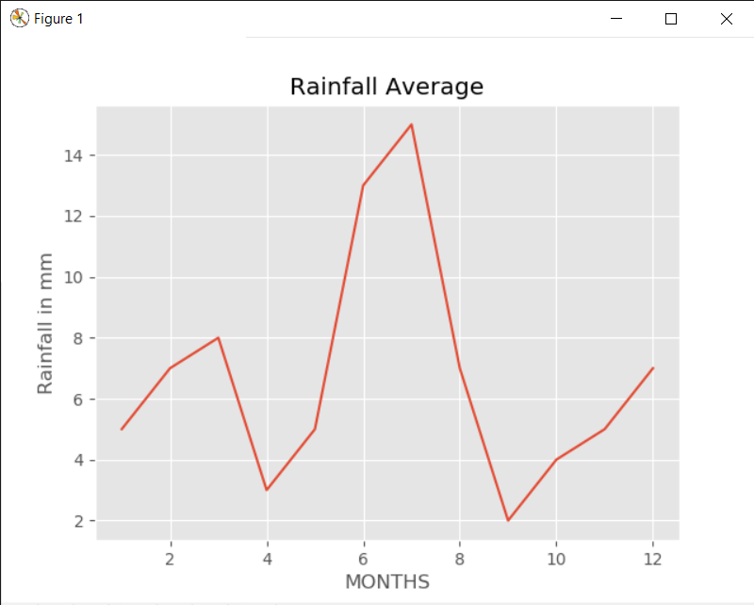
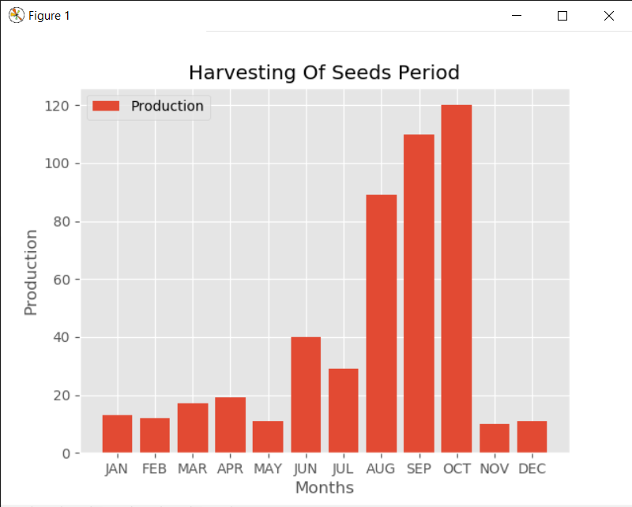
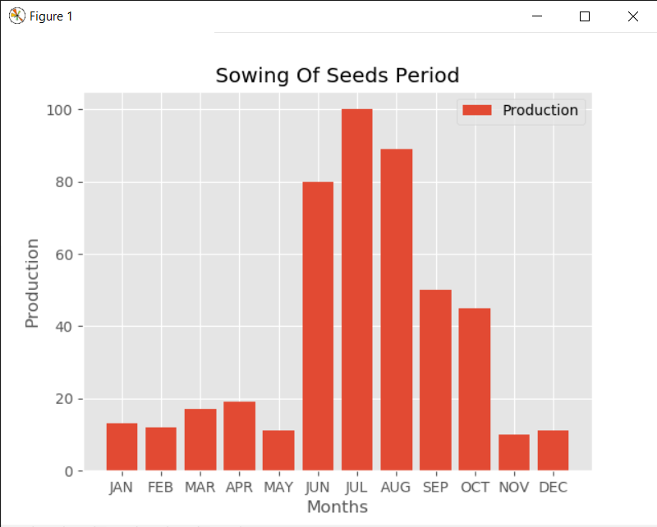

Slide 16
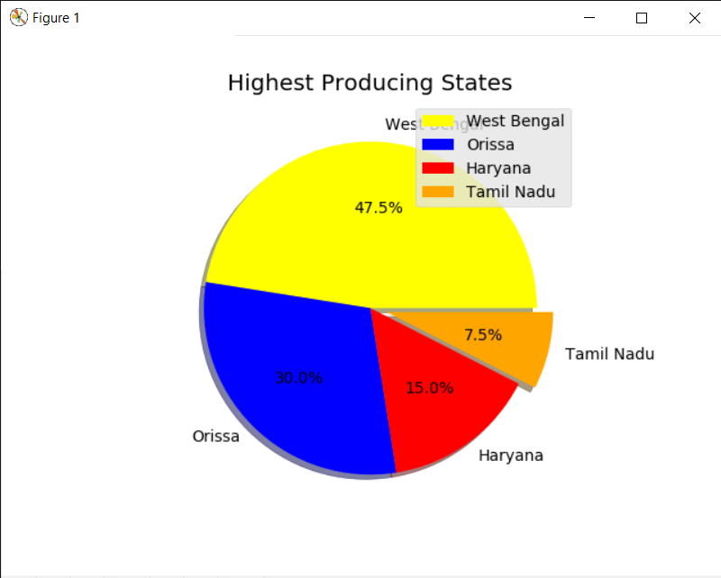

Slide 17
CONCLUSION
We conclude that, Crop yield prediction is still remaining as a challenging issue for farmers. The aim of this research is to propose and implement a rule based system to predict the crop yield production from the collection of past data.

Slide 18
WAY FORWARD
More Accurate Predictions will be Provided.
AI(Artificial Intelligence) And ML(Machine Learning) will be used for Better Hypothesis.
More Modules will be Imported For The Data Sets.
The system can be extended to the mobile application to help the farmers by
uploading the image of agriculture area.

Slide 19
THANK YOU

