Slide 1
Content Management System.

Slide 2
Agenda
1
What is Content Management System?
2
What are the Features of CMS?
3
HOW CMS WORK?
4
Components of CMS

Slide 3
Agenda
5
What are the frameworks in python for CMS?
6
CMS Platform providers
7
DEMO

Slide 4
CMS
Content
Management
System
Images, Videos,
User ideas, Media…. Etc.,
Arrange the content in proper order to
publish in web-site
Software

Slide 5
FEATURES OF CMS
SECURITY
CORE FUNCTIONALITY
SEARCH
SUPPORT
ROLES AND PERMISSION
USER INTERACTION
.
CUSTOMIZATION
MANAGING ASSETS

Slide 6
LIFE CYCLE OF CMS:
CONTENT CREATION
CONTENT MANAGEMENT
PUBLISHING
PRESENTATION

Slide 7
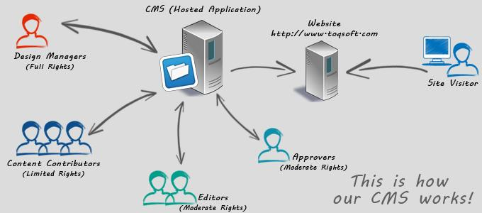
HOW CMS WORK?

Slide 8
APPLICATION OF CMS :
* Shopping website
* Personal website
* Blogging
* Portals..etc

Slide 9
Components OF CMS
1). Content Management Application(CMA).
CMA is a font end component.
Allow user to create and modify website content.
2). Content Delivery Application(CDA).
this is the backend, behind-the-scenes process that takes the content you input in the CMA, stores it properly, and makes it visible to your visitors..

Slide 10
Python Frameworks
-> Django CMS:
* Recommended to use Django CMS as a standalone project.
* It is the most popular web framework for python.
-> Wagtail :
* Can be extended by a programmer with good Django knowledge
* More friendly admin interface than Django CMS.
->Mezzanine :
* Relatively popular and has an active community
* Has an API so can be integrated with external services

Slide 11
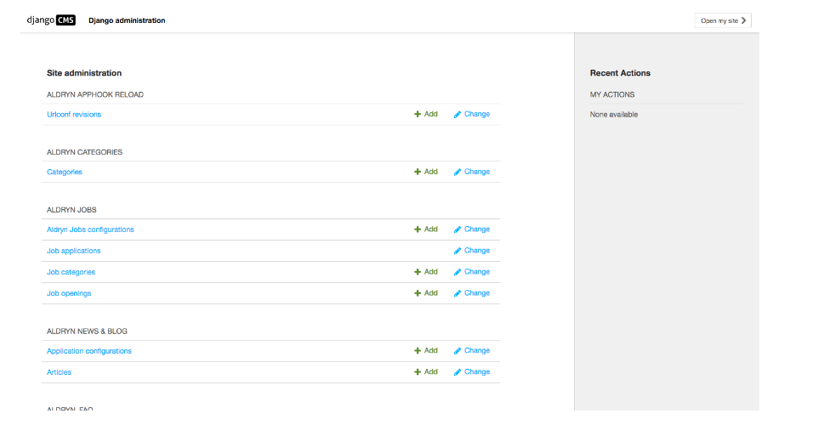

Slide 12
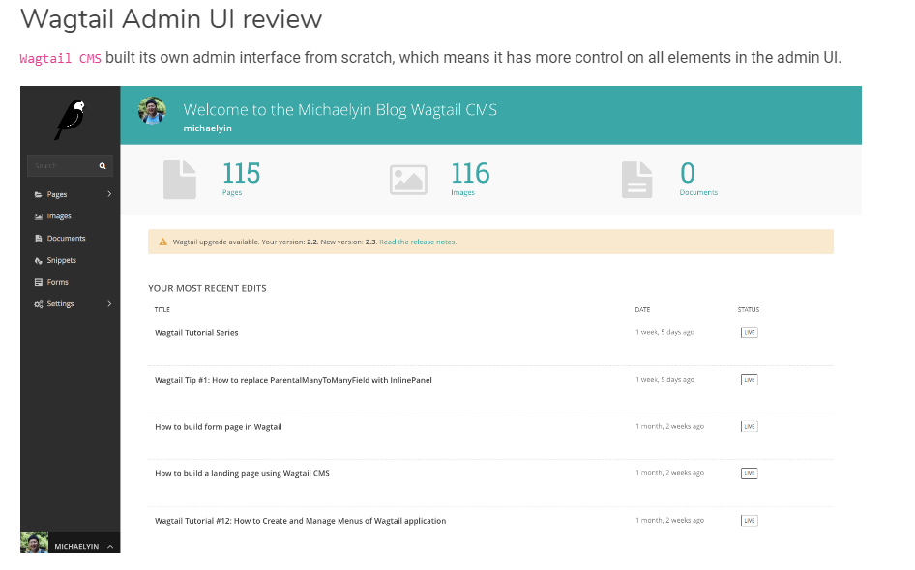

Slide 13
CMS OPEN SOURCES
Joomla :
A free and open sources WCMS built on an MVC framework. Joomla is written in PHP .
WORDPRESS :
Another free and open source WCMS based on PHP and MYSQL.
Drupal :
Similar to WordPress, Drupal offers modules (as plugins) to add more functionality to your website.

Slide 14
REFERENCES:
https://searchcontentmanagement.techtarget.com/definition/content-management-system-CMS
https://www.netguru.com/blog/drupal-django-cms-wagtail-mezzanine-comparison-python-php
https://www.slideshare.net/delgadotj/content-management-system-cms-57410833

Slide 15
Any Queries……?

Slide 16
Dhanyavaad!!!
(Thank You)

