Slide 1
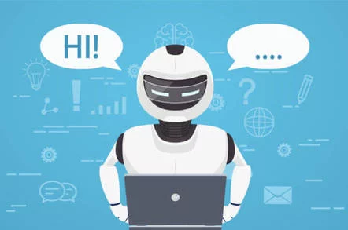
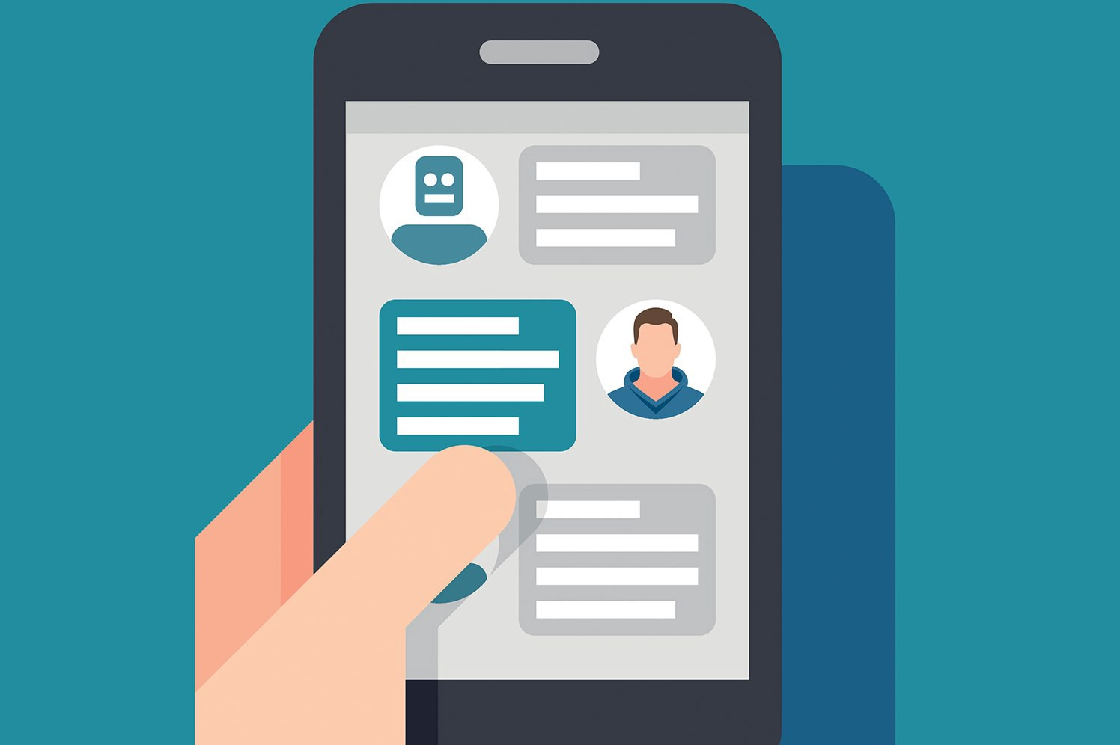
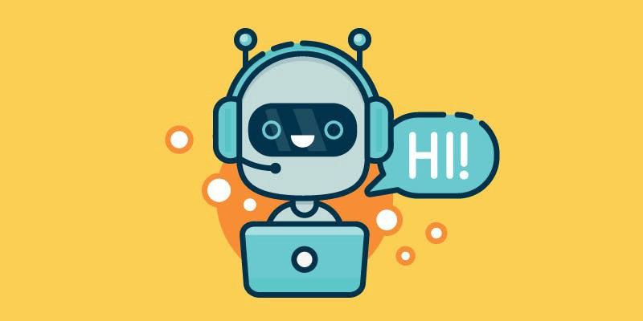
TOPIC : CHATBOT
Presented by: Sangeetha (764927)

Slide 2
Overview
What are chatbots? Why chatbots are important?
Difference between chatbots and virtual assistants
Types of Chatbots
How Do Chatbots Work?
Chatbot use cases
Chatbot example
Deep Learning Approach
References

Slide 3
What are chatbots? Why chatbots are important?
A chatbot is an artificial intelligence (AI) software that can simulate a conversation (or a chat) with a user in natural language through messaging applications, websites, mobile apps or through the telephone.
A chatbot is often described as one of the most advanced and promising expressions of interaction between humans and machines. However, from a technological point of view, a chatbot only represents the natural evolution of a Question Answering system leveraging Natural Language Processing (NLP).

Slide 4
Difference between chatbots and virtual assistants
The key difference is that a chatbot is largely server or company oriented while virtual assistants (use artificial neural networks) like Cortana or the more popular one Siri are user-oriented. ... Both, virtual assistants and chatbots feature a human interface system, but in ways that are different from each other.

Slide 5
Types of Chatbots
Simple chatbots works with the help of pre-written keywords. These keywords are embedded with a software, each time software matches the keywords with the user entered. Almost every simple chatbots starts its conversation with the greeting, may be hello, good morning like that. Responses are pre written in simple chatbots.
Smart chatbots are AI customer service chatbots and it is far advanced than simple chatbots. Instead of pre-loaded instructions, it collect information from the web based on the use queries. The words which are typed is analyzed by the robot before processing.

Slide 6
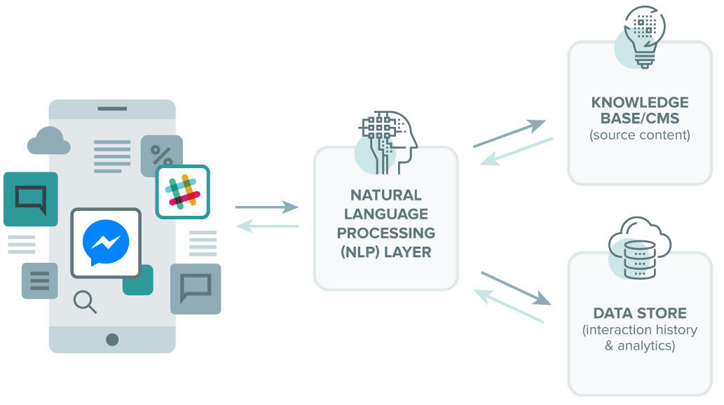
How Do Chatbots Work?

Slide 7
Chatbot use cases
Expensify: “Concierge”
1-800-Flowers: “GWYN”
Endurance: A Companion for Dementia Patients
Hipmunk
Whole Foods

Slide 8
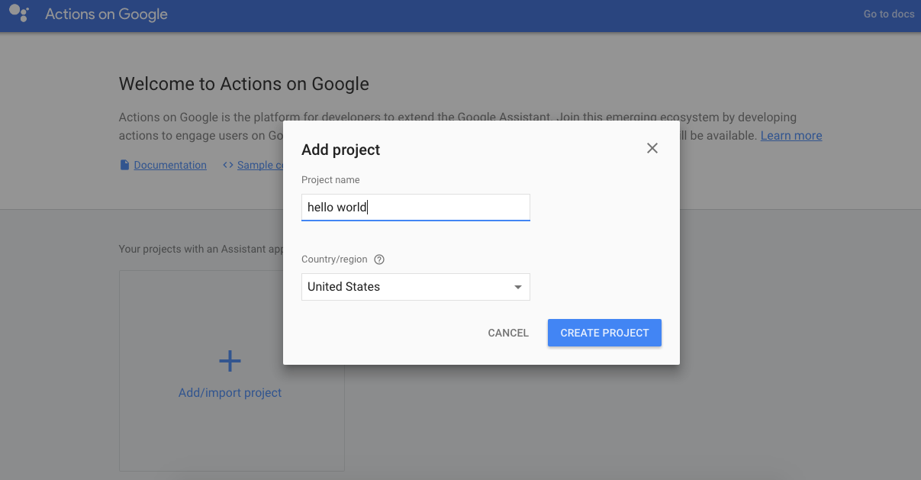
How to create a bot

Slide 9
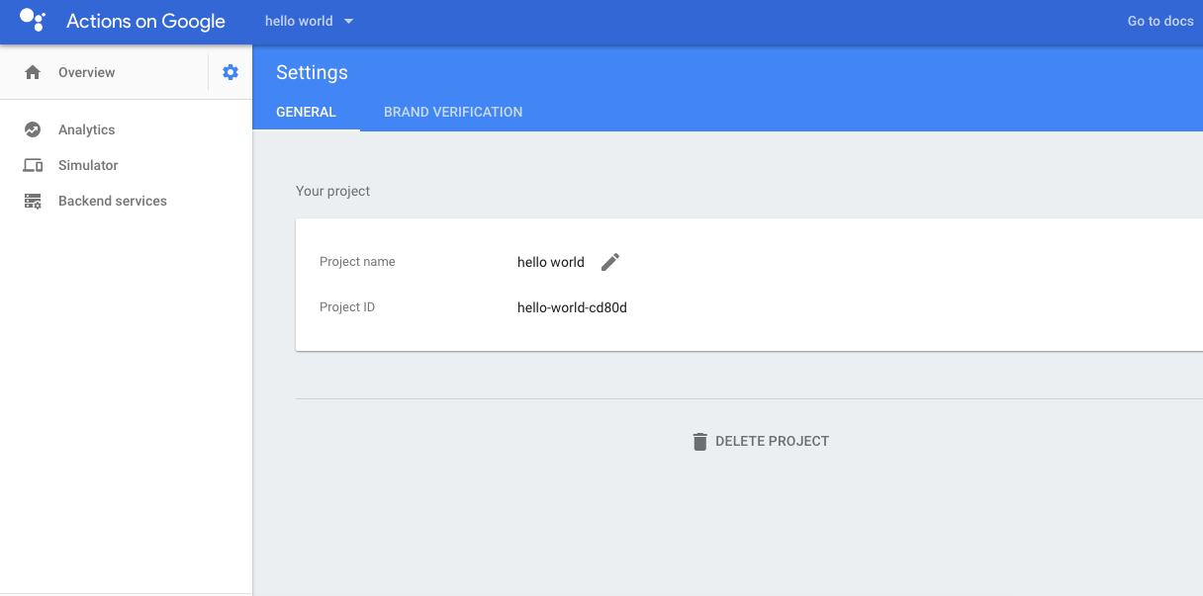

Slide 10
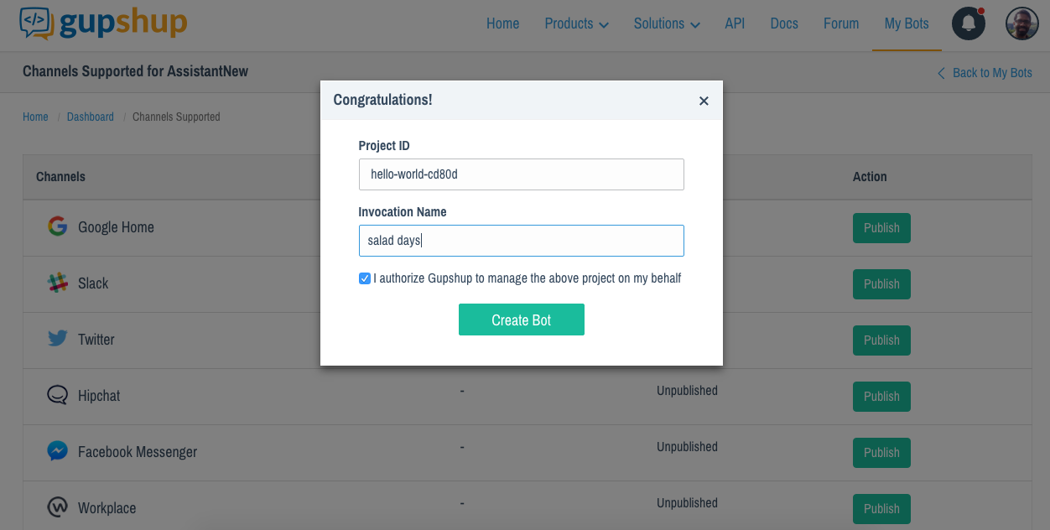

Slide 11
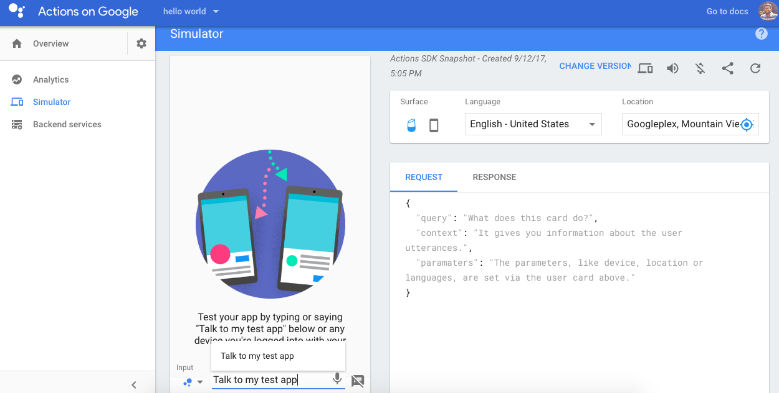
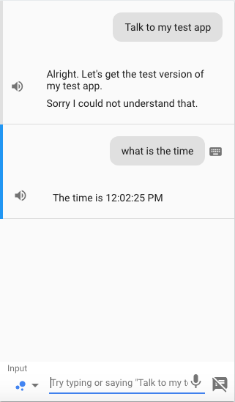

Slide 12
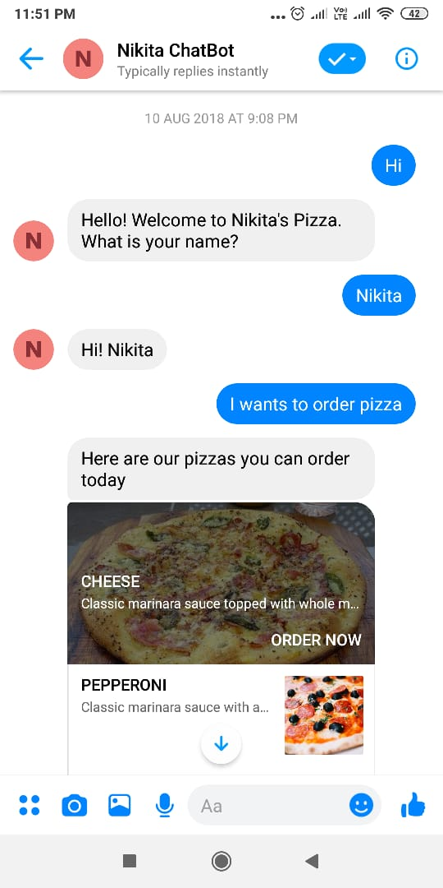
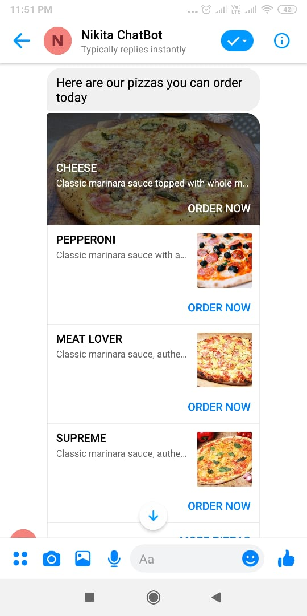
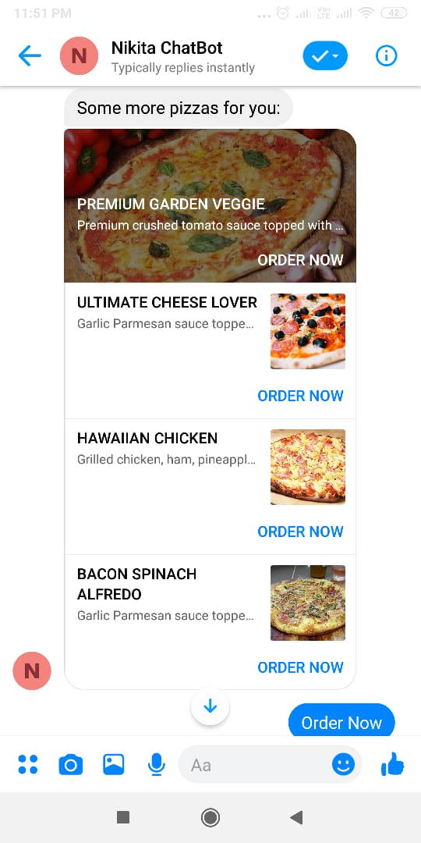
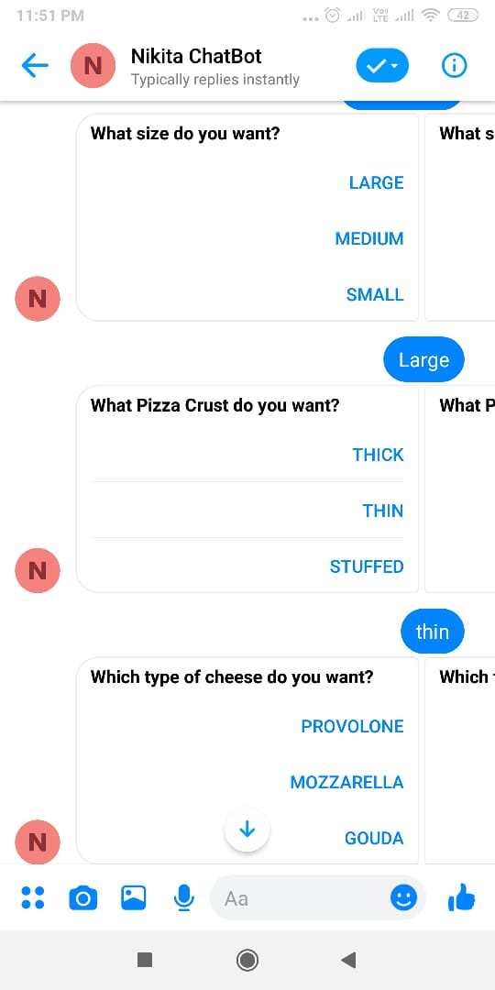
Chatbot example

Slide 13
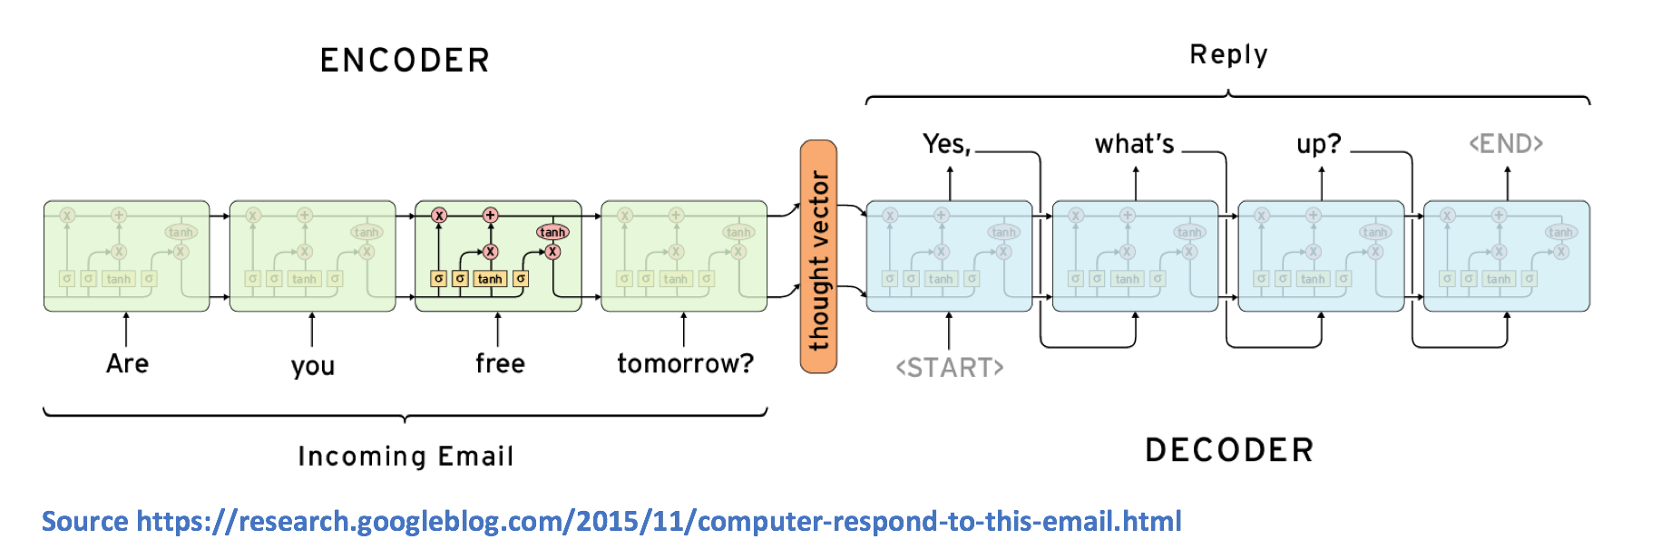
Deep Learning Approach
A sequence to sequence model is composed of 2 main components, an encoder RNN and a decoder RNN. From a high level, the encoder’s job is to encapsulate the information of the input text into a fixed representation. The decoder’s is to take that representation, and generate a variable length text that best responds to it.

Slide 14
Instant bots or custom bots
https://acobot.ai/
https://acobot.ai/bot/257
https://techbare.cognizant.com/rubix/
https://techbare.cognizant.com/forty2/
https://aws.amazon.com/ec2/faqs/
​https://dialogflow.com
https://dialogflow.com/docs/intents/

Slide 15
References
https://acobot.ai/
https://www.wordstream.com/
https://www.impactbnd.com/
https://emerj.com/
https://www.gupshup.io/ (Actions by google developer platform)
https://postcron.com/ (bot on fb)
https://www.interactions.com/

Slide 16
Any queries?
Thanks

