Slide 1
JERRY! SMART DEVICE CONTROLLER
Ganta, Aashritha (a_g1374)
Kadkol, Shweta Sudheer (s_k233)
Manika Ganeshbapu, Vishal Kumar (v_m255)
Paliwal, Manvick (m_p475)
Chada, Meghana (m_c754)

Slide 2
What does Jerry! do?
The idea behind ‘Jerry!’ is to build a voice-command based controller which manages devices like lights and fans etc. making it interactive and efficient at the same time.
A web interface which picks voice-commands → performs the given instruction → Displays the results on GUI.
The system also has a dashboard which lets the user view his/her list of devices and operate them with GUI as well.

Slide 3
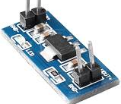
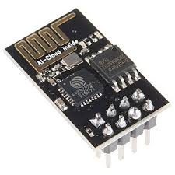
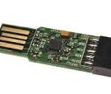
What is Jerry! Made off?
A COMPONENTS
A. ESP 8266
B. 5v relay switch
C. Router
D. Connecting wires
E. PCB
F. 5v power supply (adapter will do)
G. AMS 1117 dc voltage regulator
H. Soldering iron
I. Header pins
J. FTDI to USB adapter
ESP 8266
AMS 1117
FTDI to USB adapter

Slide 4

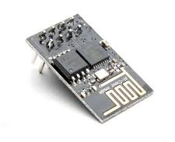
How is Jerry! Implemented?
Jerry! shall be implemented with an ESP8266 Version 01
a. 1MB Flash
b. Built-in TCP / IP protocol stack
c. 32-bit micro controller
d. 80 MHz
f. WIFI enabled
Connections
a. 5v Power supply connects to Relay Switch and AMS1117.
b. AMS1117 gives 3.3v output to ESP8266 Module.
c. ESP GPIO Pin 2 connects to Relay Switch Control Pin.

Slide 5
Jerry’s web interface
All voice interactions with the user are handled by the Web application Interface.
You supply one or more reliable content feeds in RSS or JSON format. The content can be audio content that the device plays to the customer or text content that device reads to the customer.
The code then handles the request appropriately. I.e. it will handle the request in sequence that the user provides.
With respect to GUI, the dashboard is designed to make it as user friendly as possible and to keep it simple overall. Micro framework like flask makes the application light and accommodative of most browsers.

Slide 6
How to use Jerry! ?
Joining Wireless Network
Creating User Profile
Interact with the system using GUI
Give voice base commands using specific keywords

Slide 7
Framework
The project follows a Model-View-Controller Framework as outlined above. Requests from User, be it voice commands or dashboard related, are sent to controller which in turn interacts with Model (Circuit). The responses are sent to User Interface (View) which is available for user to see.

Slide 8
Class Diagram

Slide 9
Special feature of Jerry!
FSM-like Routine Simulation
The 4 routines are step-by-step visual simulation of device management based on their priorities. The user selects the priority with which he/she wants the services triggered. This makes Jerry! in a way ubiquitous and controls more ground.

Slide 10
Verification , Validation and Results
https://git.txstate.edu/v-m255/ProjectJERRY/
The above GIT link contains 6 branches and 11 commits
It has all the necessary documentation covering all phases of the Software Development Life Cycle of Jerry!
Hardware Testing was done simultaneously and adapted dynamically. Software Testing was done as a separate phase.

Slide 11
Future Work
Actual implementation of FSM-like routine instead of simulation to achieve smart home.
Fetch results from trusted sources with respect to news, weather and maps to present a Gist to the users
Make the product, especially the dashboard more mobile-friendly.
Limit the constraints on exceptions.

Slide 12

Thank You!

