Slide 1


Slide 2

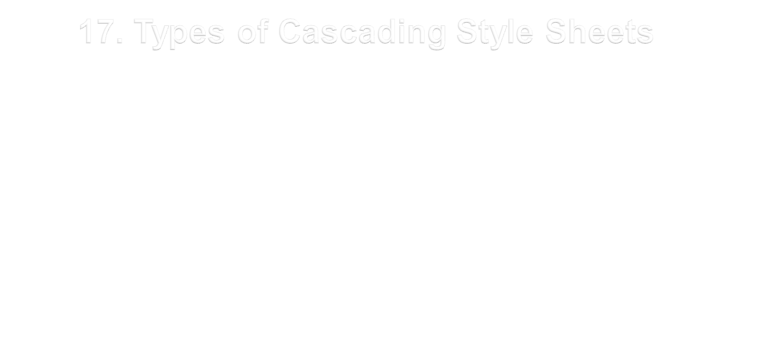

-
- By Narendra Mohan
Assistant Professor
CEA Department, GLA University Mathura

Slide 3

  Inline CSS
  Internal CSS
  External CSS

Slide 4


adds the style attribute to the relevant tag
style attribute can contain any CSS property
Will work for only the specified tag at that line only
<p style="color:green;margin-left:20px; text-transform: uppercase;” >
GLA University
</p>

Slide 5

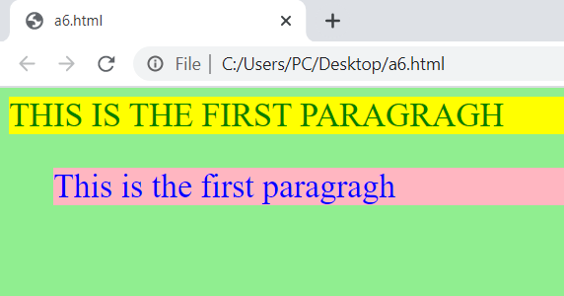
<html>
<head>
</head>
<body bgcolor=“lightgreen”>
<p style = "color:green;background-color:yellow; text-transform: uppercase;font-size:30px;" >
This is the first paragragh</p>
<p style = "color:blue;background-color: lightpink;margin-left:40px;font-size: 30px; " >
This is the first paragragh</p>
</body>
</html>

Slide 6

Used when a single document has a unique style
Defined in the head section of an HTML page
Defined within the <style> tag
Scope is up to the same document only
Every document has its own Internal CSS, if required.
<style>
p {text-align: center; color: red;}
h1{color: red; text-transform: lowercase;}
</style>

Slide 7

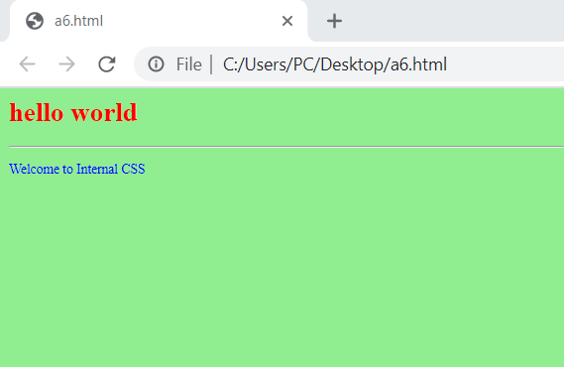
<html>
<head>
<style type="text/css">
p {color: blue;}
hr {color:lightpink;}
h1{color: red; text-transform: lowercase;}
body {background-color:lightgreen;}
</style>
</head>
<body>
<h1>hello world</h1><hr>
<p>Welcome to Internal CSS</p>
</body>
</html>

Slide 8

Can be written on any text editor and save file as filename.css
Used when the style is applied to many pages.
With an external style sheet, you can change the look of an entire Web site by changing one file.
Each page must link to the style sheet using the <link> tag.
Mystyle.css
h1 {color: red;}
H6{Color: green;}
hr {color:blue;}
p {margin-left:20px;}
Abc.html
<head> <link rel="stylesheet" type="text/css" href="mystyle.css"> </head>

Slide 9

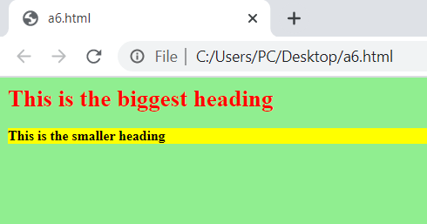
a6.html
<html>
<head>
<link rel="stylesheet" type="text/css" href="mystyle.css">
</head>
<body>
<h1> This is the biggest heading</h1>
<h3> This is the smaller heading</h3>
</body>
</html>
h1{color: red;}
h3{background-color: yellow;}
mystyle.css

Slide 10

All the styles will "cascade" into a new "virtual" style sheet by the following rules:
  Inline style (inside an HTML element) (Highest priority)
  Internal style sheet (in the head section)
  External style sheet
  Browser default (Lowest priority)

Slide 11



