Slide 1
Stock Portfolio Case Study

Slide 2
Agenda
Project overview
UML Diagrams
System architecture
Technology stack

Slide 3
Project overview
Stock portfolio management is web application that helps to investor to track their stocks by using charts and offline services like email alerts.

Slide 4
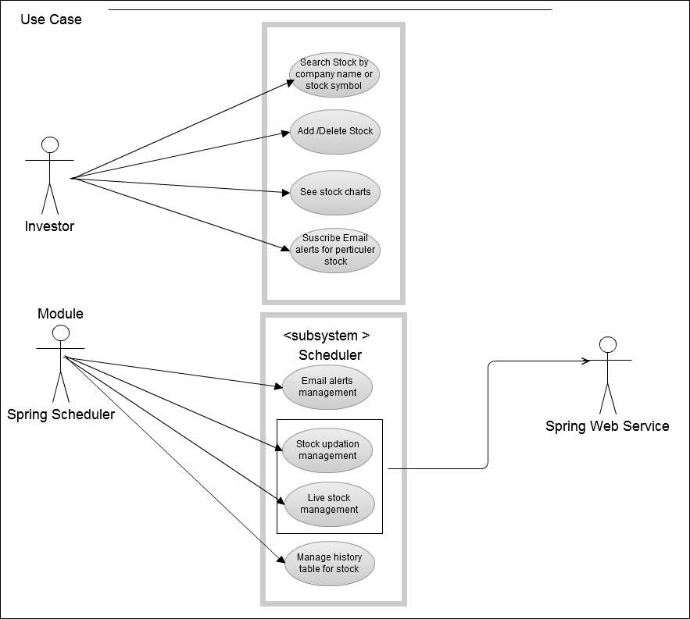
End User UseCase

Slide 5
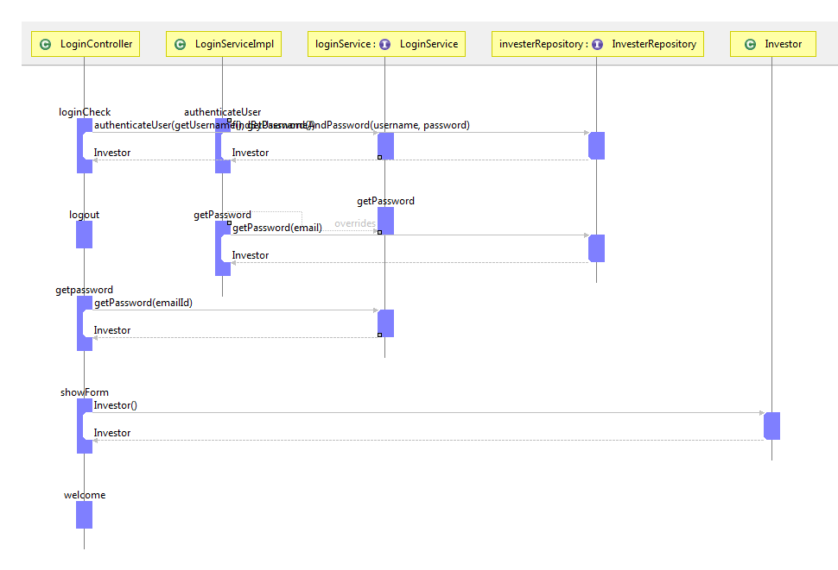
Sequence Diagram
Login Flow:-

Slide 6
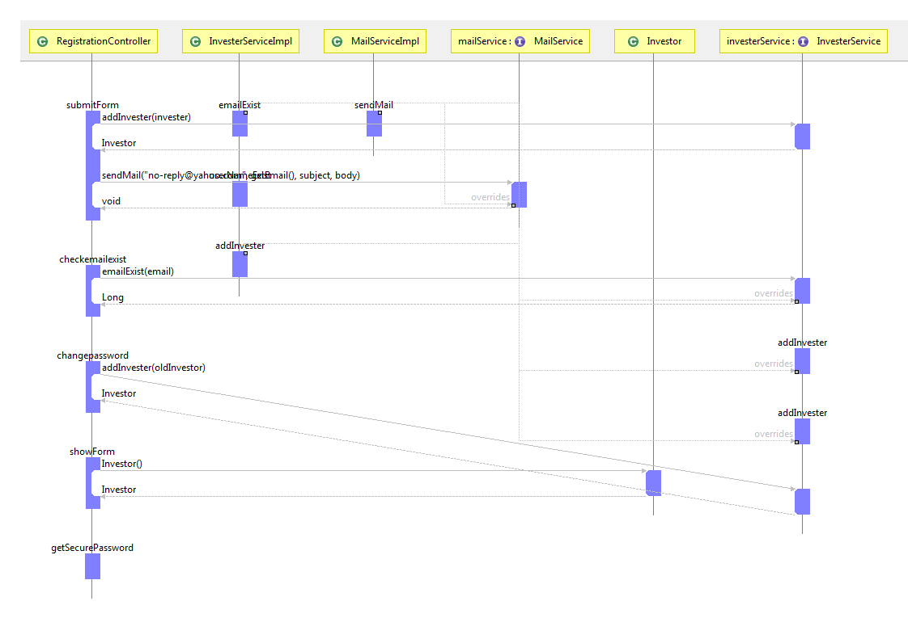
Sequence Diagram
Registration Flow:-

Slide 7
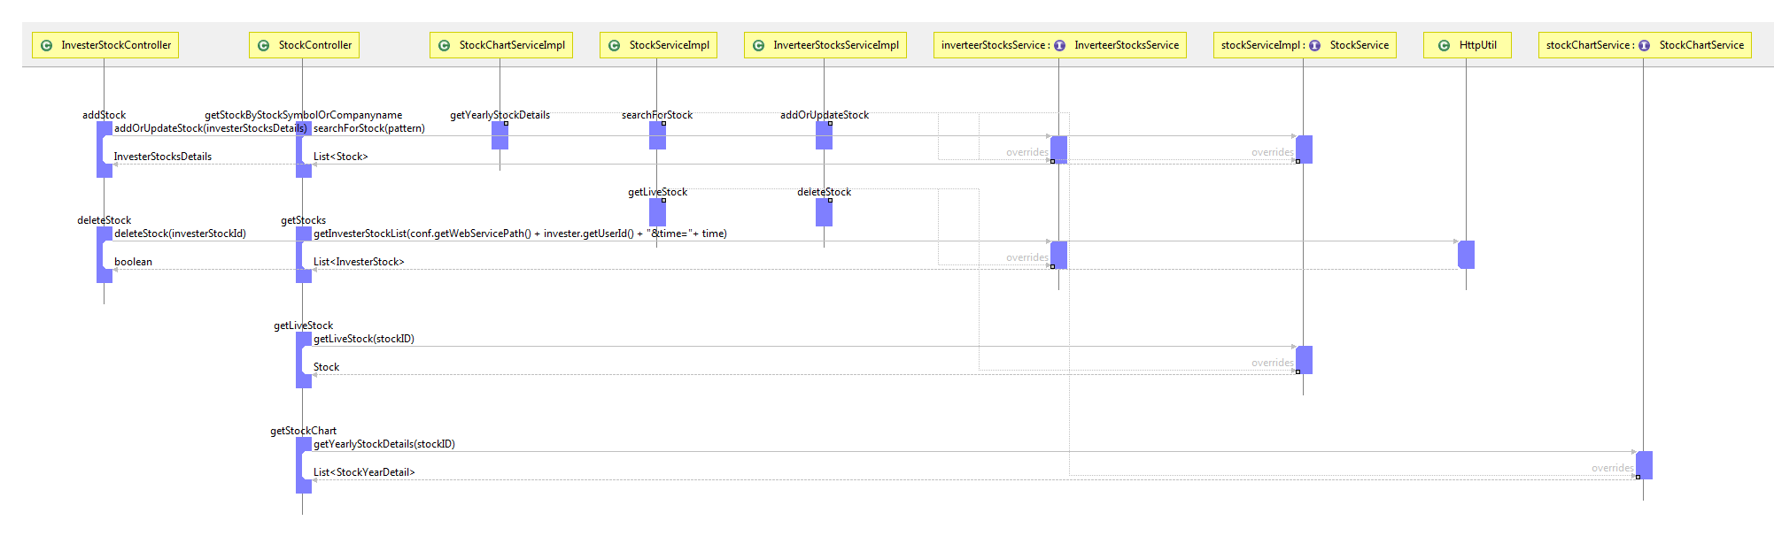
Sequence Diagram
Registered Investor Flow:-

Slide 8
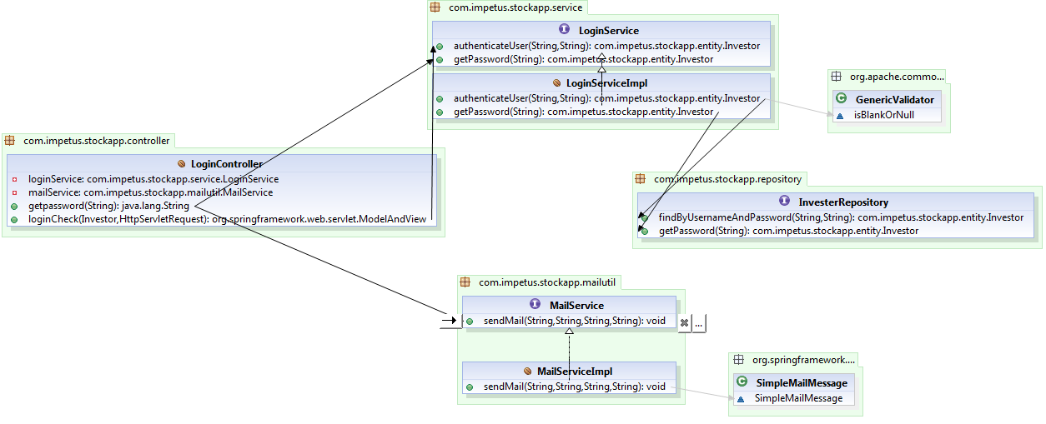
Class Diagram- Login Flow

Slide 9
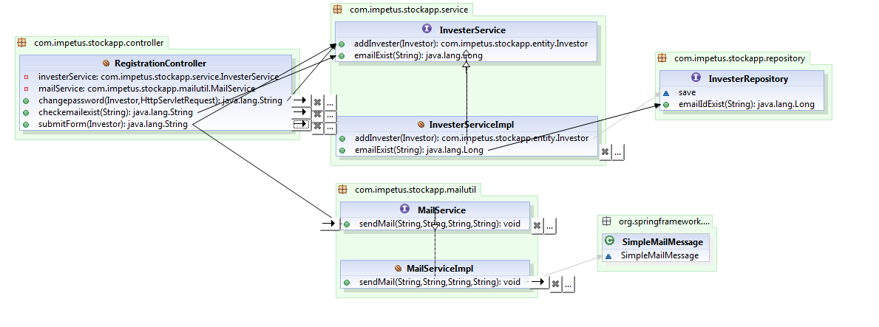
Class Diagram- Registration Flow

Slide 10
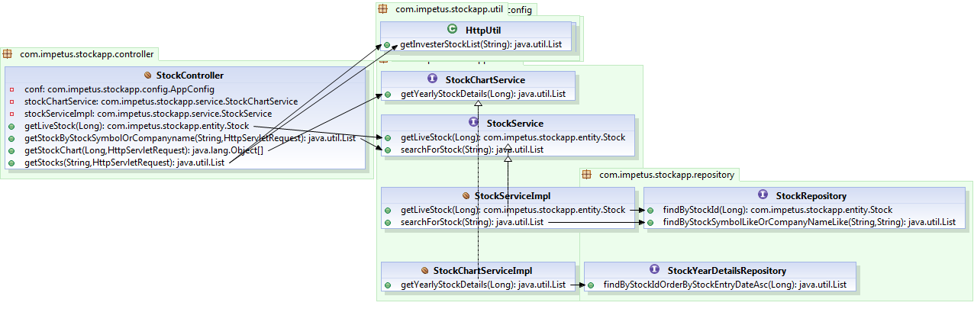
Class Diagram- Stock Flow

Slide 11
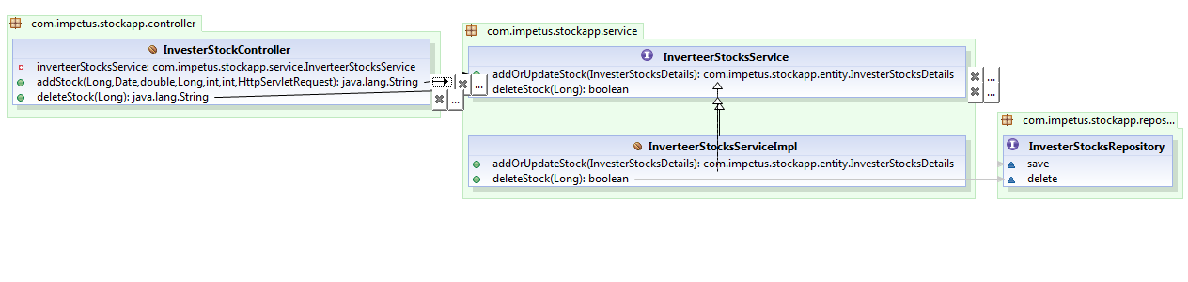
Class Diagram- Investor-Stock Flow

Slide 12
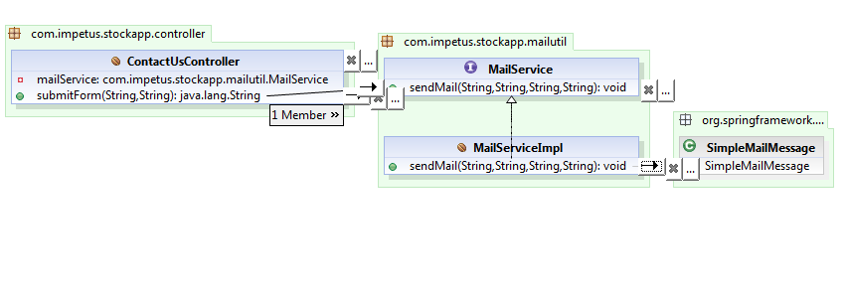
Class Diagram- Contact Us Flow

Slide 13
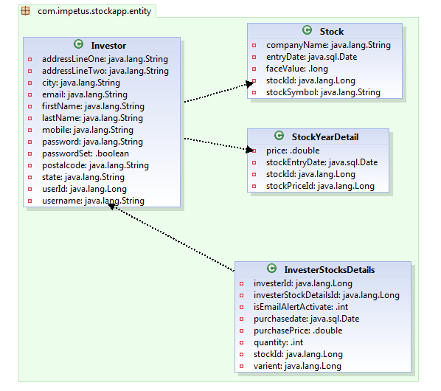
Class Diagram- Entities

Slide 14
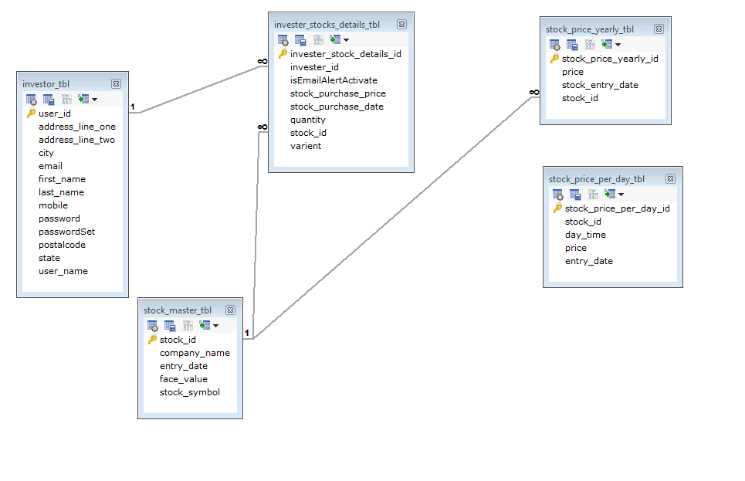
ER Diagram

Slide 15
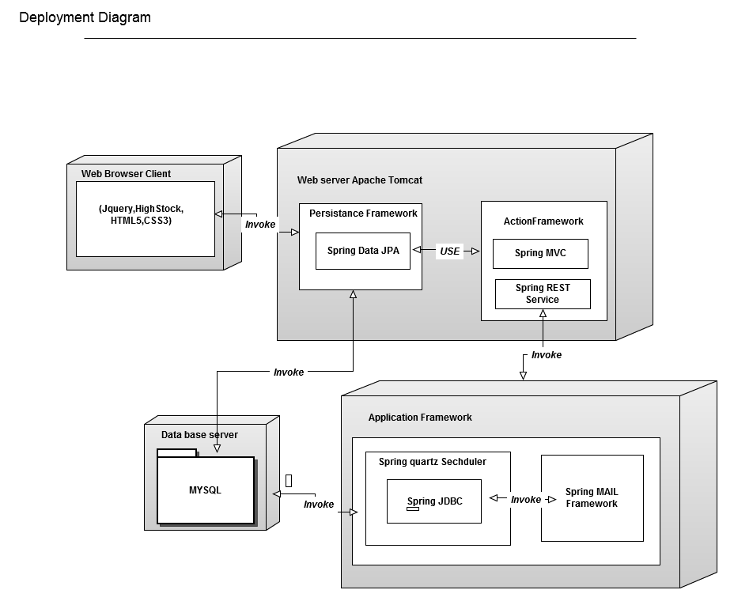
Component Interaction Diagram

Slide 16
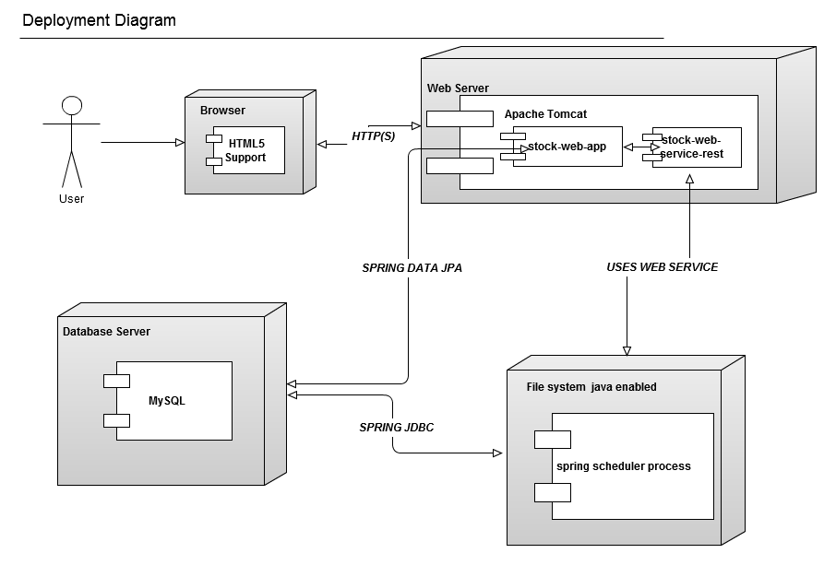
Deployment Diagram

Slide 17
Technology stack
GUI
JSP/HTML5/CSS3/Java Script
Jquery 1.7.
Middle tier
Spring MVC 3.1.2
DAO layer
Spring Data JPA 1.3.0
DB
Mysql5.0

Slide 18
Thank you

