Slide 1
INDUCTION
DevOps 7103
2023

Slide 2
Key Information
Module Tutor | Dr Naveed ISLAM
Email | ni2@bolton.ac.uk
Office Location | Room: C2-007a
Drop-in Availability | Available Wednesday(12:00-2:00 PM), other days By Appointment
Weblink to Moodle Class | https://moodle.bolton.ac.uk/course/view.php?id=29636
Weblink to online session | https://moodle.bolton.ac.uk/mod/lti/view.php?id=2109487
Weblink to Module Specification | https://modules.bolton.ac.uk/SWE7103

Slide 3
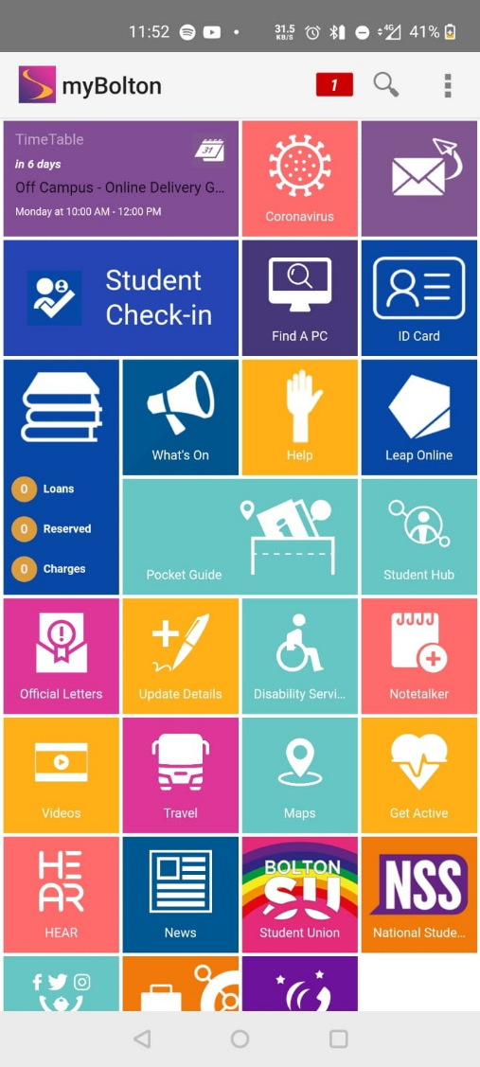
MyBolton
Please download the MyBolton App on your smartphone
Available on
Google Play Store
Apple App Store
Links to timetables, email, useful info
This is how we take registers and include track and trace
Please download it now…

Slide 4
Module Communications
Check your University of Bolton email address and the Moodle area dedicated to this module regularly, as many module communications are channelled through these media.
It is also requirement to follow the appropriate email etiquette when emailing the Module Tutor:
Use the University of Bolton email rather than your private email
Address your Module Tutor by the right title and name
Explain clearly your enquiry/requirement
Check your email message for any grammar/spelling mistakes
End your message with your name and student ID number
Your Module Tutor will normally aim to respond to your email messages within 2 full working days of receipt. However, responses will be longer in holiday periods

Slide 5
Moodle
Online material for all your modules is on Moodle
https://moodle.bolton.ac.uk
The modules on Moodle should be the same as the modules on your timetable
Lecture materials, assignment hand-ins and Zoom lectures all available through Moodle
All assessments are submitted through and Turnitin where appropriate

Slide 6
Module Description
DevOps is the combination of cultural philosophies, practices, and tools that increases an organization’s ability to deliver applications and services at high velocity.
This speed enables organizations to better serve their customers and compete more effectively in the market.
Organizations generally face issues during project delivery due to lack of collaboration between different teams specifically the development and the operations.
This module provides enough opportunities to develop a suite of relevant conceptual skills and practices to adopt strategies in applying DevOps solutions in diverse applications.

Slide 7
Attendance
We will be completing registers in every class
On campus you will scan QR codes using the MyBolton app.
We have policies and procedures to monitor and deal with students regularly missing classes
If your attendance drops below 80% you will asked to attend a meeting with your personal tutor
We will contact you to find out why you are absent
As a last resort students can be withdrawn for non-attendance
If you are going to miss a class email your module tutor via your University Email
It you are going to be absent for longer email your personal tutor too

Slide 8
Teaching Software
Video Conferencing is done using Zoom – you can download this from bolton.zoom.us
Microsoft Teams: Useful for two-way interactions and allowing your tutor to view your screen

Slide 9
Learning and Teaching: Campus Plus
This module is delivered using a blended learning approach with scheduled online and face-to-face sessions.
Tuesday: 10:45-11:45 (Online Session)
Wednesday: 9:00 -12:00 and 13:00 – 16:00 (Face-to-Face workshop session for SWE/CNS)
Friday: 13:00 – 16:00 (Face-to-Face workshop session for M.Sc CNS)

Slide 10
Module Major Topics
Major Topics
Introduction to the module and assessments, Software Development Life Cycle (SDLC); Culture and principles in DevOps, Latest trends, challenges and tools in DevOps, Cloud computing platforms (AWS, Azure, Google Cloud) Version control systems: Source code management, best practices, its tools, benefits, version control with git, GitHub etc; Containerization (Introduction to containers, benefits, containers vs virtualization, container orchestration), Building and Testing: Concept and Best Practices, tools (Maven) Continuous Integration and Continuous Delivery (CI/CD): (best practices, automating CI/CD pipeline, stages(build, test, deploy)), Jenkins Configuration Management

Slide 11
Indicative Reading
Humble, J. and Kim, G., 2018. Accelerate: The science of lean software and devops: Building and scaling high performing technology organizations. IT Revolution.
Bass, L., Weber, I. and Zhu, L., 2015. DevOps: A software architect's perspective. Addison-Wesley Professional.
Davis, J. and Daniels, R., 2016. Effective DevOps: building a culture of collaboration, affinity, and tooling at scale. " O'Reilly Media, Inc.".
Beyer, B., Jones, C., Petoff, J. and Murphy, N.R., 2016. Site Reliability Engineering: How Google Runs Production Systems. " O'Reilly Media, Inc.".
Kim, G., Humble, J., Debois, P. and Willis, J., 2016. The DevOps Handbook:: How to Create World-Class Agility, Reliability, and Security in Technology Organizations. IT Revolution.
Humble, J. and Farley, D., 2010. Continuous Delivery: Reliable Software Releases through Build, Test, and Deployment Automation (Adobe Reader). Pearson Education.

Slide 12
Learning Outcomes
On successful completion of this Module you will be expected to be able to:
Plan, Construct and Implement a DevOps solution for a given business scenario
Critically evaluate strategies for implementation of a DevOps solution to a given business problem
Identify and critically evaluate potential operational security issues with cloud based software development.
Critically evaluate the tools used in the solution development and implementation cycle.

Slide 13
Assessment
A group project that delivers a fully functioning and documented solution to a given problem.
Learning Outcomes 1 2 3 4 Standard University Regulations - 100%
Can be
Delivery CI\CD
Delivery IAC
Or a combination of both
You will choose the project - think about it
Teams once chosen will not change
Group work - group success or group failure - teams of 4/5
You will be required to demonstrate your solution

Slide 14
Assessment
Assessment Number | 1
Assessment Type (and weighting) | Report (100%)
Assessment Name | Practical Project Output
Assessment Submission Date | 05/01/2024

Slide 15
Assessments submission instructions
Written assessments should be word-processed in Arial or Calibri Light font size 12. There should be double-spacing, and each page should be numbered.
There should be a title page identifying the programme name, module title, assessment title, your student number, your marking tutor and the date of submission.
You should include a word-count at the end of the assessment (excluding references, figures, tables and appendices).
Where a word limit is specified, the following penalty systems applies:
Up to 10% over the specified word length = no penalty
10 – 20% over the specified indicative word length = 5 marks subtracted (but if the assessment would normally gain a pass mark, then the final mark to be no lower than the pass mark for the assessment).
More than 20% over the indicative word length = if the assessment would normally gain a pass mark or more, then the final mark will be capped at the pass mark for the assessment.

Slide 16
Assessments submission instructions
4. All written work should be referenced using the standard University of Bolton referencing style– see: https://www.bolton.ac.uk/library/Study-Skills/Referencing/Home.aspx
5. Unless otherwise notified by your Module Tutor, electronic copies of assignments should be saved as word documents and uploaded into Turnitin via the Moodle class area. If you experience problems in uploading your work, then you must send an electronic copy of your assessment to your Module Tutor via email BEFORE the due date/time.
6. Please note that when you submit your work to Moodle, it will automatically be checked for matches against other electronic information. The individual percentage text matches may be used as evidence in an academic misconduct investigation (see Section 13).
7. Late work will be subject to the penalties:
Up to 7 calendar days late = 10 marks subtracted but if the assignment would normally gain a pass mark, then the final mark to be no lower than the pass mark for the assignment.
More than 7 calendar days late = This will be counted as non-submission and no marks will be recorded.
Late submission of assessments on refer and those which are graded Pass/Fail only, is not permitted. Students may request an extension to the original published deadline date as described below.

Slide 17
Assessments submission instructions
In the case of exceptional and unforeseen circumstances, an extension of up to 14 days after the assessment deadline may be granted. This must be agreed by your Programme Leader, following a discussion with the Module Tutor.
You should complete an Extension Request Form available from your Tutor and attach documentary evidence of your circumstances, prior to the published submission deadline.
Extensions over 14 calendar days should be requested using the Mitigating Circumstances procedure, with the exception of extensions for individual projects and artefacts which, at the discretion of the Programme Leader, may be longer than 14 days.
Requests for extensions which take a submission date past the end of the module (normally week 15) must be made using the Mitigating Circumstances procedures.
Some students with registered disabilities will be eligible for revised submission deadlines. Revised submission deadlines do not require the completion extension request paperwork.
Please note that the failure of data storage systems is not considered to be a valid reason for an extension. It is therefore important that you keep multiple copies of your work on different storage devices before submitting it.

Slide 18
Assessment Feedback
Feedback on items of assessment can be formal (such as on a signed feedback form) or informal (such as advice from a tutor in a tutorial).
Feedback is therefore not just your grade or the comments written on your feedback form; it is advised you get from your Tutor and sometimes your peers about how your work is progressing, how well you have done, what further actions you might take.
Other than in exceptional circumstances (such as might be caused by staff illness), you can expect your assignment and examination work to be marked and feedback provided not more than 15 working days from the deadline date.
However, please note that such feedback will be provisional and unconfirmed until the Assessment Board has met and may, therefore, be subject to change.
Please take time to read or listen to your assessment feedback. This can be very useful in determining your strengths and key areas for development, and can, therefore, help you improve on future grades.

Slide 19
Academic Misconduct
Academic misconduct may be defined as any attempt by a student to gain an unfair advantage in any assessment.
This includes plagiarism, collusion, commissioning (contract cheating) amongst other offences.
In order to avoid these types of academic misconduct, you should ensure that all your work is your own and that sources are attributed using the correct referencing techniques.
You can also check originality through Turnitin.
Please note that penalties apply if academic misconduct is proven. See the following link for further details: https://www.bolton.ac.uk/about/governance/policies/student-policies/

Slide 20

More Questions and Queries…
Further Queries would be responded, respectively...

