Slide 1
An Introduction to
Behaviour Driven Testing
(BDT)
[Originally presented to NMQA, 2008]
Mark Crowther – Empirical Pragmatic Tester
mark@cyreath.co.uk
V1.5
Notes:
January 2009

Slide 2


About this slide pack.
This slide pack provides a brief overview of Behaviour Driven Testing.
Contact Mark Crowther to learn more about this approach, the tools and techniques used and with any queries or feedback you may have.
Copyright notice
This document is copyright of Mark Crowther - © Mark Crowther 2009. The content and trademarks are the property of and copyright of their respective owners. All rights reserved.
You may not, except with the express written permission of Mark Crowther make derivative works or commercially exploit the content or the publication. Nor may you transmit it or store it in any website or other form of electronic retrieval system except as permitted by this copyright notice.
Any redistribution or reproduction of part or all of the content or publication in any form is prohibited other than the following:
you may print or download the complete document or extracts of the content to a local hard disk and you may transmit it to an individual third party for personal and non-commercial use only; but only if you acknowledge Mark Crowther as the source of the publication and provide this copyright notice intact.
For more information contact Mark Crowther.

Slide 3
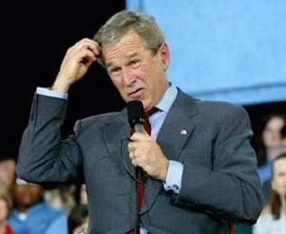
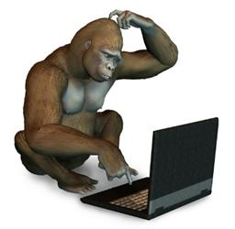
Behaviour Driven Testing
Q) What is
Behaviour Driven Testing
anyway?
http://scrapetv.com/News/News%20Pages/usa/images-2/george-bush-confused.jpg
http://www.scotlands-enchanting-kingdom.com/images/confused-monkey.jpg

Slide 4
Behaviour Driven Testing
Q) What is
Behaviour Driven Testing
anyway?
The testing perspective on
Behaviour Driven Development

Slide 5
Behaviour Driven Testing
Gosh-dang it...
Behavior Driven
wut?
Ooee ugh... ee OO oo?

Slide 6
Behaviour Driven Testing
Test Driven Development
Behaviour Driven Development
Behaviour Driven Testing

Slide 7
Behaviour Driven Testing
TDD
BDD BDT
Dan North
Mark Crowther

Slide 8
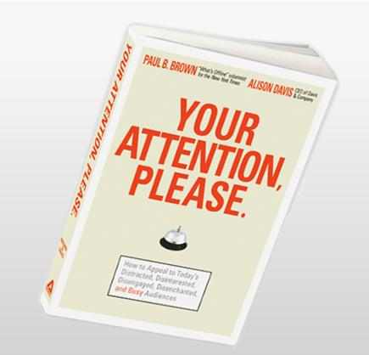
Behaviour Driven Testing
Here
comes
the
explanation
http://www.davisandco.com/products/yourattentionplease/

Slide 9
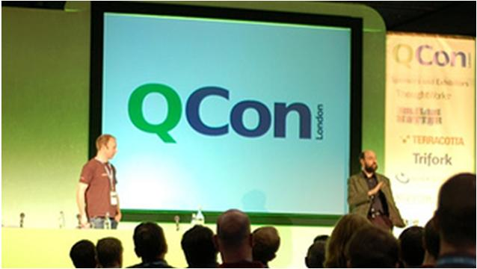
Behaviour Driven Testing
November 2007 - QCon Developer Conference
Dan North presents Behaviour Driven Development
Dan first wrote a paper about his idea in 2003
http://www.infoq.com/presentations/bdd-dan-north

Slide 10
Behaviour Driven Testing
Dan made the following observations:
In TDD:
When a developer writes a UNIT TEST
they are thinking of BEHAVIOUR that CODE
not yet written - will ENACT
in the future
once the code is WRITTEN

Slide 11
Behaviour Driven Testing
Dan made the following observations:
  Developers write Unit Tests before any code is written
    At this point they’re not tests...
    They can’t be – there’s nothing to test at this point
    they’re EXAMPLES or SPECIFICATIONS
    of behaviour future code will enact

Slide 12
Behaviour Driven Testing
Dan made the following observations:
    The code then get’s written
    The Unit Tests then pass
    NOW the Unit Test will become a test, a regression test
Timeline
Code
Regression Test
Unit Test
Requirement

Slide 13
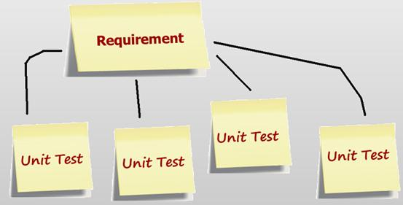
Behaviour Driven Testing
In Behaviour Driven Development

Slide 14
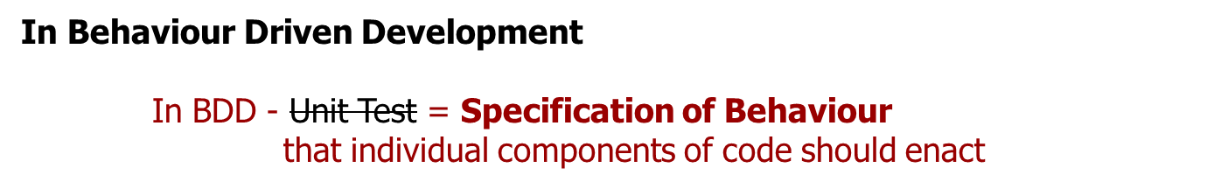
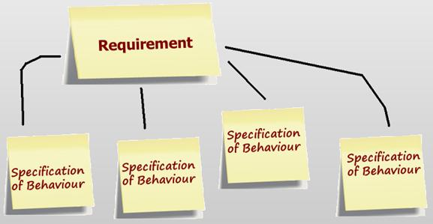
Behaviour Driven Testing

Slide 15
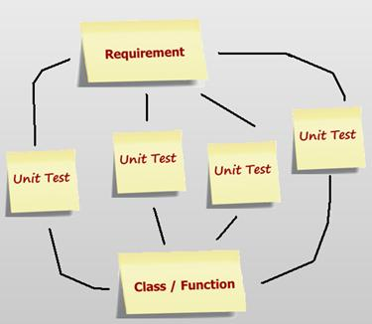
Behaviour Driven Testing
In Behaviour Driven Development
    As code is written to meet the ‘Specifications of behaviour’ for the component
    behaviour starts to emerge
    and the customer
    Requirements start to
    get delivered

Slide 16
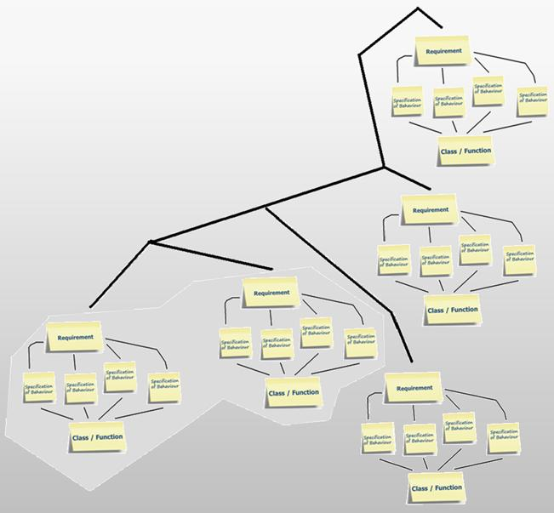
Behaviour Driven Testing
In Behaviour Driven Development
    As further Requirements are delivered
    Component Integration Testing
    is possible and usable functionality
    emerges allowing possible
    deployment

Slide 17
Behaviour Driven Testing
    Functionality that is expressed as BEHAVIOUR....
    “Functional Testing is the system level testing of
    Characteristics the application exhibits
    and Behaviours it can enact”
    Mark Crowther – A Testing Taxonomy

Slide 18
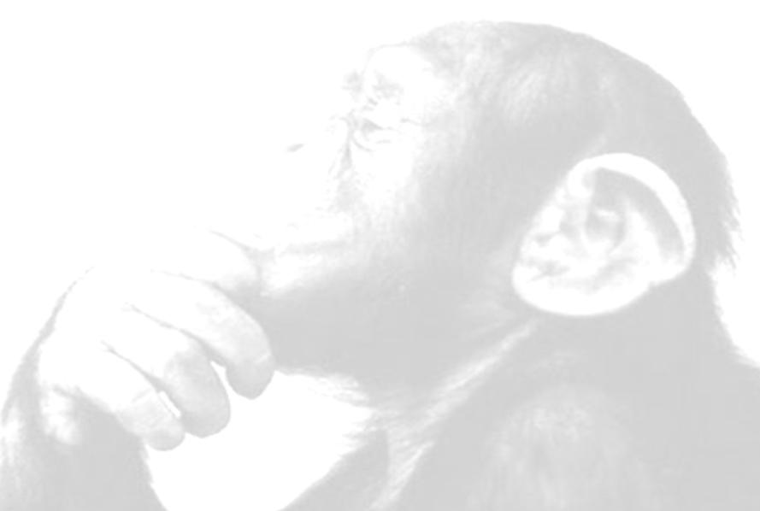
Behaviour Driven Testing
    Why is focusing TESTING on
    BEHAVIOUR
    so important?

Slide 19

Behaviour Driven Testing
    Why is a focus on BEHAVIOUR so important?
    Users usually don’t care about technical implementation
    they care about BEHAVIOUR of the software
The software was crap and never did what I wanted ...
... but I LOVE the way you implemented that CLASS!!
“...our clients don't value the code as such;
they value the things that the code does for them.” – Michael Bolton
http://www.stickyminds.com/s.asp?F=S14180_ART_2
http://hotlard.files.wordpress.com/2009/07/thumbs-up-low-res1.jpg

Slide 20
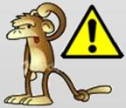
Behaviour Driven Testing
    Why is focusing TESTING on BEHAVIOUR so important?
    User Acceptance Testing is all about BEHAVIOUR the system can enact in response to user interaction
    When we test at the FUNCTIONAL and SYSTEM level we test BEHAVIOUR
        As testers we should NEVER be testing application CODE directly,
        that’s what DEVELOPERS are meant to do
        Every bug we raise as testers should be described in terms of BEHAVIOUR
        So how does this CHANGE what we do?

Slide 21
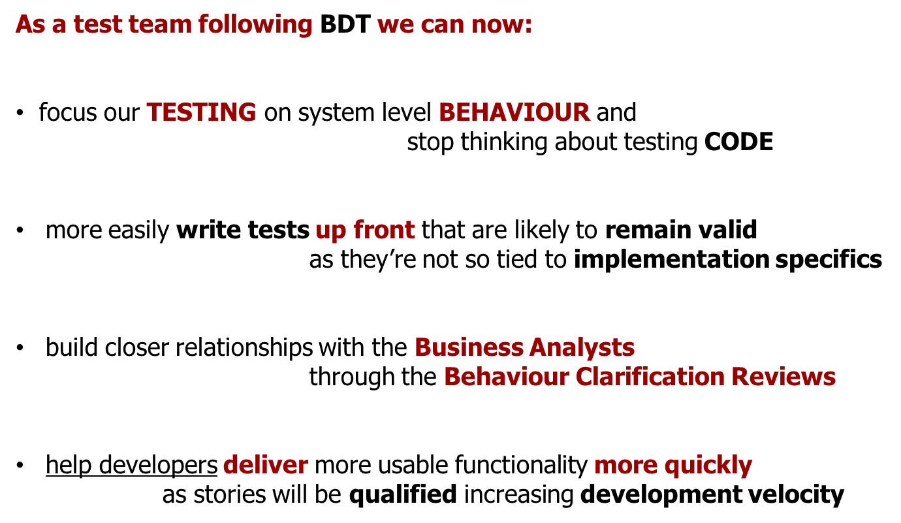
Behaviour Driven Testing

Slide 22
Behaviour Driven Testing
    As a test team following BDT we can now:
    write tests that are ‘Just Enough’ to cover the intended BEHAVIOUR of the system – so ensure good coverage
    meaning tests will all be a priority to run,
      all will be the ‘The Most Important Tests’

Slide 23
Behaviour Driven Testing
    The Tester in a BDT environment needs to:
    Help with STORY DEFINITION to avoid ILL DEFINED requirements
    Focus on identifying BUSINESS VALUE and not ABSTRACT IDEAS
    Focus on CUSTOMER USE over the TECHNICAL IMPLEMENTATION
    Focus on FINDING BUGS and not on CONFIRMING COMPLETNESS
    More effort into
    TESTING the RIGHT things

Slide 24
Behaviour Driven Testing
        So how does this CHANGE what we do?
        Stakeholder / User Business Analyst
        Stories / Requirements / Needs
        Business Analyst Tester
        Refined (Test) Scenarios / Automated Tests
        Tester Developer
        Code Deploy / Test Execution / Accepted system
        

Slide 25
Behaviour Driven Testing
        So how does this CHANGE what we do?
        Exploratory Testing
Learn, plan and execute at once
Look for bugs, missing features and opportunities for improvement
Combination/Interaction Testing
Focus on interactions between features
Scenario Testing
Use combined real-world scenarios that exercise multiple stories
Business Cycle Testing
Execute scenarios based on end of day/month/qtr/year business tasks
Non-Functional Testing
Performance, Security, Accessibility, Compatibility
        SEMI AUTOMATED / MANUAL TEST EXECUTION
        
http://www.io.com/%7Ewazmo/papers/agile_testing_challenges.pdf

Slide 26




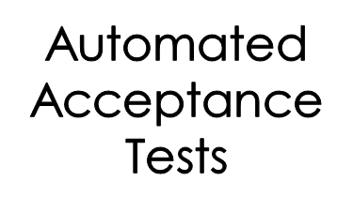

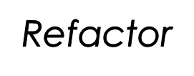

Behaviour Driven Testing
        So how does this CHANGE what we do?
        The Test Team adopt an XP like approach – XP/SCRUM compatible

Slide 27

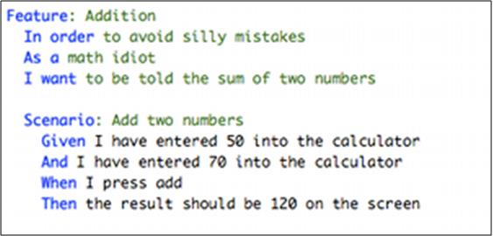
Behaviour Driven Testing
        Components that enable BDT
http://cukes.info/
Test Scenario
Test Case

Slide 28





Behaviour Driven Testing
        Components that enable BDT
        Remote Control
http://seleniumhq.org/
        browser.open @the_url
        browser.window_focus
        browser.window_maximize
        browser.type(“q”,”hello world”)
        browser.click(“btnG”)
        browser.wait_for_page_to_load(“5000”)
        browser.get_title.should == “hello world – Google Search”
        Grid
        IDE
http://seleniumhq.org

Slide 29
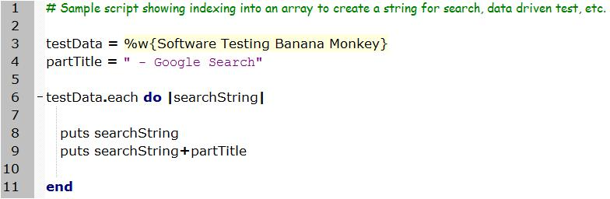


Behaviour Driven Testing
        Components that enable BDT
http://www.ruby-lang.org/en/
http://oreilly.com/catalog/9780596516178/

Slide 30
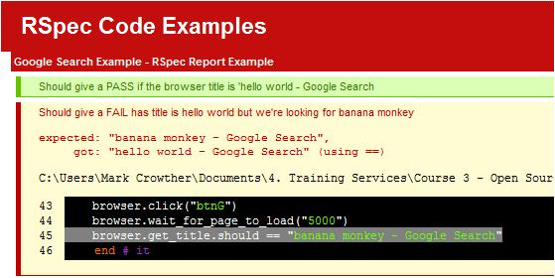
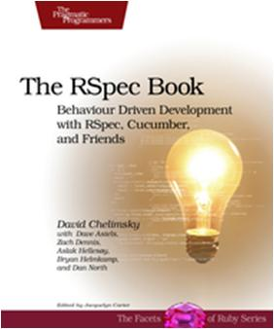
Behaviour Driven Testing
        Components that enable BDT
http://rspec.info/
http://www.pragprog.com/titles/achbd/the-rspec-book

Slide 31


Behaviour Driven Testing
        An outline of a BDT process
        BUSINESS ANALYST identifies the FEATURES the CUSTOMER/USER wants
        Testers use Cucumber FEATURES as TEST SCENARIOS
        Tester writes TEST CASES as behaviour driven Cucumber SCENARIOS
        Developer writes code that make TEST CASES PASS
Cucumber Feature = Test Scenario
Cucumber Scenario = Test Case

Slide 32
Behaviour Driven Testing
        An outline of a BDT process
        TEST CASES get AUTOMATED by the testers
        Code is DEPLOYED and Test execute their AUTOMATED TESTS
        BUGS get fixed, automated tests run as REGRESSION TESTS
        When done Customer / User ACCEPTS the software
        (Acceptance & Quality Criteria met)

Slide 33
Behaviour Driven Testing
    Final thought...
    why Ruby?

Slide 34
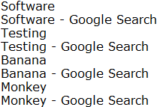
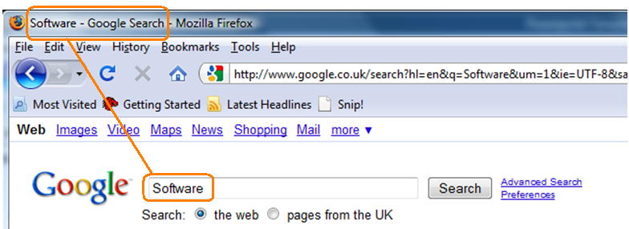
Behaviour Driven Testing
Example Test Scenario:
Enter a number of search strings
Check the string
Check the string returned in the title

Slide 35
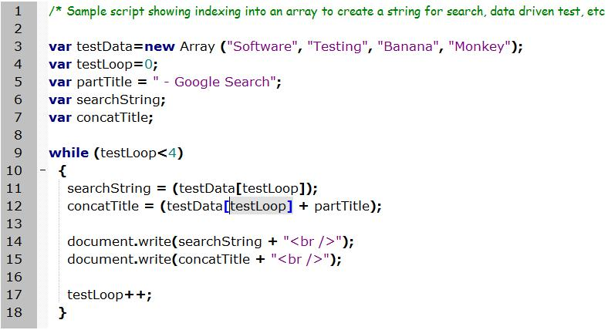

Behaviour Driven Testing
JavaScript:
http://www.oreilly.com/catalog/9780596101992

Slide 36
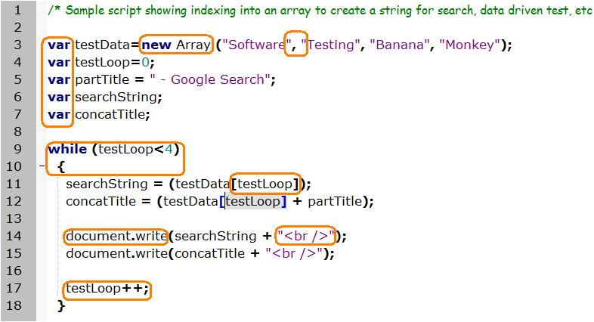
Behaviour Driven Testing
JavaScript:
http://www.oreilly.com/catalog/9780596101992

Slide 37

Behaviour Driven Testing
Ruby:
I eat Jelly Babies for BREAKFAST!
(and then write Ruby tests)
Bert – the Ruby Powered Testing Jelly Monkey
http://images.neopets.com/pets/happy/mynci_jelly_baby.gif

Slide 38
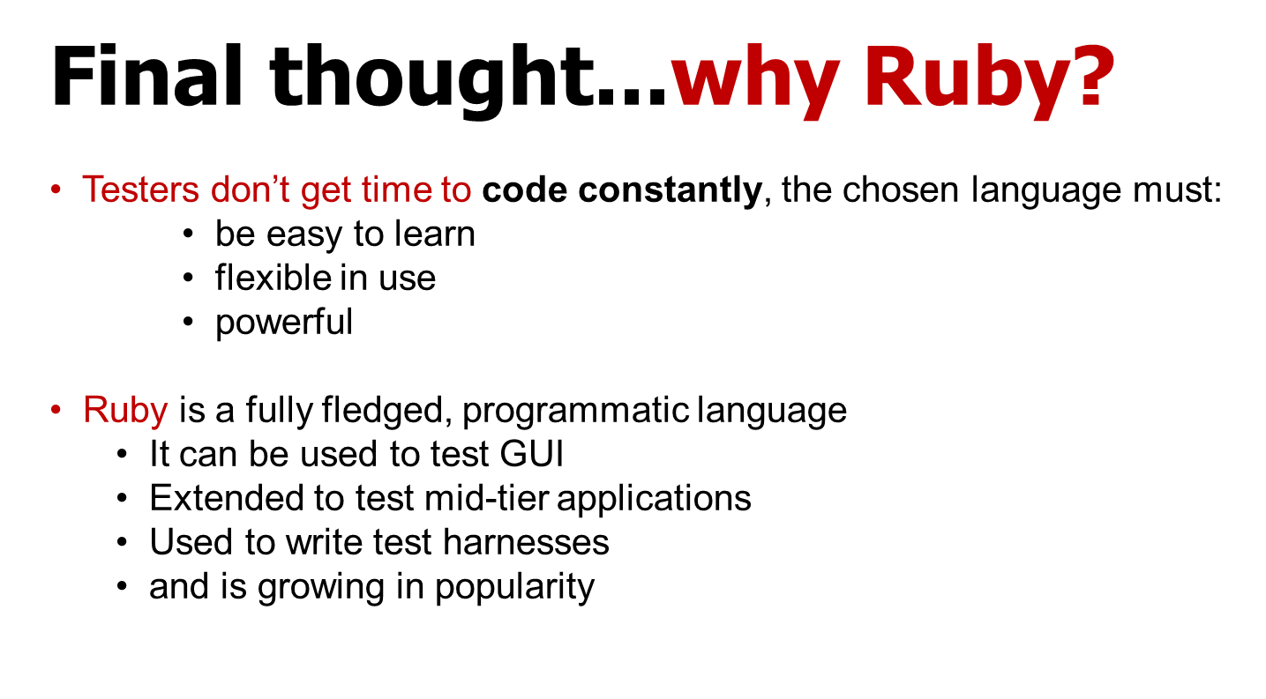
Behaviour Driven Testing
Tester’s

Slide 39
Mark Crowther – Empirical Pragmatic Tester
mark@cyreath.co.uk

