Slide 1

GUEST LECTURE · CSIT321 · DATA WAREHOUSING & MINING
Data & AI:
The Honest Tour.
What your textbook covers, what industry actually does,
and what you need to know before your first job interview.
60 minutes · no fluff · bring questions
VISHAL MISHRA
Head of AI & Data · 20+ years shipping data platforms

Slide 2
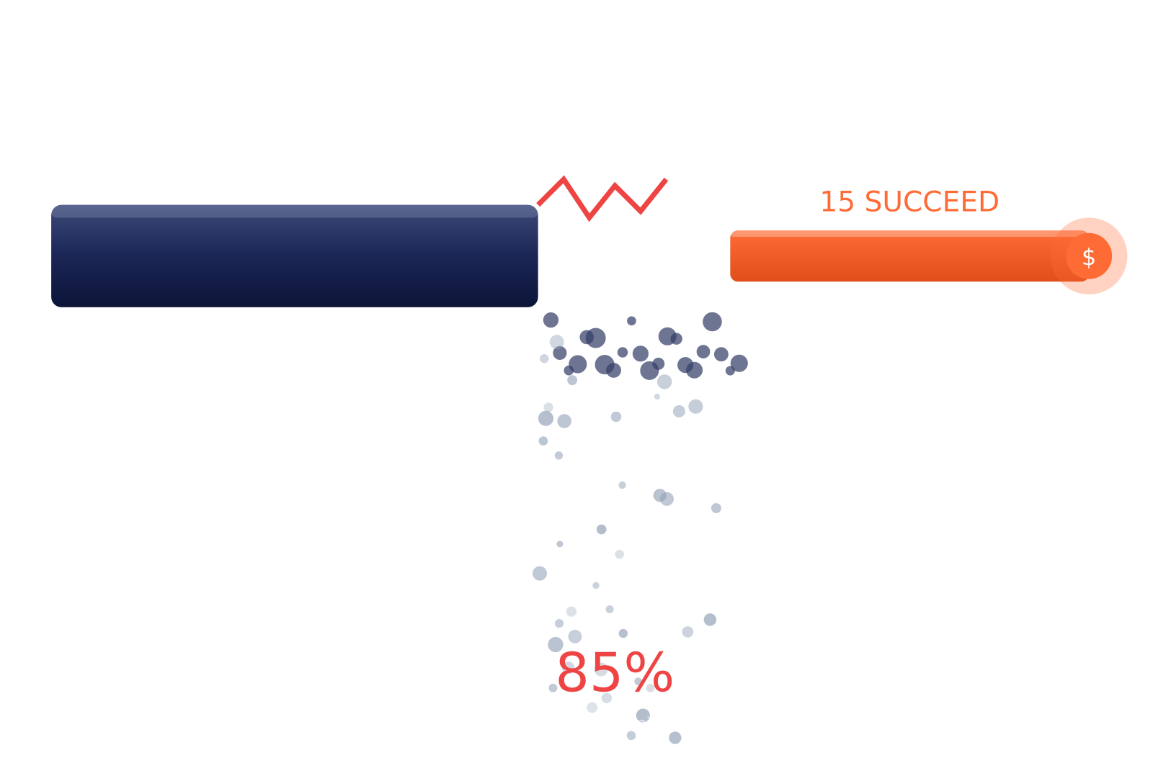
REALITY CHECK
85%
of data & AI projects fail
to deliver business value.
Not because the tech is broken.
Because nobody asked 'why are we building this?'
The good news: the 15% that succeed are led by people who understand BOTH the pipes AND the business. That's the job I'm describing today.
02 / 32 · DATA & AI

Slide 3
THE NEXT 60 MINUTES
Here's the ride.
Six acts. Minimal textbook, maximum reality.
01
The Landscape
02
Warehouse 101
Why every company is now a data company
OLTP vs OLAP · the cube · why it still matters
03
Dimensional Modeling
04
Modern Stack
Star · Snowflake · Galaxy · ROLAP/MOLAP/HOLAP
ETL → ELT · Lake · Lakehouse · Medallion
05
Data Mining → AI
06
Your Launchpad
KDD · classification · clustering · road to GenAI
Free courses · student programs · certs that matter
03 / 32 · DATA & AI

Slide 4
01
THE LANDSCAPE
Why every company
is now a data company.
In 2026, "non-tech company" is an extinct species.
04 / 32 · DATA & AI

Slide 5
THE LANDSCAPE
There is no such thing as a "non-tech company" in 2026.
Airline, bank, retailer, hospital all quietly running a data/AI org the size of a small country.
$1.8T
402 ZB
2.5M+
90%
global data & analytics
spend by 2027
of data will be
created in 2026
open data/AI roles
worldwide
of the world's data
is from post-2022
Translation: the market isn't short on demand. It's short on people who know what they're doing.
THE LANDSCAPE
05 / 32 · DATA & AI

Slide 6
WHERE CS GRADS LAND
Six roles, one data ecosystem.
You'll touch at least three of these in your first 3 years.
Data Engineer
Analytics Engineer
Data Analyst / BI
"the plumber"
"the translator"
"the storyteller"
Builds the pipes. Moves data. Fixes it at 2am.
Turns raw data into trusted business metrics.
Talks to the business. Builds dashboards. Asks 'why'.
₹8–25 L · $25–75K
₹10–28 L · $30–90K
₹6–18 L · $20–60K
Data Scientist
ML / AI Engineer
Data Architect
"the detective"
"the operator"
"the CTO's CTO"
Statistical models, A/B tests, forecasting.
Ships models to prod. Tunes LLMs. Fights drift.
Designs the whole house. The one the CTO calls.
₹12–35 L · $40–110K
₹15–50 L · $60–180K
₹25–70 L · $100–250K
Early-career ranges · India (INR lakhs/yr) and global (USD/yr). Blend of Glassdoor, LinkedIn, community data.
THE LANDSCAPE
06 / 32 · DATA & AI

Slide 7
02
WAREHOUSE 101
Why OLTP can't do
what OLAP does.
Module I · syllabus deep-dive starts here.
07 / 32 · DATA & AI

Slide 8
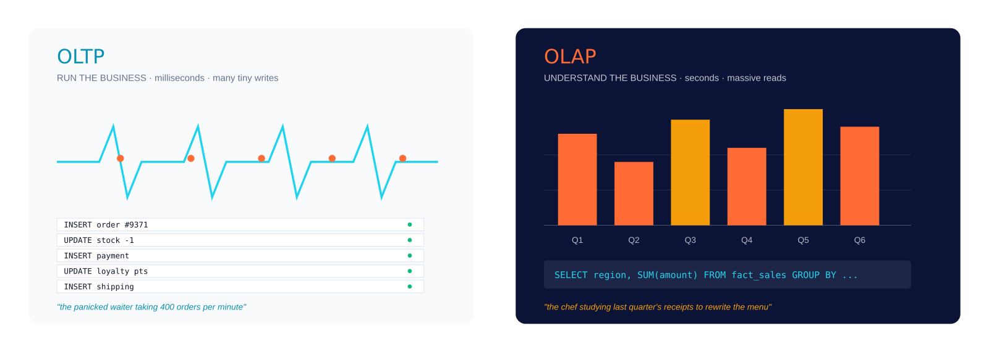
WAREHOUSE 101
OLTP vs OLAP same SQL, completely different brains.
One runs the business. One understands it. Mix them up → your bank crashes at 11 a.m.
WAR STORY · the intern ran SELECT SUM(amount) FROM transactions on prod and crashed the bank at 11 a.m. Every senior has lived this.
WAREHOUSE 101
08 / 32 · DATA & AI

Slide 9
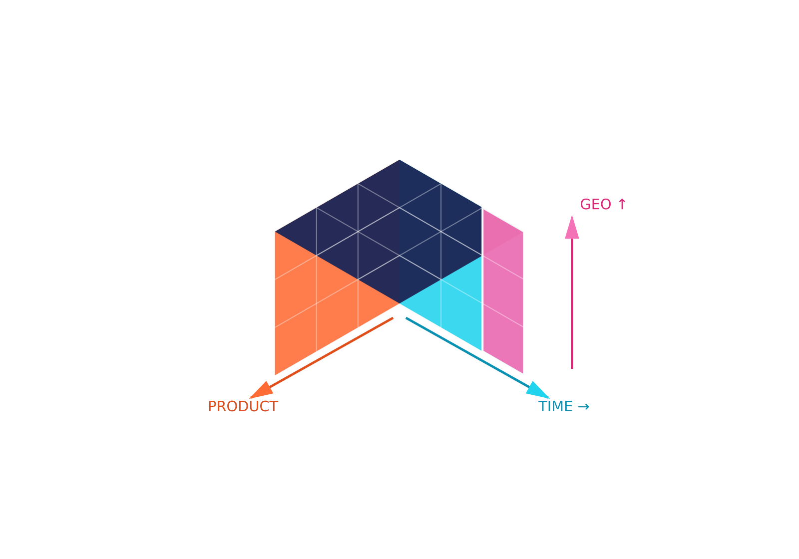
MULTIDIMENSIONAL THINKING
The Data Cube reality is 3D+.
Rows & columns are 2D. Business questions aren't. That's the whole idea.
THE 5 MOVES ON A CUBE
SLICE
Fix one dim → 'Sales in Q3'
DICE
Fix many dims → 'Q3, India, Mobile'
DRILL-DOWN
Go deeper → Year → Month → Day
ROLL-UP
Go higher → Day → Month → Year
PIVOT
Rotate the cube → swap axes
MODERN ANGLE ·
You won't build a literal cube in 2026. But every PivotTable, every Looker dashboard, every 'Slice by region' button is the cube in disguise.
WAREHOUSE 101
09 / 32 · DATA & AI

Slide 10
03
DIMENSIONAL MODELING
How to shape data
so humans can ask it questions.
Module II · the part that makes or breaks a warehouse.
10 / 32 · DATA & AI

Slide 11
DIMENSIONAL MODELING
Facts vs Dimensions the mental model.
A fact is something that happened. A dimension is the context around it.
Ravi bought 2 iPhones on Tuesday at the Dubai Mall for AED 7,400.
CUSTOMER (dim)
QTY (fact)
DATE (dim)
STORE (dim)
AMOUNT (fact)
FACT_SALES
DIM_CUSTOMER
DIM_PRODUCT
DIM_DATE
sale_id (PK)
customer_id (PK)
product_id (PK)
date_id (PK)
customer_id (FK)
name
name
day
product_id (FK)
age
category
day_of_week
date_id (FK)
tier
brand
month
store_id (FK)
city
price
quarter
country
sku
year
quantity → MEASURE
is_weekend
amount → MEASURE
is_holiday
DIMENSIONAL MODELING
11 / 32 · DATA & AI

Slide 12
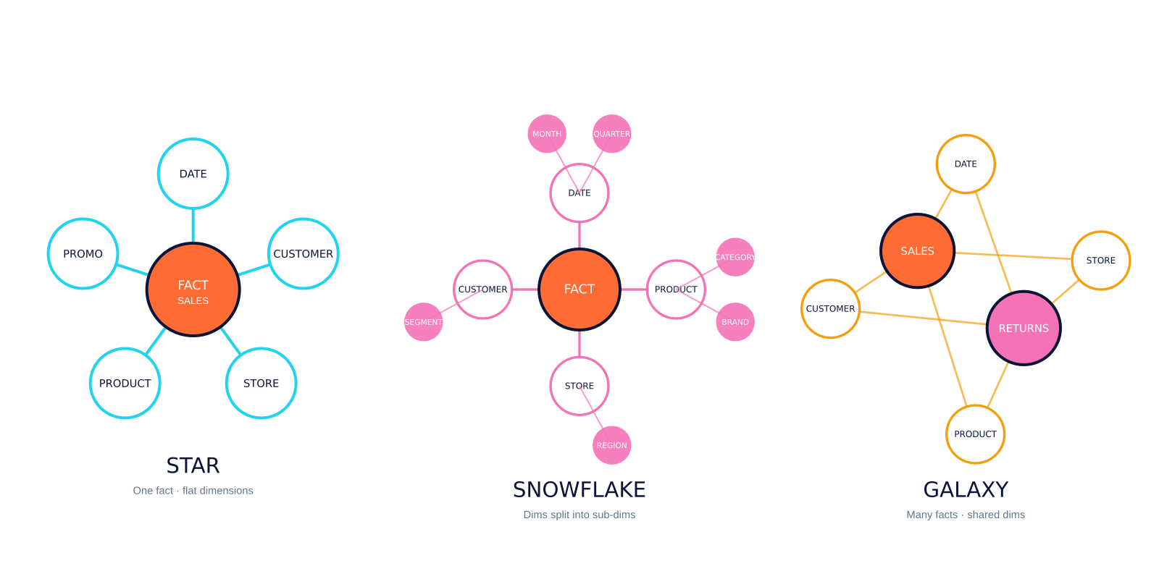
DIMENSIONAL MODELING
Star · Snowflake · Galaxy.
Three ways to arrange facts-and-dims. Trade-offs: speed vs storage vs complexity.
INDUSTRY RULE OF THUMB · start STAR. Snowflake only if a dim is huge and rarely changes. Galaxy arrives on its own when the business grows.
DIMENSIONAL MODELING
12 / 32 · DATA & AI

Slide 13
OLAP STORAGE MODELS
ROLAP · MOLAP · HOLAP.
Your textbook treats them as equals. Industry has picked a winner.
ROLAP
MOLAP
HOLAP
★ WON
Relational OLAP
Multidimensional OLAP
Hybrid OLAP
STORAGE
STORAGE
STORAGE
Relational DB (tables)
Proprietary cube files
Cube for hot + DB for cold
✓ PRO
✓ PRO
✓ PRO
Scales to huge data
Blazing-fast reads
Best of both
✗ CON
✗ CON
✗ CON
Slower queries
Rebuilds, storage cost
Complex to run
TODAY
TODAY
TODAY
Snowflake, BigQuery, Redshift, Databricks all ROLAP descendants
SSAS cubes, Essbase mostly legacy
Mostly replaced by cloud warehouses with caching
REALITY · cloud warehouses use ROLAP storage + columnar/in-memory tricks to feel like MOLAP. You get both. You pay per query. You go home.
DIMENSIONAL MODELING
13 / 32 · DATA & AI

Slide 14
04
THE MODERN STACK
From ETL to Lakehouse
in one evolution story.
The part that's NOT in your textbook but IS in every job description.
14 / 32 · DATA & AI

Slide 15
THE MODERN STACK
ETL vs ELT the order of operations changed everything.
Same three letters. Different order. Billion-dollar consequence.
ETL · the old way (pre-2015)
SOURCES
EXTRACT
TRANSFORM
LOAD
WAREHOUSE
CRM, ERP, files
on a lonely server
into warehouse
rigid · slow
ELT · the modern way (post-2015) after cloud compute got cheap
SOURCES
EXTRACT
LOAD
LAKEHOUSE
TRANSFORM
anything, any format
as-is, raw
inside, with SQL
ETL · transform before storing. Rigid, slow, but disciplined.
ELT · load everything, transform on demand. Flexible, fast, cheap.
MODERN STACK
15 / 32 · DATA & AI

Slide 16
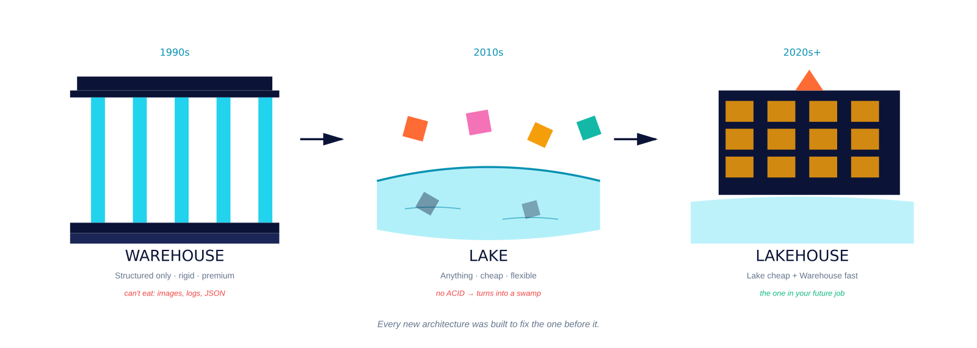
20 YEARS IN ONE SLIDE
Warehouse → Lake → Lakehouse.
Each new architecture was built to fix the last one's problem.
TODAY'S LAKEHOUSE PLAYERS
Databricks + Delta
Snowflake + Iceberg
Azure Fabric / OneLake
BigQuery + BigLake
AWS S3 + Iceberg / Hudi
MODERN STACK
16 / 32 · DATA & AI

Slide 17
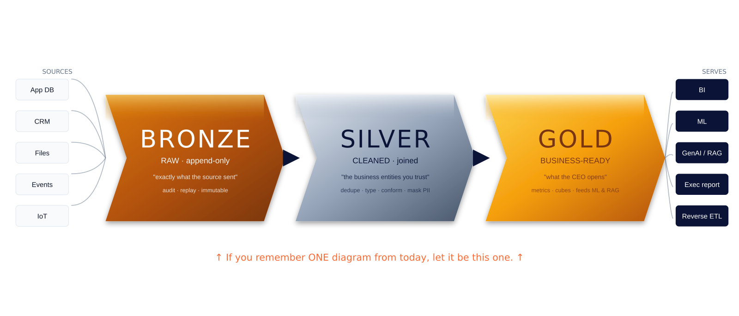
THE HERO SLIDE
Medallion Architecture.
Bronze → Silver → Gold. Three layers, one pipeline, ruthless discipline.
If you remember ONE diagram from this lecture, let it be this one. Every modern platform Databricks, Snowflake, Fabric, BigQuery is a dialect of Bronze→Silver→Gold.
MODERN STACK
17 / 32 · DATA & AI

Slide 18
MODERN DATA STACK · FIELD MAP
You don't need to know every tool. You need to know which tool solves which problem.
INGESTION
STORAGE
COMPUTE / SQL
TRANSFORM
move bytes in
hold them cheap
query fast
shape the data
· Fivetran
· Airbyte
· Kafka
· Debezium
· S3 / ADLS / GCS
· Delta
· Iceberg
· Hudi
· Databricks
· Snowflake
· BigQuery
· DuckDB
· dbt
· SQLMesh
· Spark
· Dataform
ORCHESTRATION
BI / ANALYTICS
ML / AI
OBSERVABILITY
run jobs on time
humans see it
train + serve
catch bad data
· Airflow
· Dagster
· Prefect
· Mage
· Power BI
· Tableau
· Looker
· Metabase
· MLflow
· Vertex AI
· SageMaker
· Ray
· Monte Carlo
· Great Expectations
· Soda
· Elementary
CAREER TIP · master ONE tool per category and you're employable anywhere. Nobody uses all 32 every team picks 6–8.
MODERN STACK
18 / 32 · DATA & AI

Slide 19
05
DATA MINING → AI
KDD, classification, clustering,
and the road to GenAI.
Modules III, IV, V the punchline of your syllabus.
19 / 32 · DATA & AI

Slide 20
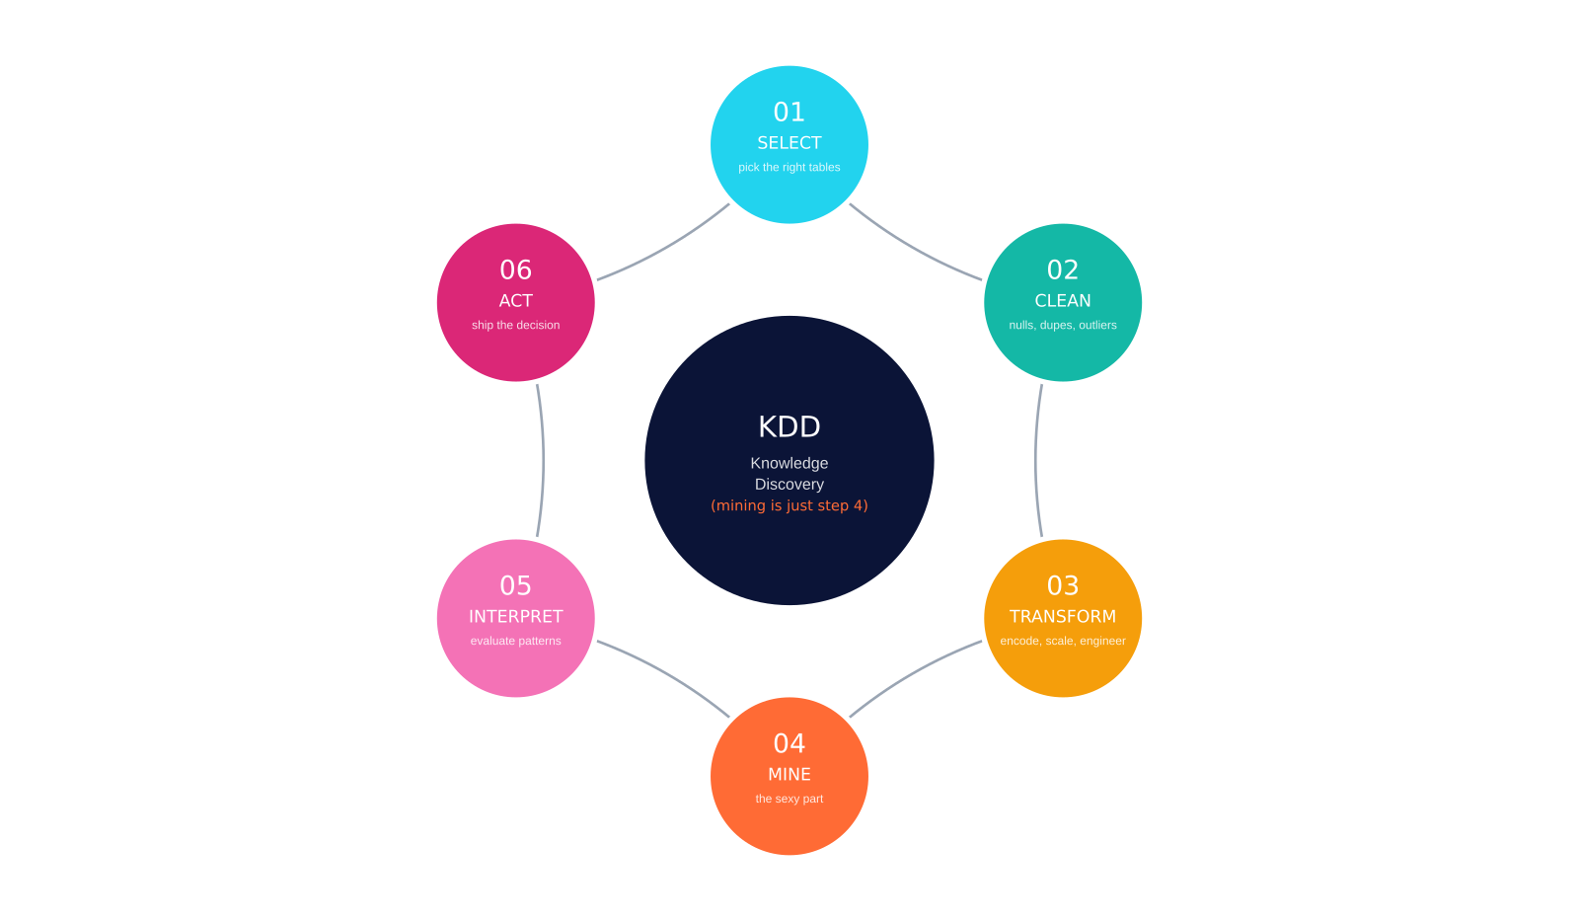
THE KDD PROCESS
Knowledge Discovery in Databases.
Data mining is step 4 of 6. The other 5 are where the work actually lives.
WHERE THE TIME ACTUALLY GOES
70%
unglamorous work.
Cleaning, joining, coaxing.
The other 30%?
Modeling (15%) + Shipping (15%)
The '70% data prep' stat
is industry folklore, and roughly true. Accept it early it makes you happier.
DATA MINING → AI
20 / 32 · DATA & AI

Slide 21
MODULE IV IN ONE SLIDE
The 5 techniques · one cheat sheet.
When a business problem lands on your desk, you'll pattern-match to one of these.
CLASSIFICATION
REGRESSION
CLUSTERING
What class is this?
How much? How many?
Who belongs together?
Is this spam? Will this loan default?
What will revenue be next month?
Segment 40M customers into 8 personas
Logistic · Tree · RF · XGBoost · NN
Linear · RF · GBM · Prophet
K-means · DBSCAN · Hierarchical
ASSOCIATION
ANOMALY
ORIGIN STORY · BEER + DIAPERS
What goes with what?
What's weird here?
1990s: someone ran association rules on Walmart receipts. Men who bought diapers also bought beer. That's Market Basket Analysis. That's also how Netflix recommends your next show.
Beer + diapers. Bread + butter.
Fraud detection. Server outages.
Apriori · FP-Growth
Isolation Forest · Autoencoder
DATA MINING → AI
21 / 32 · DATA & AI

Slide 22
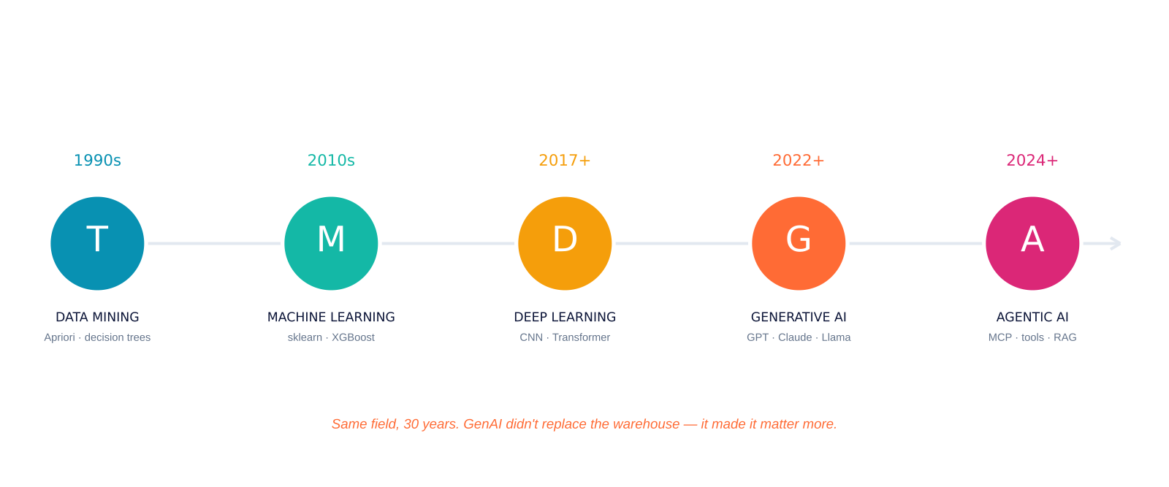
30 YEARS, ONE FIELD
Data Mining → ML → Deep Learning → GenAI → Agentic AI.
If you understand mining, ML makes sense. If ML makes sense, GenAI isn't magic.
THE PLOT TWIST
GenAI didn't replace the warehouse it made it matter MORE.
LLMs are useless without your clean, governed Gold layer to ground them. RAG without clean data is a confident liar.
DATA MINING → AI
22 / 32 · DATA & AI

Slide 23
MODULE V IN REALITY
Where this ALL actually ships.
Real industries. Real dollars. Problems being solved right now.
RETAIL / E-COM
BANKING
TELECOM
basket · recs · demand forecasting
fraud · credit · AML
churn · network optimization
Amazon: 35% of revenue from recommendation engine
HDFC blocks millions of fraudulent txns/year with ML
Jio predicts churn 90 days out with ML
HEALTHCARE
LOGISTICS
MEDIA / SOCIAL
diagnosis · drug discovery · imaging
routing · demand · warehousing
recs · moderation · ranking
AI reads chest X-rays faster than radiologists
Swiggy/Zomato ETAs are pure ML
Netflix, YouTube, Instagram = recommendation engines
DATA MINING → AI
23 / 32 · DATA & AI

Slide 24
THINGS YOUR TEXTBOOK WILL NOT TELL YOU
War stories · how this breaks in production.
Three failure modes. Nobody teaches them. Everybody hits them.
SCHEMA DRIFT
SILENT QUALITY
MODEL DECAY
THE SCENE
THE SCENE
THE SCENE
Upstream team renames a column. Your pipeline silently writes NULL for 3 weeks. CFO notices in a board meeting.
Source feed doubles a record. Dashboard shows 2× revenue. Everyone high-fives. Until the auditor shows up.
Fraud model was 94% in training. Six months later it's 61% and nobody noticed the dashboard was static.
THE LESSON
THE LESSON
THE LESSON
Validate schemas at every boundary. Great Expectations · Soda · dbt tests.
Monitor row counts, freshness, and distributions. If it moves 3σ, alert.
Every model needs a drift monitor + retrain cadence from day one.
COMMON THREAD · data quality is not a stage. It's a religion. Build monitoring BEFORE you build dashboards.
DATA MINING → AI
24 / 32 · DATA & AI

Slide 25
06
YOUR LAUNCHPAD
Free courses, student programs,
and the certs that matter.
Screenshot this section.
25 / 32 · DATA & AI

Slide 26
FREE COURSES
Free courses from the OEMs themselves.
These companies WANT you certified. They give it away. Use them.
DATABRICKS
SNOWFLAKE
MICROSOFT
GOOGLE CLOUD
Databricks Academy
Snowflake University
Learn · Fabric / Azure
Cloud Skills Boost
Lakehouse, Spark, Delta, MLflow all free
Zero-to-hero SQL + warehouse fundamentals
DP-203, DP-600, AI-900 prep free
BigQuery, Dataproc, Vertex AI labs
customer-academy.databricks.com
learn.snowflake.com
learn.microsoft.com
cloudskillsboost.google
AWS
NVIDIA
HUGGING FACE
DEEPLEARNING.AI
AWS Skill Builder
Deep Learning Institute
HF Learn
Andrew Ng courses
Redshift, Glue, SageMaker fundamentals
GPU computing, LLMs, RAG, Triton
LLMs, fine-tuning, agents, RL gold tier
ML, deep learning, GenAI, MLOps
skillbuilder.aws
nvidia.com/dli
huggingface.co/learn
deeplearning.ai
YOUR LAUNCHPAD
26 / 32 · DATA & AI

Slide 27
STUDENT PROGRAMS
Your .edu email unlocks thousands in cloud credits.
It expires when you graduate. Claim it THIS WEEK.
GitHub Student Developer Pack
$200K+
AWS Educate
$50–$200
Copilot Pro, JetBrains, 100+ premium tools
Free training + AWS cloud credits
Google Cloud for Students
$300 + extras
Microsoft Azure for Students
$100 renewable
Skills Boost subscription + credits on request
$100 credit, no credit card, free dev tools
Databricks Community Edition
Unlimited · free forever
Snowflake Student Trial
$400 credits · 120d
Free Spark + notebook cluster
120 days of Snowflake + training path
NVIDIA DLI Teaching Kits
Free, certified
Kaggle
Free GPUs/TPUs
Self-paced DL/GenAI courses + certs
Also: your portfolio. Competitions + datasets
DO THIS THIS WEEK · every semester you delay, you're leaving thousands of dollars of compute on the table.
YOUR LAUNCHPAD
27 / 32 · DATA & AI

Slide 28
CERTS + COMMUNITIES
The certs that matter · the rooms that keep you current.
Not an exhaustive list. A deliberately short one.
CERTS THAT MATTER IN 2026
COMMUNITIES TO STAY CURRENT
Databricks Data Engineer Associate
r/dataengineering · r/MachineLearning
Azure DP-700 Fabric Analytics Engineer
Locally Optimistic (Slack) analytics eng
AWS Data Engineer Associate (DEA-C01)
dbt Slack dbt + modern data stack
Google Cloud Professional Data Engineer
MLOps Community (Slack)
Snowflake SnowPro Core
Hugging Face Discord
NVIDIA Generative AI with LLMs
Kaggle forums
dbt dbt Analytics Engineering Cert
Podcasts: Data Engineering · Latent Space · DataFramed
TRUTH BOMB · build ONE end-to-end project, push to GitHub, write it up on LinkedIn stands out more than any cert.
YOUR LAUNCHPAD
28 / 32 · DATA & AI

Slide 29
BUILD. SHIP. BRAG.
5 portfolio projects that don't suck.
Each teaches one concept from this lecture. Each looks great on a resume.
1
Mini Medallion Warehouse
TEACHES
Python + DuckDB + dbt + Metabase
Bronze/Silver/Gold, ELT, BI
2
Streaming Fraud Detector
TEACHES
Kafka + Spark + Delta + Streamlit
Real-time pipes, anomaly detection
3
Retail Recommender
TEACHES
Apriori / ALS on MovieLens
Association rules, collaborative filtering
4
Customer Churn Predictor
TEACHES
pandas + sklearn + SHAP + FastAPI
Classification, feature eng, serving
5
RAG over your college PDFs
TEACHES
LangChain + Chroma + Llama / GPT
Embeddings, RAG, GenAI basics
Don't try to build a unicorn. Ship something small, end-to-end, with a README and a Loom video. That IS a portfolio.
YOUR LAUNCHPAD
29 / 32 · DATA & AI

Slide 30
IF YOU REMEMBER TEN THINGS
10 things I want you to walk out remembering.
01
OLTP runs the business. OLAP understands it. Don't mix them.
02
Start with a STAR schema. Everyone does. Everyone should.
03
ELT replaced ETL because cloud compute became cheaper than transform servers.
04
Bronze → Silver → Gold is the default mental model. Memorize it.
05
70% of a data scientist's job is cleaning data. Accept it early.
06
Classification · Regression · Clustering · Association · Anomaly match the question to the tool.
07
GenAI made data quality MORE important, not less. RAG without clean data is a liar.
08
Data quality is a religion, not a stage. Monitor schemas and distributions always.
09
Pick ONE cloud stack and go deep. T-shaped > shallow across 10.
10
Build ONE end-to-end project. Ship it. The README matters more than the stack.
30 / 32 · DATA & AI

Slide 31
ONE MORE THING.
The tools will change.
The patterns won't.
In five years, half the tool names on the earlier slides will be gone replaced by better ones. But OLTP vs OLAP, facts vs dimensions, batch vs streaming, Bronze vs Gold those are forever. Learn the patterns. The tools are just the accent.
Thank you. Next session we build a mini Medallion warehouse from scratch. SQLite, Python, React. Bring your laptop.
31 / 32 · DATA & AI

Slide 32
Q
A
&
ask the dumb questions. that's the whole point.
32 / 32 · DATA & AI

