Slide 1
BLOOD BANK MANAGEMENT SYSTEM

Slide 2
EFFORT BY-
ANAND KUMAR
ANKIT KUMAR
AJ R LADDHA
ANSHUL GUPTA

Slide 3
WHY WE CHOOSE THIS PROJECT ?
Scarcity of rare blood group.
Unavailability of blood during emergency.
Less awareness among people about blood donation..
Deaths due to lack of blood during operations.
With computer system it can be more fast and accurate.

Slide 4
INTRODUCTION:
A pilot project that is designed for the blood bank to gather blood from various sources and distribute it to the needy people having high requirements for it.
The software is designed to handle the daily transactions of the blood bank and search the details when require.
It helps to register the details of donors, blood collection detail.
The software application is designed in such a manner that it can suit the needs of all the blood bank requirements in the course of future.

Slide 5
EXISTING SYSTEM
PROPOSED SYSTEM
The manual system is tedious , time consuming and space consuming
Lack of Data Security.
Maintenance of the records is difficult.
Creates room for errors as the data is entered manually by the persons.
Retrieval of data takes a lot of time.
Maintaining the stock of blood and the daily transactions with computerisation is easier.
Resolve the emergency issue of blood requirement if possible.
Data will be secured.
Easy to maintain the records and transactions.
One can easily collect data whenever required.

Slide 6
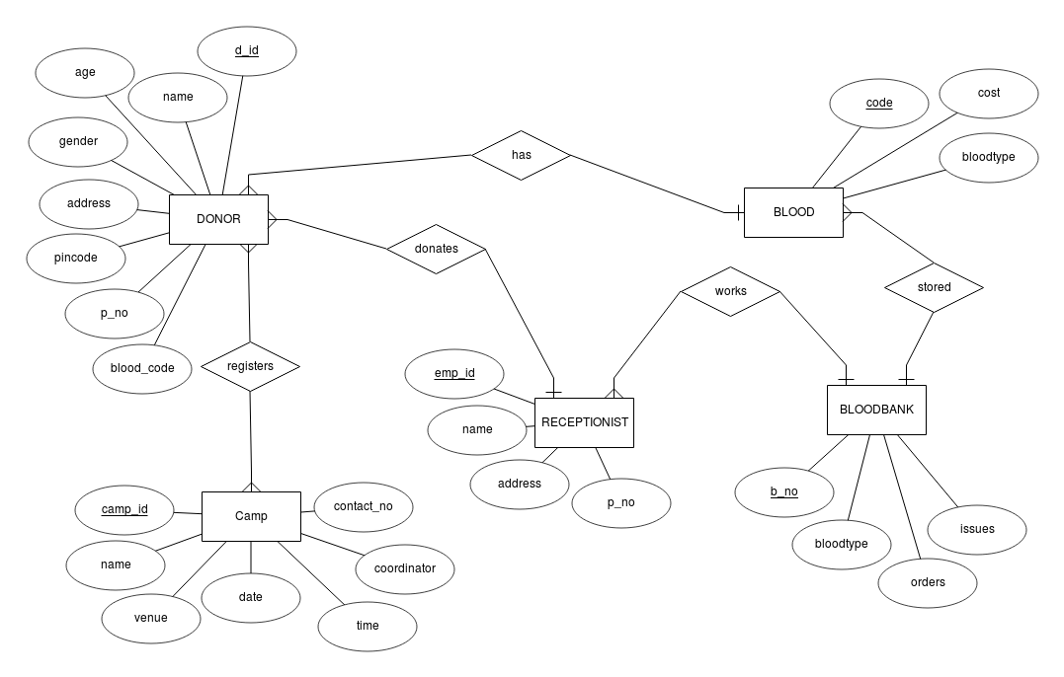
ER DIAGRAM -

Slide 7
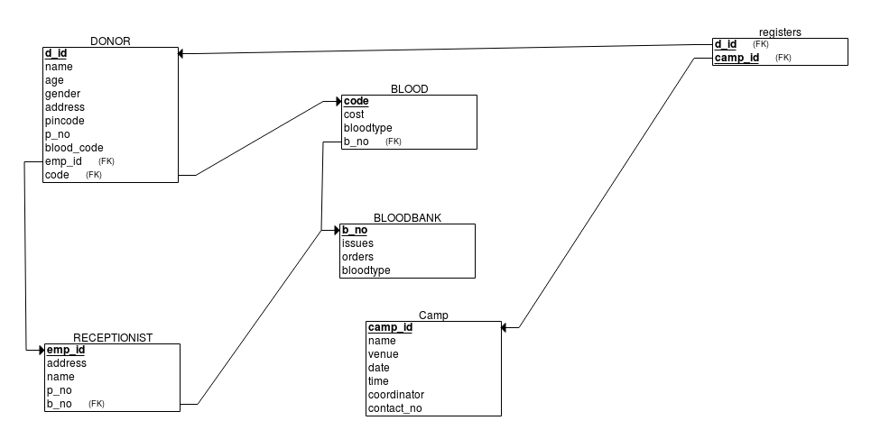
RELATIONAL SCHEMA -

Slide 8
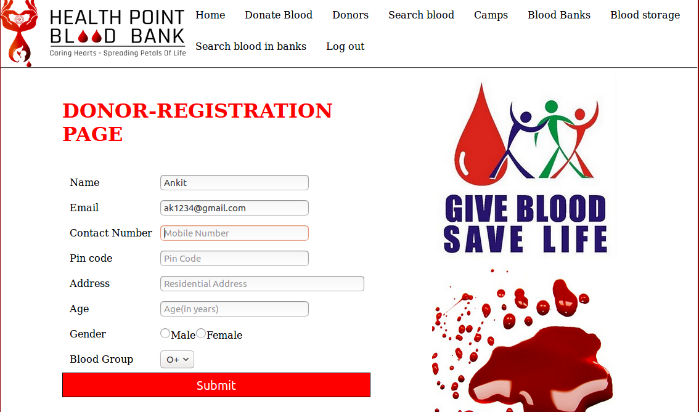
DONOR REGISTERATION -

Slide 9
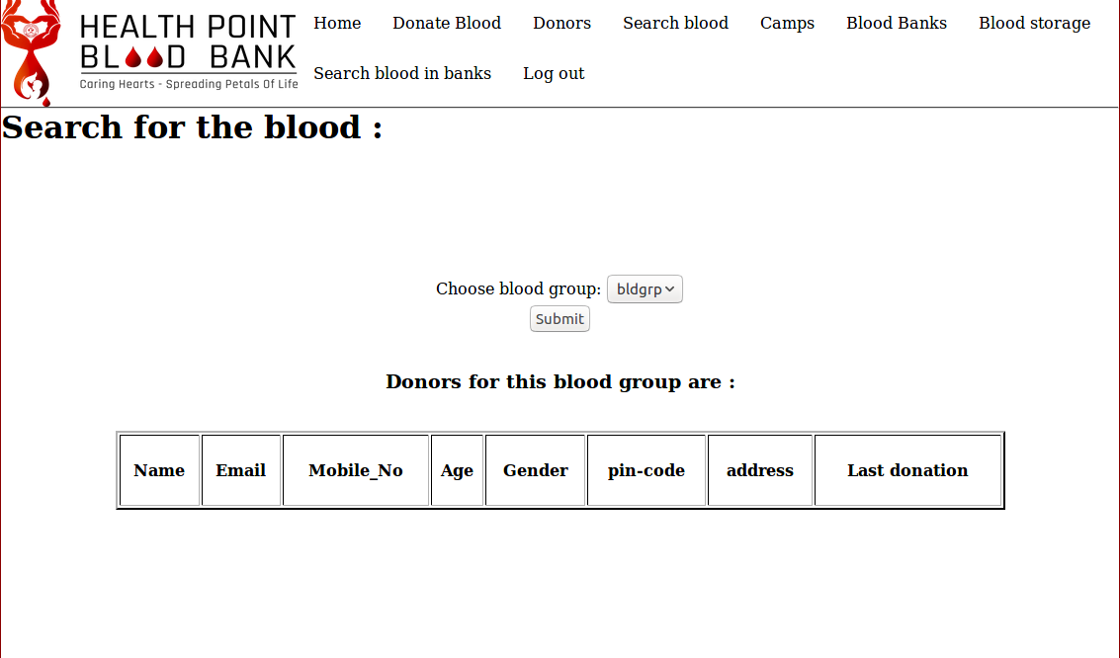
SEARCH THE BLOOD -

Slide 10
NEW USER SIGN UP-
LOGIN-
Name
Email
Contact Number
Age
Gender
Blood Group
Password
USER LOGIN
ADMIN LOGIN
RECEPTIONIST LOGIN
1. Email id.
2. Password
1. Admin Email id.
2. Password
1. Receptionist Email id.
2. Password

Slide 11
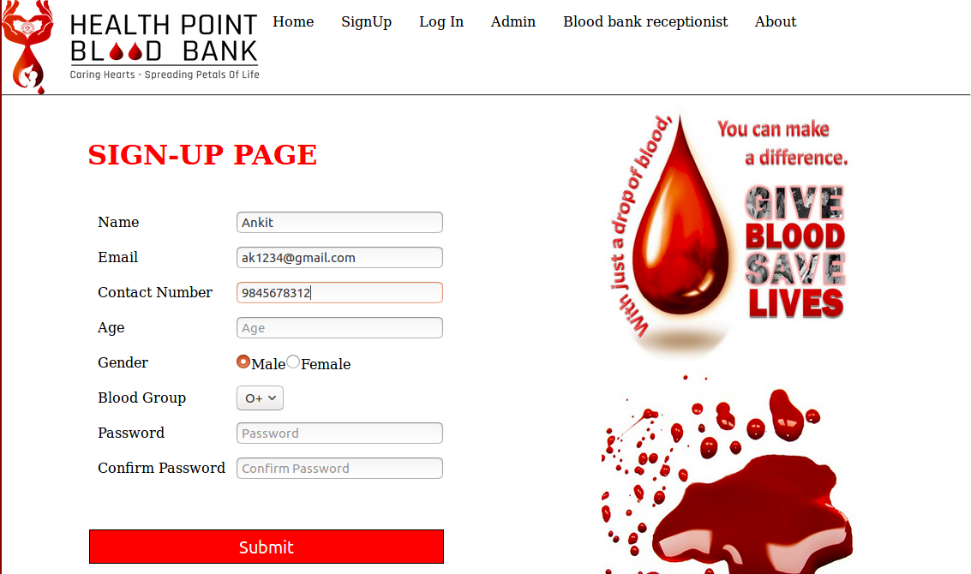
SIGN UP PAGE SNAPSHOT-

Slide 12
USER LOGIN PAGE-
Register for blood donation.
Check available donor in donor list.
Search blood.
Camp Details and registration for camps.
Blood storage in different blood banks.
Search blood in blood banks.
Log out.

Slide 13
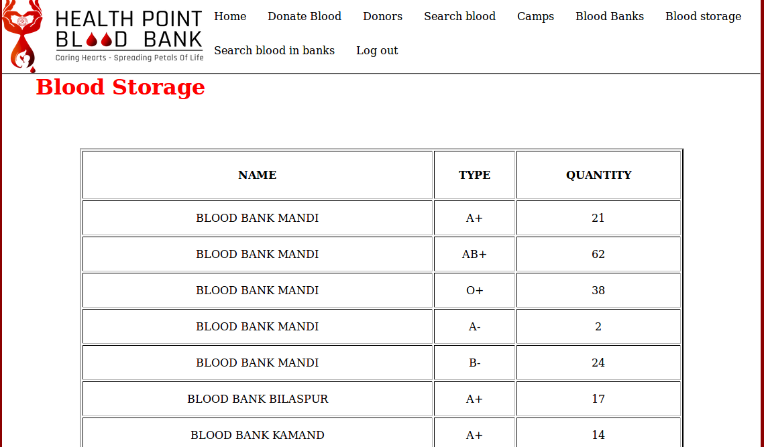
BLOOD STORAGE IN DIFFERENT BANKS-

Slide 14
DESCRIPTION OF LOGIN PAGE
User can register if he is willing to donate the blood.
See the donor list.
Search the donor of a particular blood group.
See the camp and Register for a camp if it is in nearby area.
Available blood banks,blood storage quantity of each type in each bank.
Search blood of a particular blood group from all blood banks.

Slide 15
ADMIN PAGE-
Check donors list.
Add new camps.
Delete camps.
Update camp details.
Check camp registration.
Blood banks list.
Add new blood bank.
Total blood storage in different blood bank.

Slide 16
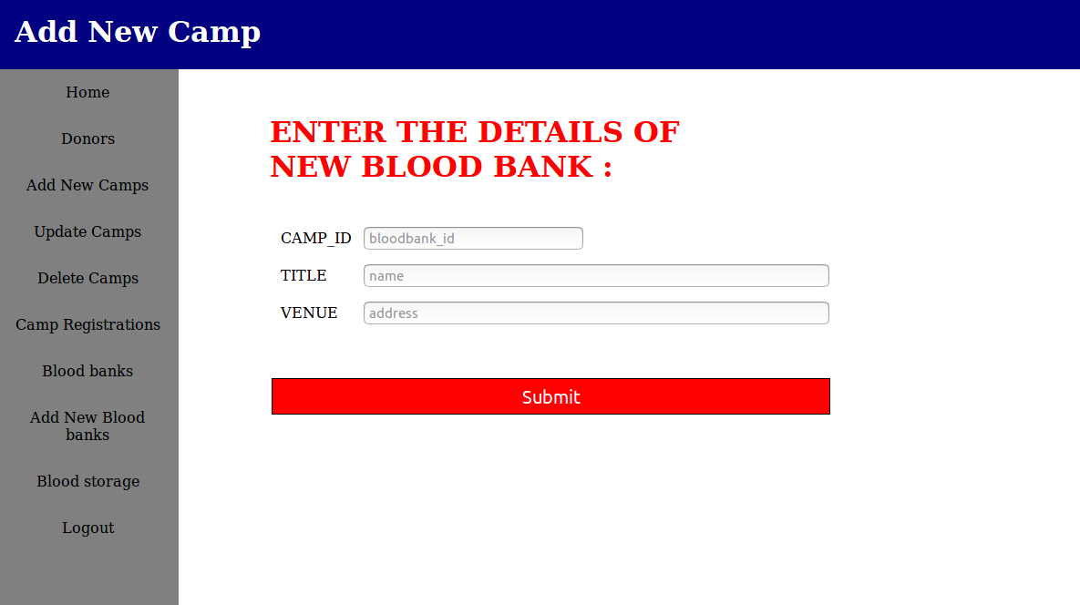
ADD NEW BLOOD BANK-

Slide 17
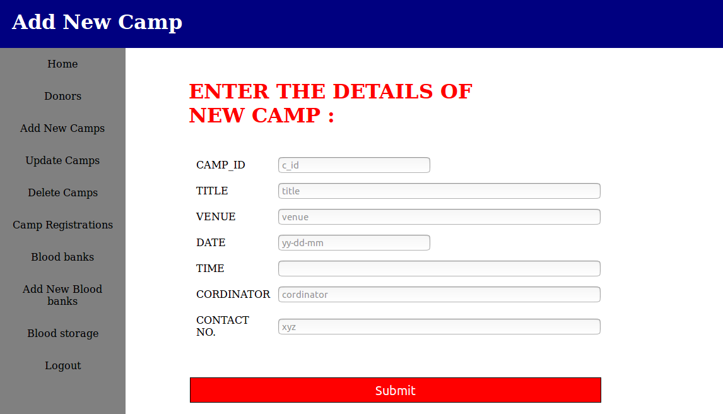
ADD NEW CAMP-

Slide 18
RECEPTIONIST PAGE
Blood transaction from donor to blood bank.
Storage in its own blood bank.

Slide 19
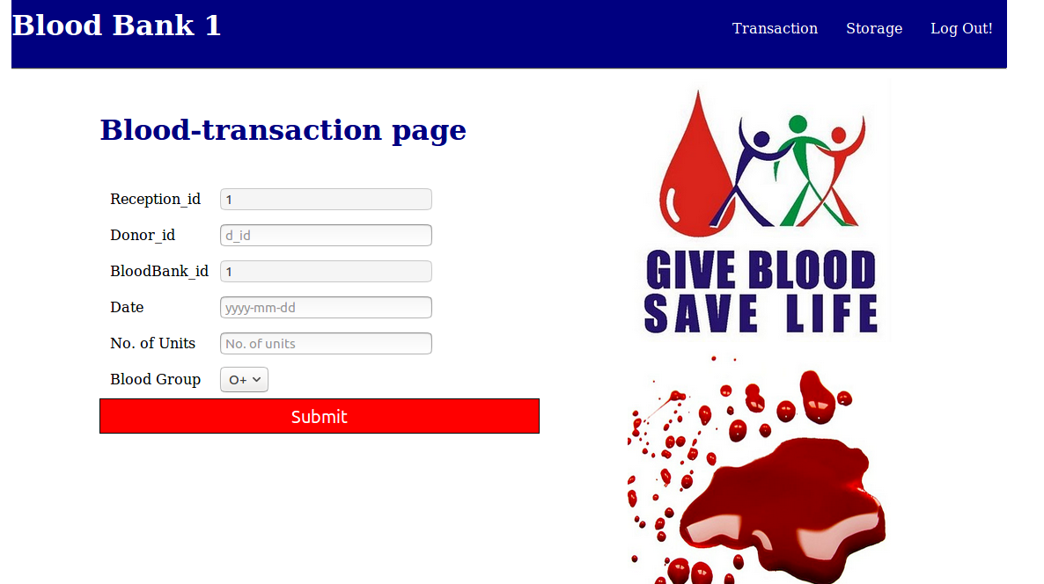
TRANSACTION PAGE

Slide 20
SOFTWARE REQUIRED
HARDWARE REQUIRED
OS: Windows XP, Linux,Mac.
XAMPP or LAMP
Apache 4.5 or later.
PHP 5.6.
Browse- Firefox 5.0 or Google chrome 2.0 or Internet Explorer 7.2.
Intel P4 1.5 ghz or more.
At least 512MB RAM.
100 gb Harddisk.

Slide 21
Thanks.
Hope you had like it.

