Slide 1
🛡️Disaster Shield AI
An AI-powered assistant for disaster preparedness and emergency guidance

Slide 2
Problem Statement
Every year, people face difficulties during disasters and emergencies while trying to protect their lives and families. Lack of quick access to reliable safety information can increase risks during critical situations.
Challenges
During disasters, people need quick and reliable information.
Searching through long emergency manuals is difficult.
Incorrect information during emergencies can be dangerous.
People need simple step-by-step safety guidance.

Slide 3

Project Objective
Build an AI-powered assistant that provides disaster preparedness guidance and answers medical emergency-related questions.
The system retrieves information from verified documents and generates clear, safety-focused responses using Gemini 2.5 Flash.

Slide 4

Project structure
app.py
main.py
Safety.py
requirements.txt
app.py
User Interface Layer responsible for chatbot interaction, accepting user queries, and displaying generated responses.
main.py
Core AI processing layer responsible for Gemini integration, prompt handling, and response generation.
safety.py
Content moderation layer responsible for inappropriate word filtering and user input validation.
requirements.txt
Contains required Python dependencies for installation and deployment.

Slide 5
Google Gemini 2.5 Flash (LLM)
Python
Streamlit
Google GenAI SDK
Technology Stack

Slide 6
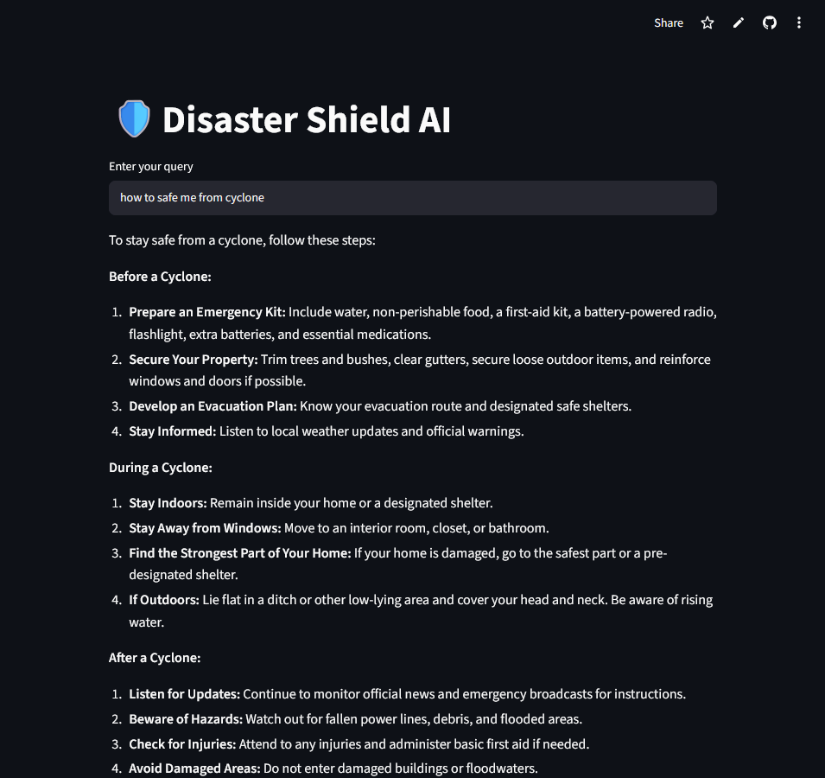
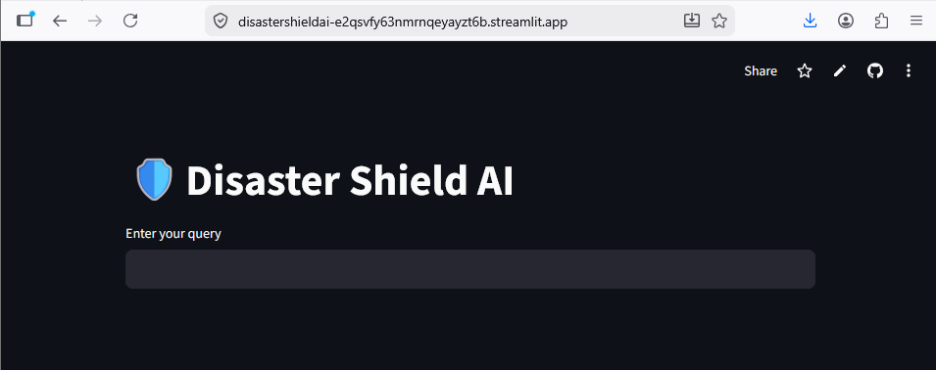
Testing image
Frontend app image
Frontend Interface & Output Testing
Frontend Interface
Developed using Streamlit for user interaction.
Provides a simple chatbot interface for asking disaster and medical emergency-related questions.
Output Testing
The chatbot successfully generates safety-focused responses using Google Gemini 2.5 Flash.
Tested with different emergency-related queries to evaluate response quality.

Slide 7
Conclusion
Developed an AI-powered chatbot for disaster preparedness and medical emergency guidance. Uses Google Gemini 2.5 Flash to generate helpful and safety-focused responses. Provides a simple interface for users to access emergency information. Implements content filtering for safer interactions.

Slide 8
Thank you

