Slide 1
Store Performance

Slide 2
Introduction
This data story explores and compares the performance of co-relation stores (26 and 171) and trial stores (77, 86, and 88) over the three-month period of February, March, and April. By focusing on key metrics—including total sales (in millions), total customers, total transactions, and average transactions per customer—we aim to uncover patterns, correlations, and insights that inform strategic decision-making.
Using the Pyramid Framework as a structured approach, we delve into the dynamic trends of each store group, highlighting peaks and troughs, and identifying how trial initiatives may align with or diverge from established performance baselines.
This analysis sets the stage for actionable insights and data-driven recommendations to enhance overall store performance and revenue outcomes.

Slide 3
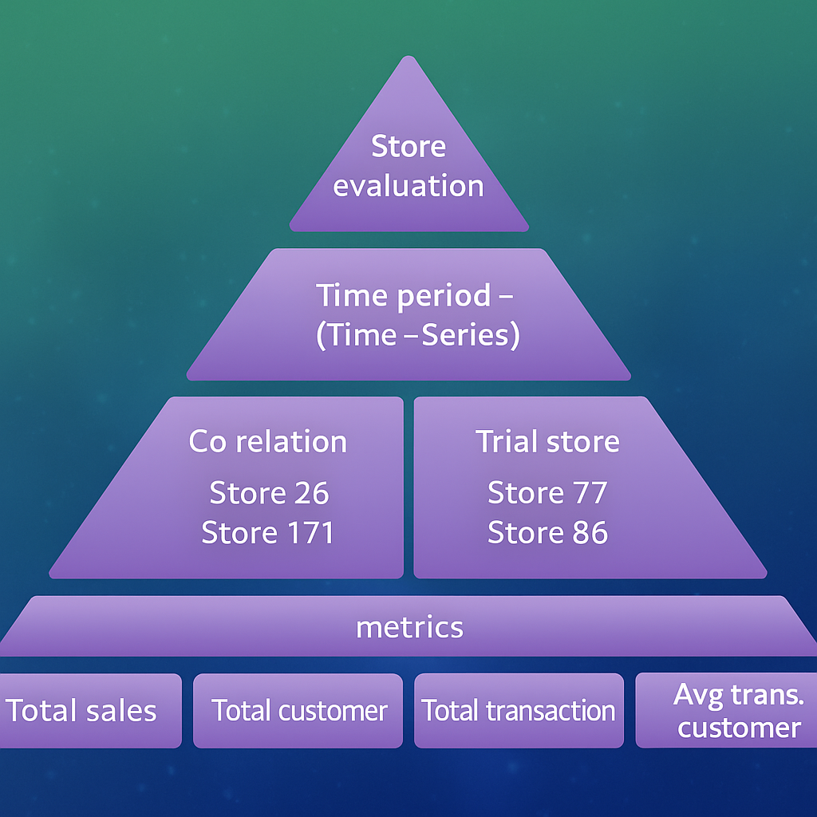
Pyramid Framework

Slide 4
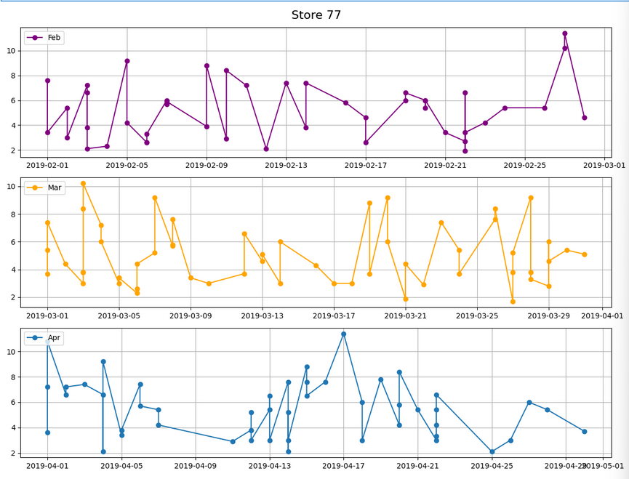
Store 77- (trail store) Performance
Data patterns :-
In Feb. month sales mostly touching 8 value But in march there have signific change in starting of march sales goes up for some time and then after 10 days then goes down and then they spikes goes up and down.
But in April there total different sales goes drastically down in starting of April after 10 days sales goes up for 4- 5 days and again sales goes down.
And continuously going down and down .In April highest peak was 10 and lowest is 4

Slide 5
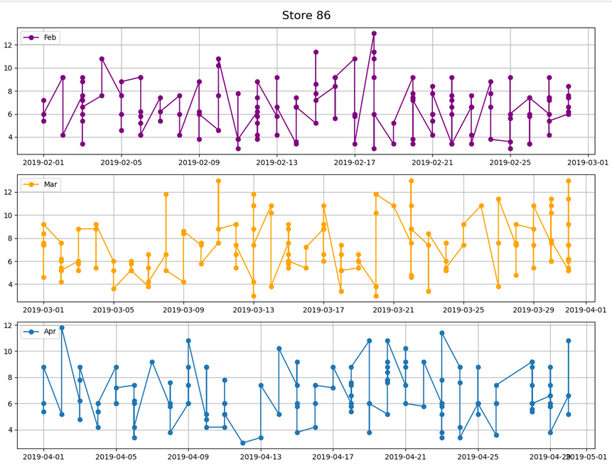
Store 86- (trail store) Performance
Data patterns:-
In February mostly touch 10 and then goes down and goes up and behave moderate
But in march starting with lowest point and heating 10 and this one goes down and continuous pattern immerge but after 20 days value break pattern and hit highest point but after 708 days value behave continuous pattern
In April month mostly value behave 4 to 10

Slide 6
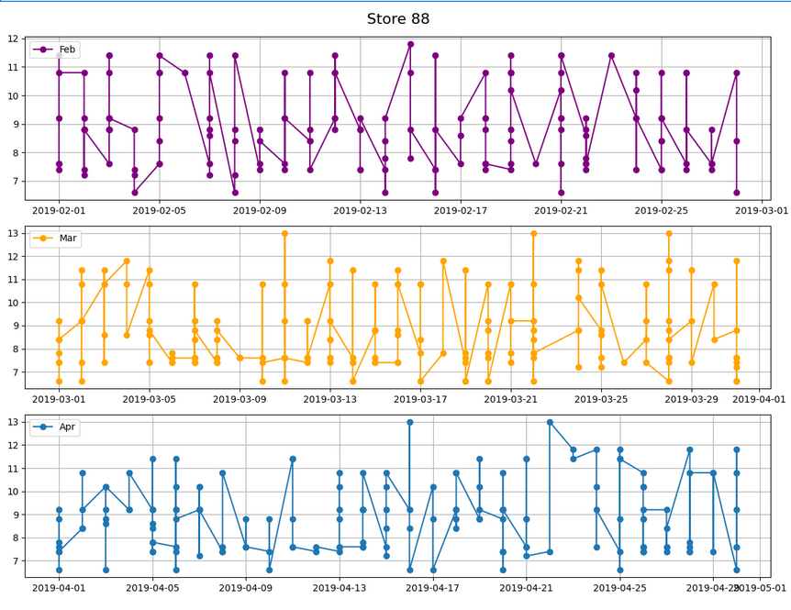
Store 88- (trail store) Performance
Data patterns:-
In February starting with lowest point and hitting highest point
And this pattern behave same
In March 3rd time hitting most sales value and data move 7 to 11 between
But in April sales mostly hitting 11 there short peaks immerge but suddenly goes down but after 20 heating the highest time and stay some time then goes down and then again goes up and after pattern behave normal before 20.
And the short time pattern very different compare to normal data points and patterns.

Slide 7
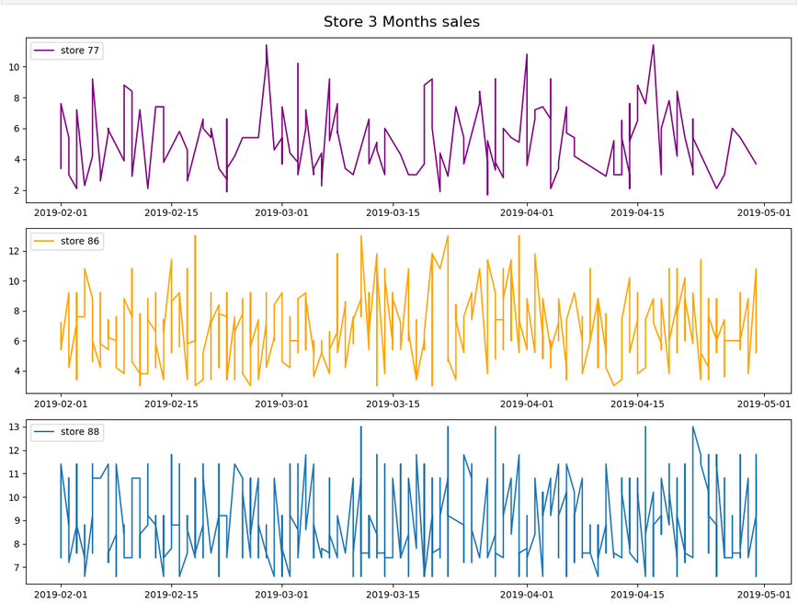
Store 77,86,88- (trail store) Performance
Data patterns: -
In store 77 there 3 times sales hits highest peak and overall pattern behave same.
In store 88 starting sales is hight but quite some time sales goes down but not overall bad but after 10 or 20 days sales has increase
In store 88 march to April sales hit highest peaks 5 times in one month period.
Overall store 88 sales pattern don’t have major changes value between moving 7 to 11.

Slide 8
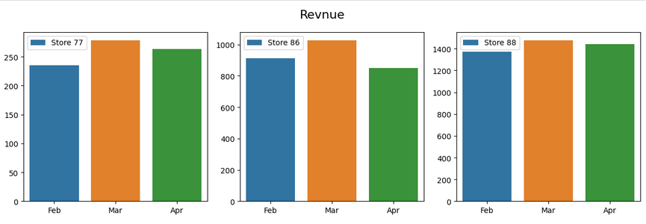
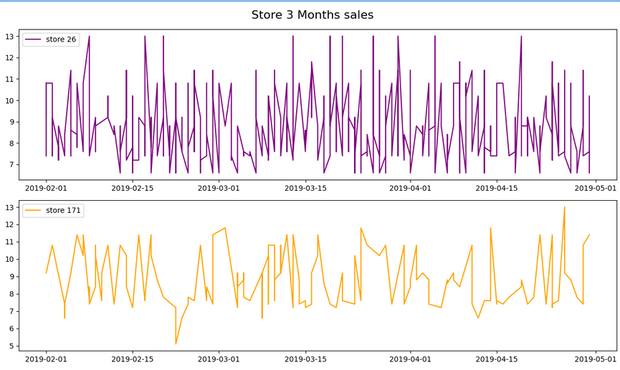
Store 77,86,88- (trail store) –Revenue ,total
Insights:-
In march store 77 and 86 and 88 Revenue is high.
But in February trail store down compare to other months.
Store 26,171 - (Co -relation) Performance:-
Store 26 sales between moving 7 to 10 but some the are they have braked sales
In store 177 sales goes hit lowest point time and hit and one time happened break normal pattern and touch the highest point overall store 171 moving between 7 to 11

Slide 9
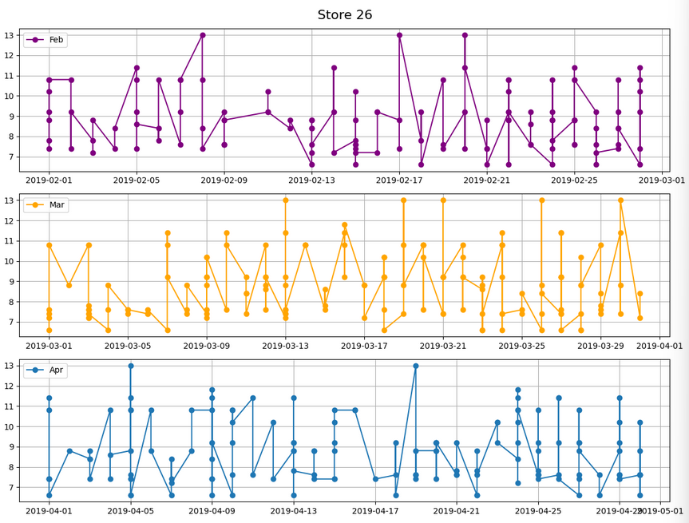
Store 26 (co rel.) sales performance
Insights:-
In February sales moving between 7 to 11 between but 3 times sales archive highest point.
In March sales moving between 8 to 11 between but 5 time sales archive highest point.
In April sales moving between 8 to 11 between but 2 time sales archive highest point.

Slide 10
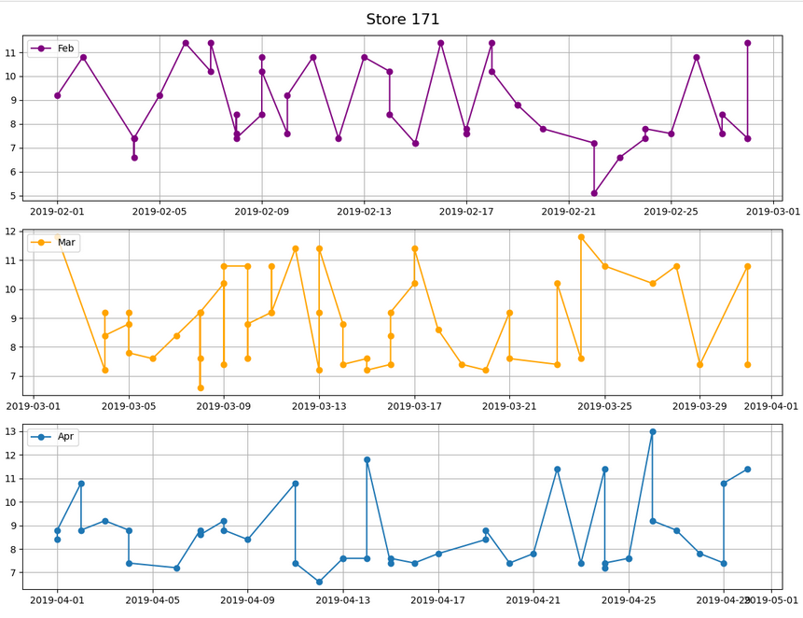
Store 171 (co rel.) sales performance
Insights:-
In February starting 17 days is high but after sales goes down.
In starting of march starting with highest point and sales goes drastically and after 2 days sales goes up and generate better sales after 1 week sales goes down for short time and then sales goes up for shot time and then sales crash and goes down. But the 3 or 4 days they sustain the highest peak.
In April month stating days sales goes down significantly then then they brake and generate peak and then goes down After continuous pattern immerge range between 7 to 11 one day happened sales break this pattern but after they come up back.

Slide 11
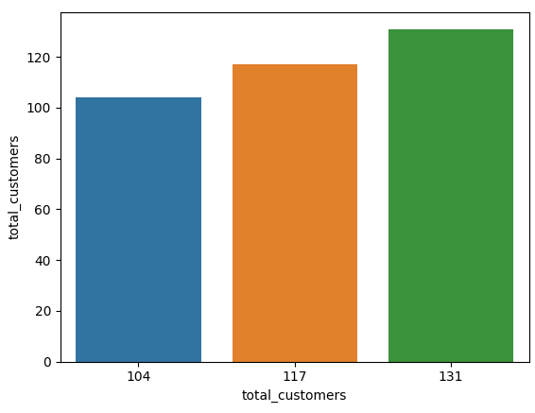
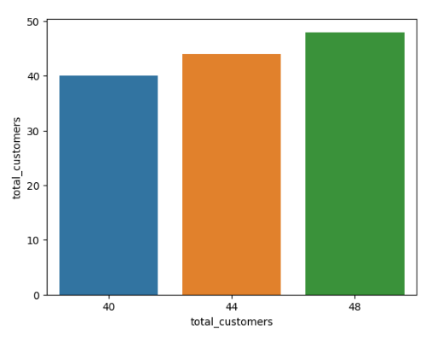
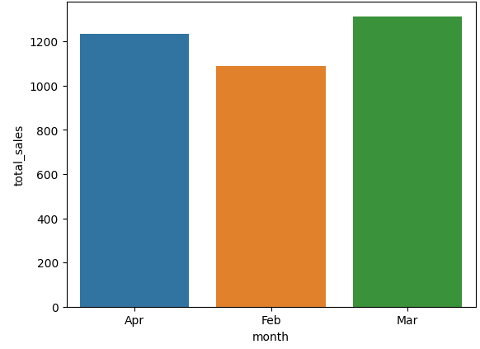
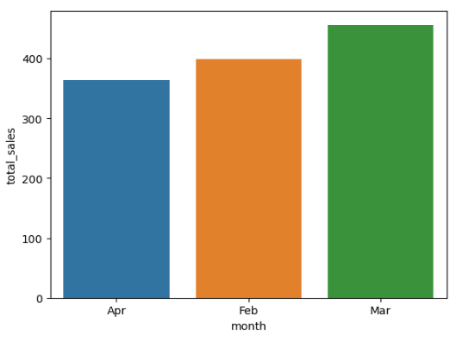
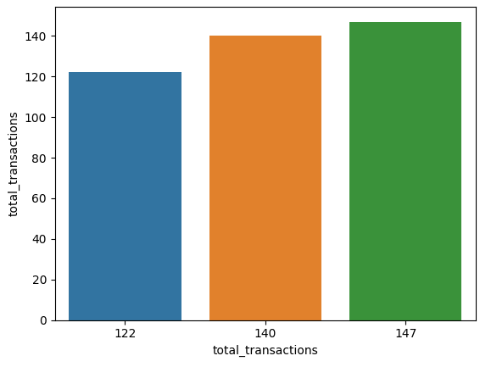
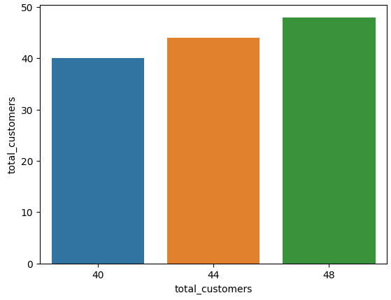
Most co related store similar to trail store - relationship (Pearosn r):-
Store 26
Store 171

Slide 12
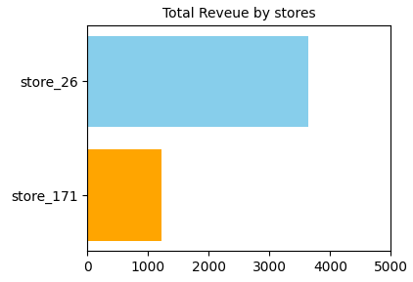
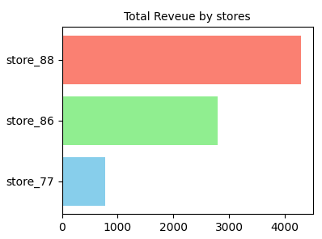
Trail store and co store Total Revenue
Conclusion:- The Pyramid Framework analysis reveals that trial stores (77, 86, and 88) showed significant sales fluctuations across February, March, and April, with pronounced peaks, especially in March. In contrast, co-relation stores (26 and 171) demonstrated more consistent patterns, albeit with occasional spikes.
March emerged as a high-revenue month for all stores, while February saw relatively
lower sales across the trial stores. April marked a general decline, particularly notable in
trial stores, though some sporadic peaks occurred.
The similarity in performance trends between co-relation and trial stores suggests a
degree of alignment, as highlighted by the Pearson correlation insights. These patterns
inform opportunities for targeted strategies and interventions to stabilize and optimize
sales across store types.

Slide 13
Thank You

