Slide 1
Gen - Z career aspiration

Slide 2
Gen-Z Career Aspirations: Shaping the Future of Work
Introduction
Generation Z, born between the mid-1990s and early 2010s, is rapidly entering the global workforce, bringing with them new perspectives, expectations, and values. This generation is digitally native, socially conscious and driven by purpose rather than just paycheck.
Understanding their career aspirations, workplace preferences, and motivations is crucial for companies looking to attract, retain, and empower the next wave of talent.
This study captures insights from 3,613 Gen-Z participants, representing 1,828 unique pin codes, across multiple countries and diverse backgrounds. Through their responses, we explore what drives their career choices, what kind of work environments they thrive in, the leadership they aspire to work under, and their views on salary, work-life balance, and social impact.
The findings of this analysis offer valuable guidance for:
Employers seeking to build Gen-Z-friendly workplaces,
Managers aiming to foster better relationships with young talent,
And policymakers & educators preparing the next workforce generation.

Slide 3
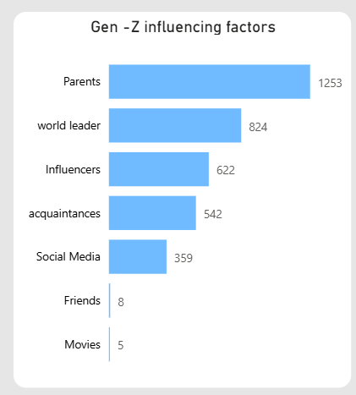
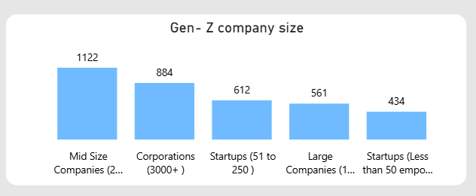
Career Influences
Who shapes Gen-Z’s career ambitions?
Parents are the biggest influencers (1,253 participants), far outpacing others.
World leaders (824) and Influencers (622) play significant roles.
Friends (8 participants) and Movies (5 participants) barely move the needle.
Preferred Company Size
Gen Z prefers environments that are dynamic yet structured:
Surprisingly, large corporations (3000+ employees) (884 participants) still hold appeal.
Startups attract many, but fewer favor smaller startups (434 participants) than mid-sized firms.

Slide 4
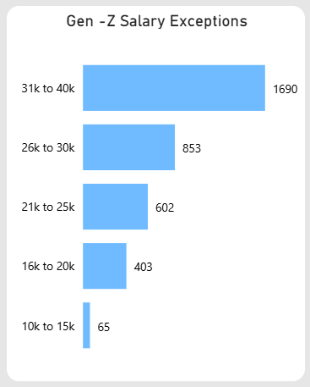
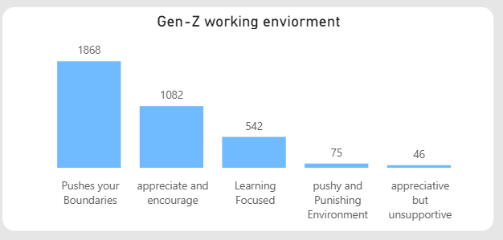
Salary Expectations
Most Gen-Z professionals aim high in their salary expectations.
Nearly 47% (1,690 participants) expect salaries between 31k to 40k.
Fewer expect lower ranges, with only 65 participants comfortable
in the 10k to 15k range.
Work Environment Preferences
The majority (1,868 participants) want a work culture that “pushes your boundaries”.
A supportive environment that appreciates and encourages (1,082 participants) is the next best choice.
Very few favor environments that are “pushy and punishing” (75) or “appreciative but unsupportive” (46).

Slide 5
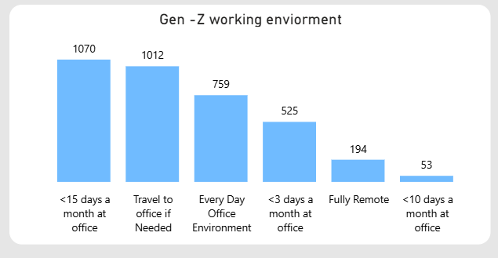
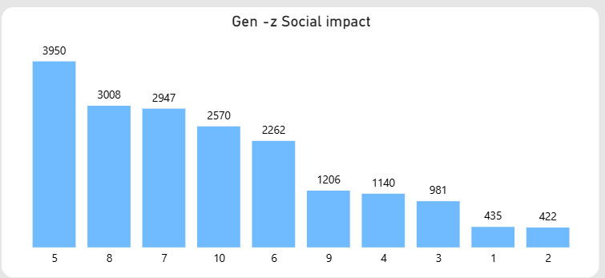
Work Location Preferences
1,070 participants prefer to work in the office less than 15 days a month.
1,012 participants are fine traveling to the office if needed.
Only 194 participants favor fully remote work, highlighting that hybrid work wins over remote-only setups.
Social Impact Awareness
Social responsibility matters.
The majority (3,950 participants) rate the importance
of social impact at 5/10 or above, showing Gen-Z’s
growing consciousness toward making a positive
difference through work.

Slide 6
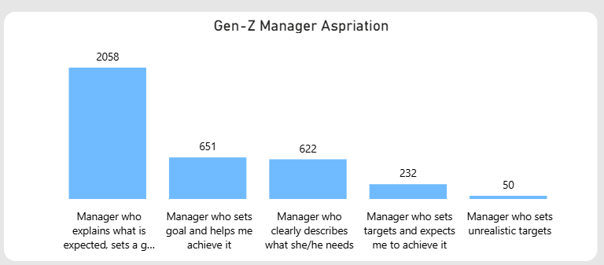
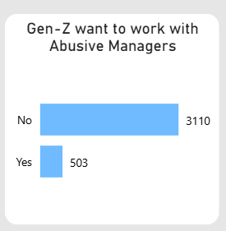
Ideal Manager Traits
Most (2,058 participants) want a manager who explains
expectations clearly and sets a growth plan.
Very few tolerate managers with unrealistic targets.
Tolerance for Toxic Managers
A strong stance 3,110 participants say NO to working with abusive managers.
However, 503 participants are either resigned to it or pragmatic about facing difficult leadership.

Slide 7
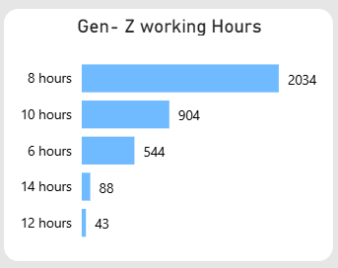
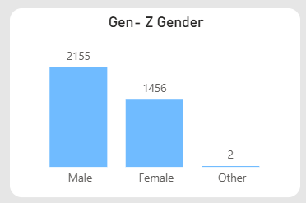
Preferred Working Hours
The classic 8-hour workday still resonates with
most (2,034 participants).
However, a substantial number are open to working 10
hours (904 participants), suggesting some flexibility when motivated.
Gen- Z Gender
males dominate the survey, representing 2,155 participants,
about 60% of the total respondents.
Females form a strong voice too, with 1,456 participants,
around 40%, showcasing the rising ambition and drive
of young women entering the workforce.

Slide 8
Conclusion
Gen Z seeks balance—growth-driven yet supportive workplaces.
They aspire for clarity in leadership, competitive salaries, and flexible working styles.
Family and global role models inspire them more than peers or media.
They prioritize mental well-being and ethical leadership over toxic productivity.
Final Thought
As this generation shapes the future of work, employers, leaders, and society must listen closely.
Creating workplaces where Gen Z can thrive isn’t just about perks— it’s about purpose, people, and progress.

Slide 9
Thank you

