Slide 1
UCS4001 · DBMS
ONLINE FOOD
DELIVERY SYSTEM
Database Management System Project
Team Members:
Vishal Mansuriya · 2410030220
Amar Singh Yadav · 2410030145
Anurag · 2410030069
Siddhant · 25scs1003004724
Section: 2CSE10

Slide 2
PROJECT INTRODUCTION
02
📌 About The System
🎯 Key Objectives
The Online Food Delivery System is a relational database project designed to manage customer orders, restaurant information, food items, delivery services, and payment records.
This project demonstrates core DBMS concepts — tables, relationships, primary/foreign keys — applied to a real-world application scenario.
Manage customer details & profiles
Store restaurant & food item info
Record and track customer orders
Manage delivery personnel data
Store payment transaction records
Apply real-world DBMS concepts
Online Food Delivery System · DBMS Project · Section 2CSE10

Slide 3
ENTITIES OVERVIEW
03
👤
CUSTOMER
🏪
RESTAURANT
customer_id (PK), name, email, phone, address
rest_id (PK), name, location, phone, rating
🍕
FOOD
🧾
ORDER
food_id (PK), name, price, category, rest_id (FK)
order_id (PK), amount, date, status, customer_id (FK)
🚚
DELIVERY
💳
PAYMENT
delivery_id (PK), name, phone, vehicle, status, address
payment_id (PK), method, amount, status, order_id (FK)
Online Food Delivery System · DBMS Project · Section 2CSE10

Slide 4
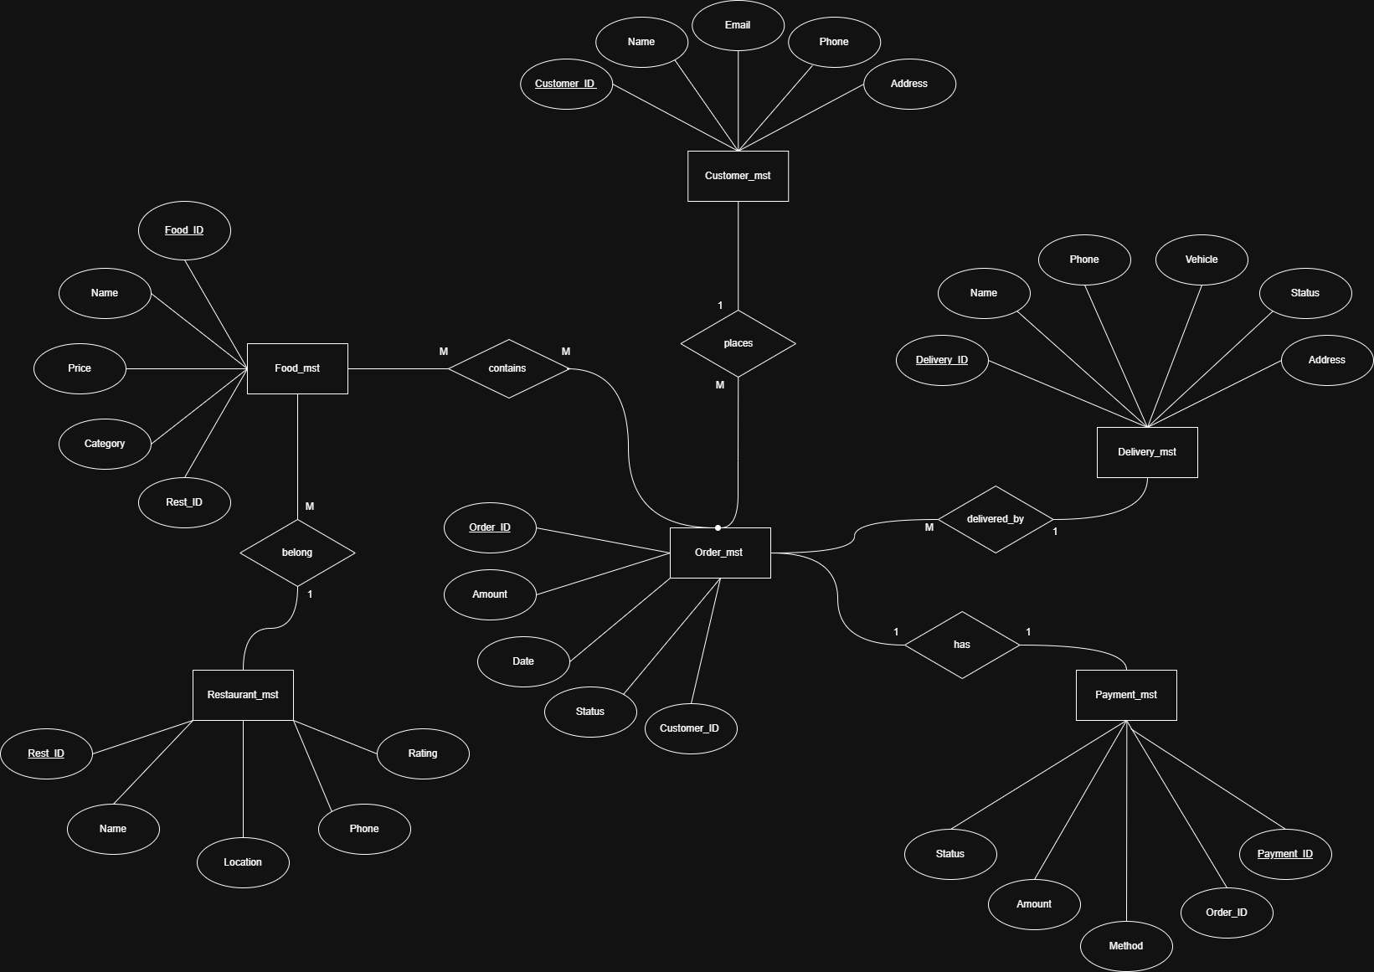
ER DIAGRAM
Entity Relationship Model — Online Food Delivery System
Source: github.com/vishalmansuriya/DBMS-project

Slide 5
SQL SCHEMA & SAMPLE DATA
06
📄 CREATE TABLE Statements
🔢 Sample Data
CREATE TABLE Customer_mst (
customer_id INT PRIMARY KEY,
name, email, phone, address
);
CREATE TABLE Order_mst (
order_id INT PRIMARY KEY,
amount, date, status,
customer_id INT -- FK
);
CREATE TABLE Payment_mst (
payment_id INT PRIMARY KEY,
method, amount, status,
order_id INT -- FK
Customer: Vishal · v@gmail.com
Restaurant: Pizza Hut · Delhi
Food: Pizza · ₹250 · Fast Food
Order: ₹250 · 2026-02-22 · Delivered
🔐 Foreign Keys
FOOD.rest_id → RESTAURANT.rest_id
ORDER.customer_id → CUSTOMER.id
PAYMENT.order_id → ORDER.order_id
Source: github.com/vishalmansuriya/DBMS-project · DBMS-Code.txt

Slide 6
RELATIONSHIPS & CARDINALITIES
05
1 : M
PLACES
One customer can place multiple orders. Each order belongs to exactly one customer.
CUSTOMER → ORDER
1 : M
PROVIDES
One restaurant can provide many food items. Each food item belongs to one restaurant.
RESTAURANT → FOOD
M : N
CONTAINS
One order can contain multiple food items. One food item can appear in multiple orders.
ORDER → FOOD
1 : M
DELIVERED_BY
One delivery person can deliver many orders. Each order is delivered by one person.
DELIVERY → ORDER
1 : 1
HAS
Each order has exactly one payment record. Each payment belongs to one order.
ORDER → PAYMENT
Online Food Delivery System · DBMS Project · Section 2CSE10

Slide 7
NORMALISATION
07
Eliminating Redundancy · Ensuring Data Integrity · Structuring Tables Efficiently
1NF
2NF
3NF
BCNF
First Normal Form
Second Normal Form
Third Normal Form
Boyce-Codd NF
Each column must contain atomic (indivisible) values. No repeating groups or arrays.
Must be in 1NF. Every non-key attribute must be fully dependent on the entire primary key.
Must be in 2NF. No transitive dependencies — non-key columns depend only on the PK.
Stronger version of 3NF. For every functional dependency X→Y, X must be a super key.
customer_id | name | phone
1 | Vishal | 9876543210
(One phone per row — no comma lists)
Order_Food table: (order_id, food_id) → quantity
Not: food_id → food_name (partial dependency removed)
Remove: order_id → customer_id → customer_name
Fix: store customer_name in Customer_mst only
Restaurant table: rest_id → name, location
All determinants are super keys ✔
📌 Applied to this project:
✔ Customer_mst, Restaurant_mst, Food_mst — all in 3NF
✔ Payment_mst references order_id (FK) — no order data repeated
✔ Order_mst references customer_id (FK) — no customer name duplication
✔ Food_mst references rest_id (FK) — no restaurant data repeated
Online Food Delivery System · DBMS Project · Section 2CSE10

Slide 8
CONCLUSION
The Online Food Delivery System ER model provides a clear representation of how different entities interact in a database environment. This project demonstrates database design, entity relationships, and real-world DBMS implementation.
🗂
🔗
🔑
💡
ER Modeling
Normalization
Keys & Constraints
Real-World Design
Entities, attributes & relationships
Structured & optimized schema
PK / FK integrity enforced
Applied DBMS to food delivery
👥 Vishal Mansuriya · Amar Singh Yadav · Anurag · Siddhant
🐙 github.com/vishalmansuriya/DBMS-project

