Slide 1
Zoho
Campaigns

Slide 2
Campaign ?
A campaign is a planned set of activities that people carry out over a period of time in order to achieve something such as social or political change.
A plan to do a number of things in order to achieve a special aim

Slide 3
Campaigns types
Campaigns
Email
SMS
Social

Slide 4
Email
Email campaign is used to send content like templates/promotion/offers/discount etc to multiple or individually audience.
SMS
Sms campaign is used to send sms like links/ message/newoffers etc to multiple or individually audience.
Social
Social campaign is used to send content like templates/promotion/offers/discount/link at our Instagram/Facebook/Linkdin/etc to multiple or individually audience.

Slide 5
Zoho Campaigns
“Zoho Campaign is Products of Zoho Corporation Pvt. Ltd .”
Zoho Campaign is used to increase product profitability 20% to 50% more to send by marketing automation with the help of zoho.
Zoho Campaigns is the part of digital marketing /promotions/automation.
Zoho Campaigns send your product to customers at minimum time.

Slide 6
List Create
Create List Name
Add Contact
Add/Import/Sync/Sign Up
Add Contact Multiple
Save

Slide 7
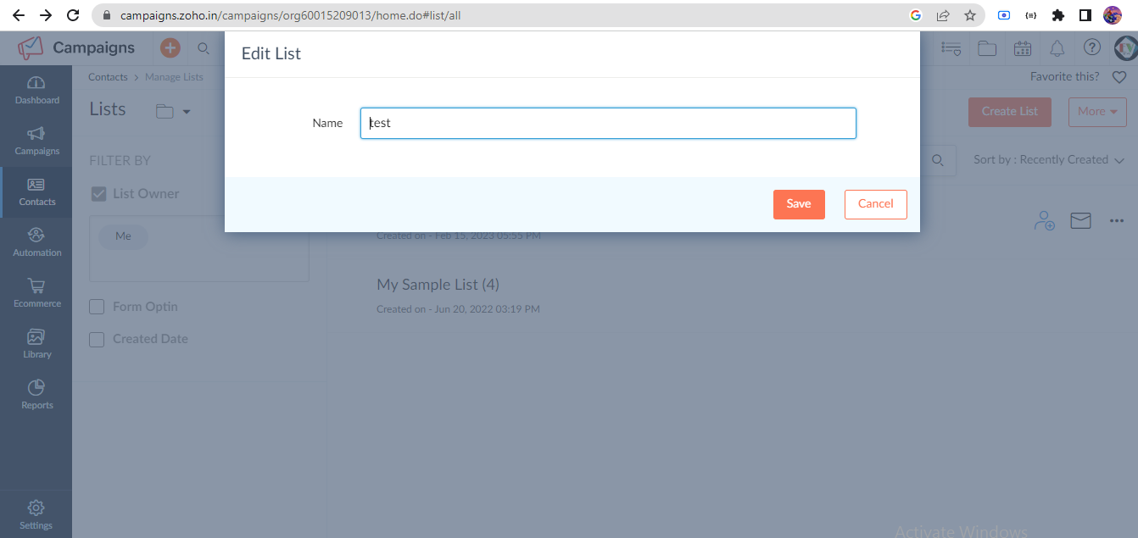
Create list

Slide 8
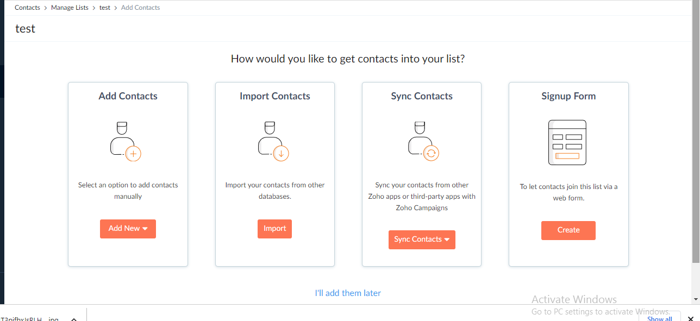
Add contact/import/sync/signup form

Slide 9
Create Email Campaign
Email Campaign
Regular Email.
A/B testing
Zoho Meeting
Zoho Survey
Zoho Forms
Ecommerce

Slide 10
Campaign create (Email)
Email Campaign
Campaign name And Topic
Add Subject
Add Sender
Choose list or Segments
Add Content like template/html/text etc.
Preview for testing.
Select Time Period Send Immediately or Later

Slide 11
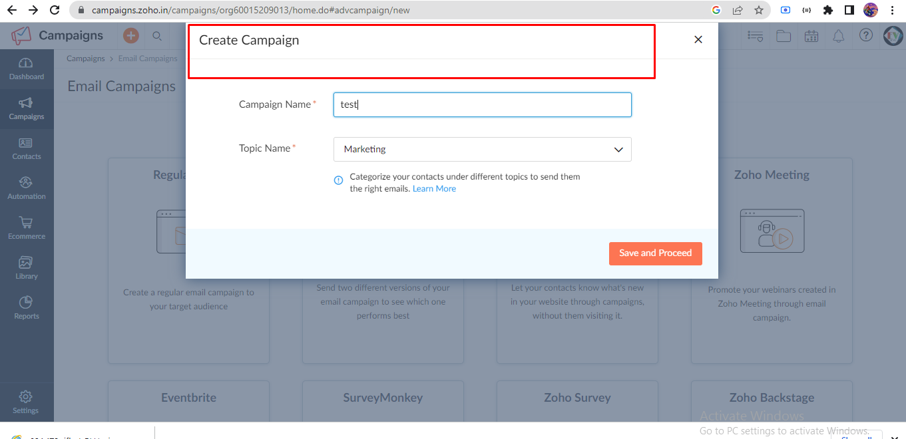
Create campaign name and Topic

Slide 12
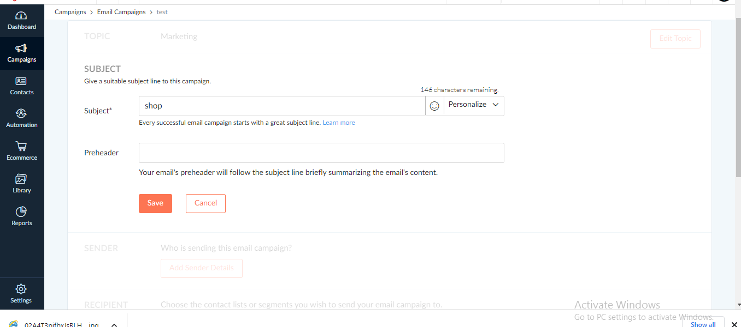
Add Subject

Slide 13
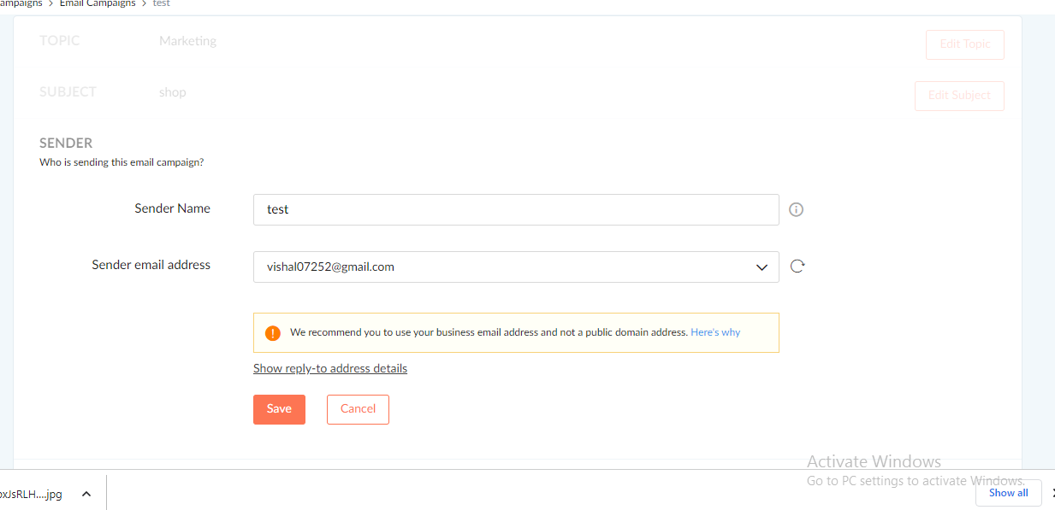
Add Sender Detail

Slide 14
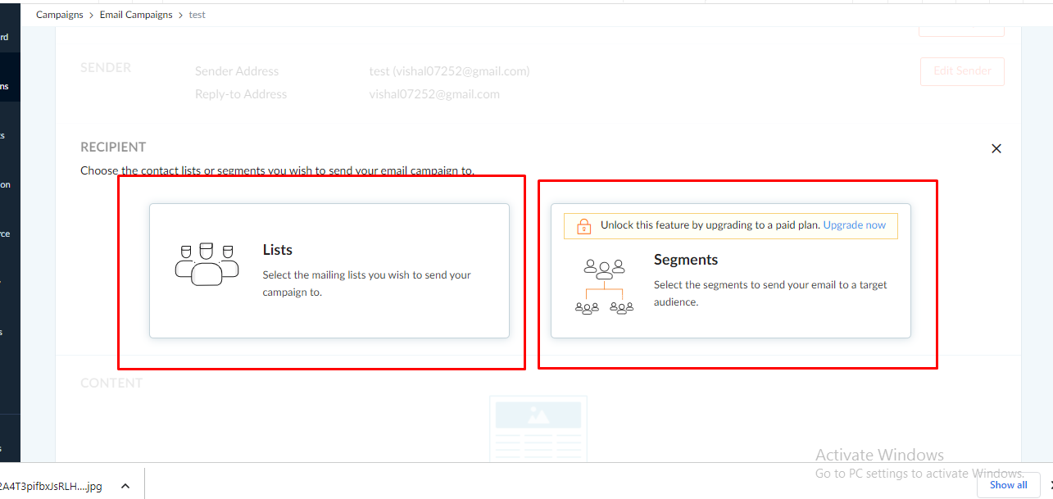
Choose list or Segments

Slide 15
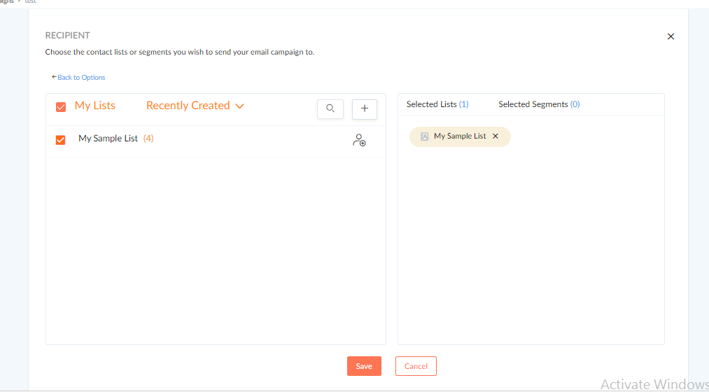
Select list and save

Slide 16
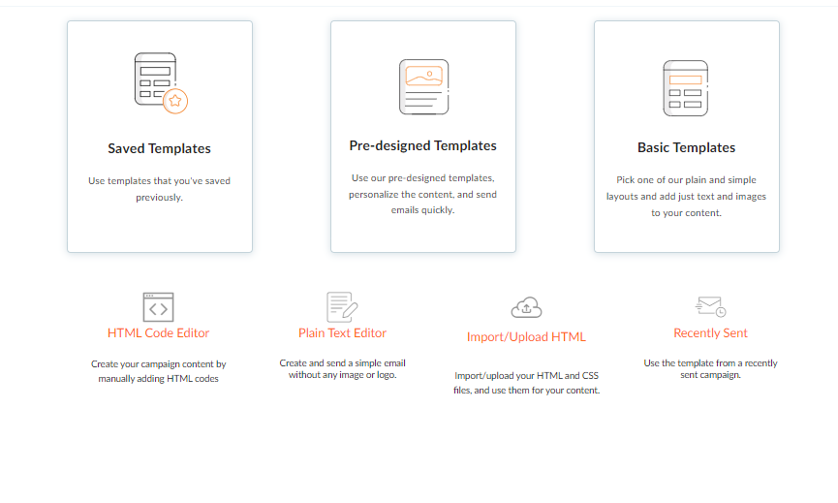
Create Campaign Content

Slide 17
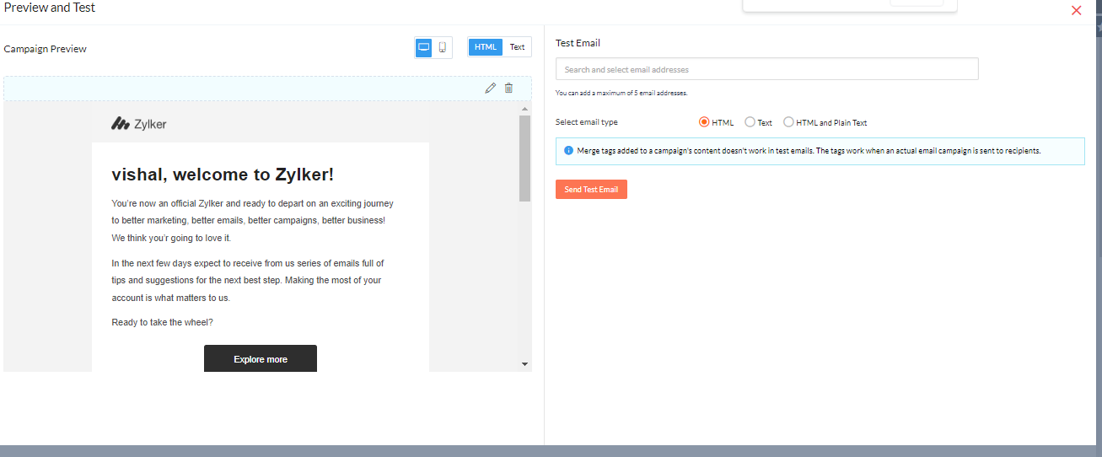
Create Email Template And Testing.

Slide 18
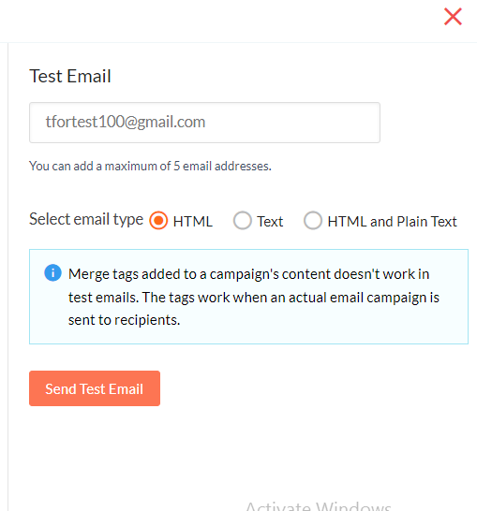
Testing First

Slide 19
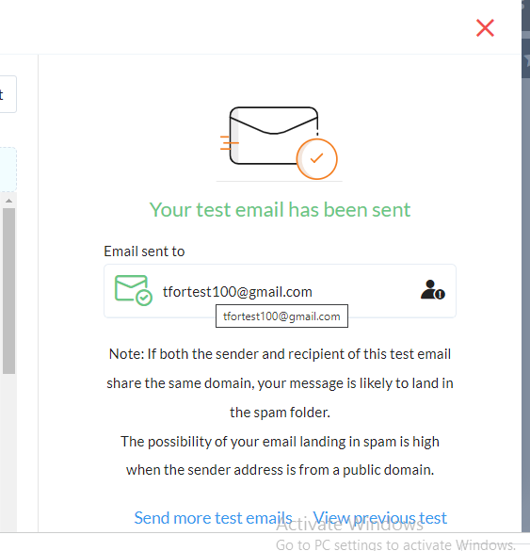
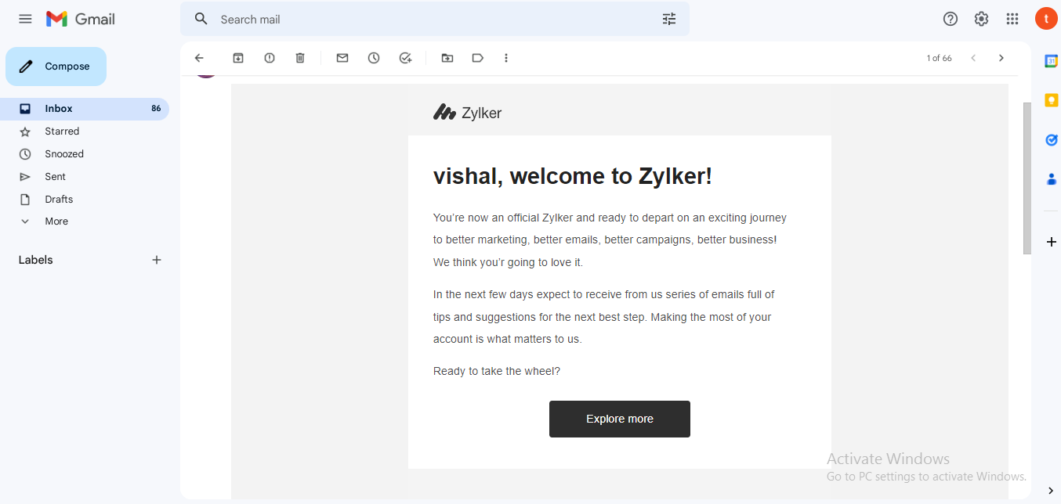
Before the Proceed we need to testing at own email address

Slide 20
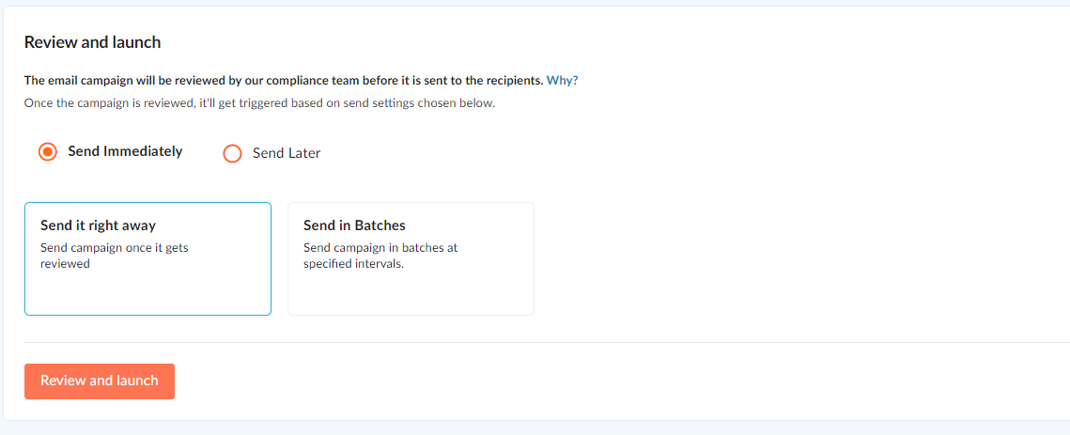
Send Immediately is used to send once.

Slide 21
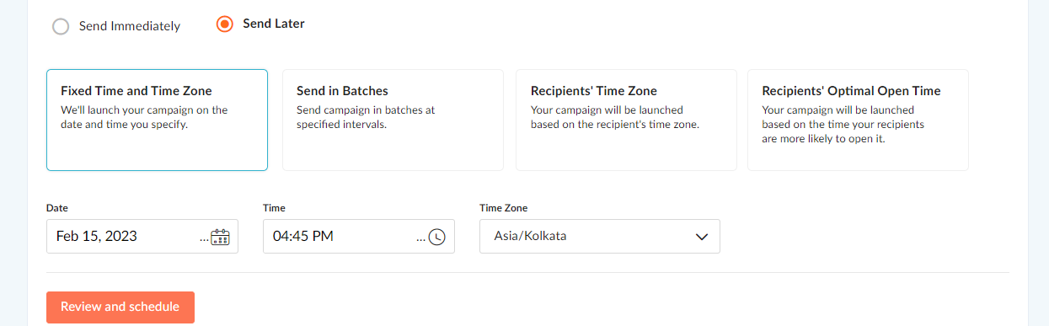
Send Later to used for send campaign with time period.

Slide 22
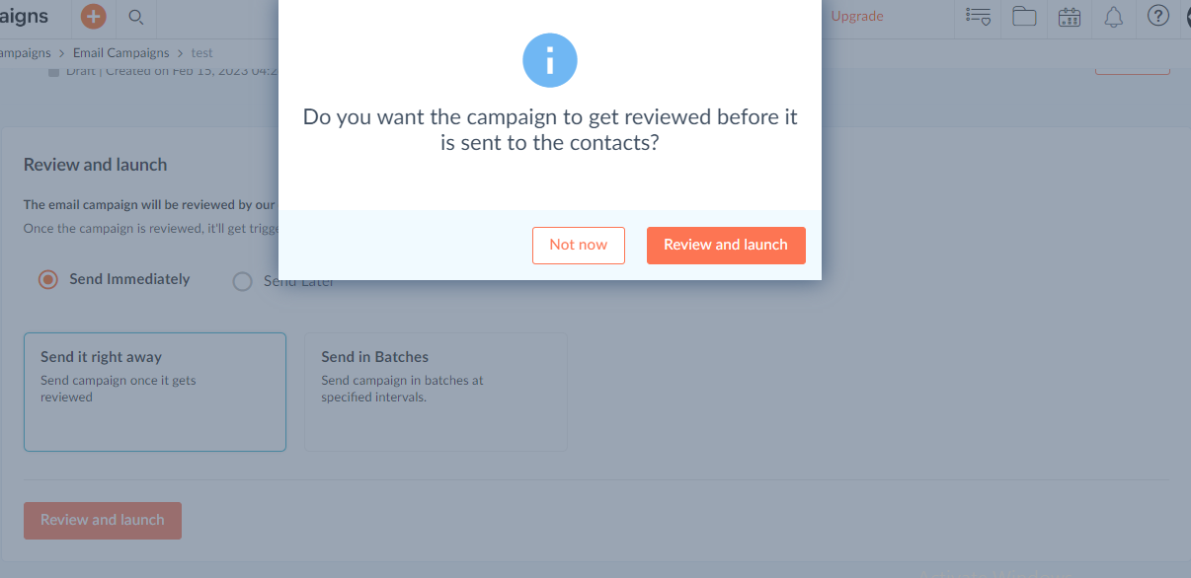

Slide 23
Campaign create (Sms)
Sms Campaign
Campaign name
Enter Gateway like twillio
Choose list or Segments
Add Content like template/html/text etc.
Select Time Period Send Immediately or Later
Preview for testing.

Slide 24
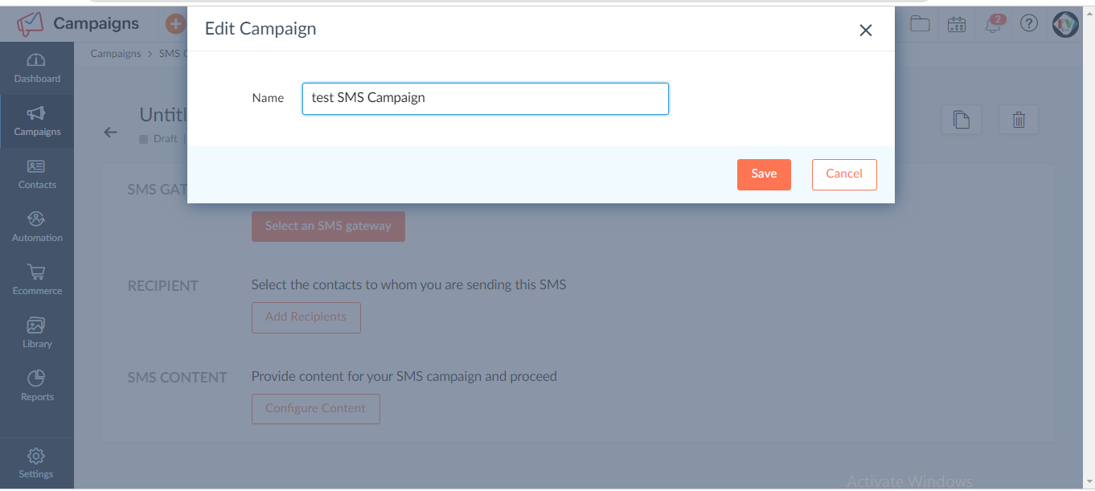
SMS Campaign

Slide 25
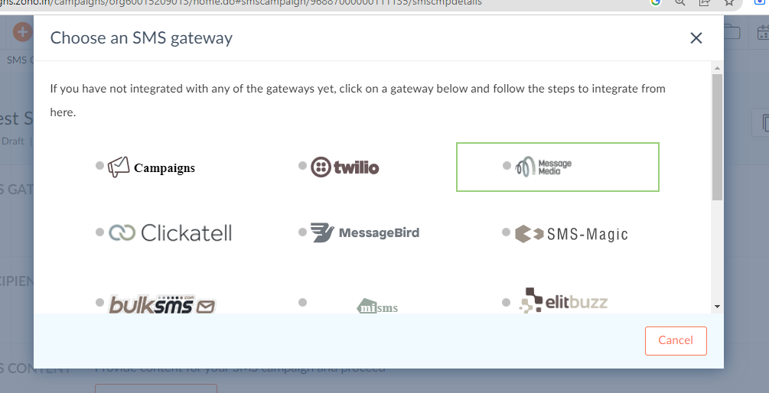
Choose Gateway

Slide 26
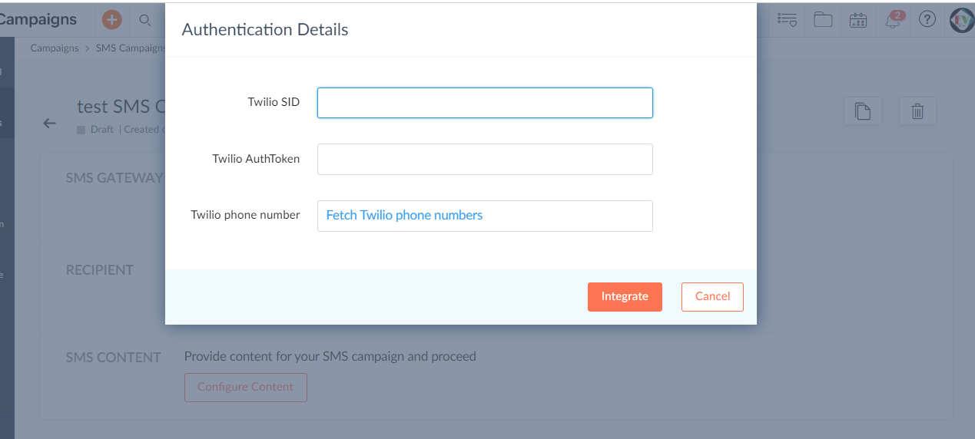
Add SID/TOKEN zoho fetch the twilio no. and click integrate

Slide 27
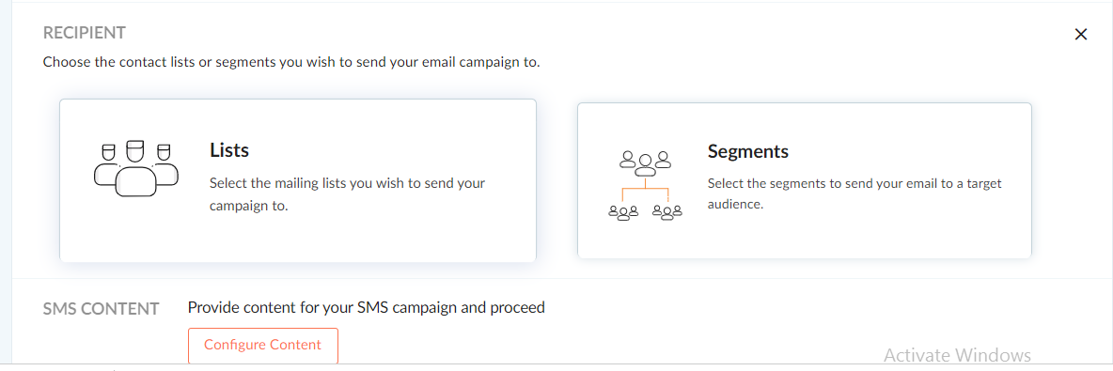
Choose list or Segments

Slide 28
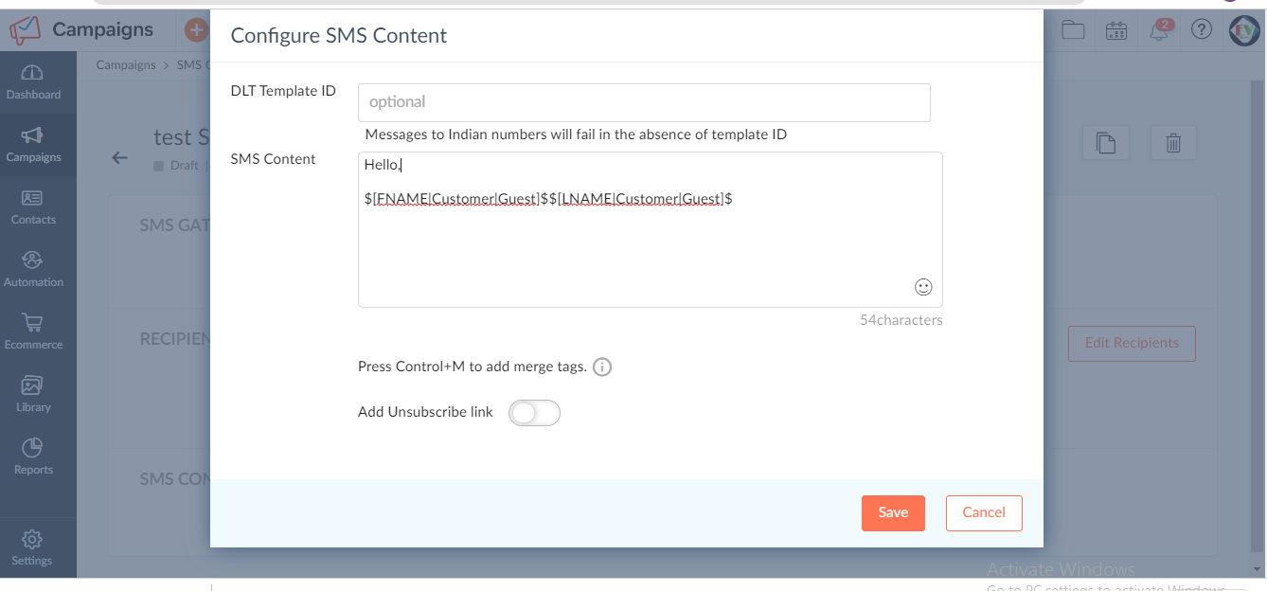
Create sms Content and save

Slide 29
Segmentation
Segmentation:- Zoho Campaign Have segmentation feature for create segments for store the sync detail.
Shop List(Books, Toys , Grocery etc.)
Books list
Toys list

Slide 30
Workflow Create
Click on Automation =>Workflow
Select Templates /Custom/Conditional
Drag trigger item and drop
Sms send items
Wait time
Exit workflow

Slide 31
Workflow
Workflow is used for the sms/email content at selective time periods.

Slide 32
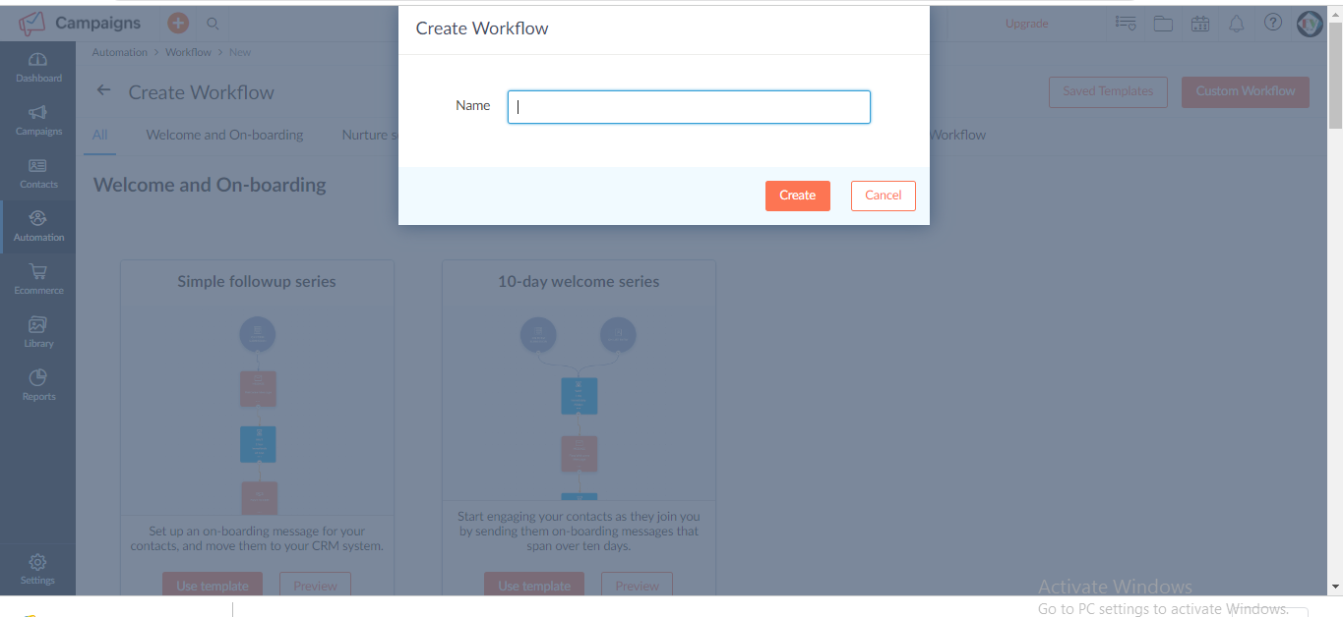
Create Workflow Name

Slide 33
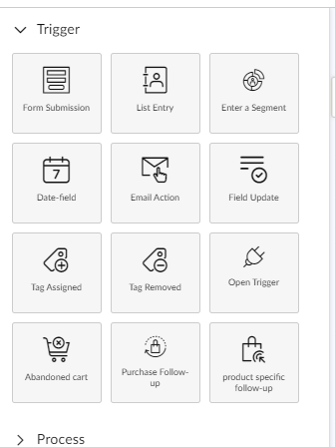
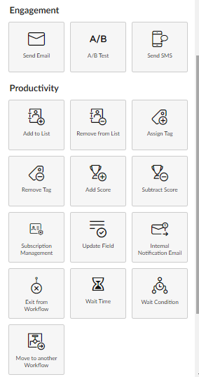
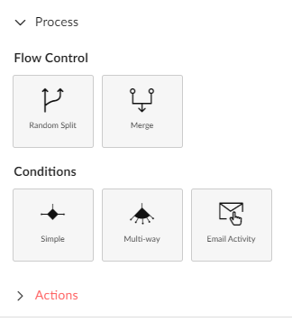
Workflow is work with three Sub-Module which the collection of items

Slide 34
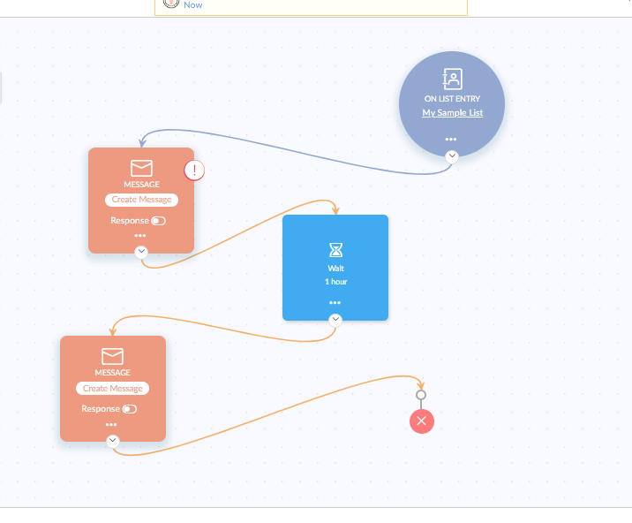

Slide 35
Zoho Campaigns vs other Campaigns
Zoho Campaigns
Zoho Campaigns Work with multiple Campaigns for one user ex-Email ,SMS, Social sites, Ecommerce Websites, Etc.
Zoho Campaign have multiple workflow action like segmentation, email send, signup form, wait time etc feature
Zoho Campaign have prebuild Email Templates to use campaigns
Other Campaigns
Other Campaign Workflow Feature less than zoho campaigns
Other Campaign doesn’t use Workflow Feature.
Other Campaigns work only single campaigns like Email or Sms, or Social Sites.

Slide 36
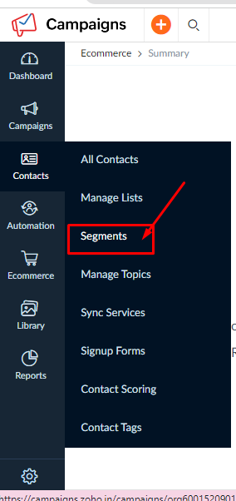
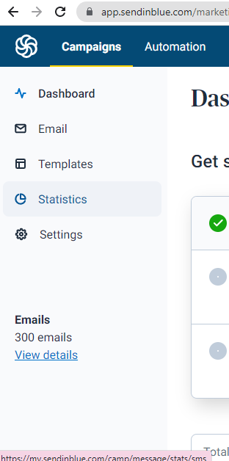
Semgmentation

Slide 37
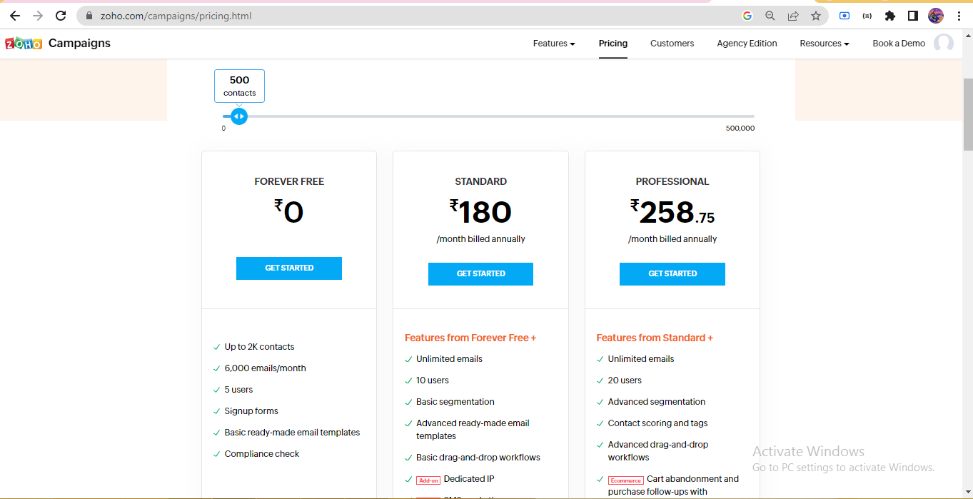
Zoho Campaigns

Slide 38
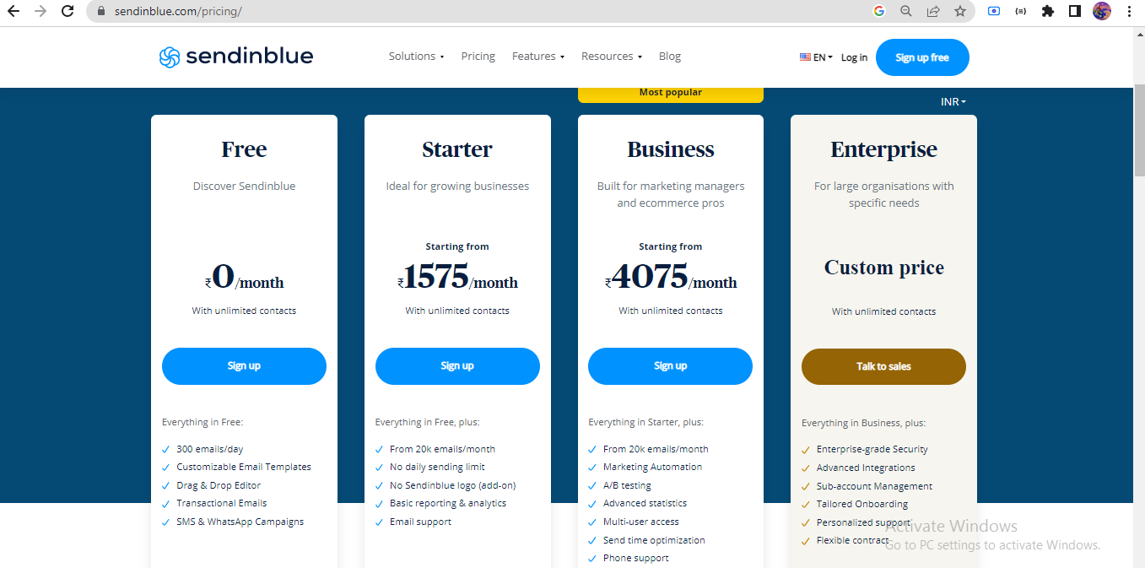
Other Campaigns

Slide 39
Submitted To:
Sir Gaurav Khurana
Sir Jay Bhatoa
Submitted By
Vishal Kumar
vishal.kumar@heliostechlabs.com
Thank You

