Slide 1





Sales
Financial Performance
07/08/2025
Created by Vishal Kumar
Intern- ElevateLabs

Slide 2

Objective
To analyze coffee sales revenue and performance across locations, product categories, and time periods
DASHBOARD KPI
01
Total Orders: 149.12K
02
Total Revenue: 698K
03
Total Quantity Sold: 214K
04
Average Order Value: 74.74K

Slide 3

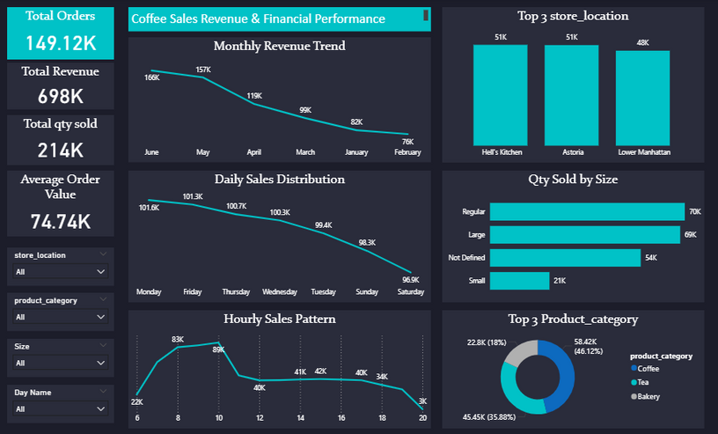
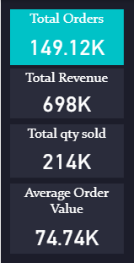

Key Metrics:
Key Visuals:
Total Orders: 149.12K
Total Revenue: 698K
Total Quantity Sold: 214K
Average Order Value: 74.74K
Monthly Revenue Trend
Daily Sales Distribution
Hourly Sales Pattern
Top 3 Store Locations
Quantity Sold by Size
Top 3 Product Categories

Slide 4
POWER QUERY
Cleaned raw sales data imported from POS systems.
Transformed date and time fields for time-based analysis.
Created calculated columns for Order Value, Revenue, and Size Buckets.
Built relationships between tables: orders, products, and store locations.
Applied filters on store_location, product_category, size, and day name to enable dynamic dashboard interactivity.

Slide 5

ALL WORKS
Data Collection: Extracted transaction-level sales data.
Data Preparation: Processed in Power Query with transformations.
Data Modeling: Established relationships in Power Bl data model.
Visualizations: Designed charts and KPIs for comprehensive insights.
Interactivity: Integrated slicers for store, product, size, and day filters.
Analysis: Highlighted key findings in sales trends, top performers, and customer preferences.

Slide 6


SUMMARY
Sales performance shows a downward trend in revenue over recent months.
Mondays and Fridays recorded the highest daily sales.
8-10 AM peak hours indicate morning rush as a key sales period.
Hell's Kitchen and Astoria are the top-performing store locations.
Regular and large sizes are most popular among customers.

Slide 7

Thank You
Hopefully, this year's report can make our company even better

