Slide 1




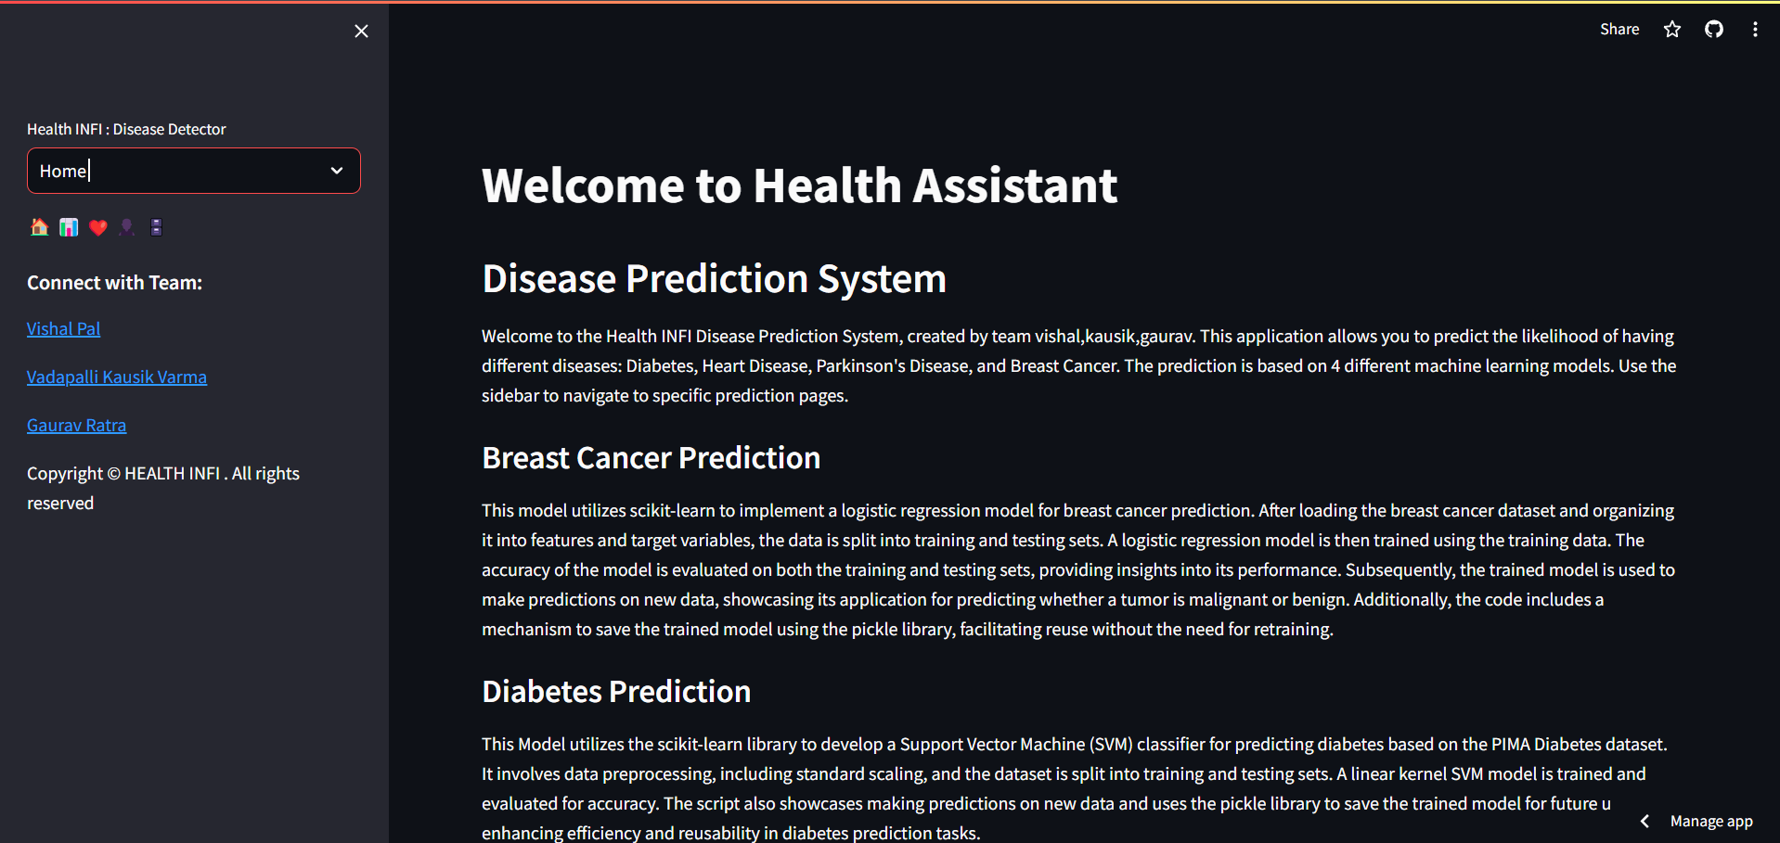
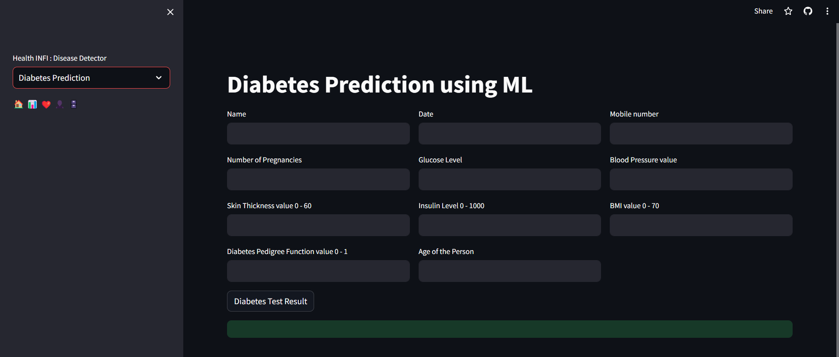
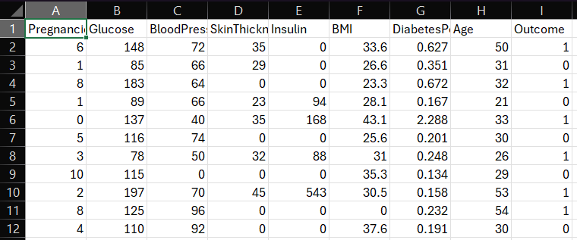
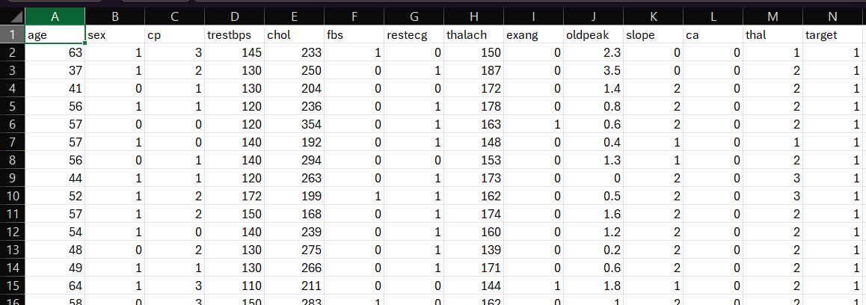
Project Title : Disease prediction from symptom
School of Computer Science Engineering and Technology
Bennett University, India
Introduction
Techniques Utilized
The objective of this project is to develop accurate and reliable machine learning models for disease prediction.
Problem Statement
Developing a data science model to predict diseases from symptoms, enhancing early detection and supporting informed healthcare decisions
Streamlit is used to deploy aur app . Python and Rstudio is used to make and train models.
User Interface/Demo Snapshots
Solution
the disease prediction project has provided valuable insights into the early detection and prediction of breast cancer, diabetes, heart disease, and Parkinson's. While the model has its limitations, it has the potential to assist healthcare professionals in identifying individuals at risk and implementing preventive measures. Further research and refinement of the model are necessary to improve its accuracy and applicability in real-world healthcare settings.
TABLE 1. SAMPLE TABLE
Conclusion
the disease prediction project has provided valuable insights into the early detection and prediction of breast cancer, diabetes, heart disease, and Parkinson's. While the model has its limitations, it has the potential to assist healthcare professionals in identifying individuals at risk and implementing preventive measures. Further research and refinement of the model are necessary to improve its accuracy and applicability in real-world healthcare settings.
Team & Mentor
Mentor : Dr. Shahnawaz Ahmad
Member 1: Vishal Pal E22CSEU0334
Member 2: Vadapalli Kausik Varma E22CSEU0343
Member 3: Gaurav Ratra E22CSEU0359
GitHub: https://github.com/vishalp018/Heath_Infi
https://www.youtube.com/watch?v=uOeL7yGIRO8

