Slide 1

Health INFI Disease Prediction model
Data science project report

Slide 2
Problem Statement
__________________________________
Objective
The objective of this project is to develop accurate and reliable machine learning models for disease prediction.
Target Diseases
Breast Cancer
Diabetes
Heart Disease
Parkinson's

Slide 3
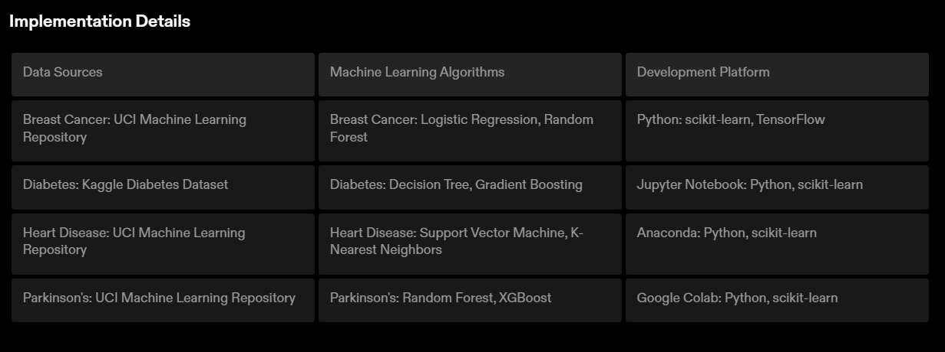
Implementation
________________________
Implementation
The disease prediction project was implemented using a combination of data sources, machine learning algorithms, and a development platform to achieve accurate and reliable predictions.

Slide 4
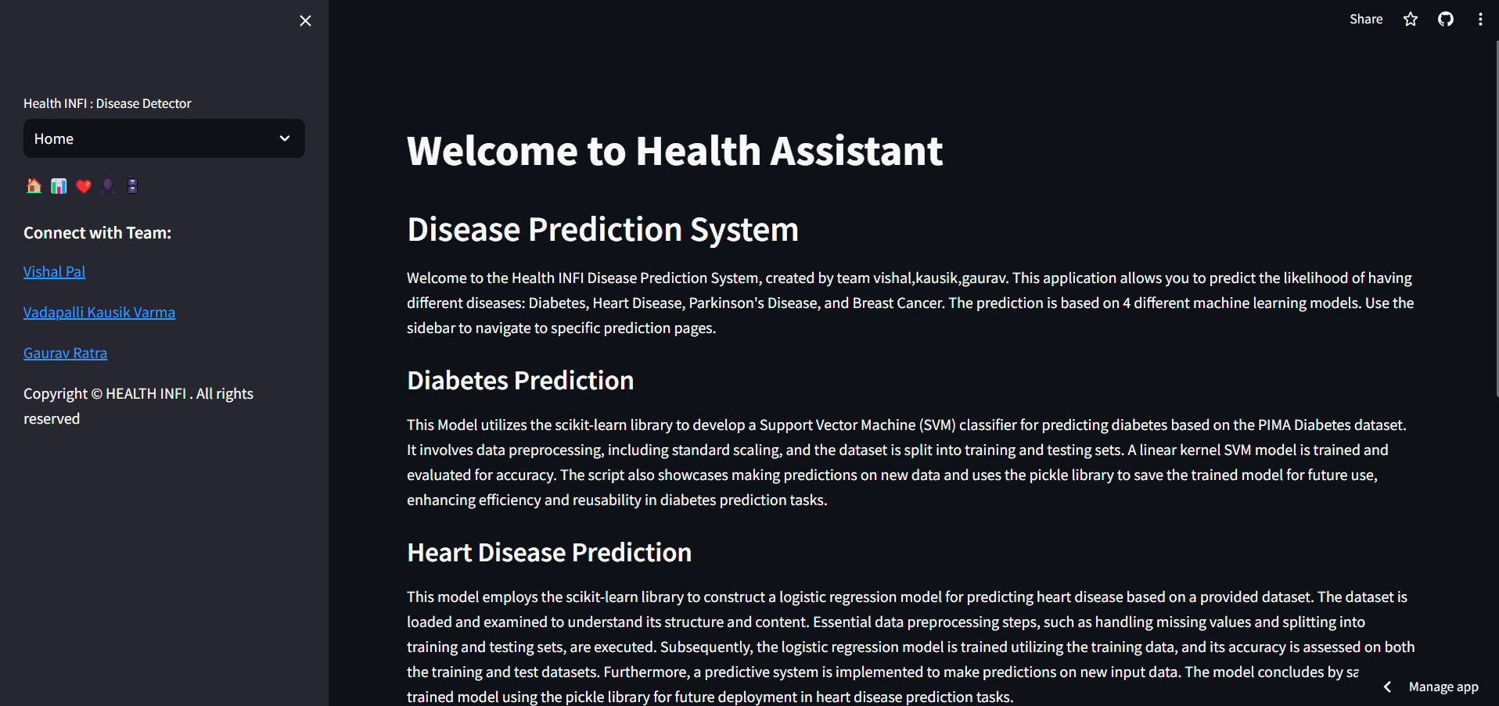
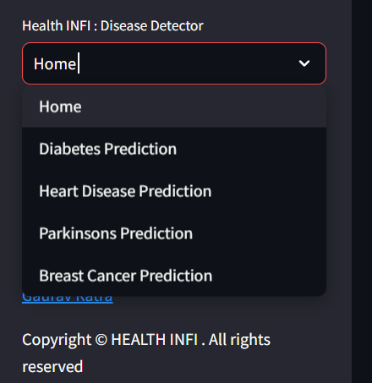
SNaP SHOT
Heath infi

Slide 5
Limitations and Conclusion
__________________________________________
Limitations of the Disease Prediction Model
The accuracy of the model may vary depending on the quality and quantity of the input data.
The model may not account for all relevant factors and variables that contribute to the development of the diseases.
Conclusion
In conclusion, the disease prediction project has provided valuable insights into the early detection and prediction of breast cancer, diabetes, heart disease, and Parkinson's. While the model has its limitations, it has the potential to assist healthcare professionals in identifying individuals at risk and implementing preventive measures. Further research and refinement of the model are necessary to improve its accuracy and applicability in real-world healthcare settings.

Slide 6
.
Vishal pal , vadapalli kausik varma , gaurav ratra
______________________________________________________________________________
Batch 12
______

