Slide 1
Customer Churn Analysis
& Machine Learning Predictions
Predicting customer retention, identifying key churn drivers, and proposing data-driven strategies.
Dataset: Telco Customer Churn (7,043 Accounts)

Slide 2
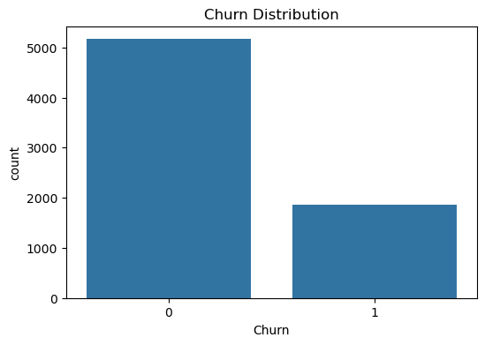
Executive Summary & Project Goal
The Business Problem
• Customer Churn occurs when subscribers cancel their service. Acquiring new customers costs 5-25x more than retaining existing ones.
• Key Objectives: Analyze customer behavior, clean and preprocess customer data, train predictive models (Logistic Regression, Decision Trees, Random Forests), and determine the primary risk factors.
• Base Dataset: 7,043 unique customer accounts with 21 socio-demographic, service subscription, and financial attributes.
• Base Churn Rate: 26.54% of customers have churned (1,869 churned vs. 5,174 active). This represents a significant revenue leakage.

Slide 3
Data Pipeline: Preprocessing & Engineering
1. Data Cleaning & Structuring
• ID Removal: Dropped customerID as it has no predictive power and adds noise.
• Type Conversion: TotalCharges contained blank space strings. These were coerced to numeric (NaNs generated).
• Imputation: Filled missing TotalCharges values (11 records) using the column mean value.
• Deduplication: Identified and removed duplicate customer records to ensure model integrity.
2. Feature Engineering & Scaling
• Binary Mapping: Mapped binary categorical variables (gender, Partner, Dependents, PhoneService, PaperlessBilling, Churn) to 0 and 1 (e.g., Male=1, Female=0).
• Dummy Encoding: Applied pd.get_dummies(drop_first=True) to multi-class variables (Contract, PaymentMethod, InternetService, and protection add-ons).
• Train/Test Split: Divided dataset into 80% training set (to fit models) and 20% test set (to evaluate generalization).
• Feature Scaling: Standardized features using StandardScaler on training data and transformed test data to prevent scale bias.

Slide 4
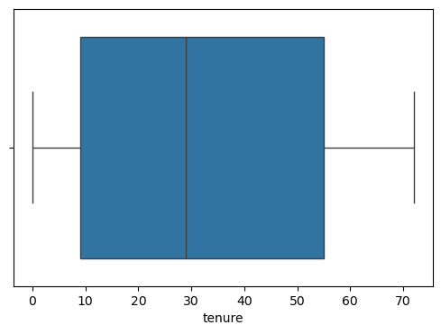
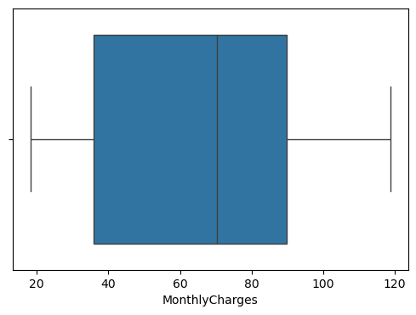
EDA: Customer Tenure & Monthly Charges
Distribution Insights (Boxplots)
• Tenure Distribution: (Top Chart): Shows a bimodal distribution. A large group of customers have very short tenure (0-10 months) and represent the highest churn risk, while another large group is highly stable (60-72 months).
• Monthly Charges: (Bottom Chart): The boxplot highlights that monthly charges are concentrated between $35 and $90. Higher monthly bills are directly linked with a higher churn probability.
• Key Takeaway: : The risk of churn is heavily concentrated in the early months of a customer's life cycle, particularly if they are billed high monthly rates immediately.

Slide 5
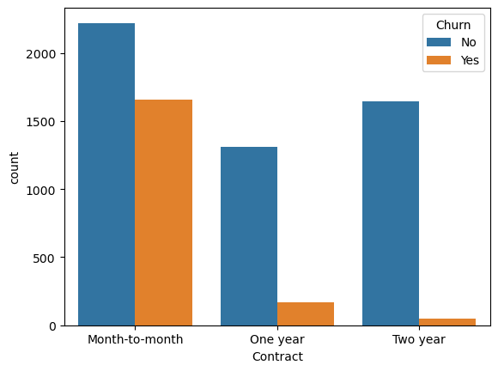
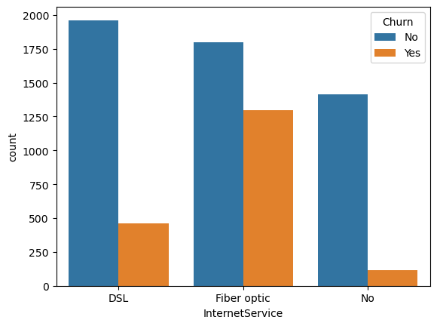
EDA: Services & Contract Types vs. Churn
Service & Contract Risk Factors
• Contract Type Influence: Month-to-month contracts have an extremely high churn rate. Conversely, customers signed on 1-year and 2-year contracts show remarkable stability and very low churn rates.
• Internet Service Risk: Fiber Optic subscribers exhibit a significantly higher rate of churn compared to DSL or No-Internet users. This indicates issues with price sensitivity, service quality, or heavy competitor targeting.
• Payment Methods: Electronic Check is highly correlated with churn. Auto-pay payment methods (Credit Card, Bank Transfer) display high retention, representing a major optimization area.

Slide 6
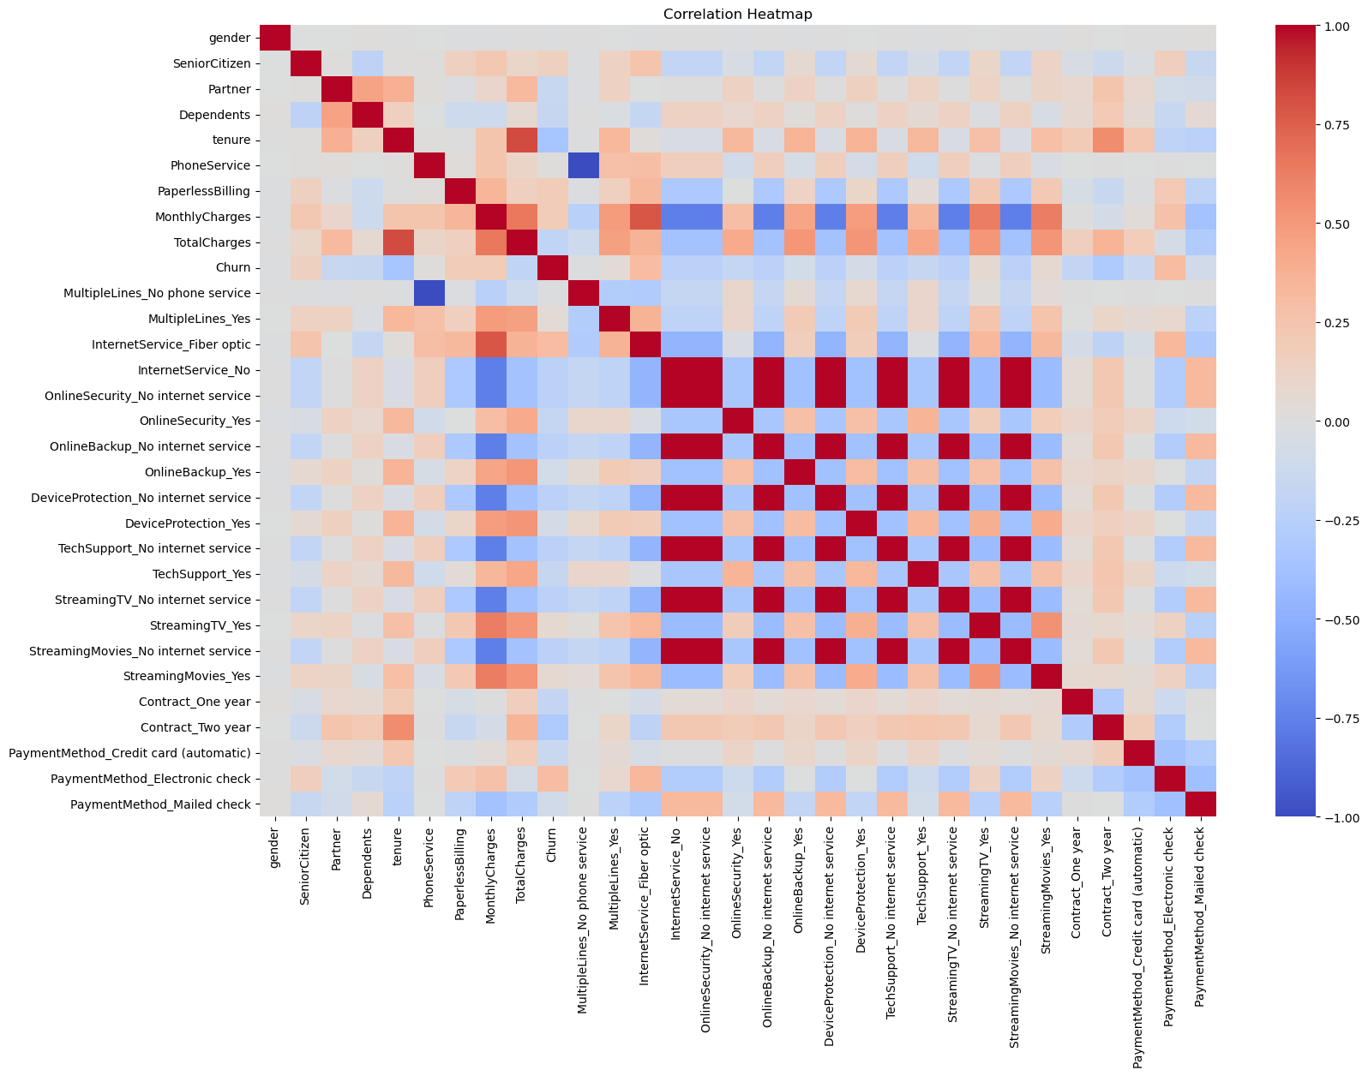
Correlation Heatmap & Feature Inter-relationships
Heatmap Analysis
• Internet Services Link: The heatmap reveals moderate-to-strong relationships among internet-related service features, indicating that customers often subscribe to multiple value-added services together.
• Multicollinearity: Detected between tenure, MonthlyCharges, and TotalCharges (since TotalCharges is a mathematical product of the other two). This must be handled during modeling (e.g. through regularized algorithms or scale adjustments).
• Strongest Direct Churn Correlations: Internet Service (Fiber Optic) and Payment Method (Electronic Check) show the highest positive correlation coefficients with the target variable Churn.

Slide 7
Model Development & Validation Strategy
Evaluation Framework & Algorithms
• Logistic Regression: Used as our baseline model. Standardized inputs, evaluated with cross-validation. Shows stable convergence, high interpretability, and excellent ROC-AUC performance.
• Decision Tree Classifier: Initially fit without constraints (resulting in heavy overfitting, 1.0 training accuracy). Subsequently regularized with max_depth=5 to limit splits, improving generalization on unseen test data.
• Random Forest Classifier: An ensemble method trained with 100 estimators. Bagging reduces variance and provides robust predictions, though it suffers slightly in test accuracy here compared to Logistic Regression.
• Validation Protocol: Divided dataset into 80% train / 20% test splits. Features normalized using StandardScaler. Evaluated Logistic Regression stability using 5-Fold Cross Validation.

Slide 8
Model Performance Comparison
Results Summary
Logistic Regression outperformed the tree-based models across overall metrics. While Decision Trees and Random Forests had slightly higher precision for churn prediction, Logistic Regression captured significantly more actual churners (higher recall) and showed superior overall discrimination (ROC-AUC: 0.862).
Model | Test Accuracy | Churn Precision | Churn Recall | Churn F1-Score | ROC-AUC
Logistic Regression | 82.26% | 0.69 | 0.60 | 0.64 | 0.8620
Decision Tree (max_depth=5) | 80.62% | 0.70 | 0.46 | 0.56 | -
Random Forest (n=100) | 79.42% | 0.65 | 0.46 | 0.54 | -

Slide 9
Key Drivers of Churn: Model Coefficients
Top Churn Drivers (Increases Risk)
▲ Fiber Optic Internet (+0.625): The strongest positive predictor. Indicates high billing dissatisfaction, technical stability issues, or heavy competitor marketing.
▲ Total Charges (+0.609): High absolute accumulated charges increase churn probability, likely capturing pricing pain points for older cohorts.
▲ Streaming Movies / TV (+0.231 / +0.181): Premium entertainment services marginally increase churn likelihood, possibly due to cord-cutting behavior.
▲ Paperless Billing (+0.164): Direct correlation, potentially due to lower friction in billing reviews or digital payments.
▲ Electronic Check Payment (+0.151): Electronic check users churn significantly more than auto-pay users.
Top Loyalty Drivers (Reduces Risk)
▼ Tenure Length (-1.310): The single strongest predictor of retention. The longer a customer stays, the dramatically less likely they are to leave.
▼ Monthly Charges (-0.629): Negative coefficient (when accounting for tenure/total charges), reflecting high customer value lock-in.
▼ Two-Year Contract (-0.619): Long-term contract commitments are highly effective in ensuring customer loyalty and preventing churn.
▼ One-Year Contract (-0.269): Also provides moderate retention security, though less than two-year contracts.
▼ Online Security / Tech Support (-0.158 / -0.120): Adding cybersecurity and tech assistance heavily locks customers in and reduces churn.

Slide 10
Strategic Recommendations for Business Impact
✔ Migrate to Auto-Pay Provide a $2-$5 monthly discount for transitioning from Electronic Check to Credit Card or Bank Auto-Pay to automate renewals and reduce transaction friction.
✔ Optimize Fiber Optic Retention Run quality audits and price-sensitivity check campaigns on Fiber Optic users. Bundle streaming discounts to cushion the premium price points.
✔ Contract Conversion Incentives Target month-to-month subscribers with custom offers to upgrade to 1 or 2-year contracts. High risk of churn occurs in the first 12 months; lock-ins protect this window.
✔ Bundle Security & Technical Add-ons Promote Online Security and Tech Support as a combined value pack. These sticky services increase retention and boost long-term customer life time value (LTV).

