Slide 1
MACHINE LEARNING PROJECT PRESENTATION
Real vs. Fake News Detection
A Comparative Analysis of NLP Pipeline and Machine Learning Classifiers
Dataset size: 44,689 articles | Feature Extraction: TF-IDF (5,000 features, Unigrams & Bigrams) Primary Classifier: Logistic Regression & Random Forest | Validation Split: 80/20 Stratified Split

Slide 2
Project Context & Objectives
THE PROBLEM OF MISINFORMATION
The rapid expansion of social media and online journalism has dramatically accelerated the spread of fake news. Misinformation can manipulate public opinion, influence democratic processes, and foster social division. Automating the detection of deceptive content is a critical task in natural language processing (NLP). Traditional machine learning classifiers offer transparent, efficient, and highly accurate solutions when combined with robust text preprocessing and TF-IDF feature representations.
KEY PROJECT GOALS
• End-to-End NLP Pipeline: Develop standard text normalization, cleaning, and Porter stemming to reduce text noise.
• TF-IDF Representation: Convert unstructured text into a structured 5,000-dimensional TF-IDF vector space with bigrams.
• Model Comparison: Evaluate six distinct machine learning classifiers: Logistic Regression, Naive Bayes, SVM, Passive Aggressive, Decision Tree, and Random Forest.
• Critical Error Analysis: Analyze confusion matrices and ROC curves to identify classification bottlenecks and dataset biases.

Slide 3
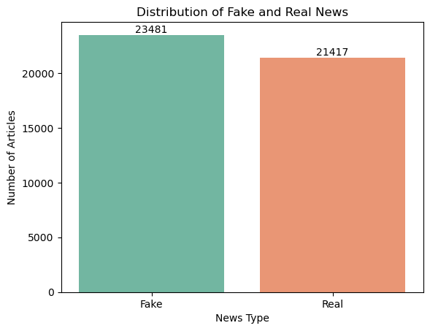
Dataset Statistics & Balance
DATASET COMPOSITION
• Source Files: fake.csv (23,481 records) and true.csv (21,417 records)
• Original Raw Total: 44,898 records
• Duplicates Removed: 209 duplicate records identified and dropped
• Cleaned Dataset: 44,689 unique records
• Class Balance: Fake News: 23,478 (52.5%) | Real News: 21,211 (47.5%)
• Dataset Attributes: title (article headline), text (body content), subject (article category), date (publication date)

Slide 4
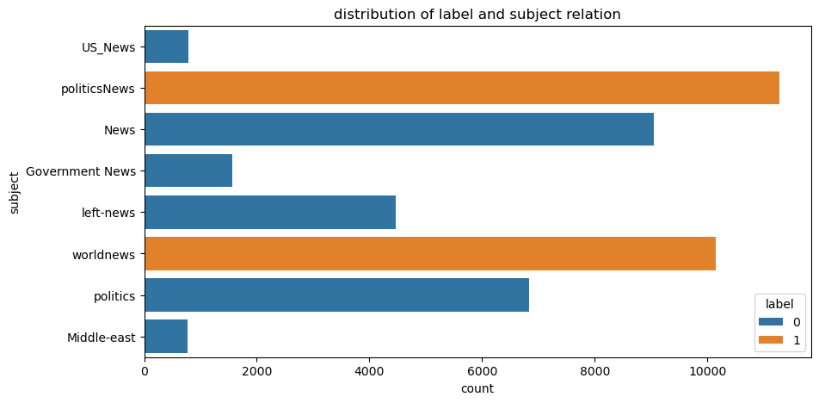
Exploratory Data Analysis: Subject Distribution
SUBJECT METADATA AS A STRONG PREDICTOR
Cross-tabulation of labels and subjects reveals a complete structural split in the dataset: • Fake News subjects: News (9,050), politics (6,841), left-news (4,459), Government News (1,570), US_News (783), and Middle-east (778). • Real News subjects: politicsNews (11,272) and worldnews (10,145). • Key Insight: There is zero subject category overlap between classes. Using 'subject' directly as a feature in a classifier would result in trivial, 100% accurate classification, but would fail to generalize to external articles. Thus, we build the classifier purely on text content.

Slide 5
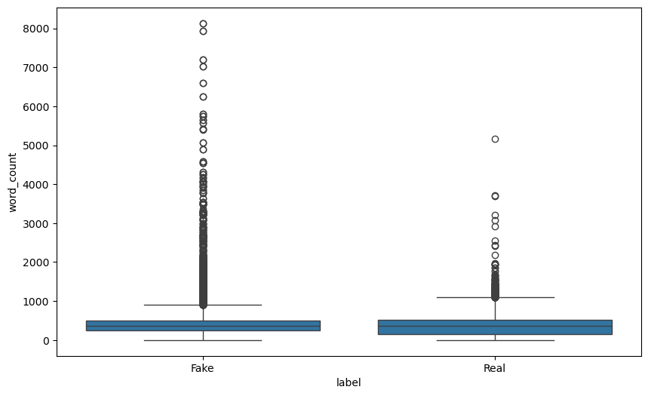
Exploratory Data Analysis: Article Lengths
TEXT LENGTH ANALYTICS
An analysis of the word count across the entire corpus reveals: • Overall word count: Mean of 405.28 words and standard deviation of 351.27 (Max: 8,135 words, Min: 0 words). • Real News word count: Mean = 385.64 words, Median = 359 words. • Fake News word count: Mean = 423.20 words, Median = 363 words. • Key Insight: Fake articles in this dataset tend to be slightly longer on average and exhibit wider variation (longer tail) than real news articles. However, the medians are very close (359 vs 363), suggesting the overall distributions are highly overlapping.

Slide 6
Text Preprocessing Pipeline
1. Content Combination
Concatenated the Title and Text fields into a single 'content' column to capture textual patterns from both the headline and the body together.
2. Lowercasing
Converted all character sequences to lowercase. This normalizes the text and ensures that words like 'Trump' and 'trump' map to the same token.
3. URL & HTML Removal
Applied regular expressions to strip out hyperlinks ('http\S+|www\S+') and HTML tags ('<.*?>'). These elements contain formatting noise.
4. Punctuation Stripping
Removed all punctuation marks using python's 'string.punctuation' translation table. This normalizes token count representation.
5. Selective Stopwords
Removed standard English stopwords. Critically, key negation terms (e.g. 'not', 'no', 'nor') were retained to preserve semantic logic context.
6. Porter Stemming
Applied the Porter Stemmer to reduce words to their base linguistic forms (e.g., 'playing/plays' -> 'play'), compressing final vector dimensionality.

Slide 7
Feature Representation & Splitting
TF-IDF VS. BAG-OF-WORDS
A simple Bag-of-Words (BoW) approach only counts raw word occurrences, meaning common terms like 'said' or 'people' dominate the feature representations even if they carry no discriminative power. TF-IDF (Term Frequency-Inverse Document Frequency) addresses this by scaling token frequencies relative to how often they occur across the entire corpus. This scales down very common terms while emphasizing rare, high-signal terms that are heavily concentrated in specific documents. This provides a vastly superior input representation for traditional machine learning classifiers.
VECTORIZER & SPLIT CONFIGURATION
• Maximum Features: Restricted vocabulary size to the top 5,000 terms based on term frequency across the corpus to prevent extreme feature sparsity.
• Minimum Document Frequency (min_df = 2): Removed rare tokens that appear in fewer than 2 articles, eliminating spelling mistakes and isolated noise.
• N-gram Range = (1, 2): Extracted both single words (unigrams) and word pairs (bigrams). This preserves critical local context like 'white house' or 'donald trump'.
• Stratified Train-Test Split (80/20): Split data into 35,751 training and 8,938 testing samples. Using a stratified split ensures the class ratio is identical in both partitions.

Slide 8
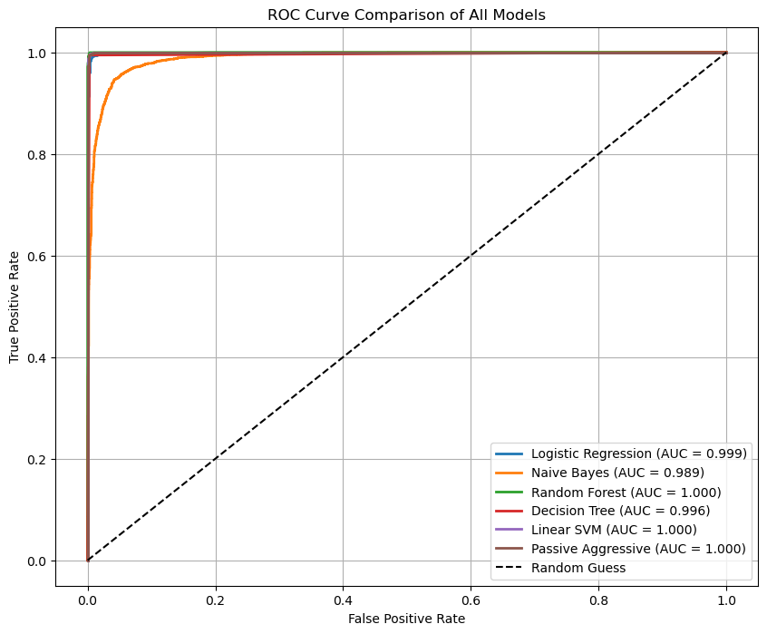
Model Performance Comparison
Model | Accuracy | Precision | Recall | F1 Score
Random Forest | 99.88% | 99.86% | 99.88% | 99.87%
Linear SVM | 99.69% | 99.60% | 99.74% | 99.67%
Passive Aggressive | 99.68% | 99.58% | 99.74% | 99.66%
Decision Tree | 99.61% | 99.60% | 99.58% | 99.59%
Logistic Regression | 99.23% | 98.92% | 99.46% | 99.19%
Naive Bayes | 94.93% | 94.42% | 94.93% | 94.68%

Slide 9
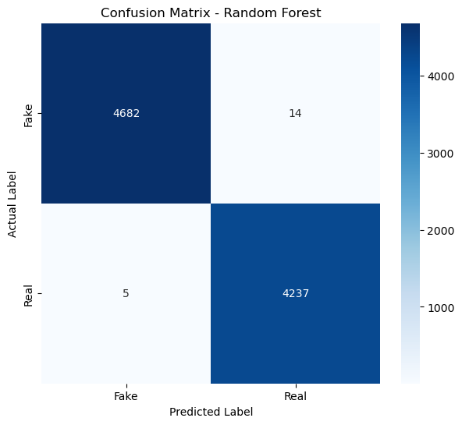

Confusion Matrix & Error Analysis
RANDOM FOREST (BEST PERFORMANCE)
Accuracy: 99.88% | F1 Score: 99.87% • True Negatives (Fake): 4,690 | True Positives (Real): 4,237 • False Positives: 6 | False Negatives: 5 Only 11 total errors out of 8,938 test samples.
LOGISTIC REGRESSION (BASE MODEL)
Accuracy: 99.23% | F1 Score: 99.19% • True Negatives (Fake): 4,650 | True Positives (Real): 4,219 • False Positives: 46 | False Negatives: 23 Slightly higher error rates, but runs in 0.28 seconds.

Slide 10
Conclusions & Critical Takeaways
1. High Efficacy of Traditional Classifiers
Traditional machine learning algorithms (Random Forest, SVM, Passive Aggressive) achieved near-perfect accuracy (>99.6%). This indicates that when raw text is preprocessed rigorously (cleaning URLs, HTML, punctuation, and selective stopword removal), TF-IDF vectorization with unigrams and bigrams provides a highly discriminative feature space.
2. Critical Technical Insight: Retaining Negations
In the stopword removal stage, keeping negation terms ('not', 'no', 'nor') was a crucial design choice. Removing these words is a common mistake that strips context, as 'not real' and 'real' would map to the same core representation. Retaining them preserves basic logic structure, which benefits TF-IDF classifiers.
3. Critical Evaluation: Source & Publisher Bias
A deeper investigation of the dataset reveals a major source bias. Real news is heavily comprised of Reuters articles, which regularly start with specific signifiers like 'WASHINGTON (Reuters)' or '(Reuters)'. The classifiers likely pick up on these exact bigram features ('reuters', 'washington reuters') as strong proxies for authenticity. In real-world deployment, these publisher signifiers should be stripped before model training to evaluate pure linguistic and stylistic differences.

