Slide 1





NEXT GEN EMPLOYABILITY PROGRAM
College Name: Vignana Bharathi Engineering College, Hyderabad
Team Name: EY Team _29
https://nextgen.edunetworld.com
nextgenep@edunetfoundation.org

Slide 2
CAPSTONE PROJECT SHOWCASE
Project title: Cloud Based Website for tourist places
Problem Statement| Project Overview| Solution & Proposed Value Proposition | Wow Factor | Modelling & Results | Team Intro | Q&A
Notes:
Let me quickly walk you through the brief plan for today. We are going to discuss the need for this program, what it offers to the students, how it will help you choose a fine career pathway, how to get enrolled in this program and so on….

Slide 3

V
PROBLEM STATEMENT
To create a user-friendly and efficient cloud-based website dedicated to assisting travelers in planning their trips to various tourist destinations. This website will serve as a valuable resource, allowing users to easily explore and organize their travel itineraries with convenience and effectiveness.
Notes:
We now request our technical expert Mr so and so to help you understand the finer details of the course and curriculum.

Slide 4
Project overview
Goals & Objectives
Responsive Design
Expected Outcomes
Information quality
Responsiveness
Customer service
Accessibility
Navigation
Visual appearance
Trust
Ease of use
Interactivity
Attractive Layout
Uploading to cloud
Gather popular tourist places information

Slide 5
SOLUTION:
Collected information of various places
Created a website using HTML, CSS
Added google maps for directions
Integrated with MakeMyTrip
Included various tourist places

Slide 6
THE WOW in your solution
Straightforward search filters
Predictive Search
Beautiful images
Customer feedback
Google map integration
MakeMyTrip integration

Slide 7
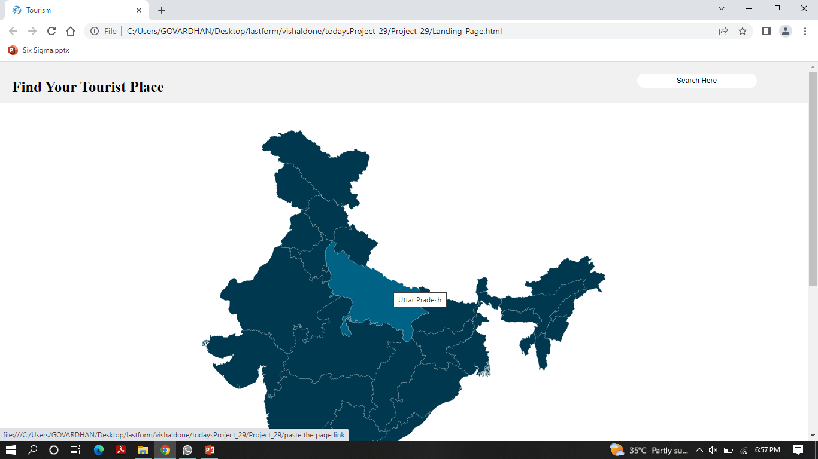
Modelling & ReportS

Slide 8
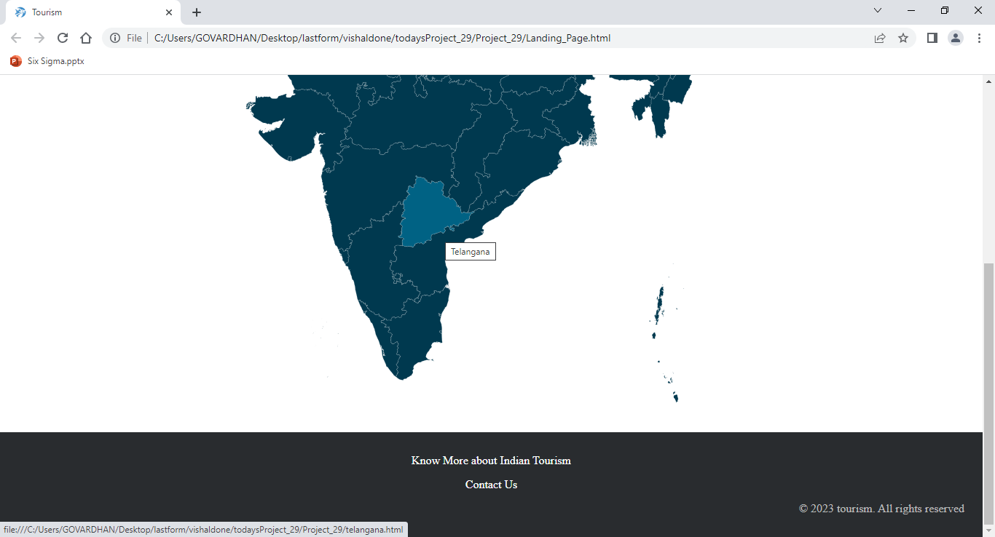
Modelling & Reports

Slide 9
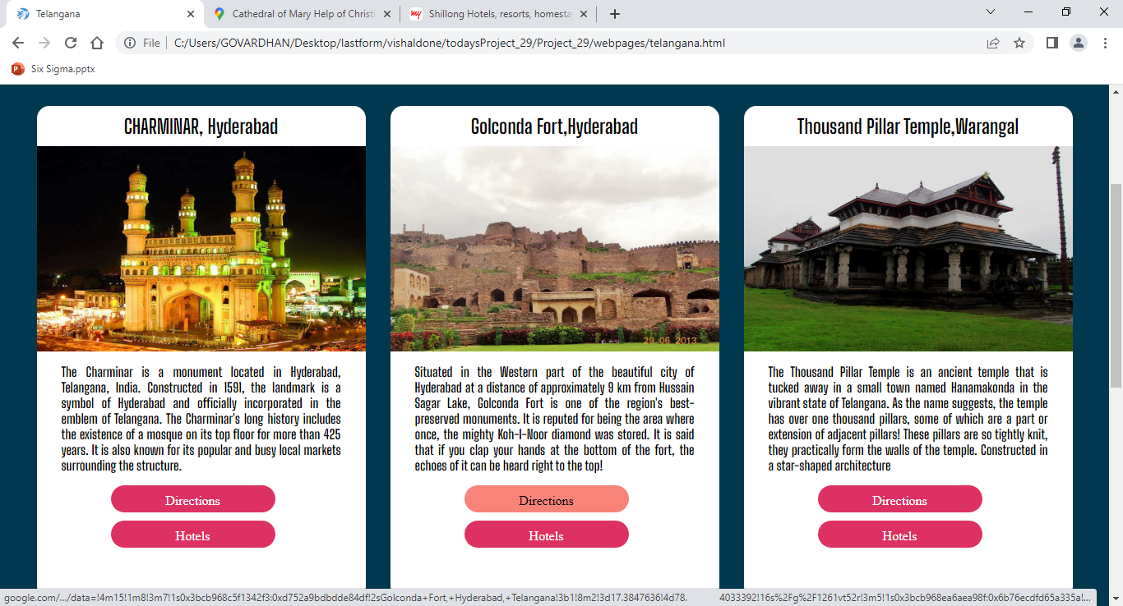
Modelling & Reports

Slide 10
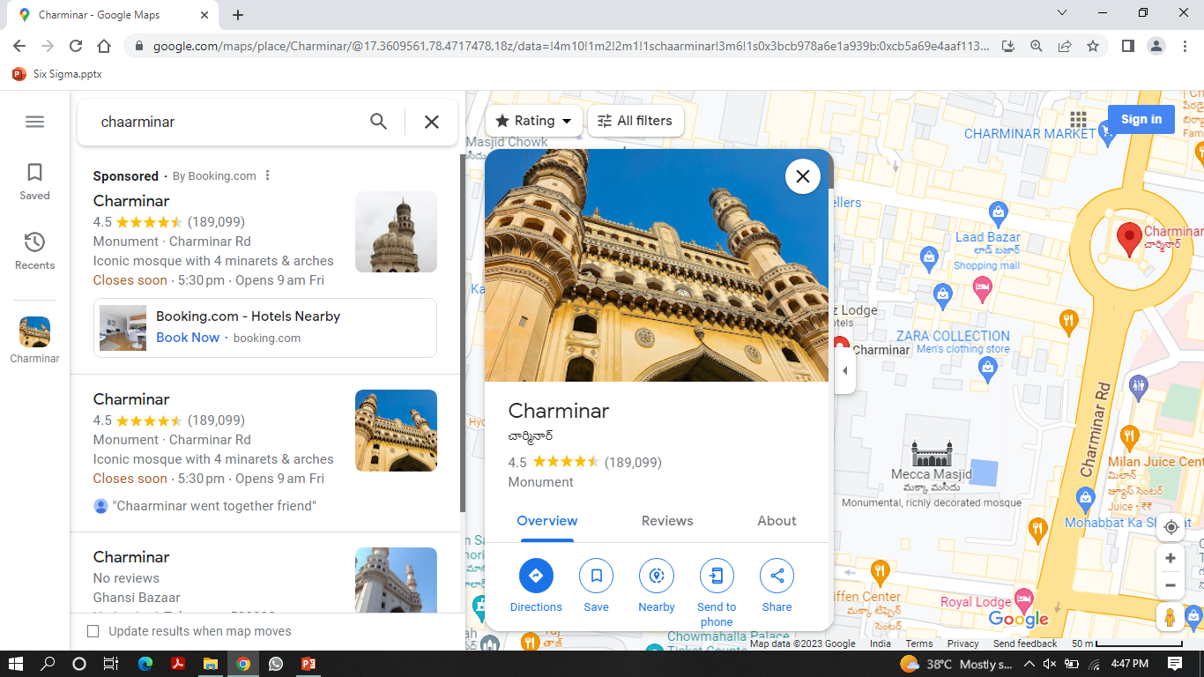
Modelling & reports

Slide 11
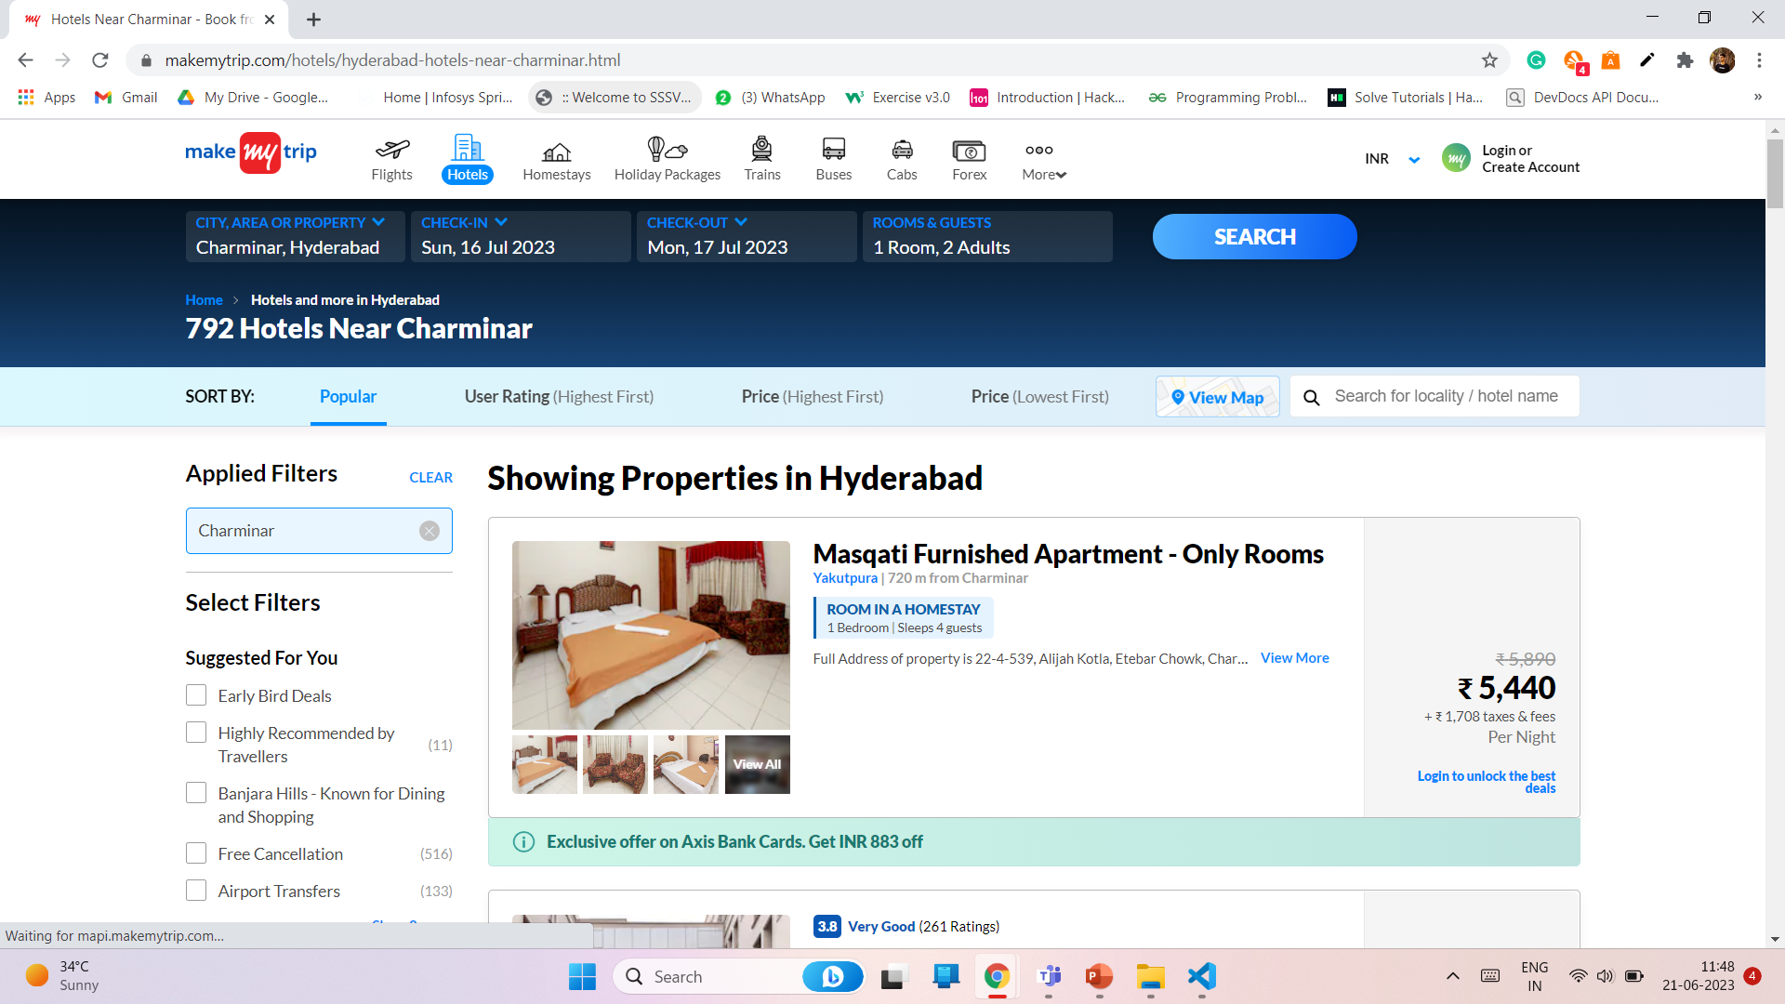
Modelling & reports

Slide 12
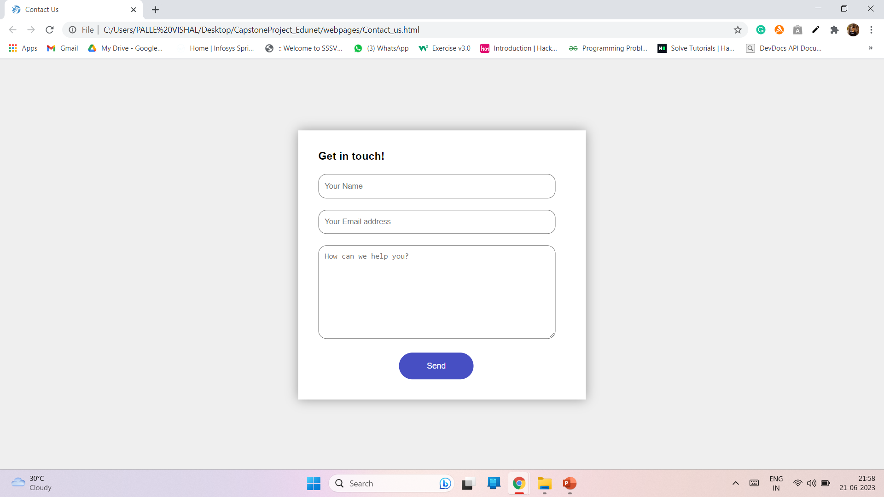
Modelling & reports

Slide 13
ABOUT OUR TEAM
TEAM MEMBERS
GUIDED BY
S. VIVEK RAO
P. VISHAL
P. VIVEK
T. ANJANEYULU
P. SAI TARUN
DR. DIANA BABY

Slide 14


Any
questions/comments?

