Slide 1
Boston Housing Project
By
Vishal Panchal

Slide 2
ABOUT THE PROJECT :
THE BOSTON HOUSING DATASET CONSISTS OF INFORMATION ON HOUSING IN BOSTON, MASSACHUSETTS. IT HAS ABOUT 506 ROWS AND 14 COLUMNS OF DATA.
THE COLUMNS CONSIST OF MANY PARAMETERS SUCH AS CRIM RATE, ZN, INDUS, NOX, RM, AGE, DIS, RAD, TAX, PTRATIO, B, LSTAP, MEDV.
THIS STUDY HELPS YOU TO UNDERSTAND FACTORS IMPACTING HOUSING PRICES, SOCIOECONOMIC IMPACTS, URBAN PLANNING NEEDS, REAL ESTATE INVESTMENT STRATEGIES, AND POLICY-MAKING.

Slide 3
PROBLEM STATEMENT :
What is the mean and median value of MEDV?
What is the distribution of 'Crim' values?
What is the average number of rooms ('rm') per dwelling?
What is the average MEDV for tracts that bound the river (CHAS = 1) compared to those that don’t (CHAS = 0)?
What is the average nitric oxide concentration (NOX) for different values of ‘INDUS’?
What is the average proportion of owner-occupied units built before 1940 (age)?
What is the average distance ('dis') to Boston employment centers for different rad values?
What is the average ‘ MEDV ' for each ' rad ' value?
What is the average 'tax' for different 'rad' values?
What is the average ‘PTRATIO' (pupil-teacher ratio) for towns with different 'chas' values?
What is the average value of 'b' (proportion of Black residents) across different 'rad' values?
What is the correlation between ‘LSTATE' and 'medv’?
Create a scatter plot of 'rm' against 'medv'. What trend do you observe?
Create a pivot table summarizing the total count of 'towns' for each value of 'rad' and 'chas’.
Question15:How does the crime rate (CRIM) impact property values (MEDV)?

Slide 4
Mean and Median Value of 'MEDV’ :
To understand the central tendency of housing prices.

Slide 5
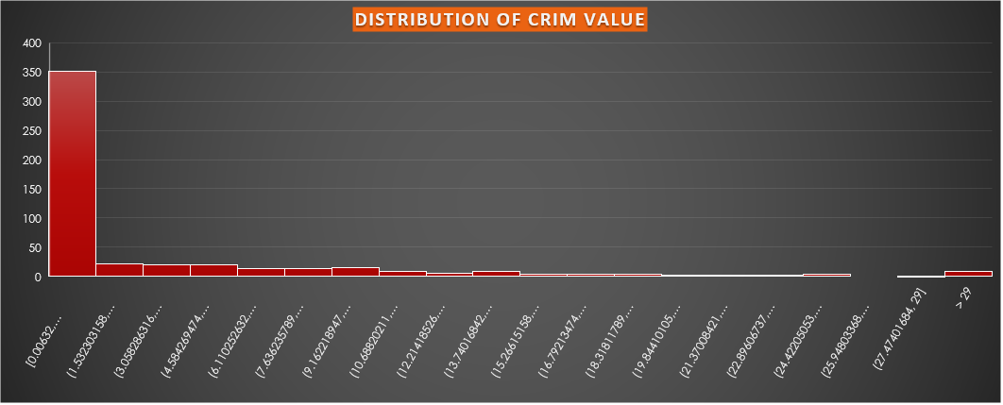
Distribution of 'crim' Values :
To analyze the spread and frequency of crime rates in different areas.

Slide 6
Average Number of Rooms ('rm') per Dwelling :
To get an idea of the typical size of homes in the dataset.

Slide 7
Average 'MEDV' for Tracts Bound by the River::
To examine if being near the river affects housing prices.

Slide 8
Average 'NOX' for Different 'INDUS' Values:
To study the impact of industrial activity on air quality.

Slide 9
Average Proportion of Owner-Occupied Units Built Before 1940 ('age’) :
To understand the age distribution of homes in the dataset.

Slide 10
Average 'dis' for Different 'rad' Values:
To analyze how accessibility to employment centers varies by location.

Slide 11
Average 'MEDV' for Each 'RAD' Value :
To see how housing prices vary with different accessibility indices.

Slide 12
Average 'tax' for Different 'rad' Values :
To investigate how property taxes vary with accessibility indices.

Slide 13
Average 'PTRATIO' for Different 'Chas' Values:
To examine if proximity to the river affects education quality.

Slide 14
Average 'b' Across Different 'rad' Values:
To understand the demographic distribution with respect to accessibility indices.

Slide 15
Correlation Between 'LSTAT' and 'MEDV’ :
To study the relationship between lower status of the population and housing prices.

Slide 16
Scatter Plot of 'RM' Against 'MEDV’ :
To visualize the trend between the number of rooms and housing prices.

Slide 17
Pivot Table of TOWNS Count by 'RAD' and 'CHAS':
To provide a summary count of towns by accessibility and proximity to the river.

Slide 18
The crime rate (CRIM) impact property values (MEDV):
Higher crime rates typically decrease property values due to lower perceived safety, reduced demand, higher insurance costs, and poorer quality of life.

Slide 19
CONCLUSION :
The Boston housing dataset analysis provides valuable insights into factors affecting home values.
These insights are beneficial for real estate professionals, urban planners, and policymakers, helping them make informed decisions.
Continuous exploration and advanced analytical methods will further enhance the utility and accuracy of the insights derived from the data.

Slide 20
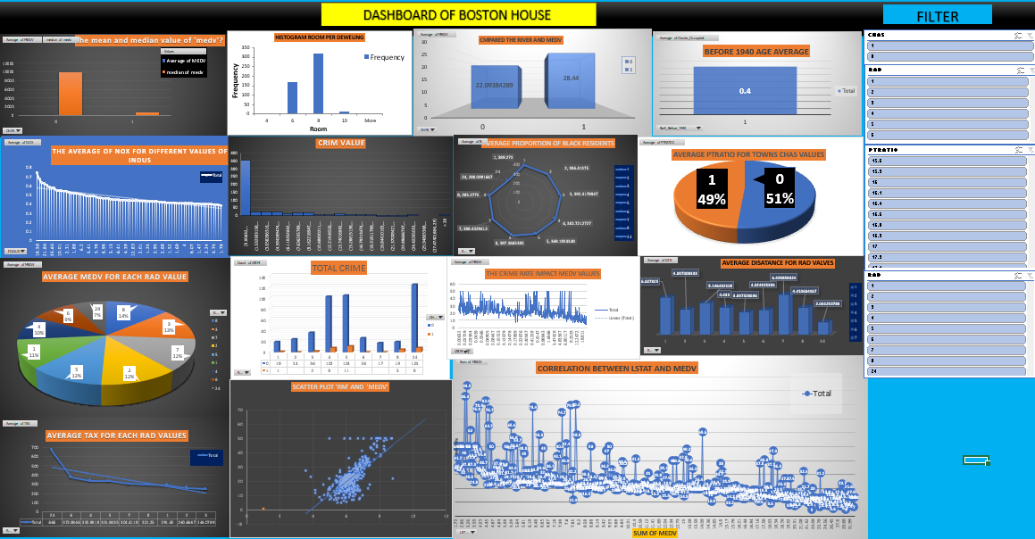

Slide 21
THANK YOU

