Slide 1
Supply Chain Management Using Blockchain
Vidyavardhini’s College of Engineering & Technology
K.T. Marg, Vartak College Campus, Vasai Rd, Vasai-Virar, Maharashtra 401202
Department of Computer Science and Engineering [Data Science]
Group No: NN
Samruddhi Mhatre roll No
Akash Adarkar roll No
Vishal Phatkare 47
Prof. Sumeet Shingi
Date: 17/10/2023

Slide 2
Contents
Introduction
Problem Statement
Literature Survey
Proposed System
Architecture/Framework/Block diagram/Algorithm/Process Design
Details of Hardware/Software used
Output
Result Analysis
Conclusion
References
Thank you

Slide 3
Introduction
Modern supply chains involve multiple stakeholders, complex processes, and a high volume of transactions, making them prone to inefficiencies and fraud.
Blockchain enables the creation of a transparent and traceable supply chain, allowing every participant to view and verify transactions in real-time.
Smart contracts on blockchain automate and enforce agreements between parties, such as payment upon receipt of goods or meeting specific conditions.
Blockchain uses encryption and consensus mechanisms to secure data, reducing the risk of data breaches and fraudulent activities.
Participants can access real-time updates on the movement and status of goods, leading to better decision-making and reduced delays.
Blockchain reduces paperwork, manual processes, and intermediaries, streamlining operations and reducing costs.

Slide 4
Problem Statement
Traditional supply chain systems may lack the transparency and visibility required to track goods and transactions in real-time. This opacity can lead to inefficiencies, delays, and difficulties in resolving disputes.
Without the immutability of blockchain, supply chain data is vulnerable to tampering and manipulation. This can result in fraud, counterfeit products, and unreliable records, impacting the authenticity and quality of products.

Slide 5
Literature Survey
Sr. No | Paper Title | Advantages | Disadvantages
1 | Blockchain Technology for Supply Chain Management, 2022 | Real-time, transparent access to supply chain data for all participants. | High transparency may not be suitable for certain confidential information.
2 | Smart Supply Chain Management Using the Blockchain and Smart Contract, 2021 | Records on a blockchain are tamper-proof, ensuring the integrity of data. | Errors in recording data can be difficult to correct once added.
3 | The impact of the blockchain on the supply chain, 2018 | Access to real-time data improves decision-making | Dependence on the speed and efficiency of the blockchain network.
4 | Blockchain in Supply Chain Management, 2022 | Blockchain enables end-to-end traceability, ensuring product authenticity | The complexity of recording extensive product data on the blockchain can be challenging.
5 | Blockchain technology in supply chain management, 2022 | Blockchain can track the environmental impact of products | Some blockchain networks have significant energy consumption

Slide 6
Proposed system
Lack of Transparency: Traditional supply chain systems may lack the transparency and visibility required to track goods and transactions in real-time. This opacity can lead to inefficiencies, delays, and difficulties in resolving disputes.
Data Inaccuracy and Fraud: Without the immutability of blockchain, supply chain data is vulnerable to tampering and manipulation. This can result in fraud, counterfeit products, and unreliable records, impacting the authenticity and quality of products.
Increased Costs: Traditional supply chain systems often involve manual processes and multiple intermediaries. This can result in higher operational costs due to labor-intensive tasks and the need for third-party verification.
Inefficient Processes: Manual interventions and paperwork in traditional supply chains can lead to slower processes, bottlenecks, and a lack of real-time data. This can result in delays in product delivery and decision-making.
Increased Risk of Disputes: The lack of transparent, immutable records can result in disagreements and disputes among supply chain participants, leading to costly legal issues and damaged relationships.

Slide 7
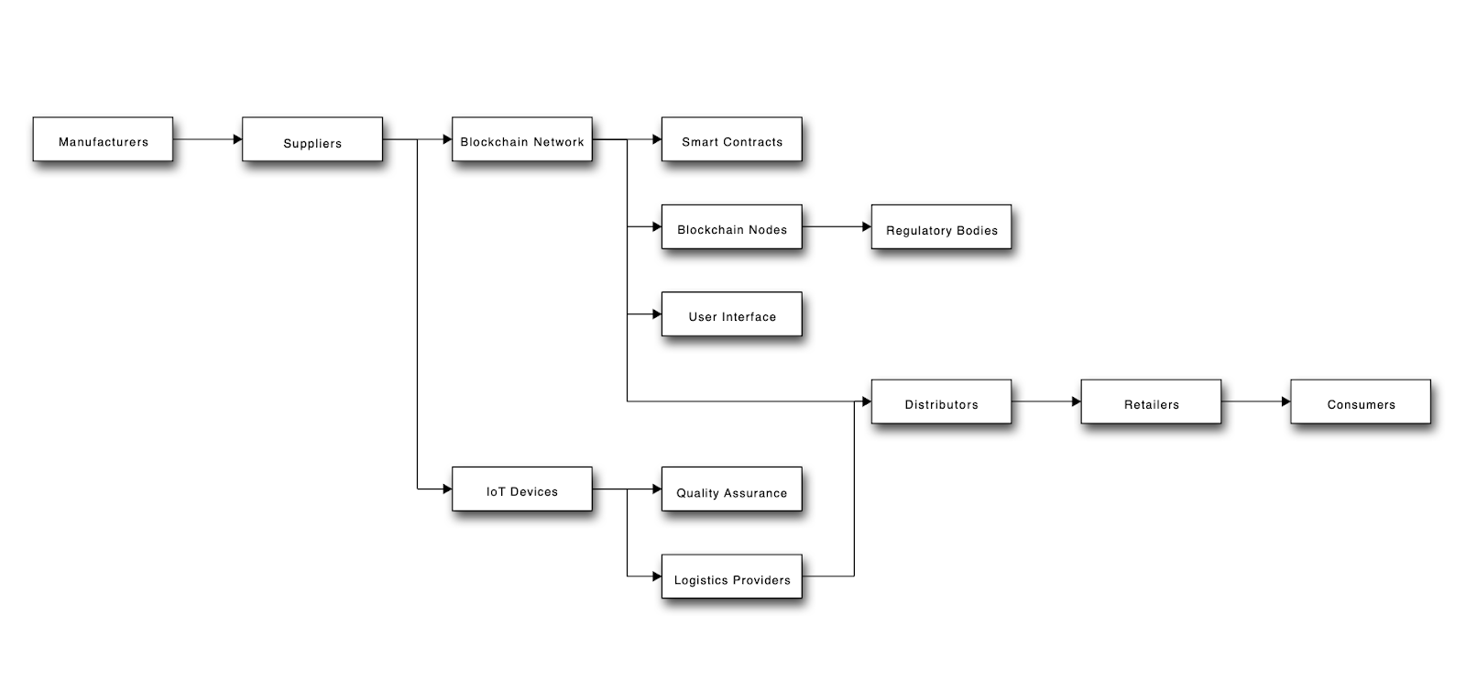
Framework

Slide 8
Details of Hardware/Software used
Hardware Requirements:
High-Performance CPUs: Intel i5 or i7
Sufficient RAM: Minimum 4 GB
Storage Space: 500 GB of storage. SSDs are preferred for faster data access.
Software Requirements:
Blockchain Platform:
Hyperledger Fabric
Ethereum
Smart Contract Development:
Solidity
Chaincod

Slide 9
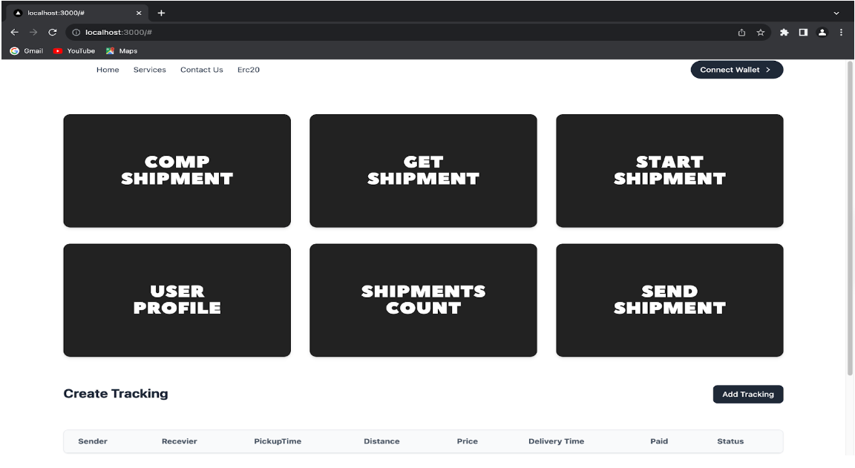
Output

Slide 10
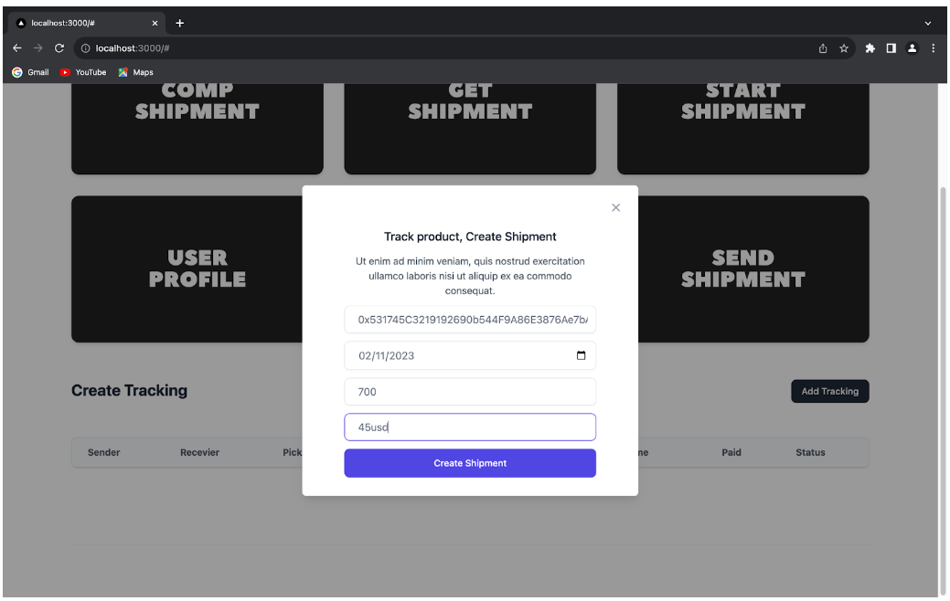

Slide 11
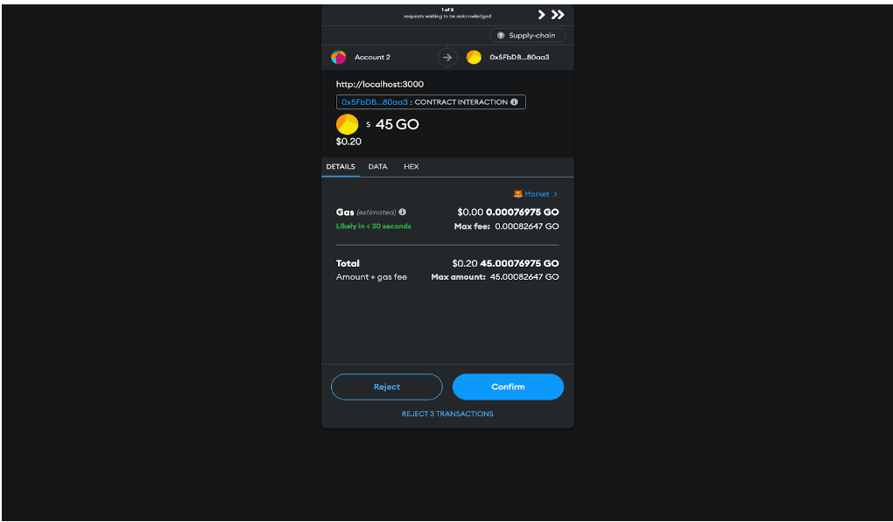

Slide 12
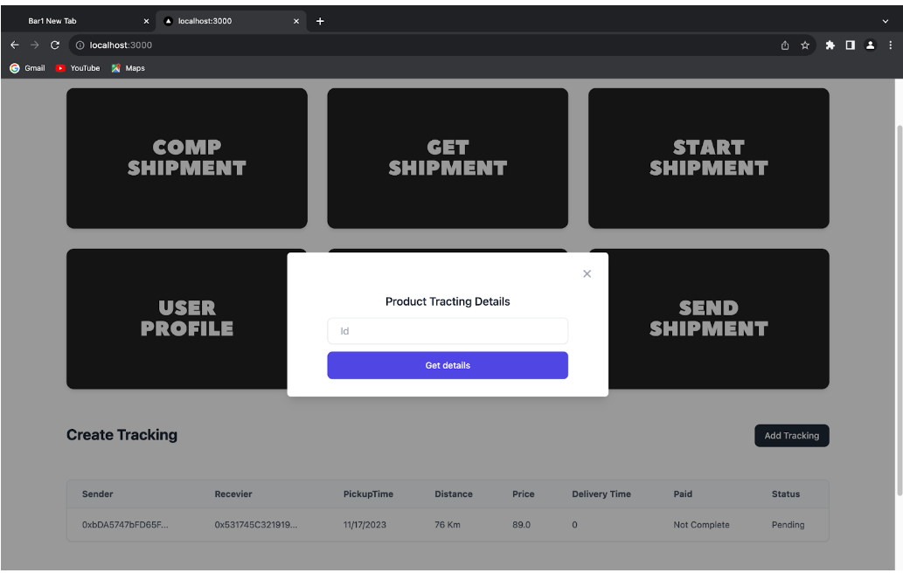

Slide 13
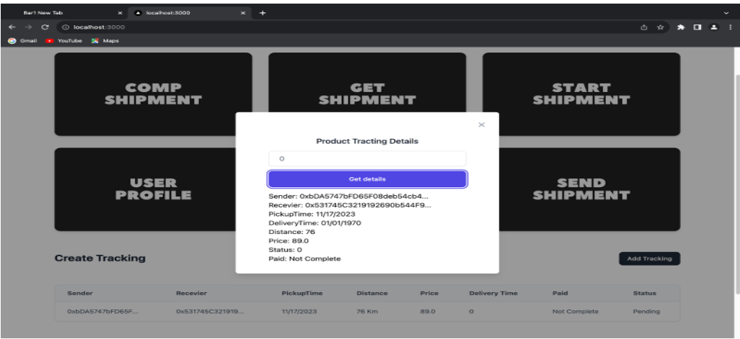

Slide 14
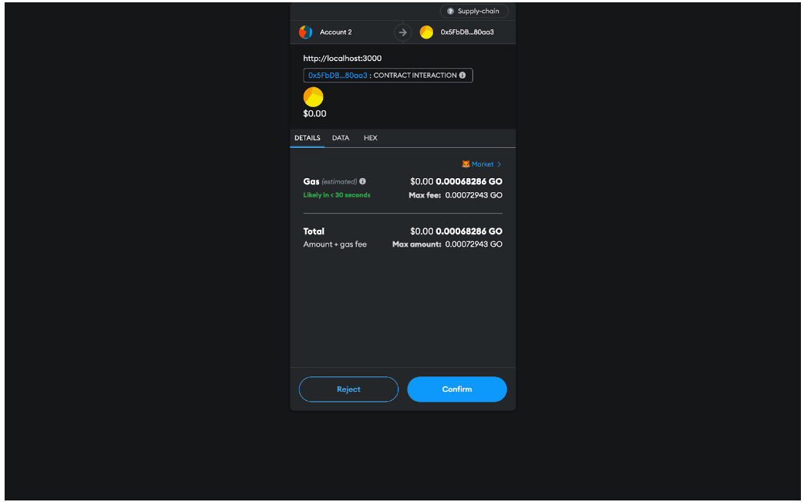

Slide 15
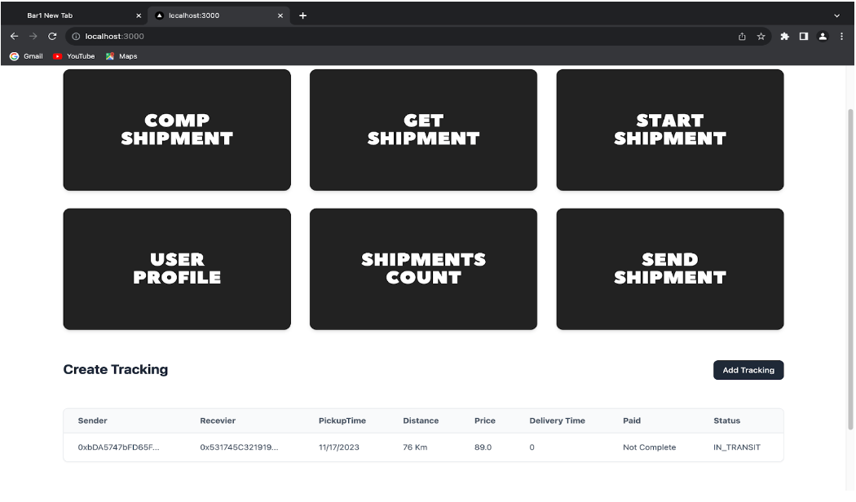

Slide 16
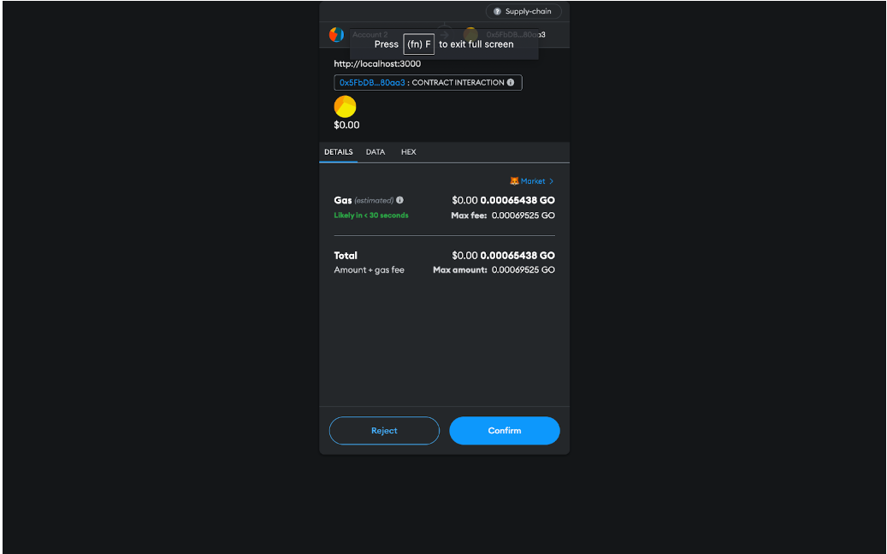

Slide 17
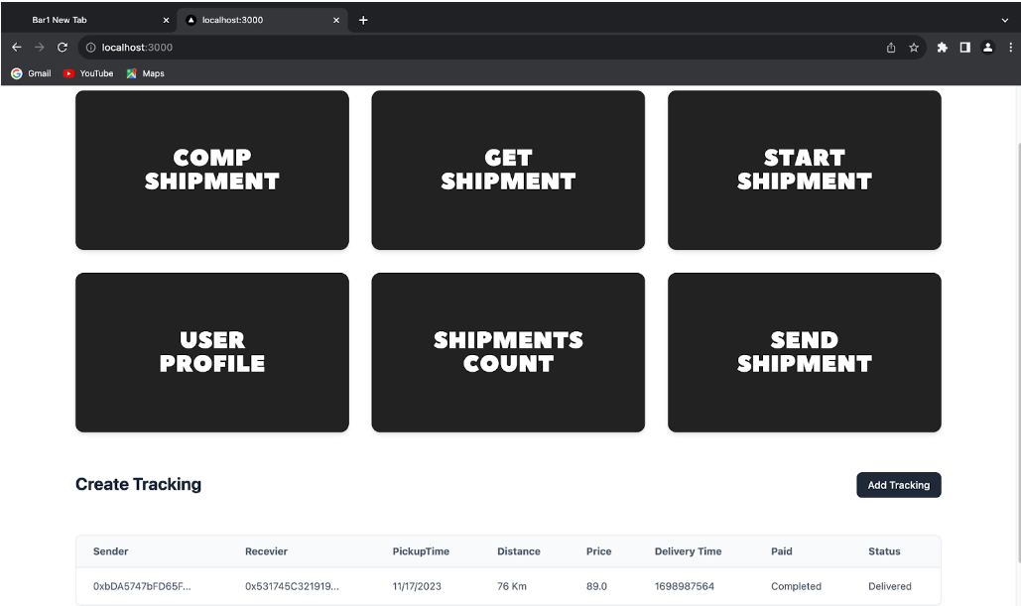

Slide 18
Result Analysis

Slide 19
Conclusion
Implementing Supply Chain Management Using Blockchain enhances transparency, reduces fraud, streamlines processes, and lowers operational costs. It offers real-time data access, quality control, compliance efficiency, and promotes environmental sustainability, leading to improved customer confidence, global supply chain coordination, and a resilient ecosystem. However, challenges like integration complexity and regulatory compliance must be addressed for effective implementation.

Slide 20
References
[1] Blockchain Technology for Supply Chain Management, 2022 Omega, vol. 34, no. 6, pp. 519–532, 2022.
[2]Smart Supply Chain Management Using the Blockchain and Smart Contract Supply Chain Management International Journal, vol. 13, no. 5, pp. 381–386, 2021
[3] The impact of the blockchain on the supply chain, 0e Journal of Excipients and Food Chemicals, vol. 7, no. 3, pp. 76–78, 2019.
[4] Blockchain in Supply Chain Management, January 2022.
[5] O. Alfandi, S. Otoum, and Y. Jaraweh, “Blockchain technology in supply chain management,” in Proceedings of the 2020 IEEE Network Operations and Management, 2022

Slide 21
Thank you

