Slide 1
Characteristics of a Organization
Characteristics that distinguish corporations from proprietorships and partnerships.
Separate Legal Existence
Limited Liability of Stockholders
Transferable Ownership Rights
Ability to Acquire Capital
Continuous Life
Government Regulations
Additional Taxes
Corporate Management
Advantages
Disadvantages

Slide 2
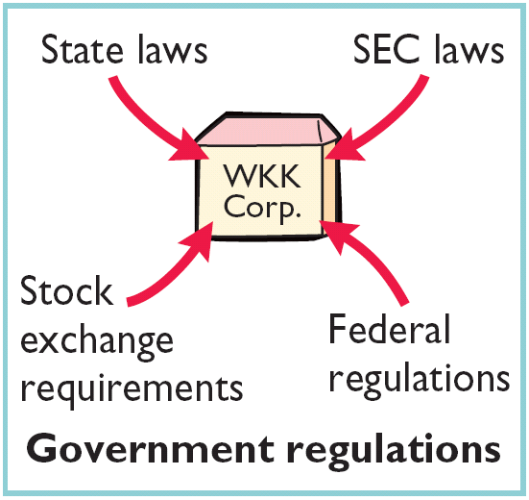
Characteristics of a Organization
Characteristics that distinguish corporations from proprietorships and partnerships.
Separate Legal Existence
Limited Liability of Stockholders
Transferable Ownership Rights
Ability to Acquire Capital
Continuous Life
Government Regulations
Additional Taxes
Corporate Management

Slide 3
Characteristics of a Organization
Characteristics that distinguish corporations from proprietorships and partnerships.
Separate Legal Existence
Limited Liability of Stockholders
Transferable Ownership Rights
Ability to Acquire Capital
Continuous Life
Government Regulations
Additional Taxes
Corporate Management
Corporations pay income taxes as a separate legal entity and in addition, stockholders pay taxes on cash dividends.

Slide 4
Characteristics of a Organization
Characteristics that distinguish corporations from proprietorships and partnerships.
Separate Legal Existence
Limited Liability of Stockholders
Transferable Ownership Rights
Ability to Acquire Capital
Continuous Life
Government Regulations
Additional Taxes
Corporate Management
Separation of ownership and management prevents owners from having an active role in managing the company.

Slide 5
Characteristics of a Organization
Stockholders
Chairman and
Board of
Directors
President and
Chief Executive
Officer
General
Counsel and
Secretary
Vice President
Marketing
Vice President
Finance/Chief
Financial Officer
Vice President
Operations
Vice President
Human
Resources
Treasurer
Controller

Slide 6
Forming a Corporation
Initial Steps:
Formed by grant of a state charter.
Corporation develops by-laws.
Companies generally incorporate in a state whose laws are favorable to the corporate form of business (Delaware, New Jersey).
Corporations expense organization costs as incurred.

Slide 7


Ownership Rights of Stockholders
Stockholders have the right to:
Illustration 11-3
1. Vote in election of board of directors and on actions that require stockholder approval.
2. Share the corporate earnings through receipt of dividends.

Slide 8
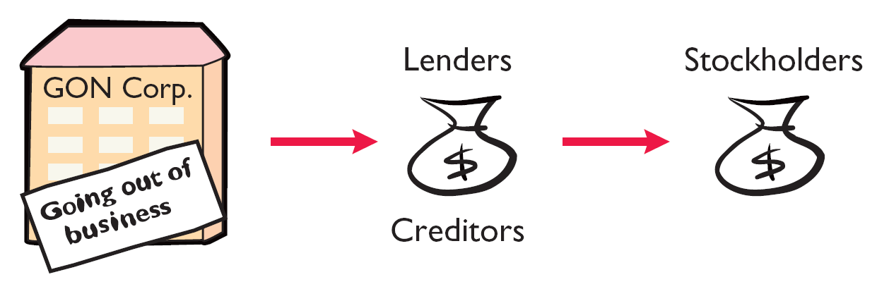
Ownership Rights of Stockholders
Stockholders have the right to:
Illustration 11-3
4. Share in assets upon liquidation in proportion to their holdings. This is called a residual claim.

Slide 9
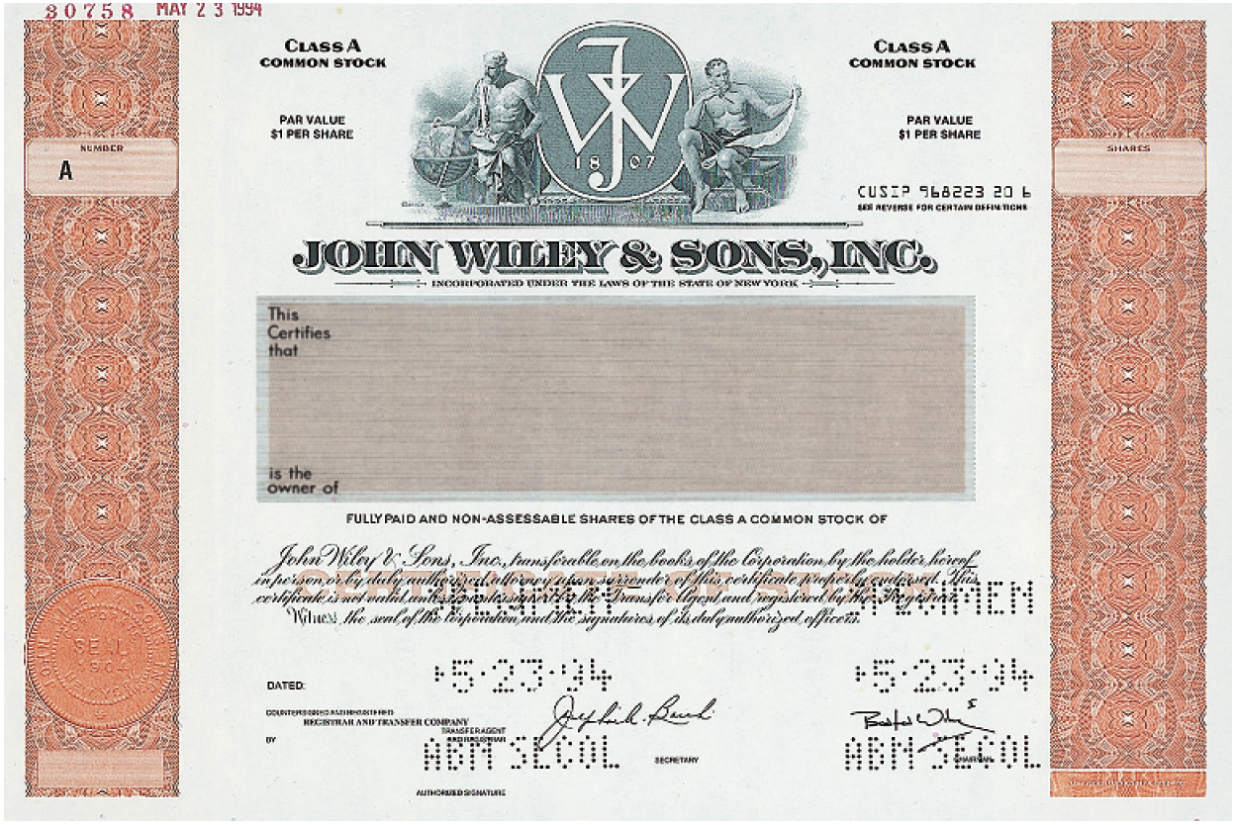

Ownership Rights of Stockholders
Illustration 11-4
Prenumbered
Class
Class A COMMON STOCK
Class A COMMON STOCK
PAR VALUE $1 PER SHARE
PAR VALUE $1 PER SHARE
Name of corporation
Stockholder’s name
Shares
Stock Certificate
Signature of corporate official

Slide 10
Stock Issue Considerations
Authorized Stock
Charter indicates the amount of stock that a corporation is authorized to sell.
Number of authorized shares is often reported in the stockholders’ equity section.

Slide 11
Stock Issue Considerations
Market Value of Stock
Stock of publicly held companies is traded on organized exchanges.
Interaction between buyers and sellers determines the prices per share.
Prices tend to follow the trend of a company’s earnings and dividends.
Factors beyond a company’s control, may cause day-to-day fluctuations in market prices.
National Association of Securities Dealers Automated Quotations
LO 1 Identify the major characteristics of a corporation.

Slide 12


Slide 13
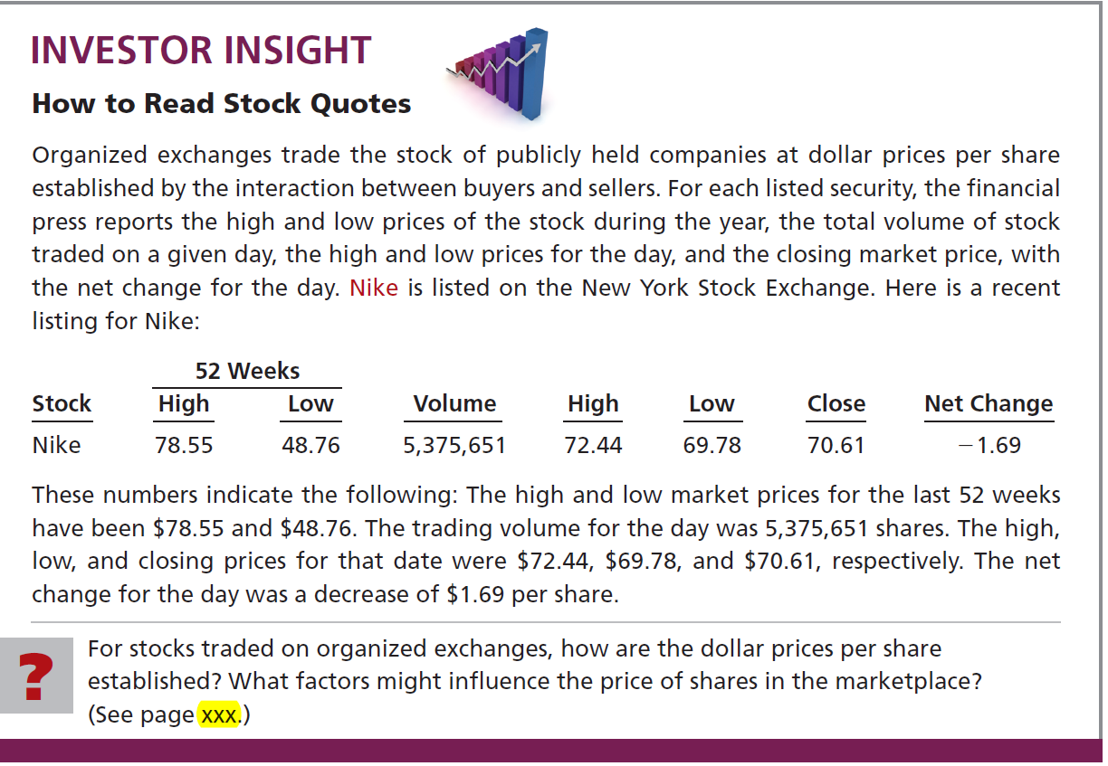


Slide 14
Stock Issue Considerations
Par and No-Par Value Stock
Years ago, par value determined the legal capital per share that a company must retain in the business for the protection of corporate creditors.
Today many states do not require a par value.
No-par value stock is quite common today.
In many states the board of directors assigns a stated value to no-par shares.

Slide 15
Corporate Capital
Common Stock
Account
Paid-in Capital
Paid-in Capital in Excess of Par
Account
Preferred Stock
Account
Two Primary Sources of Equity
Retained Earnings
Account
Paid-in capital is the total amount of cash and other assets paid in to the corporation by stockholders in exchange for capital stock.

Slide 16
Corporate Capital
Common Stock
Account
Paid-in Capital
Paid-in Capital in Excess of Par
Account
Preferred Stock
Account
Two Primary Sources of Equity
Retained Earnings
Account
Retained earnings is net income that a corporation retains for future use.

Slide 17




Accounting for Common Stock Issues
Issuing Par Value Common Stock for Cash
Illustration: Assume that Hydro-Slide, Inc. issues 2,000 shares of $1 par value common stock. First 1,000 shares are issued at par. Prepare Hydro-Slide’s journal entry if (a) if the next 1,000 share are issued for $1 per share, and (b) the next 1,000 shares are issued for $5 per share.
a)
Cash 1,000
Common stock (1,000 x $1) 1,000
b)
Cash 5,000
Common stock (1,000 x $1) 1,000
Paid-in capital in excess of par value 4,000

Slide 18
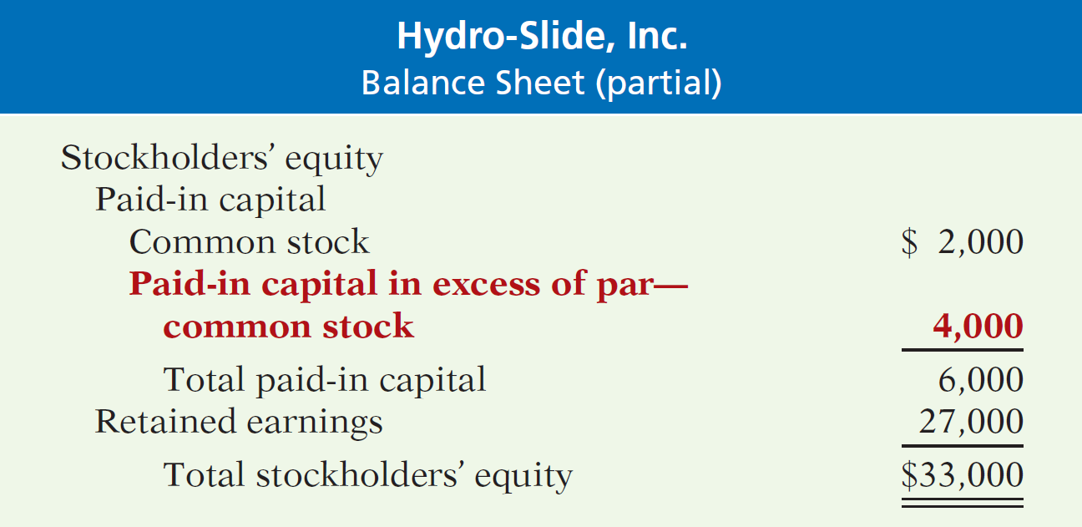
Accounting for Common Stock Issues
Illustration 11-7

Slide 19



Accounting for Common Stock Issues
Issuing No-Par Common Stock for Cash
Illustration: Assume that instead of $1 par value stock, Hydro-Slide, Inc. has $5 stated value no-par stock and the company issues 5,000 shares at $8 per share for cash.
Cash 40,000
Common stock 25,000
Paid-in capital in excess of stated value 15,000

Slide 20

Accounting for Common Stock Issues
Issuing No-Par Common Stock for Cash
Illustration: What happens when no-par stock does not have a stated value?
Cash 40,000
Common stock 40,000

Slide 21
Dividends
Distribution of cash or stock to stockholders on a pro rata (proportional) basis.
Types of Dividends:
Cash dividends.
Property dividends.
Stock dividends.
Scrip.
Dividends expressed: (1) as a percentage of the par or stated value, or (2) as a dollar amount per share.

Slide 22

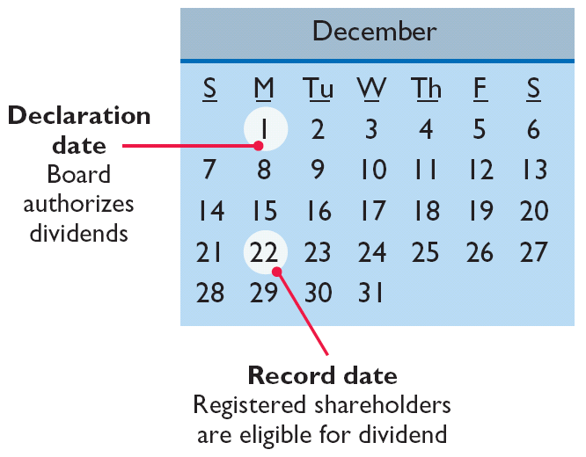
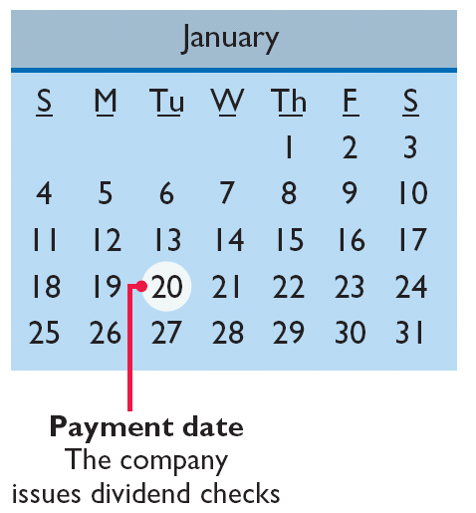
Dividends
Three dates:
Illustration 11-12

Slide 23
Dividends
Cash Dividends
For a corporation to pay a cash dividend, it must have:
  Retained earnings - Payment of cash dividends from retained earnings is legal in all states.
  Adequate cash.
  A declaration of dividends by the Board of Directors.

Slide 24
Cash Dividends
Illustration: On Dec. 1, the directors of Media General declare a 50¢ per share cash dividend on 100,000 outstanding shares of $10 par value common stock. 150,000 shares are authorized and 110,000 shares are issued. The dividend is payable on Jan. 20 to shareholders of record on Dec. 22.
December 1 (Declaration Date)
Cash dividends 50,000
Dividends payable 50,000
December 22 (Date of Record)
No entry
January 20 (Payment Date)
Dividends payable 50,000
Cash 50,000

Slide 25
Dividends
Stock Split
  Reduces the market value of shares.
  No entry recorded for a stock split.
  Decrease par value and increase number of shares.

Slide 26
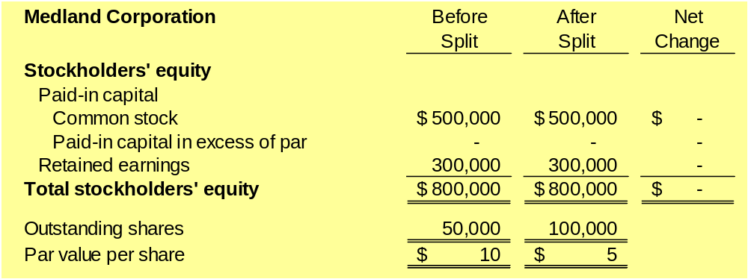
Dividends
Effects of Stock Splits NO JOURNAL ENTRY
Illustration 11-17

Slide 27
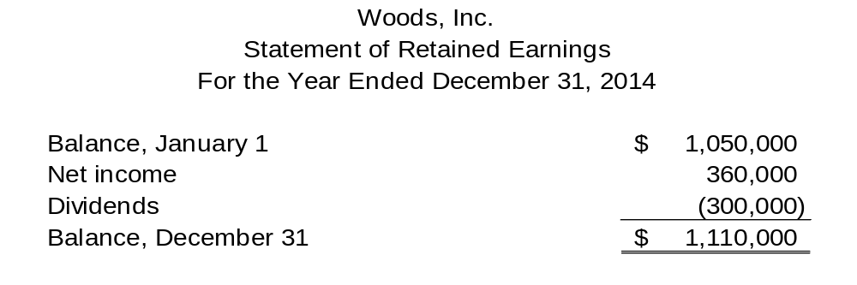
Retained Earnings Statement
Before issuing the report for the year ended December 31, 2014, you discover a $50,000 error (net of tax) that caused the 2013 inventory to be overstated (overstated inventory caused COGS to be lower and thus net income to be higher in 2013. Would this discovery have any impact on the reporting of the Statement of Retained Earnings for 2014?

Slide 28
Accounting for Common Stock
Illustration: Attorneys have helped Jordan Company incorporate. They have billed the company $5,000 for their services. They agree to accept 4,000 shares of $1 par value common stock in payment of their bill. At the time of the exchange, there is no established market price for the stock. Prepare the journal entry for this transaction.
Organizational Expense 5,000
Common Stock (4,000 x $1) 4,000
Paid-in Capital in Excess of Par 1,000
LO 2

Slide 29
Accounting for Common Stock
Illustration: Athletic Research Inc. is an existing publicly held corporation. Its $5 par value stock is actively traded at $8 per share. The company issues 10,000 shares of stock to acquire land recently advertised for sale at $90,000. Prepare the journal entry for this transaction.
Land 80,000
Common Stock (10,000 x $5) 50,000
Paid-in Capital in Excess of Par 30,000
LO 2

Slide 30
Accounting for Stock Transactions
Accounting for Preferred Stock
Typically, preferred stockholders have a priority as to:
  Distributions of earnings (dividends).
  Assets in event of liquidation.
  Generally do not have voting rights.
Accounting for preferred stock at issuance is similar to that for common stock.
LO 4

Slide 31
Accounting for Preferred Stock
Illustration: Stine Corporation issues 10,000 shares of $10 par value preferred stock for $12 cash per share. The journal entry to record the issuance is:
Cash 120,000
Preferred Stock (10,000 x $10) 100,000
Paid-in Capital in Excess of Par 20,000
Preferred stock may have a par value or no-par value.
LO 4

Slide 32
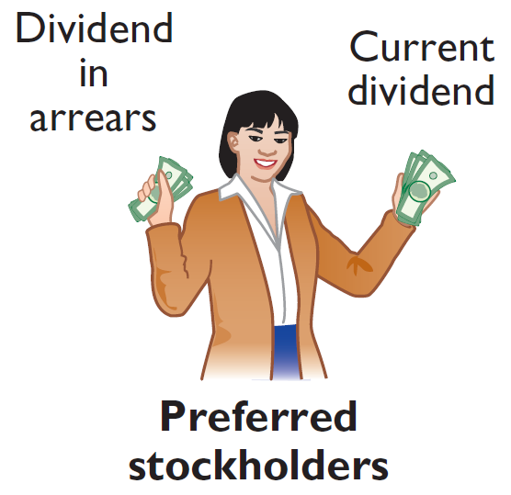
Accounting for Preferred Stock
Dividend Preferences
Right to receive dividends before common stockholders.
Per share dividend amount is stated as a percentage of the preferred stock’s par value or as a specified amount.
Cumulative Dividend Preferred stockholders must be paid both current-year dividends and any unpaid prior-year dividends before common stockholders receive dividends.
LO 4

Slide 33
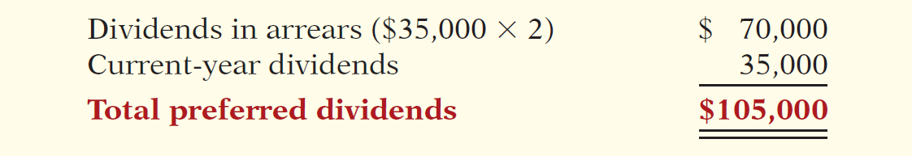

Accounting for Preferred Stock
Cumulative Dividend
Illustration: Scientific Leasing has 5,000 shares of 7%, $100 par value, cumulative preferred stock outstanding. Each $100 share pays a $7 dividend (.07 x $100). The annual dividend is $35,000 (5,000 x $7 per share). If dividends are two years in arrears, preferred stockholders are entitled to receive the following dividends in the current year.
Illustration 11-11
Computation of total dividends to preferred stock
Advance slide in presentation mode to reveal dividend amounts.
LO 4

Slide 34
Dividends
Allocating Cash Dividends Between Preferred and Common Stock
Holders of cumulative preferred stock must be paid any unpaid prior-year dividends and their current year’s dividend before common stockholders receive dividends.
LO 5

Slide 35
Dividends
Illustration: On December 31, 2015, IBR Inc. has 1,000 shares of 8%, $100 par value cumulative preferred stock. It also has 50,000 shares of $10 par value common stock outstanding. At December 31, 2015, the directors declare a $6,000 cash dividend. Prepare the entry to record the declaration of the dividend.
Cash Dividends 6,000
Dividends Payable 6,000
Preferred Dividends: 1,000 shares x $100 par x 8% = $8,000
LO 5

Slide 36
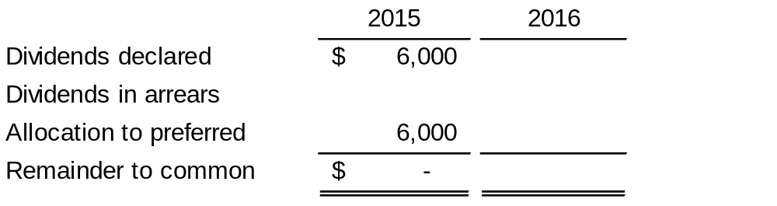
Dividends
Illustration: At December 31, 2016, IBR declares a $50,000 cash dividend. Show the allocation of dividends to each class of stock.
$ 50,000
2,000
**
8,000
*
$ 40,000
* 1,000 shares x $100 par x 8% = $8,000
** 2015 Pfd. dividends $8,000 – declared $6,000 = $2,000
LO 5

Slide 37
Accounting for Preferred Stock
Liquidation Preferences
Most preferred stocks have a preference on corporate assets if the corporation fails.
Provides security for the preferred stockholder.
Preference to assets may be for the par value of the shares or for a specified liquidating value.
LO 4

Slide 38
Accounting for Treasury Stock
Treasury stock - corporation’s own stock that it has reacquired from shareholders, but not retired.
Corporations purchase their outstanding stock:
  To reissue the shares to officers and employees under bonus and stock compensation plans.
  To enhance the stock’s market value.
  To have additional shares available for use in the acquisition of other companies.
  To increase earnings per share.
LO 3 Explain the accounting for treasury stock.

Slide 39
Accounting for Treasury Stock
Purchase of Treasury Stock
Debit Treasury Stock for the price paid to reacquire the shares.
Treasury stock is a contra stockholders’ equity account, not an asset.
Purchase of treasury stock reduces stockholders’ equity.
LO 3 Explain the accounting for treasury stock.

Slide 40
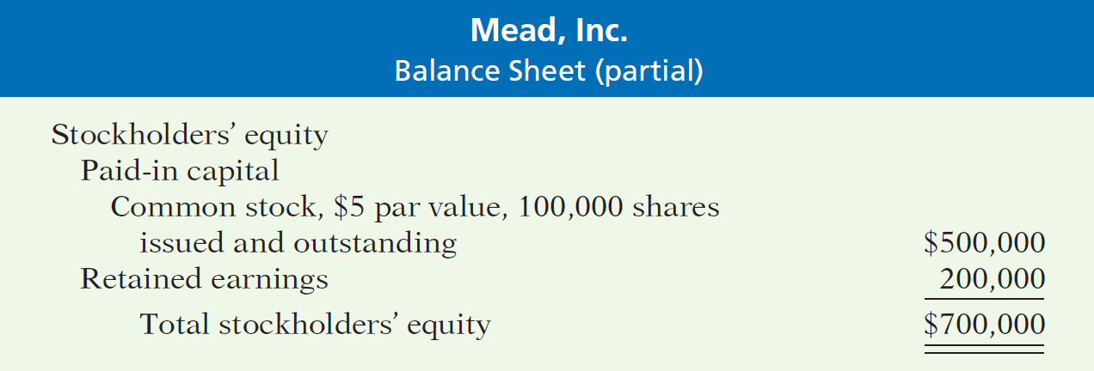
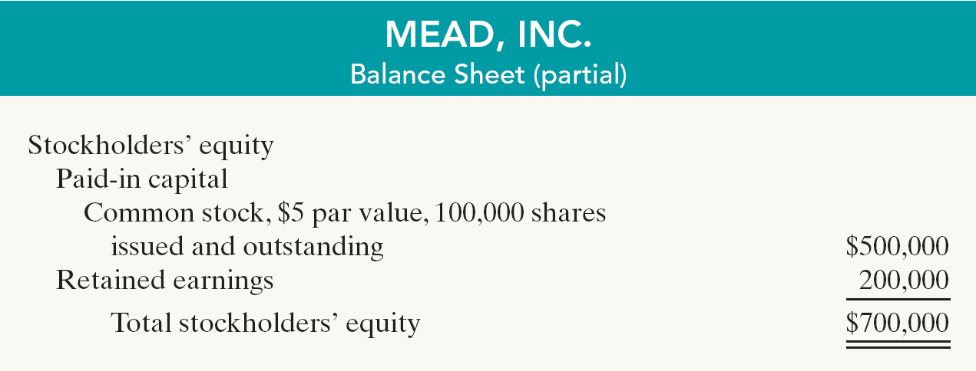
Accounting for Treasury Stock
Illustration 11-8
Illustration: On February 1, 2014, Mead acquires 4,000 shares of its stock at $8 per share.
Treasury stock (4,000 x $8) 32,000
Cash 32,000
LO 3 Explain the accounting for treasury stock.

Slide 41
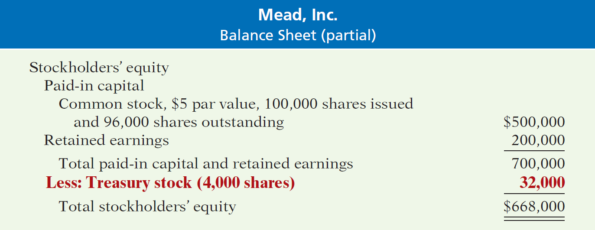
Accounting for Treasury Stock
Stockholders’ Equity with Treasury stock
Illustration 11-9
Both the number of shares issued (100,000), outstanding (96,000), and the number of shares held as treasury (4,000) are disclosed.
LO 3 Explain the accounting for treasury stock.

Slide 42
Accounting for Treasury Stock
Disposal of Treasury Stock
Sale of Treasury Stock
  Above Cost
  Below Cost
Both increase total assets and stockholders’ equity.
LO 3 Explain the accounting for treasury stock.

Slide 43
Above Cost
Accounting for Treasury Stock
Illustration: On July 1, Mead sells for $10 per share 1,000 shares of its treasury stock, previously acquired at $8 per share.
July 1
Cash 10,000
Treasury stock 8,000
Paid-in capital treasury stock 2,000
A corporation does not realize a gain or suffer a loss from stock transactions with its own stockholders.
LO 3 Explain the accounting for treasury stock.

Slide 44
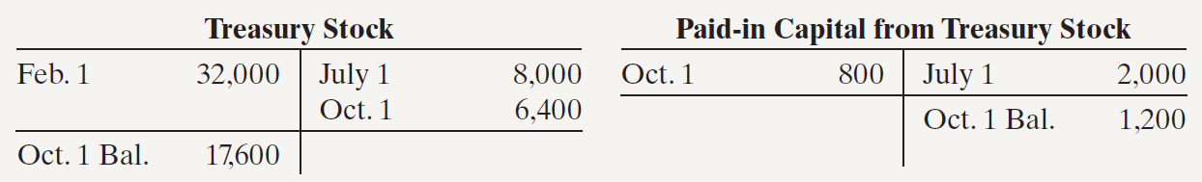
Below Cost
Accounting for Treasury Stock
Illustration: On Oct. 1, Mead sells an additional 800 shares of treasury stock at $7 per share.
Oct. 1
Cash 5,600
Paid-in capital treasury stock 800
Treasury stock 6,400
Illustration 11-10
LO 3 Explain the accounting for treasury stock.

Slide 45
Below Cost
Accounting for Treasury Stock
Illustration: On Dec. 1, assume that Mead, Inc. sells its remaining 2,200 shares at $7 per share.
Dec. 1
Cash 15,400
Limited to balance on hand
Paid-in capital treasury stock 1,200
Retained earnings 1,000
Treasury stock 17,600
LO 3 Explain the accounting for treasury stock.

