Slide 1
Usefulness and Format
Usefulness of the Statement of Cash Flows
Provides information to help assess:
  Entity’s ability to generate future cash flows.
  Entity’s ability to pay dividends and meet obligations.
  Reasons for difference between net income and net cash provided (used) by operating activities.
  Cash investing and financing transactions during the period.
LO 1

Slide 2
Usefulness and Format
Classification of Cash Flows
Operating Activities
Investing Activities
Financing Activities
Income Statement Items
Changes in Investments and Long-Term Asset Items
Changes in Long-Term Liabilities and Stockholders’ Equity Items
LO 2

Slide 3
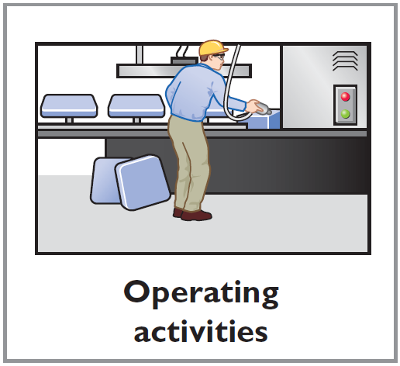
Usefulness and Format
Classification of Cash Flows
Operating activities—Income statement items
Cash inflows:
From sale of goods or services.
From interest received and dividends received.
Cash outflows:
To suppliers for inventory.
To employees for wages.
To government for taxes.
To lenders for interest.
To others for expenses.
LO 2

Slide 4
Usefulness and Format
Classification of Cash Flows
Investing activities—Changes in investments and long-term assets
Cash inflows:
From sale of property, plant, and equipment.
From sale of investments in debt or equity securities of other entities.
From collection of principal on loans to other entities.
Cash outflows:
To purchase property, plant, and equipment.
To purchase investments in debt or equity securities of other entities.
To make loans to other entities.
LO 2

Slide 5
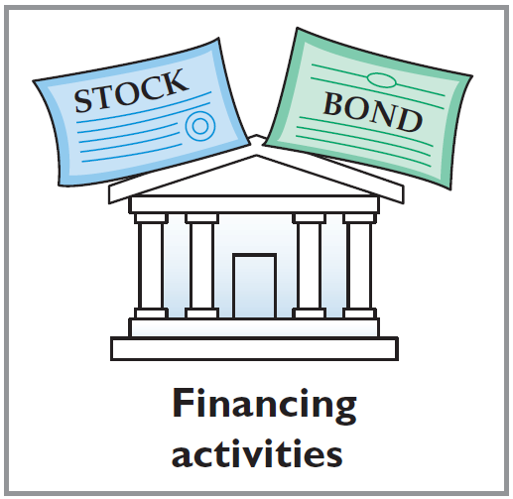
Usefulness and Format
Classification of Cash Flows
Financing activities—Changes in long-term liabilities and stockholders’ equity
Cash inflows:
From sale of common stock.
From issuance of debt (bonds and notes).
Cash outflows:
To stockholders as dividends.
To redeem long-term debt or reacquire
capital stock (treasury stock).
LO 2

Slide 6
Illustration: Classify each of these transactions by type of cash flow activity.
1. Issued 100,000 shares of $5 par value common stock for $800,000 cash.
2. Borrowed $200,000 from Castle Bank, signing a 5-year note bearing 8% interest.
3. Purchased two semi-trailer trucks for $170,000 cash.
4. Paid employees $12,000 for salaries and wages.
5. Collected $20,000 cash for services performed.
Financing
Financing
Investing
Operating
Operating
LO 2

Slide 7
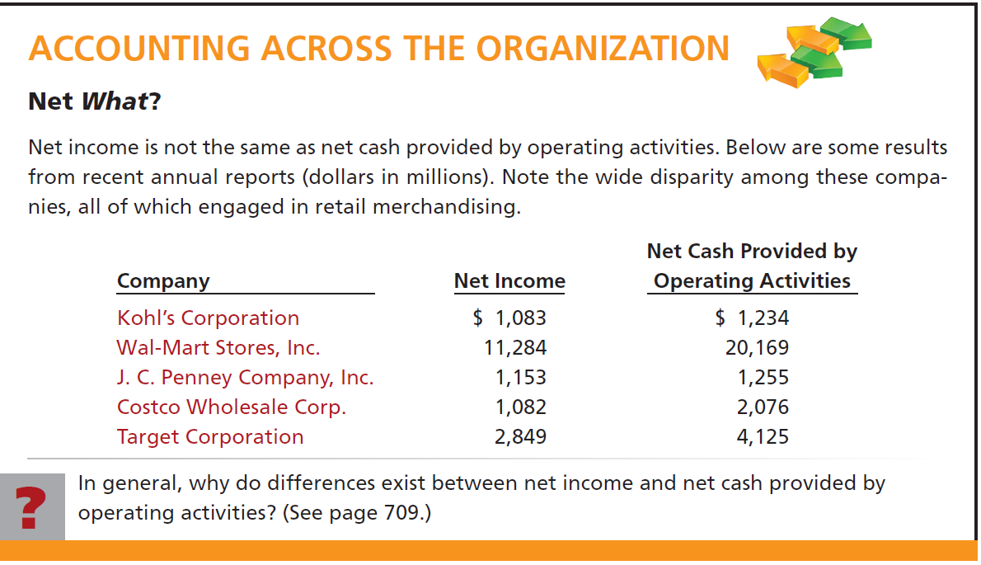
LO 2

Slide 8
Usefulness and Format
Format of the Statement of Cash Flows
Order of Presentation:
  Operating activities.
  Investing activities.
  Financing activities.
Direct Method
Indirect Method
LO 2

Slide 9
Usefulness and Format
Preparing the Statement of Cash Flows
Three sources of information:
  Comparative balance sheets
  Current income statement
  Additional information
LO 2

Slide 10
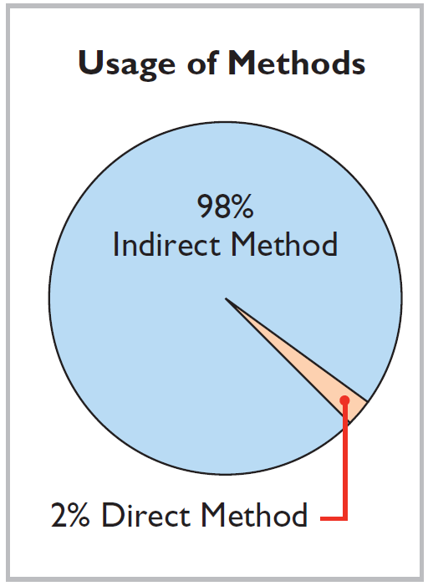
Usefulness and Format
Indirect and Direct Methods
Companies favor the indirect method for two reasons:
  Easier and less costly to prepare.
  Focuses on differences between net income and net cash flow from operating activities.
LO 2

Slide 11
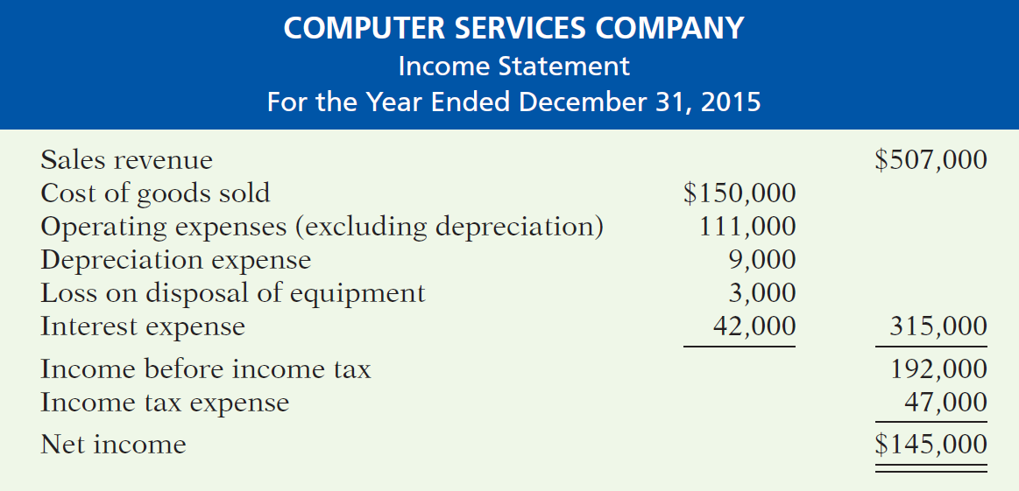
Preparing the Statement of Cash Flows
Illustration – Indirect Method
LO 3

Slide 12
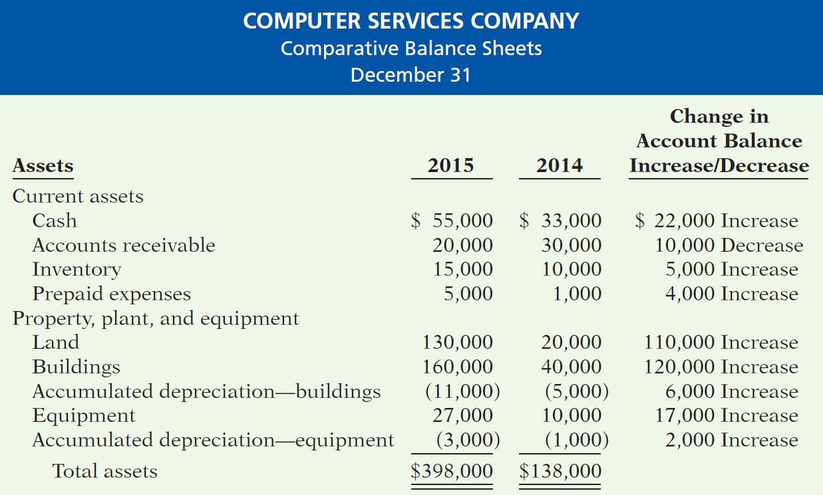
Preparing the Statement of Cash Flows
Illustration 13-4
LO 3

Slide 13
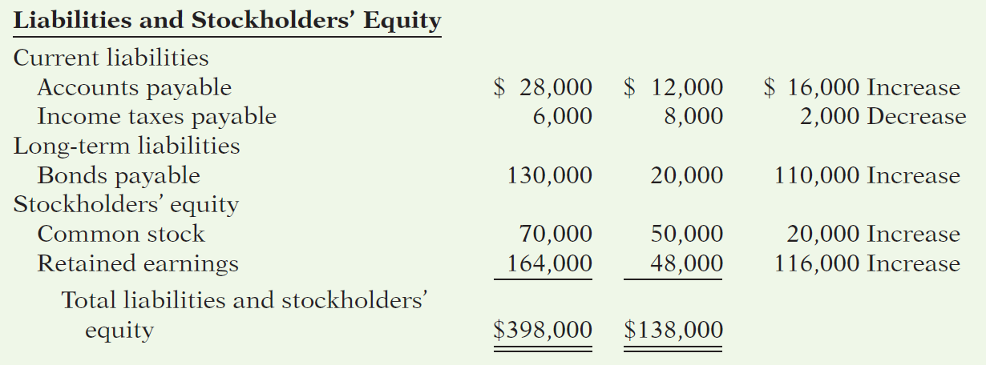
Preparing the Statement of Cash Flows
Illustration 13-4
Additional information for 2015:
Depreciation expense was comprised of $6,000 for building and $3,000 for equipment.
The company sold equipment with a book value of $7,000 (cost $8,000, less accumulated depreciation $1,000) for $4,000 cash.
Issued $110,000 of long-term bonds in direct exchange for land.
A building costing $120,000 was purchased for cash. Equipment costing $25,000 was also purchased for cash.
Issued common stock for $20,000 cash.
The company declared and paid a $29,000 cash dividend.
LO 3

Slide 14
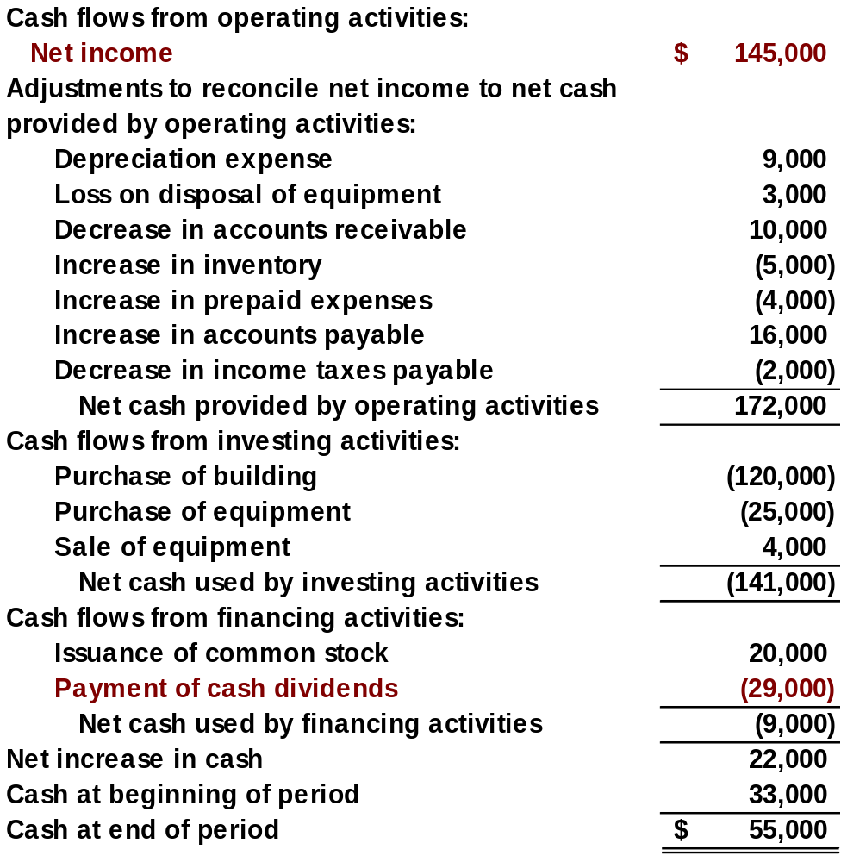
Statement of Cash Flows
Indirect Method
LO 3

Slide 15
Step 2: Investing and Financing Activities
Question
Which is an example of a cash flow from an investing activity?
  Receipt of cash from the issuance of bonds payable.
  Payment of cash to repurchase outstanding capital stock.
  Receipt of cash from the sale of equipment.
  Payment of cash to suppliers for inventory.
LO 3

Slide 16
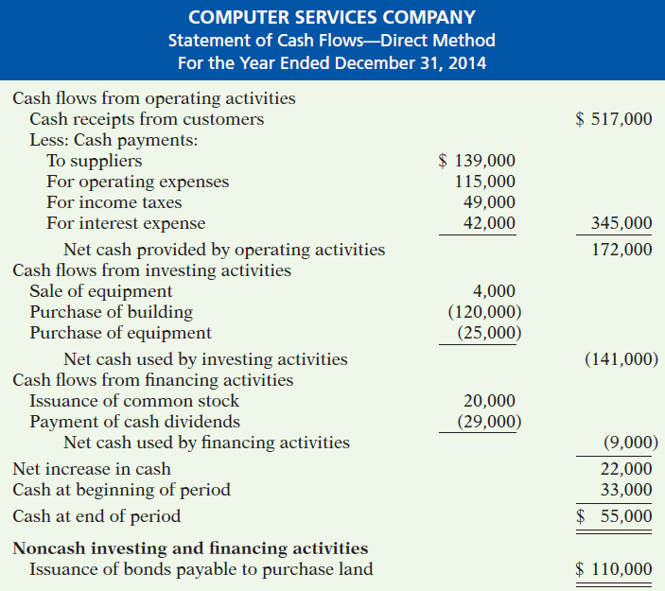

APPENDIX 13A Statement of Cash Flow-Direct Method
Step 2: Investing and Financing Activities
Illustration 13A-16
Statement of cash flows, 2015—direct method

