Slide 1
Basics of Financial Statement Analysis
Analyzing financial statements involves:
Characteristics
Comparison
Bases
Tools of
Analysis
Liquidity
Profitability
Solvency
Intracompany
Industry averages
Intercompany
Horizontal
Vertical
Ratio

Slide 2
Horizontal Analysis
Horizontal analysis, also called trend analysis, is a technique for evaluating a series of financial statement data over a period of time.
  Purpose is to determine the increase or decrease that has taken place.
  Commonly applied to the balance sheet, income statement, and statement of retained earnings.

Slide 3
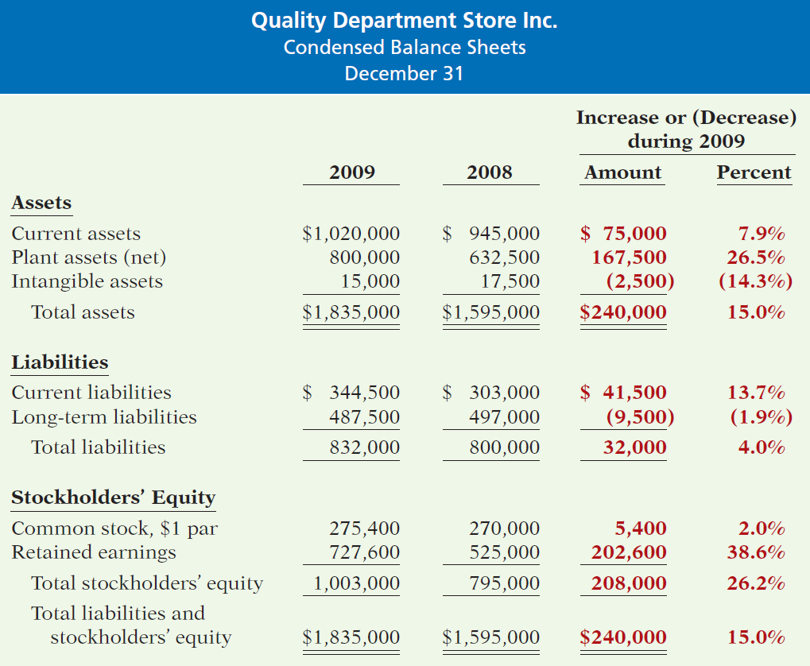
Horizontal Analysis
Illustration 14-5
Horizontal analysis of
balance sheets
Changes suggest that the company expanded its asset base during 2009 and financed this expansion primarily by retaining income rather than assuming additional long-term debt.
LO 3 Explain and apply horizontal analysis.

Slide 4
Vertical Analysis
Vertical analysis, also called common-size analysis, is a technique that expresses each financial statement item as a percent of a base amount.
  On an income statement, we might say that selling expenses are 16% of net sales.
  Vertical analysis is commonly applied to the balance sheet and the income statement.

Slide 5
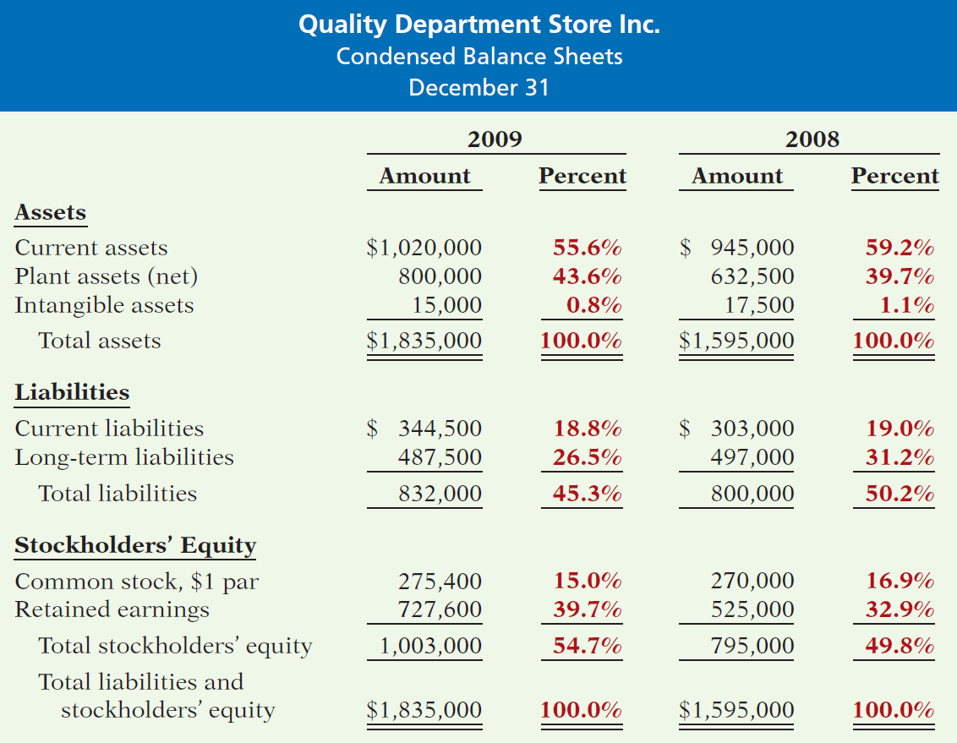
Vertical Analysis
Illustration 14-8
Vertical analysis of
balance sheets
These results reinforce the earlier observations that Quality is choosing to finance its growth through retention of earnings rather than through issuing additional debt.

Slide 6
Ratio Analysis
Ratio analysis expresses the relationship among selected items of financial statement data.
Financial Ratio Classifications
Liquidity
Profitability
Solvency
Measures short-term ability of the company to pay its maturing obligations and to meet unexpected needs for cash.
Measures the income or operating success of a company for a given period of time.
Measures the ability of the company to survive over a long period of time.

Slide 7
Ratio Analysis
Liquidity Ratios
Measure the short-term ability of the company to pay its maturing obligations and to meet unexpected needs for cash.
  Short-term creditors such as bankers and suppliers are particularly interested in assessing liquidity.
  Ratios include the current ratio, the acid-test ratio, Receivable turnover, and inventory turnover.

Slide 8
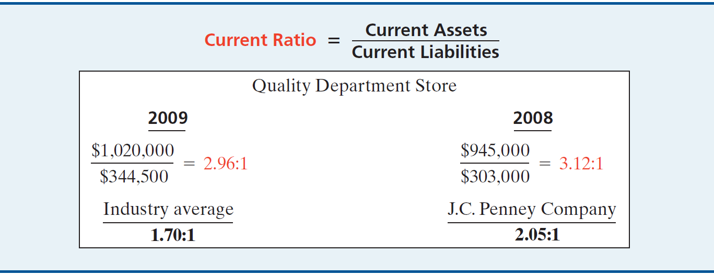
Liquidity Ratios
Ratio Analysis
1. Current Ratio
Ratio of 2.96:1 means that for every dollar of current liabilities, Quality has $2.96 of current assets.

Slide 9
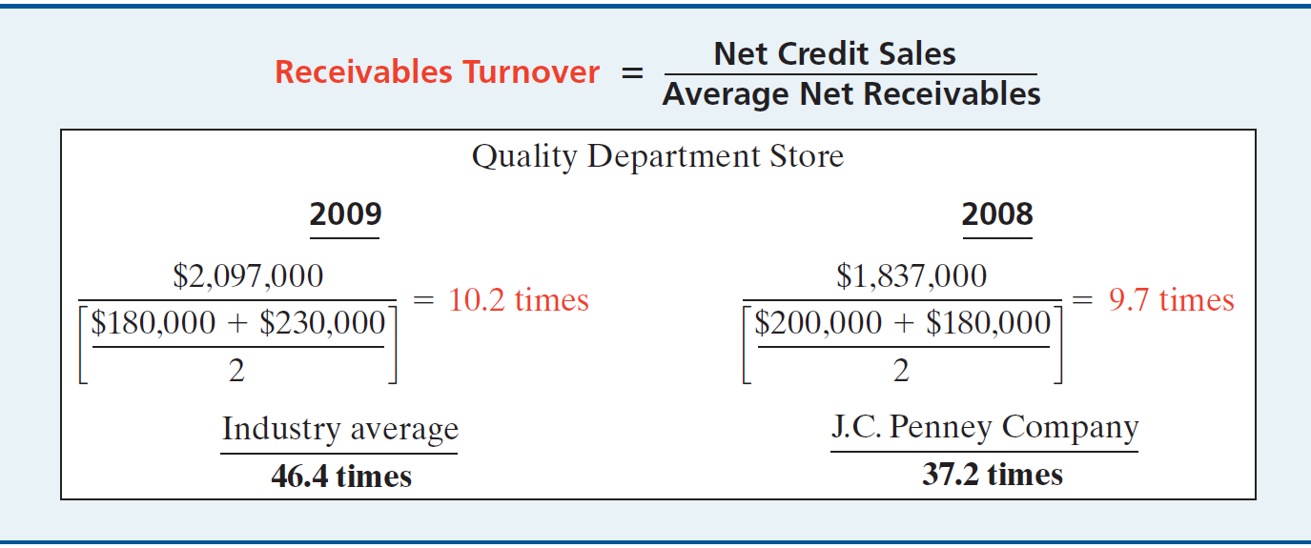
Liquidity Ratios
Ratio Analysis
3. Receivable Turnover
Measures the number of times, on average, the company collects receivables during the period.
LO 5

Slide 10
Liquidity Ratios
Ratio Analysis
Receivable Turnover
$2,097,000
= 10.2 times
($180,000 + $230,000) / 2
A variant of the Receivable turnover ratio is to convert it to an average collection period in terms of days.
365 days / 10.2 times = every 35.78 days
Receivables are collected on average every 36 days.
LO 5 Identify and compute ratios used in analyzing a firm’s liquidity, profitability, and solvency.

Slide 11
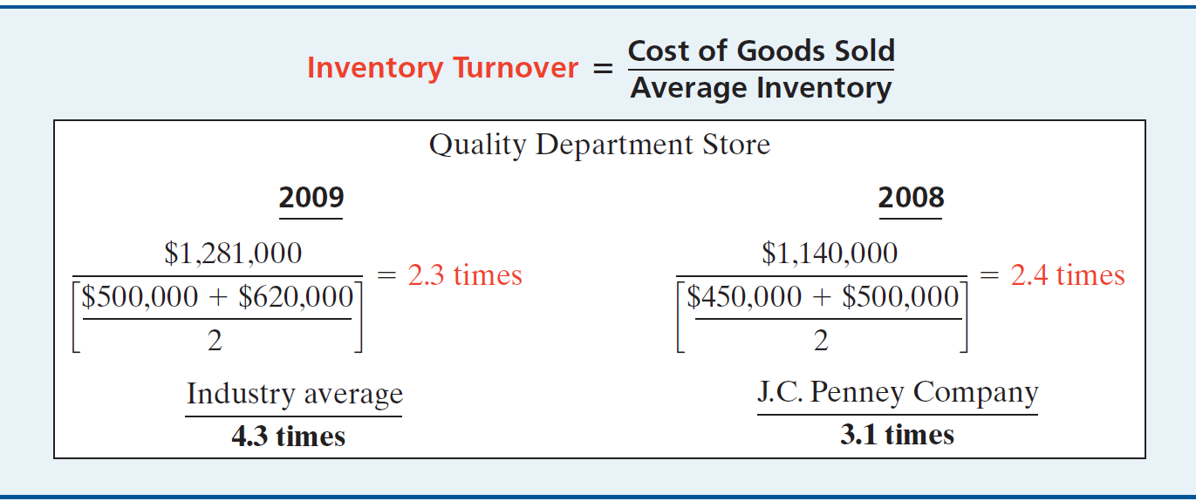
Liquidity Ratios
Ratio Analysis
4. Inventory Turnover
Measures the number of times, on average, the inventory is sold during the period.
LO 5

Slide 12
Liquidity Ratios
Ratio Analysis
Inventory Turnover
$1,281,000
= 2.3 times
($500,000 + $620,000) / 2
A variant of inventory turnover is the days in inventory.
365 days / 2.3 times = every 159 days
Inventory turnover ratios vary considerably among industries.
LO 5 Identify and compute ratios used in analyzing a firm’s liquidity, profitability, and solvency.

Slide 13
Ratio Analysis
Solvency Ratios
Solvency ratios measure the ability of a company to survive over a long period of time.
  Debt to Total Assets and
  Times Interest Earned
  are two ratios that provide information about debt-paying ability.

Slide 14
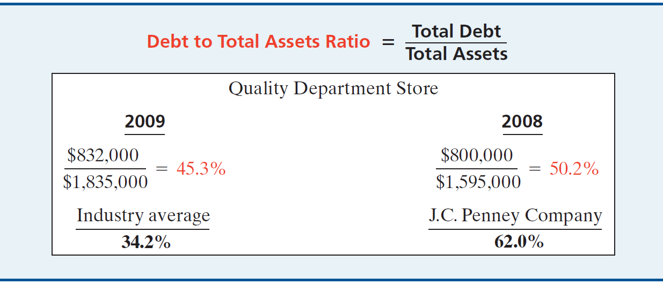
Solvency Ratios
Ratio Analysis
12. Debt to Total Assets Ratio
Measures the percentage of the total assets that creditors provide.
LO 5

