Slide 1
Cost-Volume-Profit Relationships

Slide 2
Cost Classifications for Predicting Cost Behavior
Cost behavior refers to how a cost will react to changes in the level of activity. The most common classifications are:
  Variable costs.
  Fixed costs
  Mixed costs.

Slide 3
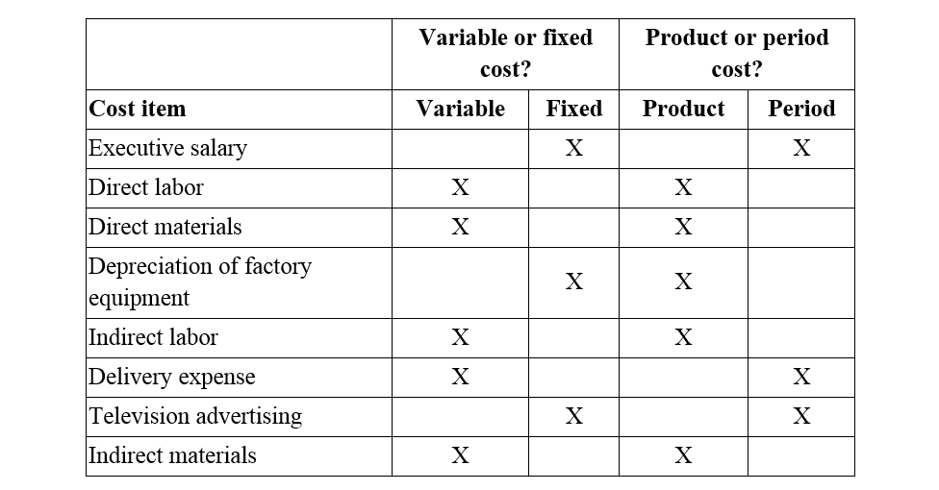

Slide 4
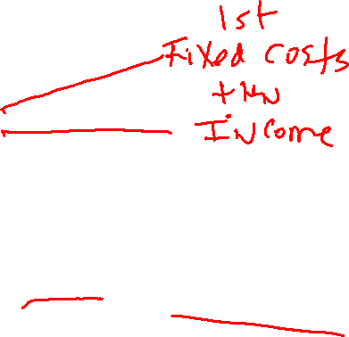

Break-even in Unit Sales:
Contribution Margin
Contribution margin = Sales-Variable Costs
Contribution Margin Per Unit =
  Sales per unit-Variable Costs per unit
  or
  CM divided by Units
SO…..
CM is used first to cover fixed expenses.
Any remaining CM contributes to net operating income.

Slide 5

Break-even in Unit Sales:
Set up breakeven in units calculation as:
CM per unit X BE Sales in UNITS = Fixed Expenses
Doing the Algebra
Unit sales to
break even
=
Fixed expenses
CM per unit

Slide 6

Break-even in Unit Sales:
Example, company has sales price per unit of $500 and variable costs per unit of $300. Fixed costs = $80,000. How many units will the company need to sell to breakeven?
First set up as:
CM/Unit X BE Units = Fixed costs
CM per Unit = $500-$300 = $200 per Unit
$200 CM per unit X BE Units = $80,000
Do the algebra: $80,000/$200 = BE Units
400 Units X $500 = $200,000
BE Unit sales = 400
BE Sales Dollars =

Slide 7
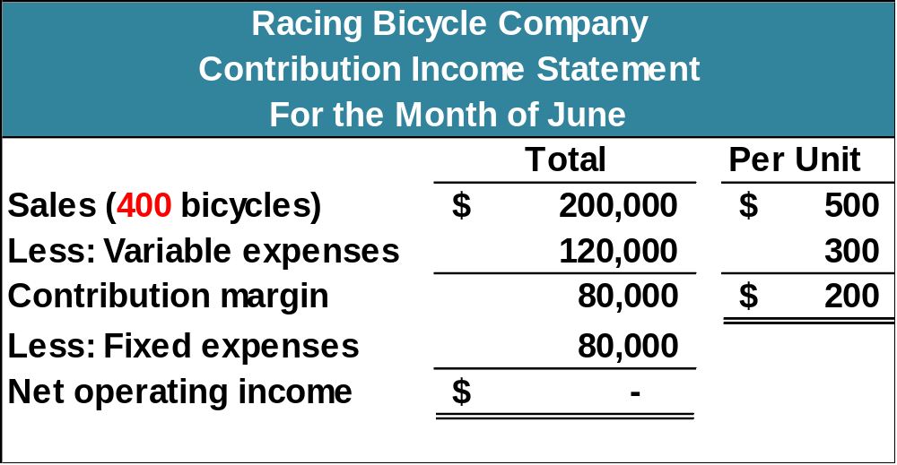
The Contribution Approach
If RBC sells 400 units in a month, it will be operating at the break-even point.

Slide 8


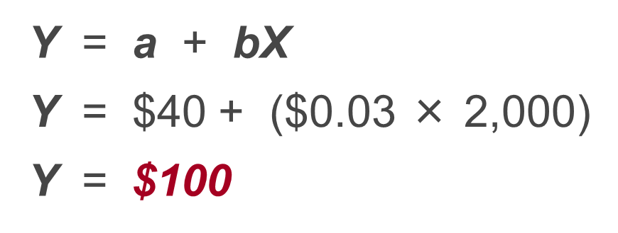
An Example
If your fixed monthly utility charge is $40, your variable cost is $0.03 per kilowatt hour, and your monthly activity level is 2,000 kilowatt hours, what is the amount of your utility bill?

Slide 9
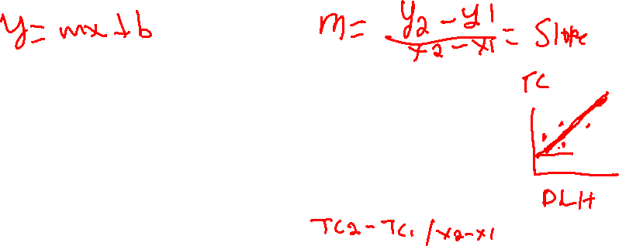
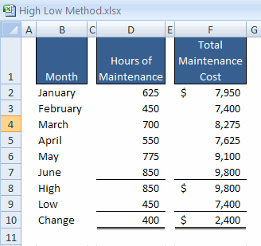
The High-Low Method – An Example
The variable cost per hour of maintenance is equal to the change in cost divided by the change in hours.
$2,400
400
= $6.00/hour

Slide 10
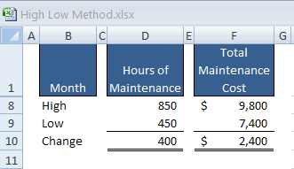
The High-Low Method – An Example
Total Fixed Cost = Total Cost – Total Variable Cost
Total Fixed Cost = $9,800 – ($6/hour × 850 hours)
Total Fixed Cost = $9,800 – $5,100
Total Fixed Cost = $4,700

Slide 11
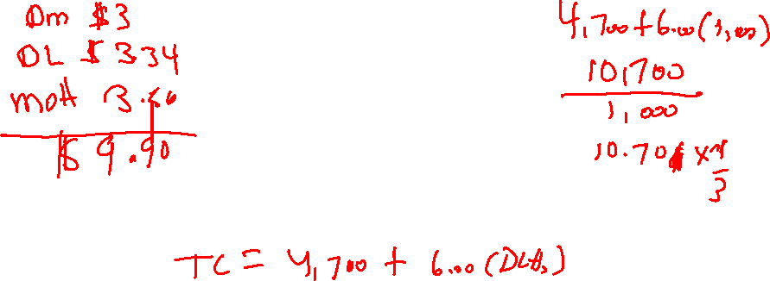
The High-Low Method – An Example
The Cost Equation for Maintenance
Y = $4,700 + $6.00X

Slide 12

Target Profit
Target profit uses the following equation.
Unit sales to attain
the target profit
Target profit + Fixed expenses
CM per unit
=

Slide 13
Target Profit Analysis in Terms of
Unit Sales
Suppose Racing Bicycle Company wants to know how many bikes must be sold to earn a profit of $20,000.
Unit sales to attain
the target profit
Target profit + Fixed expenses
CM per unit
=
$20,000 + $80,000
$200
Unit sales =
Unit sales = 500

Slide 14
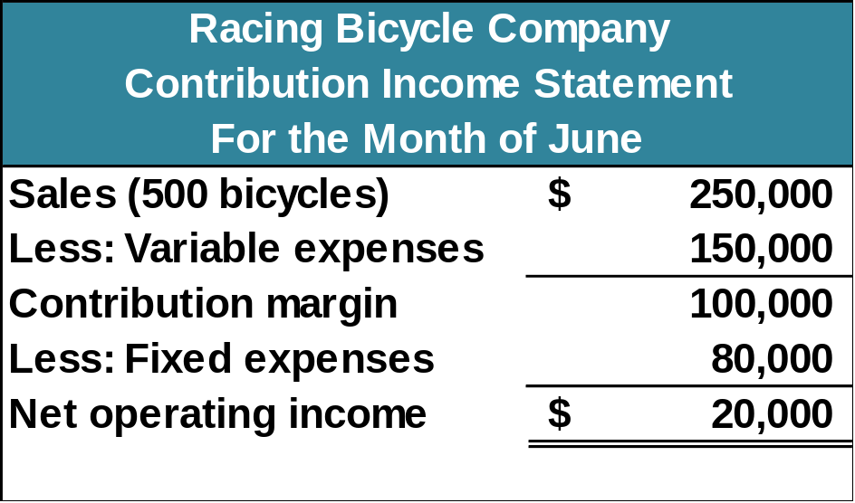
Basics of Cost-Volume-Profit Analysis
The contribution income statement is helpful to managers in judging the impact on profits of changes in selling price, cost, or volume. The emphasis is on cost behavior.
Contribution Margin (CM) is the amount remaining from sales revenue after variable expenses have been deducted.

Slide 15
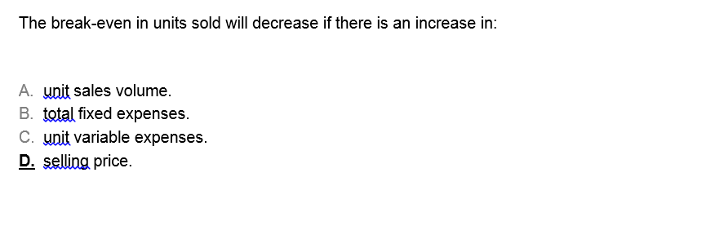
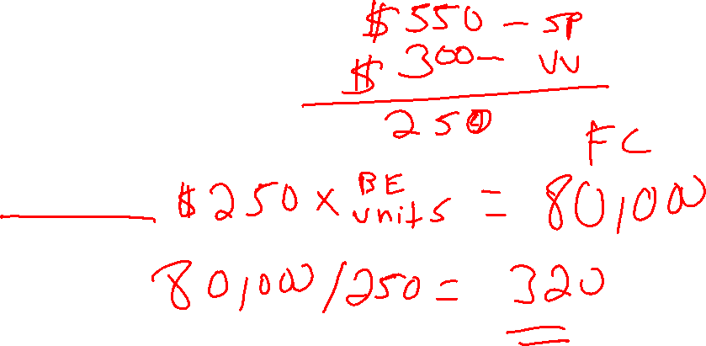

Slide 16
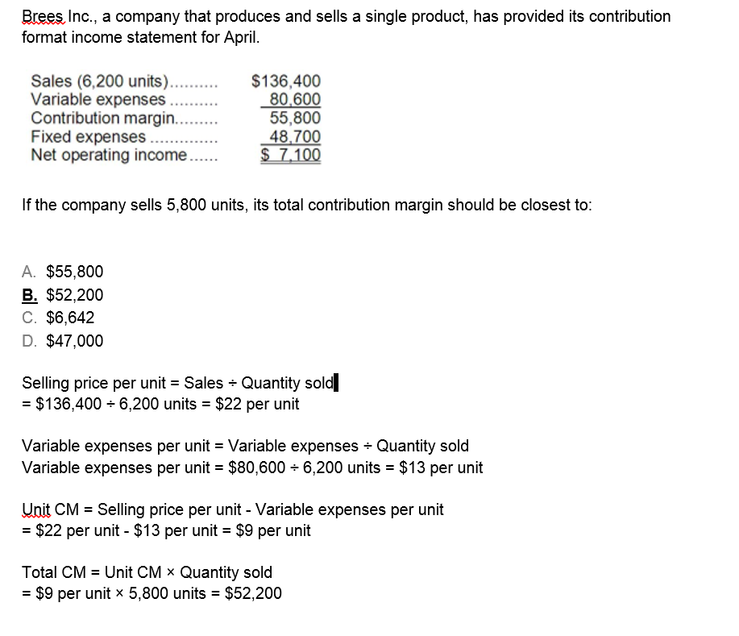
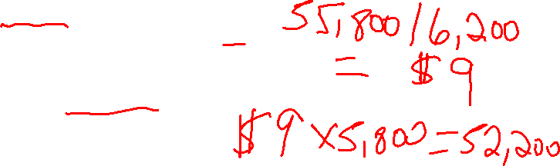

Slide 17
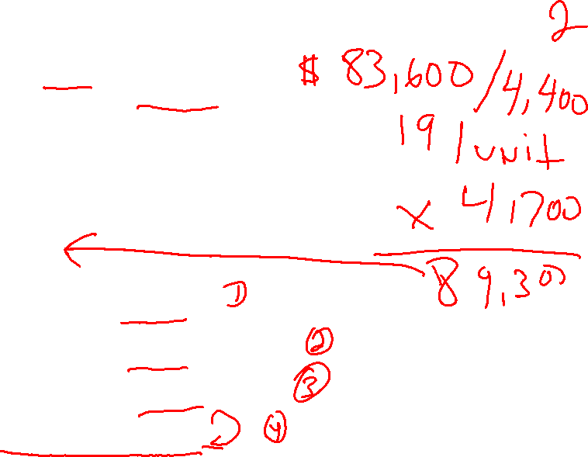
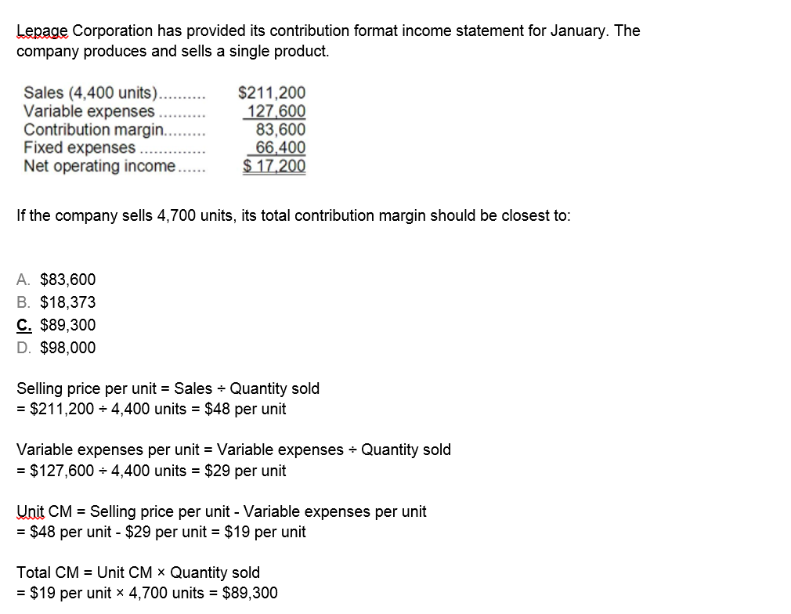

Slide 18
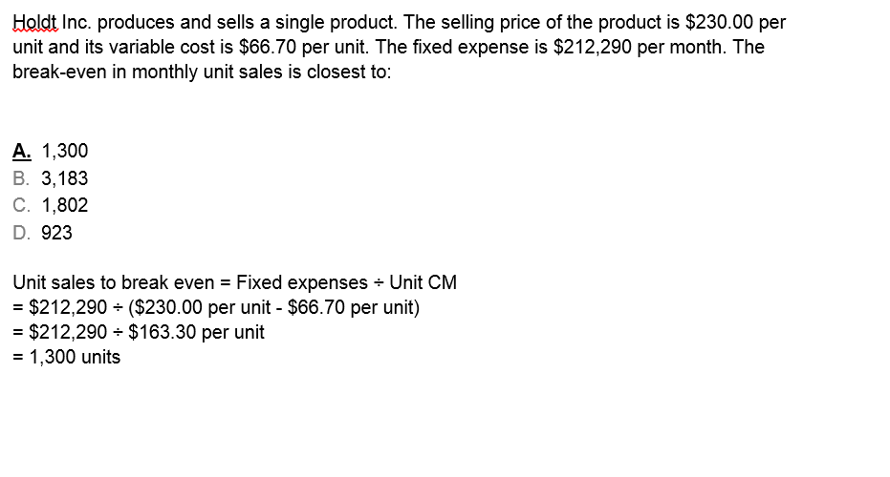
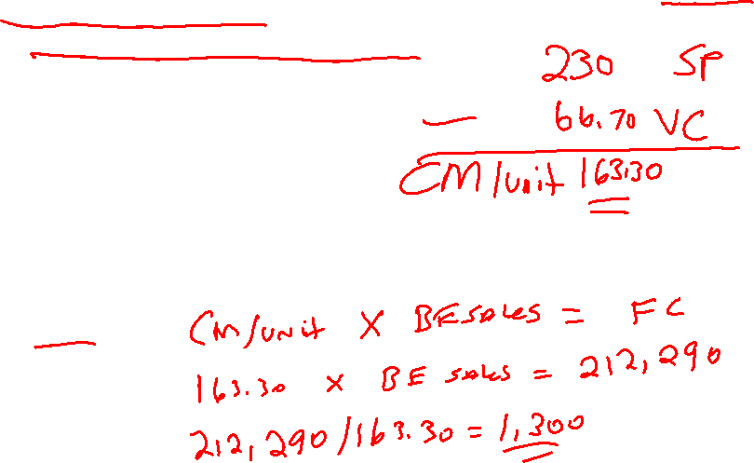


Slide 19
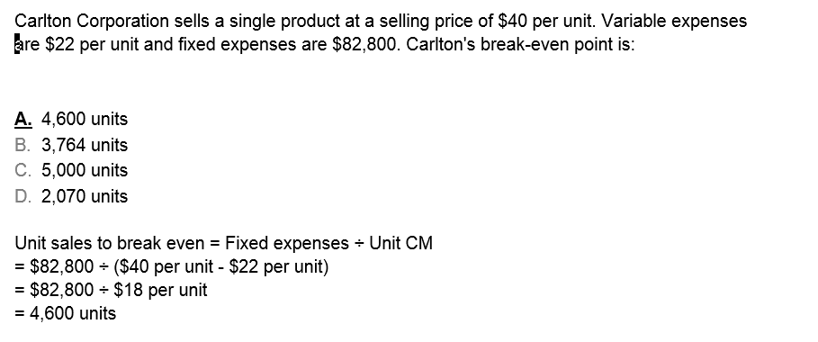
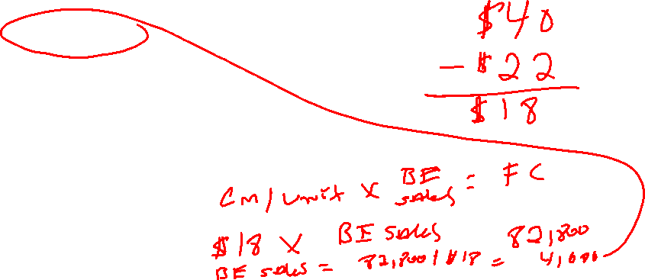

Slide 20
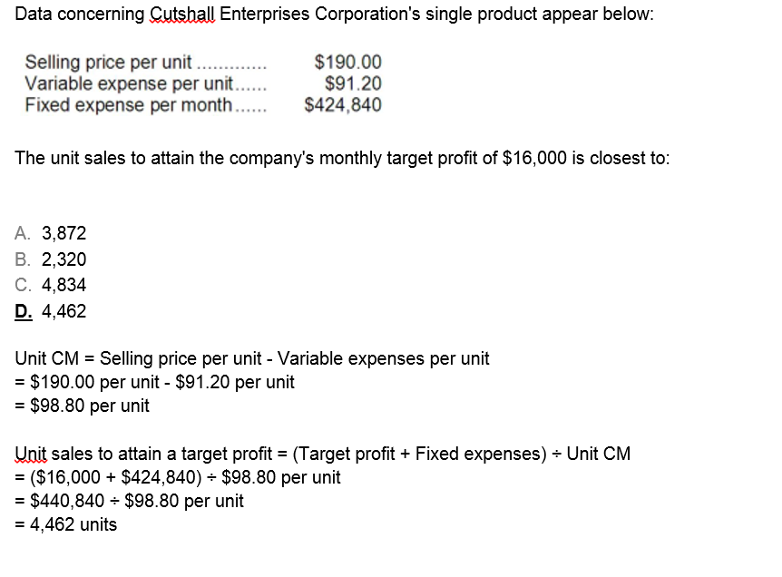
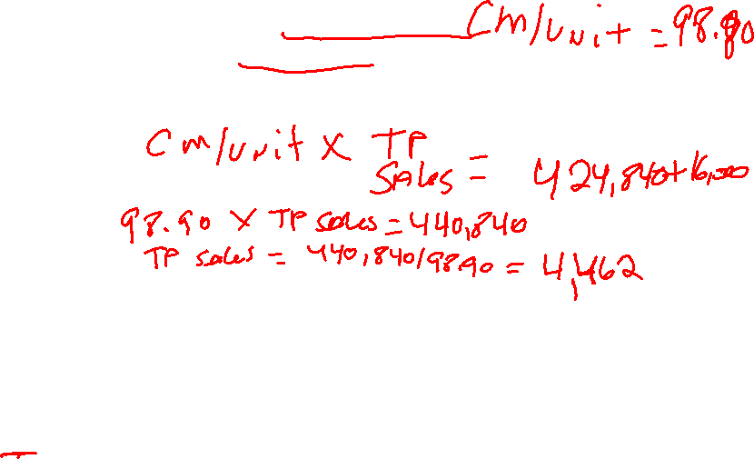


Slide 21
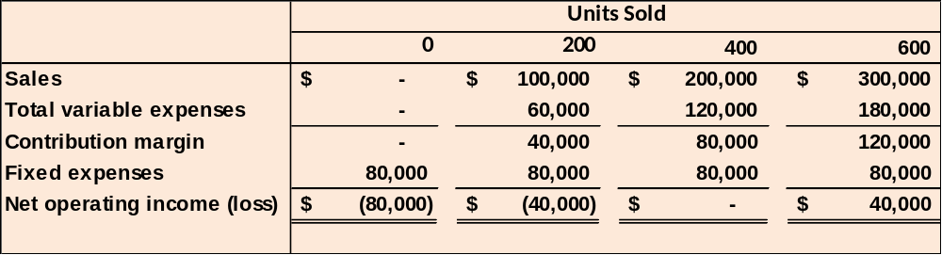
CVP Relationships in Graphic Form
The relationships among revenue, cost, profit, and volume can be expressed graphically by preparing a CVP graph. Racing Bicycle developed contribution margin income statements at 0, 200, 400, and 600 units sold. We will use this information to prepare the CVP graph.

Slide 22
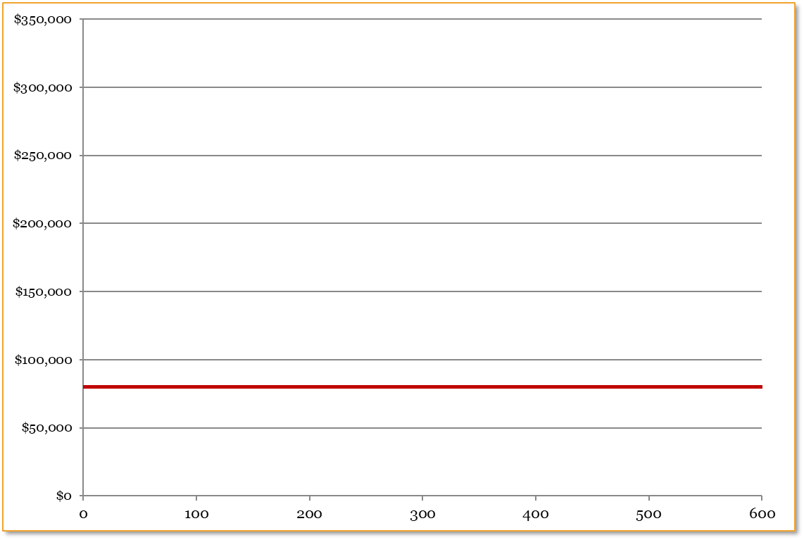
Preparing the CVP Graph
Dollars
In a CVP graph, unit volume is usually represented on the horizontal (X) axis and dollars on the vertical (Y) axis.
Units

Slide 23
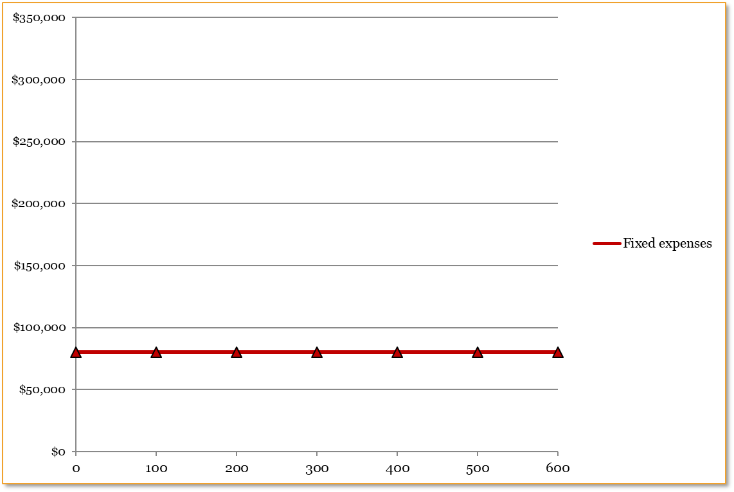
Preparing the CVP Graph
❶
Draw a line parallel to the volume axis to represent total fixed expenses.
Dollars
Units

Slide 24
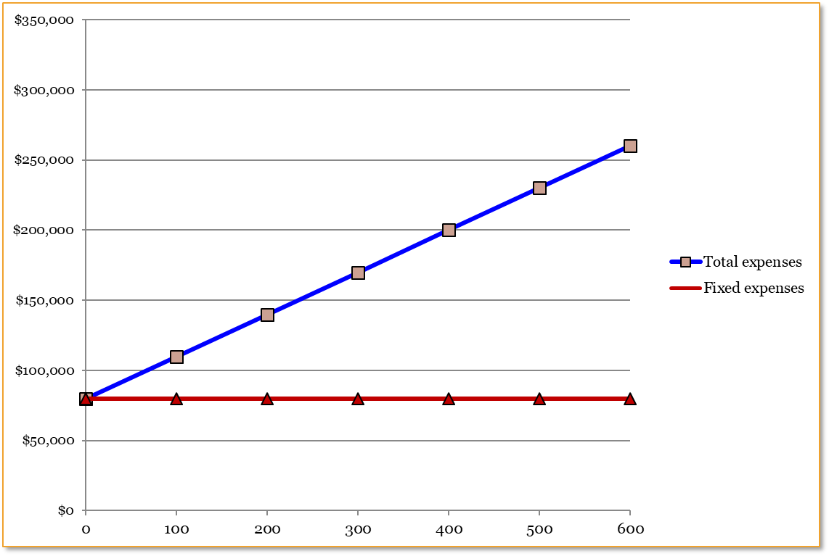
Preparing the CVP Graph
❷
Choose some sales volume, say 400 units, and plot the point representing total expenses (fixed and variable). Draw a line through the data point back to where the fixed expenses line intersects the dollar axis.
Dollars
Units

Slide 25
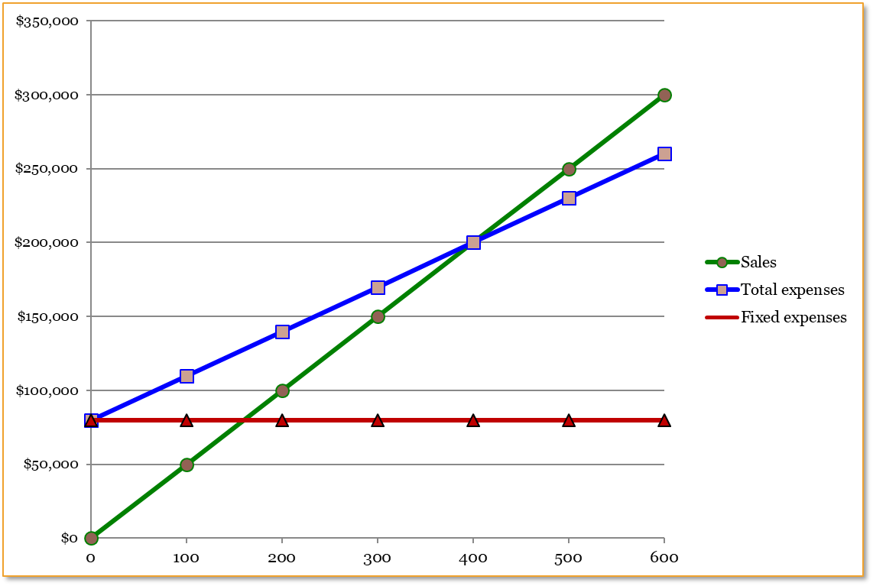
Preparing the CVP Graph
Break-even point
(400 units or $200,000 in sales)
Profit Area
Dollars
Loss Area
Units

Slide 26
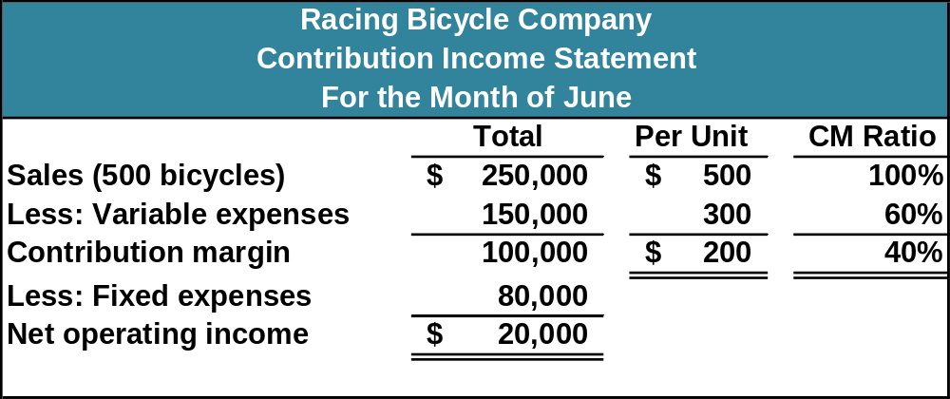
Contribution Margin Ratio (CM Ratio)
The CM ratio is calculated by dividing the total contribution margin by total sales.
$100,000 ÷ $250,000 = 40%

Slide 27
Contribution Margin Ratio (CM Ratio)
The CM ratio can also be calculated by dividing the contribution margin per unit by the selling price per unit.
The contribution margin ratio at Racing Bicycle is:
CM per unit
SP per unit
$200
$500
CM Ratio =
=
= 40%
$200 X BE UNITS = $80,000
$80,000/$200 = 400 Units X $500 = $200,000 BE Sales $
OR
Fixed Expenses/CM Ratio = BE in Sales Dollars
Set up as: BE Sales $ X CM Ratio = FC
.4 X Sales $ = $80,000
Do the algebra:
$80,000/.4 = $200,000

Slide 28
Formula Method
We can calculate the dollar sales needed to attain a target profit (net operating profit) of $100,000 at Racing Bicycle.
Dollar sales to attain
the target profit
Target profit + Fixed expenses
CM ratio
=
$100,000 + $80,000
40%
Dollar sales =
Dollar sales = $450,000

Slide 29
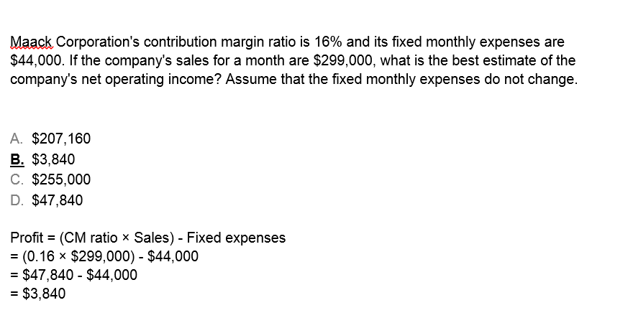
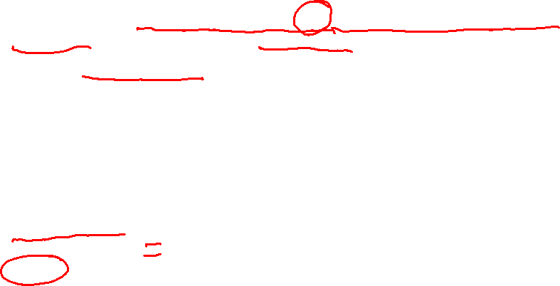

Slide 30
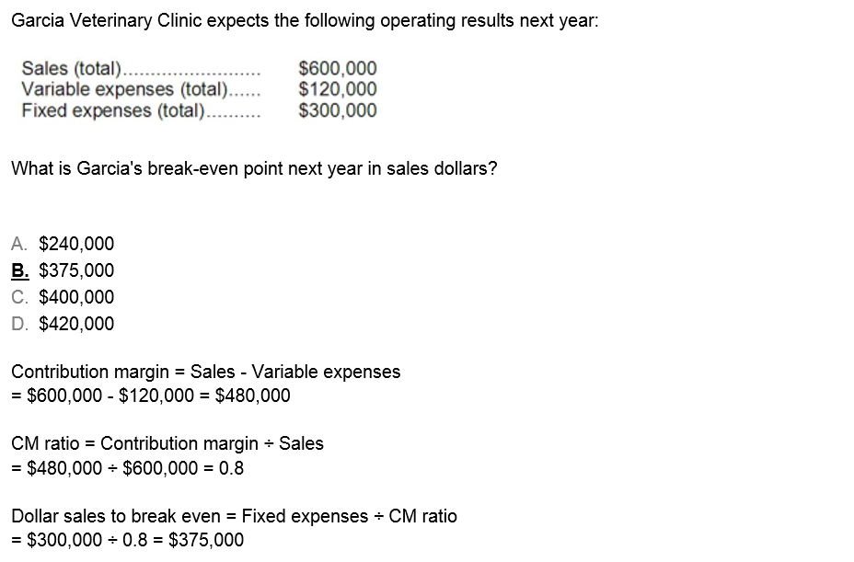
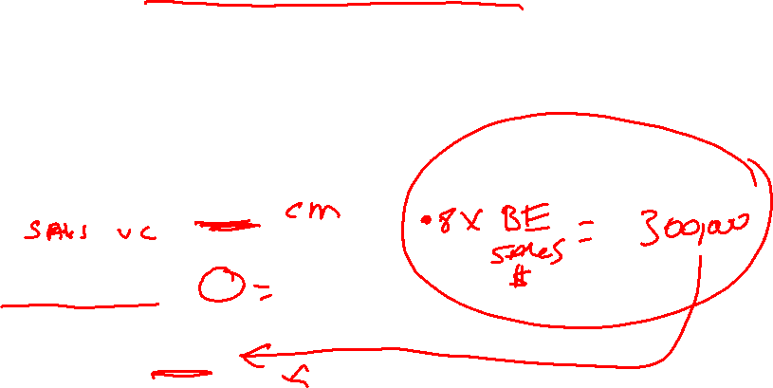

Slide 31
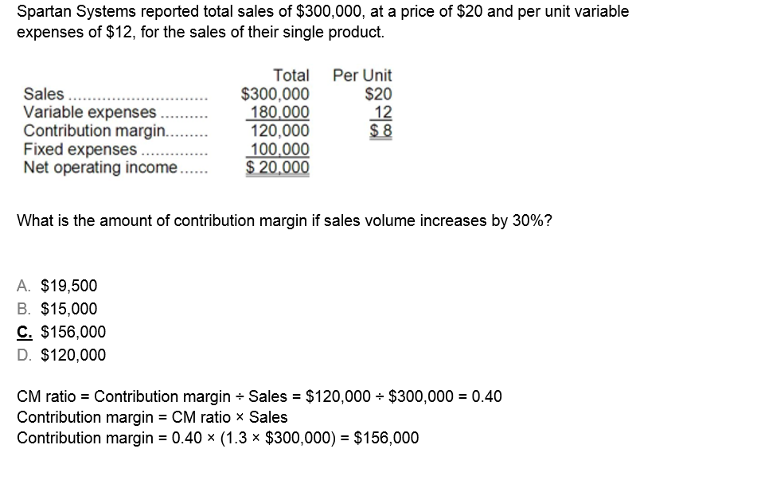
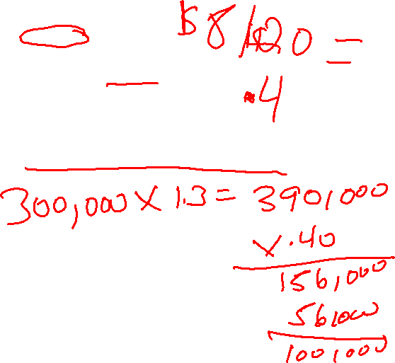


Slide 32
Contribution Margin Ratio (CM Ratio)
The CM ratio is calculated by dividing the total contribution margin by total sales.
$100,000 ÷ $250,000 = 40%

Slide 33

Changes in Fixed Costs and Sales Volume
What is the profit impact if Racing Bicycle can increase unit sales from 500 to 540 by increasing the monthly advertising budget by $10,000?

Slide 34
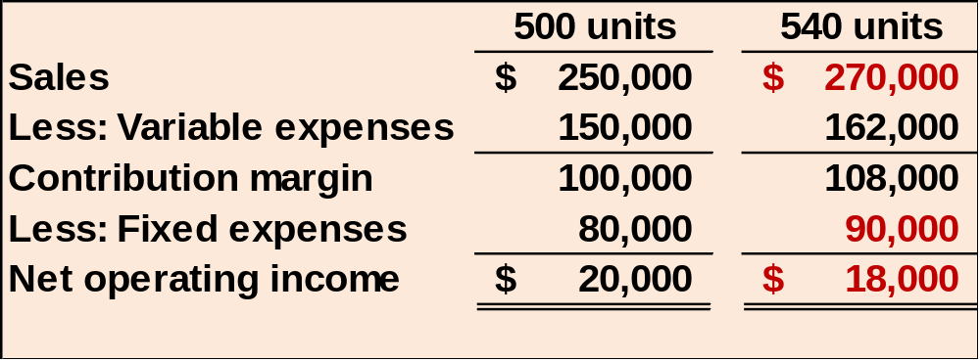
Changes in Fixed Costs and Sales Volume
$80,000 + $10,000 advertising = $90,000
Sales increased by $20,000, but net operating income decreased by $2,000.

Slide 35
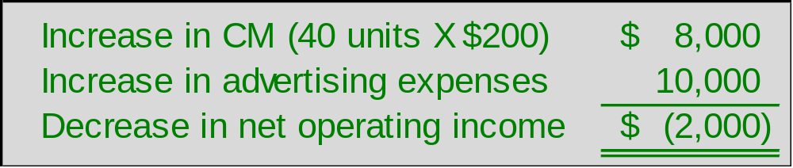

Changes in Fixed Costs and Sales Volume
A shortcut solution using incremental analysis

Slide 36
Change in Variable Costs and Sales Volume
What is the profit impact if Racing Bicycle can use higher quality raw materials, thus increasing variable costs per unit by $10, to generate an increase in unit sales from 500 to 580?

Slide 37
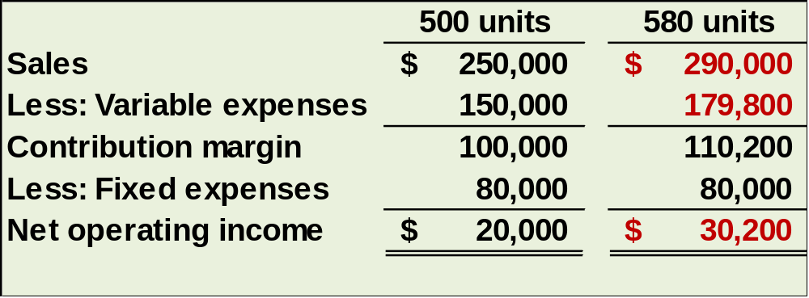
Change in Variable Costs and Sales Volume
580 units × $310 variable cost/unit = $179,800
Sales increase by $40,000 and net operating income increases by $10,200.

Slide 38
Change in Fixed Cost, Sales Price, and Volume
What is the profit impact if RBC: (1) cuts its selling price $20 per unit, (2) increases its advertising budget by $15,000 per month, and (3) increases sales from 500 to 650 units per month?

Slide 39
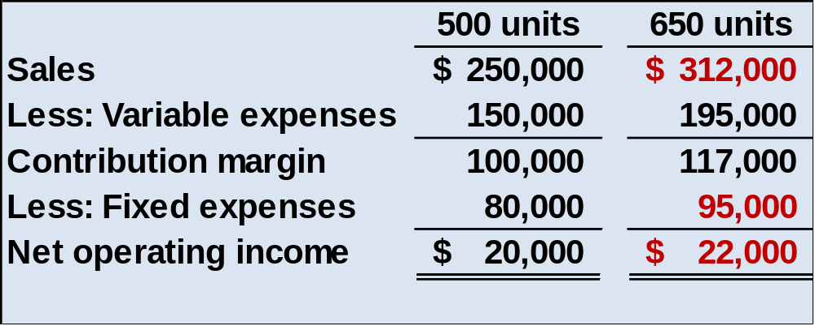
Change in Fixed Cost, Sales Price, and Volume
650 units × $480 = $312,000
Sales increase by $62,000, fixed costs increase by $15,000, and net operating income increases by $2,000.

Slide 40
Change in Regular Sales Price
If RBC has an opportunity to sell 150 bikes to a wholesaler without disturbing sales to other customers or fixed expenses, what price would it quote to the wholesaler if it wants to increase monthly profits by $3,000?

Slide 41
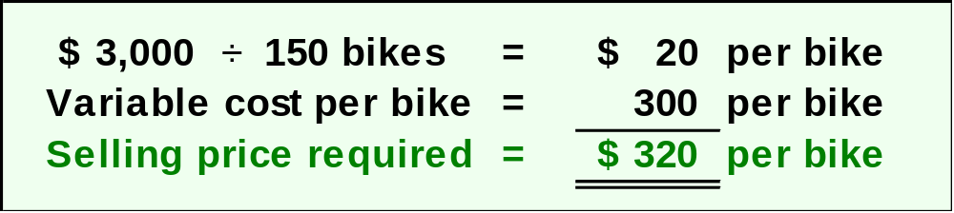
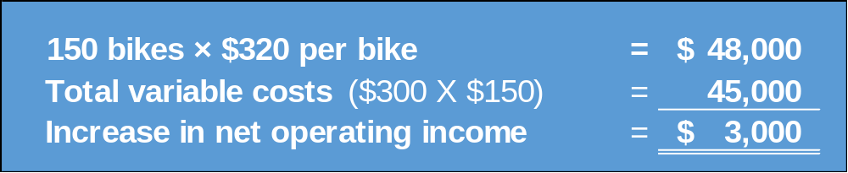
Change in Regular Sales Price

Slide 42
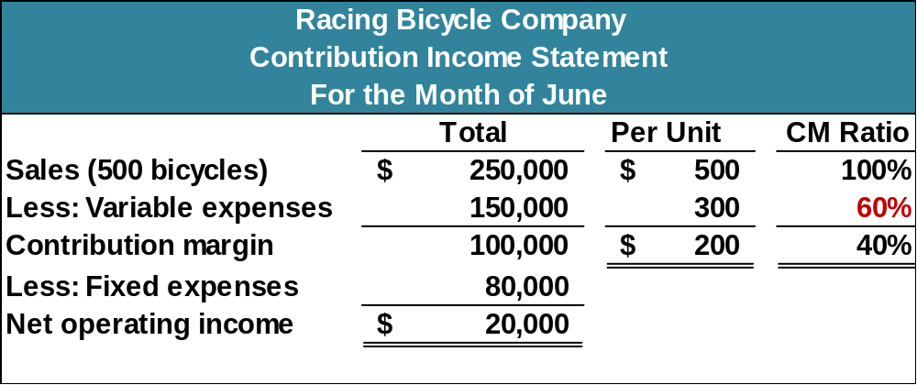
The Variable Expense Ratio
The variable expense ratio is the ratio of variable expenses to sales. It can be computed by dividing the total variable expenses by the total sales, or in a single product analysis, it can be computed by dividing the variable expenses per unit by the unit selling price.

Slide 43
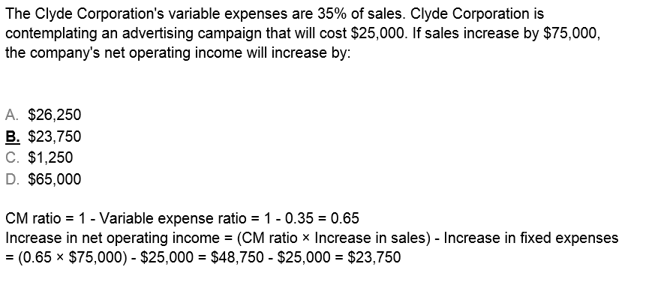
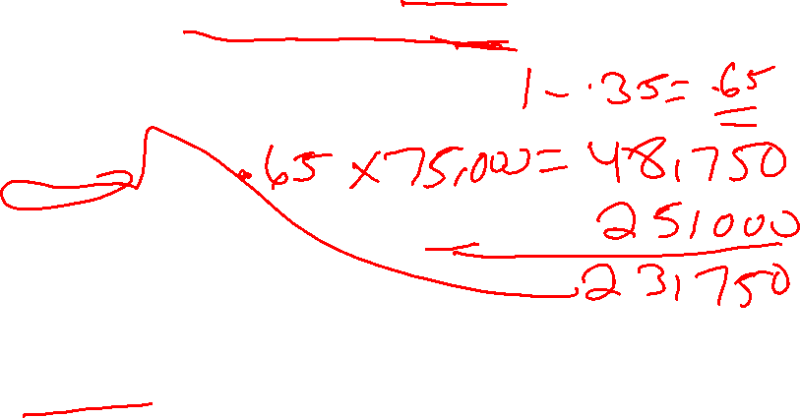

Slide 44

Structuring Sales Commissions
Companies generally compensate salespeople by paying them either a commission based on sales or a salary plus a sales commission. Commissions based on sales dollars can lead to lower profits in a company.
Let’s look at an example.

Slide 45
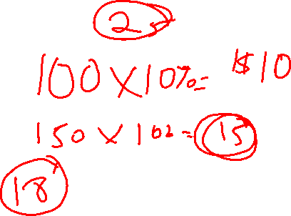

Structuring Sales Commissions
Pipeline Unlimited produces two types of surfboards, the XR7 and the Turbo. The XR7 sells for $100 and generates a contribution margin per unit of $25. The Turbo sells for $150 and earns a contribution margin per unit of $18.
The sales force at Pipeline Unlimited is compensated based on sales commissions.

Slide 46
Structuring Sales Commissions
If you were on the sales force at Pipeline, you would push hard to sell the Turbo even though the XR7 earns a higher contribution margin per unit.
To eliminate this type of conflict, commissions can be based on contribution margin rather than on selling price alone.

