Slide 1
Forms of Business Ownership
Proprietorship
Partnership
Corporation
Generally owned by one person.
Often small service-type businesses
Owner receives any profits, suffers any losses, and is personally liable for all debts.
Owned by two or more persons.
Often retail and service-type businesses
Generally unlimited personal liability
Partnership agreement
Ownership divided into shares of stock
Separate legal entity organized under state corporation law
Limited liability

Slide 2
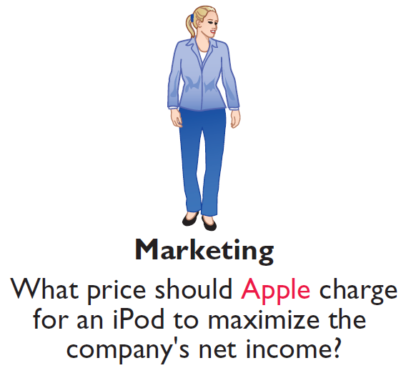
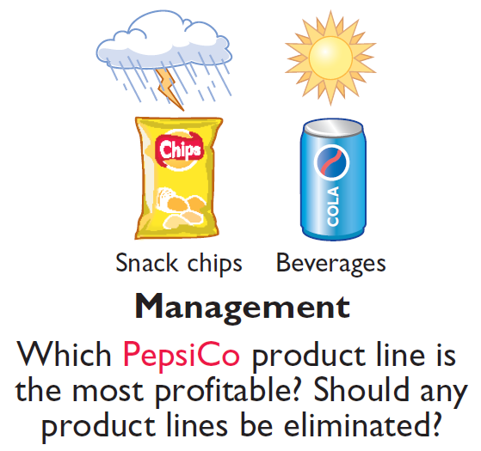
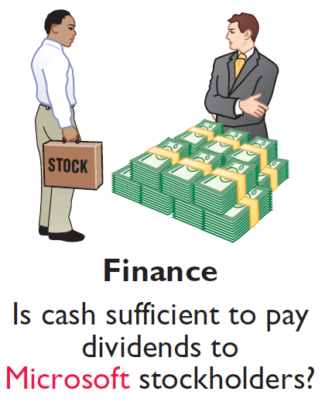

Who Uses Accounting Data
Internal Users
Illustration 1-2
Questions that internal users ask

Slide 3

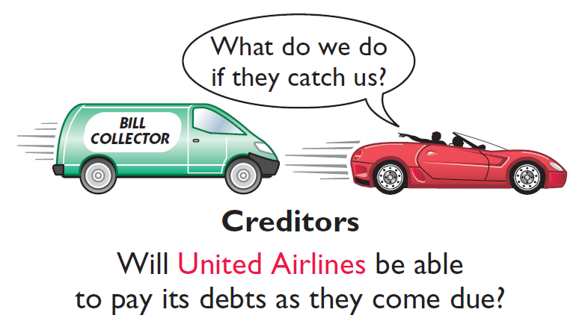
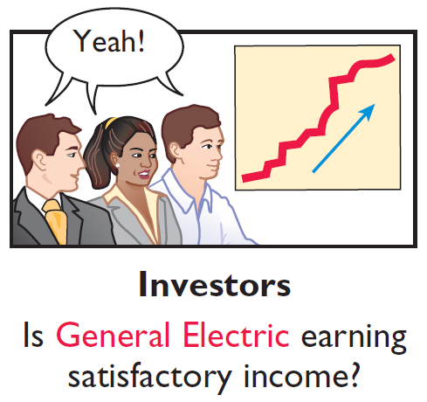
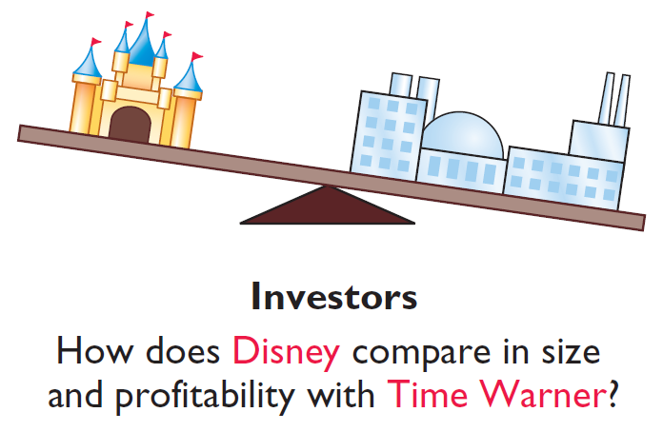
Who Uses Accounting Data
External Users
Illustration 1-3
Questions that external users ask

Slide 4
Financial accounting standards
Common set of standards and procedures is called generally accepted accounting principles (GAAP)
The Securities and Exchange Commission (SEC) has the legal priority to develop GAAP
  Has delegated that authority to the Financial Accounting Standards Board (FASB)
SEC is a federal agency that holds regulatory power over publically traded companies

Slide 5
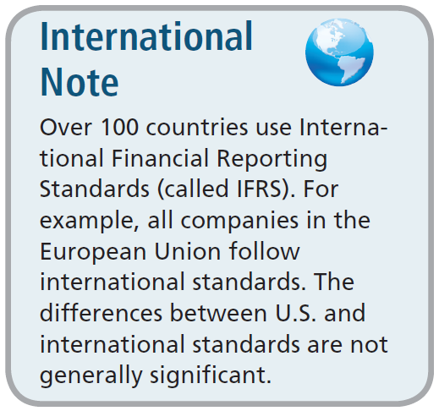

Generally Accepted Accounting Principles
Generally Accepted Accounting Principles (GAAP) – Standards that are generally accepted and universally practiced. These standards indicate how to report economic events.
Standard-setting bodies:
  Financial Accounting Standards Board (FASB)
  Securities and Exchange Commission (SEC)
  International Accounting Standards Board (IASB)

Slide 6
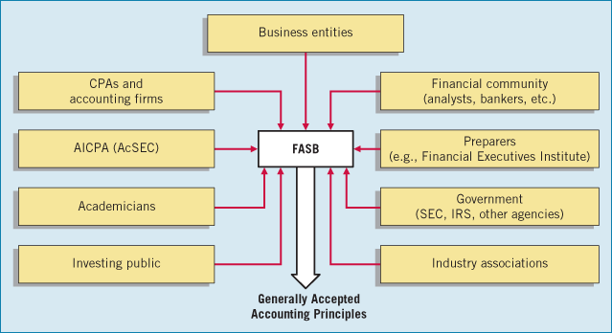
The standard setting process
GAAP is a political process
You can decide whether this is a good or bad thing.

Slide 7
Generally Accepted Accounting Principles
Financial Statements
  Balance Sheet
  Income Statement
  Statement of Stockholders’ Equity
  Statement of Cash Flows
  Note Disclosure
Various users need financial information
The accounting profession has attempted to develop a set of standards that are generally accepted and universally practiced.
Generally Accepted Accounting Principles (GAAP)

Slide 8
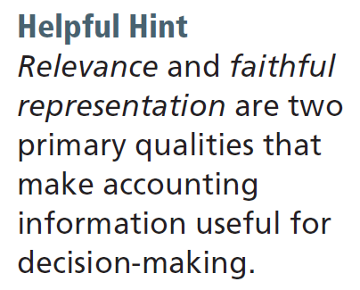
Generally Accepted Accounting Principles
Measurement Principles
Historical Cost Principle (or cost principle) dictates that companies record assets at their cost.
Fair Value Principle states that assets and liabilities should be reported at fair value (the price received to sell an asset or settle a liability).
Selection of which principle to follow generally relates to trade-offs between relevance and faithful representation.

Slide 9
Generally Accepted Accounting Principles
Assumptions
Monetary Unit Assumption requires that companies include in the accounting records only transaction data that can be expressed in terms of money.
Economic Entity Assumption requires that activities of the entity be kept separate and distinct from the activities of its owner and all other economic entities.
  Proprietorship.
  Partnership.
  Corporation.
Forms of Business Ownership

Slide 10
SOX
The Sarbanes-Oxley Act of 2002 (SOX) was a response to accounting scandals in the late 1990’s and early 2000’s
Resulted in:
  The Public Company Accounting Oversight Board (PCAOB), which oversees audit firms
  Requires stronger independence for auditors
  Requires CEOs and CFOs to personally certify financial statements and disclosures
  Requires audit committees to be made of independent directors
Requires attestation to ICFR

Slide 11
The Building Blocks of Accounting
Ethics In Financial Reporting
United States regulators and lawmakers were very concerned that the economy would suffer if investors lost confidence in corporate accounting because of unethical financial reporting.
  Recent financial scandals include: Enron, WorldCom, HealthSouth, AIG, and others.
  Congress passed Sarbanes-Oxley Act of (SOX).
  Effective financial reporting depends on sound ethical behavior.

Slide 12
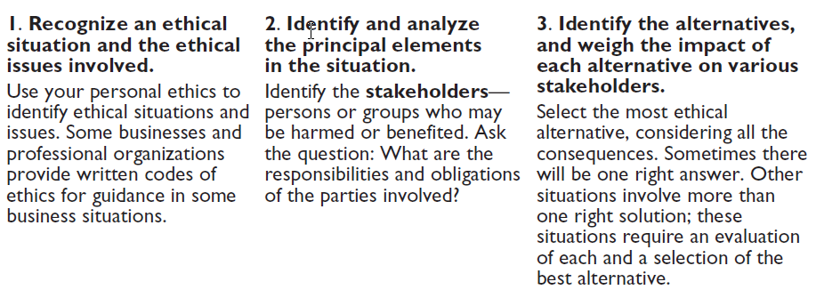
The Building Blocks of Accounting
Ethics In Financial Reporting
Illustration 1-4
Steps in analyzing ethics cases and situations

Slide 13
Public Accounting
Careers in auditing, taxation, and management consulting serving the general public.
Private Accounting
Careers in industry working in cost accounting, budgeting, accounting information systems, and taxation.
Governmental Accounting
Careers with the IRS, the FBI, the SEC, and in public colleges and universities.
Forensic Accounting
Uses accounting, auditing, and investigative skills to conduct investigations into theft and fraud.

Slide 14
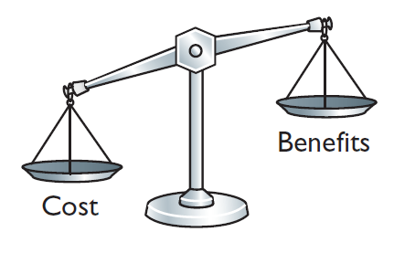
Cost Constraint
Cost Constraint
Accounting standard-setters weigh the cost that companies will incur to provide the information against the benefit that financial statement users will gain from having the information available.

Slide 15
Generally Accepted Accounting Principles
Financial Statements
  Balance Sheet
  Income Statement
  Statement of Stockholders’ Equity
  Statement of Cash Flows
  Note Disclosure
Various users need financial information
The accounting profession has attempted to develop a set of standards that are generally accepted and universally practiced.
Generally Accepted Accounting Principles (GAAP)

Slide 16
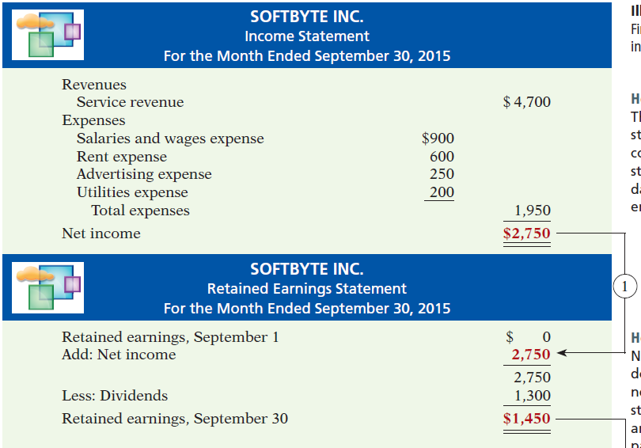
Net income is needed to determine the ending balance in retained earnings.
Financial Statements

Slide 17
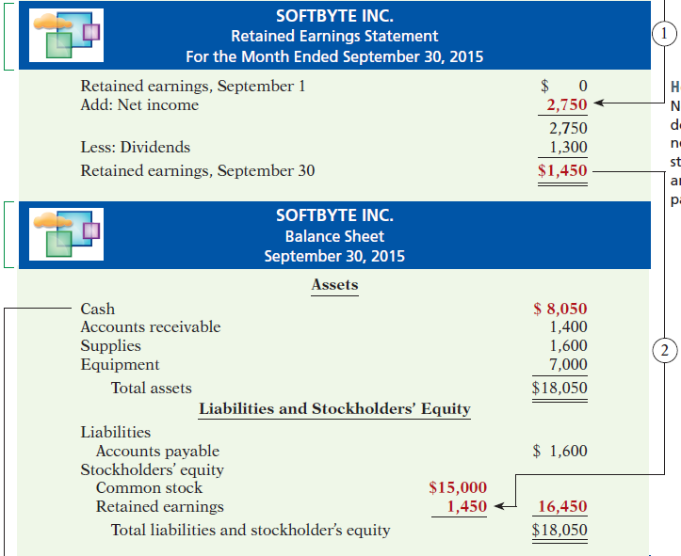
The ending balance in retained earnings is needed in preparing the balance sheet.
Financial Statements

Slide 18
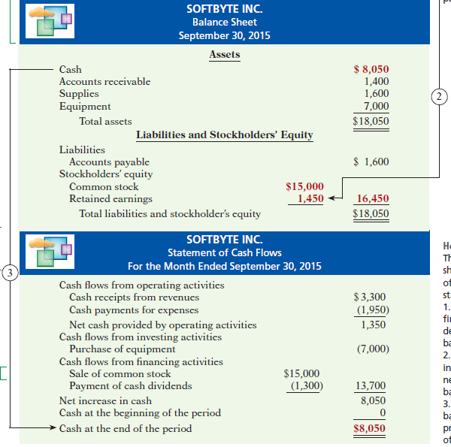
Balance sheet and income statement are needed to prepare statement of cash flows.
Financial Statements

Slide 19
Generally Accepted Accounting Principles
Question
Combining the activities of Kellogg and General Mills would violate the
  cost principle.
  economic entity assumption.
  monetary unit assumption.
  ethics principle.
Advance slide in presentation mode to reveal answers.

Slide 20
Generally Accepted Accounting Principles
Question
A business organized as a separate legal entity under state law having ownership divided into shares of stock is a
  proprietorship.
  partnership.
  corporation.
  sole proprietorship.
Advance slide in presentation mode to reveal answers.

Slide 21
The Basic Accounting Equation
Assets
Liabilities
Stockholder’s Equity
=
+
Provides the underlying framework for recording and summarizing economic events.
Assets must equal the sum of liabilities and stockholders’ equity.
Claims of creditors (liabilities) must be paid before ownership claims (stockholders’ equity).

Slide 22
The Basic Accounting Equation
Assets
Liabilities
Stockholder’s Equity
=
+
Assets
  Resources a business owns.
  Provide future services or benefits.
  Cash, Supplies, Equipment, etc.

Slide 23
The Basic Accounting Equation
Assets
Liabilities
Stockholder’s Equity
=
+
Liabilities
  Claims against assets (debts and obligations).
  Creditors - party to whom money is owed.
  Accounts payable, Notes payable, etc.

Slide 24
The Basic Accounting Equation
Assets
Liabilities
Stockholder’s Equity
=
+
Stockholders’ Equity
  Ownership claim on total assets.
  Referred to as residual equity.
  Common stock and retained earnings.

Slide 25
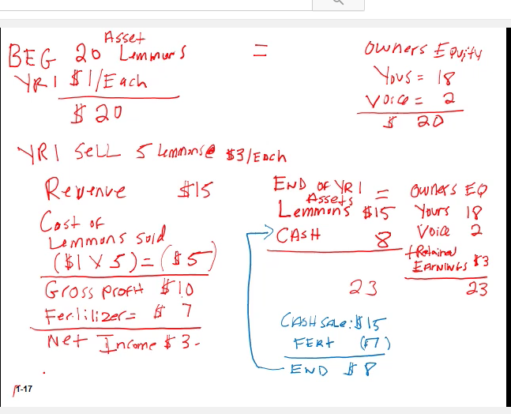




Slide 26
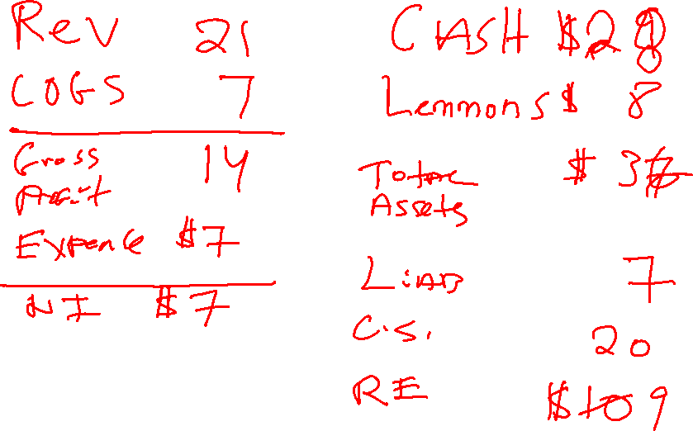






Slide 27
The Basic Accounting Equation
Assets
Liabilities
Stockholder’s Equity
=
+

Slide 28
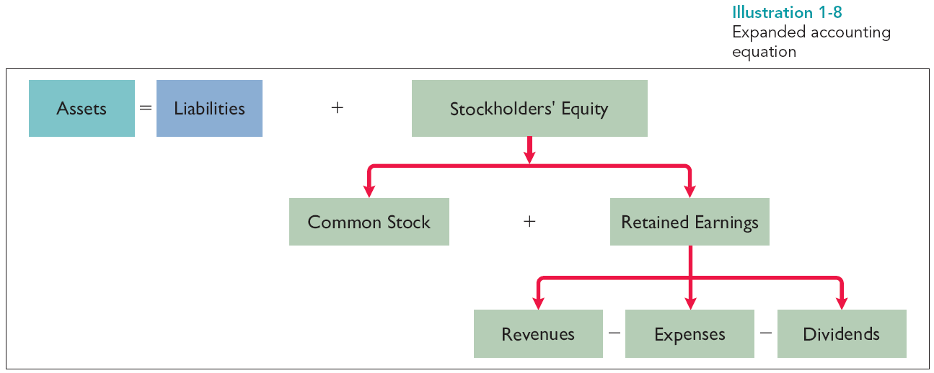
Using the Accounting Equation
Illustration 1-8
Expanded accounting equation

Slide 29
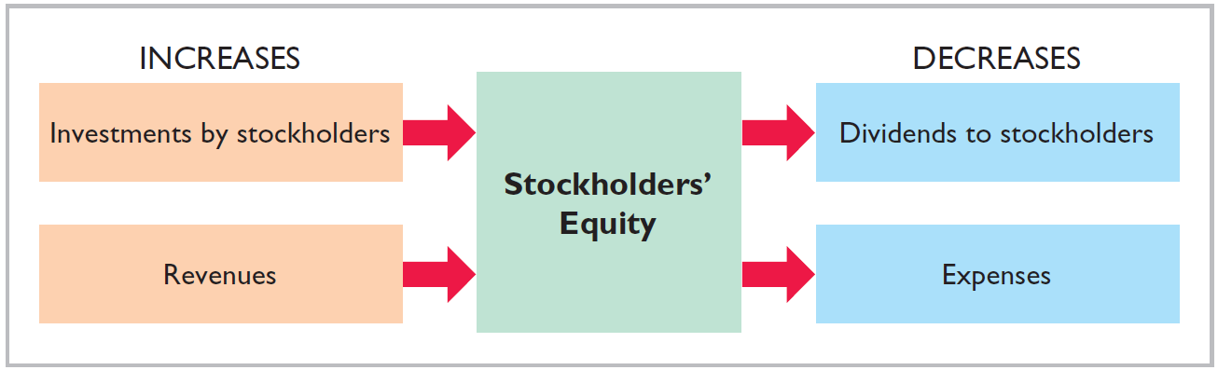
The Basic Accounting Equation
Investments by stockholders represent the total amount paid in by stockholders for the shares they purchase.

Slide 30
The Basic Accounting Equation
Revenues result from business activities entered into for the purpose of earning income.
Common sources of revenue are: sales, fees, services, commissions, interest, dividends, royalties, and rent.

Slide 31
The Basic Accounting Equation
Dividends are the distribution of cash or other assets to stockholders.
Dividends reduce retained earnings. However, dividends are not an expense.

Slide 32
The Basic Accounting Equation
Expenses are the cost of assets consumed or services used in the process of earning revenue.
Common expenses are: salaries expense, rent expense, utilities expense, tax expense, etc.

Slide 33
Net income is needed to determine the ending balance in retained earnings.
Financial Statements

Slide 34
The ending balance in retained earnings is needed in preparing the balance sheet.
Financial Statements

Slide 35
Balance sheet and income statement are needed to prepare statement of cash flows.
Financial Statements

Slide 36
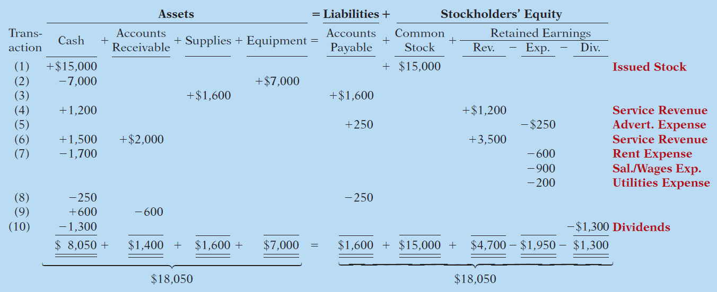
Transaction Analysis
Transaction (1). Investment by Stockholders. Ray and Barbara Neal decides to open a computer programming service which he names Softbyte. On September 1, 2015, they invest $15,000 cash in exchange for common stock.
Advance slide in presentation mode to reveal answers.

Slide 37
Transaction Analysis
Transaction (2). Purchase of Equipment for Cash. Softbyte purchases computer equipment for $7,000 cash.

Slide 38
Transaction Analysis
Transaction (3). Purchase of Supplies on Credit. Softbyte purchases for $1,600 from Acme Supply Company computer paper and other supplies expected to last several months.

Slide 39
Transaction Analysis
Transaction (4). Services Provided for Cash. Softbyte receives $1,200 cash from customers for programming services it has provided.

Slide 40
Transaction Analysis
Transaction (5). Purchase of Advertising on Credit. Softbyte receives a bill for $250 from the Daily News for advertising but postpones payment until a later date.

Slide 41
Transaction Analysis
Transaction (6). Services Provided for Cash and Credit. Softbyte provides $3,500 of programming services for customers. The company receives cash of $1,500 from customers, and it bills the balance of $2,000 on account.

Slide 42
Transaction Analysis
Transaction (7). Payment of Expenses. Softbyte pays the following expenses in cash for September: store rent $600, salaries and wages of employees $900, and utilities $200.

Slide 43
Transaction Analysis
Transaction (8). Payment of Accounts Payable. Softbyte pays its $250 Daily News bill in cash.

Slide 44
Transaction Analysis
Transaction (9). Receipt of Cash on Account. Softbyte receives $600 in cash from customers who had been billed for services [in Transaction (6)].

Slide 45
Transaction Analysis
Transaction (10). Dividends. The corporation pays a dividend of $1,300 in cash.

Slide 46
Financial Statements
Companies prepare four financial statements :
Income Statement
Retained Earnings Statement
Balance Sheet
Statement of Cash Flows

Slide 47
Net income is needed to determine the ending balance in retained earnings.
Financial Statements
Illustration 1-10
Financial statements and
their interrelationships

Slide 48
The ending balance in retained earnings is needed in preparing the balance sheet.
Financial Statements

Slide 49
Balance sheet and income statement are needed to prepare statement of cash flows.
Financial Statements

Slide 50
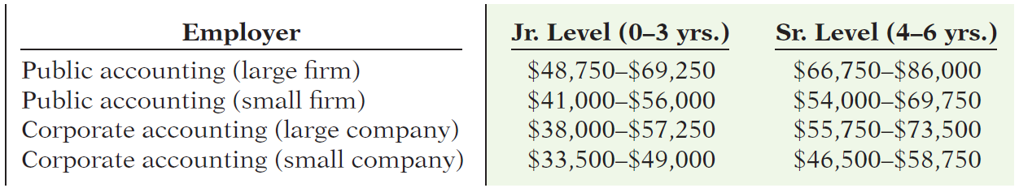
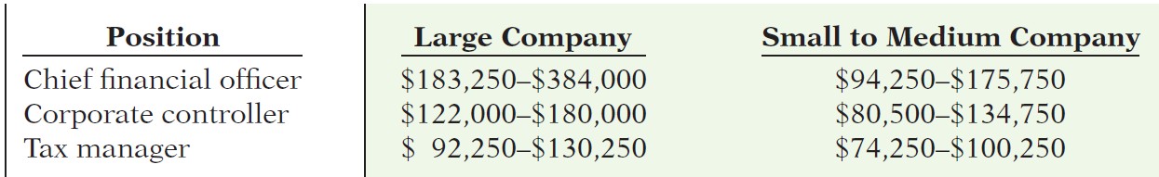
“Show Me the Money”
Salary estimates for jobs in public and corporate accounting
Illustration 1A-1
Upper-level management salaries in corporate accounting
Illustration 1A-2

Slide 51
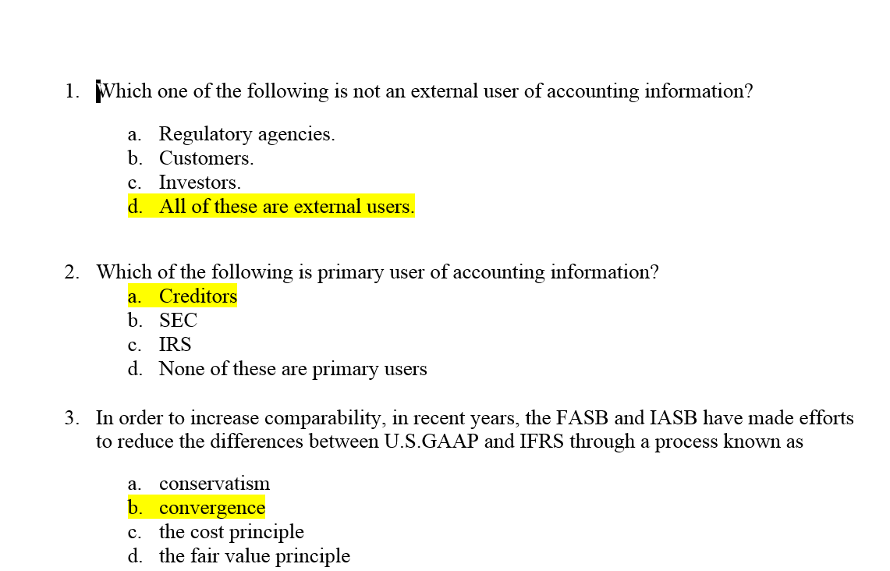

Slide 52
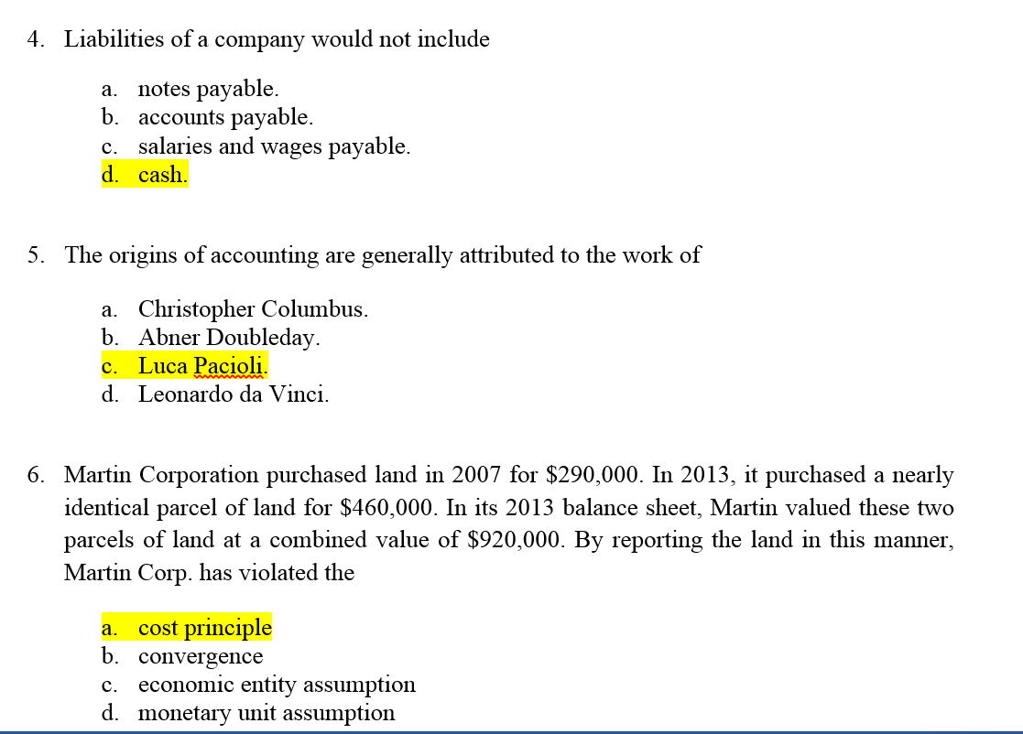

Slide 53
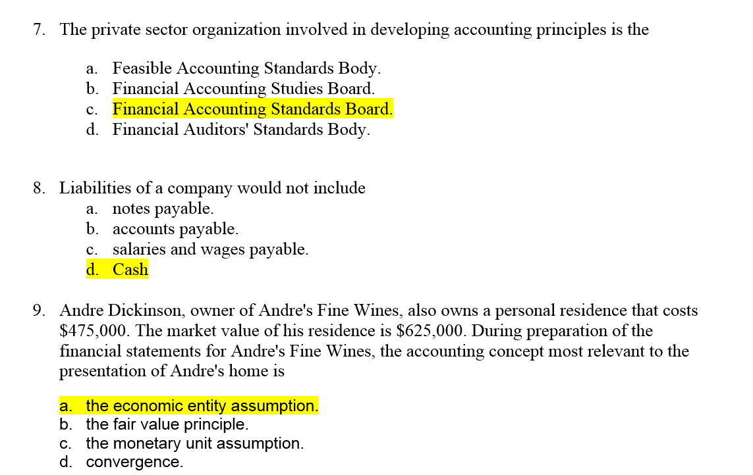

Slide 54
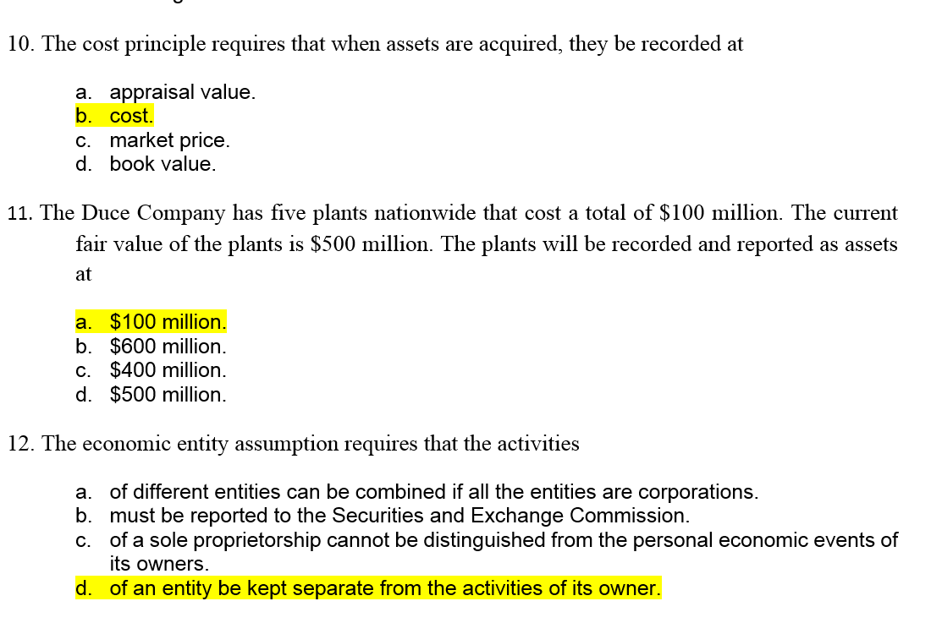

Slide 55
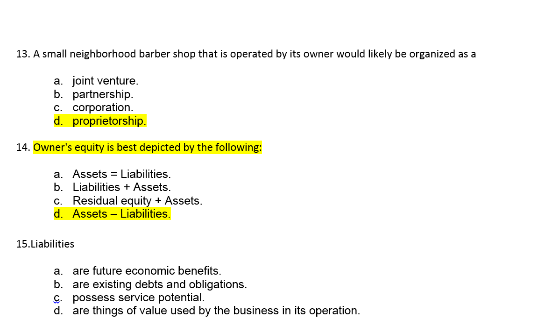

Slide 56
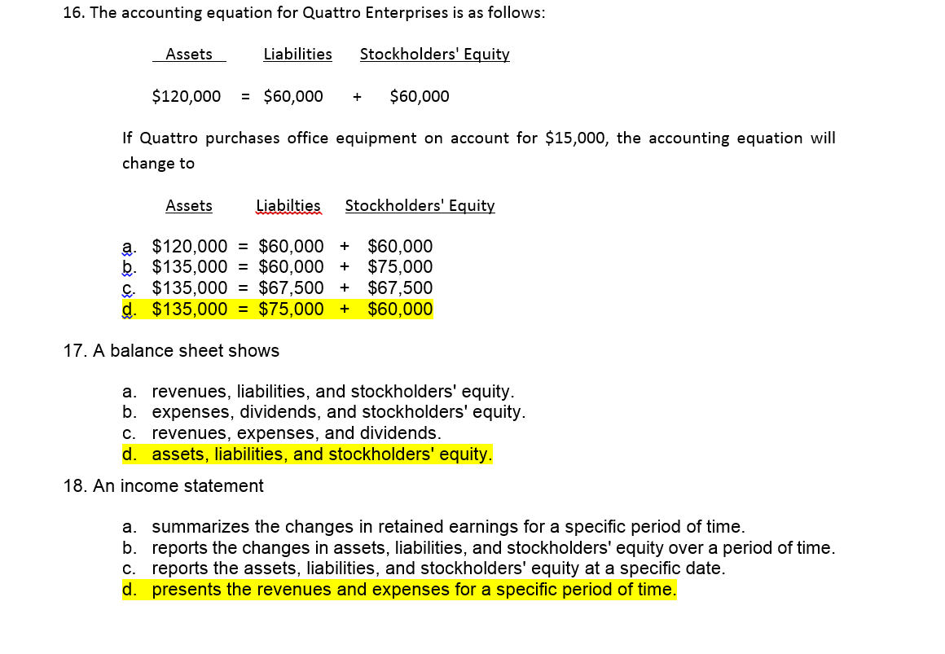

Slide 57
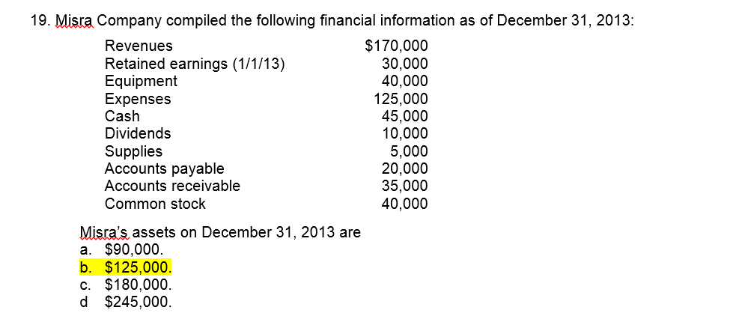


Slide 58
