Slide 1
Capital Budgeting Decisions

Slide 2
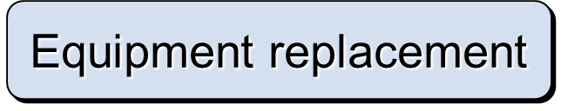
Typical Capital Budgeting Decisions
Plant expansion
Equipment selection
Lease or buy
Cost reduction

Slide 3
Typical Capital Budgeting Decisions
Capital budgeting tends to fall into two broad categories.
  Screening decisions. Does a proposed project meet some preset standard of acceptance?
  Preference decisions. Selecting from among several competing courses of action.

Slide 4
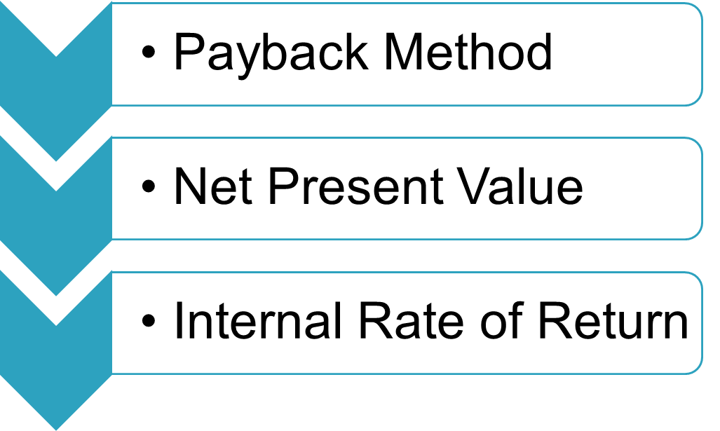
Cash Flows versus Operating Income
These methods focus on analyzing the cash flows associated with capital investment projects:
The simple rate of return method focuses on incremental net operating income.

Slide 5
Typical Cash Outflows
Repairs and
maintenance
Working
capital
Initial
investment
Incremental
operating
costs

Slide 6
Typical Cash Inflows
Salvage
value
Release of
working
capital
Reduction
of costs
Incremental
revenues

Slide 7

Time Value of Money
A dollar today is worth more than a dollar a year from now.
Therefore, projects that promise earlier returns are preferable to those that promise later returns.

Slide 8

Time Value of Money
The capital budgeting techniques that best recognize the time value of money are those that involve discounted cash flows.

Slide 9
Learning Objective 1
Determine the payback period for an investment.

Slide 10
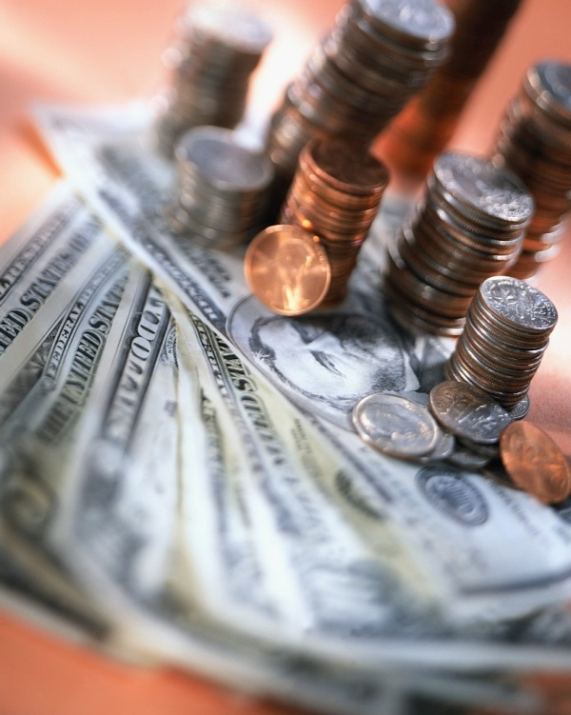
The Payback Method
The payback method focuses on the payback period, which is the length of time that it takes for a project to recoup its initial cost out of the cash receipts that it generates.

Slide 11
The Payback Method
The payback method analyzes cash flows; however, it does not consider the time value of money.
When the annual net cash inflow is the same each year, this formula can be used to compute the payback period:
Investment required
Annual net cash inflow
Payback period =

Slide 12
The Payback Method
Management at the Daily Grind wants to install an espresso bar in its restaurant that
  Costs $140,000 and has a 10-year life.
  Will generate annual net cash inflows of $35,000.
Management requires a payback period of 5 years or less on all investments.
What is the payback period for the espresso bar?

Slide 13
The Payback Method
Investment required
Annual net cash inflow
Payback period =
$140,000
$35,000
Payback period =
Payback period =
4.0 years
According to the company’s criterion, management would invest in the espresso bar because its payback period is less than 5 years.

Slide 14


Evaluation of the Payback Method
Ignores the
time value
of money.
Short-comings
of the payback
method.
Shorter payback period does not always mean a more desirable investment.
Ignores cash
flows after
the payback
period.

Slide 15
Evaluation of the Payback Method
Serves as screening tool.
Identifies investments that recoup cash investments quickly.
Strengths
of the payback
period.
Identifies products that recoup initial investment quickly.

Slide 16

Payback and Uneven Cash Flows
When the cash flows associated with an investment project change from year to year, the payback formula introduced earlier cannot be used.
Instead, the un-recovered investment must be tracked year by year.
$1,000
$0
$2,000
$1,000
$500
1
2
3
4
5

Slide 17
Payback and Uneven Cash Flows
For example, if a project requires an initial investment of $4,000 and provides uneven net cash inflows in years 1-5 as shown, the investment would be fully recovered in year 4.
$1,000
$0
$2,000
$1,000
$500
1
2
3
4
5

Slide 18
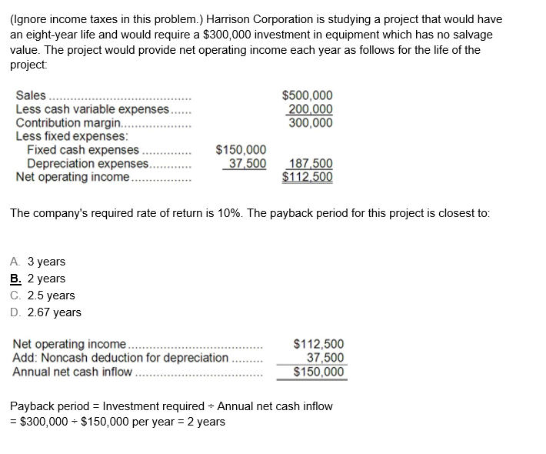

Slide 19
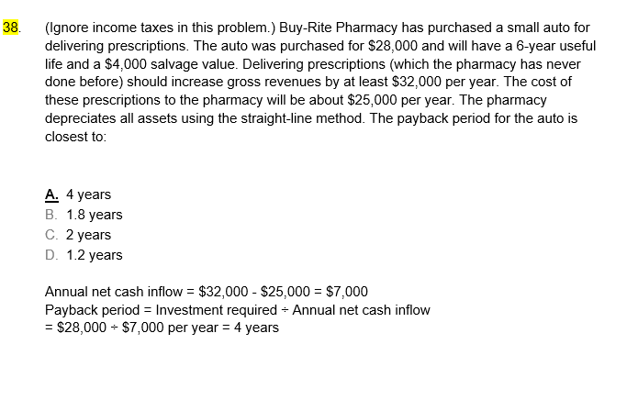

Slide 20
Learning Objective 2
Evaluate the acceptability of an investment project using the net present value method.

Slide 21
The Net Present Value Method
The net present value method compares the present value of a project’s cash inflows with the present value of its cash outflows. The difference between these two streams of cash flows is called the net present value.

Slide 22
The Net Present Value Method
Once you have computed a net present value, you should interpret the results as follows:
A positive net present value indicates that the project’s return exceeds the discount rate.
A negative net present value indicates that the project’s return is less than the discount rate.

Slide 23
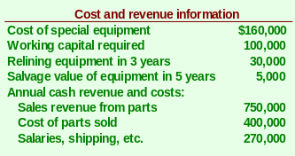
The Net Present Value Method
Lester Company has been offered a five year contract to provide component parts for a large manufacturer.

Slide 24

The Net Present Value Method
At the end of five years the working capital will be released and may be used elsewhere by Lester.
Lester Company uses a discount rate of 11%.
Should the contract be accepted?

Slide 25


The Net Present Value Method
Annual net cash inflow from operations

Slide 26
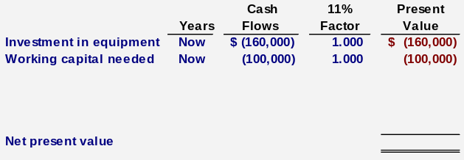
The Net Present Value Method

Slide 27
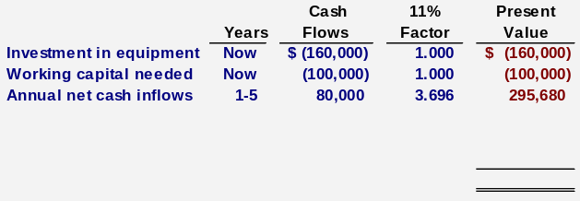
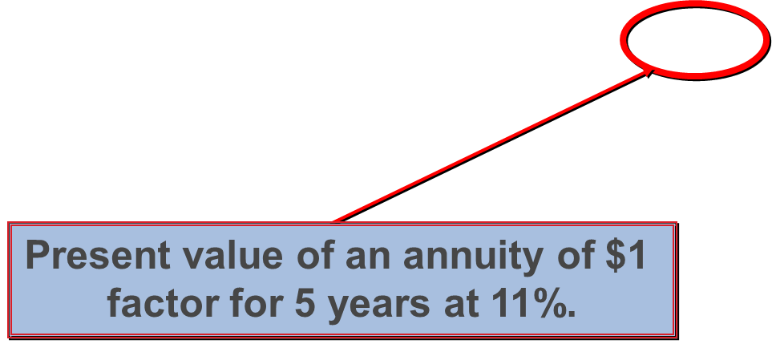
The Net Present Value Method

Slide 28
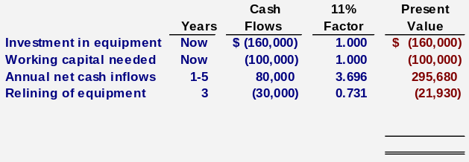
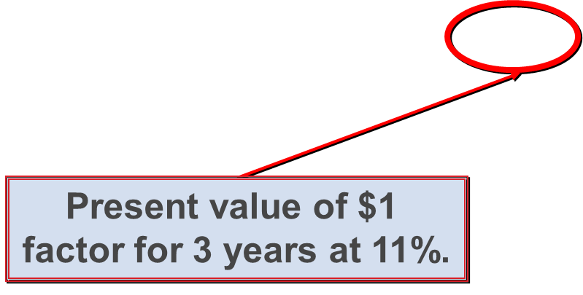
The Net Present Value Method

Slide 29
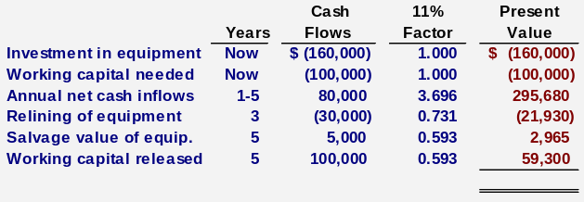
The Net Present Value Method
Present value of $1
factor for 5 years at 11%.
Total present value of the release of the working capital and the salvage value of the equipment is $62,265.

Slide 30
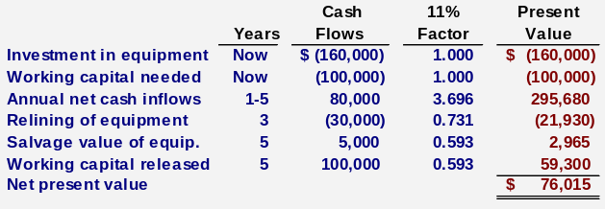
The Net Present Value Method
Accept the contract because the project has a positive net present value.

Slide 31
The Net Present Value Method
Once you have computed a net present value, you should interpret the results as follows:
A positive net present value indicates that the project’s return exceeds the discount rate.
A negative net present value indicates that the project’s return is less than the discount rate.

Slide 32
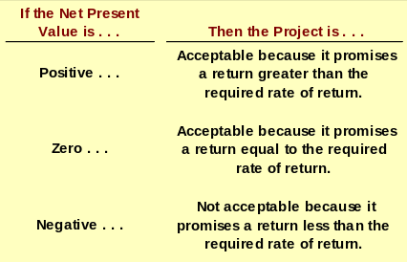
The Net Present Value Method

Slide 33
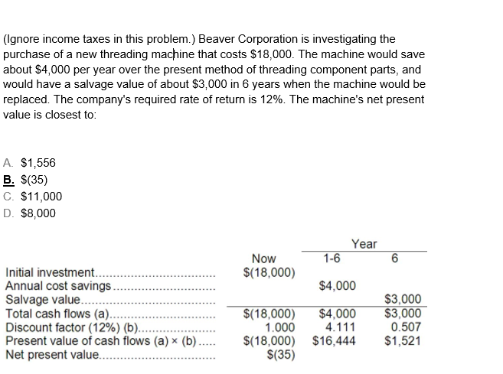

Slide 34
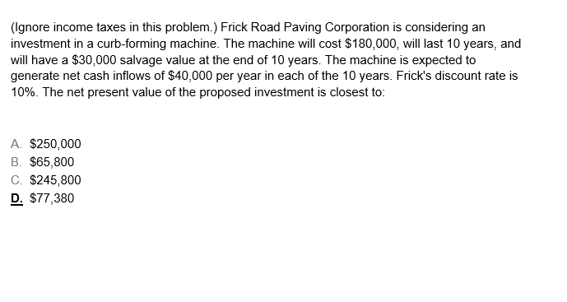
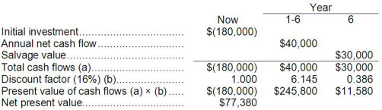

Slide 35
Learning Objective 3
Evaluate the acceptability of an investment project using the internal rate of return method.

Slide 36
Internal Rate of Return Method
The internal rate of return is the rate of return promised by an investment project over its useful life. It is computed by finding the discount rate that will cause the net present value of a project to be zero.
It works very well if a project’s cash flows are identical every year. If the annual cash flows are not identical, a trial-and-error process must be used to find the internal rate of return.

Slide 37
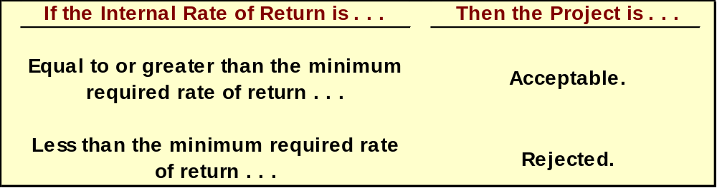
Internal Rate of Return Method
General decision rule . . .
When using the internal rate of return, the cost of capital acts as a hurdle rate that a project must clear for acceptance.

Slide 38

Internal Rate of Return Method
Decker Company can purchase a new machine at a cost of $104,320 that will save $20,000 per year in cash operating costs.
The machine has a 10-year life.

Slide 39
Internal Rate of Return Method
Future cash flows are the same every year in this example, so we can calculate the internal rate of return as follows:
PV factor for the
internal rate of return
Investment required
Annual net cash flows
=
$104, 320
$20,000
= 5.216

Slide 40
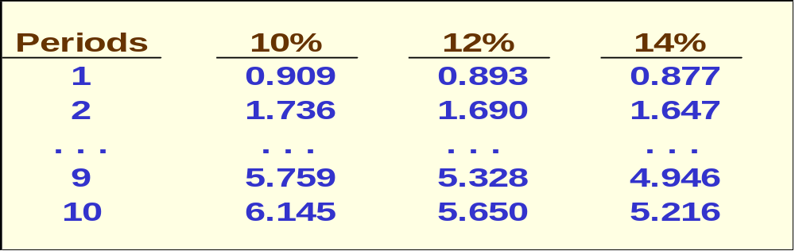
Internal Rate of Return Method
Using the present value of an annuity of $1 table . . .
Find the 10-period row, move across until you find the factor 5.216. Look at the top of the column and you find a rate of 14%.

Slide 41
Internal Rate of Return Method

Slide 42
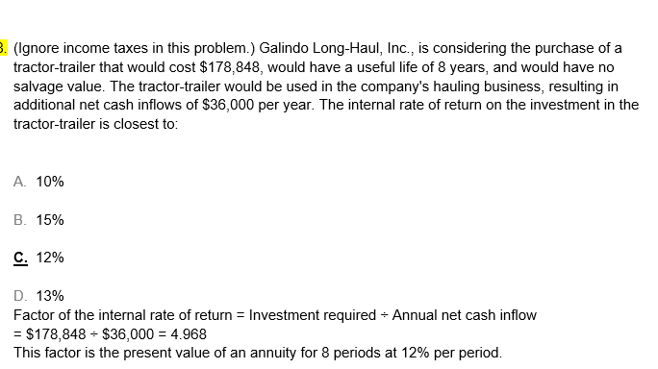

Slide 43
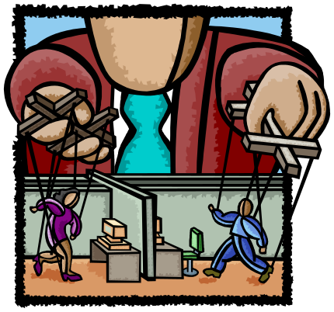
Expanding the Net Present Value Method
We will now expand the net present value method to include two alternatives. We will analyze the alternatives using the total cost approach.

Slide 44
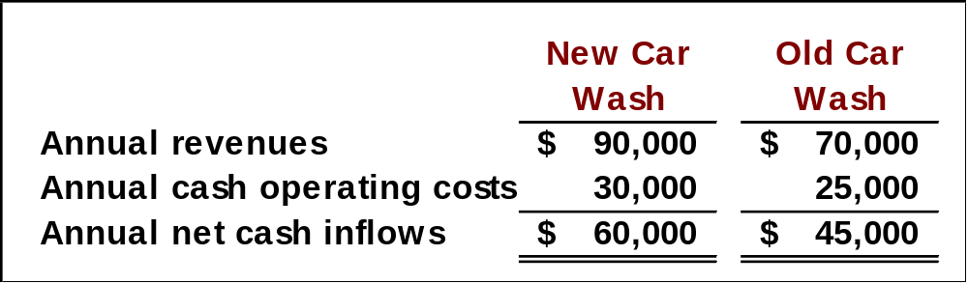
The Total-Cost Approach
White Company has two alternatives:
  remodel an old car wash or,
  remove the old car wash and install a new one.
The company uses a discount rate of 10%.

Slide 45
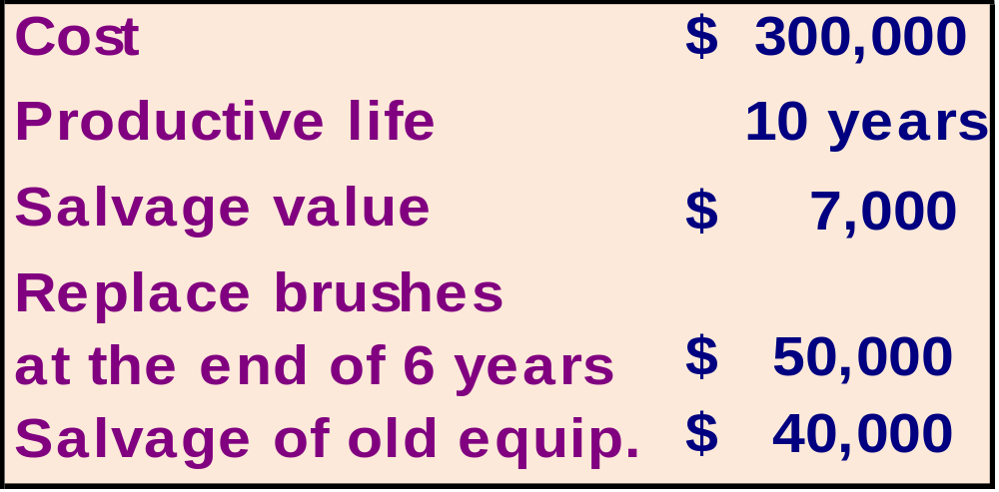
The Total-Cost Approach
If White installs a new washer . . .
Let’s look at the present value
of this alternative.

Slide 46
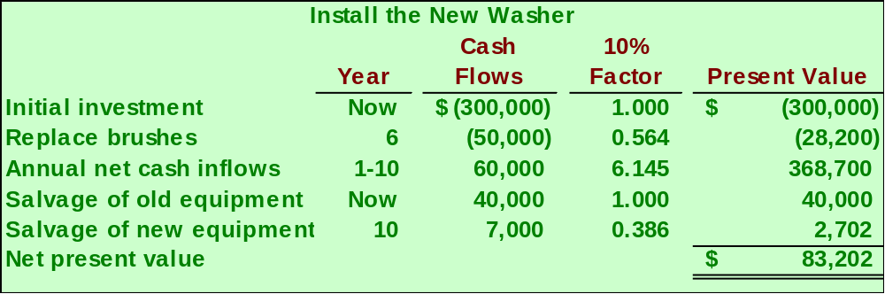
The Total-Cost Approach
If we install the new washer, the investment will yield a positive net present value of $83,202.

Slide 47
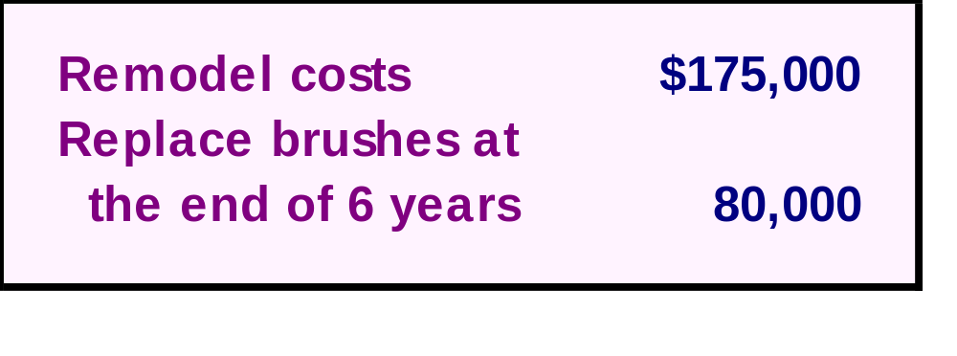
The Total-Cost Approach
If White remodels the existing washer . . .
Let’s look at the present value
of this second alternative.

Slide 48
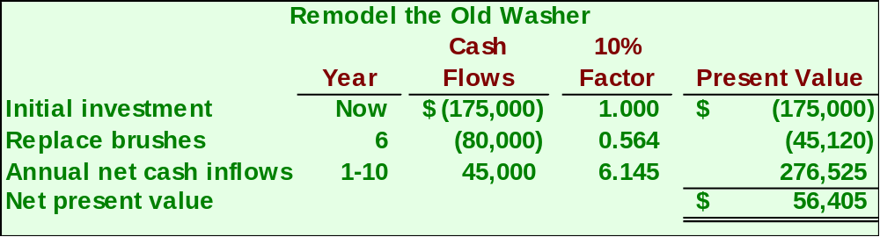
The Total-Cost Approach
If we remodel the existing washer, we will produce a positive net present value of $56,405.

Slide 49

The Total-Cost Approach
Both projects yield a positive net present value.
However, investing in the new washer will produce a higher net present value than remodeling the old washer.

Slide 50
Simple Rate of Return Method
Does not focus on cash flows -- rather it focuses on accounting net operating income.
The following formula is used to calculate the simple rate of return:
-
Annual incremental net operating income
Simple rate
of return
=
Initial investment*
*Should be reduced by any salvage from the sale of the old equipment

Slide 51

Simple Rate of Return Method
Management of the Daily Grind wants to install an espresso bar in its restaurant that:
  Cost $140,000 and has a 10-year life.
  Will generate incremental revenues of $100,000 and incremental expenses of $65,000 including depreciation.
What is the simple rate of return on the investment project?

Slide 52
Simple Rate of Return Method
Simple rate
of return
$35,000
$140,000
=
= 25%

