Slide 1
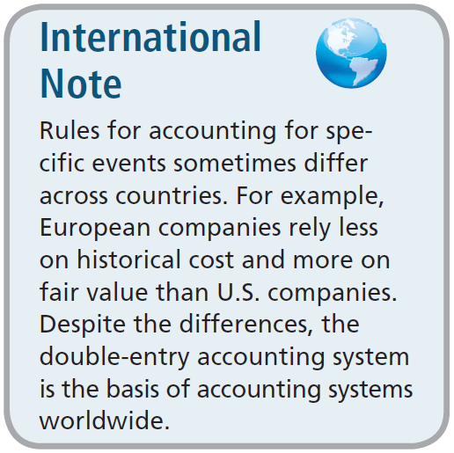
The Account
Debit and Credit Procedure
Double-entry system
  Each transaction must affect two or more accounts to keep the basic accounting equation in balance.
  Recording done by debiting at least one account and crediting another.
  DEBITS must equal CREDITS.

Slide 2


Debits/Credits Rules IF YOU FAIL TO LEARN THIS SLIDE YOU WILL NOT PASS
Balance Sheet Income Statement
Asset
Liability
+
-
=
Equity
Revenue
Expense
Debit
Credit

Slide 3
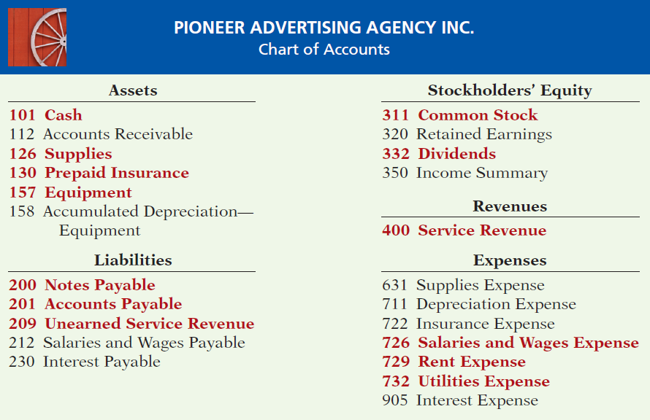

Chart of Accounts
Accounts and account numbers arranged in sequence in which they are presented in the financial statements.

Slide 4
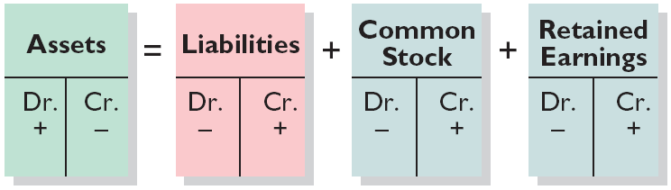
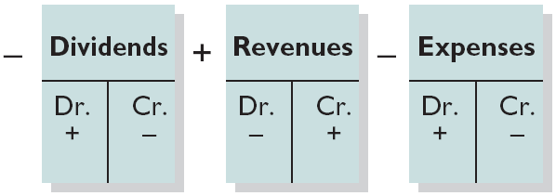
Summary of Debit/Credit Rules
Relationship among the assets, liabilities and stockholders’ equity of a business:
Illustration 2-12
Basic Equation
Assets
=
Liabilities
+
Stockholders’ Equity
Expanded Equation
Debit/Credit Effects
The equation must be in balance after every transaction. For every Debit there must be a Credit.

Slide 5
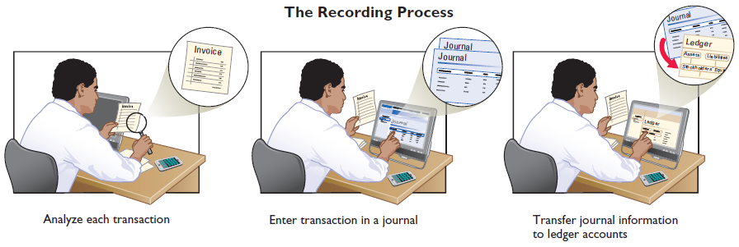
Steps in the Recording Process
Analyze each transaction
Enter transaction in a journal
Transfer journal information to ledger accounts
Business documents, such as a sales slip, a check, a bill, or a cash register tape, provide evidence of the transaction. GO TO IN CLASS EXAMPLE

Slide 6
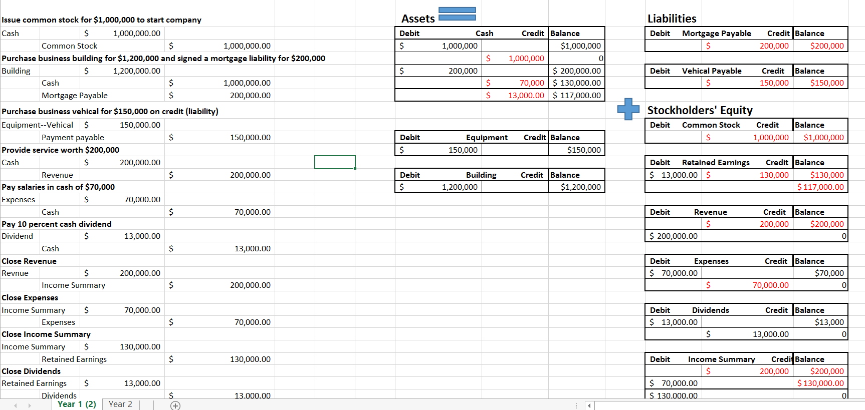

Slide 7
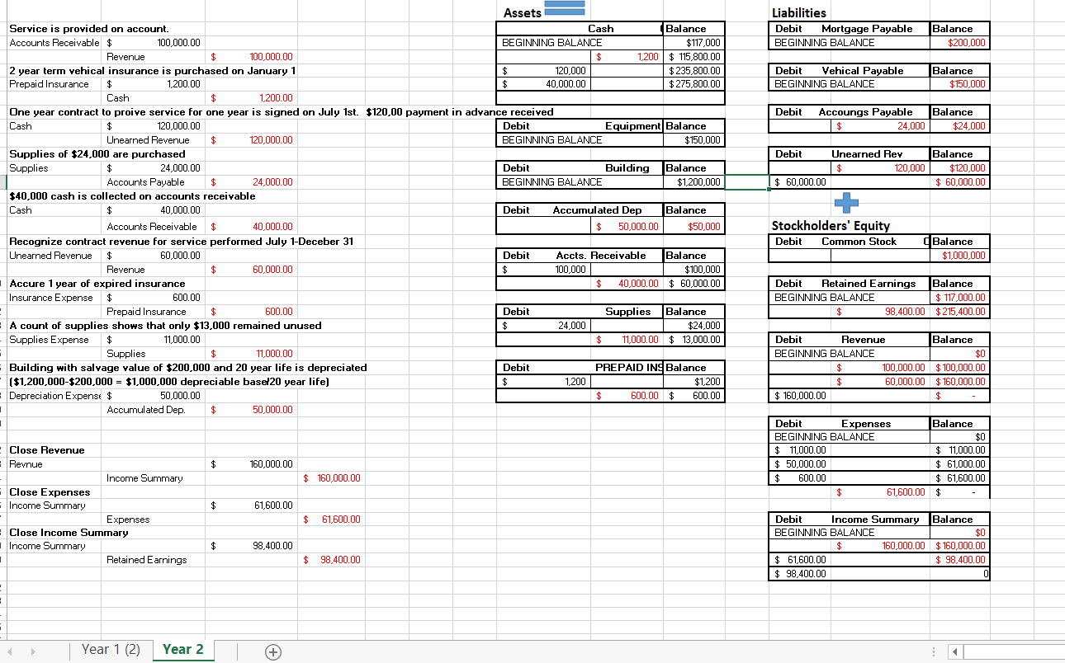

Slide 8
Debits/Credits Rules
Question
Debits:
  increase both assets and liabilities.
  decrease both assets and liabilities.
  increase assets and decrease liabilities.
  decrease assets and increase liabilities.

Slide 9
Debits/Credits Rules
Question
Accounts that normally have debit balances are:
  assets, expenses, and revenues.
  assets, expenses, and equity.
  assets, liabilities, and dividends.
  assets, dividends, and expenses.

Slide 10
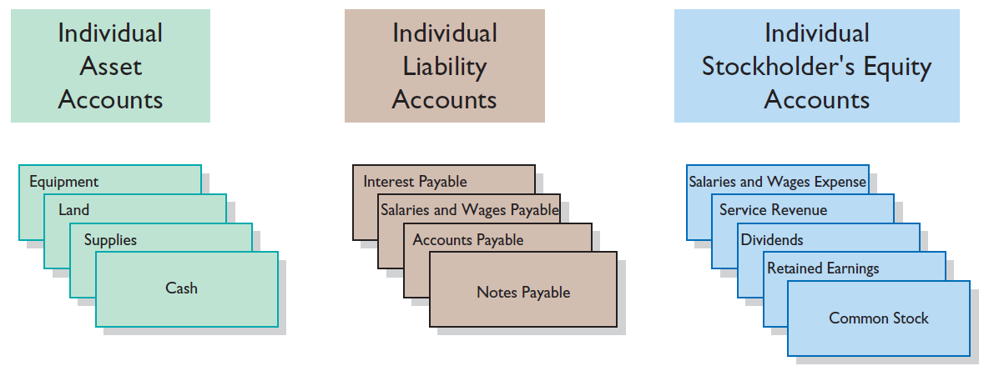
Steps in the Recording Process
The Ledger
General Ledger contains the entire group of accounts maintained by a company.
LO 5

Slide 11
Posting
Question
Posting:
  normally occurs before journalizing.
  transfers ledger transaction data to the journal.
  is an optional step in the recording process.
  transfers journal entries to ledger accounts.

Slide 12
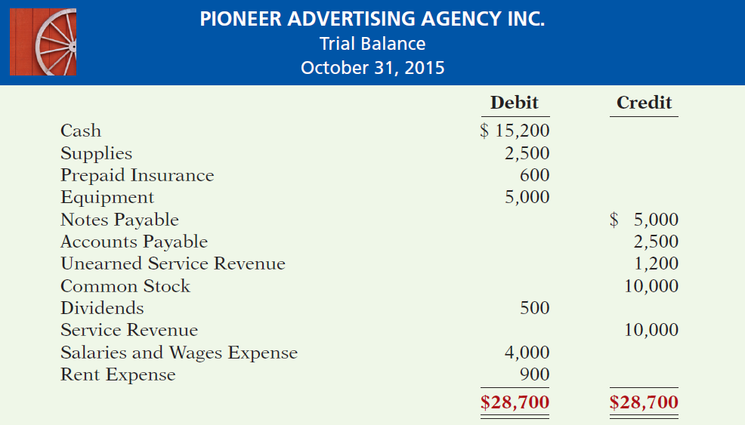
Trial Balance

Slide 13
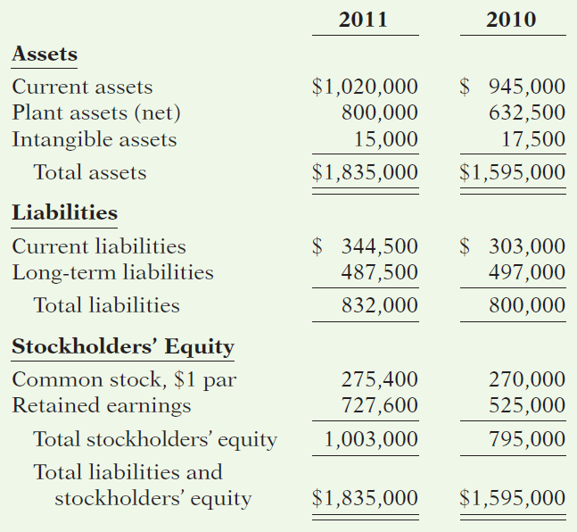
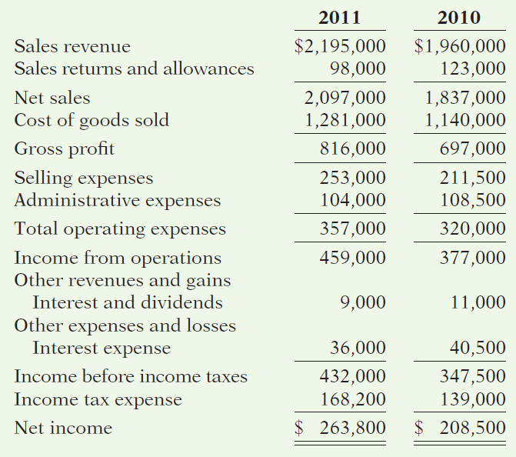
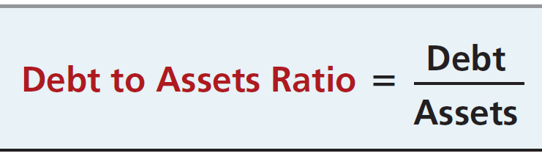
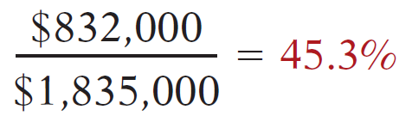
QUALITY DEPARTMENT STORE INC.
Condensed Balance Sheets
For the Years Ended December 31
QUALITY DEPARTMENT STORE INC.
Condensed Income Statements
For the Years Ended December 31
Illustration 14-12

Slide 14
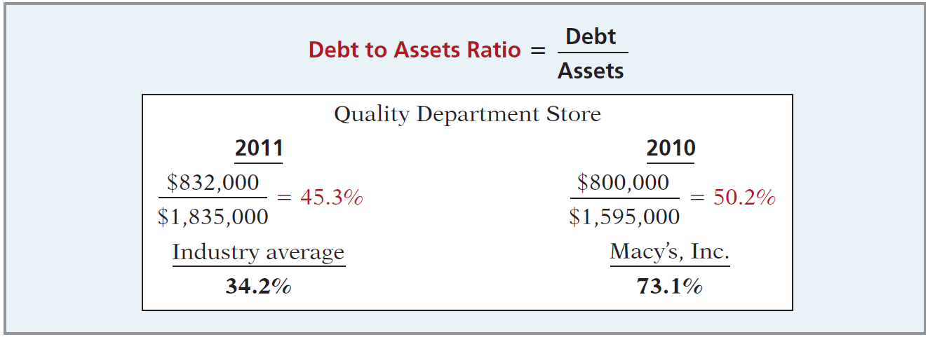
Ratio Analysis
Debt to Total Assets Ratio
Measures the percentage of the total assets that creditors provide.

