Slide 1
Timing Issues
Accrual-Basis Accounting
  Transactions recorded in the periods in which the events occur.
  Companies recognize revenues when they perform services (rather than when they receive cash).
  Expenses are recognized when incurred (rather than when paid).

Slide 2
Timing Issues
Accrual- versus Cash-Basis Accounting
Cash-Basis Accounting
  Revenues are recorded when cash is received.
  Expenses are recorded when cash is paid.
  Cash-basis accounting is not in accordance with generally accepted accounting principles (GAAP).

Slide 3







The Basics of Adjusting Entries
Types of Adjusting Entries
1. Prepaid Expenses. An Asset. For example prepaid Insurance of $1,200 policy good for 2 years.
1. Accrued Revenues. Revenues for services performed but not yet received in cash or recorded.
2. Unearned Revenues.
Cash received before services are performed.
2. Accrued Expenses. Expenses incurred but not yet paid in cash or recorded.

Slide 4
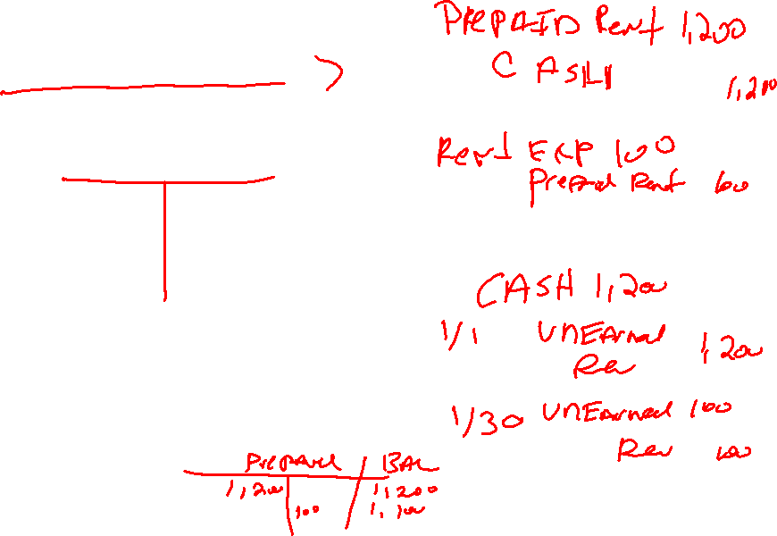
The Basics of Adjusting Entries
PREPAID EXPENSES
Payments of expenses that will benefit more than one accounting period.
Cash Payment
BEFORE
Expense Recorded
Prepayments often occur in regard to:
  insurance
  supplies
  advertising
  rent
  equipment
  buildings

Slide 5
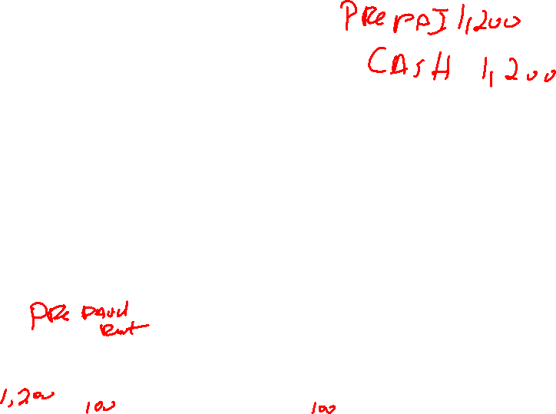
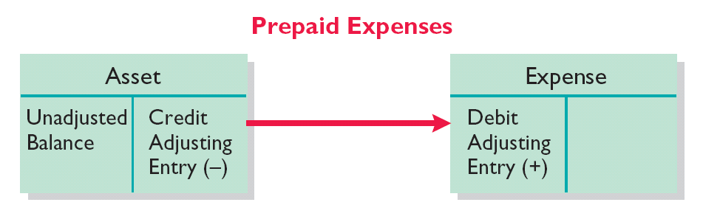
The Basics of Adjusting Entries
PREPAID EXPENSES
Expire either with the passage of time or through use.
Adjusting entry:
  Increase (debit) to an expense account and
  Decrease (credit) to an asset account.
Illustration 3-4

Slide 6
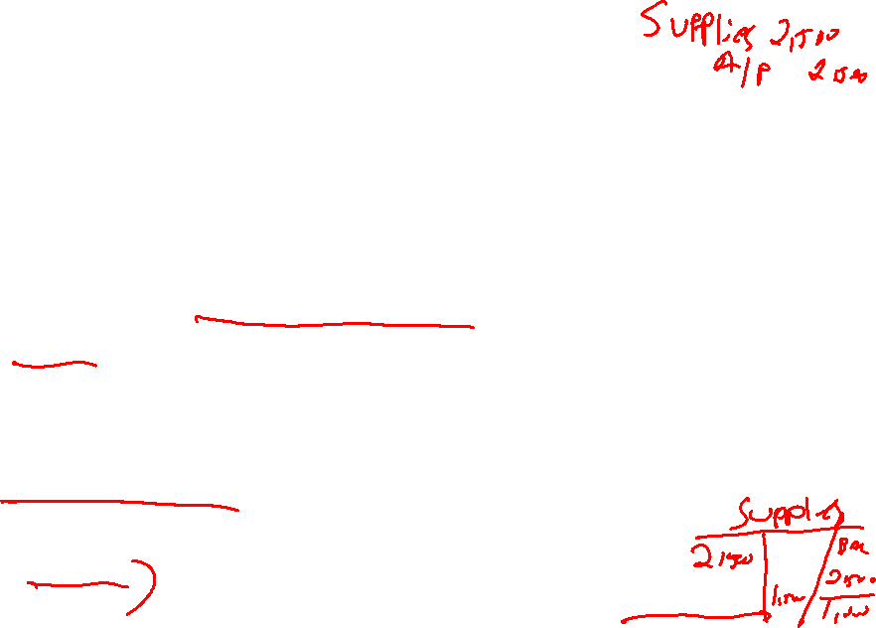
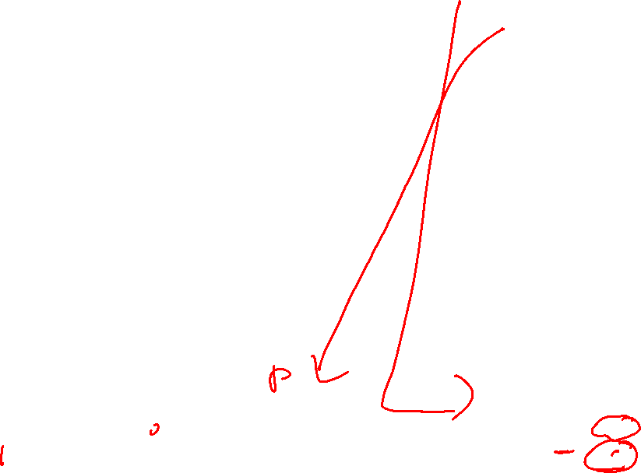
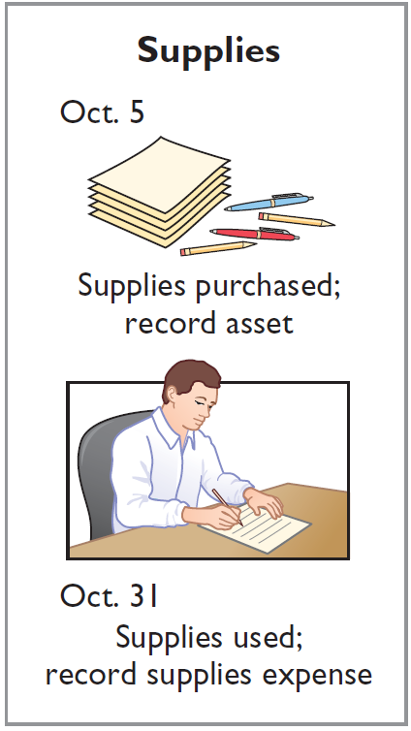
The Basics of Adjusting Entries
Illustration: Pioneer Advertising Agency Inc. purchased supplies costing $2,500 on October 5. Pioneer recorded the purchase by increasing (debiting) the asset Supplies. This account shows a balance of $2,500 in the October 31 trial balance. An inventory count at the close of business on October 31 reveals that $1,000 of supplies are still on hand.
Oct. 31
Supplies Expense
1,500
Supplies
1,500

Slide 7
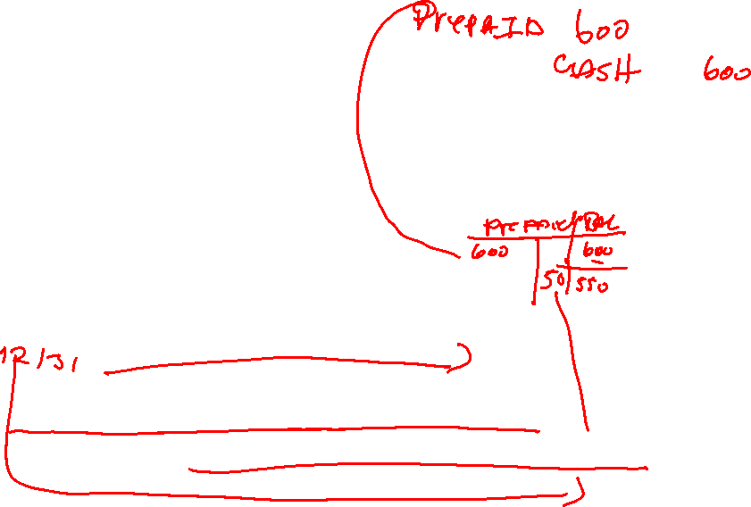
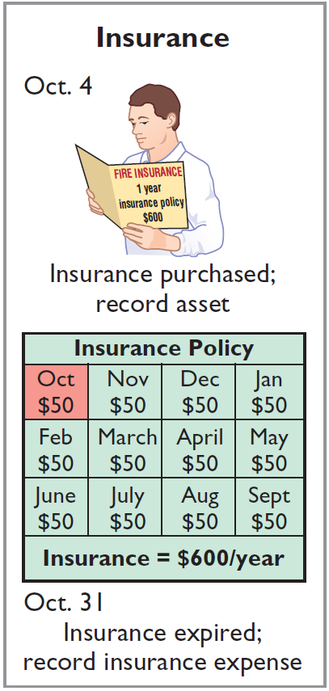

The Basics of Adjusting Entries
Illustration: On October 4, Pioneer Advertising Agency paid $600 for a one-year fire insurance policy. Coverage began on October 1. Pioneer recorded the payment by increasing (debiting) Prepaid Insurance. This account shows a balance of $600 in the October 31 trial balance. Insurance of $50 ($600 ÷ 12) expires each month.
Oct. 31
Insurance Expense
50
Prepaid Insurance
50

Slide 8
The Basics of Adjusting Entries
Depreciation
  Buildings, equipment, and motor vehicles (assets that provide service for many years) are recorded as assets, rather than an expense, on the date acquired.
  Depreciation is the process of allocating the cost of an asset to expense over its useful life.
  Depreciation does not attempt to report the actual change in the value of the asset.

Slide 9
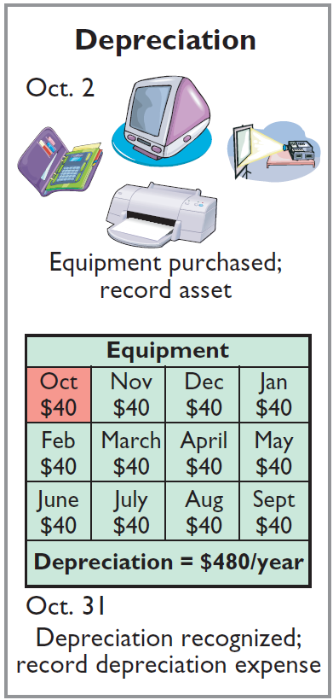
The Basics of Adjusting Entries
Illustration: For Pioneer Advertising, assume that depreciation on the equipment is $480 a year, or $40 per month.
Oct. 31
Depreciation Expense
40
Accumulated Depreciation
40
Accumulated Depreciation is called a contra asset account.
Helpful Hint
All contra accounts have increases, decreases, and normal balances opposite to the account to which they relate.

Slide 10
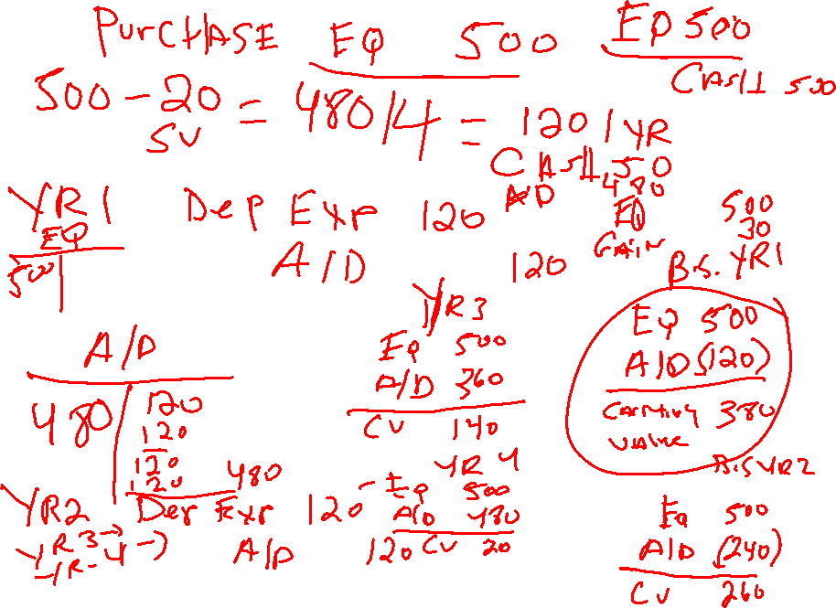

Slide 11
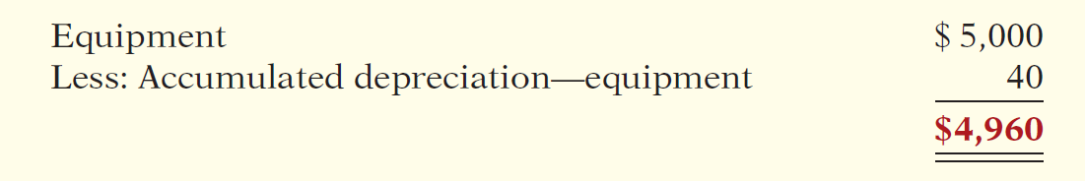
The Basics of Adjusting Entries
Statement Presentation
  Accumulated Depreciation is a contra asset account (credit).
  Appears just after the account it offsets (Equipment) on the balance sheet.
  Book value is the difference between the cost of any depreciable asset and its accumulated depreciation.
Illustration 3-8

Slide 12
The Basics of Adjusting Entries
UNEARNED REVENUES
Receipt of cash that is recorded as a liability because the service has not been performed.
Cash Receipt
BEFORE
Revenue Recorded
Unearned revenues often occur in regard to:
  Rent
  Airline tickets
  Magazine subscriptions
  Customer deposits

Slide 13
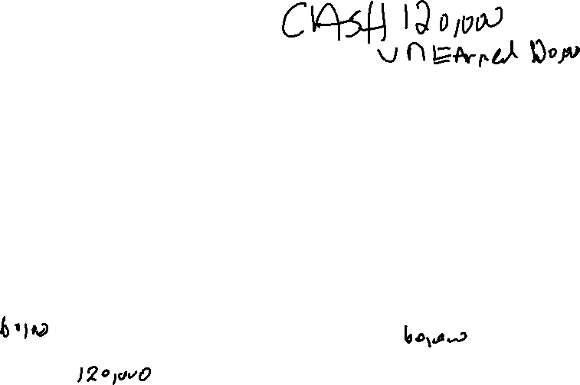
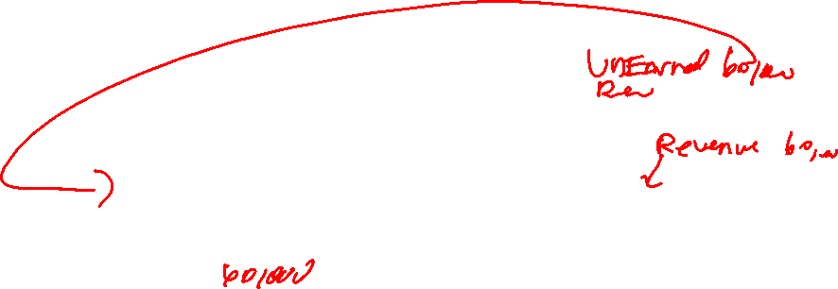
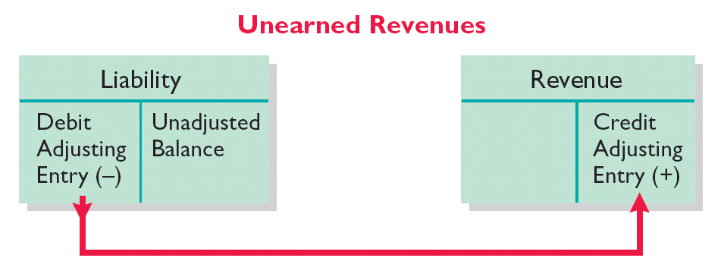
The Basics of Adjusting Entries
UNEARNED REVENUES
  Adjusting entry is made to record the revenue for services performed during the period and to show the liability that remains at the end of the accounting period.
  Results in a decrease (debit) to a liability account and an increase (credit) to a revenue account.
Illustration 3-10

Slide 14
The Basics of Adjusting Entries
Illustration: Pioneer Advertising Agency received $1,200 on October 2 from R. Knox for advertising services expected to be completed by December 31. Unearned Service Revenue shows a balance of $1,200 in the October 31 trial balance. Analysis reveals that the company performed $400 of services in October.
Oct. 31
Unearned Service Revenue
400
Service Revenue
400

Slide 15
The Basics of Adjusting Entries
ACCRUED REVENUES
Revenues for services performed but not yet received in cash or recorded.
Revenue Recorded
BEFORE
Cash Receipt
Accrued revenues often occur in regard to:
  Rent
  Interest
  Services performed
LO 5

Slide 16
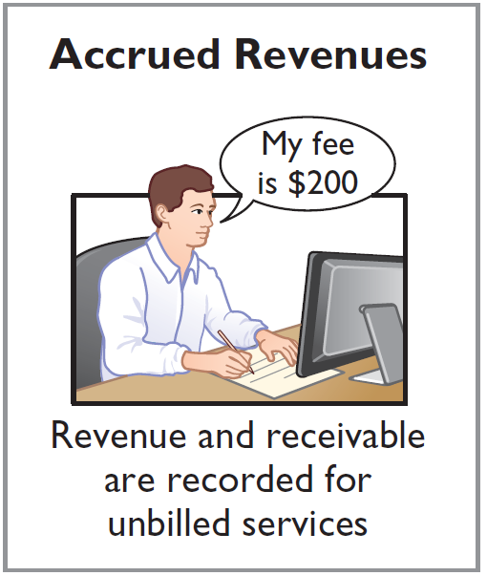
The Basics of Adjusting Entries
Illustration: In October, Pioneer Advertising Agency performed services worth $200 that were not billed to clients in October.
Oct. 31
Accounts Receivable
200
Service Revenue
200
On November 10, Pioneer receives cash of $200 for the services performed.
Nov. 10
Cash
200
Accounts Receivable
200

Slide 17
The Basics of Adjusting Entries
ACCRUED EXPENSES
Expenses incurred but not yet paid in cash or recorded.
Expense Recorded
BEFORE
Cash Payment
Accrued expenses often occur in regard to:
  Interest
  Taxes
  Salaries

Slide 18
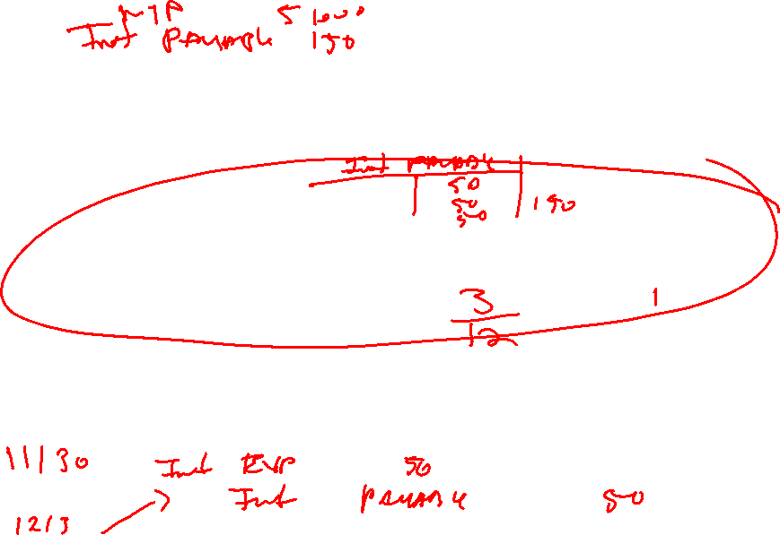
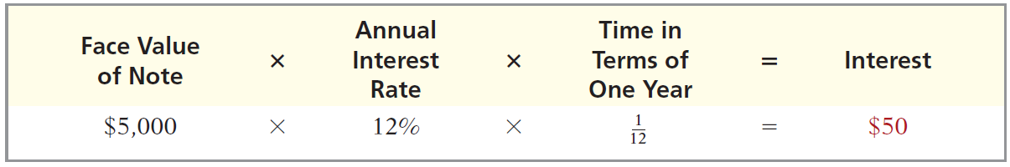
The Basics of Adjusting Entries
Illustration: Pioneer Advertising Agency signed a three-month note payable in the amount of $5,000 on October 1. The note requires Pioneer to pay interest at an annual rate of 12%.
Illustration 3-17
Oct. 31
Interest Expense
50
Interest Payable
50

Slide 19
The Basics of Adjusting Entries
Illustration: Pioneer paid salaries and wages on Friday, October 26; the next payment of salaries will not occur until Friday, November 2. The employees receive total salaries of $2,000 for a five-day work week, or $400 per day. Thus, accrued salaries at October 31 are $1,200 ($400 x 3 days).
On October 31:
Salary Expense $1,200
Salary Payable $1,200
On November 2.
Salary Payable $1,200
Salary Expense $ 800 (2 days [November 1st and 2^{nd]} X$400/day)
Cash $2,000

Slide 20
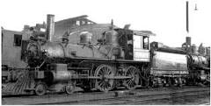
Nature of Assets
Period of Benefit
Assets have Future Economic Benefit
Assets can have Short-term (current) Benefit or Long-Term Benefit
As a general rule, current asset benefit will expire or be realized during the current year or next year.
  Examples of Current Assets Include
    Cash
    Receivables
    Inventory
Long-term assets have benefit that will expire or be realized in periods beyond the current and next year
  Examples of Non-Current Assets Include:
    Equipment
    Buildings
    Land
    Investments that the company intends to hold beyond the current and next year.

Slide 21
Long-Term Fixed Assets
Depreciation
Process of allocating the future economic benefit of long-term asset over their useful (service) life to expense in a rational and systematic manner.
  Applies to land improvements, buildings, and equipment, not land.
  Depreciable because the asset future economic benefit will decline over the asset’s useful life.

Slide 22
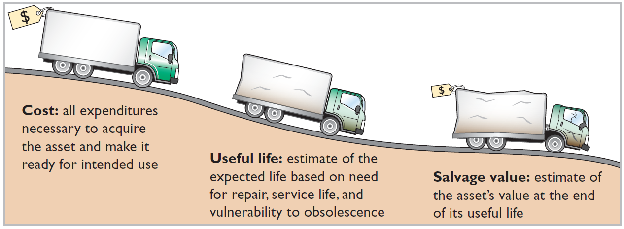
Depreciation
Factors in Computing Depreciation
Helpful Hint Depreciation expense is reported on the income statement. Accumulated depreciation
is reported on the balance sheet as a deduction from plant assets.
Alternative Terminology
Another term sometimes used for salvage value is residual value.

Slide 23
Depreciation
Illustration: Bob’s Florists purchased a small delivery truck on January 1, Year 1
Cost $13,000
Expected salvage value $1,000
Estimated useful life in years 5
Estimated useful life in miles 100,000
Dr. Equipment Asset $13,000
Cr. Cash $13,000
To record purchase of delivery truck
Required: Compute depreciation using the following.
(a) Straight-Line. (b) Units-of-Activity. (c) Declining Balance.

Slide 24
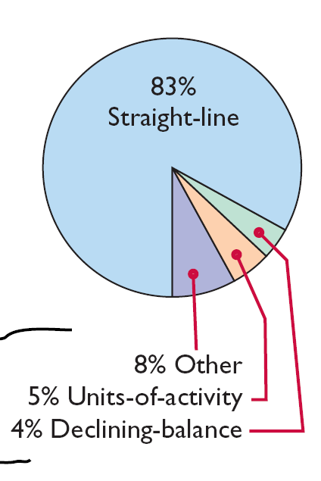
Depreciation
Depreciation Methods
Management selects the method it believes best measures an asset’s contribution to revenue over its useful life.
Examples include:
  Straight-line method.
  Units-of-activity method.
  Declining-balance method.

Slide 25
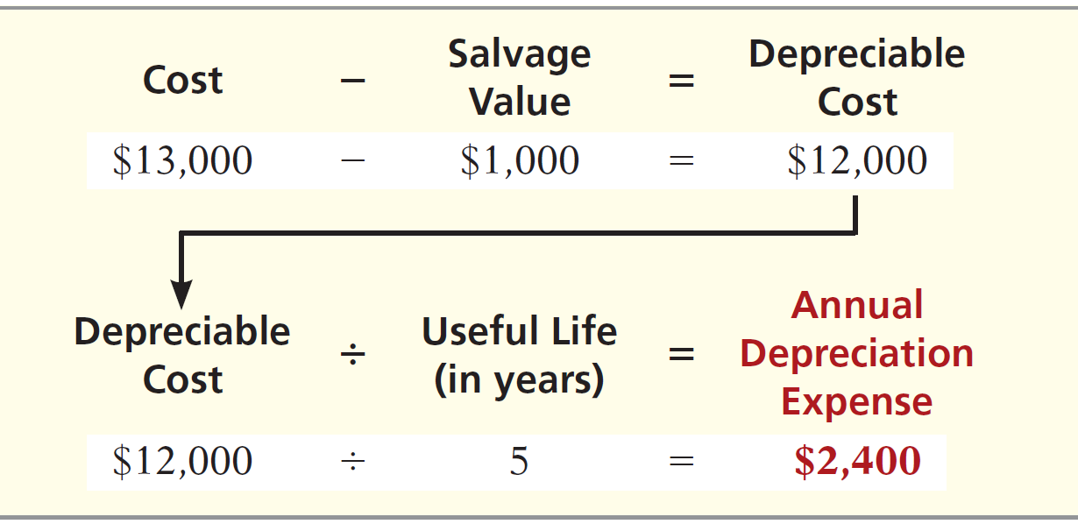
Depreciation
Straight-Line
Expense is same amount for each year.
Depreciable cost = Cost less salvage value.

Slide 26
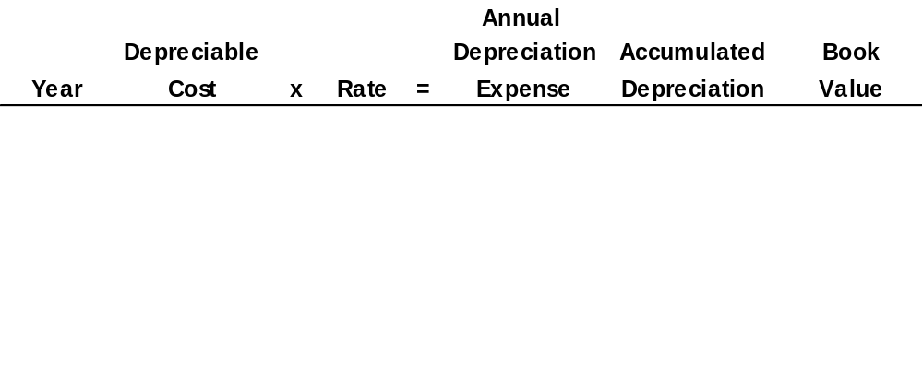
Depreciation
Illustration: (Straight-Line)
1
$ 12,000
20%
$ 2,400
$ 2,400
$ 10,600
*
2
12,000
20
2,400
4,800
8,200
3
12,000
20
2,400
7,200
5,800
4
12,000
20
2,400
9,600
3,400
5
12,000
20
2,400
12,000
1,000
Same Journal Entry Each Year
Depreciation expense 2,400
Accumulated depreciation 2,400
* Book value = Cost - Accumulated depreciation = ($13,000 - $2,400).

Slide 27
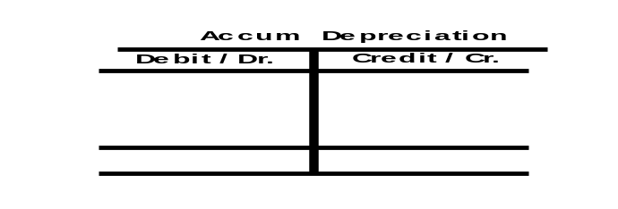
Depreciation
Cost $13,000
Expected salvage value $1,000
Estimated useful life in years 5
Annual Depreciation Calculation: $13,000 - $1,000 = Depreciable Base of $12,000 $12,000/5yrs. =
$2,400 Annual Depreciation Expense
Balance Sheet as of 1/1/Yr. 1
Equipment $13,000
less
Accumulated Depreciation ($0)
Equipment, net of
Depreciation $13,000
Income Statement Year 1
Depreciation Expense $2,400
Income Statement Year 2 Depreciation Expense $2,400
Income Statement Year 3
Depreciation Expense $2,400
Income Statement Year 4
Depreciation Expense $2,400
Income Statement Year 5
Depreciation Expense $2,400
Balance Sheet 12/31/Yr. 1
Equipment $13,000
Less Accumulated Depreciation ($2,400)
Equipment, Net of Depreciation $10,600
Balance Sheet 12/31/Yr. 2
Equipment $13,000
Less Accumulated Depreciation ($4,800)
Equipment, Net of Depreciation $8,200
Balance Sheet 12/31/Yr. 3
Equipment $13,000
Less Accumulated Depreciation ($7,200)
Equipment, Net of Depreciation $5,800
Balance Sheet
12/31/Yr. 4
Equipment $13,000
Less Accumulated Depreciation ($9,600)
Equipment, Net of Depreciation $3,400
Balance Sheet
12/31/Yr. 5
Equipment $13,000
Less Accumulated Depreciation ($12,000)
Equipment, Net of Depreciation $1,000
Journal Entry Made Each Year of Asset 5 Year Life:
Depreciation Expense $2,400
Accumulated Depreciation $2,400
$2,400
$2,400
$2,400
$2,400
$2,400
$2,400
$12,000
LO 2

Slide 28
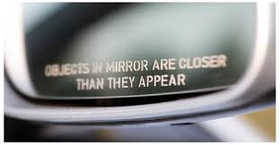
Depreciation
Depreciation is a management estimate
Actual salvage value will likely differ from that used in the calculation of annual depreciation expense
FASB requires companies to disclose uncertainty caused by accounting estimates in their financial statements.
EXAMPLE FOOTNOTE DISCLOSURE
The preparation of financial statements in conformity with generally accepted accounting principles (GAAP) requires management to make estimates and assumptions that affect the reported amounts of assets and liabilities and disclosure of contingent assets and liabilities at the date of the financial statements and the reported amounts of revenues and expenses during the reporting period. Actual results could differ from those estimates.

Slide 29
Depreciation
Say the truck is sold at the end of year 5 for $1,000
  Dr. Cash $ 1,000
  Dr. Accumulated Depreciation $12,000
  Cr. Truck Asset $13,000
Say the truck is sold at the end of year 5 for $2,000
  Dr. Cash $ 2,000
  Dr. Accumulated Depreciation $12,000
  Cr. Truck Asset $13,000
  Cr. Gain $ 1,000
What if the truck is sold at the end of year 5 for $500?
Report on the Income Statement in Year 5

Slide 30
Depreciation
Truck is sold at the end of year 5 for $500
  Dr. Cash $ 500
  Dr. Loss $ 500
  Dr. Accumulated Depreciation $12,000
  Cr. Truck Asset $13,000
Report on the Income Statement in Year 5

Slide 31
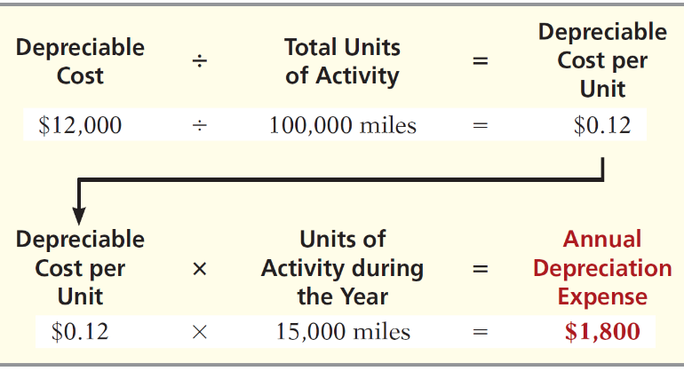
Depreciation
Units-of-Activity
Companies estimate total units of activity to calculate depreciation cost per unit.
Expense varies based on units of activity.
Depreciable cost is cost less salvage value.

Slide 32
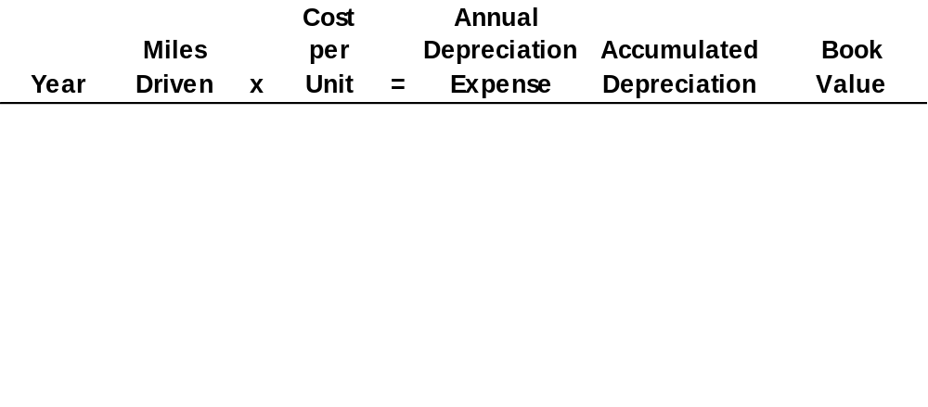
Depreciation
Illustration: (Units-of-Activity)
1
15,000
$ 0.12
$ 1,800
$ 1,800
$ 11,200
2
30,000
0.12
3,600
5,400
7,600
3
20,000
0.12
2,400
7,800
5,200
4
25,000
0.12
3,000
10,800
2,200
5
10,000
0.12
1,200
12,000
1,000
Year 1 Journal Entry
Depreciation expense 1,800
Accumulated depreciation 1,800

Slide 33
Depreciation
Declining-Balance
Accelerated method.
Decreasing annual depreciation expense over the asset’s useful life.
Twice the straight-line rate with Double-Declining-Balance.
Rate applied to book value.
Each Year Depreciation = Beginning Year Book Value X Declining-Balance Percentage
Since Straight-Line in our example was 20% (1/5 each year of five year life) Double Declining = Double Straight-Line or 40%
$13,000 X 40% = $5,200

Slide 34
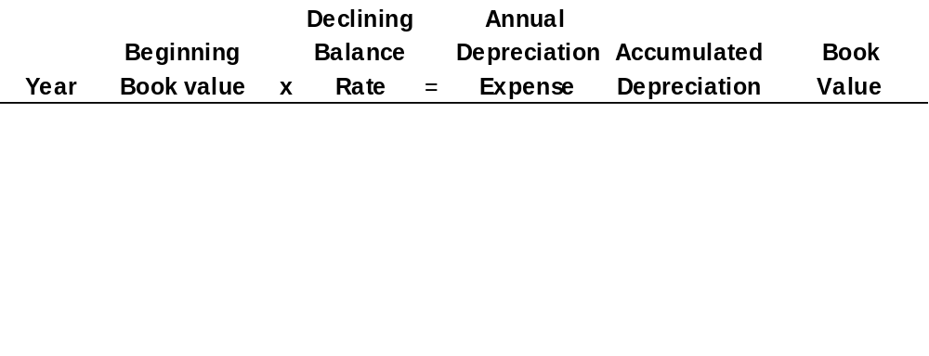
Year 2 Depreciation
$13,000 - $5,200 = $7,800
$7,800 X 40% = $3,120
Year 3 Depreciation
$7,800 - $3,120 = $4,680
$4,680 x 40% =
Depreciation
Illustration: (Declining-Balance)
1
$13,000
40%
$ 5,200
$ 5,200
$ 7,800
2
7,800
40
3,120
8,320⁺
4,680
3
4,680
40
1,872
10,192
2,808
4
2,808
40
1,123
11,315
1,685
5
1,685
40
685*
12,000
1,000
Year 1 Journal Entry
Depreciation expense 5,200
Accumulated depreciation 5,200
+Year 2 accumulated depreciation = $5,200 + $3,120 = $8,230
*Computation of $674 ($1,685 x 40%) is adjusted to $685.

Slide 35
The Classified Balance Sheet
  Presents a snapshot at a point in time.
  To improve understanding, companies group similar assets and similar liabilities together.
Standard Classifications
Illustration 4-16
Assets Liabilities and Owner’s Equity
Current assets Current liabilities
Long-term investments Long-term liabilities
Property, plant, and equipment Stockholders’ equity
Intangible assets

Slide 36
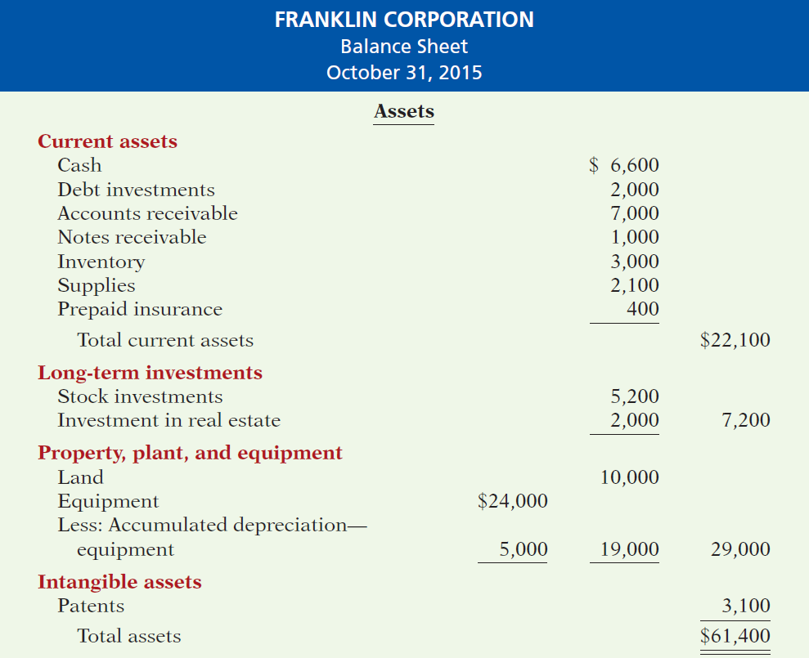
The Classified Balance Sheet
Illustration 4-17

Slide 37
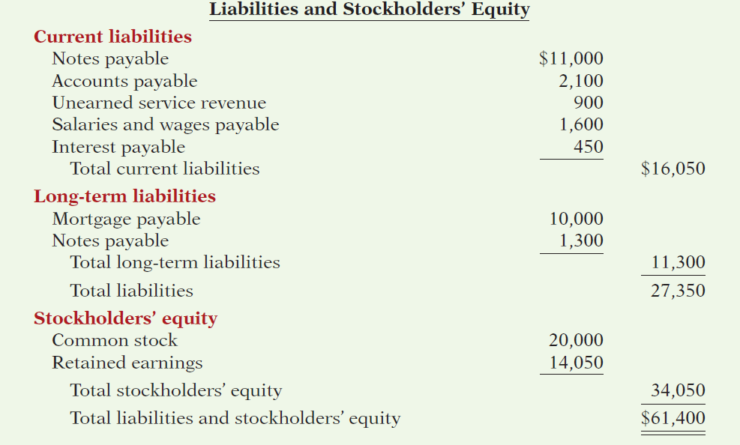
The Classified Balance Sheet
Illustration 4-17
LO 6

Slide 38
The Classified Balance Sheet
Current Assets
  Assets that a company expects to convert to cash or use up within one year or the operating cycle, whichever is longer.
  Operating cycle is the average time that it takes to purchase inventory, sell it on account, and then collect cash from customers.

Slide 39
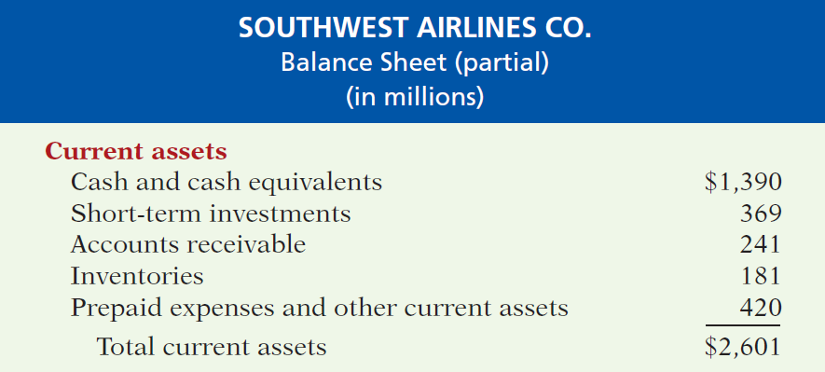

The Classified Balance Sheet
Current Assets
  Usually listed in the order they expect to convert them into cash.

Slide 40
The Classified Balance Sheet
Review Question
The correct order of presentation in a classified balance sheet for the following current assets is:
  accounts receivable, cash, prepaid insurance, inventory.
  cash, inventory, accounts receivable, prepaid insurance.
  cash, accounts receivable, inventory, prepaid insurance.
  inventory, cash, accounts receivable, prepaid insurance.

Slide 41
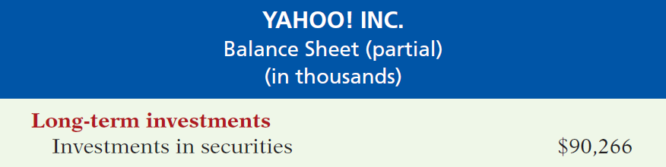
The Classified Balance Sheet
Long-Term Investments
  Investments in stocks and bonds of other companies.
  Investments in long-term assets such as land or buildings that is not currently being used in operating activities.
  Long-term notes receivable.
Illustration 4-19

Slide 42
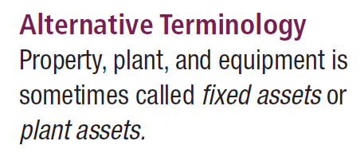
The Classified Balance Sheet
Property, Plant, and Equipment
  Long useful lives.
  Currently used in operations.
  Depreciation - allocating the cost of assets to a number of years.
  Accumulated depreciation - total amount of depreciation expensed thus far in the asset’s life.

Slide 43
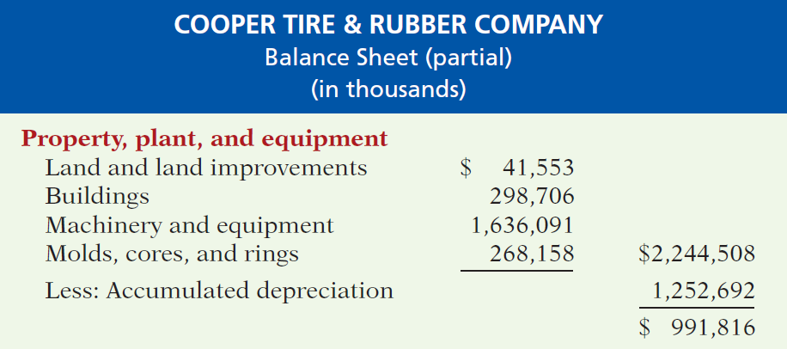
The Classified Balance Sheet
Property, Plant, and Equipment

Slide 44
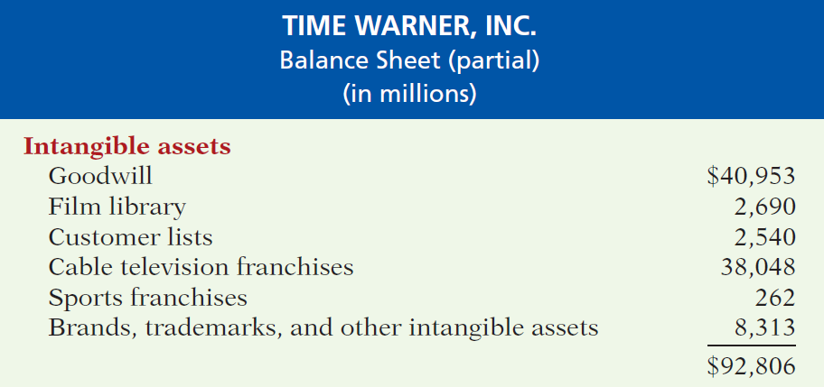
The Classified Balance Sheet
Intangible Assets
  Long-lived assets that do not have physical substance.
Illustration 4-21

Slide 45
The Classified Balance Sheet
Question
Patents and copyrights are
  Current assets.
  Intangible assets.
  Long-term investments.
  Property, plant, and equipment.

Slide 46
The Classified Balance Sheet
Current Liabilities
  Obligations the company is to pay within the coming year or its operating cycle, whichever is longer.
  Usually list notes payable first, followed by accounts payable. Other items follow in order of magnitude.
  Common examples are accounts payable, salaries and wages payable, notes payable, interest payable, income taxes payable current maturities of long-term obligations.
  Liquidity - ability to pay obligations expected to be due within the next year.
LO 6

Slide 47
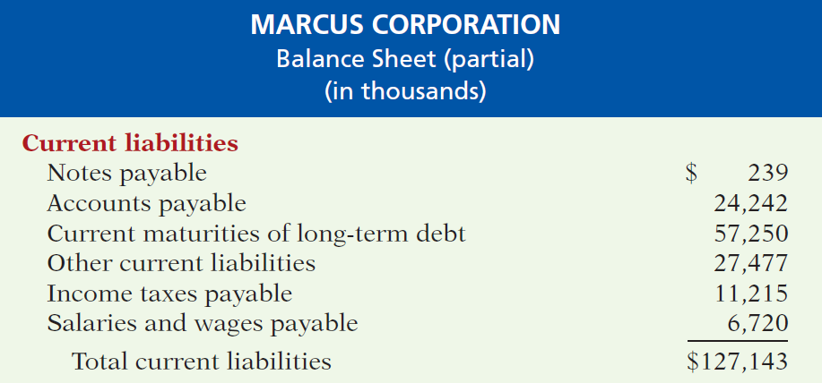
The Classified Balance Sheet
Current Liabilities
Illustration 4-22
LO 6

Slide 48
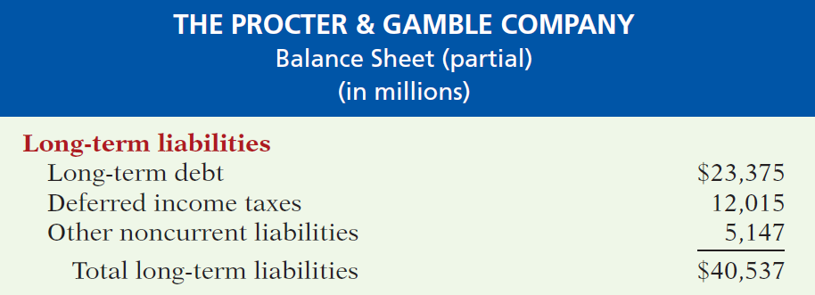
The Classified Balance Sheet
Long-Term Liabilities
  Obligations a company expects to pay after one year.
Illustration 4-23
LO 6

Slide 49
The Classified Balance Sheet
Question
Which of the following is not a long-term liability?
  Bonds payable
  Current maturities of long-term obligations
  Long-term notes payable
  Mortgages payable
LO 6

Slide 50
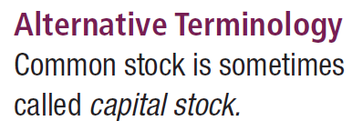
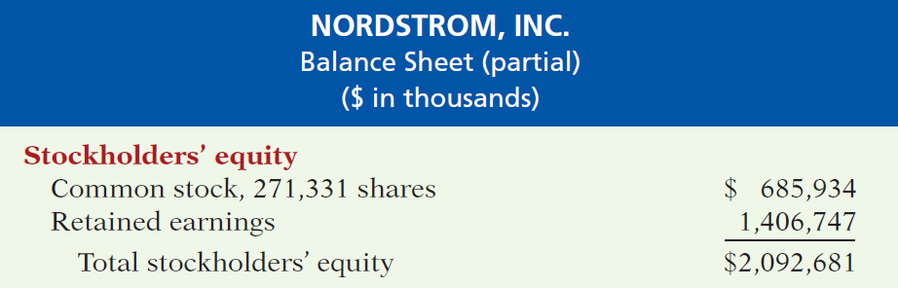
The Classified Balance Sheet
Stockholders’ (Owner’s) Equity
  Proprietorship - one capital account.
  Partnership - capital account for each partner.
  Corporation - Common Stock and Retained Earnings.
Illustration 4-24
LO 6

Slide 51
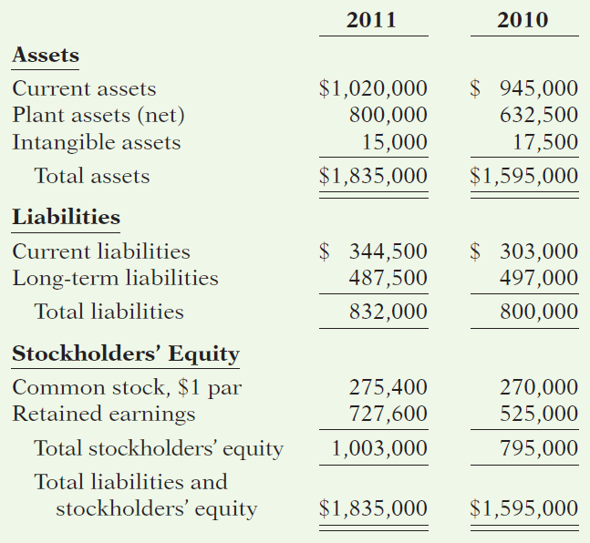
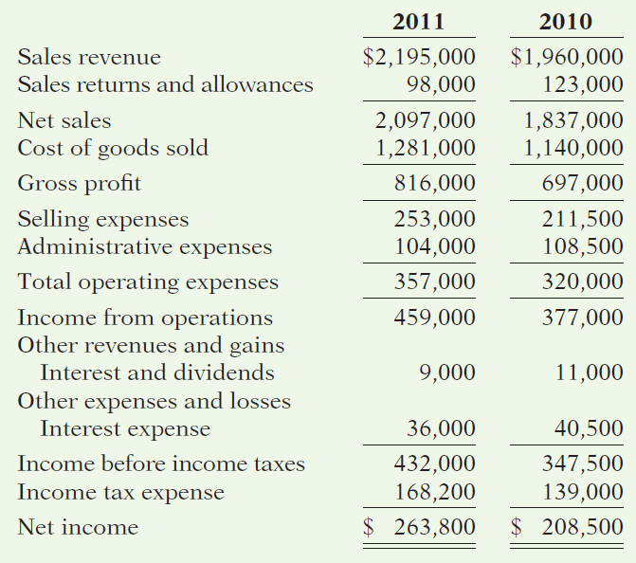
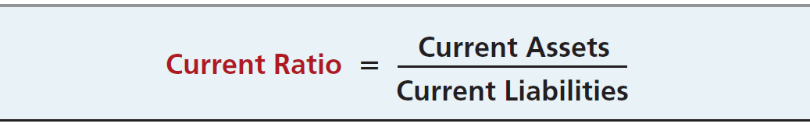
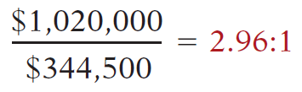
QUALITY DEPARTMENT STORE INC.
Condensed Balance Sheets
For the Years Ended December 31
QUALITY DEPARTMENT STORE INC.
Condensed Income Statements
For the Years Ended December 31
Illustration 14-12
Advance slide in presentation mode to reveal solution.
LO 5

Slide 52
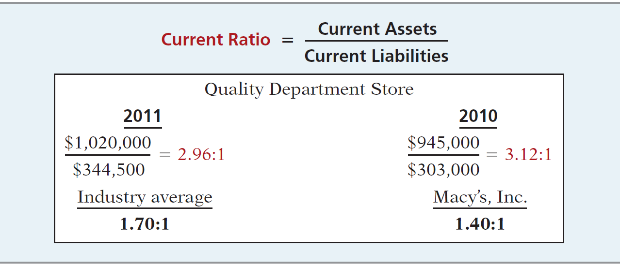
Ratio Analysis
1. Current Ratio
Illustration 14-12
Ratio of 2.96:1 means that for every dollar of current liabilities, Quality has $2.96 of current assets.
LO 5

Slide 53
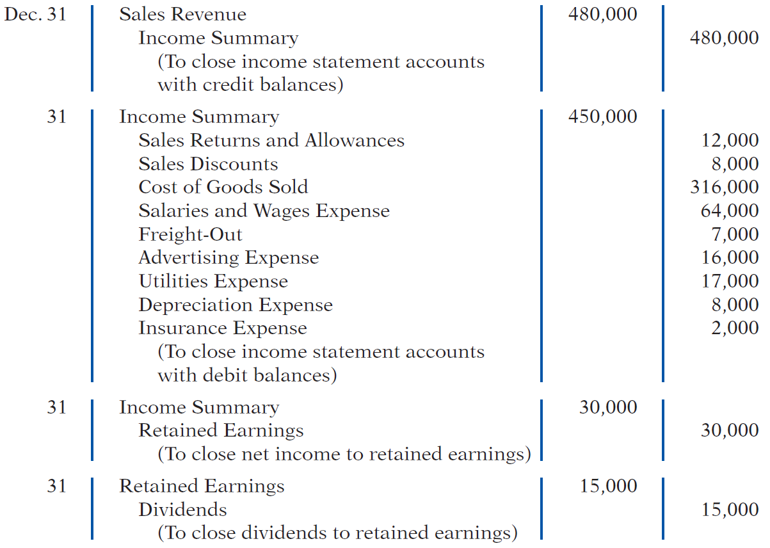
Completing the Accounting Cycle
Closing Entries

Slide 54
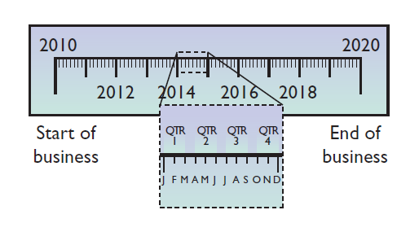
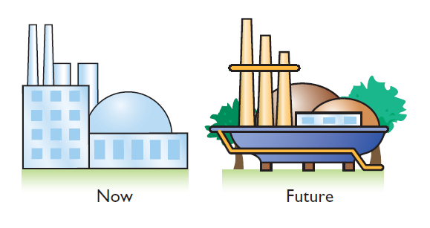
Assumptions in Financial Reporting
Illustration 3B-2
Time Period
Going Concern
States that the life of a business can be divided into artificial time periods.
The business will remain in operation for the foreseeable future.

