Slide 1



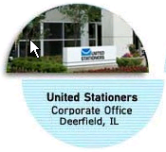
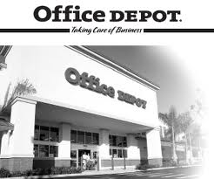
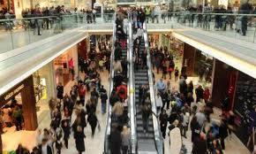

Merchandising Operations
Merchandising Companies
Buy and Sell Goods
Retailer
Wholesaler
Consumer
The primary source of revenues is referred to as sales revenue or sales.

Slide 2
Merchandising Operations
Income Measurement
Sales
Revenue
Not used in a Service business.
Less
Illustration 5-1
Income measurement process for a merchandising company
Cost of
Goods Sold
Equals
Gross
Profit
Less
Operating
Expenses
Net
Income
(Loss)
Cost of goods sold is the total cost of merchandise sold during the period.
Equals

Slide 3
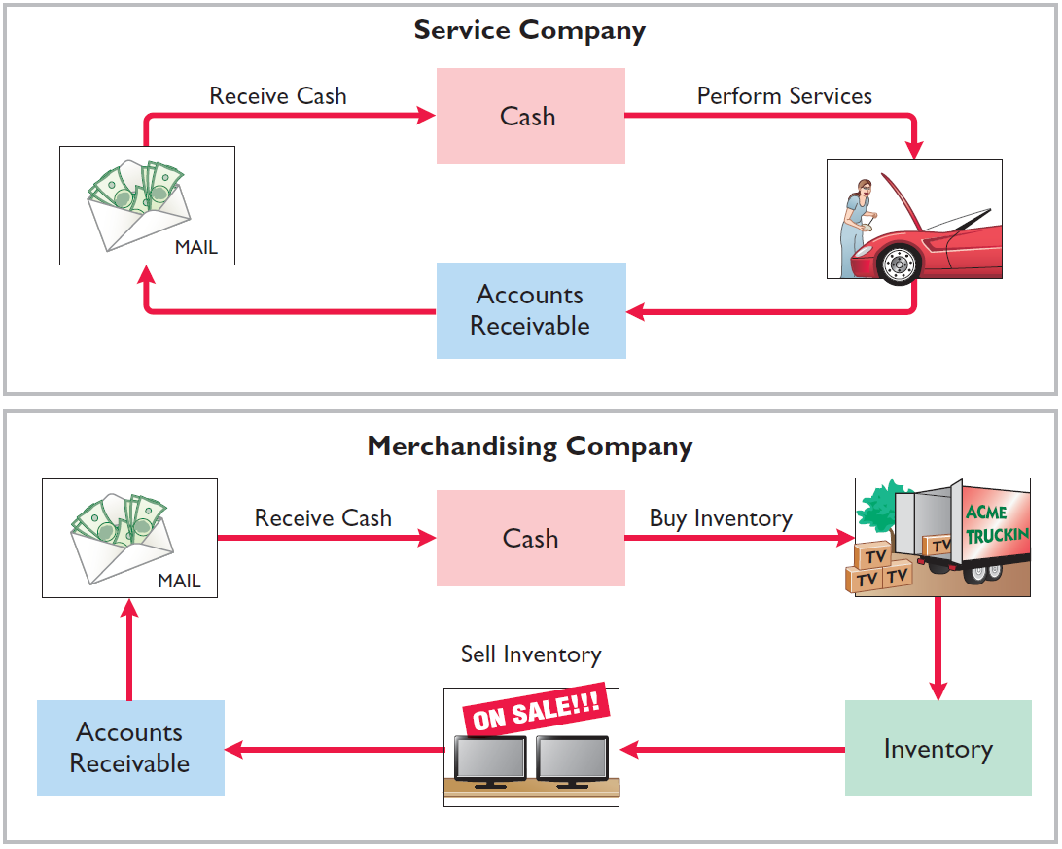
Merchandising Operations
Operating Cycles
Illustration 5-2
The operating cycle of a merchandising company ordinarily is longer than that of a service company.
Illustration 5-3

Slide 4
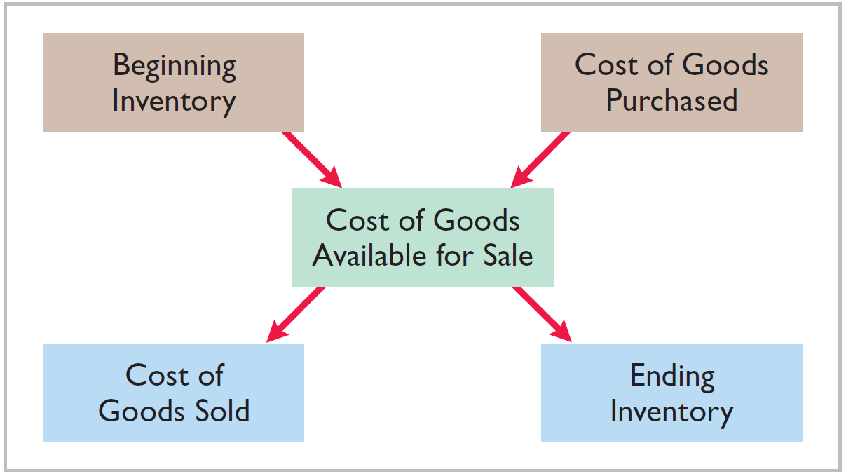
Merchandising Operations
Flow of Costs
Illustration 5-4
Companies use one of two systems to account for inventory: a perpetual inventory system or a periodic inventory system.

Slide 5
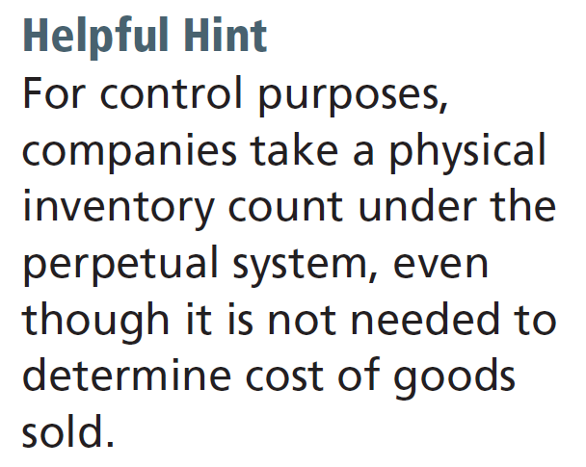
Merchandising Operations
Flow of Costs
Perpetual System
  Maintain detailed records of the cost of each inventory purchase and sale.
  Records continuously show inventory that should be on hand for every item.
  Company determines cost of goods sold each time a sale occurs.

Slide 6
Merchandising Operations
Flow of Costs
Periodic System
  Do not keep detailed records of the goods on hand.
  A physical inventory count is made to determine the cost of goods on hand.
  Calculation of Cost of Goods Sold:
Beginning inventory $ 100,000
Add: Purchases, net 800,000
Goods available for sale 900,000
Less: Ending inventory 125,000
Cost of goods sold $ 775,000

Slide 7
Merchandising Operations
Flow of Costs
Advantages of the Perpetual System
  Traditionally used for merchandise with high unit values.
  Shows the quantity and cost of the inventory that should be on hand at any time.
  Provides better control over inventories than a periodic system.

Slide 8
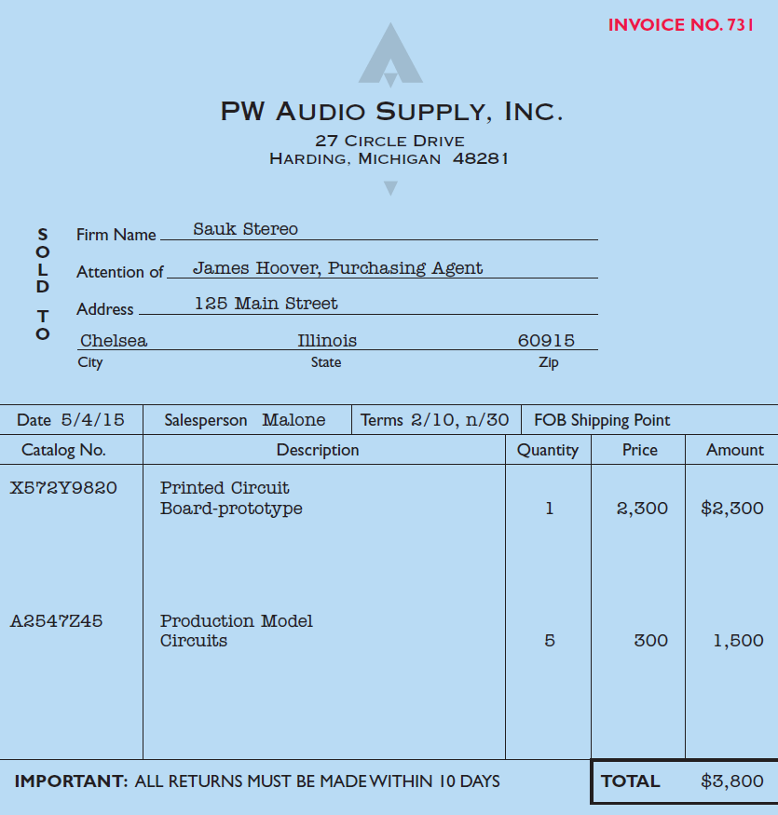
Recording Purchases of Merchandise
Illustration: Sauk Stereo (the buyer) uses as a purchase invoice the sales invoice prepared by PW Audio Supply, Inc. (the seller). Sauk Stereo makes the following journal entry to record its purchase from PW Audio Supply.
Illustration 5-6
May 4
Inventory 3,800
Accounts Payable 3,800

Slide 9
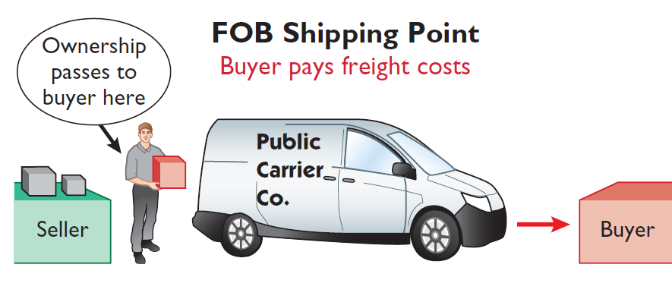
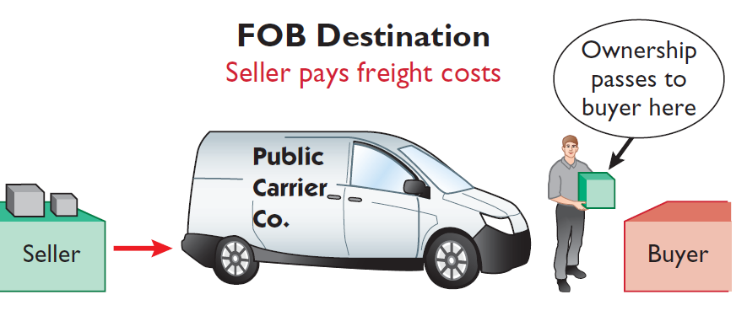
Recording Purchases of Merchandise
Freight Costs – Terms of Sale
Seller places goods Free On Board the carrier, and buyer pays freight costs .
Seller places goods Free On Board to the buyer’s place of business, and seller pays freight costs.
Freight costs incurred by the seller are an operating expense.

Slide 10
Recording Purchases of Merchandise
Illustration: Assume upon delivery of the goods on May 6, Sauk Stereo pays Public Carrier Company $150 for freight charges, the entry on Sauk Stereo’s books is:
May 6
Inventory 150
Cash 150
Assume the freight terms on the invoice in Illustration 5-6 had required PW Audio Supply to pay the freight charges, the entry by PW Audio Supply would have been:
May 4
Freight-Out (or Delivery Expense) 150
Cash 150

Slide 11
Recording Purchases of Merchandise
Purchase Returns and Allowances
Purchaser may be dissatisfied because goods are damaged or defective, of inferior quality, or do not meet specifications.
Purchase Return
Purchase Allowance
Return goods for credit if the sale was made on credit, or for a cash refund if the purchase was for cash.
May choose to keep the merchandise if the seller will grant a deduction from the purchase price.

Slide 12
Recording Purchases of Merchandise
Illustration: Assume Sauk Stereo returned goods costing $300 to PW Audio Supply on May 8. The following entry is made by Sauk Stereo.
May 8
Accounts Payable 300
Inventory 300
LO 2

Slide 13
Recording Purchases of Merchandise
Purchase Discounts
Credit terms may permit buyer to claim a cash discount for prompt payment.
Advantages:
  Purchaser saves money.
  Seller shortens the operating cycle by converting the accounts receivable into cash earlier.
Example: Credit terms may read 2/10, n/30.

Slide 14
Recording Purchases of Merchandise
Purchase Discounts - Terms
2/10, n/30
1/10 EOM
n/10 EOM
2% discount if paid within 10 days, otherwise net amount due within 30 days.
1% discount if paid within first 10 days of next month.
Net amount due within the first 10 days of the next month.

Slide 15
Recording Purchases of Merchandise
Illustration: Sauk Stereo pays the balance due of $3,500 (gross invoice price of $3,800 less purchase returns and allowances of $300) on May 14, the last day of the discount period. Sauk Stereo makes the following entry on May 14 to record the payment.
May 14
Accounts Payable 3,500
Cash 3,430
Inventory 70
(Discount = $3,500 x 2% = $70)

Slide 16
Recording Purchases of Merchandise
Illustration: If Sauk Stereo failed to take the discount and instead made full payment of $3,500 on June 3, the journal entry would be:
June 3
Accounts Payable 3,500
Cash 3,500

Slide 17
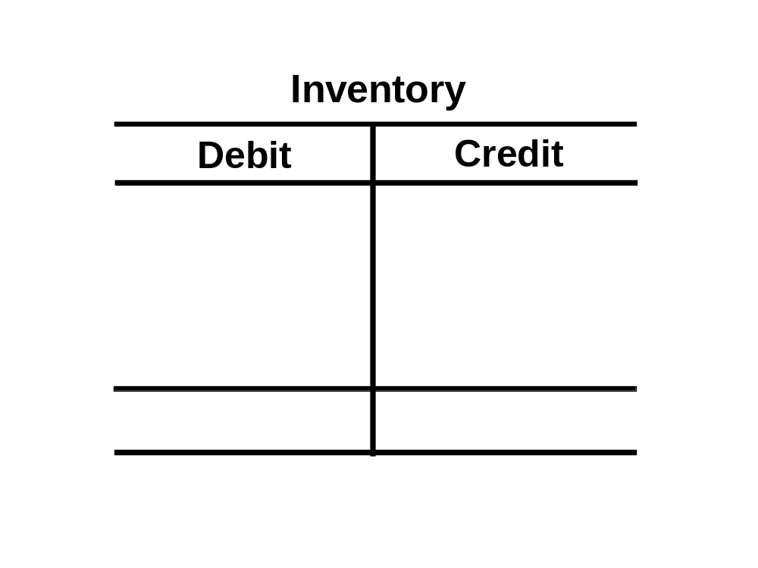
Recording Purchases of Merchandise
Summary of Purchasing Transactions
May
4th – Purchase
3,800
300
8th – Return
6th – Freight-in
150
70
14th – Discount
Balance
3,580

Slide 18
Recording Sales of Merchandise
Illustration: PW Audio Supply records the sale of $3,800 on May 4 to Sauk Stereo on account (Illustration 5-6) as follows (assume the merchandise cost PW Audio Supply $2,400).
May 4
Accounts Receivable 3,800
Sales Revenue 3,800
4
Cost of Goods Sold 2,400
Inventory 2,400

Slide 19
Recording Sales of Merchandise
Illustration: Assume Sauk Stereo pays the balance due of $3,500 (gross invoice price of $3,800 less purchase returns and allowances of $300) on May 14, the last day of the discount period. Prepare the journal entry PW Audio Supply makes to record the receipt on May 14.
May 14
Cash 3,430
Sales Discounts 70
*
Accounts Receivable 3,500
* [($3,800 – $300) X 2%]

Slide 20
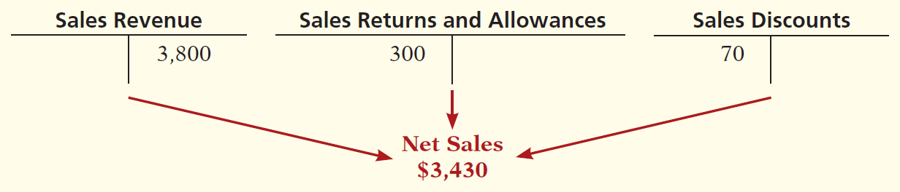
Recording Sales of Merchandise
Sales Discount
Offered to customers for the prompt payment of the balance due.
Contra-revenue account (debit) to Sales Revenue.

Slide 21
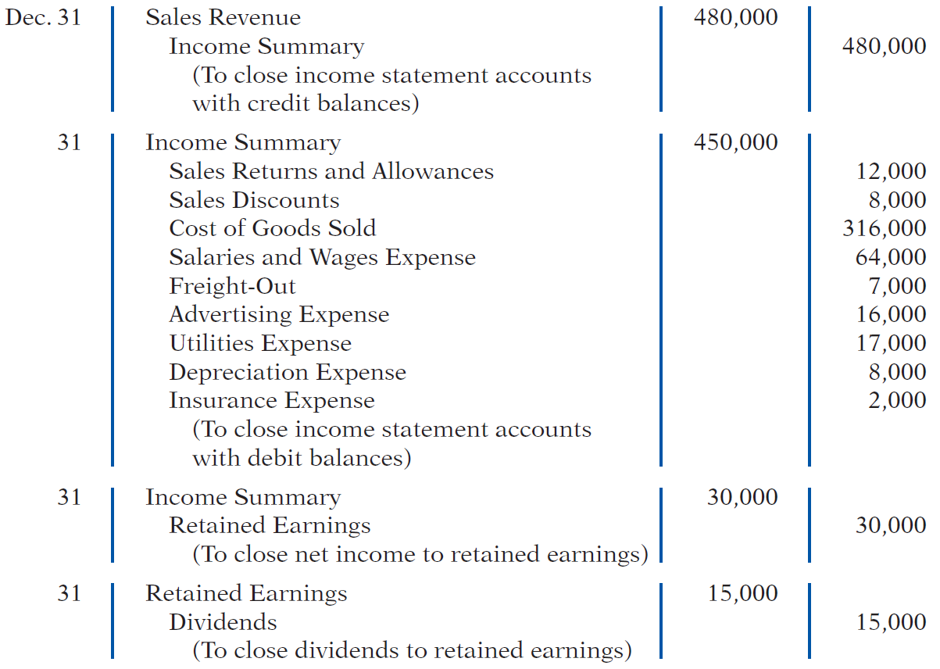
Completing the Accounting Cycle
Closing Entries

Slide 22
Forms of Financial Statements
Single-Step Income Statement
Subtract total expenses from total revenues
Two reasons for using the single-step format:
  Company does not realize any profit until total revenues exceed total expenses.
  Format is simpler and easier to read.

Slide 23
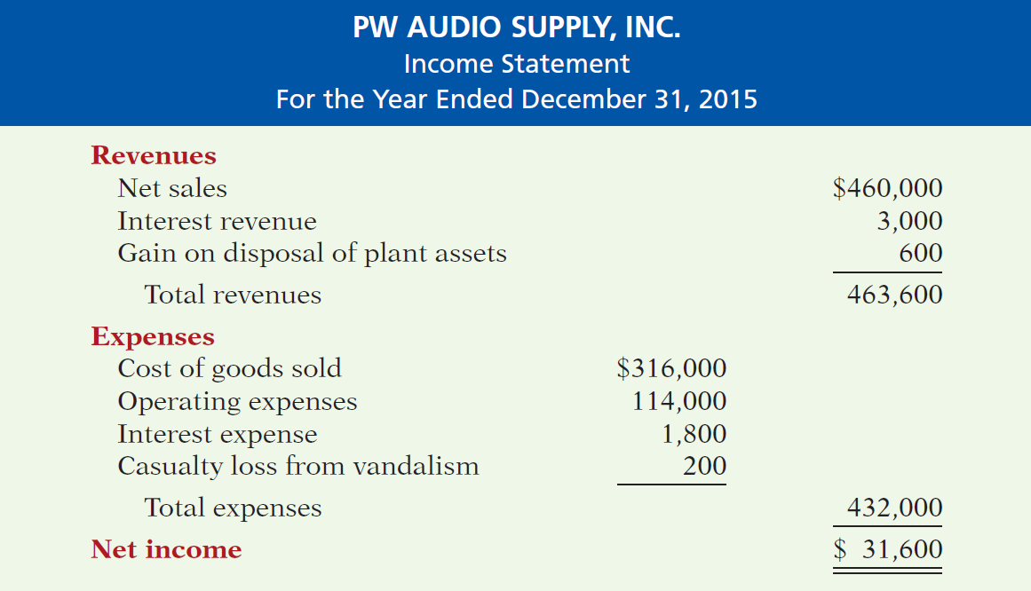
Forms of Financial Statements
Single-Step Income Statement
Illustration 5-15

Slide 24
Forms of Financial Statements
Multiple-Step Income Statement
Shows several steps in determining net income.
Two steps relate to principal operating activities.
Distinguishes between operating and non-operating activities.

Slide 25
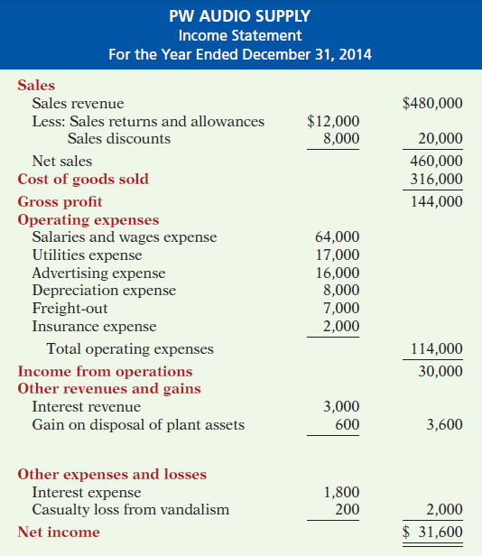
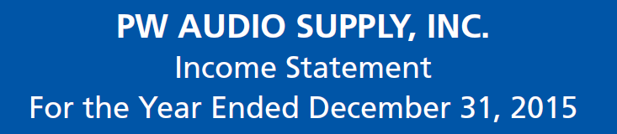
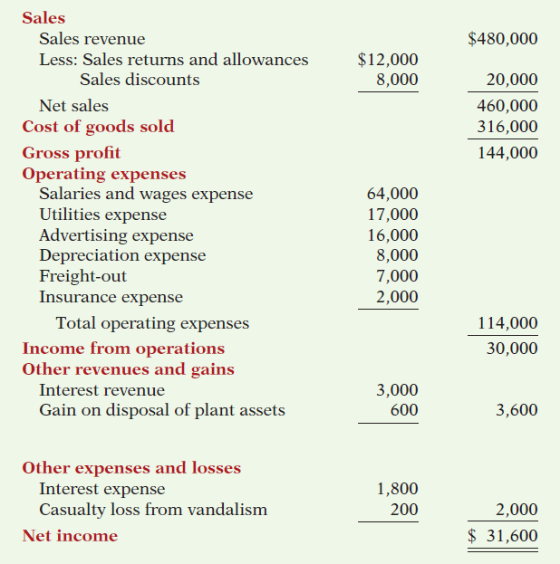
Multiple- Step
Illustration 5-14
Key Items:
Net sales
Illustration 5-14

Slide 26
Multiple- Step
Illustration 5-14
Key Items:
Net sales
Gross profit
Illustration 5-14

Slide 27
Multiple- Step
Illustration 5-14
Key Items:
Net sales
Gross profit
Operating expenses
Illustration 5-14

Slide 28
Multiple- Step
Key Items:
Net sales
Gross profit
Operating expenses
Nonoperating activities
Illustration 5-14

Slide 29
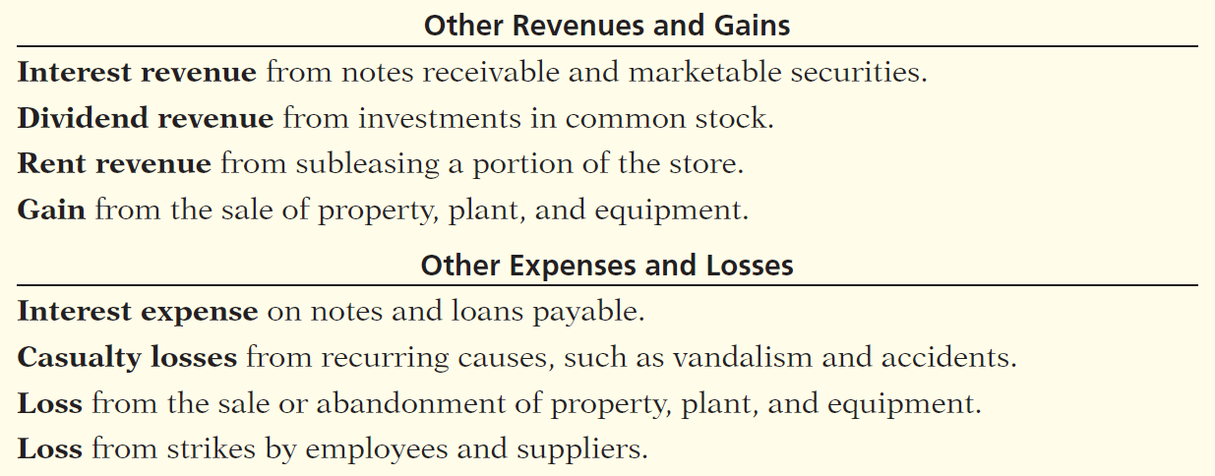
Multiple- Step
Key Items:
Net sales
Gross profit
Operating expenses
Nonoperating activities
Illustration 5-13
Illustration 5-14

Slide 30
Multiple- Step
Key Items:
Net sales
Gross profit
Operating expenses
Nonoperating activities
Net income
Illustration 5-14

Slide 31
Forms of Financial Statements
Review Question
The multiple-step income statement for a merchandiser shows each of the following features except:
  gross profit.
  cost of goods sold.
  a sales revenue section.
  investing activities section.

