Slide 1
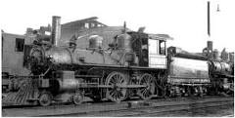
Nature of Assets
Period of Benefit
Assets have Future Economic Benefit
Assets can have Short-term (current) Benefit or Long-Term Benefit
As a general rule, current asset benefit will expire or be realized during the current year or next year.
  Examples of Current Assets Include
    Cash
    Receivables
    Inventory
Long-term assets have benefit that will expire or be realized in periods beyond the current and next year
  Examples of Non-Current Assets Include:
    Equipment
    Buildings
    Land
    Investments that the company intends to hold beyond the current and next year.

Slide 2
Long-Term Fixed Assets
Depreciation
Process of allocating the future economic benefit of long-term asset over their useful (service) life to expense in a rational and systematic manner.
  Applies to land improvements, buildings, and equipment, not land.
  Depreciable because the asset future economic benefit will decline over the asset’s useful life.

Slide 3
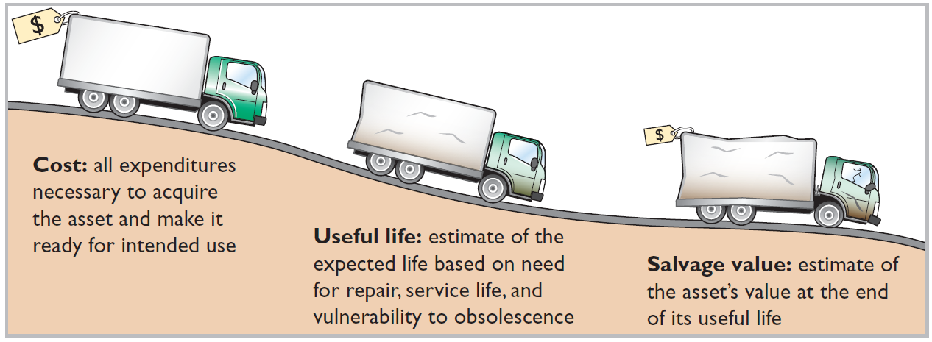
Depreciation
Factors in Computing Depreciation
Helpful Hint Depreciation expense is reported on the income statement. Accumulated depreciation
is reported on the balance sheet as a deduction from plant assets.
Alternative Terminology
Another term sometimes used for salvage value is residual value.

Slide 4
Depreciation
Illustration: Bob’s Florists purchased a small delivery truck on January 1, Year 1
Cost $13,000
Expected salvage value $1,000
Estimated useful life in years 5
Estimated useful life in miles 100,000
Dr. Equipment Asset $13,000
Cr. Cash $13,000
To record purchase of delivery truck
Required: Compute depreciation using the following.
(a) Straight-Line. (b) Units-of-Activity. (c) Declining Balance.

Slide 5
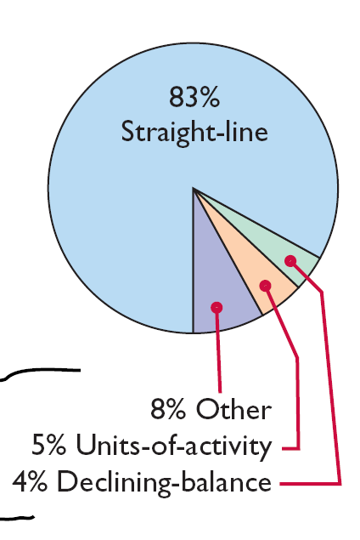
Depreciation
Depreciation Methods
Management selects the method it believes best measures an asset’s contribution to revenue over its useful life.
Examples include:
  Straight-line method.
  Units-of-activity method.
  Declining-balance method.

Slide 6
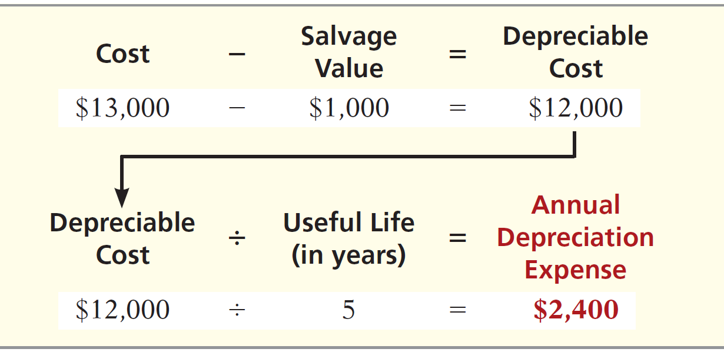
Depreciation
Straight-Line
Expense is same amount for each year.
Depreciable cost = Cost less salvage value.

Slide 7
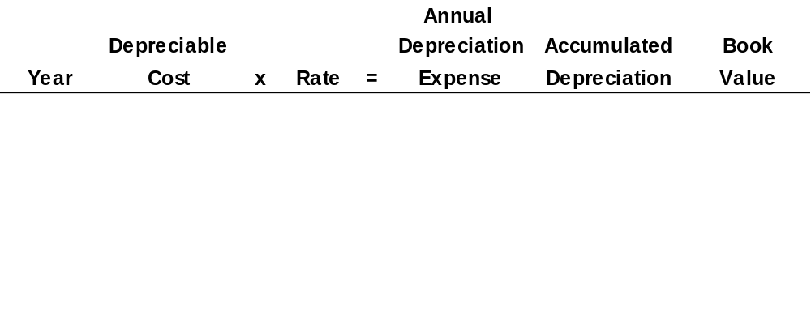
Depreciation
Illustration: (Straight-Line)
1
$ 12,000
20%
$ 2,400
$ 2,400
$ 10,600
*
2
12,000
20
2,400
4,800
8,200
3
12,000
20
2,400
7,200
5,800
4
12,000
20
2,400
9,600
3,400
5
12,000
20
2,400
12,000
1,000
Same Journal Entry Each Year
Depreciation expense 2,400
Accumulated depreciation 2,400
* Book value = Cost - Accumulated depreciation = ($13,000 - $2,400).

Slide 8
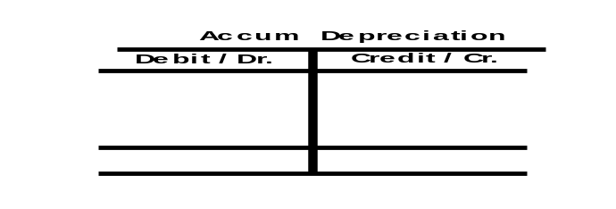
Depreciation
Cost $13,000
Expected salvage value $1,000
Estimated useful life in years 5
Annual Depreciation Calculation: $13,000 - $1,000 = Depreciable Base of $12,000 $12,000/5yrs. =
$2,400 Annual Depreciation Expense
Balance Sheet as of 1/1/Yr. 1
Equipment $13,000
less
Accumulated Depreciation ($0)
Equipment, net of
Depreciation $13,000
Income Statement Year 1
Depreciation Expense $2,400
Income Statement Year 2 Depreciation Expense $2,400
Income Statement Year 3
Depreciation Expense $2,400
Income Statement Year 4
Depreciation Expense $2,400
Income Statement Year 5
Depreciation Expense $2,400
Balance Sheet 12/31/Yr. 1
Equipment $13,000
Less Accumulated Depreciation ($2,400)
Equipment, Net of Depreciation $10,600
Balance Sheet 12/31/Yr. 2
Equipment $13,000
Less Accumulated Depreciation ($4,800)
Equipment, Net of Depreciation $8,200
Balance Sheet 12/31/Yr. 3
Equipment $13,000
Less Accumulated Depreciation ($7,200)
Equipment, Net of Depreciation $5,800
Balance Sheet
12/31/Yr. 4
Equipment $13,000
Less Accumulated Depreciation ($9,600)
Equipment, Net of Depreciation $3,400
Balance Sheet
12/31/Yr. 5
Equipment $13,000
Less Accumulated Depreciation ($12,000)
Equipment, Net of Depreciation $1,000
Journal Entry Made Each Year of Asset 5 Year Life:
Depreciation Expense $2,400
Accumulated Depreciation $2,400
$2,400
$2,400
$2,400
$2,400
$2,400
$2,400
$12,000
LO 2

Slide 9
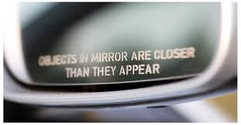
Depreciation
Depreciation is a management estimate
Actual salvage value will likely differ from that used in the calculation of annual depreciation expense
FASB requires companies to disclose uncertainty caused by accounting estimates in their financial statements.
EXAMPLE FOOTNOTE DISCLOSURE
The preparation of financial statements in conformity with generally accepted accounting principles (GAAP) requires management to make estimates and assumptions that affect the reported amounts of assets and liabilities and disclosure of contingent assets and liabilities at the date of the financial statements and the reported amounts of revenues and expenses during the reporting period. Actual results could differ from those estimates.

Slide 10
Depreciation
Say the truck is sold at the end of year 5 for $1,000
  Dr. Cash $ 1,000
  Dr. Accumulated Depreciation $12,000
  Cr. Truck Asset $13,000
Say the truck is sold at the end of year 5 for $2,000
  Dr. Cash $ 2,000
  Dr. Accumulated Depreciation $12,000
  Cr. Truck Asset $13,000
  Cr. Gain $ 1,000
What if the truck is sold at the end of year 5 for $500?
Report on the Income Statement in Year 5

Slide 11
Depreciation
Truck is sold at the end of year 5 for $500
  Dr. Cash $ 500
  Dr. Loss $ 500
  Dr. Accumulated Depreciation $12,000
  Cr. Truck Asset $13,000
Report on the Income Statement in Year 5

Slide 12
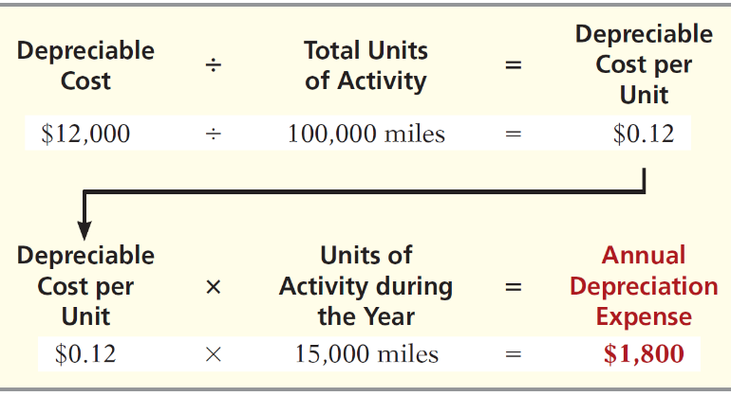
Depreciation
Units-of-Activity
Companies estimate total units of activity to calculate depreciation cost per unit.
Expense varies based on units of activity.
Depreciable cost is cost less salvage value.

Slide 13
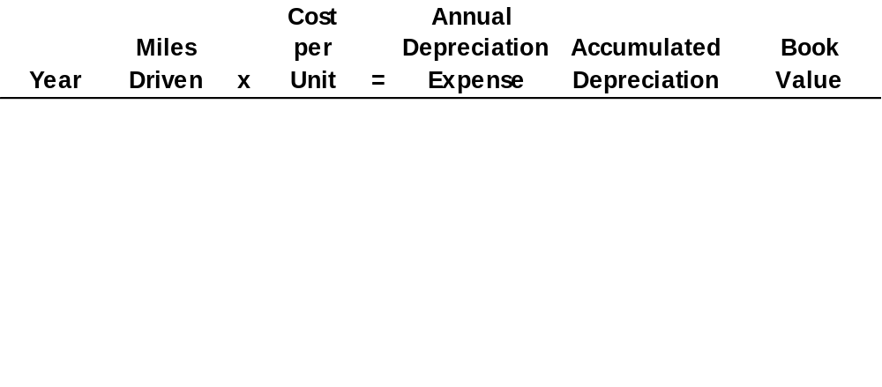
Depreciation
Illustration: (Units-of-Activity)
1
15,000
$ 0.12
$ 1,800
$ 1,800
$ 11,200
2
30,000
0.12
3,600
5,400
7,600
3
20,000
0.12
2,400
7,800
5,200
4
25,000
0.12
3,000
10,800
2,200
5
10,000
0.12
1,200
12,000
1,000
Year 1 Journal Entry
Depreciation expense 1,800
Accumulated depreciation 1,800

Slide 14
Depreciation
Declining-Balance
Accelerated method.
Decreasing annual depreciation expense over the asset’s useful life.
Twice the straight-line rate with Double-Declining-Balance.
Rate applied to book value.
Each Year Depreciation = Beginning Year Book Value X Declining-Balance Percentage
Since Straight-Line in our example was 20% (1/5 each year of five year life) Double Declining = Double Straight-Line or 40%
$13,000 X 40% = $5,200

Slide 15
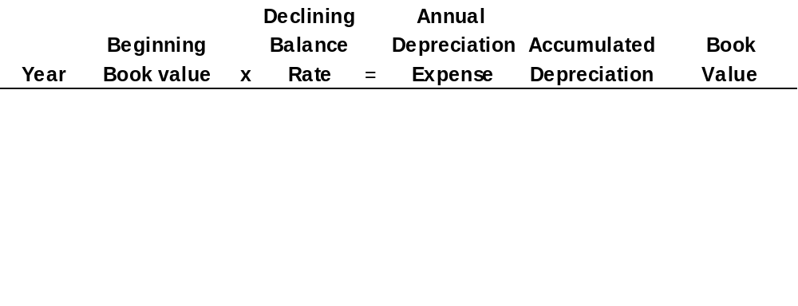
Depreciation
Illustration: (Declining-Balance)
Illustration 9-14
2015
$13,000
40%
$ 5,200
$ 5,200
$ 7,800
2016
7,800
40
3,120
8,320
4,680
2017
4,680
40
1,872
10,192
2,808
2018
2,808
40
1,123
11,315
1,685
2019
1,685
40
674
11,989
1,011
2015 Journal Entry
Depreciation expense 5,200
Accumulated depreciation 5,200
In 2020, only $11 of depreciation will be taken since we do not
depreciate below salvage value.
LO 2

Slide 16
Intangible Assets
Intangible assets are rights, privileges, and competitive advantages that result from ownership of long-lived assets that do not possess physical substance.
Limited life or indefinite life.
Common types of intangibles:
Patents
Copyrights
Goodwill
Trademarks and Trade Names
Franchises
LO 6

Slide 17
Accounting for Intangible Assets
Limited-Life Intangibles:
  Amortize to expense.
  Credit asset account.
Helpful Hint Amortization
is to intangibles what
depreciation is to plant
assets and depletion is to
natural resources.
Indefinite-Life Intangibles:
  No foreseeable limit on time the asset is expected to provide cash flows.
  No amortization.
LO 6

Slide 18
Accounting for Intangible Assets
Patents
Exclusive right to manufacture, sell, or otherwise control an invention for a period of 20 years from the date of the grant.
Capitalize costs of purchasing a patent and amortize over its 20-year life or its useful life, whichever is shorter.
Expense any R&D costs in developing a patent.
Legal fees incurred successfully defending a patent are capitalized to the Patent account.
LO 6

Slide 19
Accounting for Intangible Assets
Illustration: National Labs purchases a patent at a cost of $60,000 on June 30. National estimates the useful life of the patent to be eight years. Prepare the journal entry to record the amortization for the six-month period ended December 31.
Cost $60,000
Useful life ÷ 8
Annual expense $ 7,500
6 months x 6/12
Amortization $ 3,750
Dec. 31
Amortization Expense 3,750
Patent 3,750
LO 6

Slide 20
Accounting for Intangible Assets
Goodwill
Includes exceptional management, desirable location, good customer relations, skilled employees, high-quality products, etc.
Only recorded when an entire business is purchased.
Goodwill is recorded as the excess of purchase price over the fair value of the net assets acquired.
Not amortized.
LO 6

Slide 21
Accounting for Intangible Assets
Research and Development Costs
Expenditures that may lead to
  patents,
  copyrights,
  new processes, and
  new products.
All R & D costs are expensed when incurred.
Exception:
Software development costs incurred after “technological feasibility” can be capitalized to assets.
Research and development (R&D) costs are not intangible assets. But because they may lead to patents and copyrights, we discuss them in this section.
LO 6

Slide 22
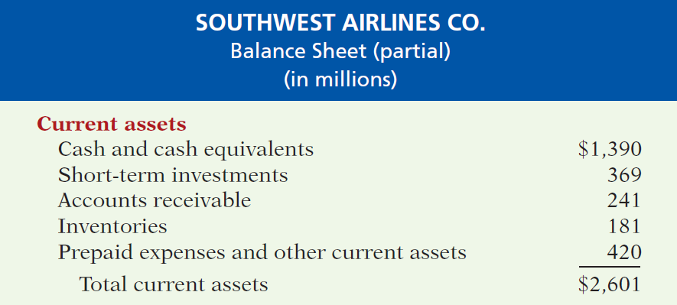

The Classified Balance Sheet
Current Assets
  Usually listed in the order they expect to convert them into cash.

Slide 23
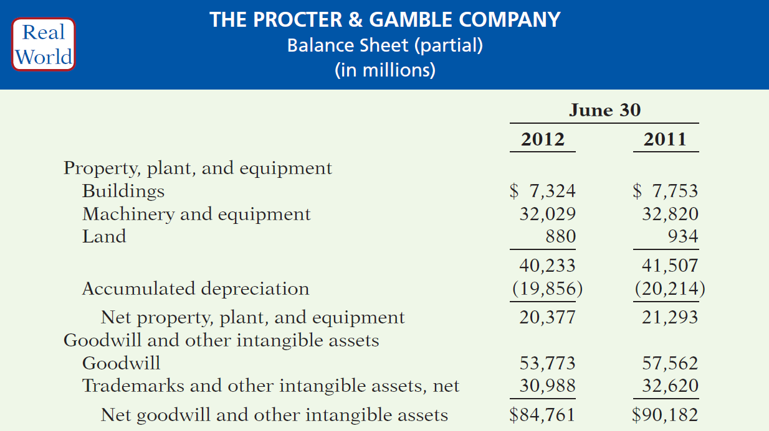
Statement Presentation and Analysis
Presentation
Illustration 9-23
LO 7

