Slide 1
SCPd
Stanford Center of Professional Development Introduction to Operations Management MS&E 260 Summer 2019
Professor: Dr. Richard Kim
Attendee: Vishal Mittal
Thanks you, John Powell Sr. Manager CPE OSS, VMware Inc.
Take1 Program, VMware Inc.

Slide 2
Agenda
Course Details
What is Operations Management
Linear problem optimal solution formulation
Inventory Management (Finite Demand)
Inventory Management (Uncertain Demand)
Queueing
Load – Capacity Analysis
Supply Chain Revenue Models
Revenue Management
Decision Analysis
Take Away’s

Slide 3
Course details
June 22nd, 2019 – August 17th, 2019
Grading:
30% Homework (5 assignments)
30% Midterm
30% Final Exam
5% Participation
5% Final Thoughts Paper
2 classes per week 1.5 hours each
15- 20 hrs. per week study hours
Availability
In person (GM Room, Stanford)
Online recording, Canvas
Live view, Canvas
Piazza for communication
Three office hours
Prerequisite
Probabilistic Analytics
Multivariable calculus
Algebra

Slide 4
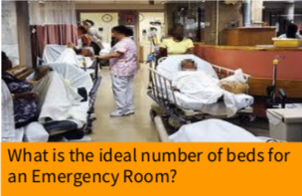
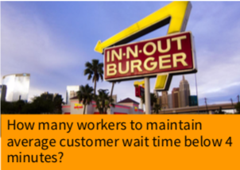
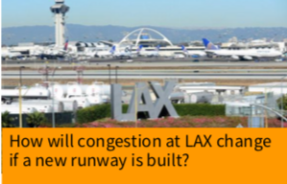
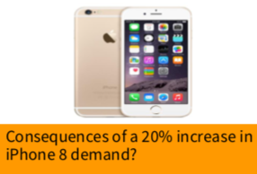
Operations Management
Use of Math and engineering to solve real world problems in optimized way.
The same science behind making 30 types of peanut butter available in Safeway and they are available when you want it.

Slide 5
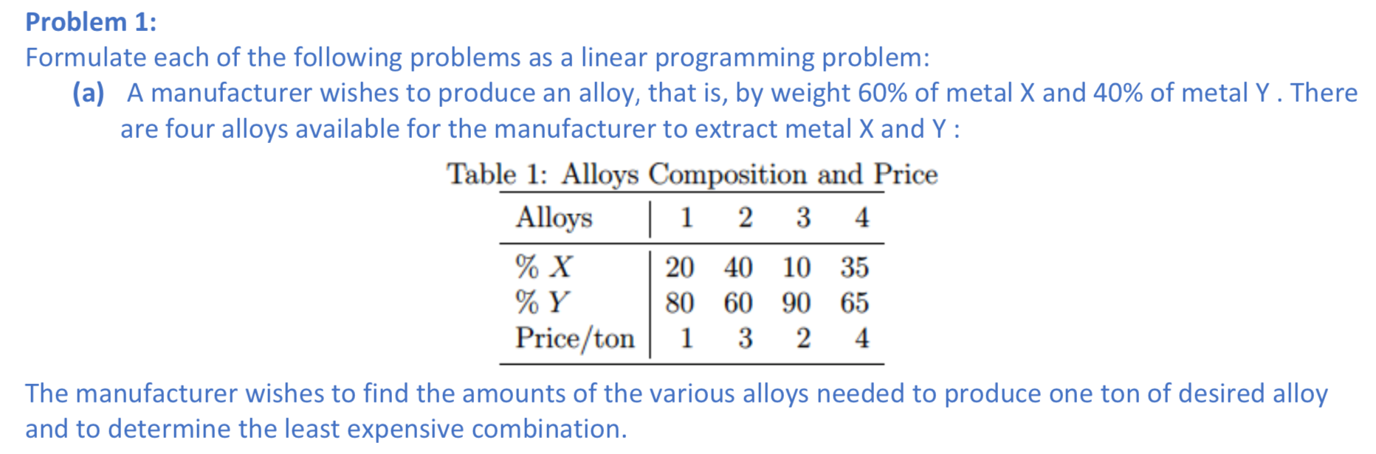
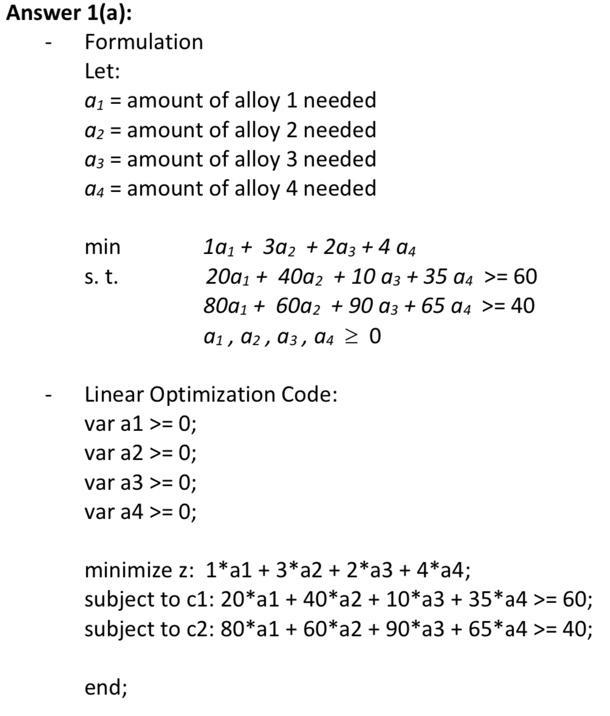
optimal solution via Linear Equation Formulation

Slide 6
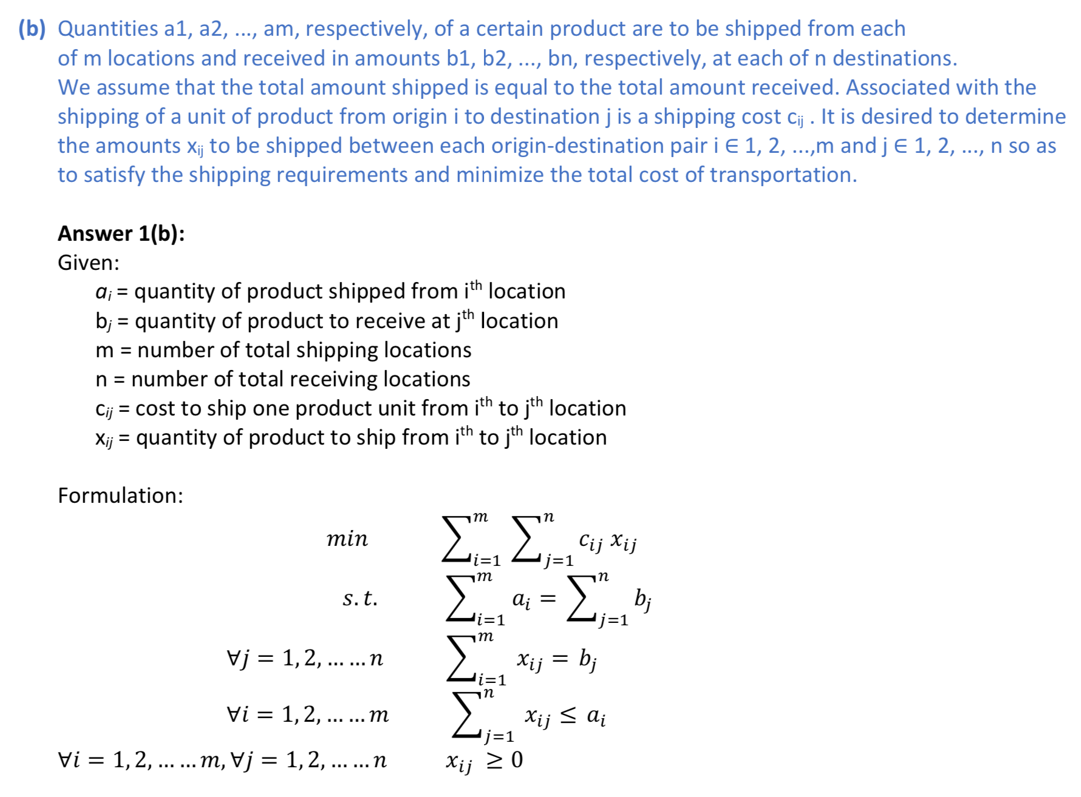

Slide 7
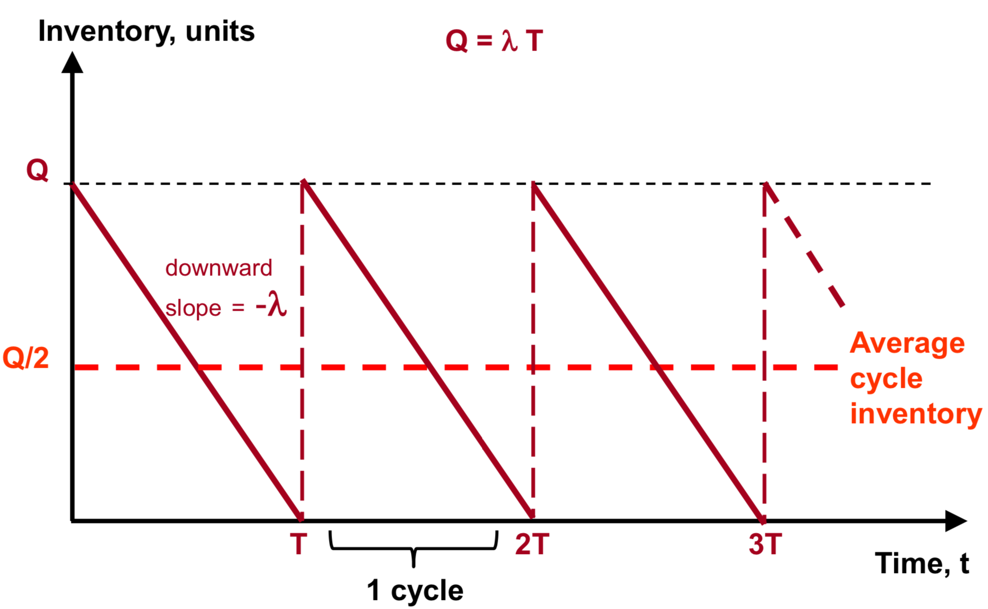
Inventory Management (Finite Demand)
Deterministic Demand (EOQ Model), Economic Order
Total Cost = Setup (Ordering) + Holding + Purchase
EOQ with Quantity Discounts
All Units Discount
Incremental Discount
EOQ with finite production rate
Used for items like: toothpaste, tissues, Christmas trees, etc.

Slide 8
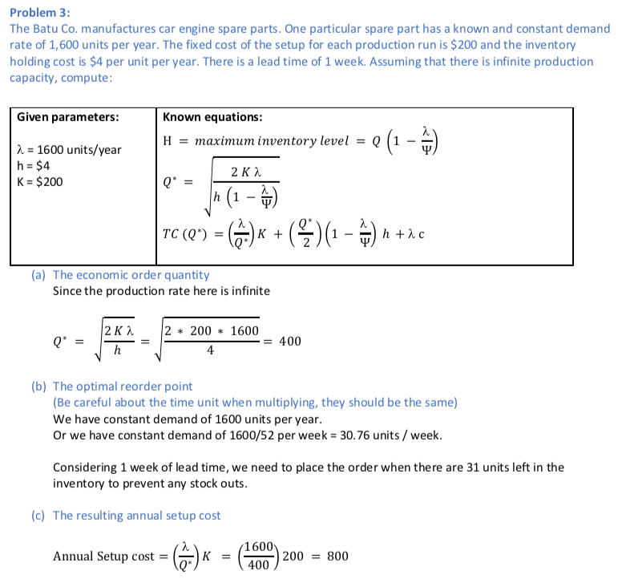
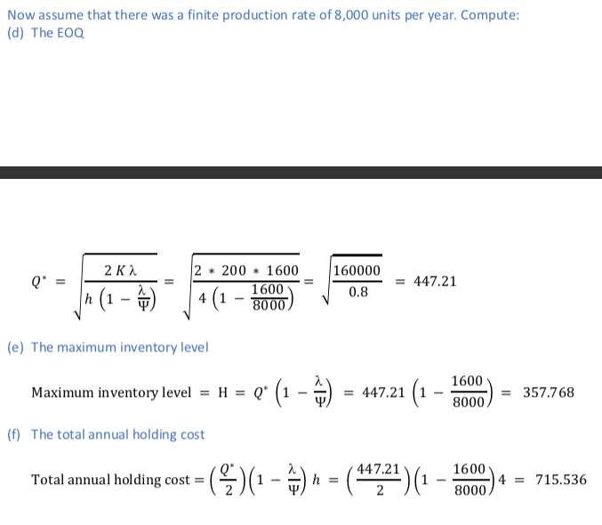

Slide 9
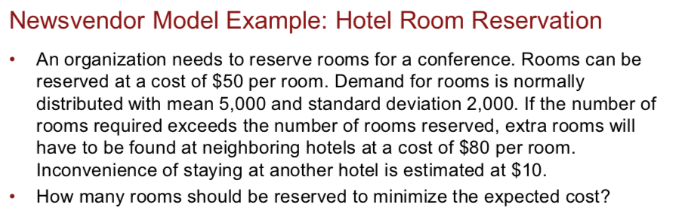
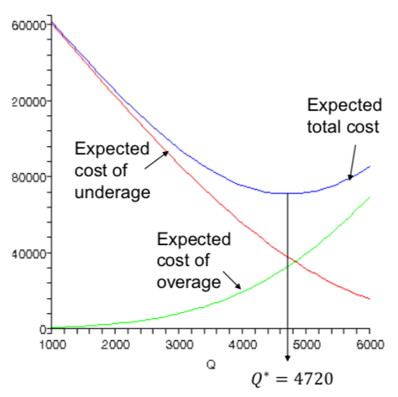
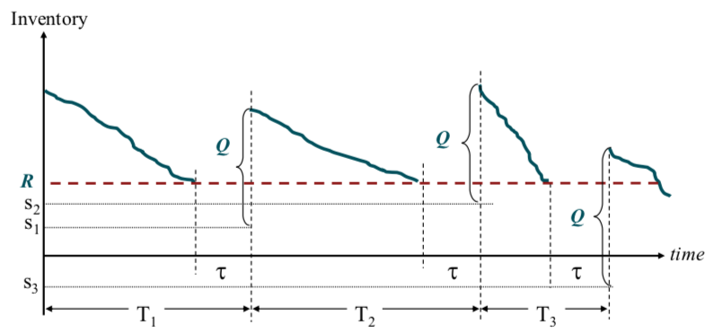
Inventory Management (Uncertain Demand)
Types:
Fixed time period (Periodic review)
One period (Newsvendor model)
Multiple periods
Fixed order quantity (Continuous review)
(Q,R)models
Standard Deviation (uniform, exponential, linear, normal)

Slide 10
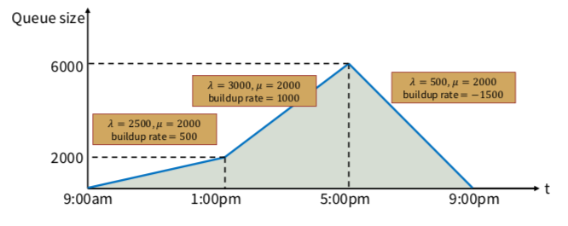
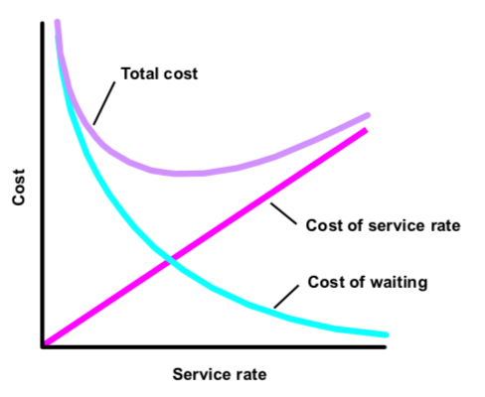
queueing
Question: Arrival Rate ?
M/M/1 queueing Model
Busty Arrivals
Disney Space Mountain ride queue
G/G/N queueing Model
Airline check-in counters, Bank ATMs, Retail cashiers
Cost analysis of queueing
Problems we solved: DMV, Disney, Car Wash, Costco Gas, Toll booth bay bridge
Psychology
Elevators and mirrors,
Ads in DMV

Slide 11
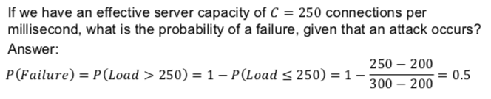
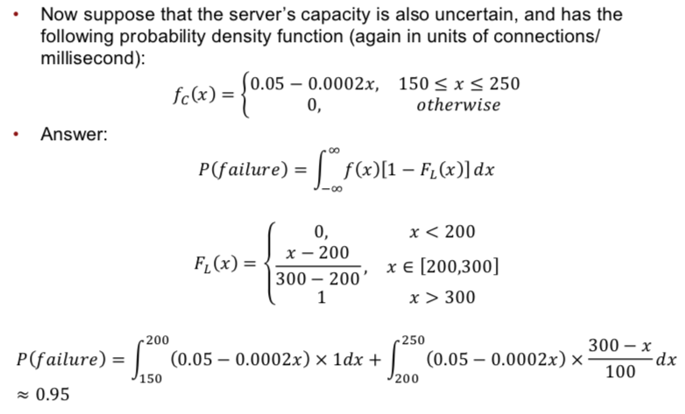
Load – Capacity Analysis
Problem: An attackers utilize very basic attack tools, such as a simple open-source application called Low Orbit Ion Cannon. Once the application is downloaded – either voluntarily or in a variant form via a malicious link – the application recruits computers into a network that floods a designated website with traffic until it slows or collapses under the load. If an attack occurs, we believe that the number of connections per millisecond to your server will be uniformly distributed between 200 and 300.

Slide 12
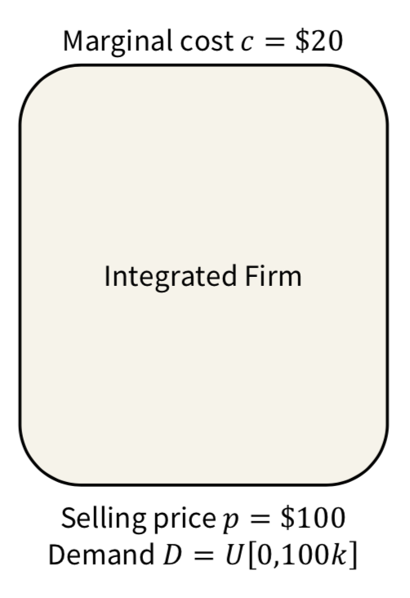
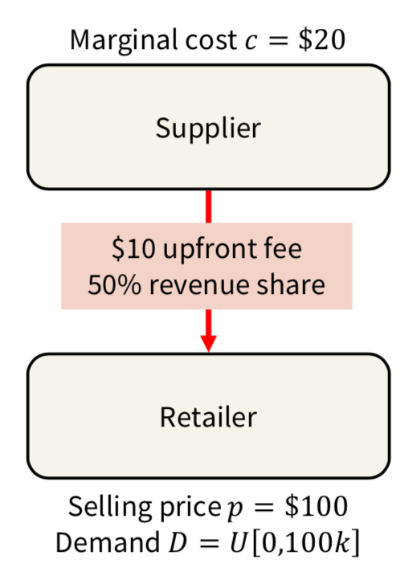
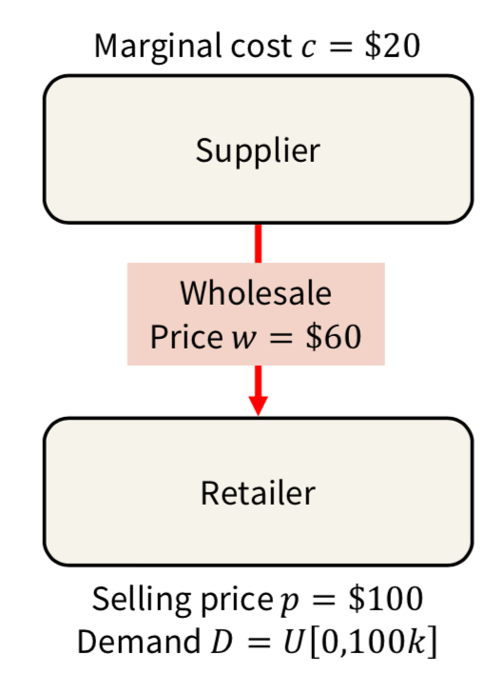
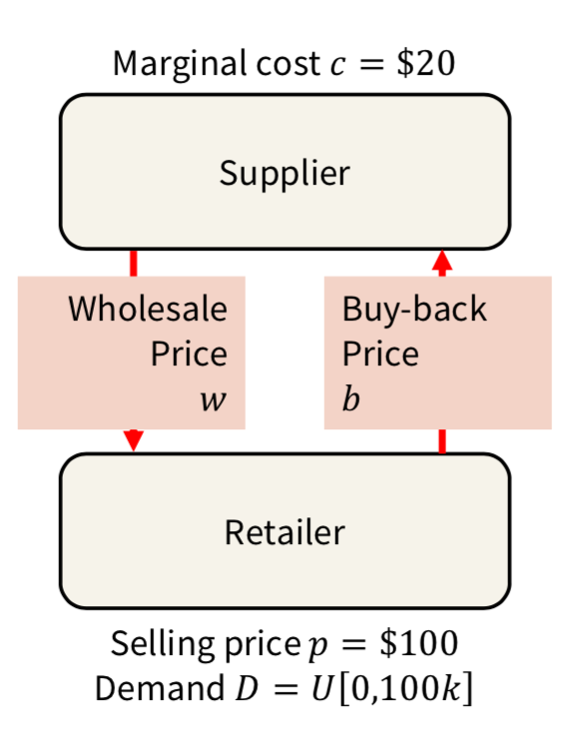
Supply Chain Revenue Models
Integrated Firm vs. Two-Firm Supply Chain vs. Revenue Sharing Contract vs. Buy Back Contracts
Costco’s Liquor Model

Slide 13
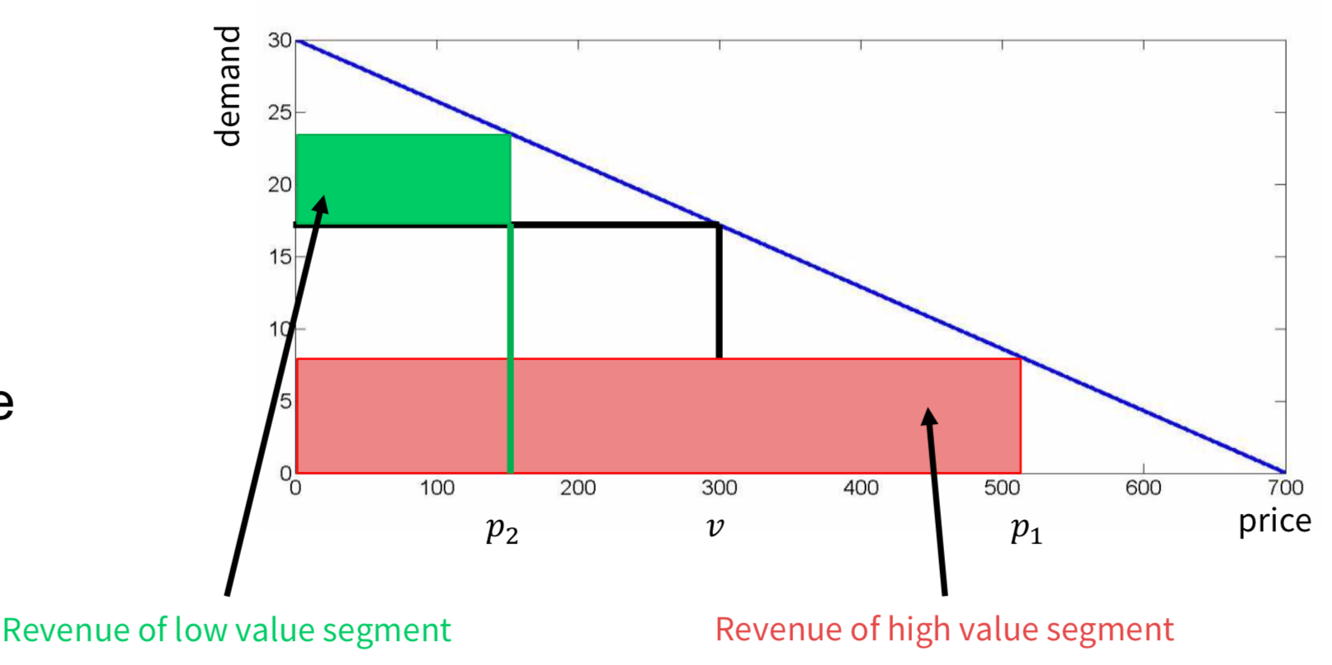
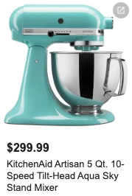
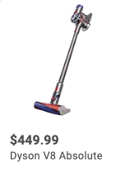
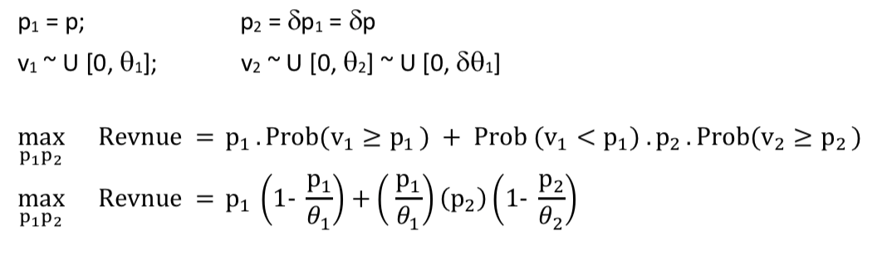
Revenue Management
Price Segmentation
Water Bottle price at Disney? https://www.youtube.com/watch?v=wPkhyKGJLvs
Dynamic Pricing
Eg. tickets of Giant’s game, airline tickets, Uber, Lyft, Parking meter,
Willingness to pay

Slide 14
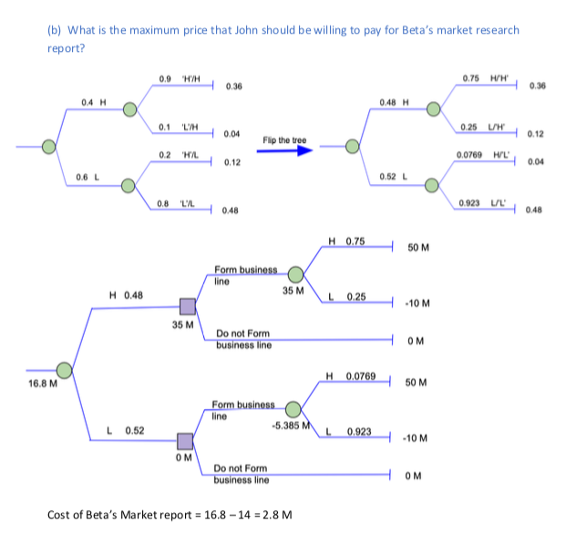
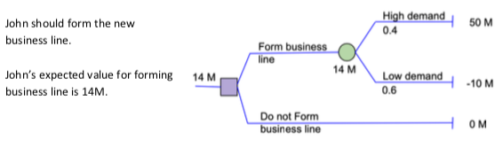
Decision Analysis
What option to chose?
What can help us with the selection?
How much should I be willing to pay for that help?

Slide 15
Take away’s
Change in perception of how we see the world around us
Trips to DMV or Universal Studios are much more fun and analytical now
Articles and news sources
Personally ☺
A+ grade certificate
Professor recommendation

