Slide 1

UE19CS204: WEB TECHNOLOGIES–l GROUP PROJECT

Slide 2

PROJECT NAME :- CLONE
SUBMITED BY :-
VISHAL POONACHA PES2UG19CS460
VOORA UDAY BHASKAR PES2UG19CS462
SUSHANT CHAUHAN PES2UG19CS417

Slide 3

ABSTRACT OF THE PROJECT
ATTEMPT TO MAKE A STREAMING WEBSITE WITH LOOK AND FEEL OF NETFLIX.
A USER CAN LOGIN AND ACCESS HIS/HER SCREEN. EVERY SCREEN REMENBERS THE TIME STAMP OF LAST WATCHED SHOWS.
USER CAN ALSO MAINTAIN A WATCH LIST AND BROWSE THROUGH CONTENTS BY GENRES.

Slide 4
FEATURES
LOGIN PAGE.
DIFFERENT SCREENS FOR EACH USER.
USERS ABLE TO STREAM MOVIES AND SERIES FROM DATA BASE.
INBUILT WEB-PLAYER.
ICONIC NETFLIX TRAILER POP-UPS.
NETFLIX NAVBAR.
MOVIE/SERIES INFORMATION FROM TMDB(THE MOVIE DATABASE) API.

Slide 5
TECHNOLOGY STACK
BACK-END:-
NODE.JS FOR BACKEND FRAMEWORK , TO MANAGE REQUESTS FROM MULTIPLE USERS.
DATABASE COMPONENT WILL BE MAINTAINED BY MONGODB OR AN SQL-BASED LANGUAGE.
FRONT-END:-
HTML AND CSS FOR BASIC STRUCTURE.
REACT.JS FOR FRONTEND FRAMEWORK AND FETCHING IMFORMATION FROM TMDB.

Slide 6
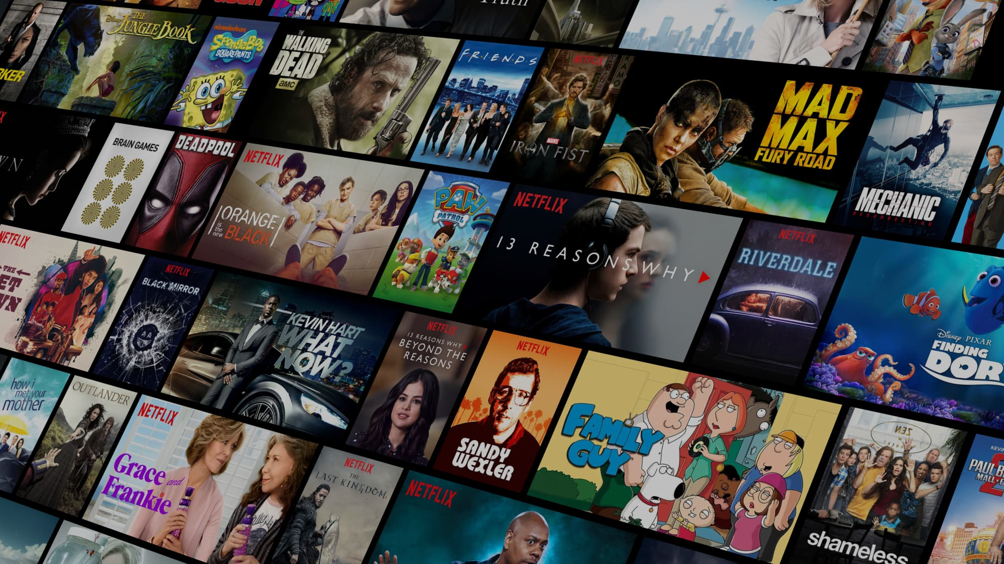
THANK YOU

