Slide 1
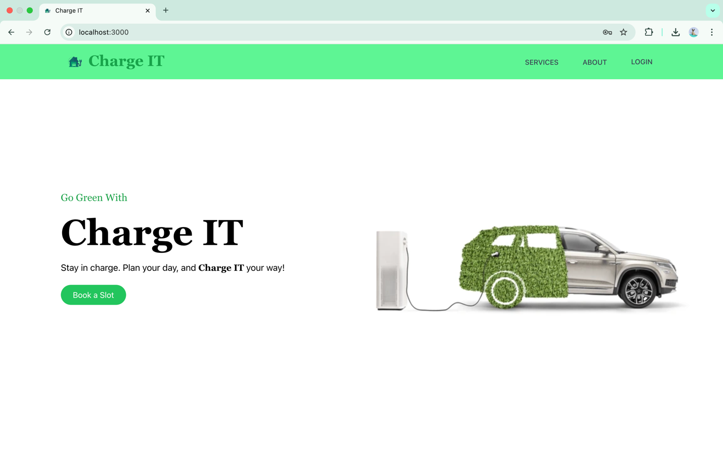
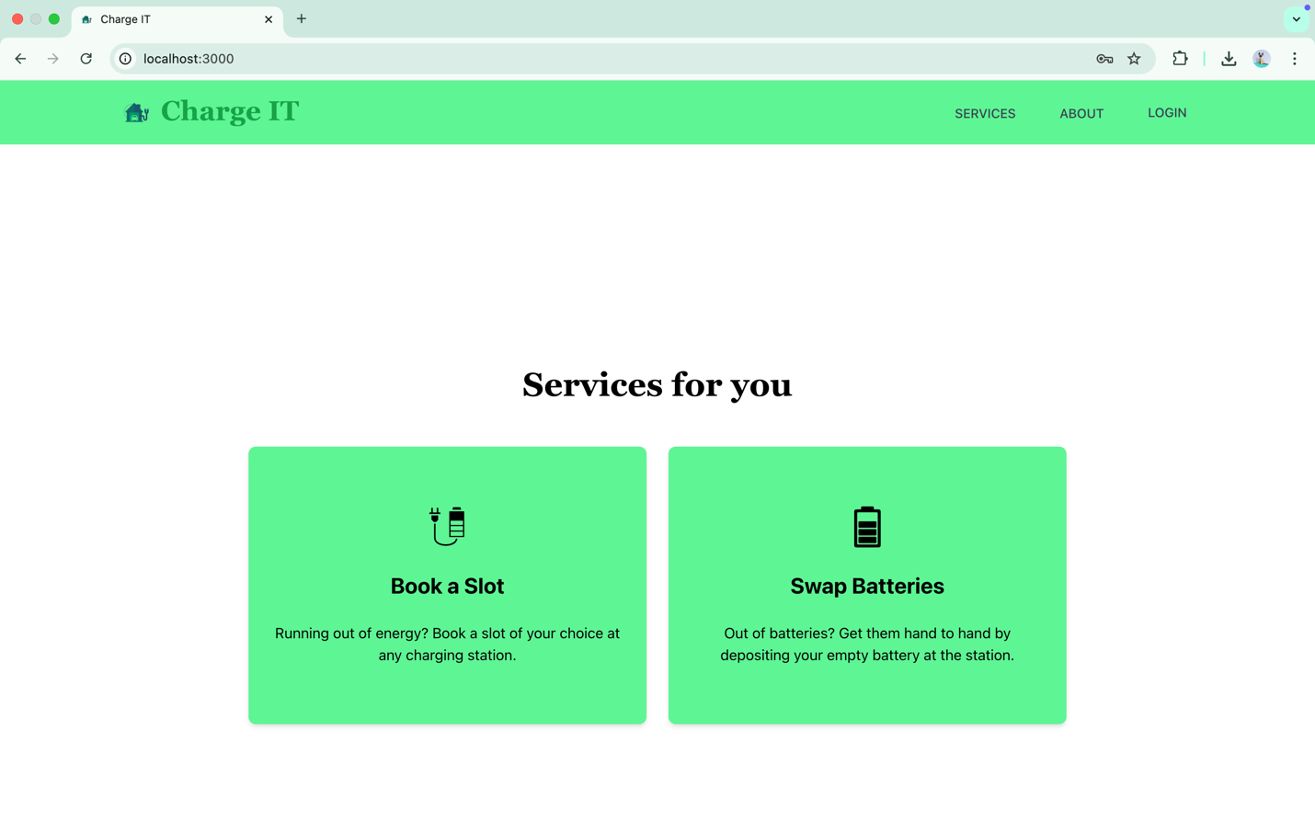
Submitted by : DEEPAK DAS TATWA(AP22110011485) PUJITHA POTLURI(AP22110011486) MNH SRAVYAVANI(AP22110011456) Under the Guidance of: Dr. Randhir Kumar SRM University AP, AndhrA Pradesh
EV Charging Station Finding Web App

Slide 2

Introduction
The EV Charging Management System is a web-based platform designed to simplify and enhance the experience of electric vehicle (EV) users.
With the increasing adoption of EVs, the demand for reliable and accessible charging infrastructure is also growing. However, EV users often face challenges such as locating available charging stations, planning long-distance travel, and dealing with wait times due to unavailable slots.
Our solution addresses these issues by providing:
Real-time station discovery
Slot booking and reservation
The system also includes role-based modules for users, admins, and station owners to ensure seamless operations and efficient management of charging stations.

Slide 3
System Overview
Modules:
• User: Booking, searching, managing EV profiles
• Admin: Station and user management
• Station Owner: Manage availability and bookings
Tech: React.js, Next.js, Firebase, Google Maps API, JWT

Slide 4
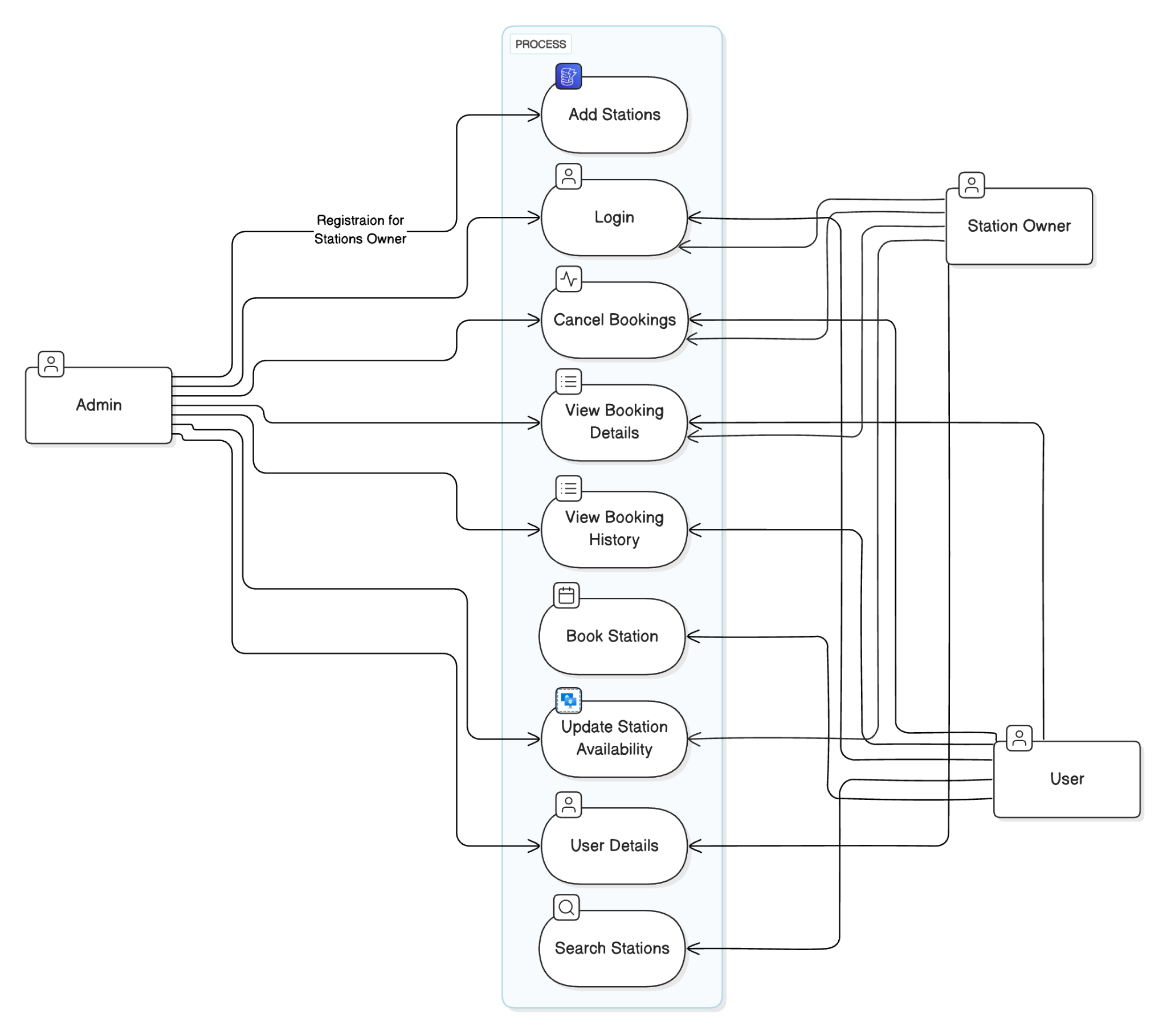
Design – Use case diagram

Slide 5
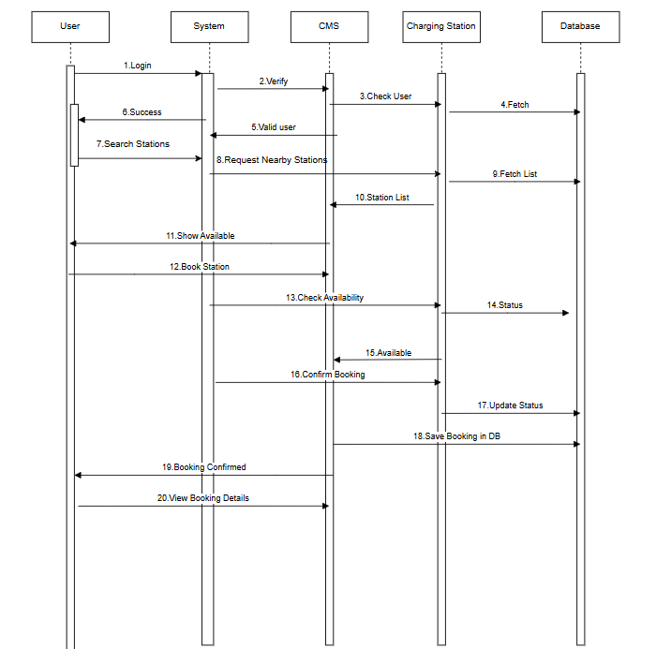
Sequence diagram

Slide 6
Model Used: Agile Software Development Model
Flexibility: Agile allows for adaptive planning and continuous improvement, which is ideal for a project that depends on real-time data and user feedback.
Incremental Delivery: The EV Charging Management System includes complex features like real-time slot booking, Google Maps API integration, and role-based access. Agile helps break these into smaller, manageable tasks.
User-Centric Approach: Frequent updates ensure that the platform evolves based on user needs and testing outcomes.
Faster Time to Market: Regular iterations mean that core features can be released early and improved over time.
Risk Mitigation: Early testing and feedback loops help identify and fix issues quickly, reducing the chance of major failures post-deployment.

Slide 7
Visual Overview Of Web Application Components
Home Page

Slide 8
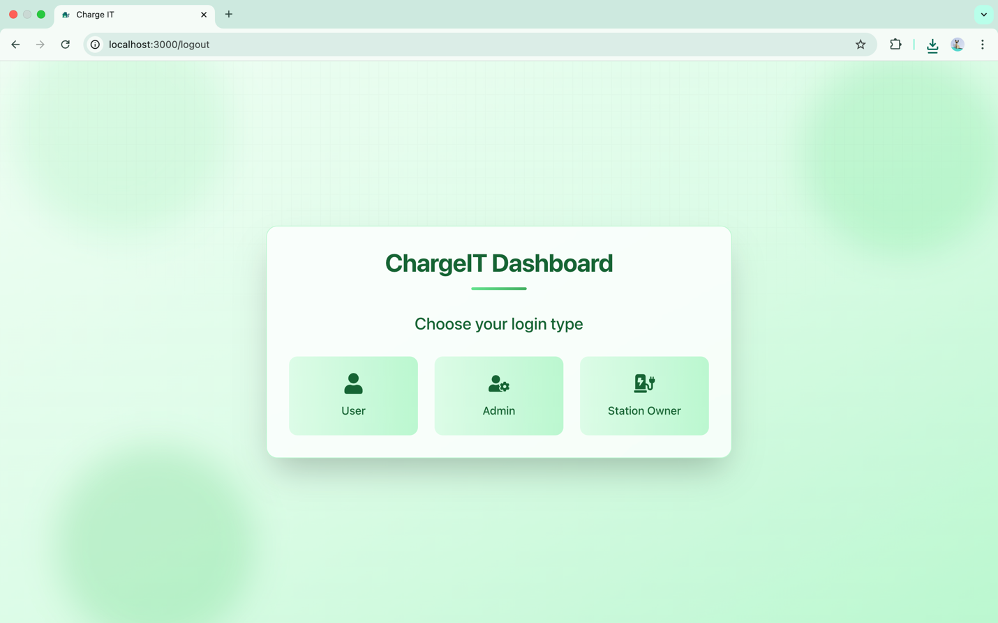
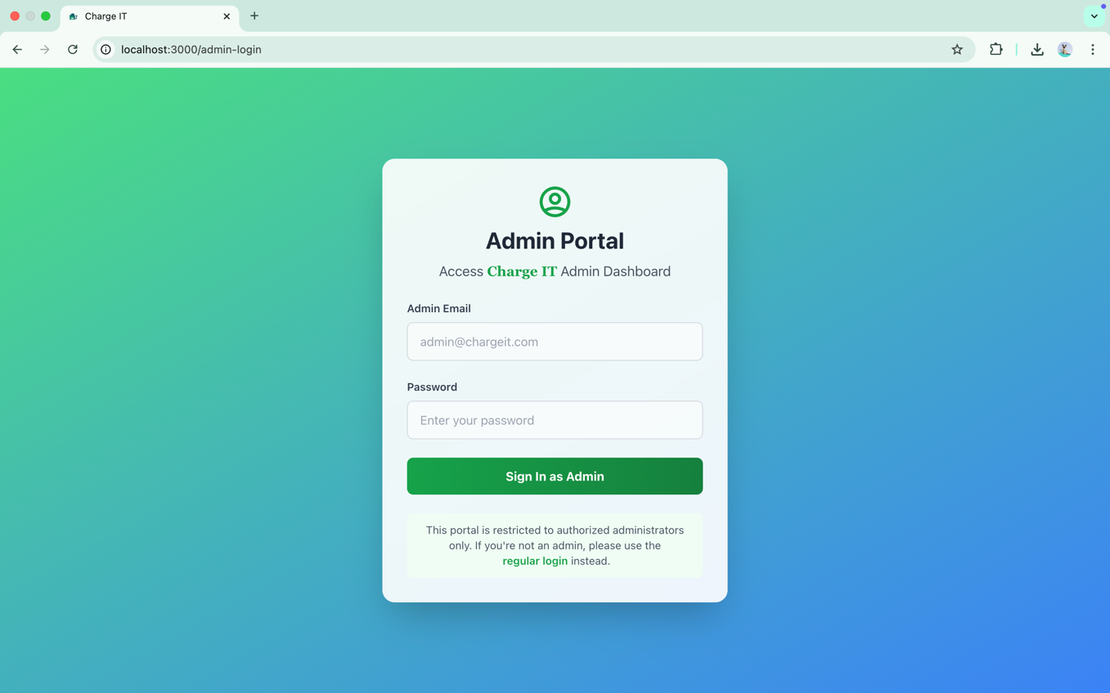
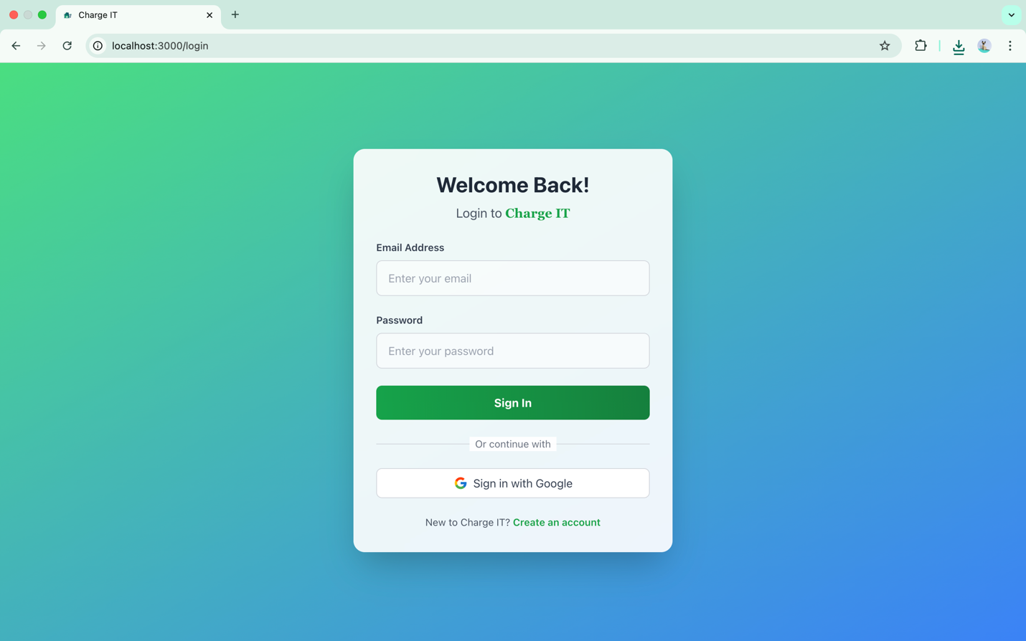
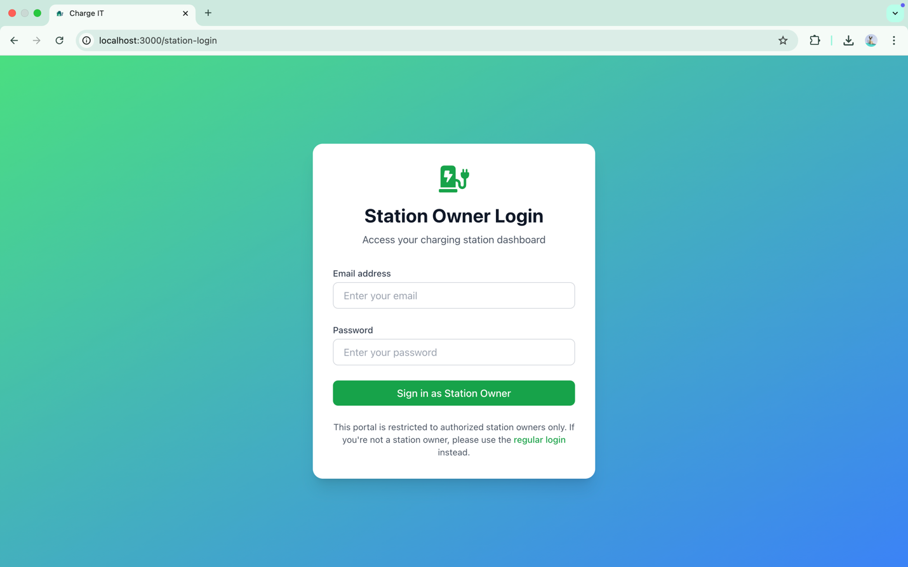
Role Selection Page
Admin Login Page
User Login/Signup Page
Station Owner Login Page

Slide 9
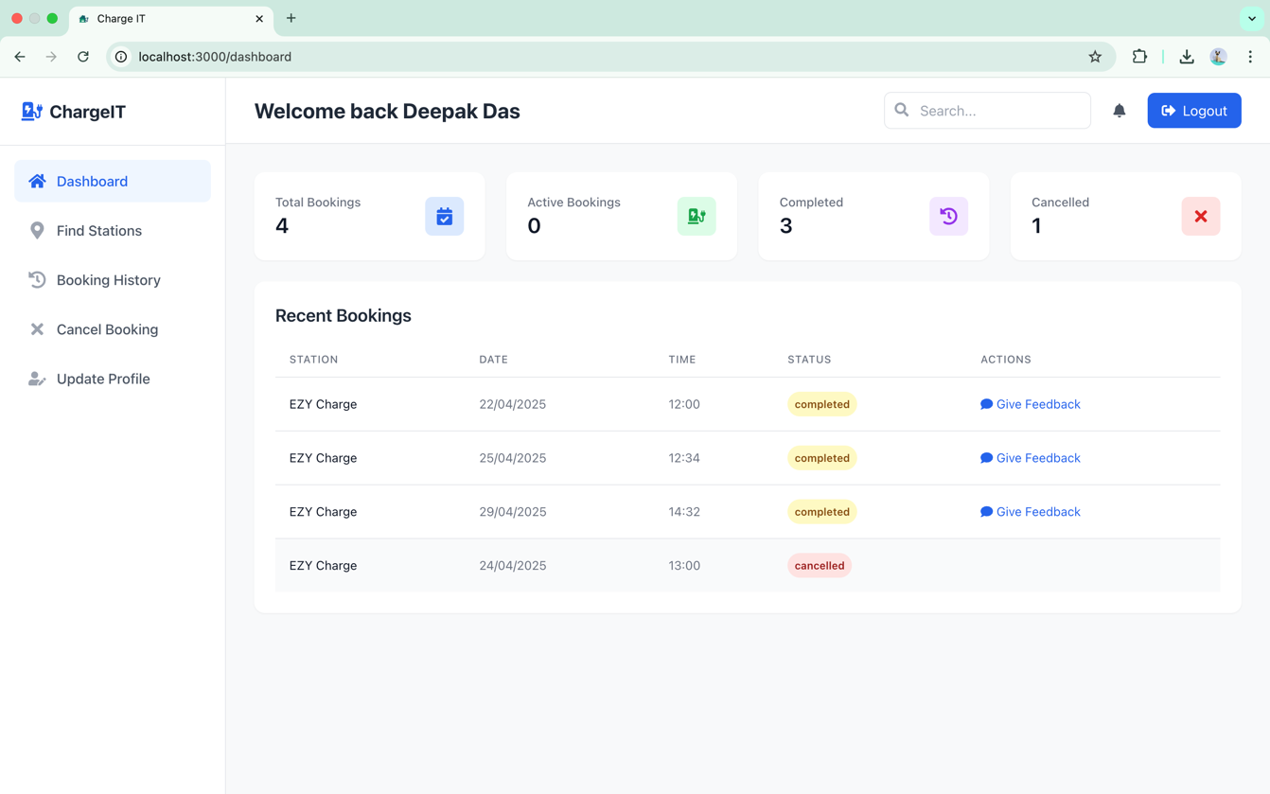
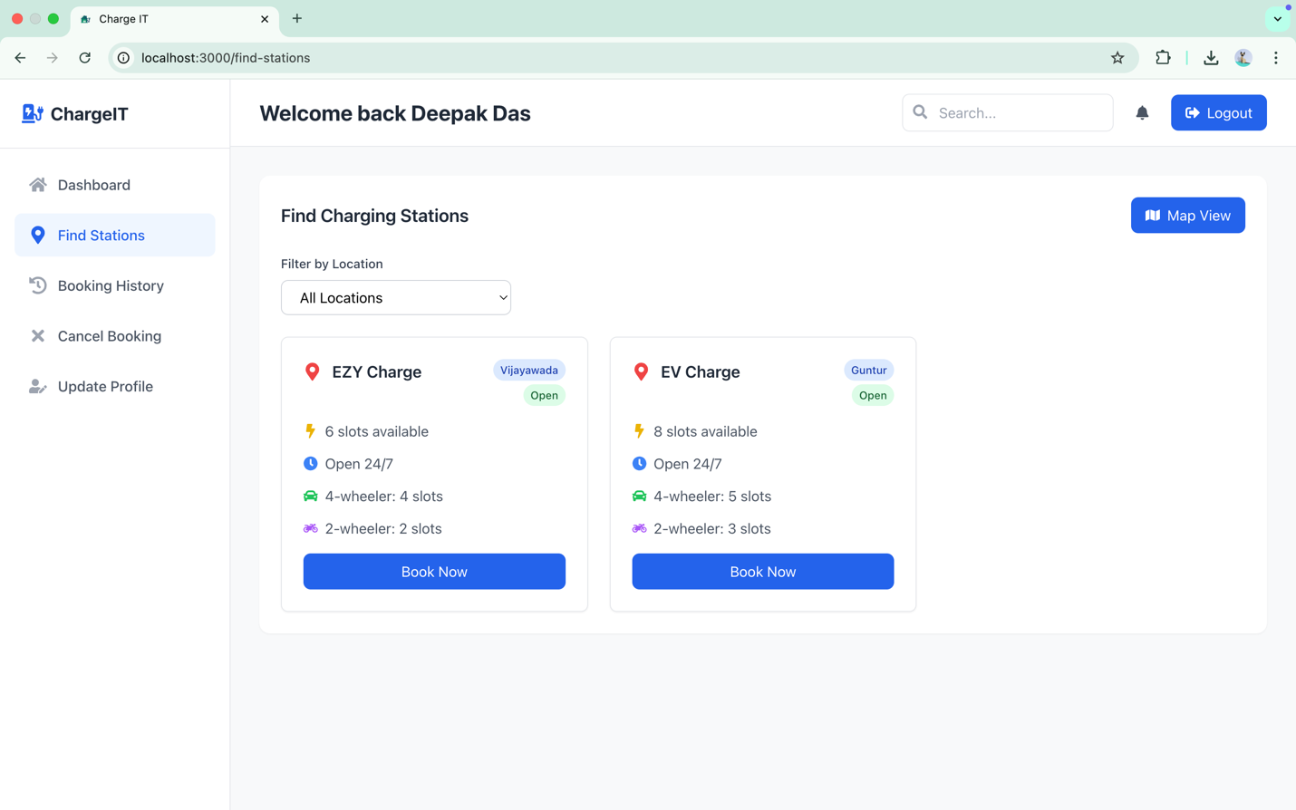
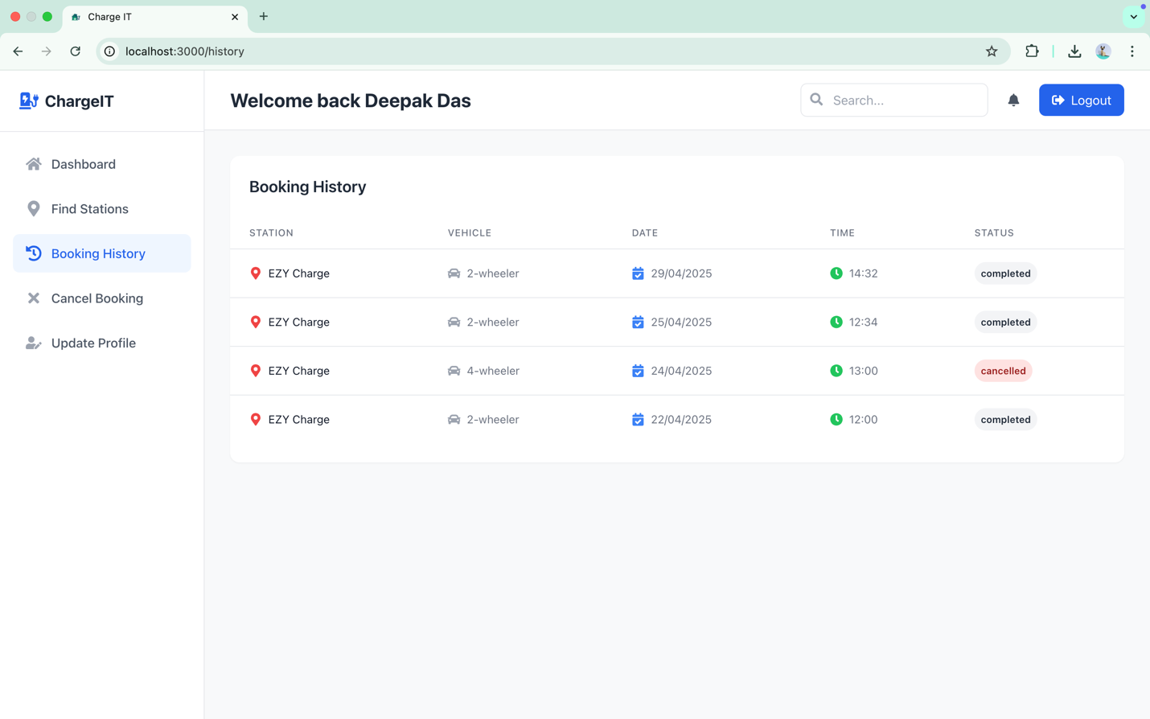
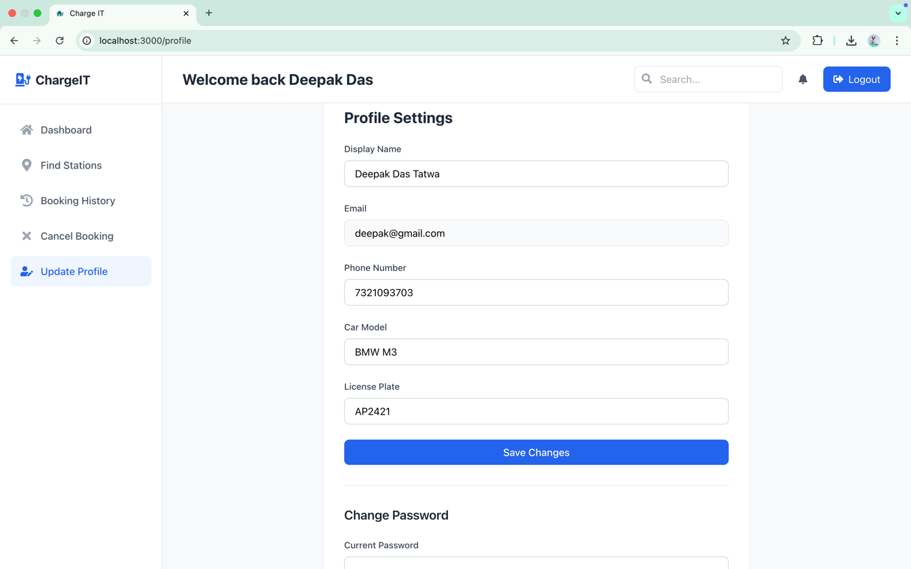
User Dashboard

Slide 10
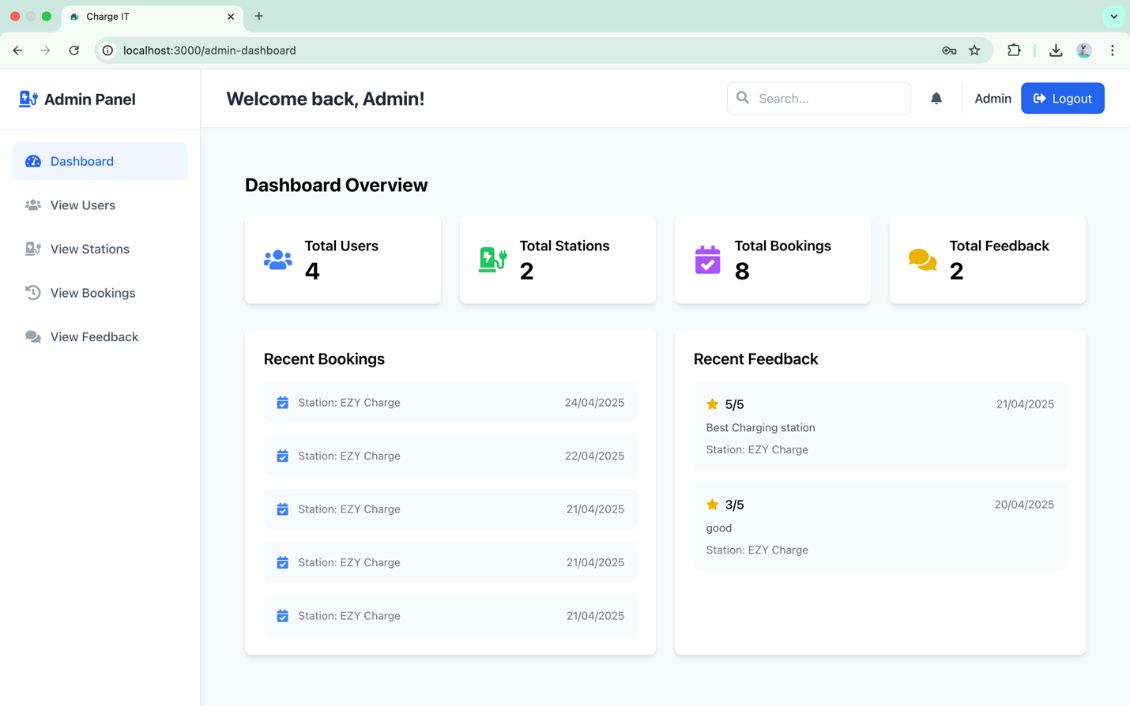
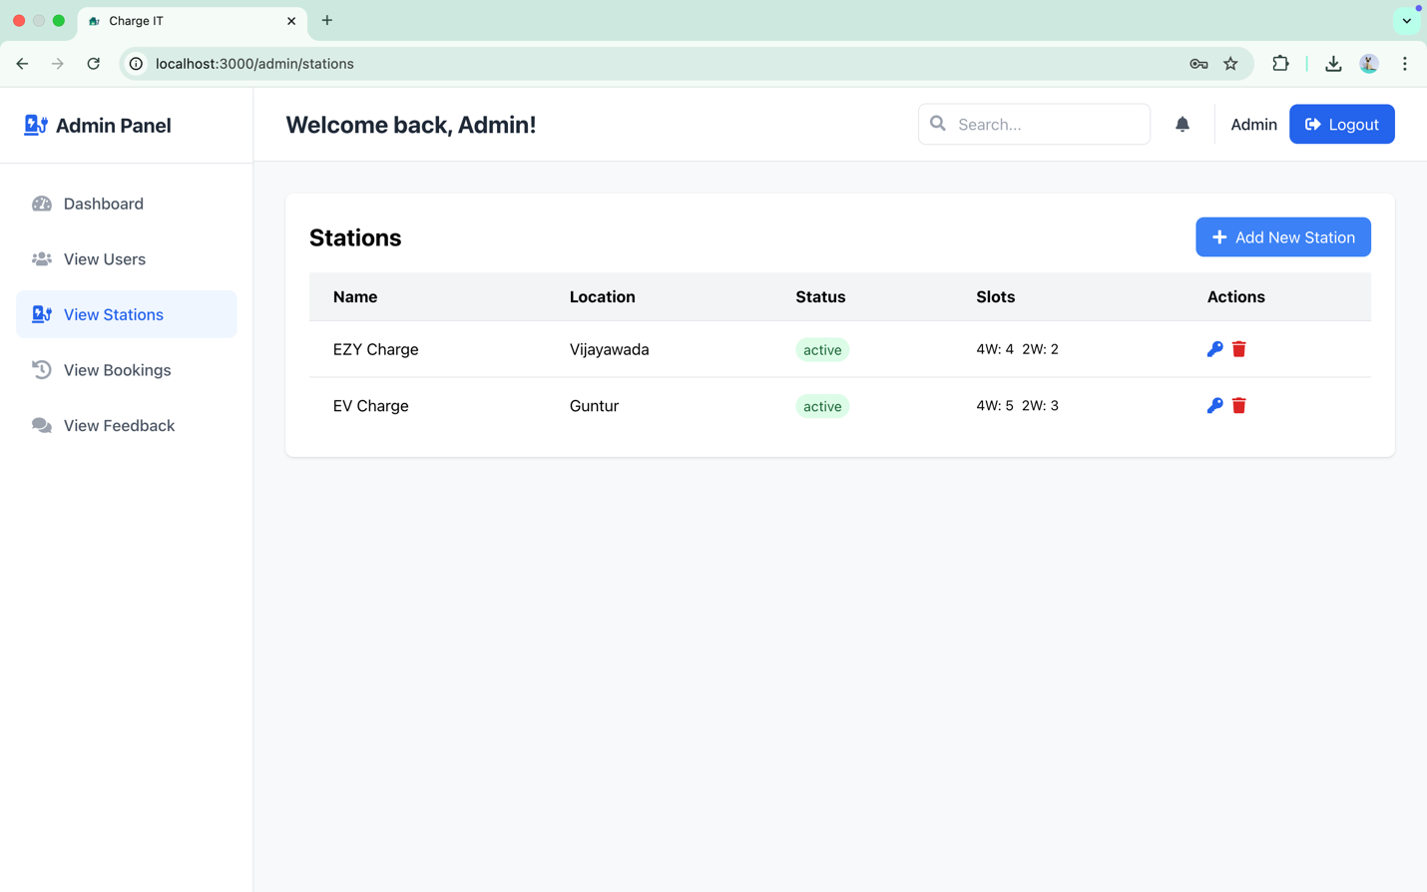
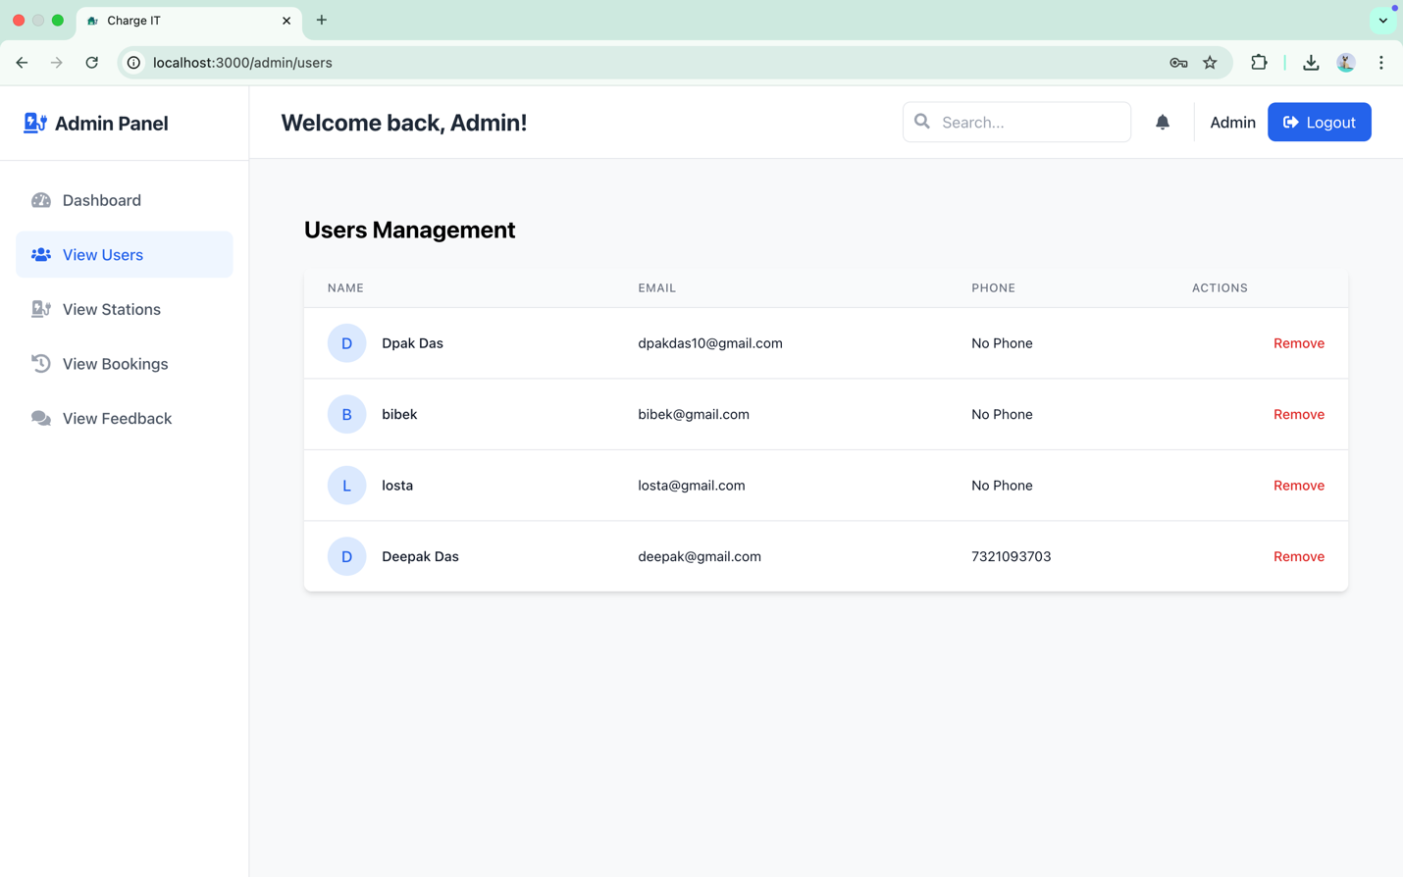
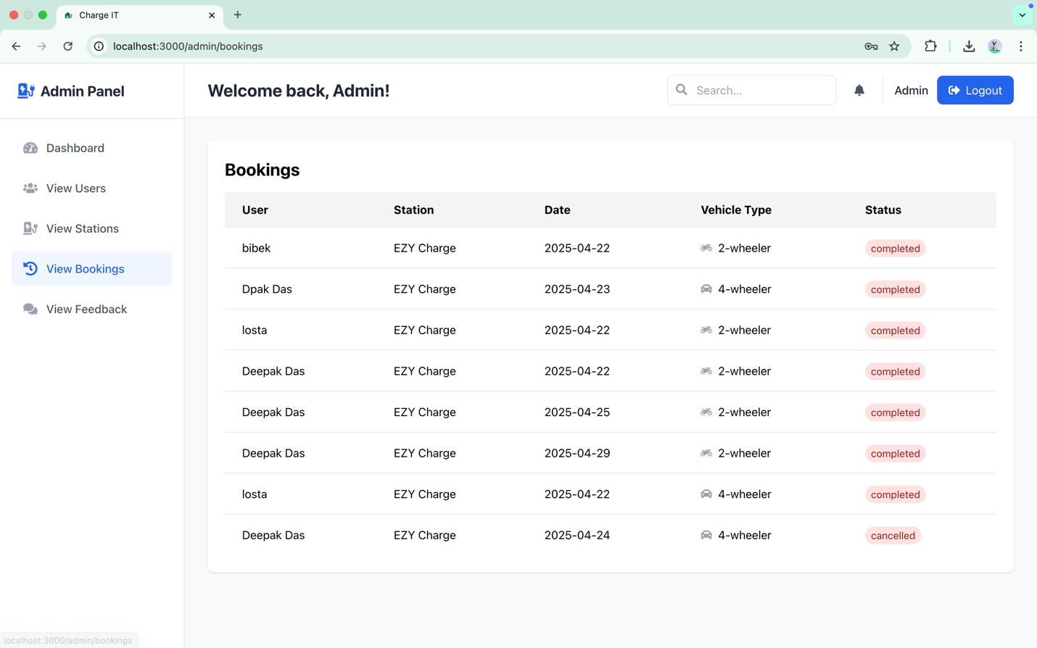
Admin Dashboard

Slide 11
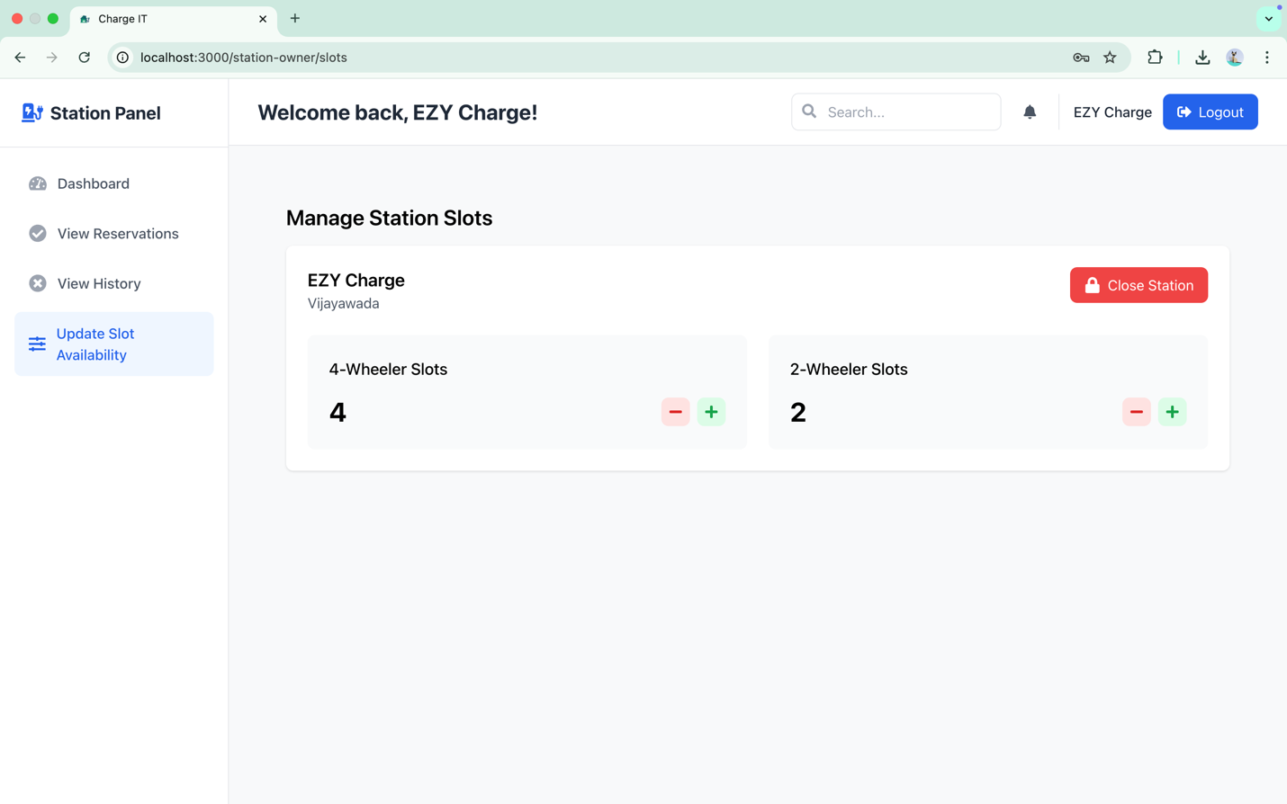
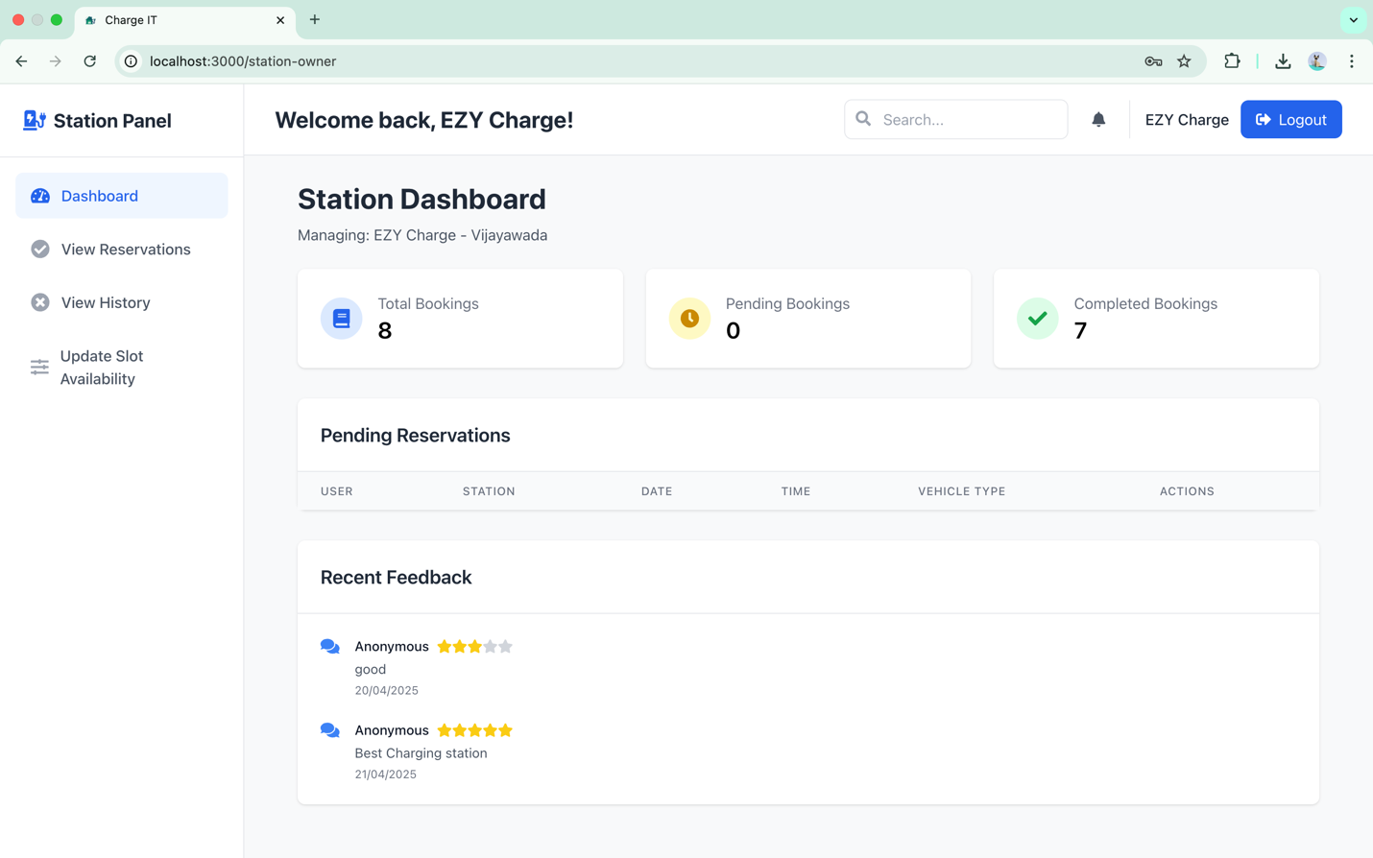
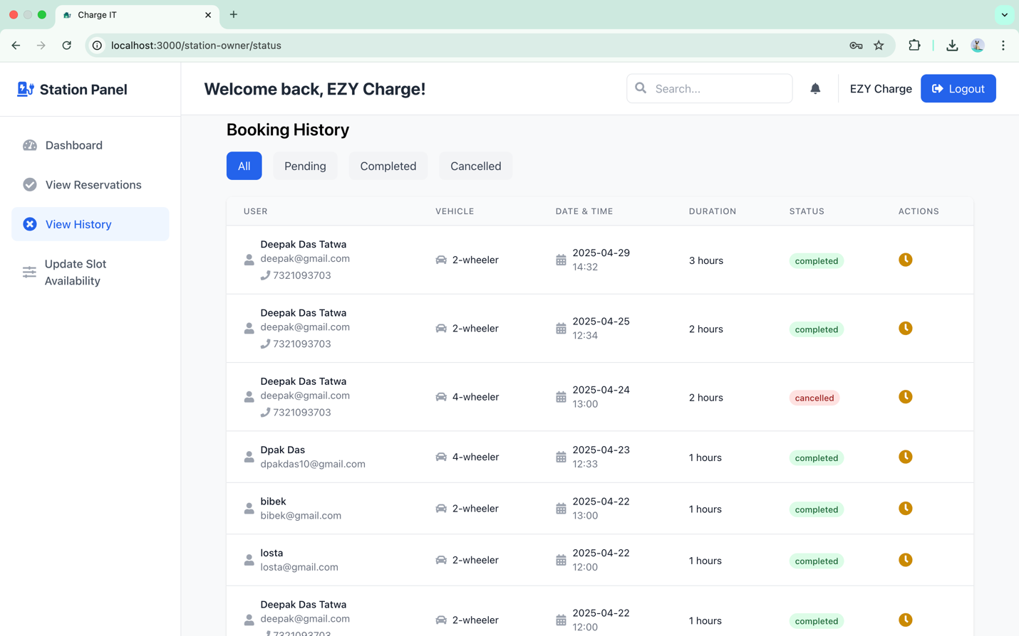
Station Owner DashBoard

Slide 12
conclusion
The EV Charging Management System is a scalable web-based platform designed to improve the EV user experience through features like station discovery, slot booking, and route planning.
With role-based modules for Users, Admins, and Station Owners, the system ensures efficient station management, real-time updates, and secure access using JWT.
It reduces wait times, improves station visibility, and supports smart city integration—encouraging sustainable, clean transportation solutions.

