Slide 1
Plagiarism Detection using Min-Hashing and LSH
Final Project
CS-GY 9223 - Mining Massive Datasets - Spring 2022
Vishal Prakash - N13633291
vp2181@nyu.edu
Vedang Mondreti - N12468767
vm2129@nyu.edu

Slide 2
Project Aim
Develop a plagiarism detection engine on a text based corpus.
Use Min-Hashing to reduce memory requirements.
Implement Locality Sensitive Hashing to improve computation time.
Analyse the performance of the engine.

Slide 3
Introduction
Similarity detection is important in today’s world of information.
Has many use cases such as Audio/Video matching, gene analysis, image searching, near-duplicate detection, etc.
Naive method involves comparing all files with each other and then calculating distance between them.

Slide 4
Issues with Naive Method on Text Documents
Documents are usually stored as vectors. Can be represented a n-grams, Term Frequency Inverse Documents, etc. For a large number of documents, vectors can become very long and sparse. Hence has high memory requirements.
At a large scale, the naive method is not feasible. Checking all pairs leads to O(n²) time complexity.

Slide 5
The Solution
To reduce the memory requirements of the engine, the vectors can be reduced to smaller signature vectors which are shorted in length but maintain document characteristics. Min-Hashing can be used to implement this.
Time consumed can be decreased by using Locality Sensitive Hashing by reducing the number of brute force comparisons.

Slide 6
Dataset Used
Text corpus developed for the purpose of enabling studies on plagiarism detection.
Contains images from research papers along with text associated to them.
Caption text
Reference text in main text body
Dataset content:
Number of original source files: 122
Number of suspicious files: 146
Each suspicious file has an annotation file containing true label.
https://data.mendeley.com/datasets/gz3hztwm5p/1

Slide 7
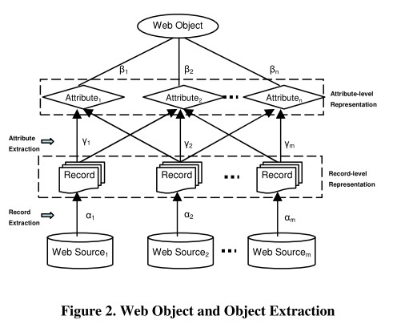
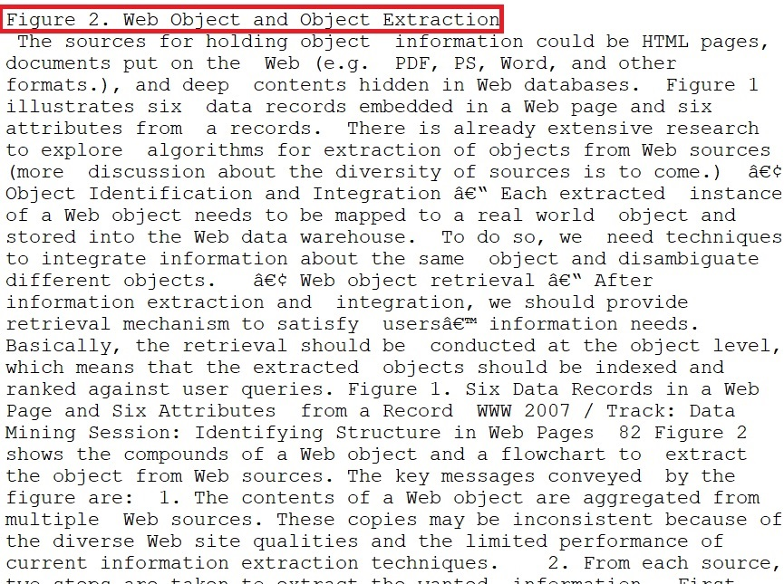
Source/Suspicious Files
Text associated with image. The first line in the red box is the image caption while the rest is text referring to the image in the main body of the paper
Image from research paper

Slide 8
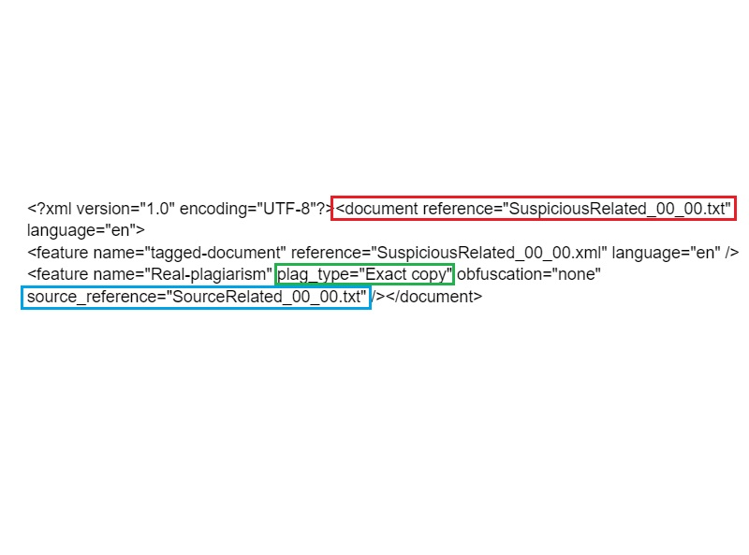
Annotations
Annotations are present in .xml files which contain true labels of suspicious documents. The red box shows the suspicious document name, the green box shows the type of plagiarism if it exists and the blue box contains the source document to which this suspicious document has been matched to.

Slide 9
Process
Source Documents
Shingling
Min-Hashing
LSH
Bins of similar documents
Compare suspicious doc with all other source docs in the same bin
N-gram vector for each doc
Shorter signature vectors
Suspicious Documents
Shingling
(using source doc text corpus)
Min-Hashing
(using same hash func as used for source docs)
LSH
(using same hash func as used for source docs)
Note: Text was cleaned to remove special characters before shingling to create appropriate shingles

Slide 10
Shingling
Goal: Convert Documents to n-gram vectors
Need for Shingling: Preserve Word Ordering
Sample 2-gram from the corpus
Grams of size n are created based on the document corpus.
Documents are represented as 0/1 vectors.

Slide 11
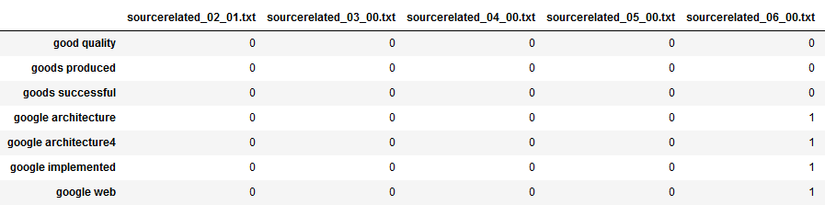
Shingling
The presence of each gram in a document is presented as a 0 or 1.
Set of grams built based on source document corpus. The same set is used to represent the suspicious document corpus.

Slide 12
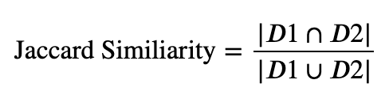
Min-Hashing
Length of Document vector after Shingling: 19267
Aim: Represent document as short signatures which preserve similarity
Develop signatures of document by hashing the column multiple times
For Jaccard Similarity → Min-Hashing

Slide 13
Min-Hashing
Permute the rows of a document vector and find the index of the first 1
Use k such permutations and generate a signature of length k
Permuting can be expensive
Use Row Hashing → Each hash functions corresponds to a permutation
Number of hash Functions used: 1000
Length of signature: 1000 (<< 19267)

Slide 14
Locality Sensitive Hashing
Goal: Find documents with a jaccard similarity ≥0.5 .
Hash the columns of the signature matrix to a large number of buckets
Compare only those documents that hash onto the same bucket
Advantage: Only a small number of pairs need be checked.
Disadvantage: Similar document might not get hashed onto the same bucket
Handling False Negatives:
Divide Each signature into b bands(r rows each) and hash each band
Find optimal values of b, r to reduce false positives and false negatives

Slide 15
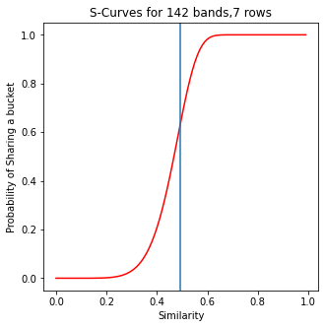
Locality Sensitive Hashing
False Negatives
Documents with 50% similarity, 60 % likely to share a bucket
False Positives

Slide 16
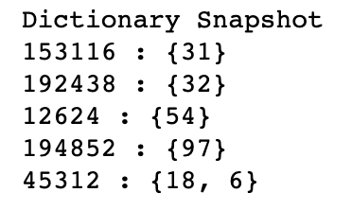
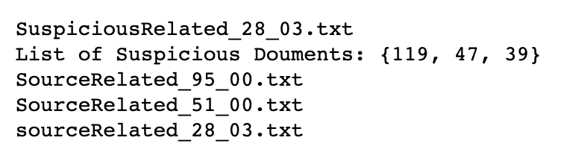
Locality Sensitive Hashing
Steps in LSH
Hash b bands of signature matrix of source corpus onto a hash table
Generate minhash signature for every suspicious document and hash it onto the same table.
Compare documents which hashed onto the same bucket.

Slide 17
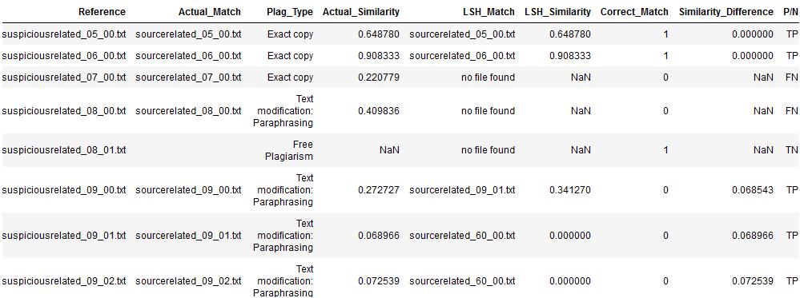
Results
Based on the matches provided by min-hashing and LSH, we mapped the LSH labels back to the original labels present in the annotations.

Slide 18
Result Analysis Pt.1
To justify our choice of using 50% as the threshold for placing documents in the same bin, we calculated the average similarity between suspicious and source documents that were originally labeled as “Exact copy”.
This gave us ~55% which is close to our set threshold.
Hence our set threshold is ideal.

Slide 19
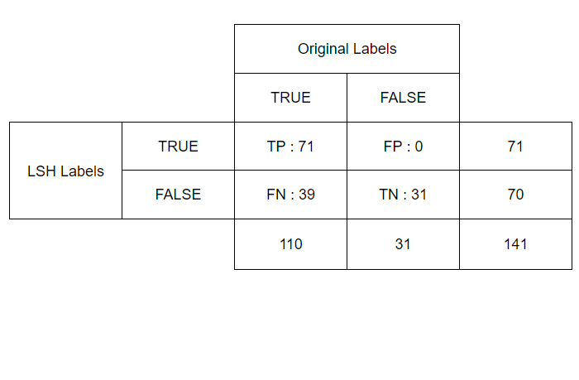
Result Analysis Pt.2
Based on the original labels, we could identify the engine’s performance in terms of True and False predictions.
Accuracy = (TP+TN)/Total = 72%
Precision = TP/(TP+FP) = 100%
Recall = TP/(TP+FN) = 65%
This analysis is solely based on identification of plagiarism and does not check for correct document matches.

Slide 20
Result Analysis Pt.3
Based on the confusion matrix, we obtained 28% false negatives. To understand if this is justifiable, we calculated the the average original similarity for all these cases.
We obtained a 15.5% similarity with original matches. That is, the textual descriptions of similar images were only 15.5% similar.
Hence it is reasonable for LSH to not have marked these suspicious documents as plagiarised.

Slide 21
Result Analysis Pt.4
For all true positive cases, we can check how many of these suspicious documents were matched to the correct source document.
We found that 56% of the TP cases were matched to the correct document.
For these cases, we calculated the average difference between the original similarity and LSH similarity.
This was found to be 19.6% which is not a very large difference. Hence LSH is not extremely far off even if it matches to a wrong document.

Slide 22
Conclusion
Represented Documents as n-grams vector
Length of document vector: 19267
Converted Documents vector to signatures that preserve similarity
Length of signature: 1000
Compare documents that hashed onto the same bucket in LSH
Results: Correctly classified 72% of the Documents

Slide 23
Future Scope
During the development of the engine, we came across several areas where the project can be extended:
Incorporation of shape-based textual reference that describes the geometry of the image.
Analyse the performance of additional hash functions during the min-hashing and LSH stages.
The size of the n-grams can be varied to increase or reduce the effect of word ordering in the documents. Characters can also be used instead of words to create the n-grams.

Slide 24
Thank You

