Slide 1
Traffic Prediction for Intelligent Transportation System using Machine Learning
NAME – R. VISHAL
ROLL NO. – 1911107
BATCH – B3
RDBMS IA - 1

Slide 2
ACKNOWLAGEMENT-
The authors of the paper are Gaurav Meena, Deepanjali Sharma and Mehul Mahrishi

Slide 3
Introduction:
Traffic Environment - Everything that can affect the traffic flowing on the road.
It helps the riders and drivers to make better travel judgement to alleviate traffic congestion, improve traffic operation efficiency, and reduce carbon emissions.
The dependency of traffic flow is dependent on real-time traffic and historical data collected from various sensor sources.
Traffic data is exploding due to the vast use of traditional sensors and new technologies, and we have entered the era of a large volume of data transportation.
Available prediction methods for traffic flow use some traffic prediction models and are still unsatisfactory to handle real-world applications.
It is cumbersome to forecast the traffic flow accurately because the data available for the transportation system is insanely huge.

Slide 4
Background:
Intelligent Transportation system (ITS) is adopted in world congress held in Paris, 1994.
ITS has used the application of computer, electronics, and communication technology to provide traveler information to increase the safety and efficiency of the road transportation systems.
The main advantage of ITS is to provide a smooth and safe movement of road transportation. It’s also helpful in the perspective of environment friendliness to reduce carbon emission
The available road network capacity is not feasible to handle this heavy load.

Slide 5
There are two possible approaches to resolve this issue.
The first one is to make new roads and new highway lanes for the smooth functioning of vehicles
The second approach uses some control strategies to use the existing road network efficiently.

Slide 6
ALGORITHMS PROPOSED-

Slide 7
Algorithm 1: For identifying the congested situation
1. Collect the traffic data in every 5 min with features:
A. Location (Measured with GPS)
B. Direction
C. Speed
D. Start-End Junction
2. Group every 5 min interval with their corresponding data.
3. Calculate the distance between each vehicle with all another vehicles within specified junction.
if the distance is less than the specific threshold between two vehicles then
those vehicles are considered to be the neighborhood vehicles
else
Not considered as neighbor vehicles.
end if

Slide 8
Algorithm 2 For classifying the congested situation
1. This will eventually give us the matrix A.
2. Now assign 1 to A[i, j]
if A[i, j] < threshold then
A[i, j] = 1
else
A[i, j] = 0
end if
3. Count A[i,j]=1 and label i, j as neighborhood vehicles
4. Repeat above steps in every 5 min for 45 min
5. Plot the graph between neighborhood vehicles and time interval.
if the neighborhood vehicles shows an increasing graph
then
the traffic congestion is identified
else
No traffic
end if

Slide 9
CLASSIFICATION METHODS USED-

Slide 10

SUPPORT VECTOR MACHINES-
The goal of the SVM algorithm is to create the best line or decision boundary that can segregate n-dimensional space into classes so that we can easily put the new data point in the correct category in the future. This best decision boundary is called a hyperplane.

Slide 11

DECITION TREES-
It is a tree-structured classifier, where internal nodes represent the features of a dataset, branches represent the decision rules and each leaf node represents the outcome.

Slide 12
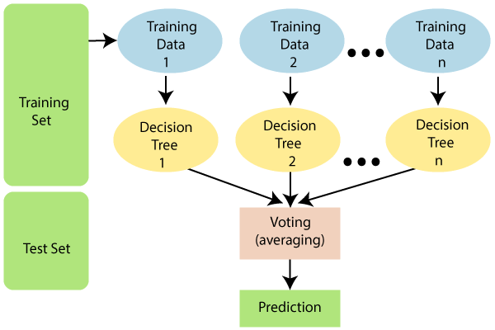
RANDOM FOREST -
It is based on the concept of ensemble learning, which is a process of combining multiple classifiers to solve a complex problem and to improve the performance of the model.

Slide 13
Steps Involved in implementation:-
Created the application which can provide us the GPS coordinates.
Perform the proposed algorithm
Evaluate the matrix for the dataset
Divide the dataset into training and testing.
Analyse different machine learning algorithms.
Predict the 45 min interval parameters through machine learning algorithm
Conclude about the traffic congestion

Slide 14
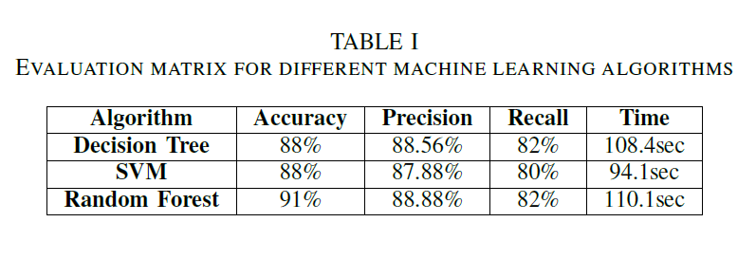
Results:

Slide 15
STRATEGY FOR IMPLEMENTATION
Building a web application
The application will have two parts-
Insertion of data
Traffic prediction
Use any one of the three methods-
Support Vector Machines
Random forest method
Decision trees

Slide 16
CONCLUSION AND FUTURE WORK:
Although deep learning and genetic algorithm is an important problem in data analysis, it has not been dealt with extensively by the ML community.
The proposed algorithm gives higher accuracy than the existing algorithms also, It improves the complexity issues throughout the dataset.
Also we have planned to integrate the web server and the application. Also the things algorithms will be further improved to much more higher accuracy.

Slide 17
BIBLIOGRAPHY-
http://ieeexplore.ieee.org.library.somaiya.edu/document/9091758
https://www.javatpoint.com/machine-learning-support-vector-machine-algorithm
https://www.javatpoint.com/machine-learning-decision-tree-classification-algorithm
https://www.javatpoint.com/machine-learning-random-forest-algorithm

Slide 18
THANK YOU

