Slide 1

WEBSERVICES
Prepared by -
Srishti Sachdeva

Slide 2
OBJECTIVE
Hosting a web service
Making WSDL class independent
Adding Custom Error message

Slide 3

JARGONS
WSDL- Web Service Definition Language
SOAP-Simple Object Access Protocol-Soap is a protocol which contains a set of predefined tags used by:-
- Stubs to create SOAP Request
- Service class to create SOAP Response
SEI- Web Service Interface (SEI) or Service Endpoint Interface
SIB -Service Implementation Bean (SIB)

Slide 4
Hosting a WebService
Ways of publishing /generating a wsdl -
Generating directly via eclipse
Publishing Endpoint in main

Slide 5
SCREENSHOTS

Slide 6
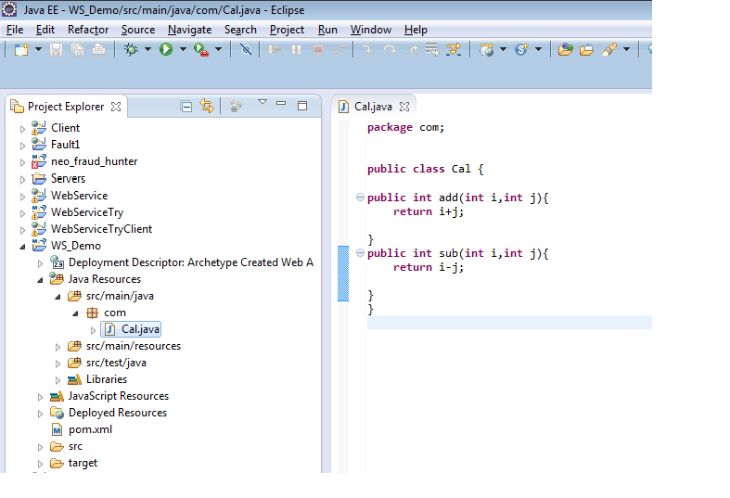

Slide 7
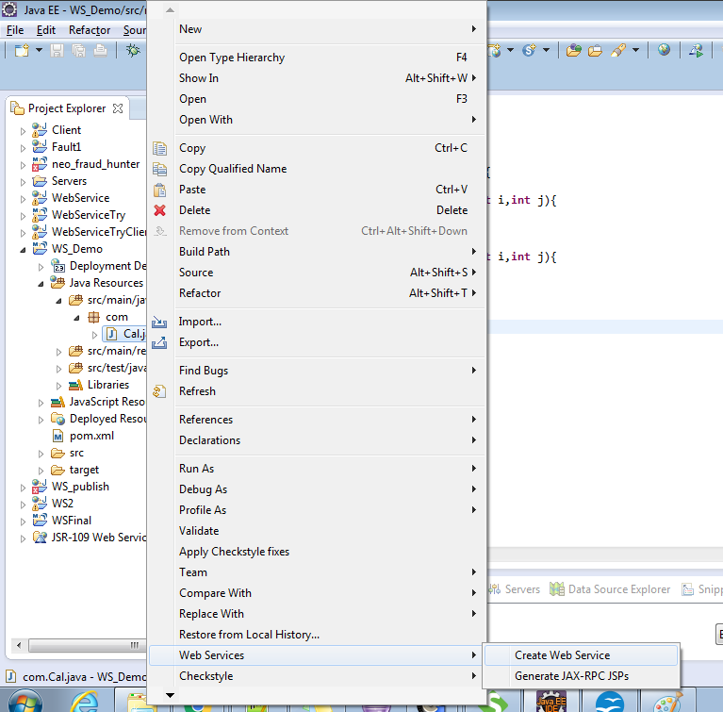
Right click on endpoint class -

Slide 8
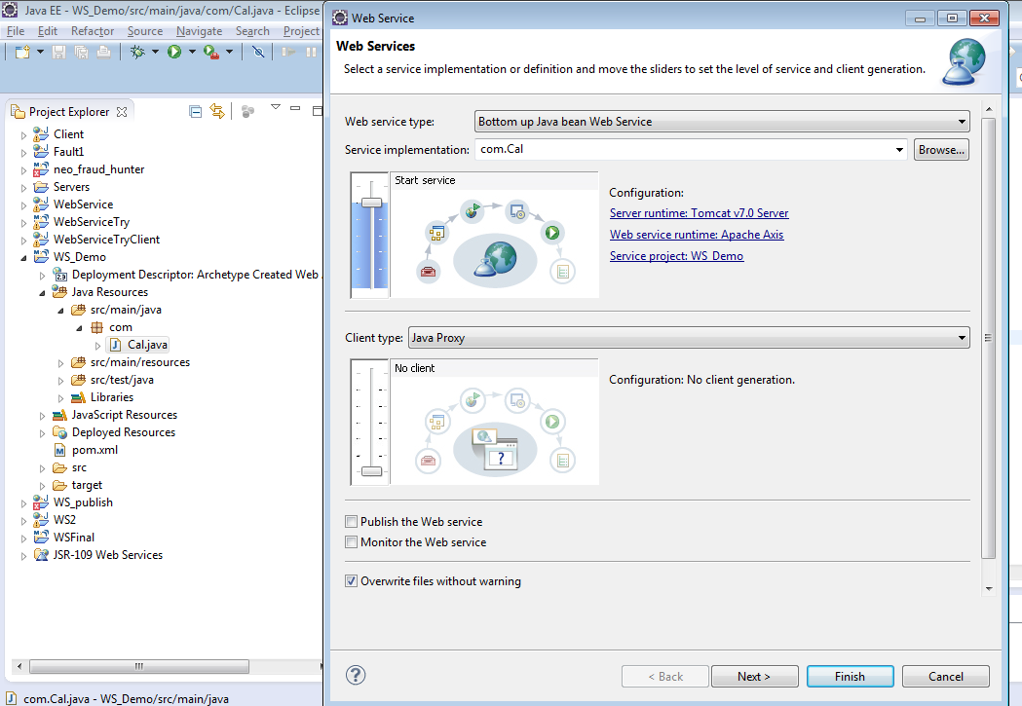

Slide 9
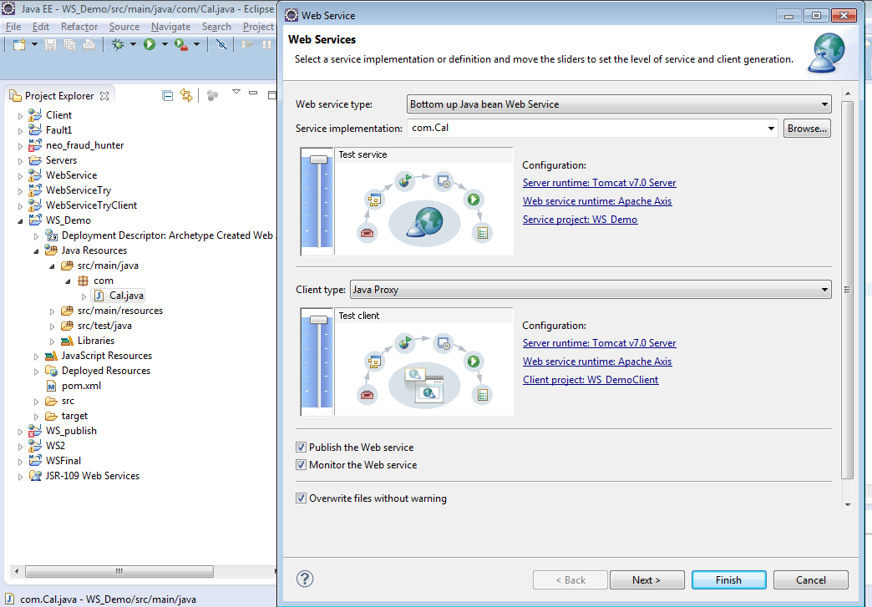

Slide 10
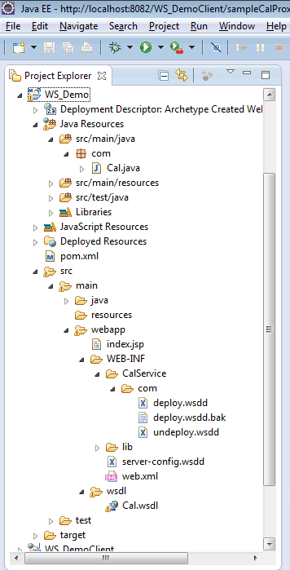
Resulting project structure-

Slide 11
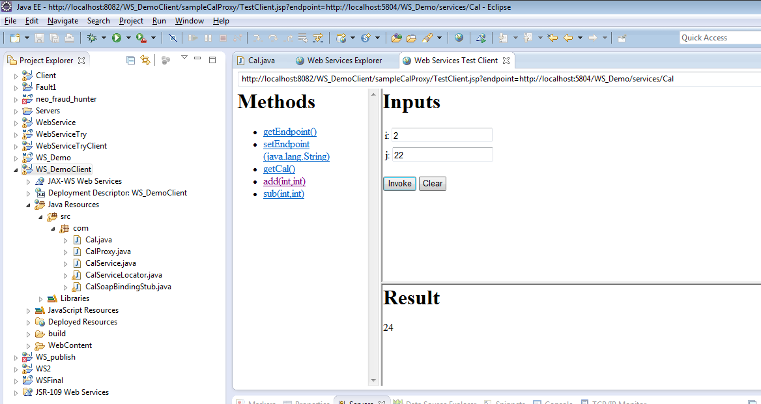
Also a demo client is generated to test our web service-

Slide 12
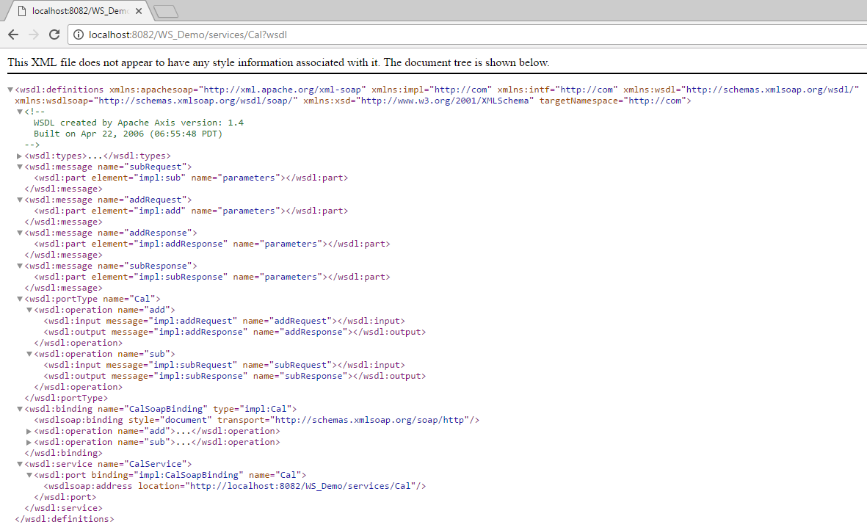
WSDL generated-

Slide 13
JAX-WS
Java API for XML Web Services (JAX-WS), is a set of APIs for creating web services in XML format (SOAP). JAX-WS provides many annotation to simplify the development and deployment for both web service clients and web service providers (endpoints).

Slide 14
JAX-WS Annotations and their purposes-
1. @WebService - This JAX-WS annotation can be used in 2 ways. If we are annotating this over a class, it means that we are trying to mark the class as the implementing the Web Service, in other words Service Implementation Bean (SIB). Or we are marking this over an interface, it means that we are defining a Web Service Interface (SEI).
Elements:
name :The name of the Web Service. Used as the name of the wsdl:portType when mapped to WSDL
serviceName : The service name of the Web Service. Used as the name of the wsdl:service when mapped to WSDL (This member-value is not allowed on endpoint interfaces.)

Slide 15
targetNamespace : If the @WebService.targetNamespace annotation is on a service endpoint interface, the targetNamespace is used for the namespace for the wsdl:portType (and associated XML elements).
If the @WebService.targetNamespace annotation is on a service implementation bean that does NOT reference a service endpoint interface (through the endpointInterface attribute), the targetNamespace is used for both the wsdl:portType and the wsdl:service (and associated XML elements).
If the @WebService.targetNamespace annotation is on a service implementation bean that does reference a service endpoint interface (through the endpointInterface attribute), the targetNamespace is used for only the wsdl:service (and associated XML elements).

Slide 16
portName : The port name of the Web Service. Used as the name of the wsdl:port when mapped to WSDL.(This member-value is not allowed on endpoint interfaces.)
wsdlLocation : The location of a pre-defined WSDL describing the service. The wsdlLocation is a URL (relative or absolute) that refers to a pre-existing WSDL file. The presence of a wsdlLocation value indicates that the service implementation bean is implementing a pre-defined WSDL contract. The JSR-181 tool MUST provide feedback if the service implementation bean is inconsistent with the portType and bindings declared in this WSDL. Note that a single WSDL file might contain multiple portTypes and multiple bindings. The annotations on the service implementation bean determine the specific portType and bindings that correspond to the Web Service.

Slide 17
endpointInterface : Describes the SEI that the SIB is implementing. This annotation allows the developer to separate the interface contract from the implementation. If this annotation is present, the service endpoint interface is used to determine the abstract WSDL contract (portType and bindings).
2. @WebMethod : This JAX-WS annotation can be applied over a method only. This specified that the method represents a web service operation.
Elements:
operationName : Name of the wsdl:operation matching the method.
action : The action for this operation. For SOAP bindings, this determines the value of the soap action.

Slide 18
exclude : Marks a method to NOT be exposed as a web method. Used to stop an inherited method from being exposed as part of this web service. If this element is specified, other elements MUST NOT be specified for the @WebMethod.
3. @WebResult : Customizes the mapping between the Web Service operation return value and the corresponding element of the generated WSDL file.
Elements:
name : The name of the return value.
partName : The name of the wsdl:part of this return value.
targetNamespace : The XML namespace of the return value.
header : If true, the result is pulled from a message header rather then the message body.

Slide 19
3. @WebParam : Customizes the mapping between operation input parameters of the Web Service and elements of the generated WSDL file. Also used to specify the behavior of the parameter.
Elements:
name : Name of the parameter in the WSDL file.
For RPC-style Web Services, the name maps to the <wsdl:part> element that represents the parameter. For document-style Web Services, the name is the local name of the XML element that represents the parameter.
targetNamespace : The XML namespace of the parameter. This value is used only used for document-style Web Services, in which the parameter maps to an XML element.The default value is the targetNamespace of the Web Service.

Slide 20
partName : The name of the wsdl:part representing this parameter.
mode : The direction in which the parameter is flowing (One of IN, OUT, or INOUT).
header : If true, the parameter is pulled from a message header rather then the message body.
4. @OneWay : This JAX-WS annotation is applied to WebMethod which means that method will have only input and no output. When a @Oneway method is called, control is returned to calling method even before the actual operation is performed. It means that nothing will escape method neither response neither exception.

Slide 21
SCREENSHOTS

Slide 22
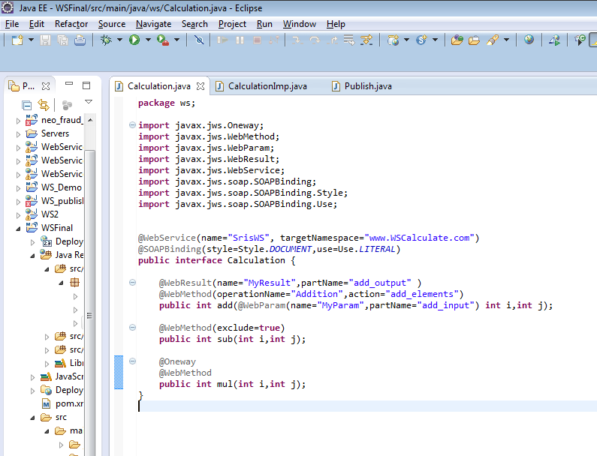

Slide 23
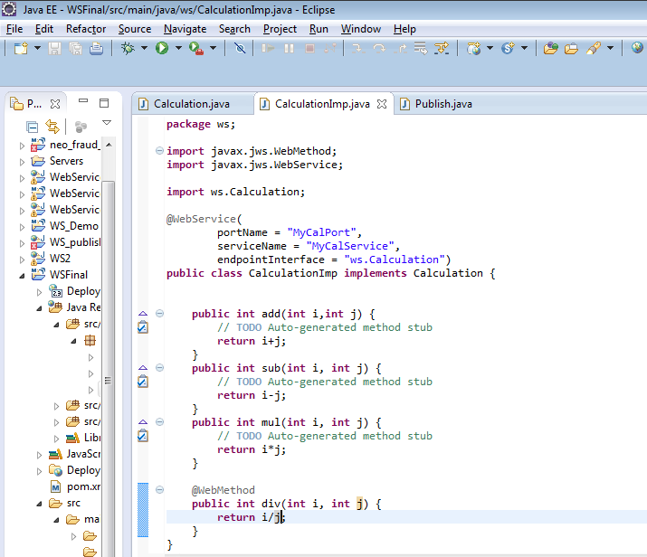

Slide 24
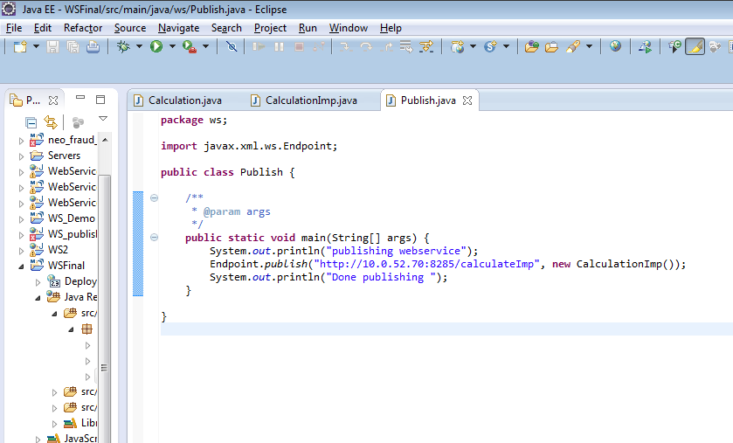
Now we will publish the endpoint:

Slide 25
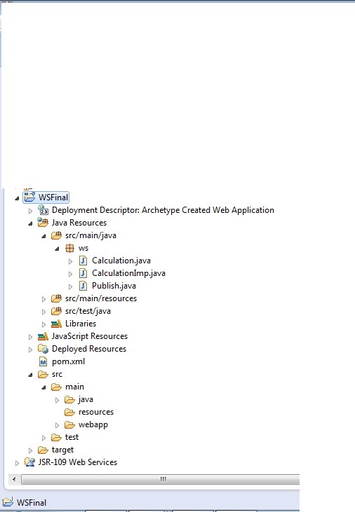
Project Structure

Slide 26
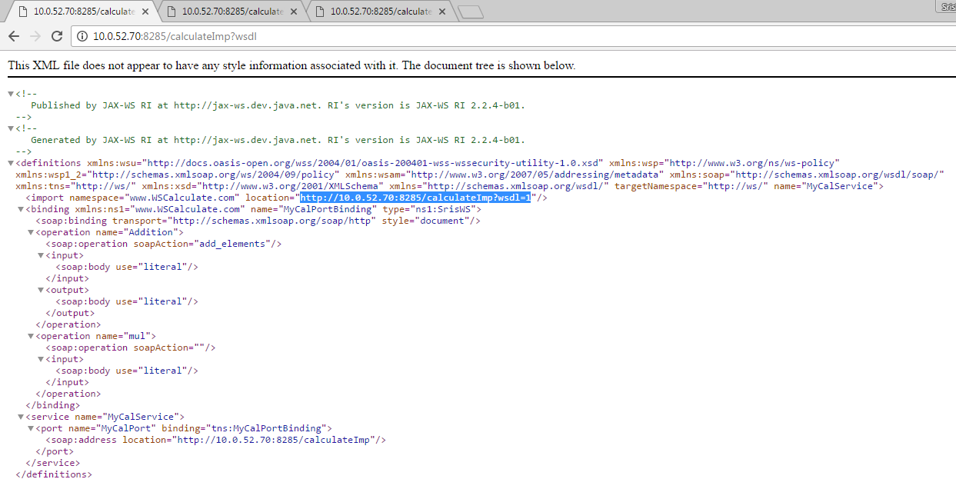
On publishing the generated WSDL (at URL: http://10.0.52.70:8285/calculateImp?wsdl) would be like:

Slide 27
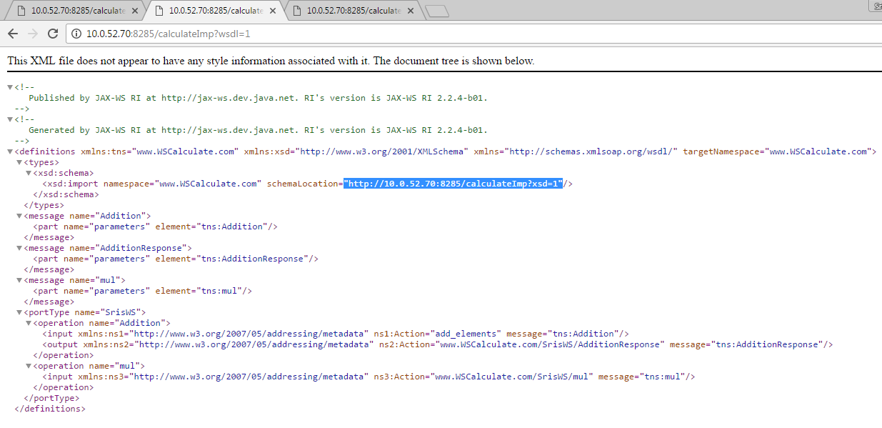

Slide 28
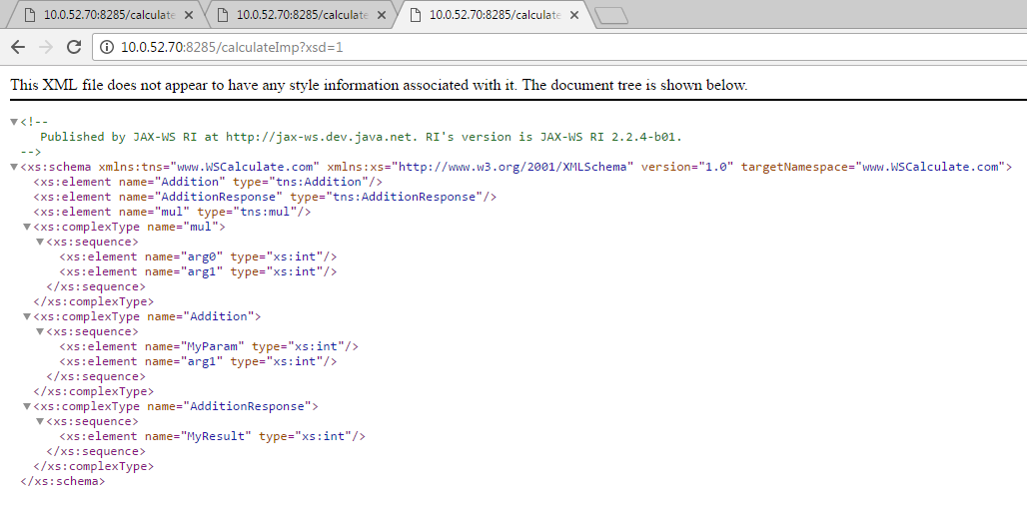

Slide 29
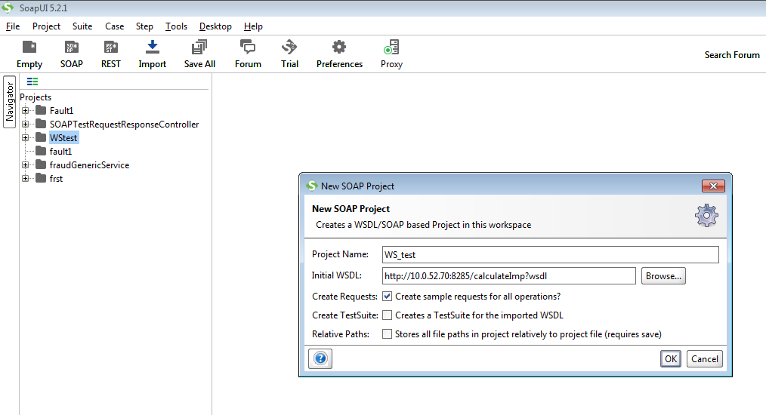
Testing on SoapUI

Slide 30
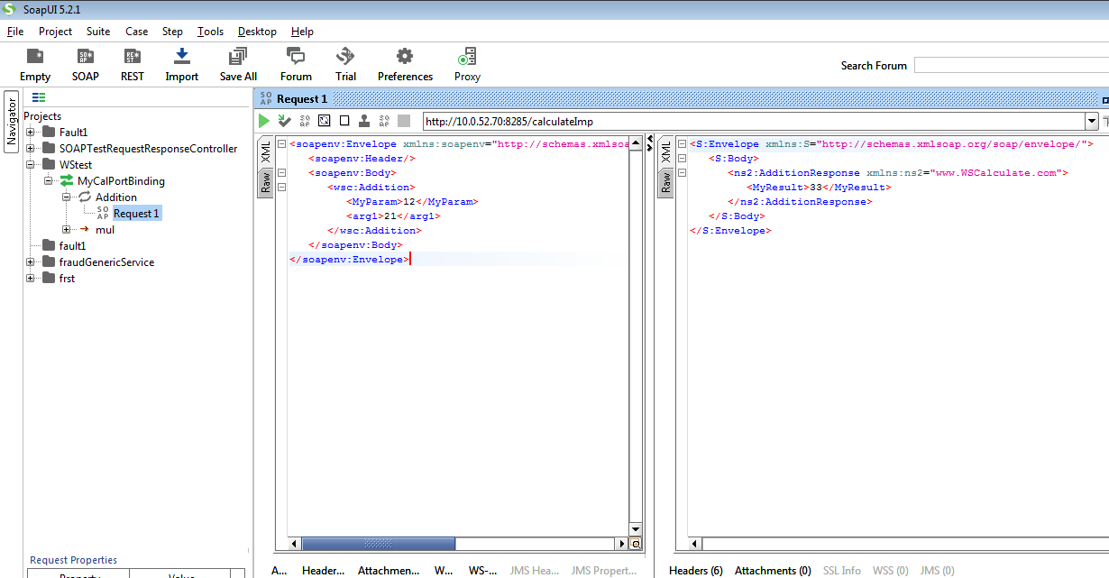

Slide 31
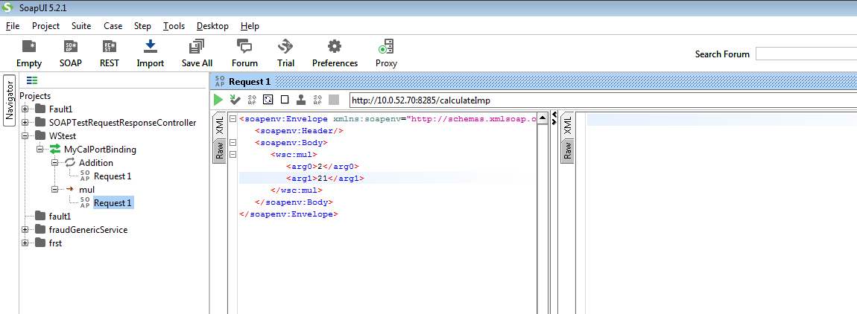

Slide 32
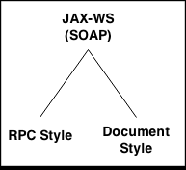
Two Ways To Develop JAX-WS
RPC style
Document style

Slide 33
The Document style indicates that the SOAP body contains a XML document which can be validated against pre-defined XML schema document.
RPC indicates that the SOAP message body contains an XML representation of a method call and uses the names of the method and its parameters to generate XML structures that represent a method’s call stack. The document/literal approach is easier because it simply relies on XML Schema to describe exactly what the SOAP message looks like while transmission.
With RPC style a web service is capable of only using simple data types like integer or string. However, DOCUMENT style is capable of richer data types for a class let’s say Person, which can have attributes like String name, Address address etc.

Slide 34
Document style indicates that in the underlying web service, underlying message shall contain full XML documents, whereas in the RPC style, the underlying message contains parameters and return values in request and response message respectively.
Default binding style- Document
Annotation used- @SoapBinding
The other important optional attribute is use. It represents the formatting style of the web service message. Its value can either be literal or encoded.
Example usage of @SOAPBinding:
@SOAPBinding(style=Style.DOCUMENT, use=Use.LITERAL)

Slide 35
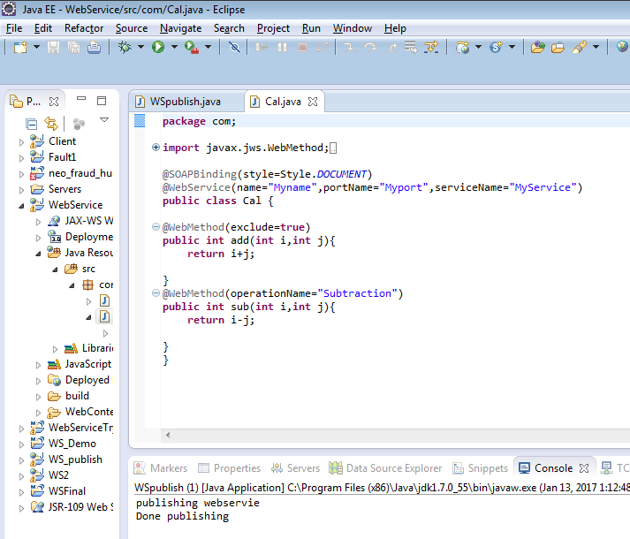
Document Style-

Slide 36
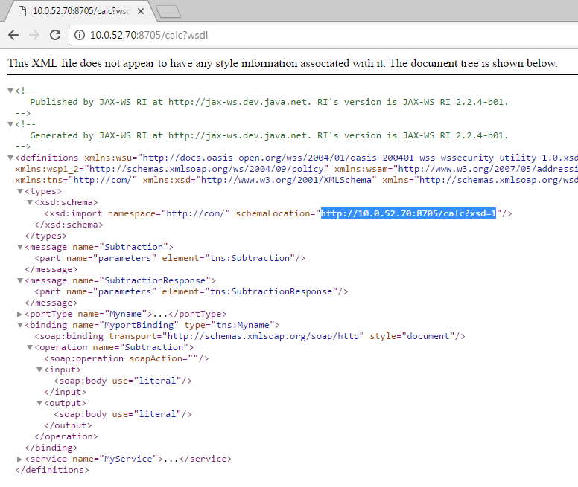

Slide 37
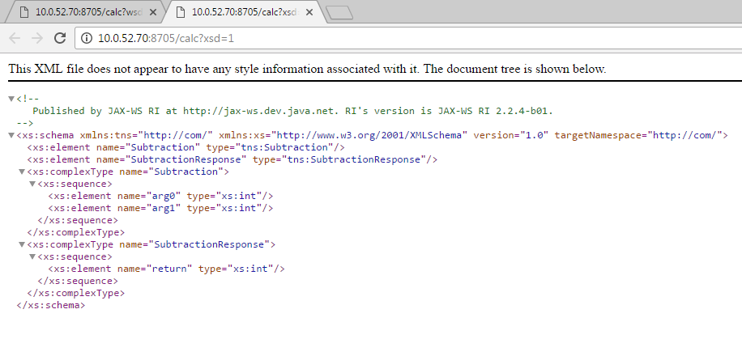

Slide 38
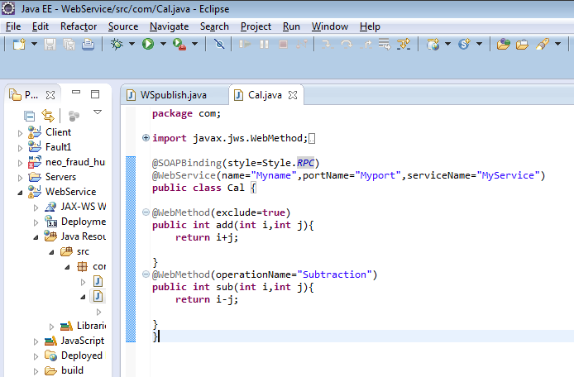
RPC Style-

Slide 39
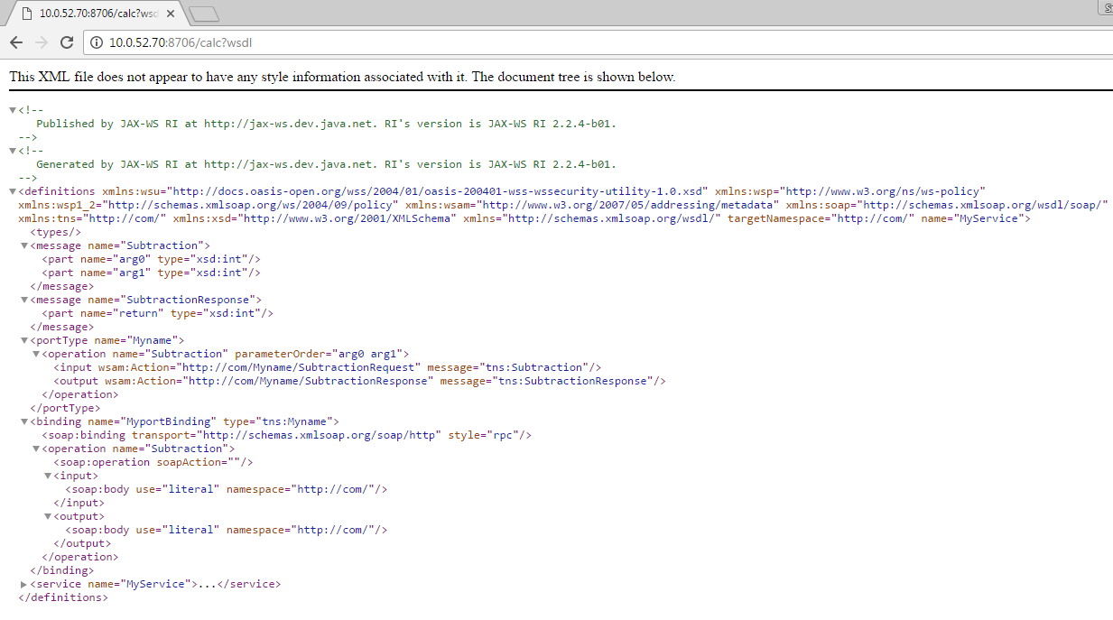

Slide 40
SOAP FAULTS
It is platform-independent way of describing the error within the SOAP message using a SOAP fault. In general, a SOAP fault is analogous to an application exception.
SOAP faults are generated by receivers to report business logic errors or unexpected conditions.
In JAX-WS, Java exceptions (java.lang.Exception) that are thrown by your Java Web service are mapped to a SOAP fault and returned to the client to communicate the reason for failure.

Slide 41
SCREENSHOTS

Slide 42
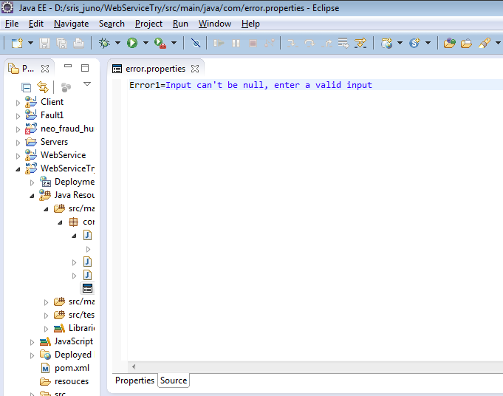

Slide 43
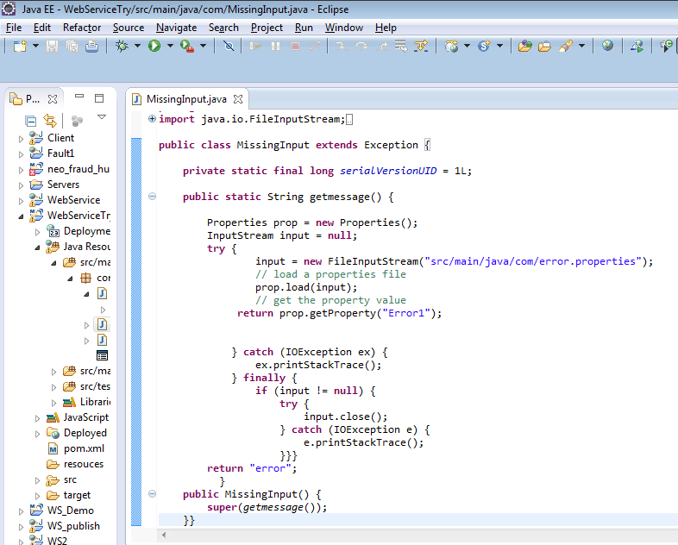

Slide 44
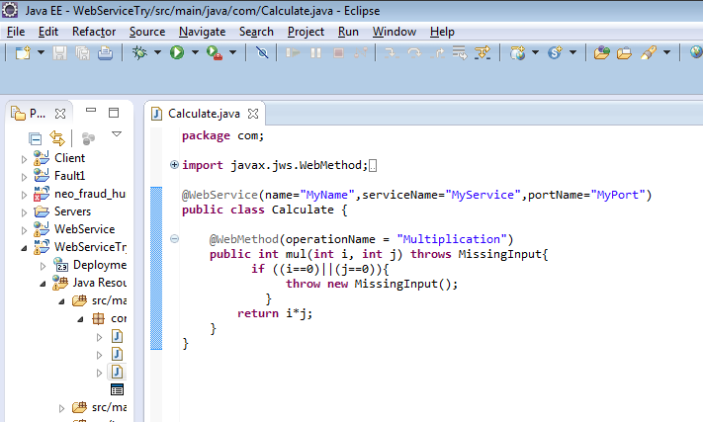

Slide 45
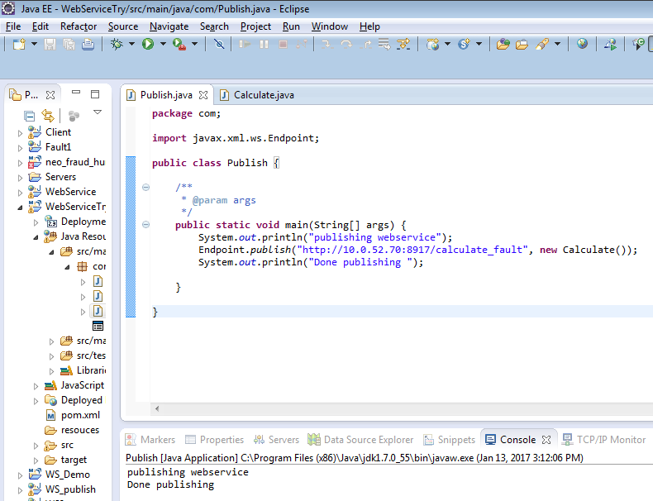

Slide 46
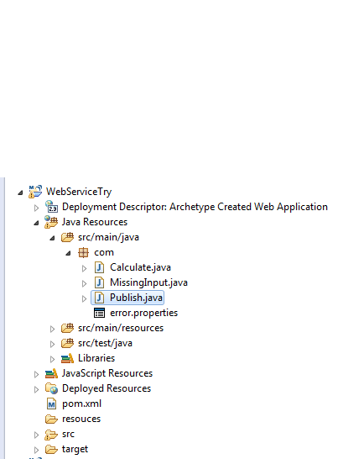
Project Structure

Slide 47
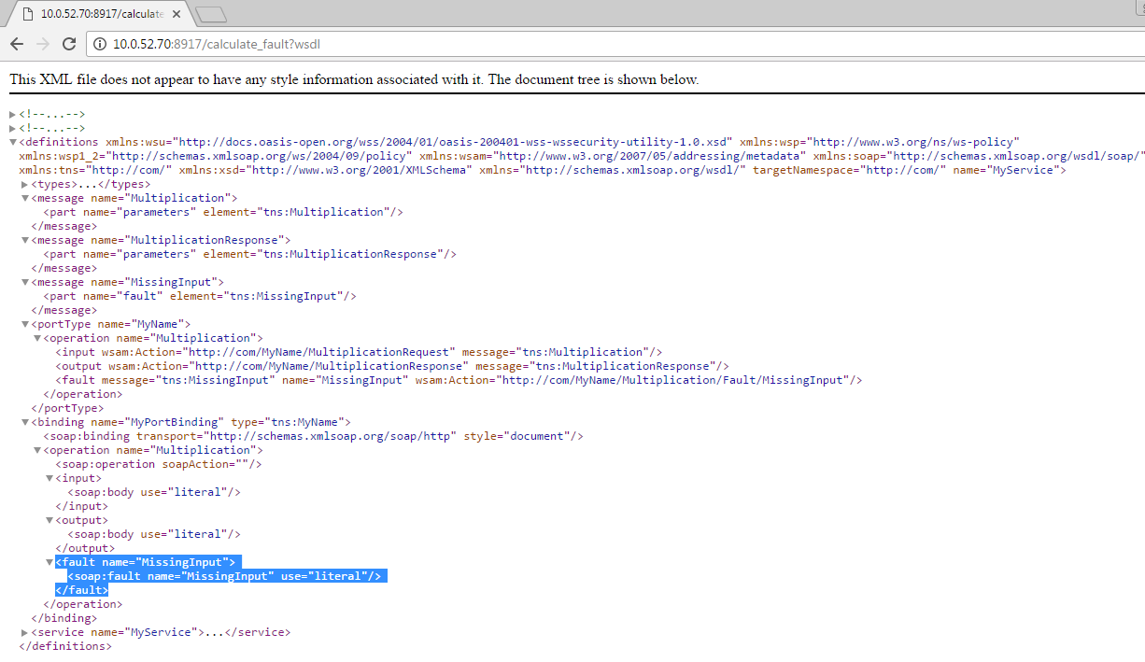
On publishing the generated WSDL (at URL: http://10.0.52.70:8917/calculate_fault?wsdl) would be like:

Slide 48
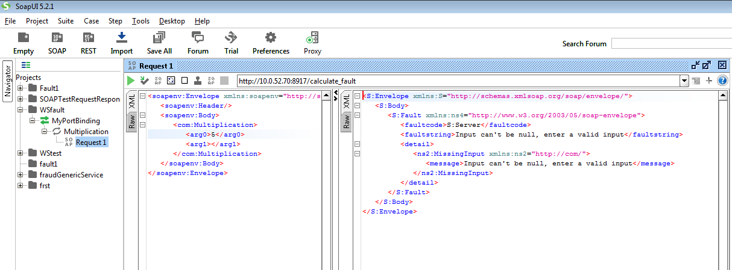
Testing on SoapUI

Slide 49
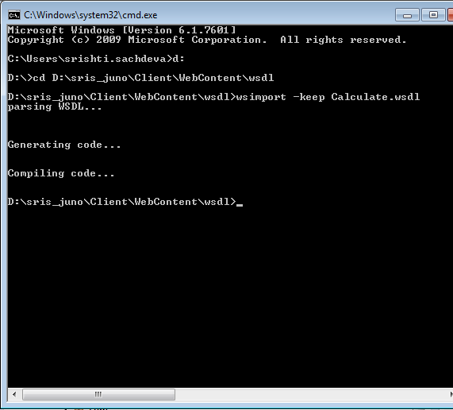
Making a WS Client
Generate the stubs using command- wsimport - keep {wsdl}

Slide 50
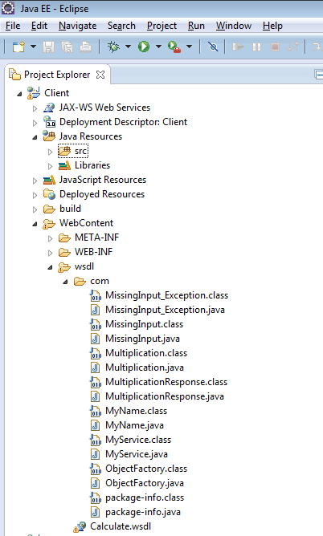
Stubs will be generated. Move them at the required place.

Slide 51
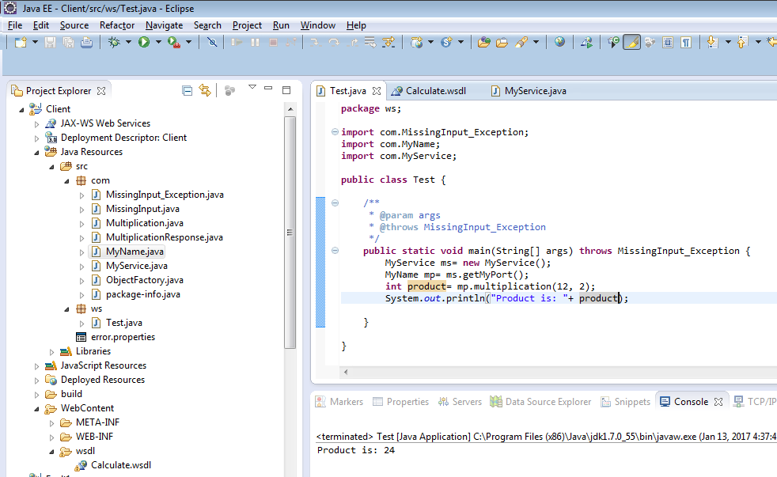

Slide 52
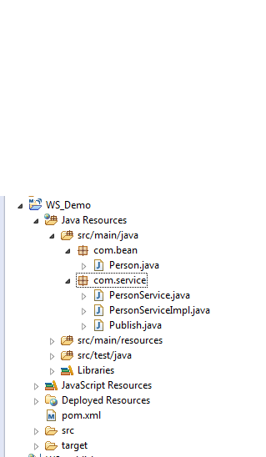
Example : Custom Data Type

Slide 53
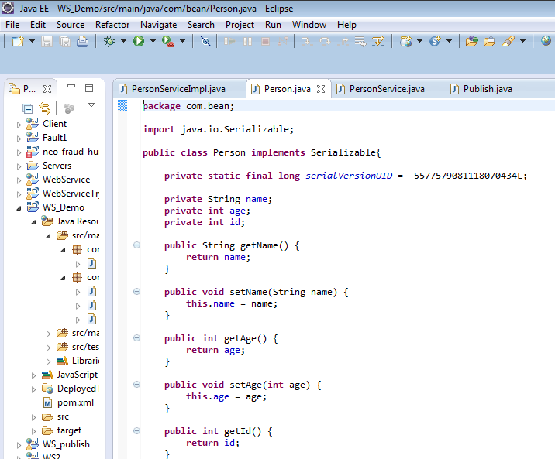
We are implementing Serializable interface because we will be transporting it over the network. We have also provided toString method implementation that will be used when we will print this object at client side.

Slide 54
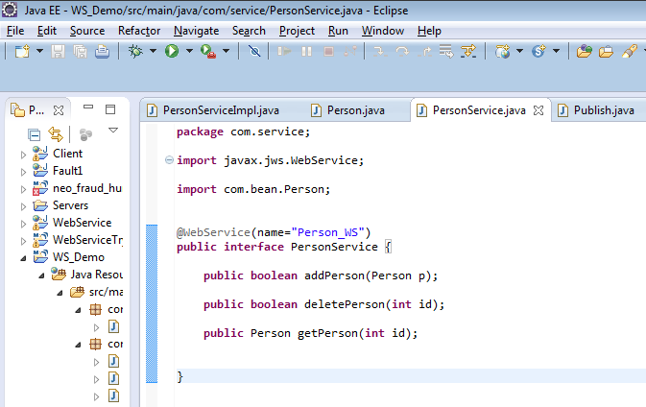

Slide 55
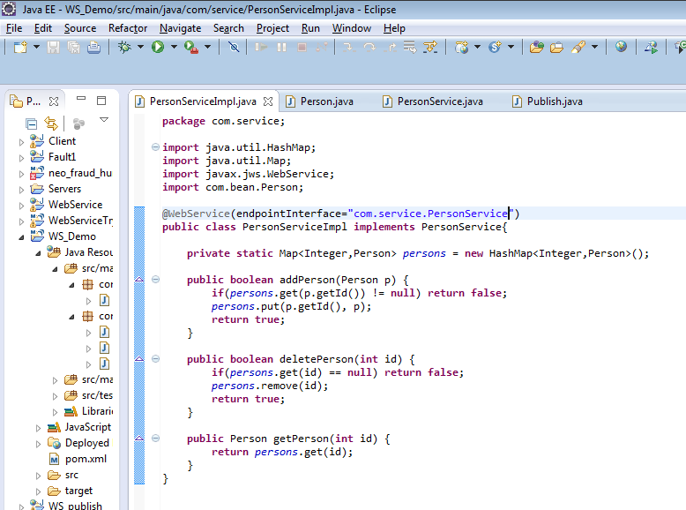

Slide 56
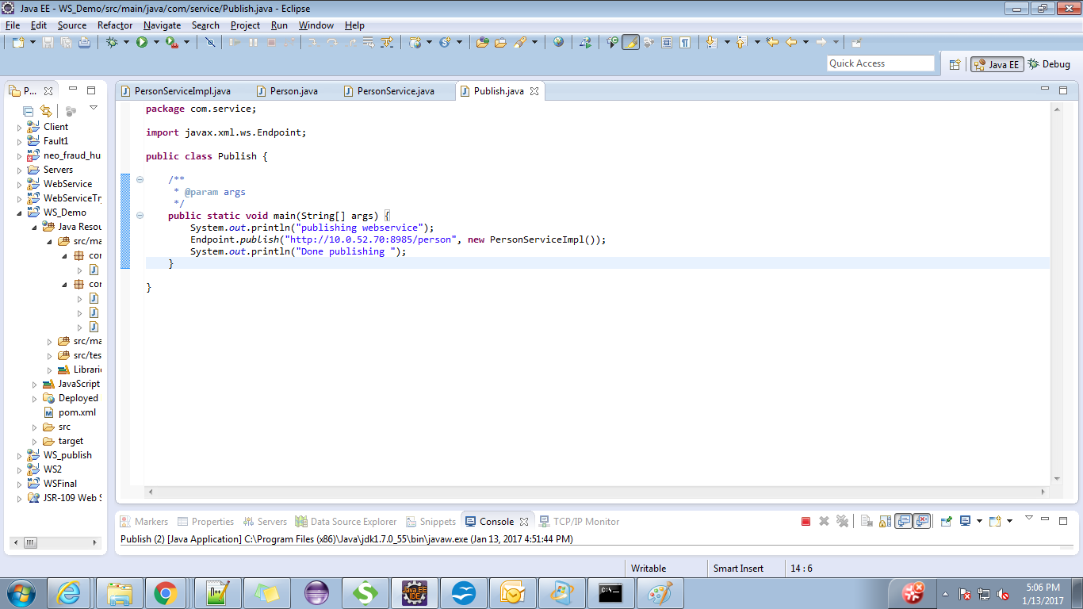

Slide 57
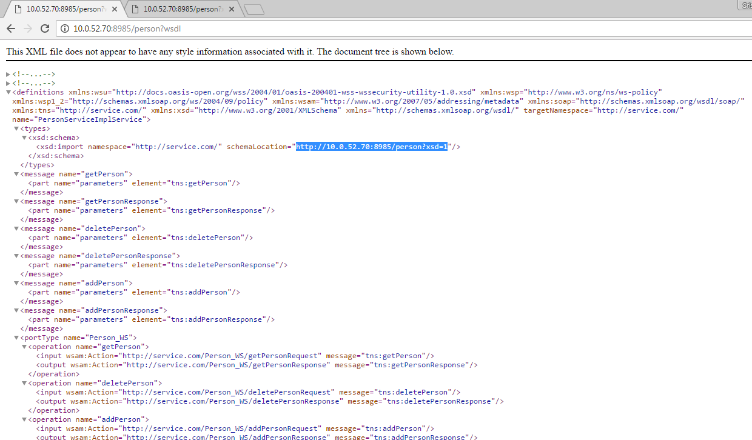
Generated WSDL

Slide 58
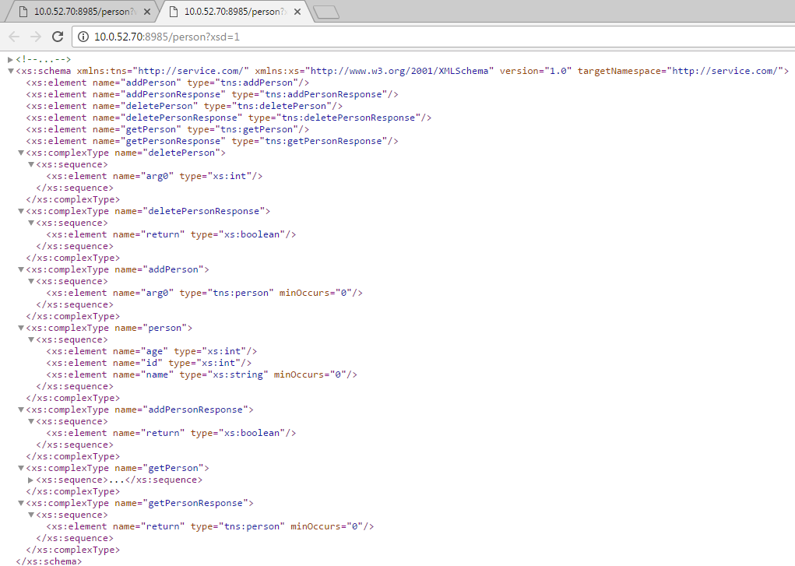

Slide 59


