Slide 1

Seasonal Agriculture Performance Analysis
Vishal
University of Mumbai
AICTE STU ID :

Slide 2

PROBLEM STATEMENT
Agricultural performance is shaped by seasonal variations in environmental conditions, farming practices, resource availability and market conditions.
Raw agricultural data does not clearly reveal how performance changes across the Kharif, Rabi and Zaid seasons.
The problem is to analyze a seasonal agriculture dataset to uncover meaningful patterns, trends, relationships and variations in performance across seasons.
Goal: support evidence-based seasonal agricultural planning through data-driven insights.

Slide 3
Project Description
This project analyzes a seasonal agriculture performance dataset of 4,000 farm records spanning 8 Indian states, 8 crops and 3 seasons (Kharif, Rabi, Zaid).
The dataset covers environmental conditions (rainfall, temperature, humidity, soil), resource usage (water, fertilizer, pesticide) and economic outcomes (cost, revenue, profit).
Using Python (Pandas, Seaborn, SciPy) in a Jupyter Notebook, the data was cleaned, explored and compared across seasons.
Statistical tests (ANOVA) and correlation analysis were used to check whether seasonal differences are meaningful and to identify the strongest drivers of yield and profit.
The output is a complete, evidence-based comparison of seasonal agricultural performance with actionable recommendations.

Slide 4

WHO ARE THE END USERS?
Farmers and farming cooperatives planning crop choice, irrigation and input use by season
State and district agricultural departments doing seasonal planning and policy-making
Agri-business and input suppliers (seed, fertilizer, irrigation equipment) targeting seasonal demand
Researchers and agricultural economists studying seasonal performance trends
NGOs and financial institutions assessing agricultural risk and lending by season

Slide 5
Technology Used
Language: Python
Data handling: Pandas, NumPy
Visualization: Matplotlib, Seaborn
Statistics: SciPy (ANOVA, correlation analysis)
Environment: Jupyter Notebook

Slide 6
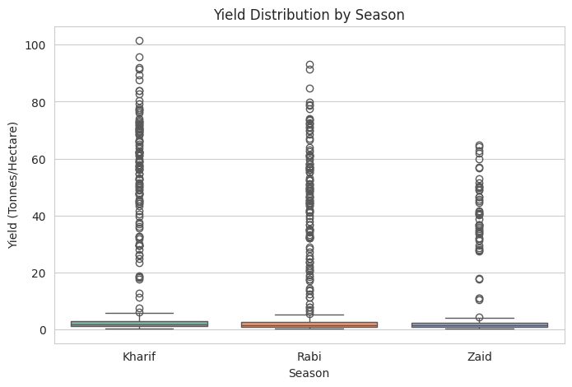
RESULTS
Yield Distribution by Season (Kharif vs Rabi vs Zaid)

Slide 7
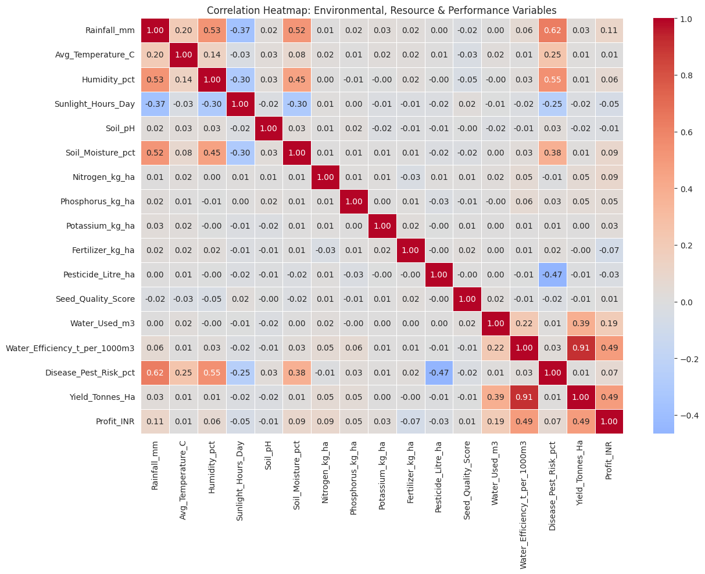
RESULTS
Correlation Heatmap: Environmental & Resource Factors vs Yield / Profit

Slide 8
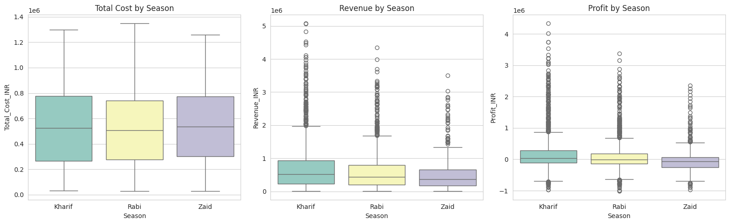
RESULTS
Economic Performance by Season: Cost, Revenue and Profit

Slide 9
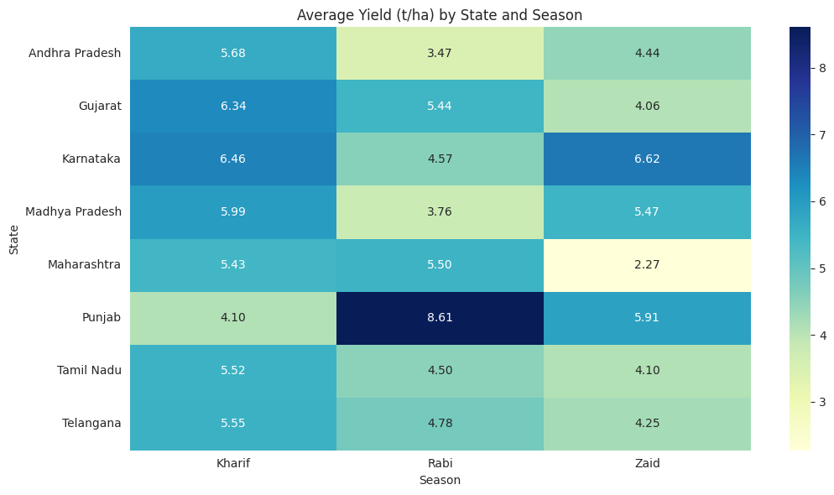
RESULTS
Average Yield (t/ha) by State and Season

Slide 10
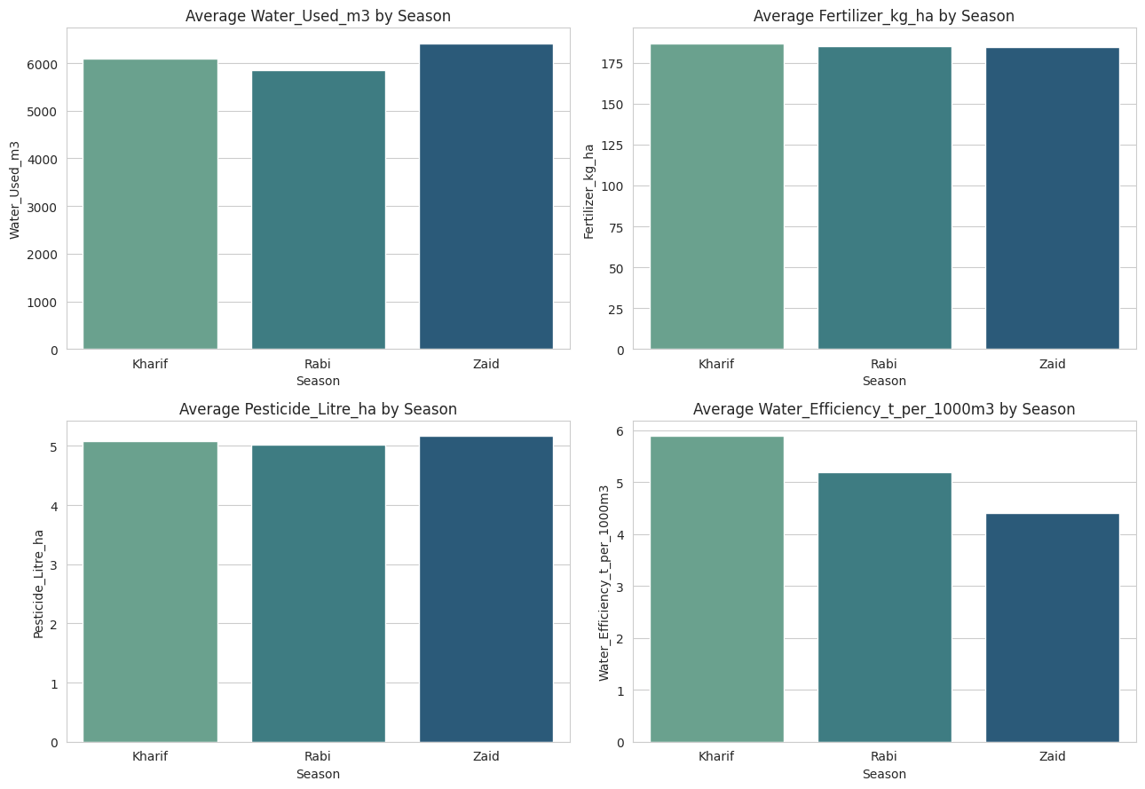
RESULTS
Average Resource Usage by Season (Water, Fertilizer, Pesticide, Efficiency)

Slide 11
Future scope
Extend the analysis to multiple years of data to confirm whether seasonal patterns hold over time
Build a regression / ML model to predict yield from environmental and resource inputs
Integrate live weather and market price feeds for real-time seasonal advisories
Investigate the root cause of negative profit margins seen across all seasons
Deploy the analysis as an interactive dashboard for farmers and planners
Add district-level and crop-level drill-downs for more targeted recommendations

Slide 12
GitHub Link
Repository: https://github.com/
Contains: Jupyter Notebook with full EDA, cleaning, statistical tests and visualizations
Dataset: seasonal_agriculture_performance_dataset.csv included in the repo
To run: clone the repo, install requirements (pandas, seaborn, scipy)
Open Seasonal_Agriculture_Performance_Analysis.ipynb in Jupyter
Run all cells to reproduce the full analysis and charts

Slide 13
VOIS Course completion certificate - Course name- Data Visualization

Slide 14
Thank you

